Slide 1
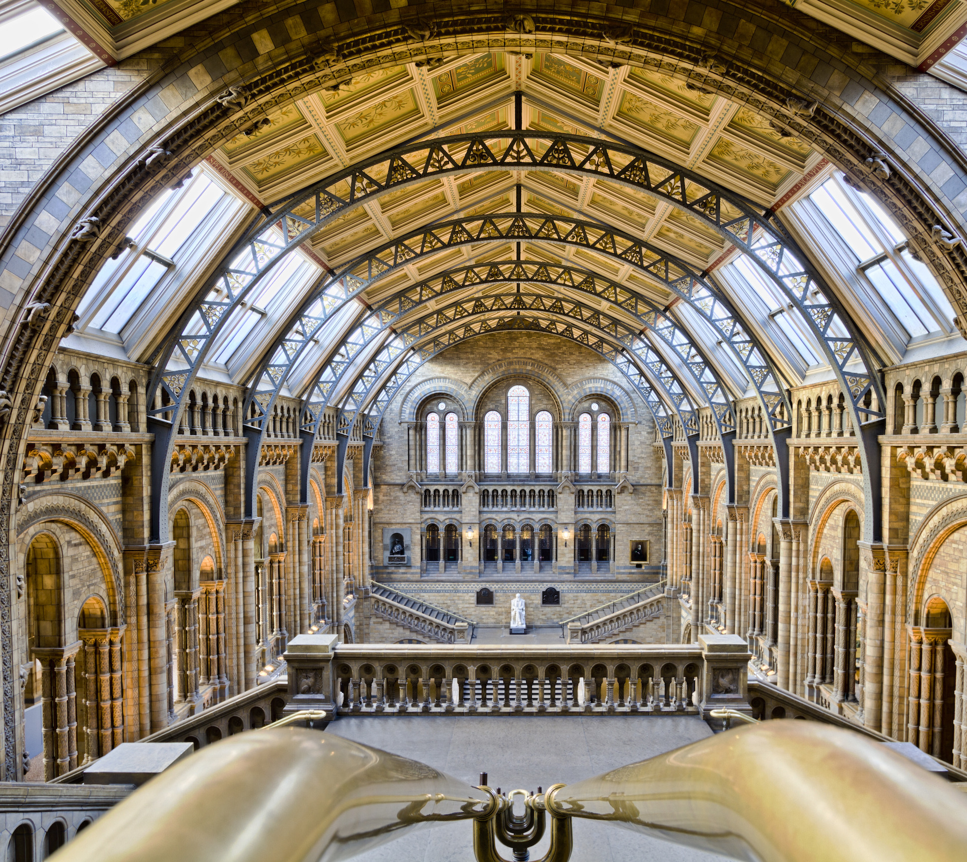

Unit 6
What was it like?

Slide 2
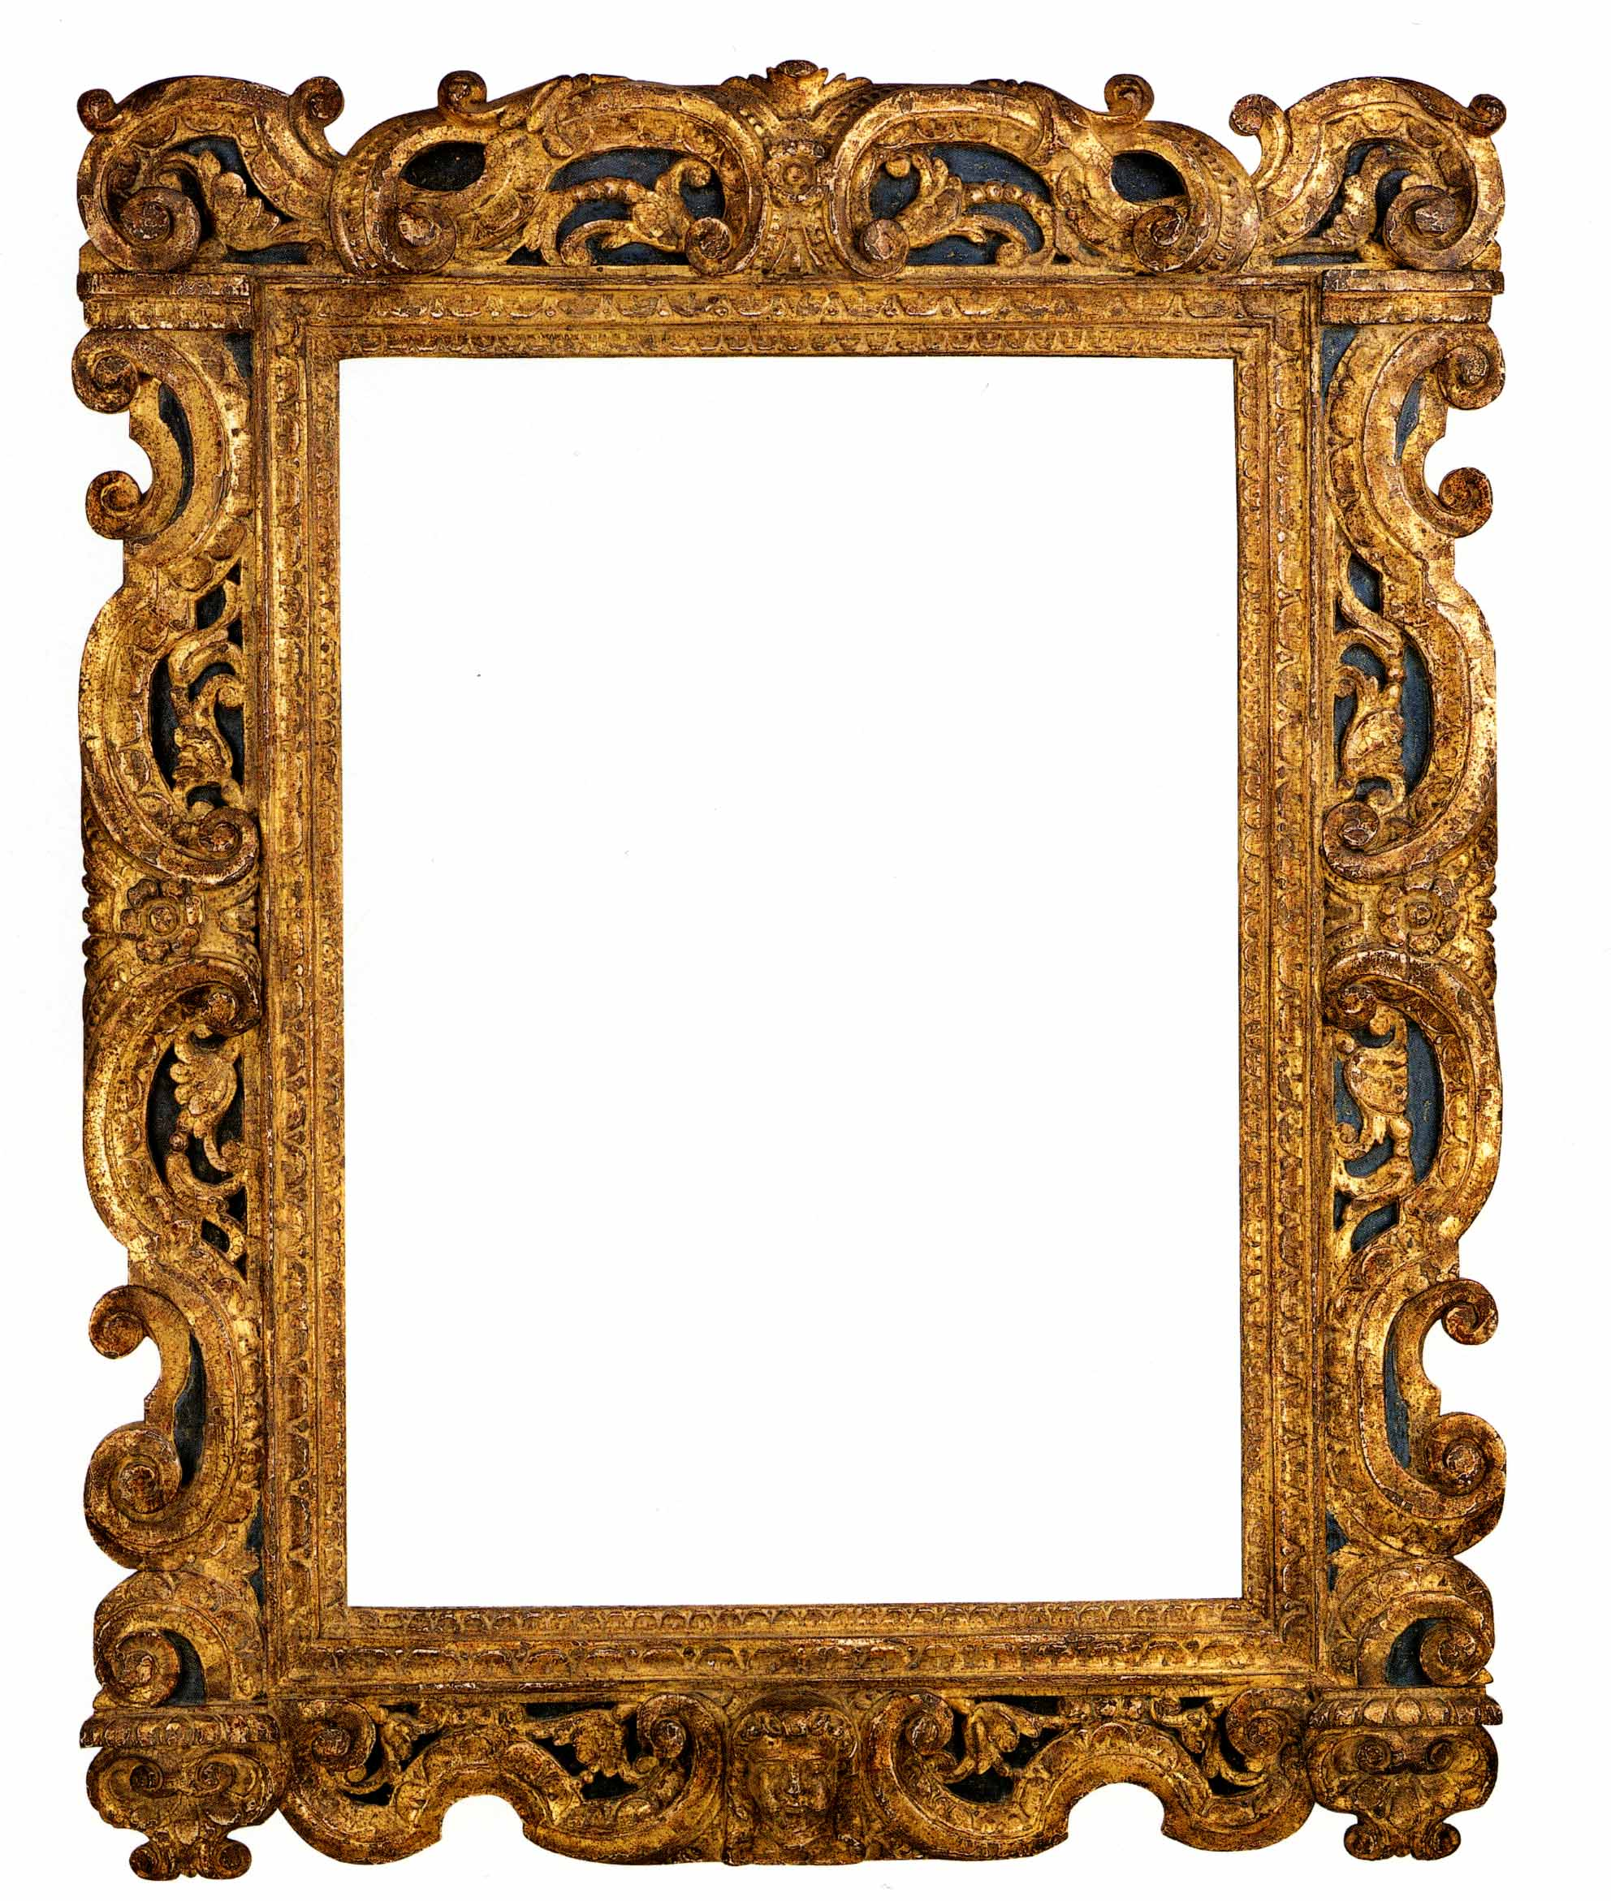
Know some new words related to Museum exhibits.
Discuss some questions about Museum exhibits.
Practice the conversation in pairs.

Slide 3
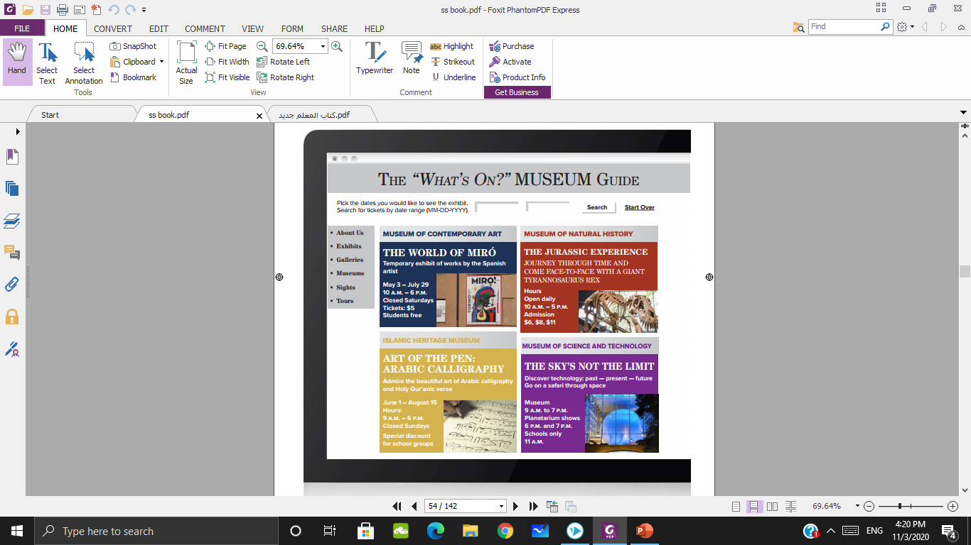
What can you see in this picture?
It’s a web page.

Slide 4
What is the subject of the web page?
Museum Exhibits.
What’s the meaning of “museum & exhibits”?

Slide 5
What is the title of the web page?
The “What’s On?” Museum Guide.
What’s the meaning of “GUIDE”?

Slide 6
What does “What’s On” mean?
What is happening?

Slide 7
2
1
3
4
What are the four types of museums?

Slide 8
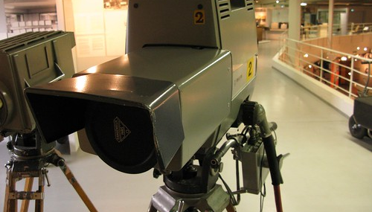
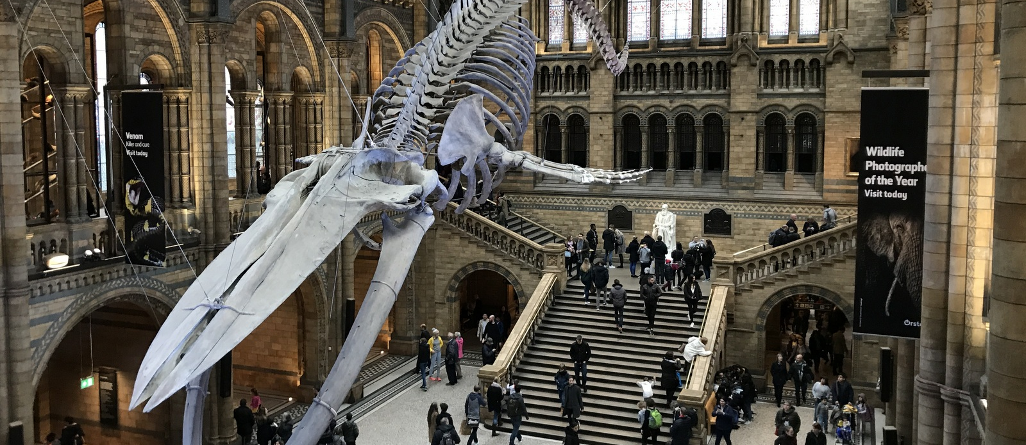
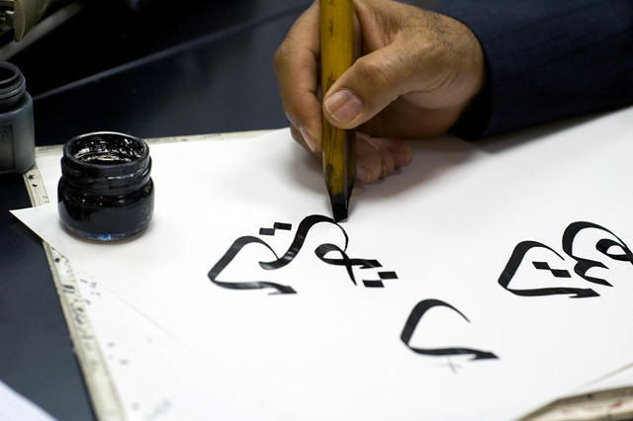
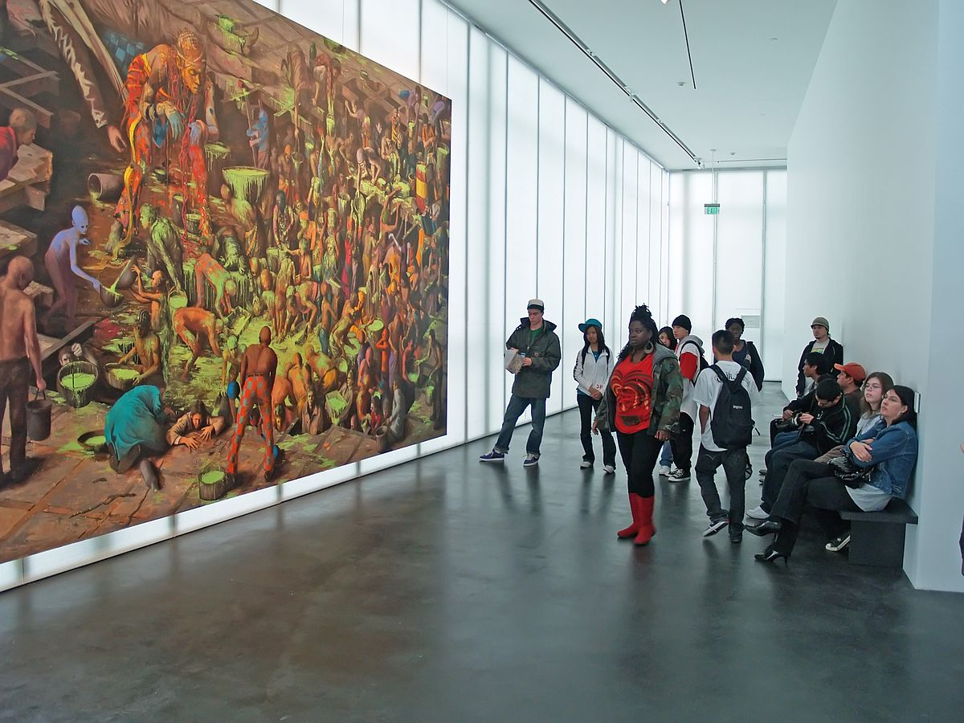
Science and technology Museum
Natural history Museum
Contemporary art Museum
Islamic heritage Museum

Slide 9
2
1
3
4
Where can you see dinosaurs?

Slide 10
2
1
3
4
Where can you see calligraphy?

Slide 11
2
1
3
4
Where can you learn about space?

Slide 12
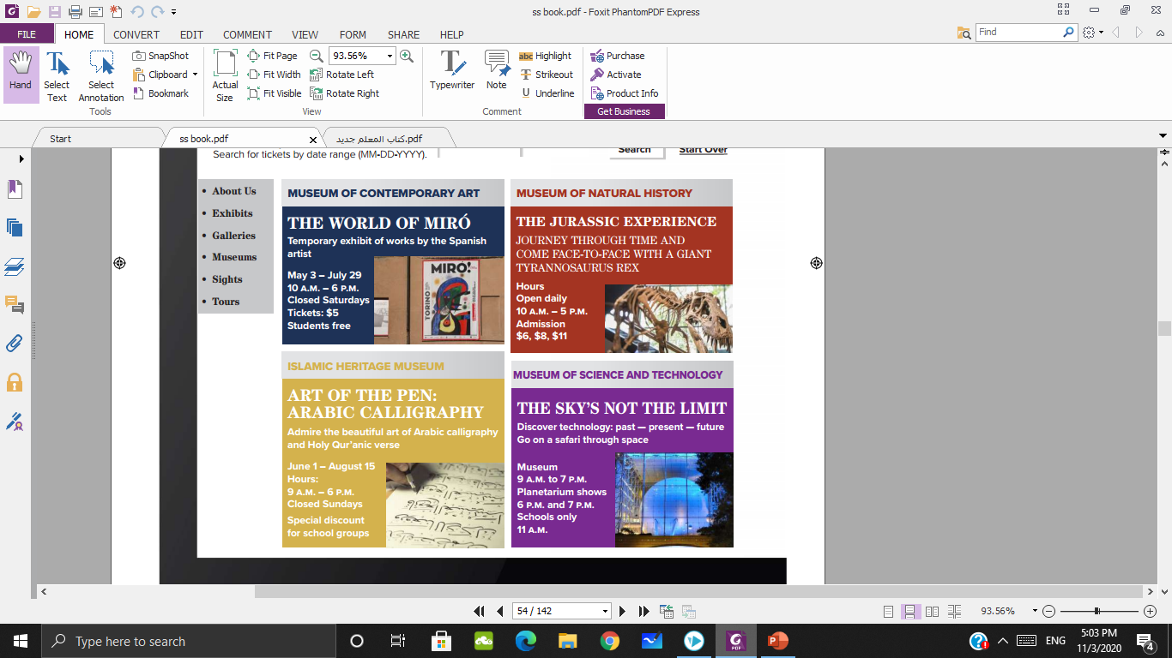

1
2
3
4

Slide 13

1
2
Which museum has no information about price?
3
4

Slide 14
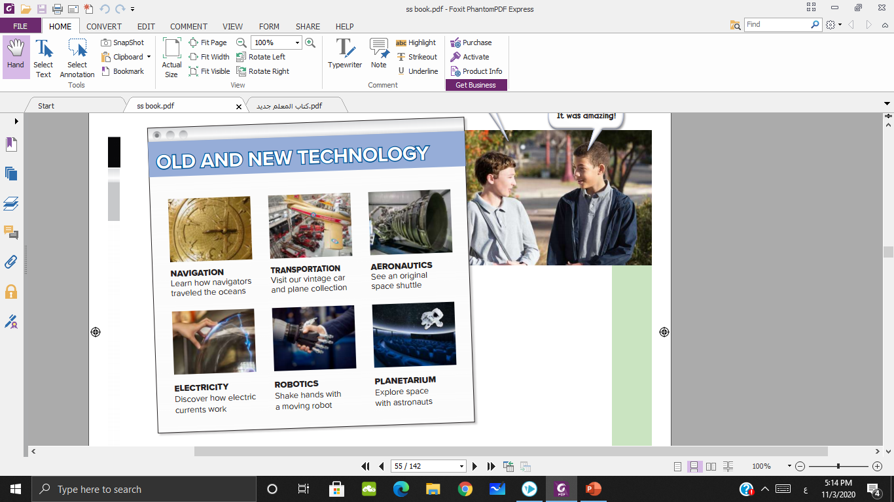

Slide 15
Which exhibit has old cars?

Slide 16
Which exhibit has electronics?

Slide 17
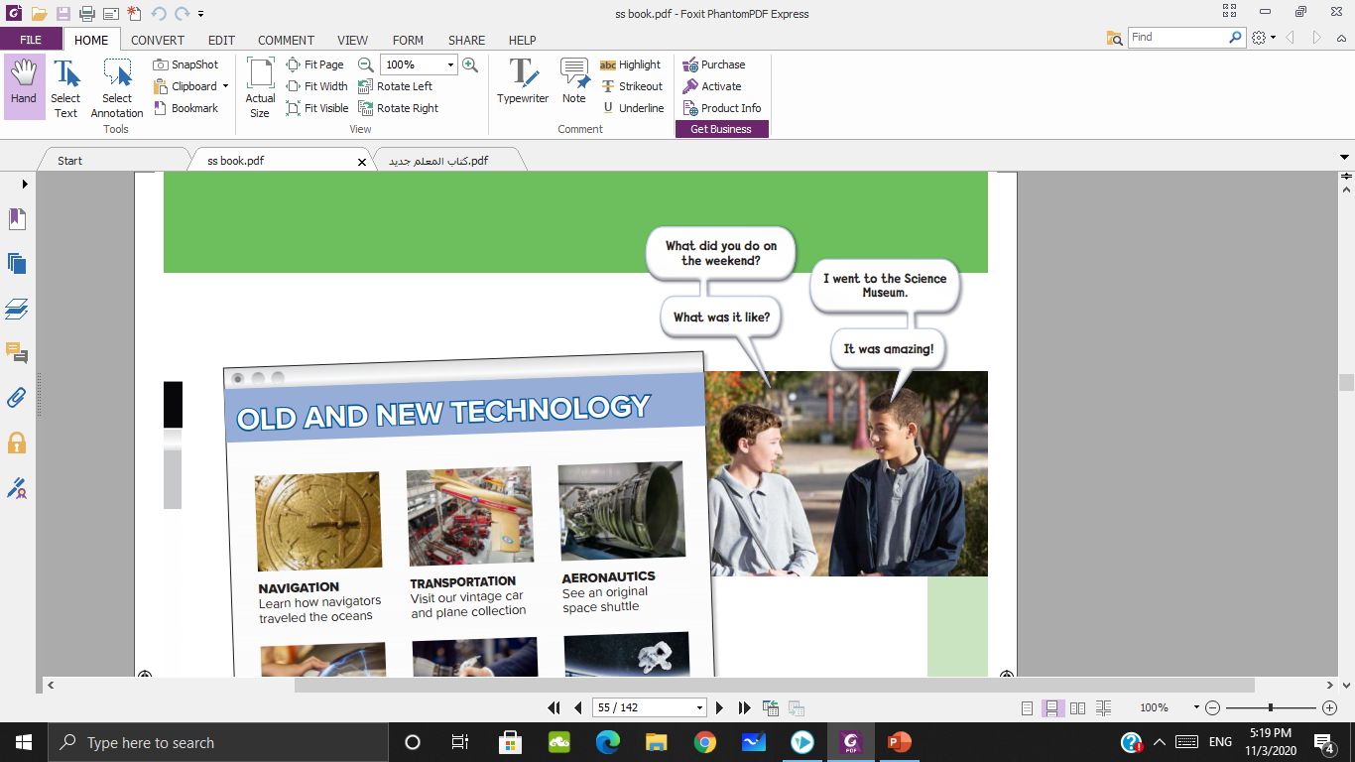
What did one of the boys do on the weekend?
He went to the Science Museum.

Slide 18
Did he like it?
Yes, he did

Slide 19
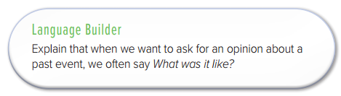

Slide 20

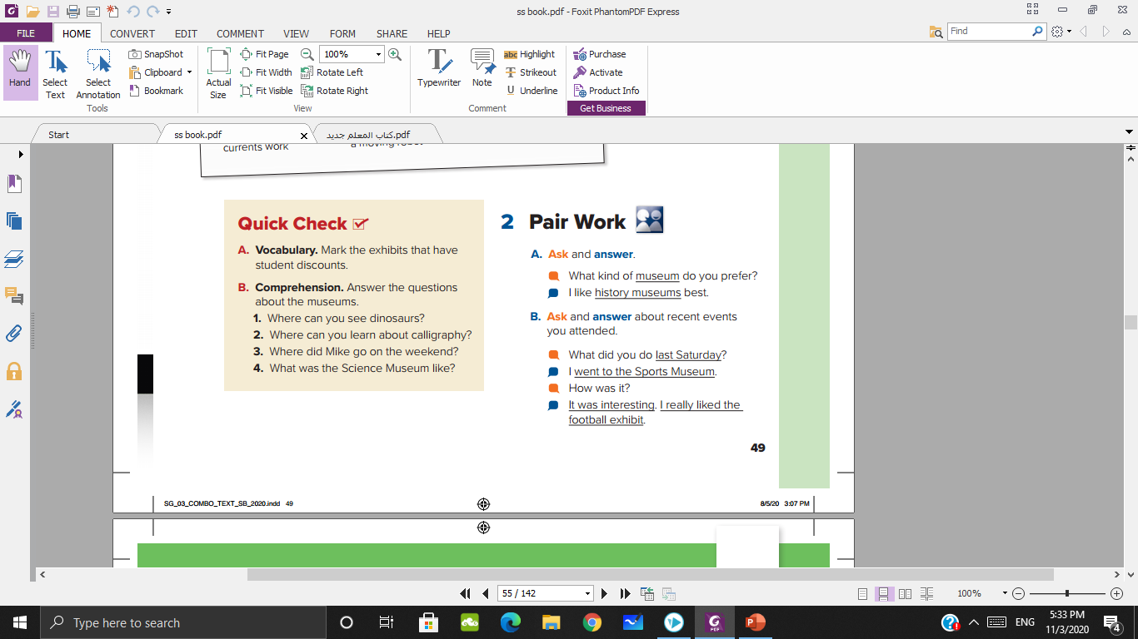
The World of Miró,
Art of the Pen: Arabic Calligraphy
The Natural History Museum

Slide 21
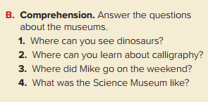
at the Museum of Natural History
at the Islamic Heritage Museum
He went to the Science Museum.
It was amazing.

Slide 22
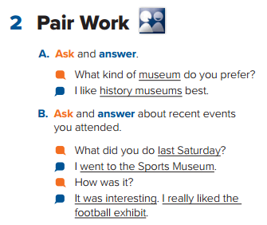

Slide 23

page 111

