Slide 1
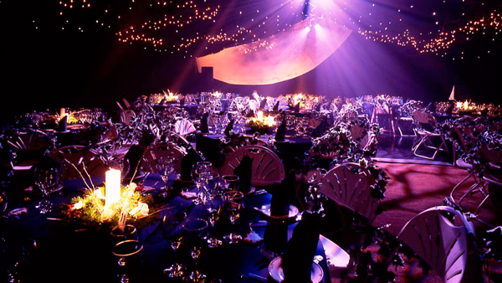
U 6 writing
Tr. Nora Khalid
This Photo by Unknown Author is licensed under CC BY-SA

Slide 2
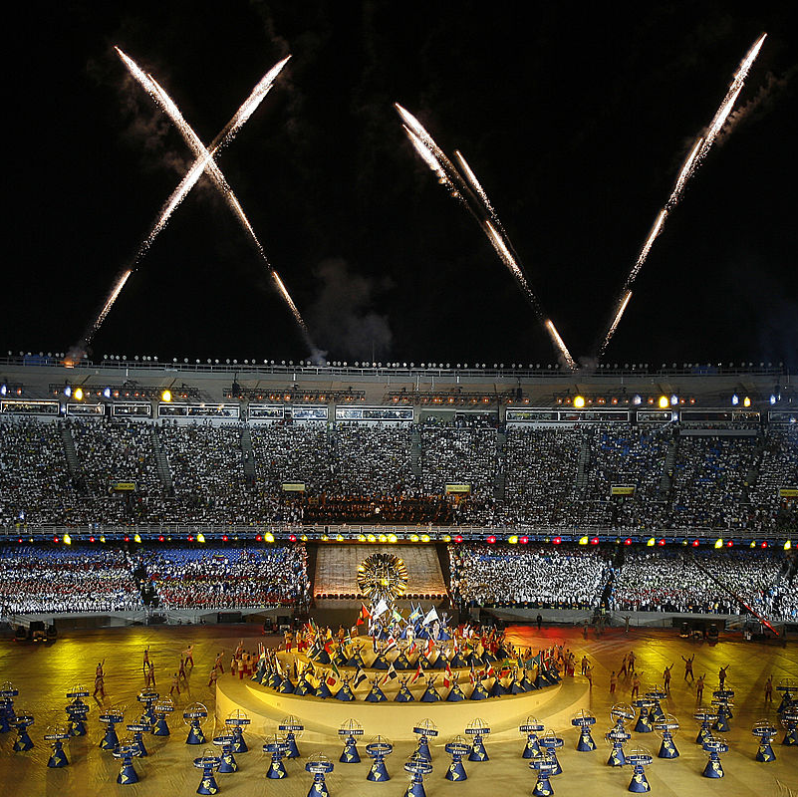
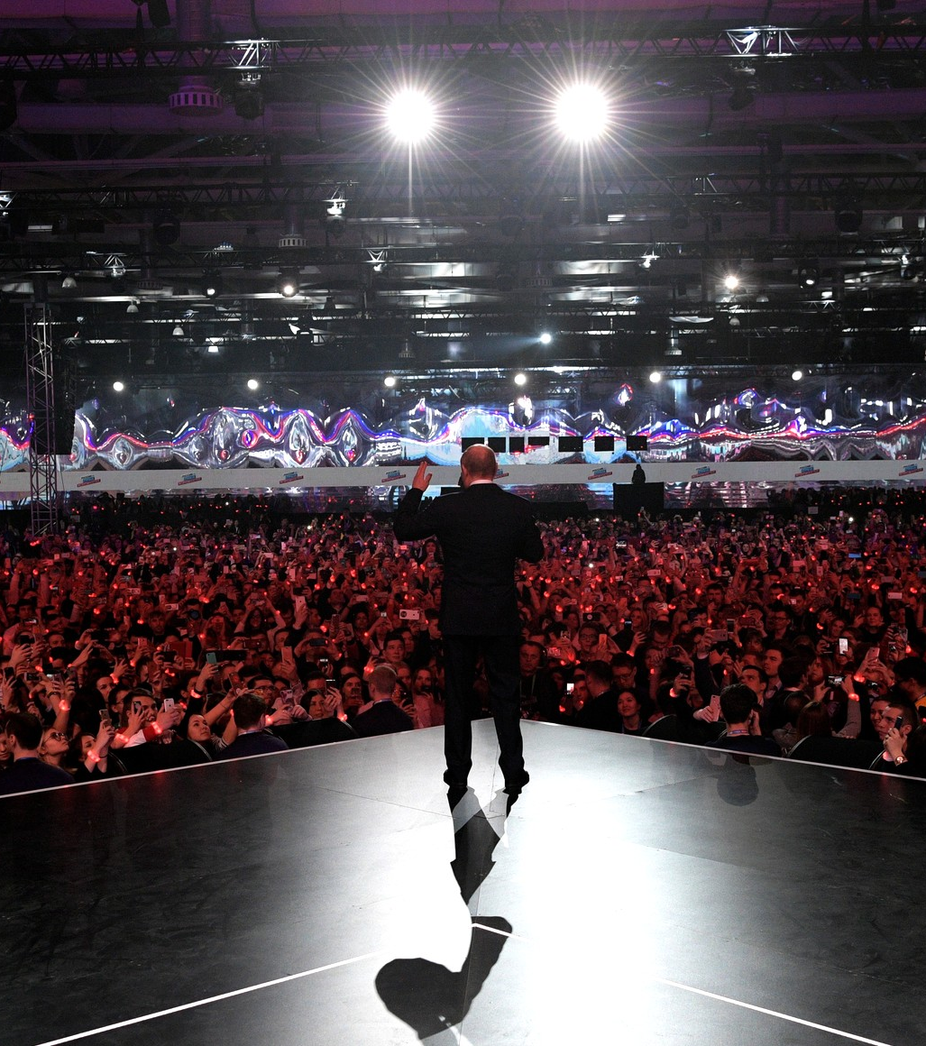
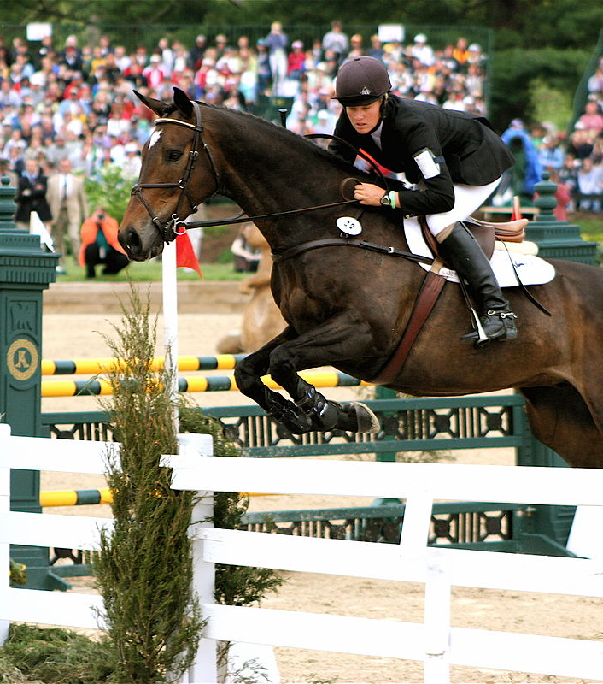
What does “event” mean?

Slide 3
Have you ever attended an event?
What kind of events have you attended?
Sport
Art
Science
Culture

Slide 6
Find time words in the first two lines.

Slide 7
Find exclamation points.
To show exitance

Slide 8
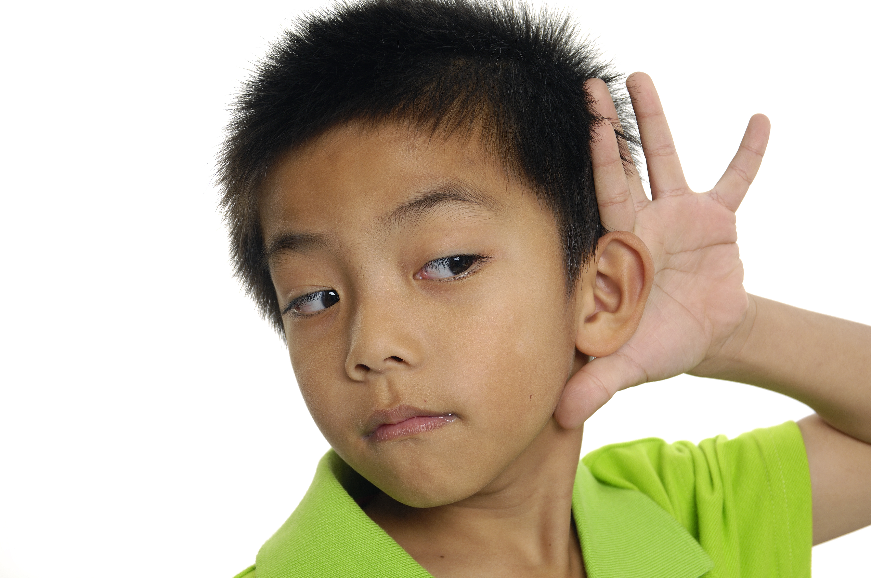
Find quotation marks.
To hear sounds and speech from the story

Slide 10
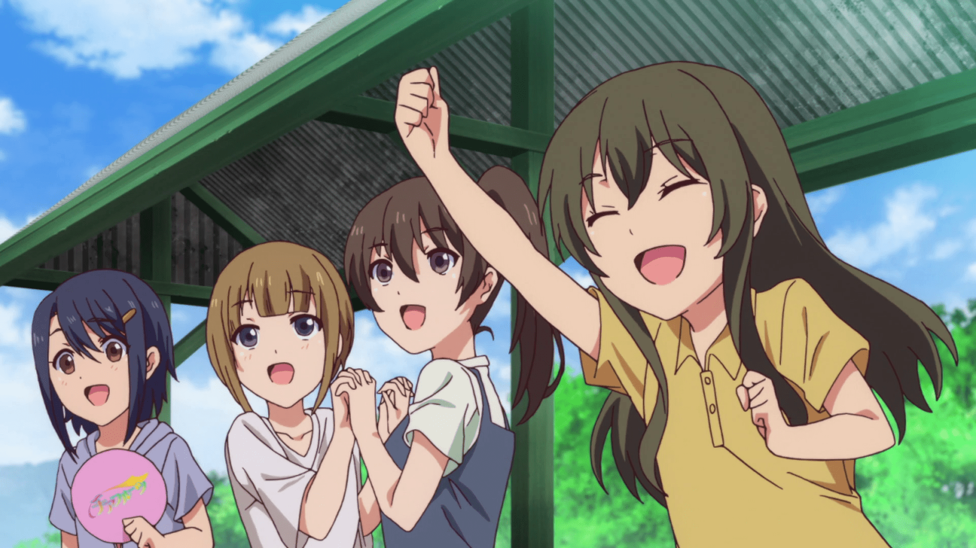
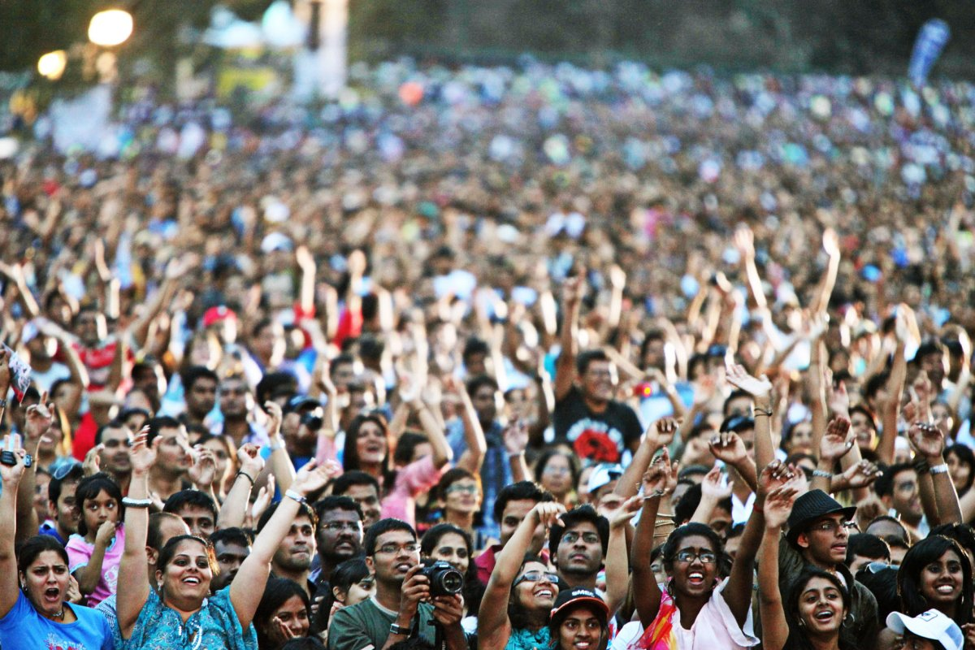
Cheered
Silent
Crowed
Nervous
Excited

Slide 11
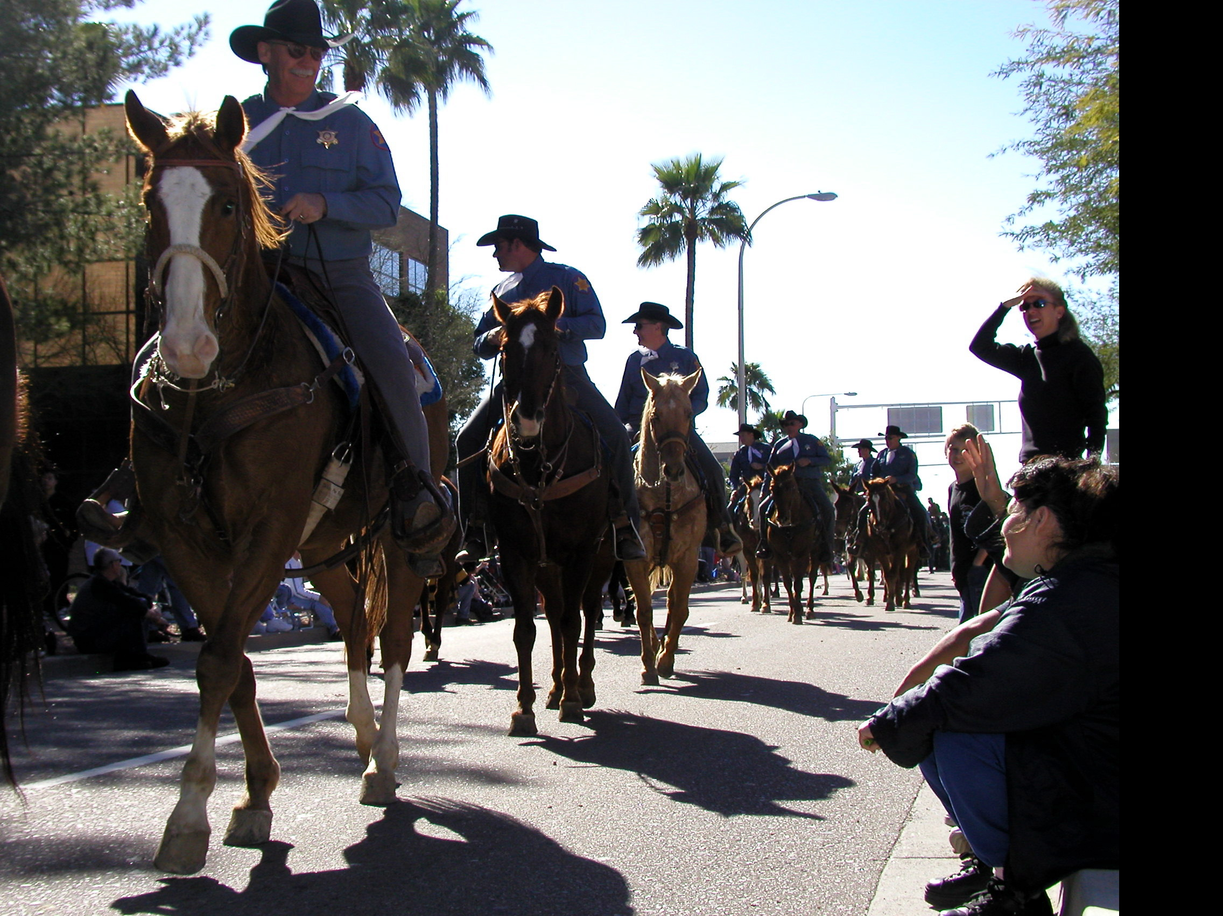
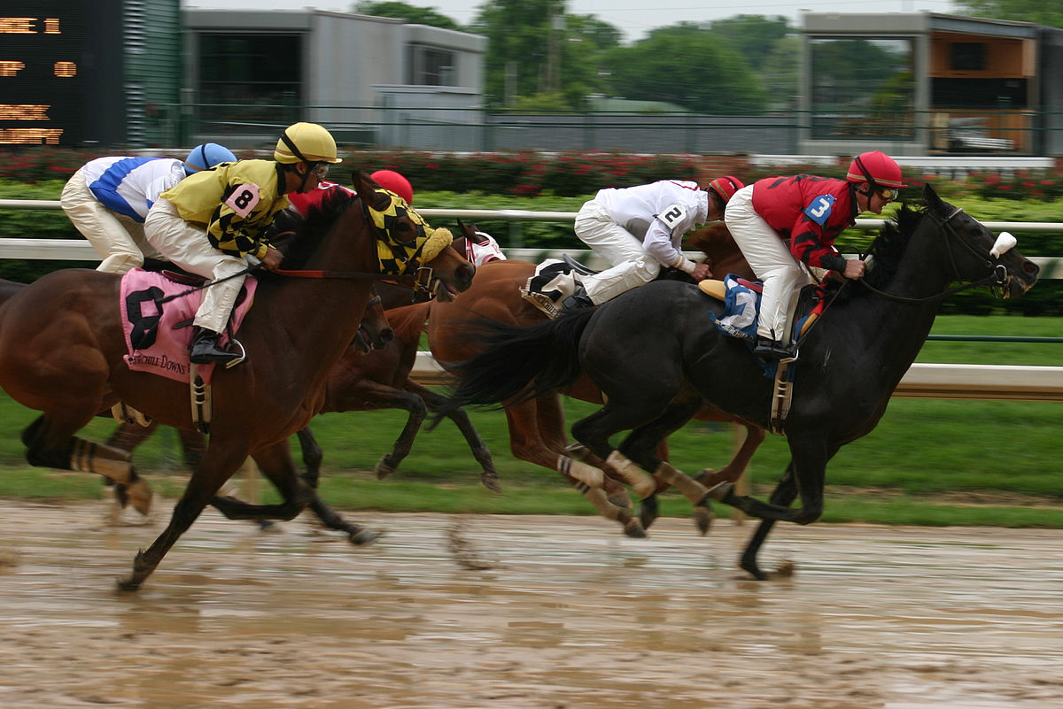
Paraded
Thundered
Shook

Slide 12
paraded
nervous
crowed
silent
thundered
shook
excited
cheered

Slide 13
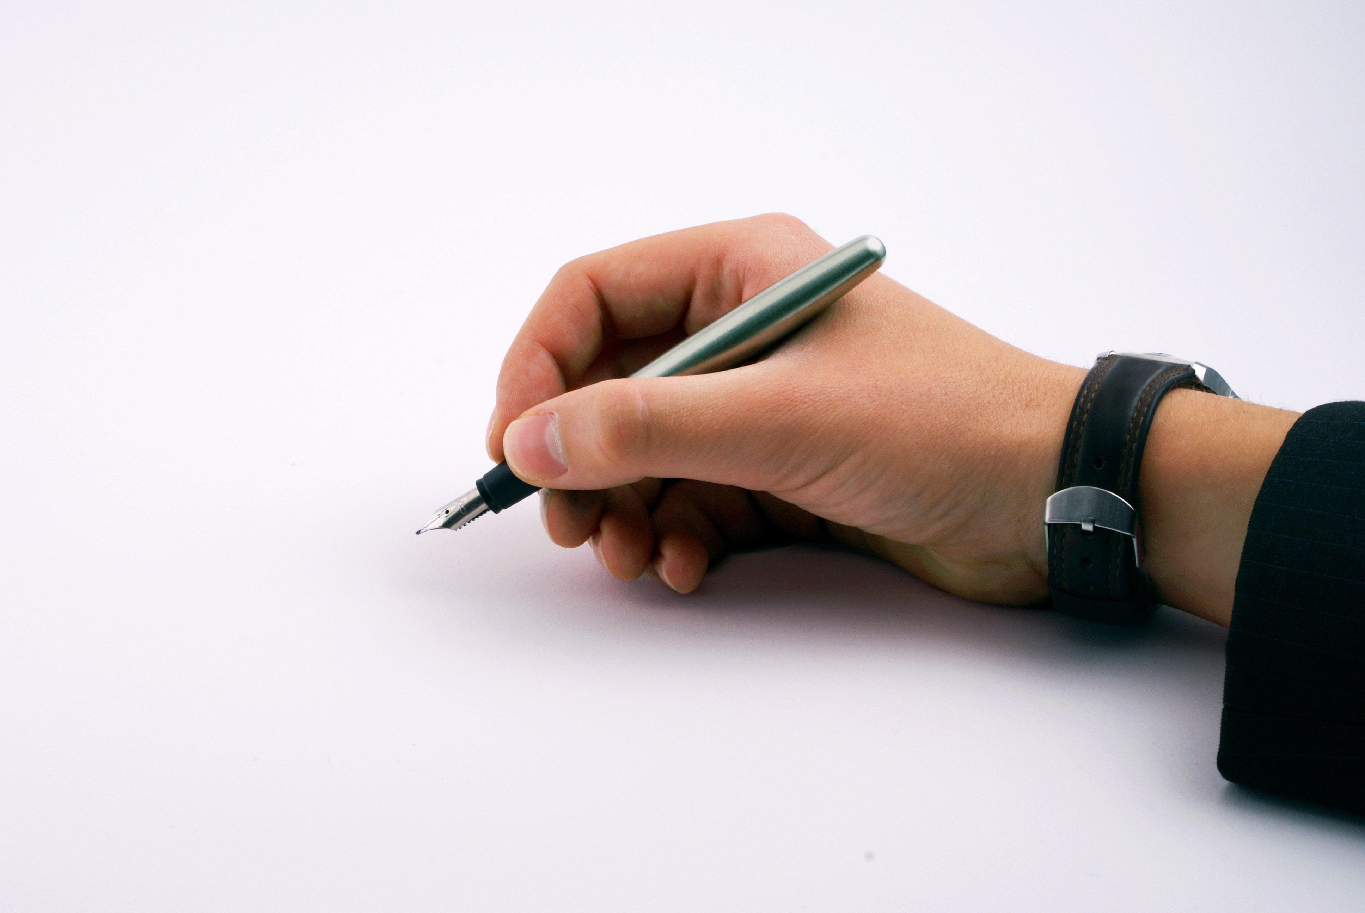
Write about an interesting museum, performance, or sports event that you attended. Use your notes from the chart to describe what you sensed and how you felt.

Slide 14
Thank you
Tr. Nora Khalid
This Photo by Unknown Author is licensed under CC BY-SA

