Slide 1
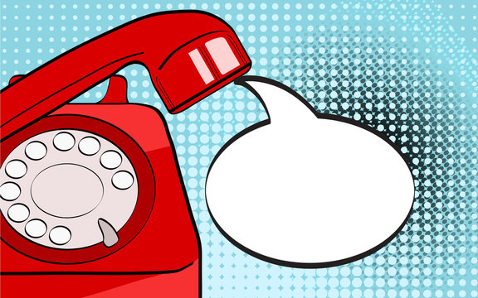
riiiiiing
ring
riiiiing
riiiiiing

Slide 2
Unit :
7
Listen and discuses
By ET Asma Almjlad

Slide 4
Match the words with the meaning
Practice asking about an accident
Practice asking about feelings

Slide 5
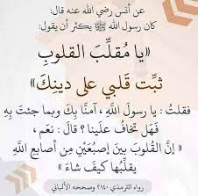

Slide 6
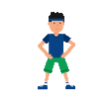

Slide 7
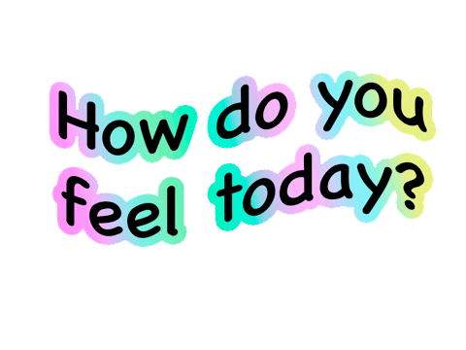
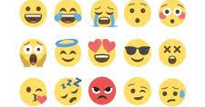
WHY?

Slide 8
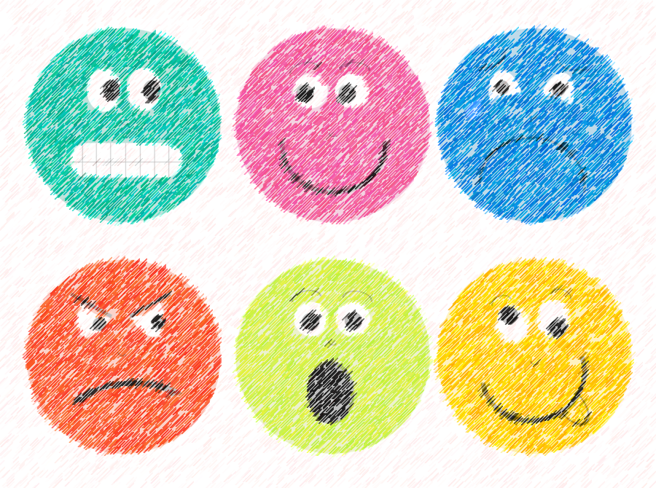
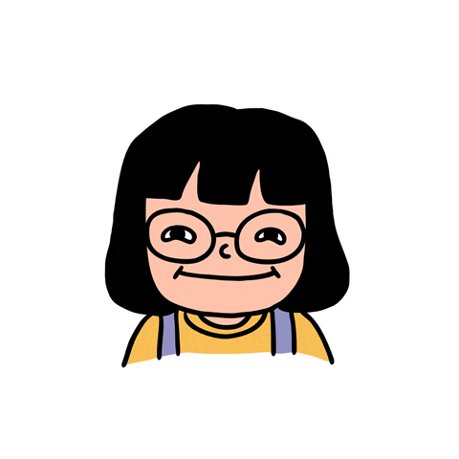
I’m happy because I’m going to a restaurant this evening.
I’m also happy because I saw an old friend yesterday

Slide 9
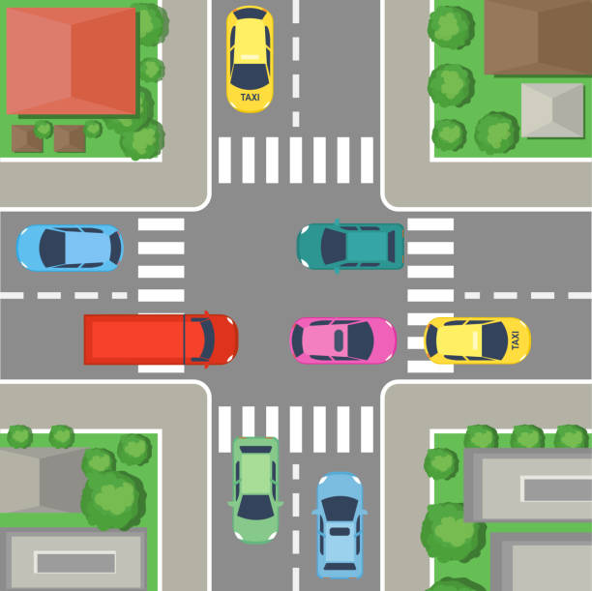
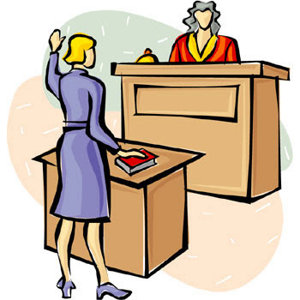
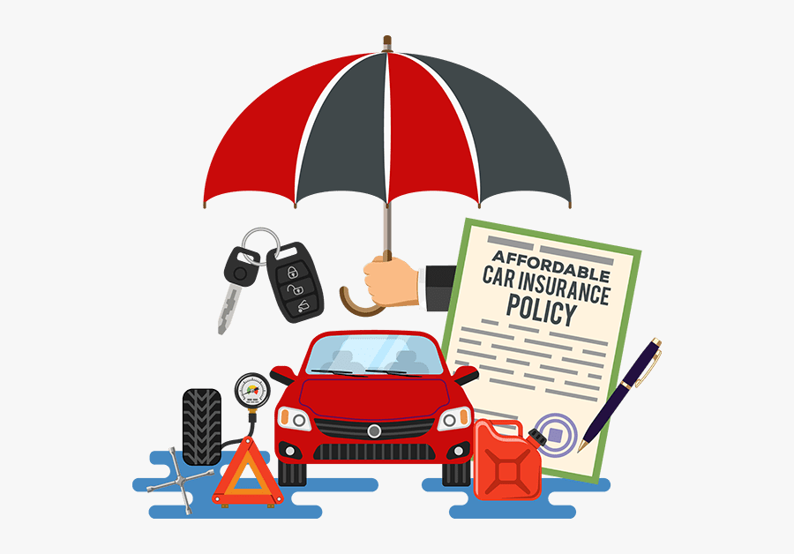
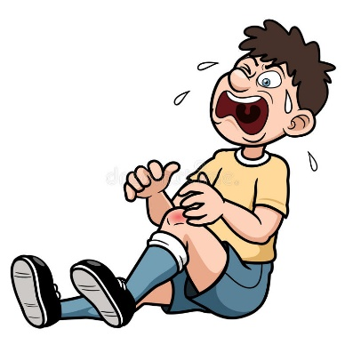
witness
intersection
insurance
injury

Slide 10
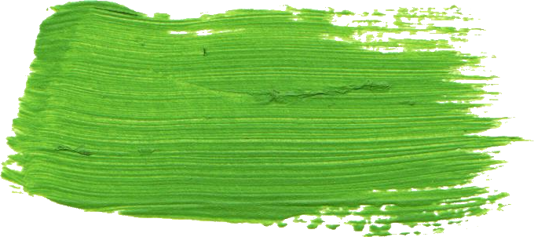
@ page 56+58
Do you think any of these people are happy?
How do you think they feel?

Slide 11
What happened?
Listen
Does the accident look very serious?
Do you think anyone was hurt?
Do you think anyone was hurt?
How do accidents often happen?

Slide 12
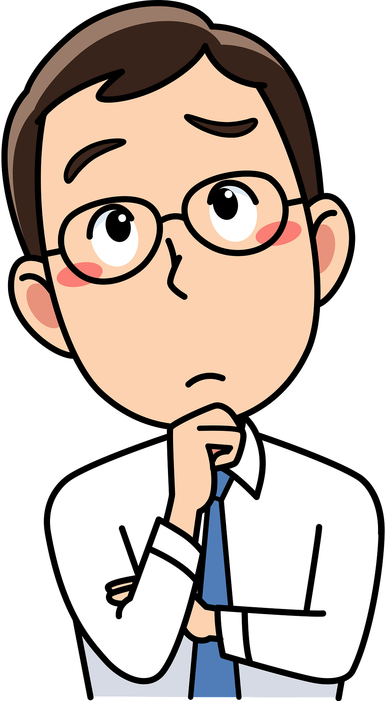
Did the car driver stop at the stop sign?
Did the SUV driver see the car coming?
Was the car driver on his cell phone?

Slide 14
What do the pictures show?

Slide 15
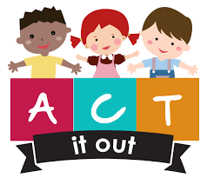
1
sleepy
scared
3
happy
2
6
sad
angry
5
4
surprised

Slide 16
Why is the witness relieved?
Why is the car driver worried?
Why didn’t the SUV driver see the car coming?
Why is the passenger always nervous when he rides with the car driver?
Why isn’t the police officer surprised there was another accident?

Slide 18
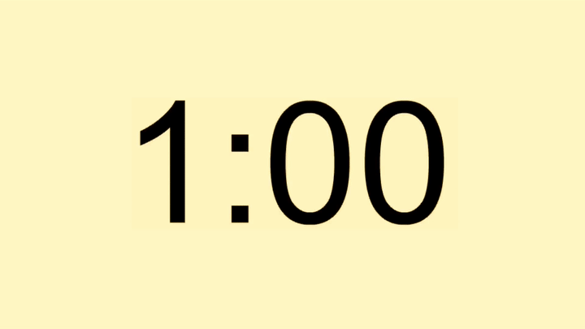
D
C
B
A

Slide 19
It happened at around 3:15 in the afternoon
No, it didn’t.
No, there weren’t.
No, it wasn’t.
Three accidents happened this week.

Slide 20
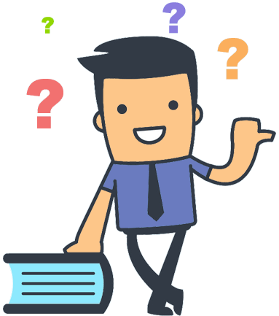

Slide 21
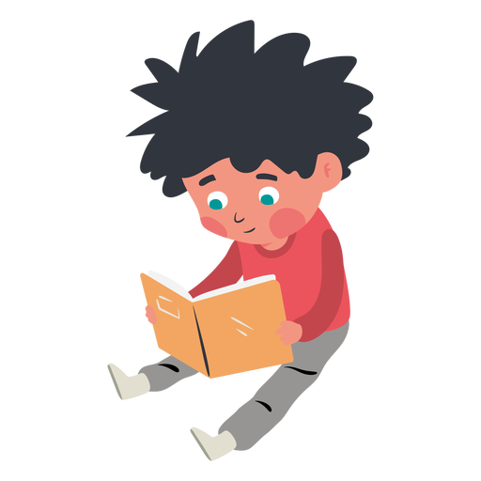

Slide 22
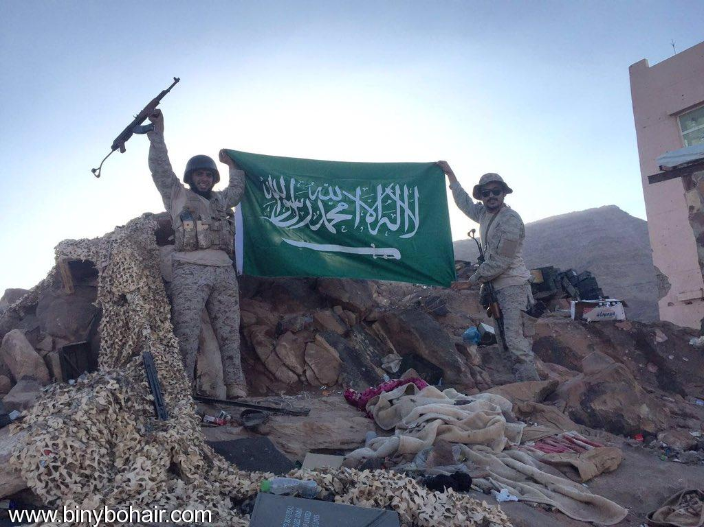
What do you feel about ………………….?

Slide 23
WORK
BOOK

Slide 24
surprised
angry
happy
worried

Slide 25
scared
Tired

