Slide 1
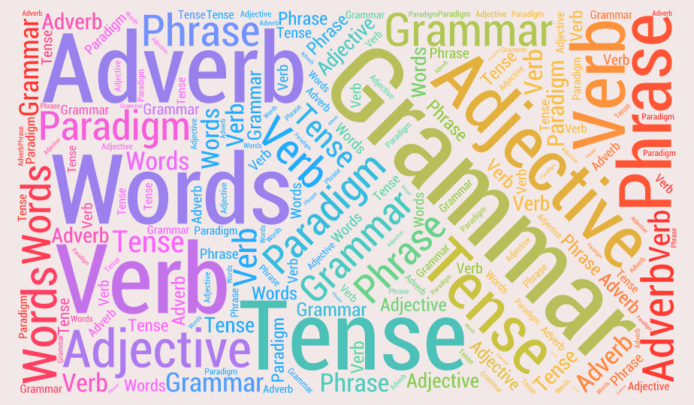
U 6 form, meaning and function
Tr. Nora Khalid

Slide 2

GOALS
1- To use intensifiers with adjectives.
2- To differentiate between “very” and “strong adjectives”

Slide 3
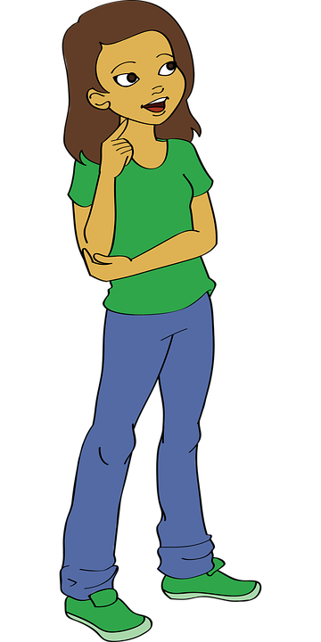
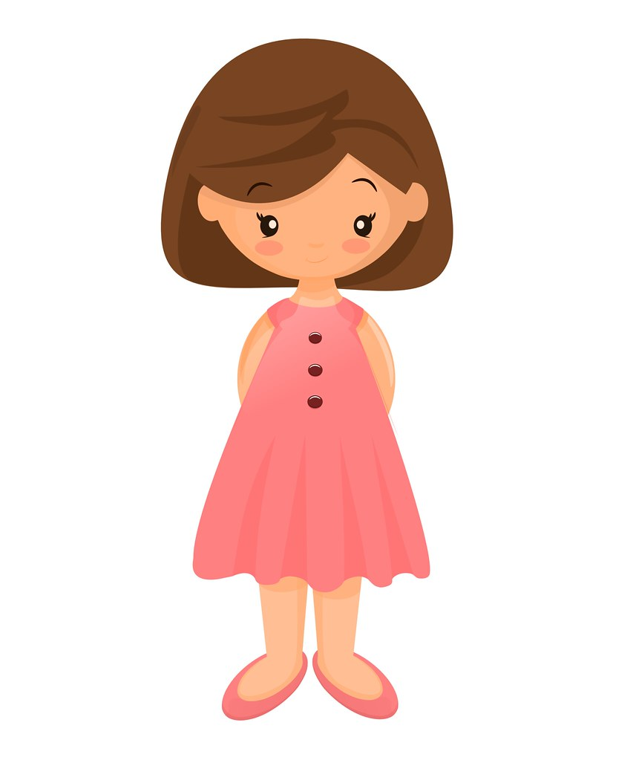
She is very tall.
She is tall.

Slide 4

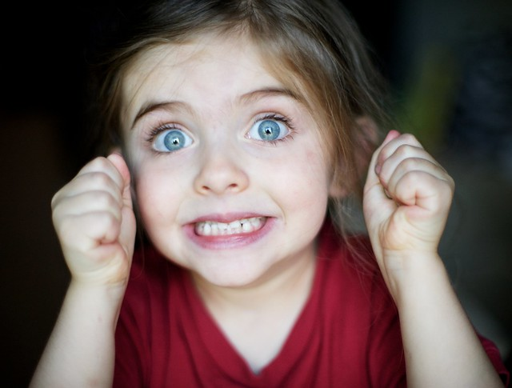
She is extremely tall.
She is excited.

Slide 5
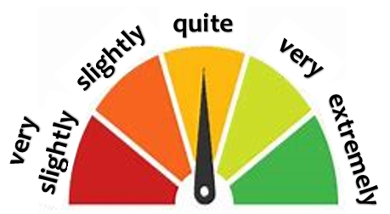

Slide 6

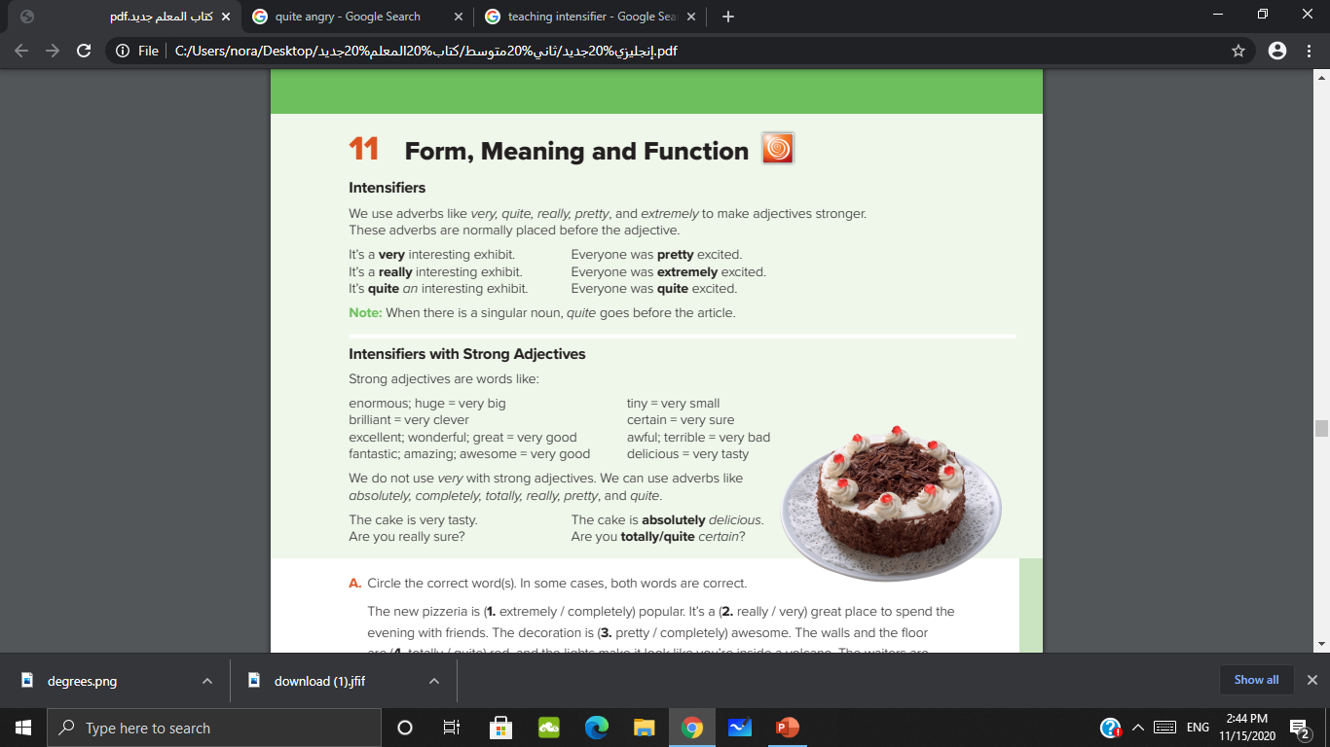

Slide 7
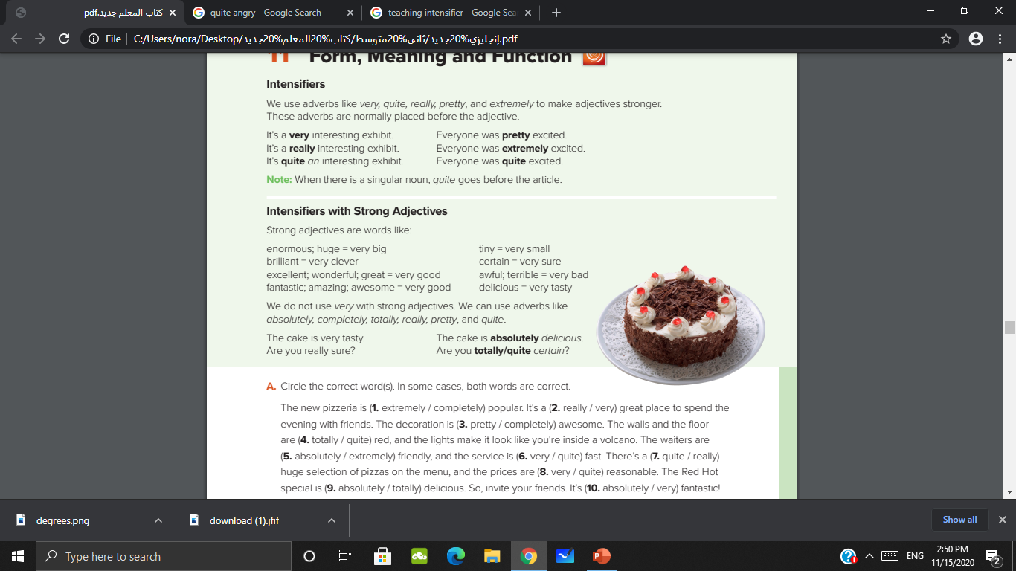

Slide 8
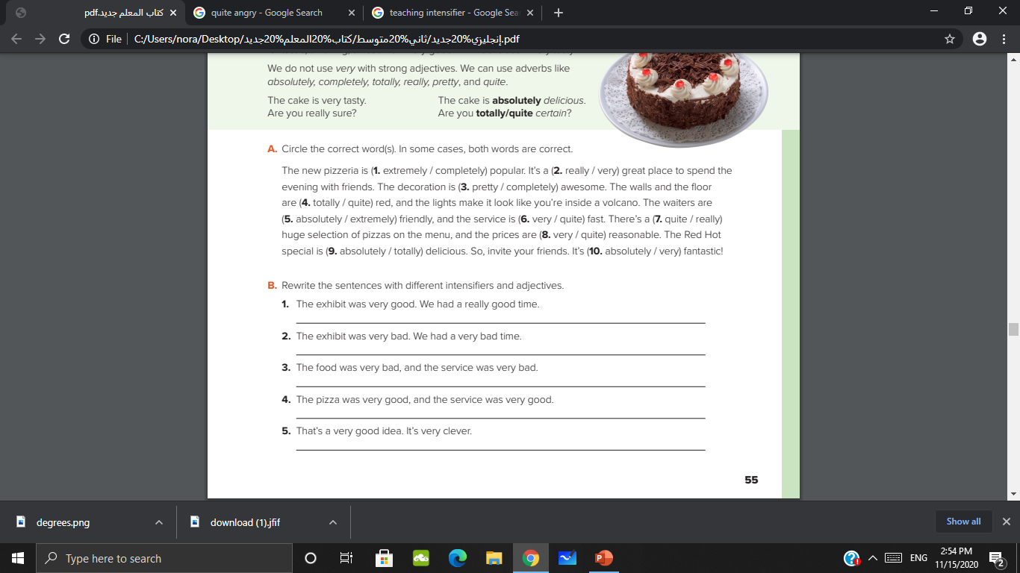

Slide 9

The exhibit was extremely interesting. We had a totally awesome time
The exhibit was quite boring. We had a completely terrible time.
The food was absolutely awful, and the service was quite slow
The pizza was really delicious, and the service was extremely friendly.
That’s a really great idea. It’s absolutely brilliant.

Slide 10
https://wordwall.net/play/6898/701/132

Slide 11


