Slide 1
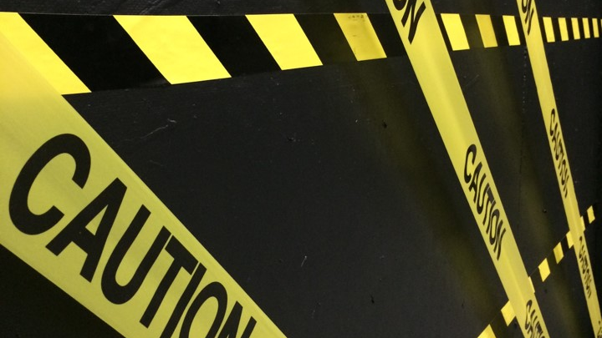
U 7 Grammar
Tr. Nora Khalid

Slide 2
Goals
To use There was/There were
To pronouns: Someone, No one, Nothing, Anything
To use adverb: Ago
To listen for specific information about an accident
To use conjunctions: because / so
To pronounce the /h/ sound

Slide 3
I went to the party yesterday. There was my friend.
I went to the party yesterday. There were my friends.
What’s the difference?

Slide 4
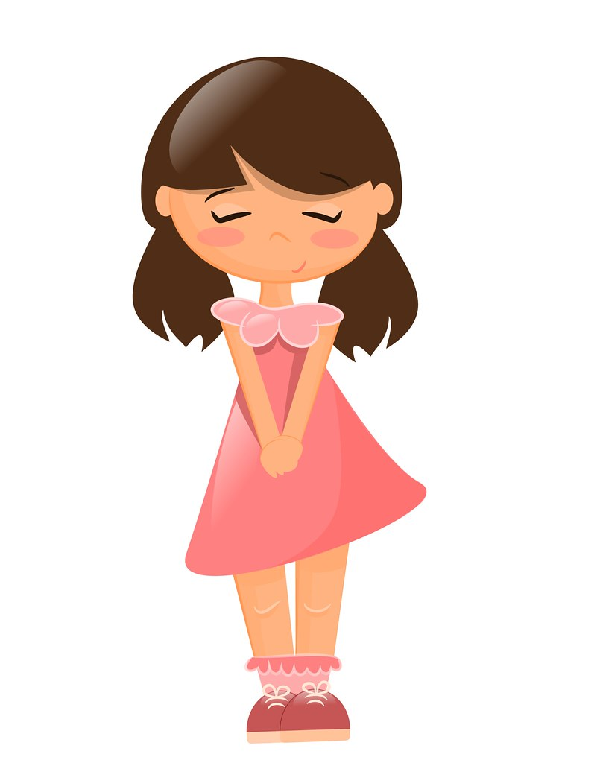
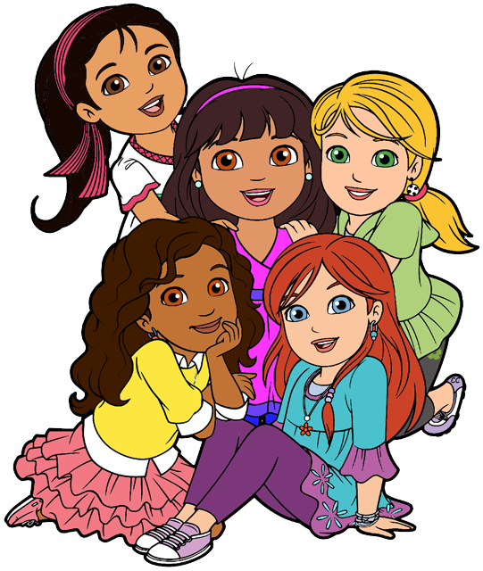
There was my friend.
There were my friends.

Slide 5

There was
“singular 1 “
There was …….
There were
“plural +1 “
There were …….

Slide 6
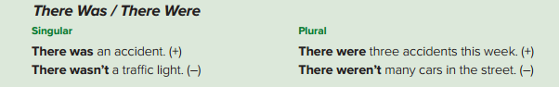
an accidents
a traffic light
Three accidents
Many cars

Slide 7
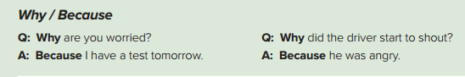
Read:
Why: for what reason.
Because: for the reason that…

Slide 8
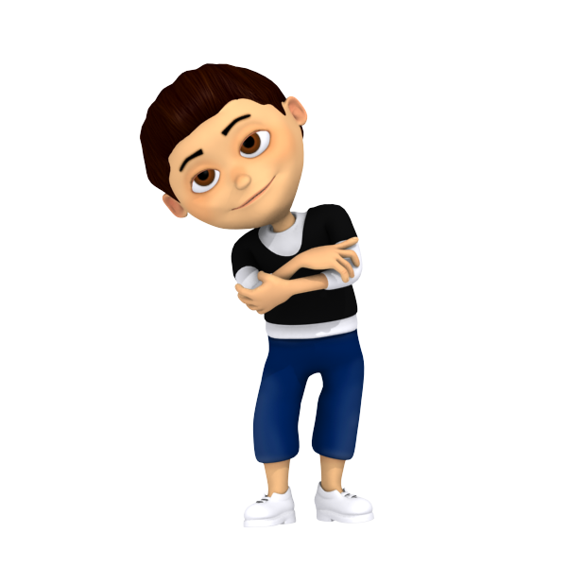
Because it is an important language.
Why do we
learn English?

Slide 9

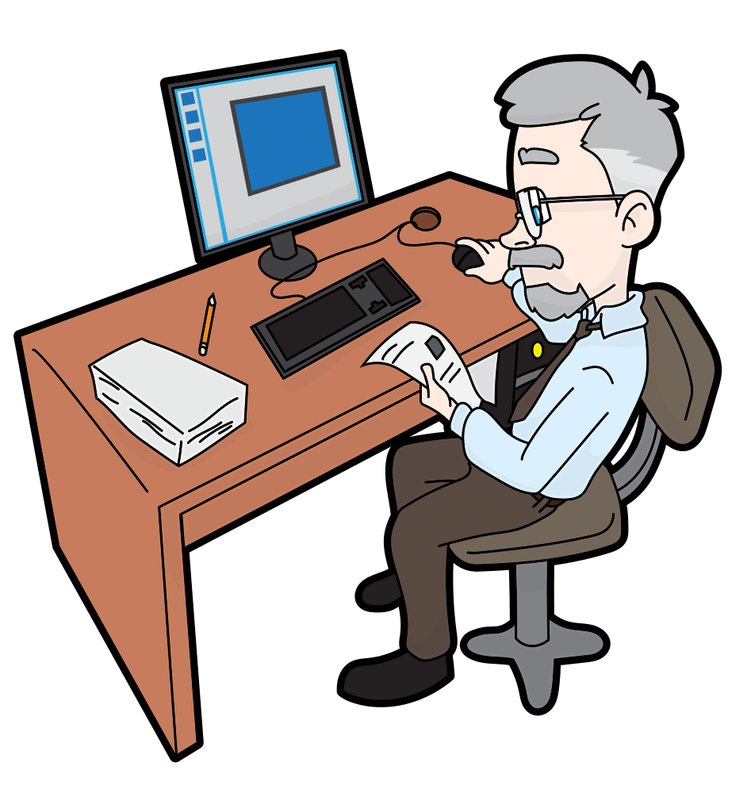
I saw Ahmed in his office 10 minutes ago.

Slide 10
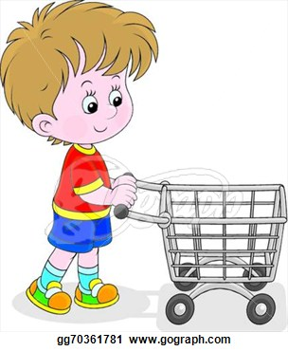
Ali went to the supermarket one hour ago.

Slide 11

ago follows an expression of time
Do we use ago to talk about the past, present, or future?
What verb tense do we use with ago?
The past
Past simple

Slide 12
I started learning English _____ ago.
I wrote a test _____ ago.
I had something to eat _____ ago.
Class started _____ ago

Slide 13
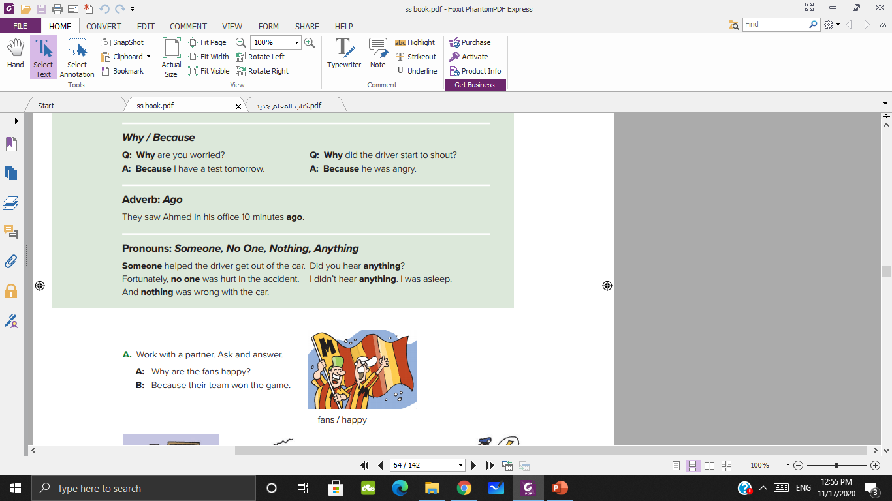
Which words refer to people?
Which words refer to things?

Slide 14
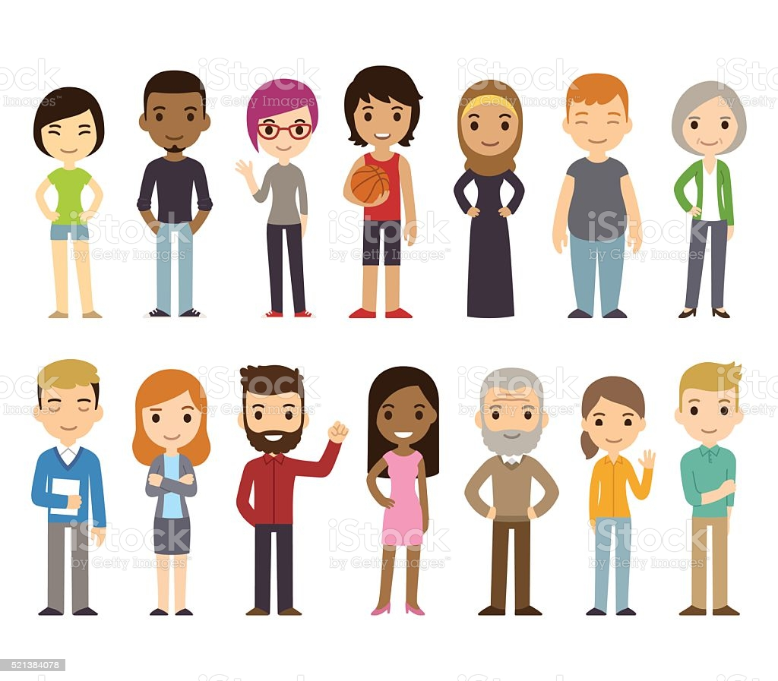
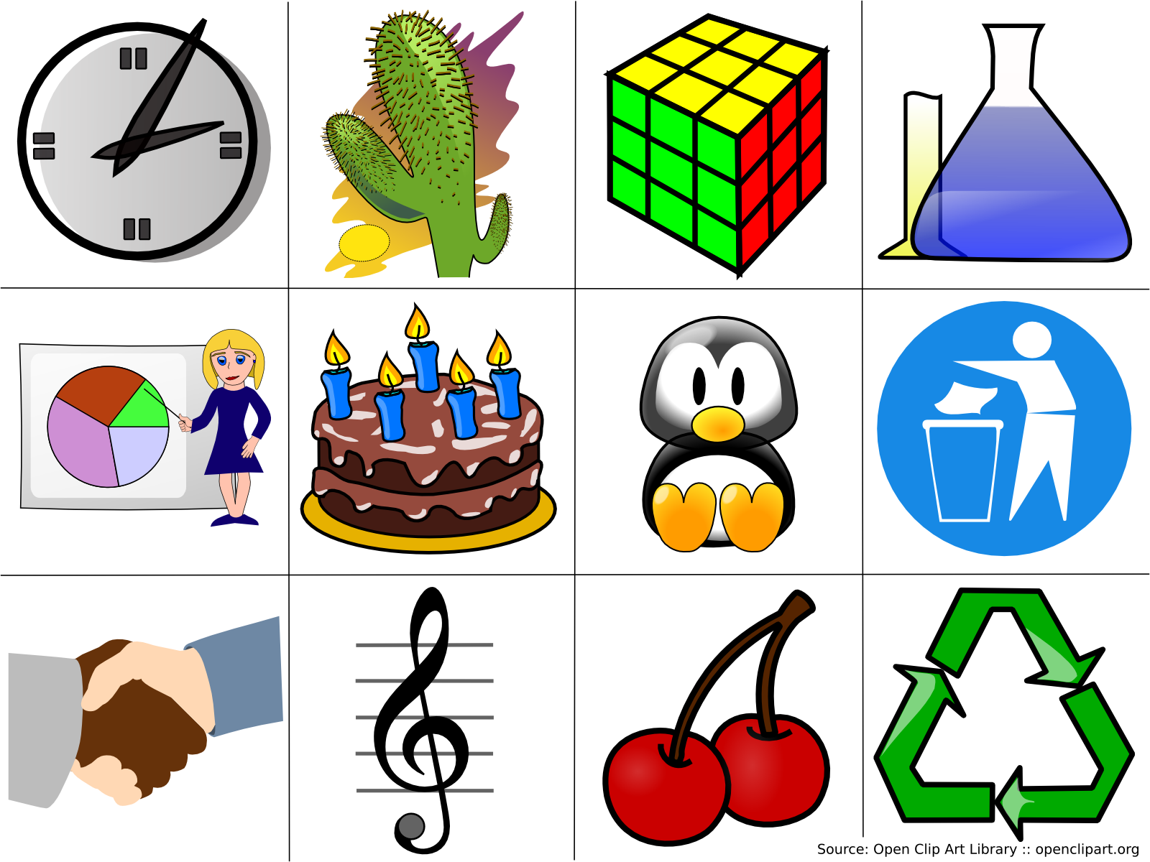
Someone
Anything
Nothing
No one

Slide 15
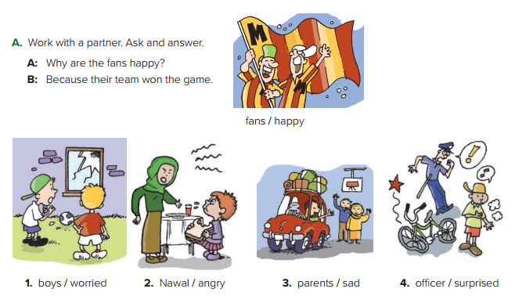
Role play

Slide 16
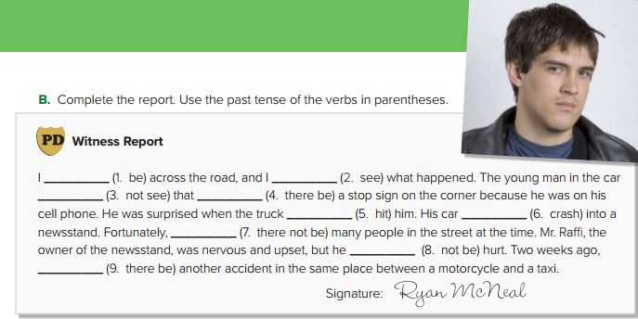
was
saw
didn’t see
there was
hit
crashed
there were not
wasn’t
there was

Slide 17
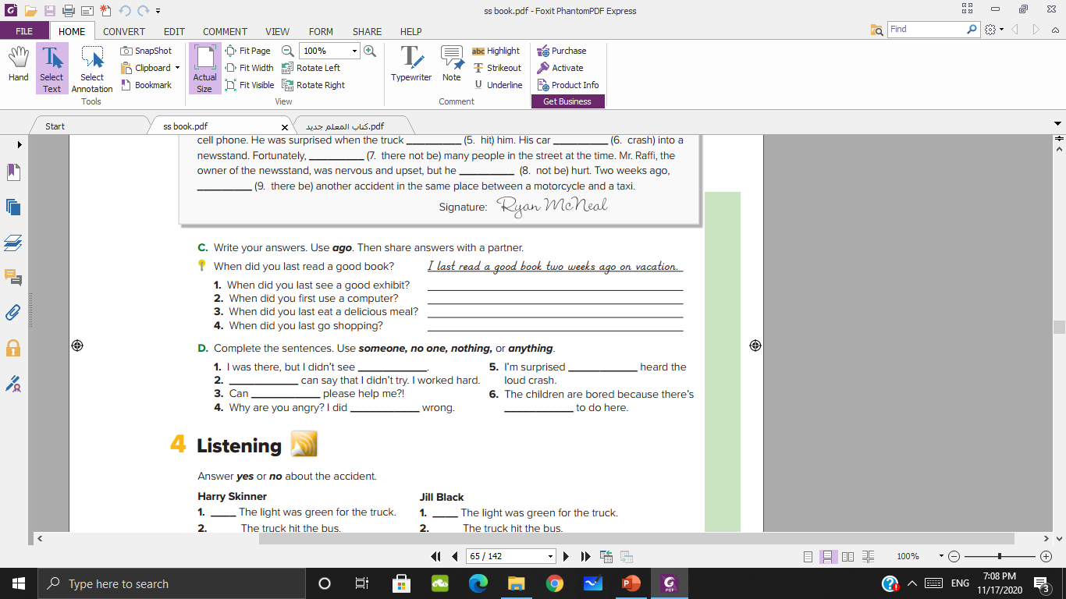
anything
someone
No one
someone
nothing
nothing

Slide 18
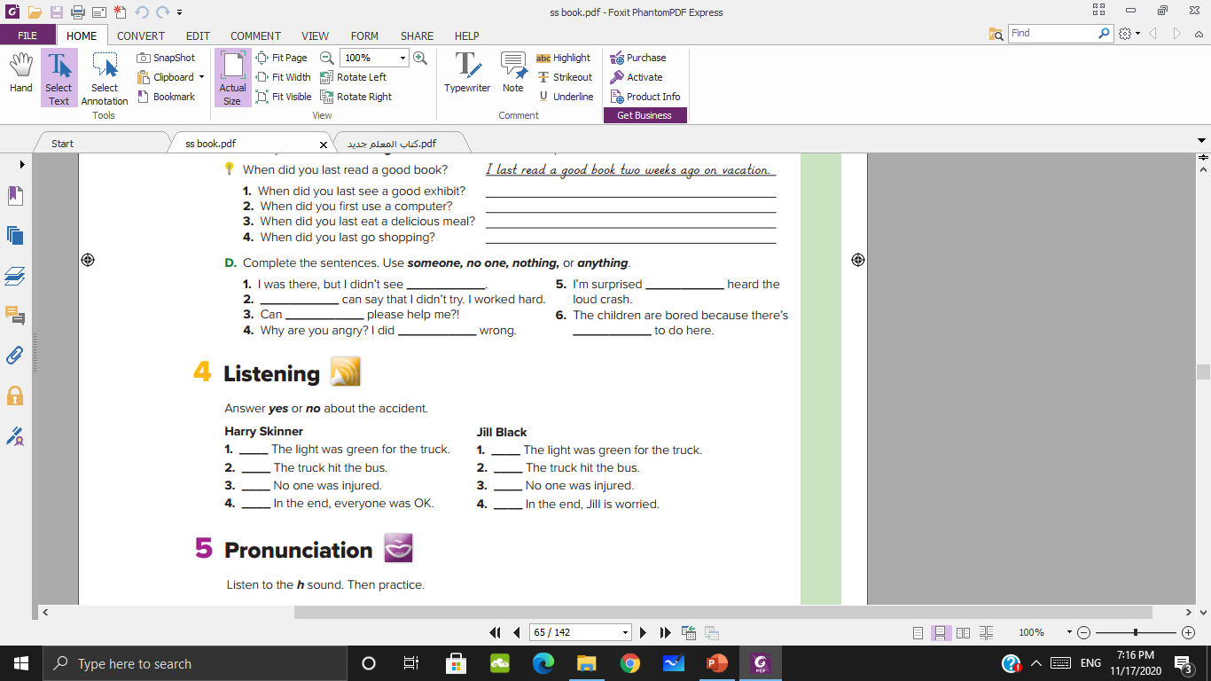

Slide 19
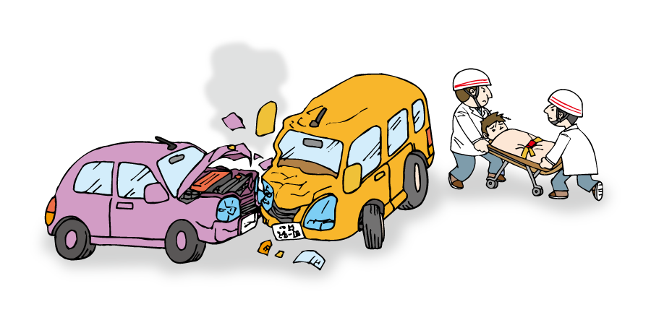


Slide 20
No
Yes
Yes
Yes
Yes
Yes
Yes
Yes

Slide 21
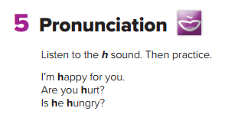

Slide 22


