Slide 1


Slide 2

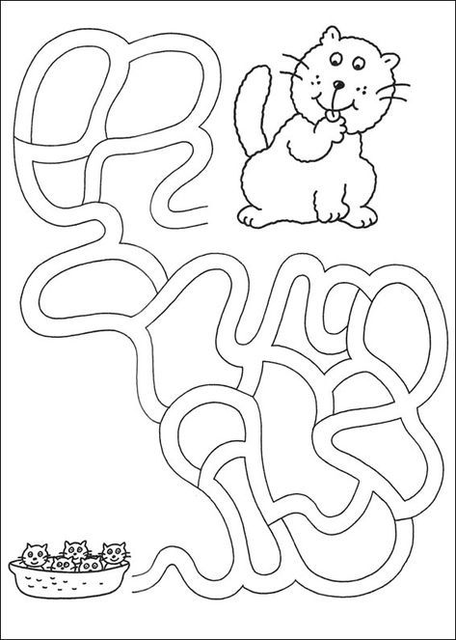
Warm up

Slide 3
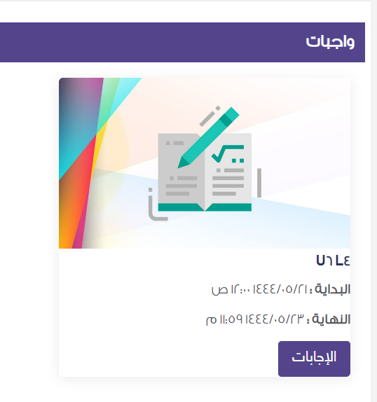


Slide 4
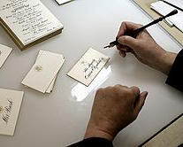
U 6
What was it like?
Reading

Slide 5
Objectives :
Answer questions about the reading passage .
Define the word “calligraphy “ .
Find the meaning of new words in the text .

Slide 6

Previous vocab

Slide 7
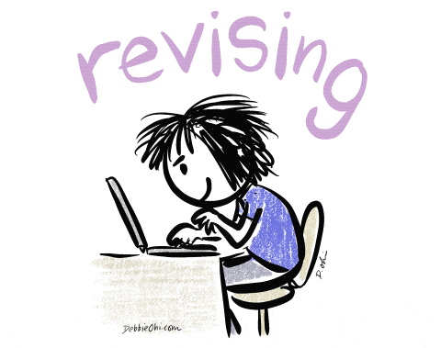
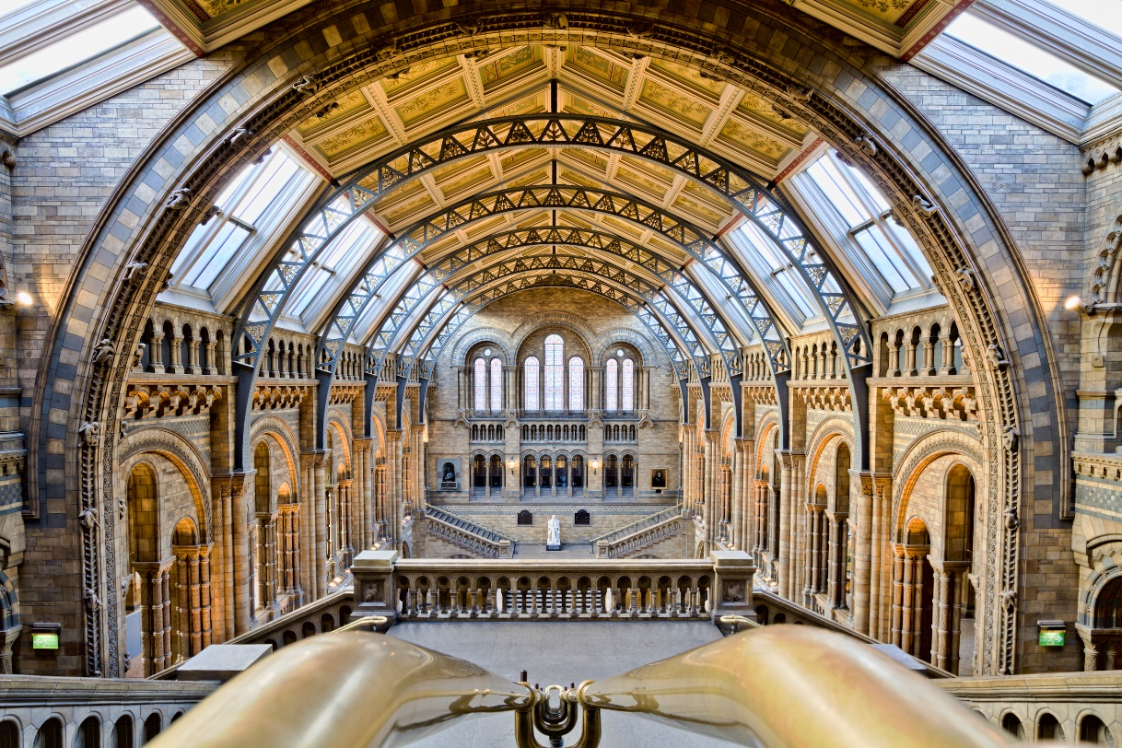
School
Museum
Office

Slide 8
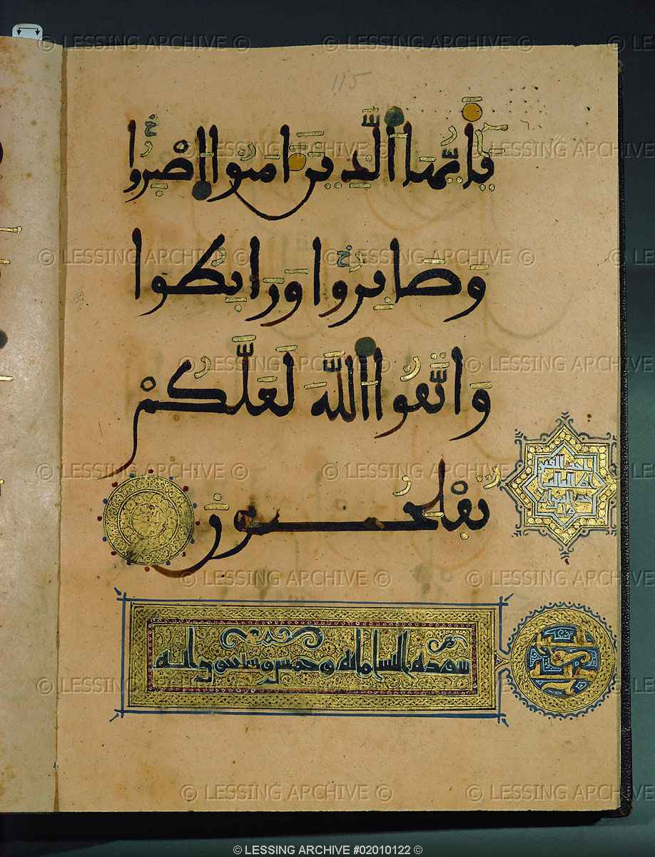
Calligraphy
Exhibit
Museum

Slide 9
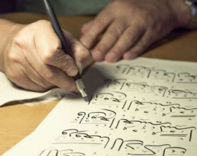

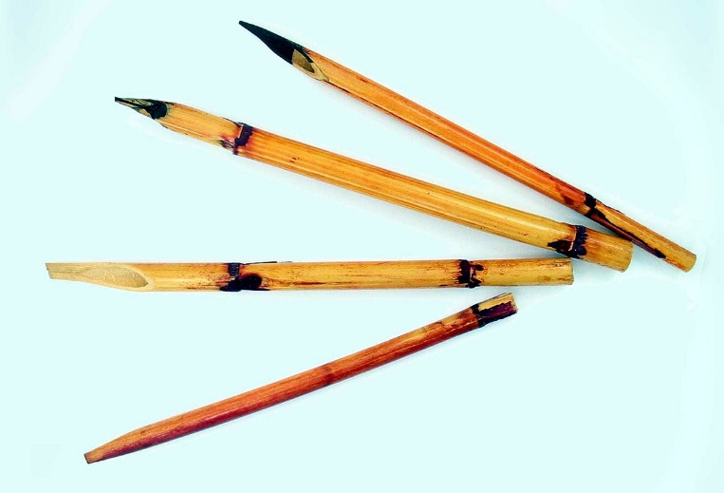
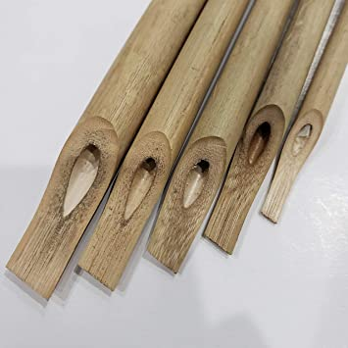
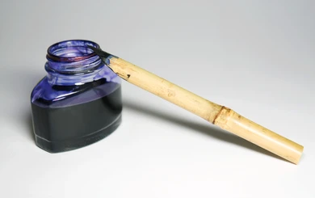
What is the man doing?
He is writing calligraphy.
What is he using to write with?
Aqlam, or special reed pen and ink.

Slide 10
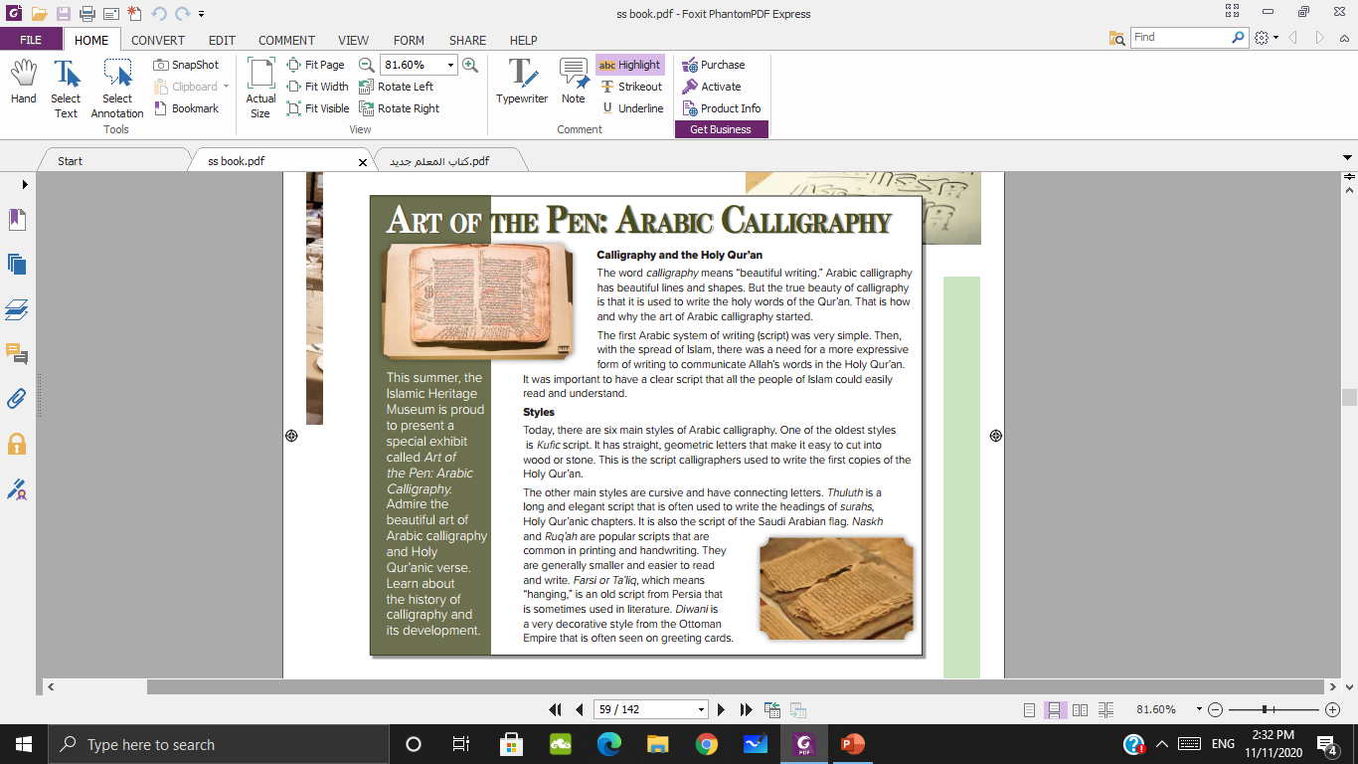
What do you see in the other two pictures?
Pages of the Holy Qur’an, calligraphy

Slide 11
Do they look new or old?
They look old.

Slide 12
Is the writing style the same or different? Why?
It’s different.

Slide 13
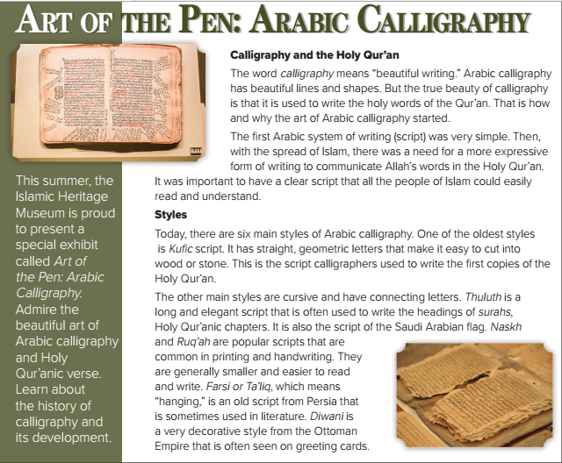
What is the title?
How many headlines are there?

Slide 14

What does calligraphy mean?
What is the reason for using calligraphy?
Was the first Arabic system of writing simple??

Slide 15
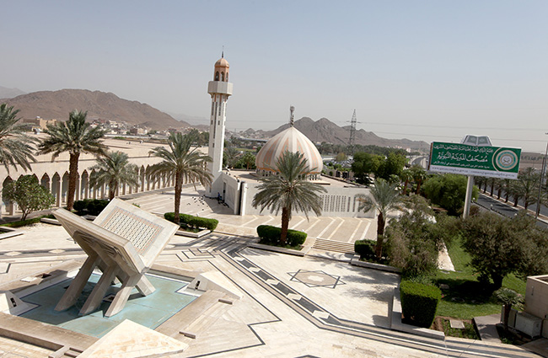
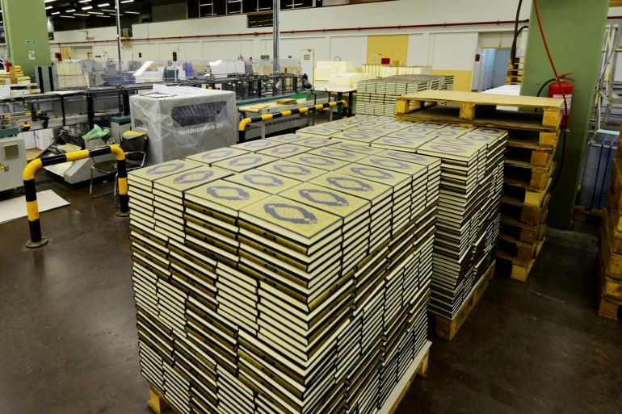
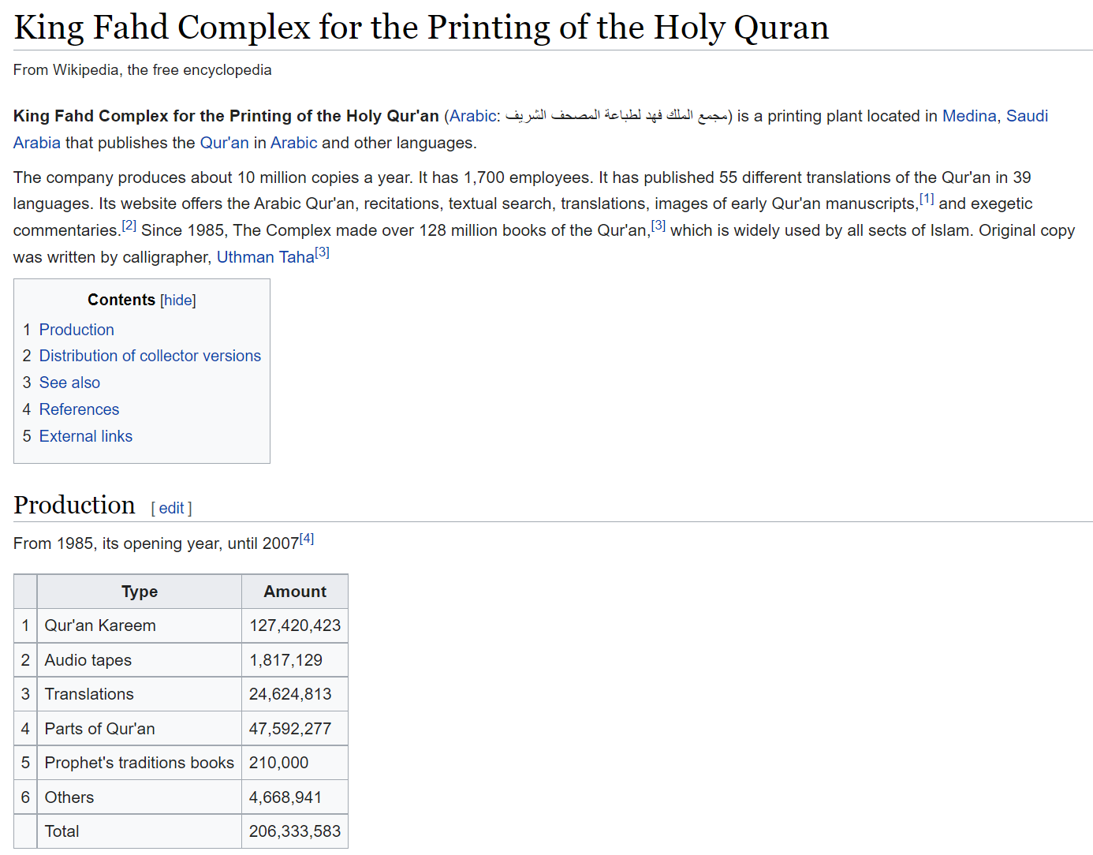

Slide 16
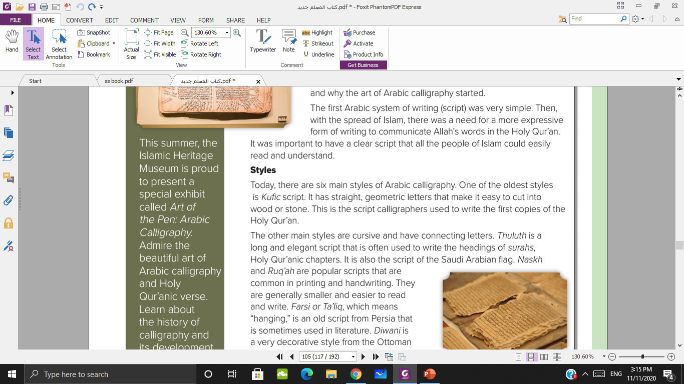
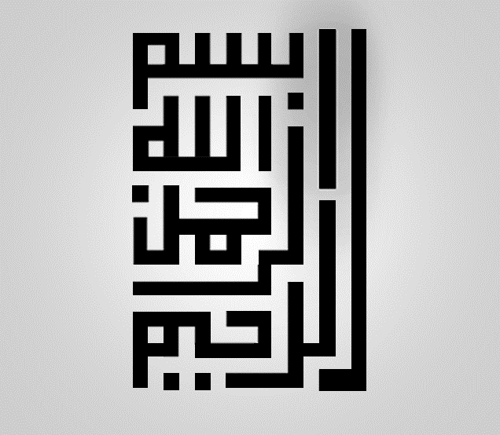
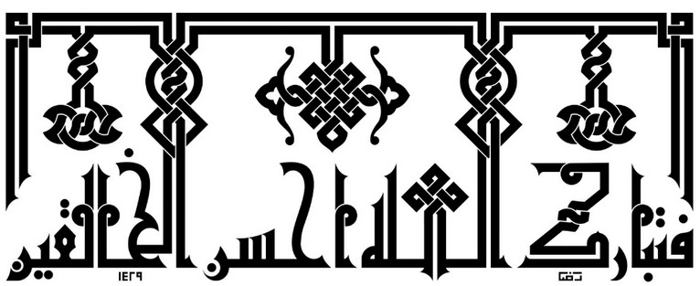
How many styles of Arabic calligraphy?
What is the oldest style of Arabic calligraphy?
Why is this used?

Slide 17
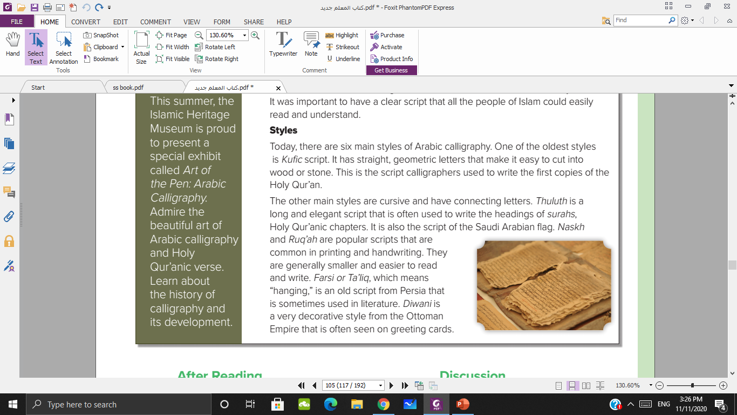
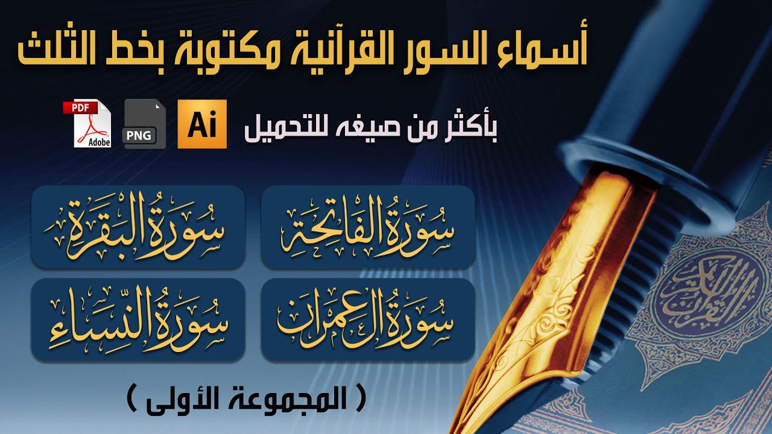
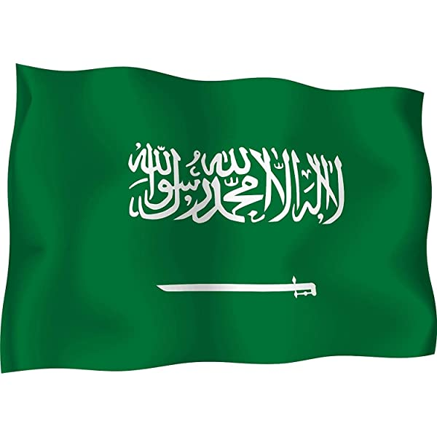
Which style is long and elegant script?
It is used to ………..
Is Thuluth the script of Saudi Arabia flag?

Slide 18

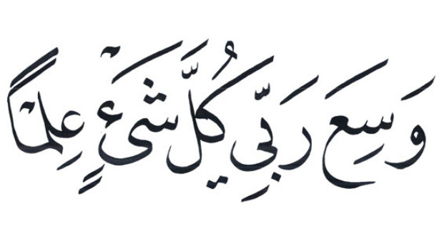
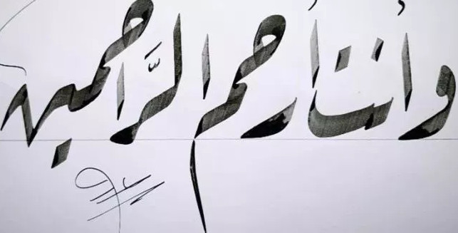
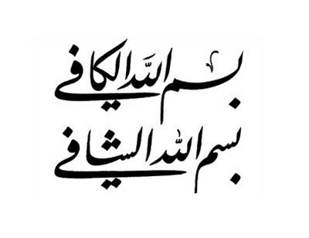
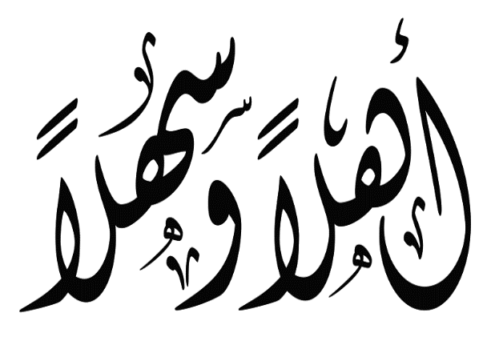
What are the popular scripts that used in printing and handwriting?
What are the other scripts mentioned in the passage?

Slide 19
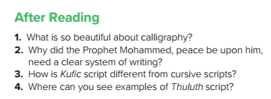

It is used to write the holy words of the Qur’an
It was important to have a clear script that all the people of Islam could easily read and understand.
Kufi script has straight, geometric letters that are not connected.
Thuluth is often used to write the headings of surahs, and it is the script on the Saudi Arabian flag.

Slide 20



Slide 21
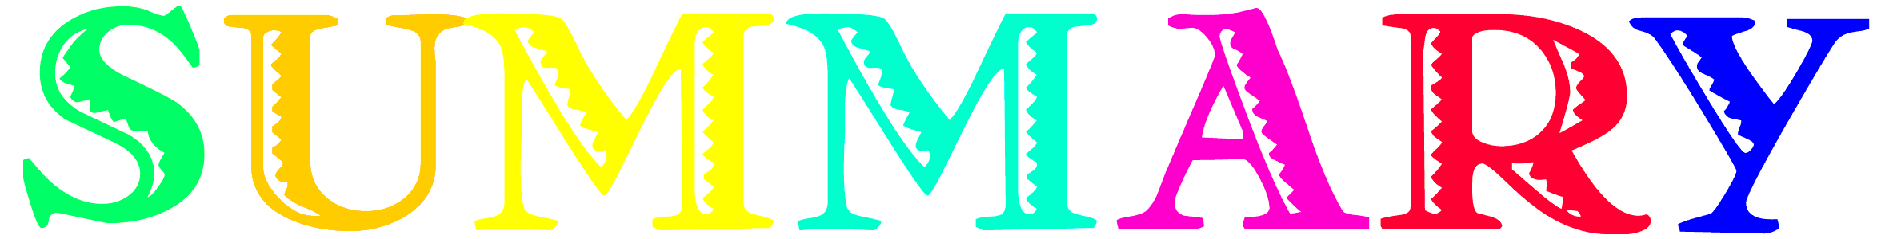
Art of the pen : Arabic calligraphy
Calligraphy and the Holy Quran
Styles
The definition of calligraphy
How and why the Arabic calligraphy started
Kufic
Thuluth
Naskh
Ruq’ah
Farsi
Diwani

Slide 22


