Slide 1

Date : 11- 6 – 1444 H
Page no. 66
Unit 8
What’s Wrong ?
Grammar

Slide 2

Objectives:
At the end of this session, the students will be able to:
1- Use “ should “ to give an advice .
2- Form questions with “ when “ clause .
3- Describe someone’s health condition .

Slide 3
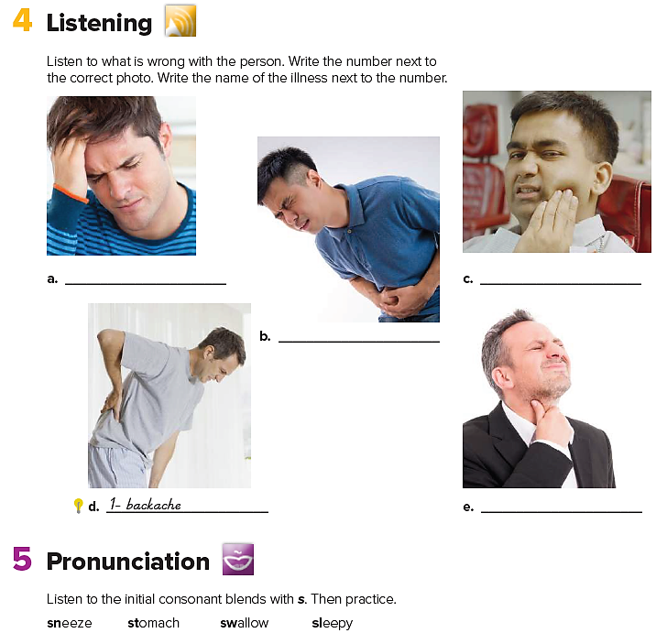

5 / cold
4 / toothache
2 / stomachache
3 / sore throat

Slide 4
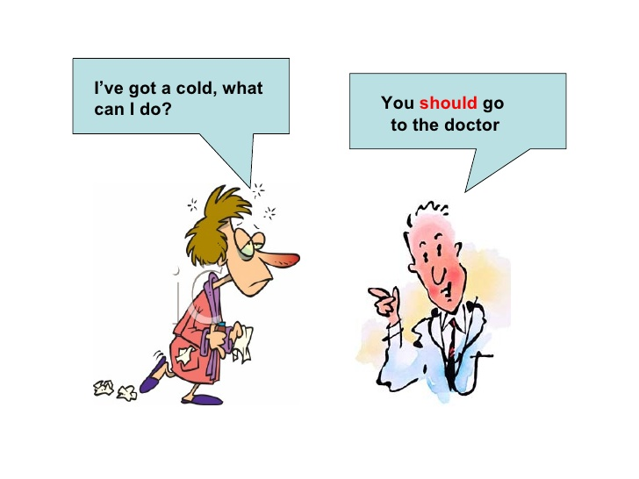
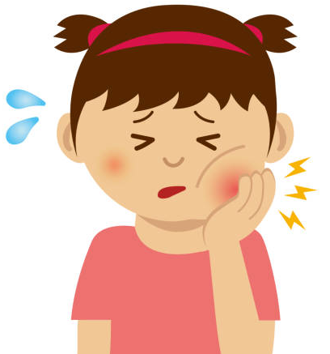

I have a toothache
You shouldn’t eat sweets

Slide 5
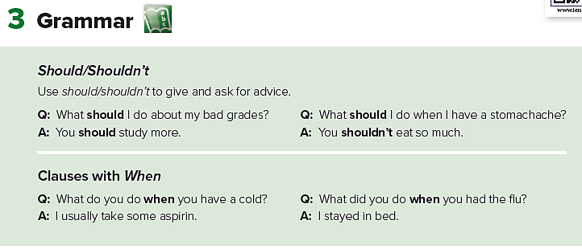
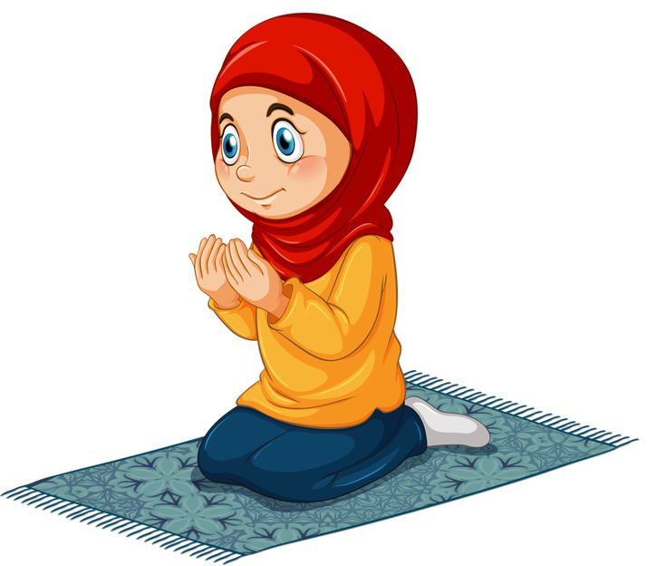

She You
We
He
I
Should # shouldn’t
V – inf.
Pray
You should pray .
Smoke
You shouldn’t smoke .

Slide 6
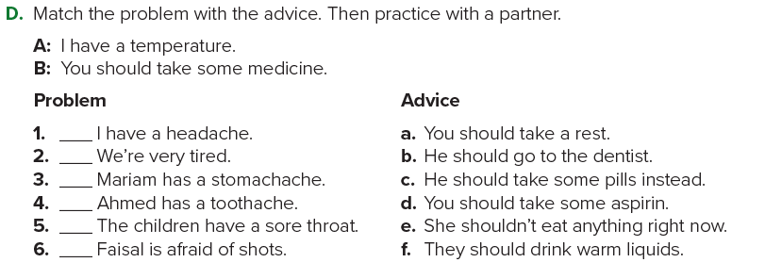
d
a
e
b
f
c

Slide 7
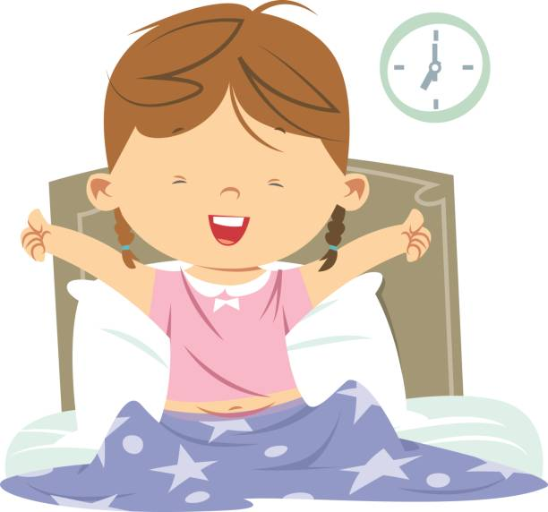
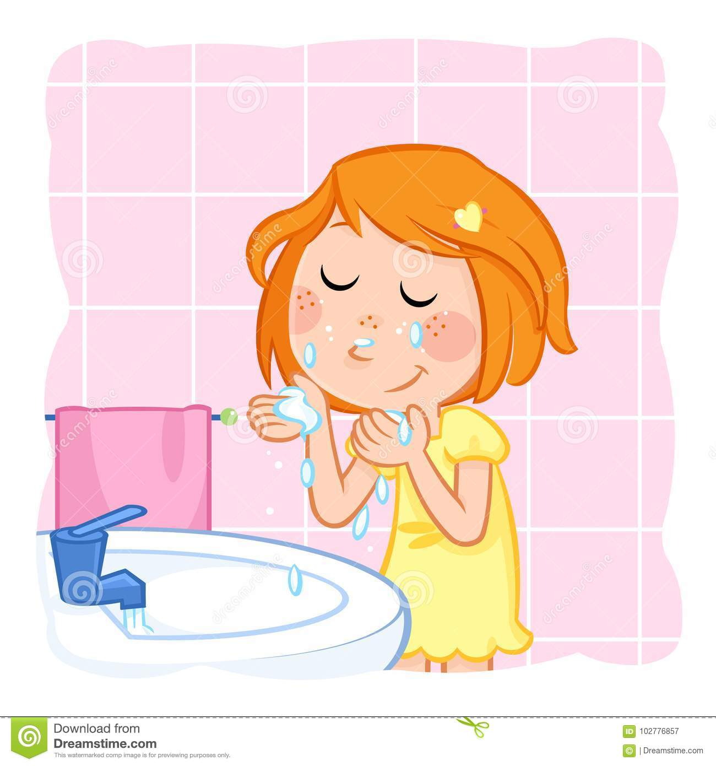
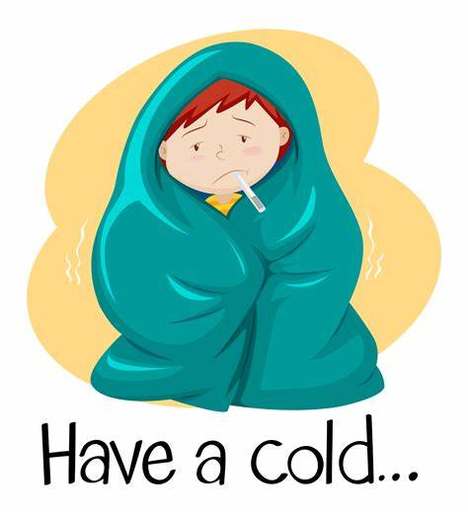
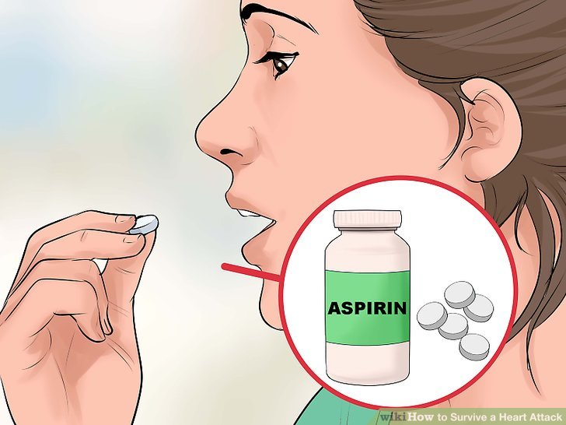
What do you do when you wake up ?
I always wash my face
What do you do when you have a cold ?
I usually take aspirin

Slide 8
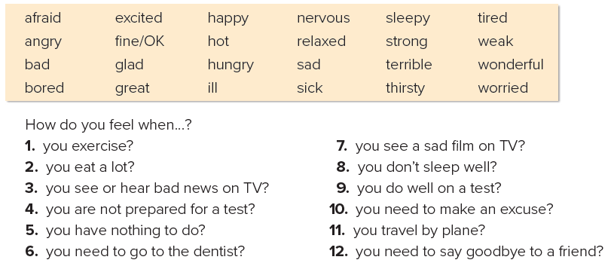

Slide 9
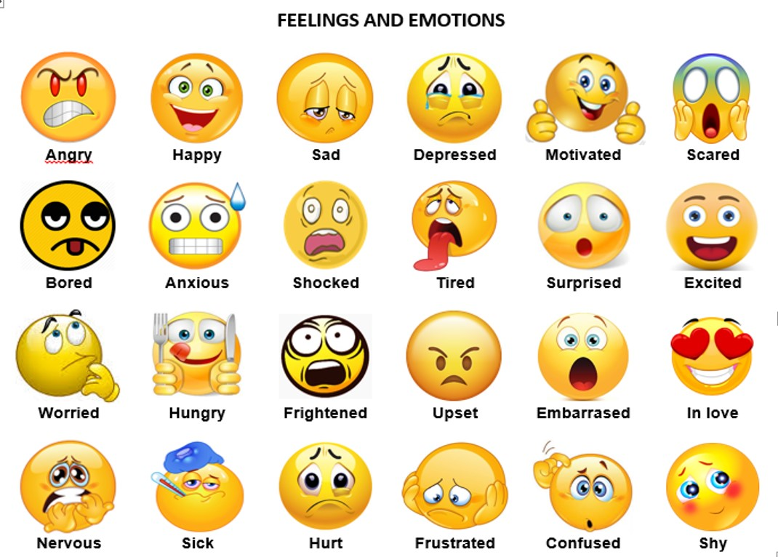
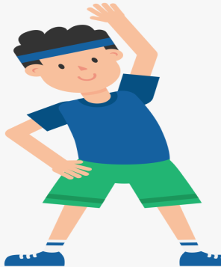
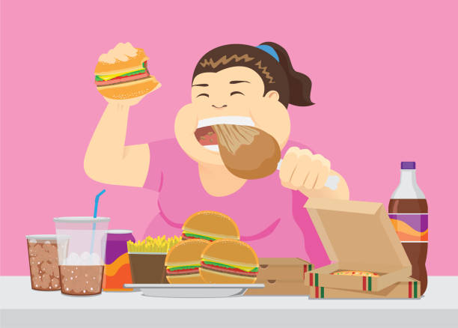

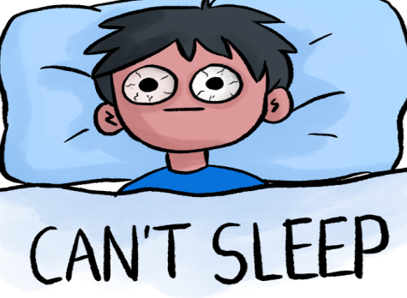
How do you feel when you ……?
I feel ……….
Exercise
Eat a lot
You are not prepared
for test

Slide 10
5 / cold
4 / toothache
2 / stomachache
3 / sore throat

Slide 11
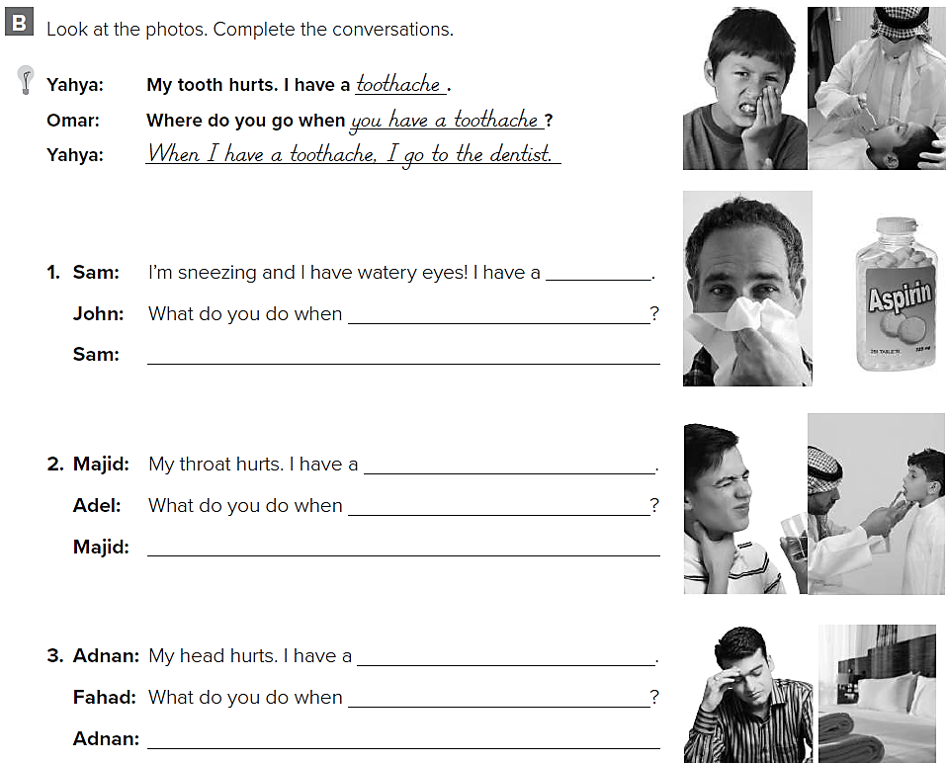
cold
you have a cold
When I have cold I take aspirin
sore throat
you have sore throat
When I have a sore throat , I go to the doctor
headache
you have headache
When I have a headache , I go to bed

Slide 12
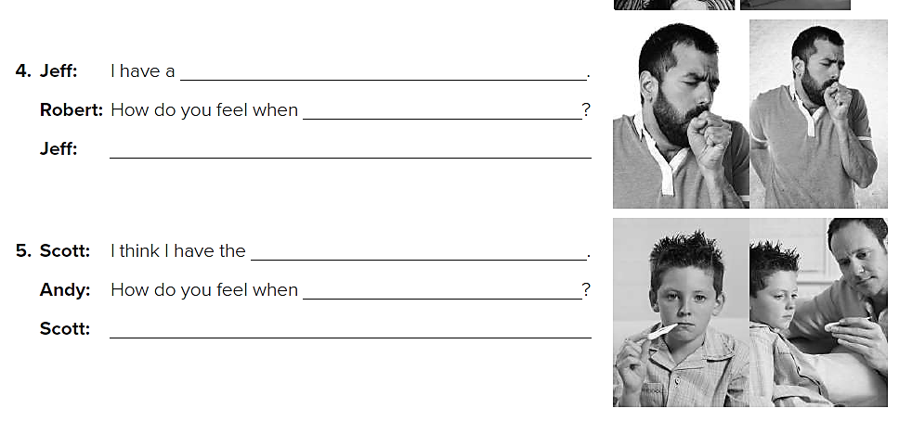
cough
you have a cough
When I have a cough , my chest hurt
flu
you have the flu
When I have the flu , I feel fever and tired

