Slide 1



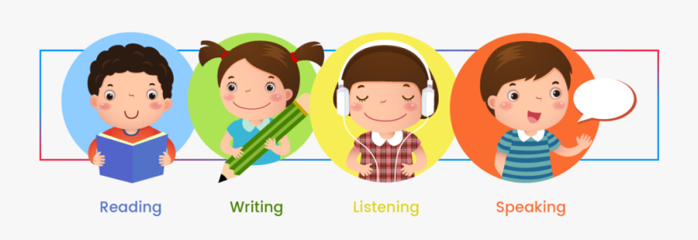

Slide 2
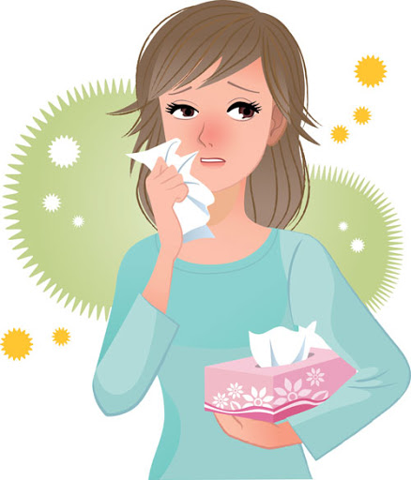
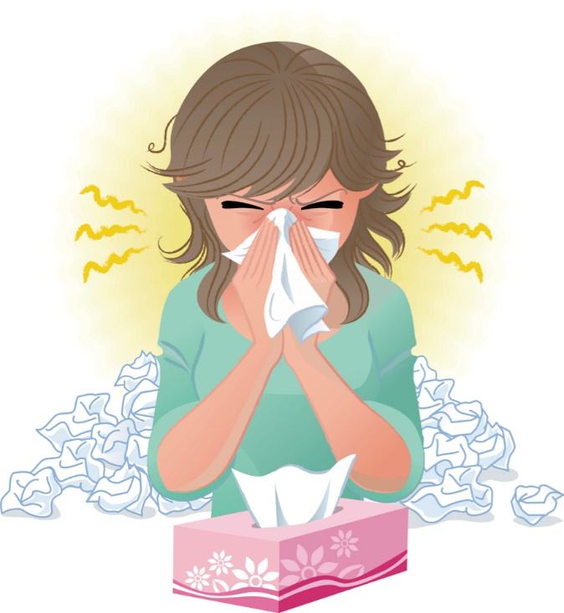

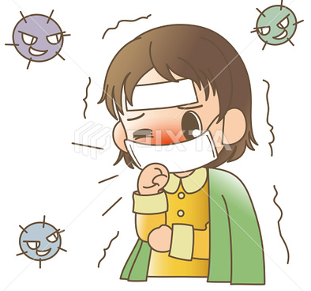

Covid 19
☺Avoid gathering !
☺We must wear a mask before
going out.
☺Social distancing is not a
choice, it is a must!
☺Keep a distance of 2 meters
to avoid accountability
☺wash hands constantly.

Slide 3
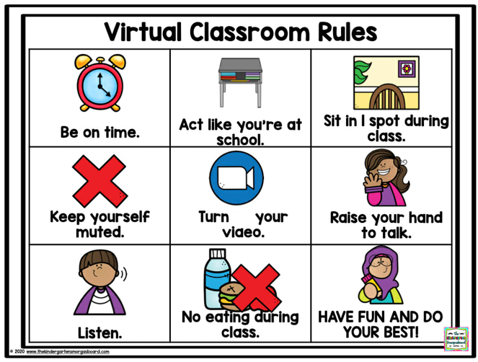
off

Slide 4





Today:
Date:
- -1442 H
everyone,
How is everything going?

Slide 5
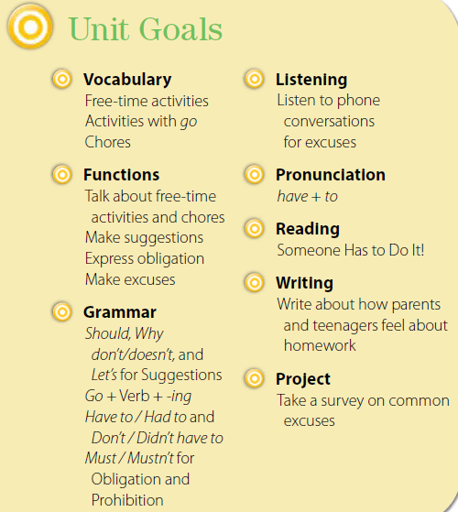

Slide 6
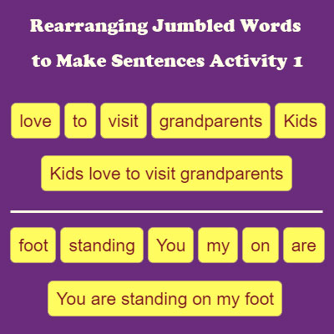

Slide 7

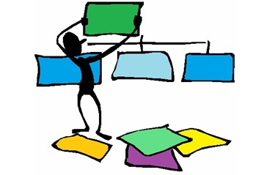


1. bus/ the/ waiting/ kids/ for/ are/ The
☺…………………….
2.large/An/very/elephant/a/animal/is
☺…………………….
3. very / is / hot / it?
☺…………………….

Slide 8



Listen & Discuss – Pair work
Apply suggestions
list a number of chores
list a number of free time activities

Slide 9

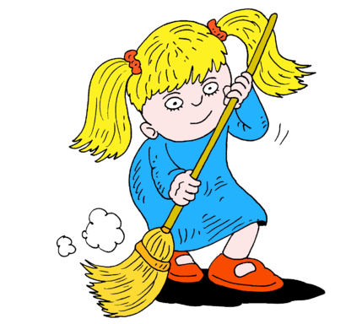
iron
mop floor
hoover
vacuum
laundry folding
sweep a floor
broom

Slide 10
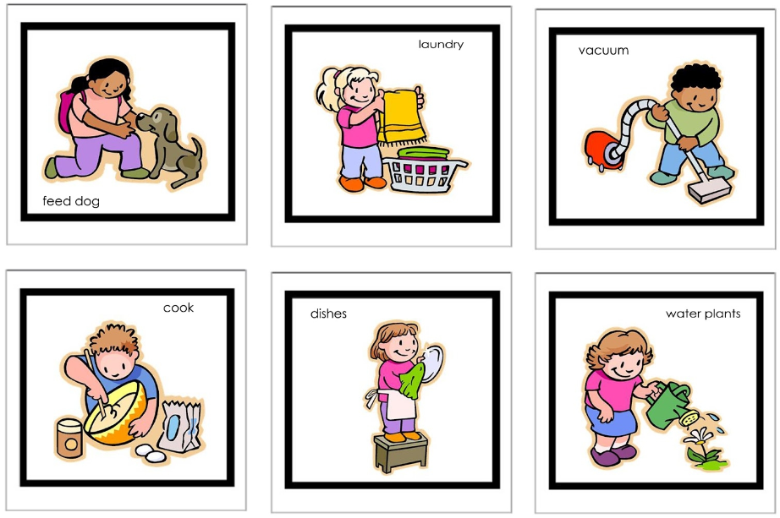

Slide 11


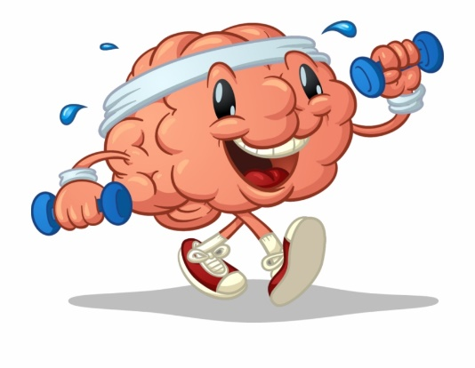

Let’s play tennis.
Let’s go to the mall tonight.
Let’s do extra homework tonight.
Why don’t we study at the library tonight?
Responses to suggestions
OK. That’s a good idea.
No, I’m sorry, I can’t.
I don’t think so.

Slide 12
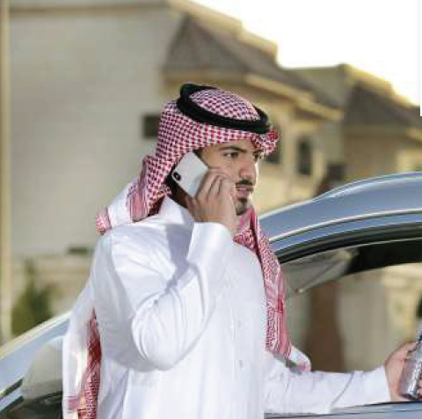
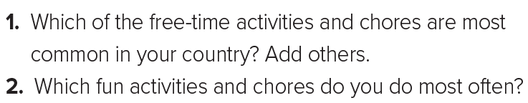
Page 2
1.Wash the dishes . Iron
2.Feed my cat and water my garden and plants
Where are the people in the first picture?
What about the people in the second picture?
☺The boy in each picture is suggesting something to his friend. What do you
think the boy with the bike wants to do? How about
the boy in the park?

Slide 13







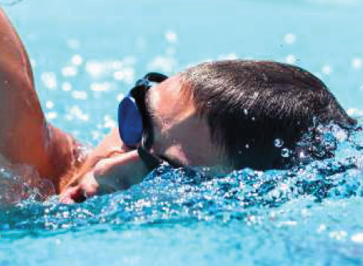
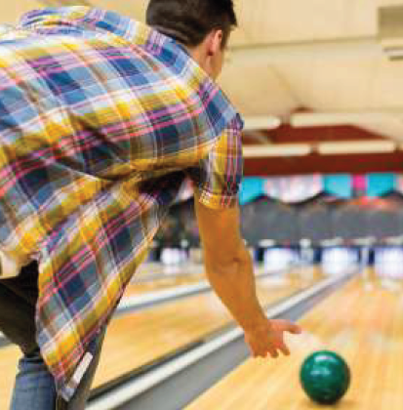

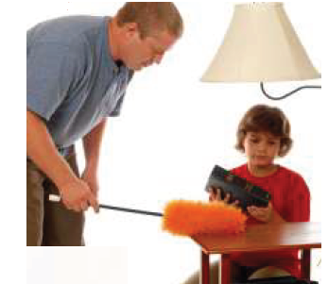
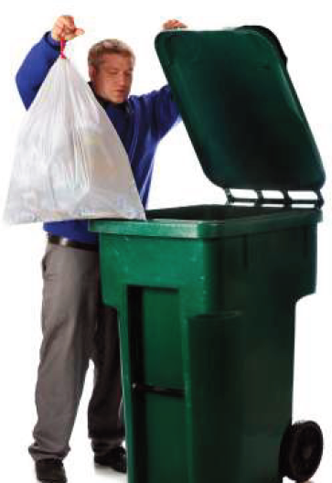


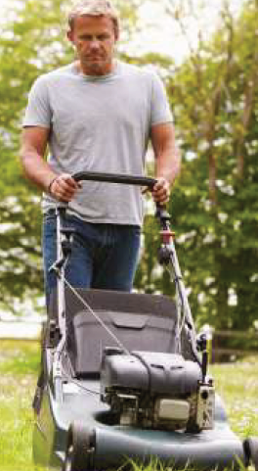

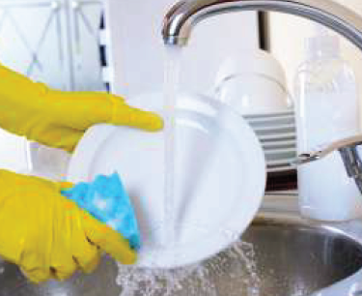
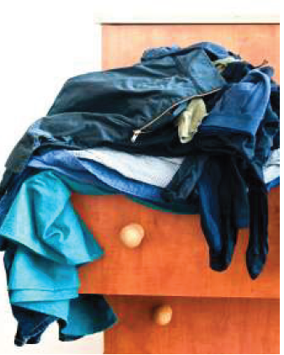

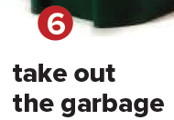

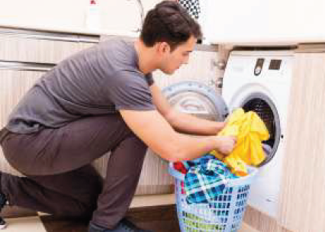
Page 1
What is the difference between the two groups of pictures?
☺What are chores?
☺How many of the pictures show people having a good time?
☺How many show people doing chores?
free-time activities and chores.
(Things you have to do around the house.)

Slide 14
Page 1
What does the young man in the car like to do?
What does the boy in the pool like to do?
Do the teens in the second group of pictures look as happy as the teens in the first group? Why not?
What chores are they doing?

Slide 15


Page 2

Slide 16
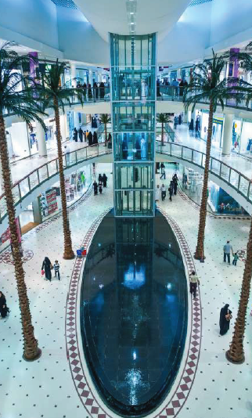
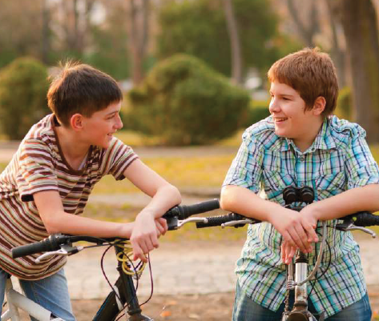


Page 2
1.What does Badr suggest to Ali?
2.Does Ali agree?
3.What does Mike suggest to Josh?
4.Does Josh agree?

Slide 17


Page 2
Check (√) the free-time activities and chores in the pictures that you do.
chores | Free-time activities
clean your room do the laundry take out the garbage | go shopping go for a drive go swimming

Slide 18
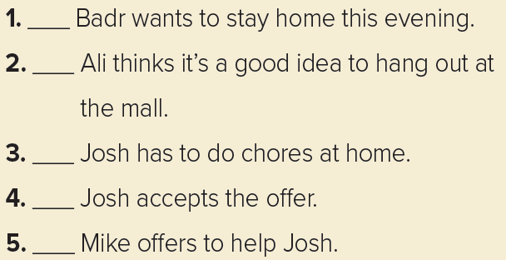
Page 2
no
yes
yes
no
no

Slide 19



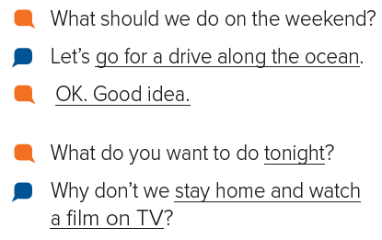
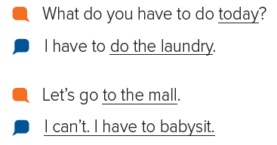
Page 2

Slide 20






Assign page 89 for practice with the vocabulary

Slide 21

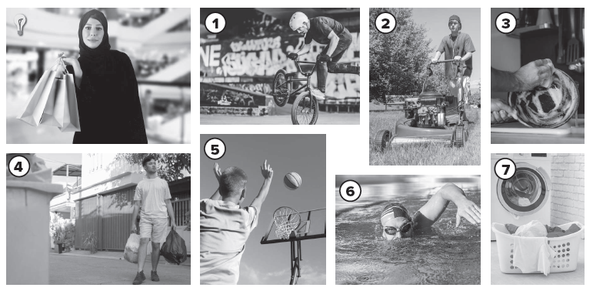
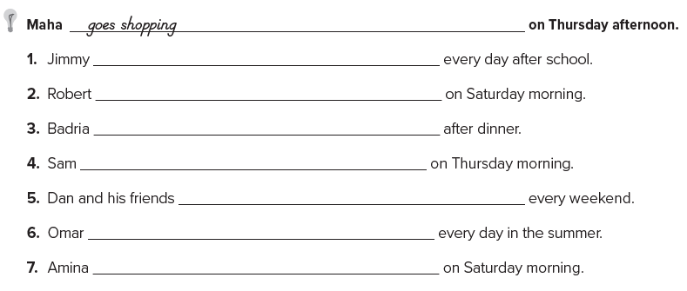
Page 89
rides his bike
mows the lawn
washes the dishes
takes out the garbage
play basketball
goes swimming
does the laundry

Slide 22


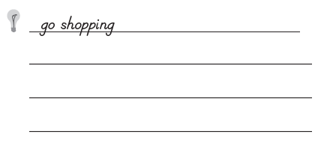

mow the lawn
take out the garbage
wash the dishes
do the laundry
go shopping
ride a bike
play basketball
go swimming

Slide 23

أتمنى الاهتمام بمتابعة الدروس في قنوات عين الرسمية من وزارة التعليم

Slide 24
