Slide 1
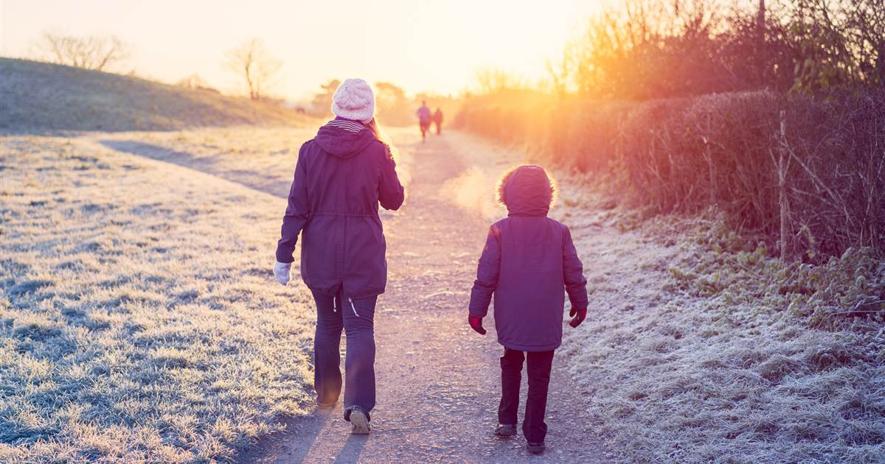
U1 let's go out
Tr. Nora Khalid

Slide 2
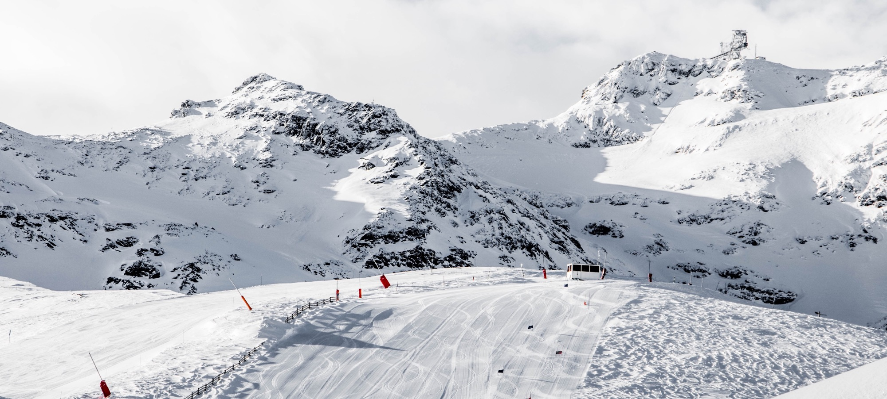
goals
Vocabulary:
Free-time activities
Activities with go
Chores
Listening and discussion:
Listen and discuss a topic about free times and activities and answer the questions
Notes:
© Copyright Showeet.com – Free PowerPoint Templates

Slide 3

Ok. That’s a good idea
No. I’m sorry, I can’t.
I don’t think so
Notes:
© Copyright Showeet.com – Free PowerPoint Templates

Slide 4



Ok. That’s a good idea
No. I’m sorry, I can’t.
I don’t think so
Notes:
© Copyright Showeet.com – Free PowerPoint Templates

Slide 5
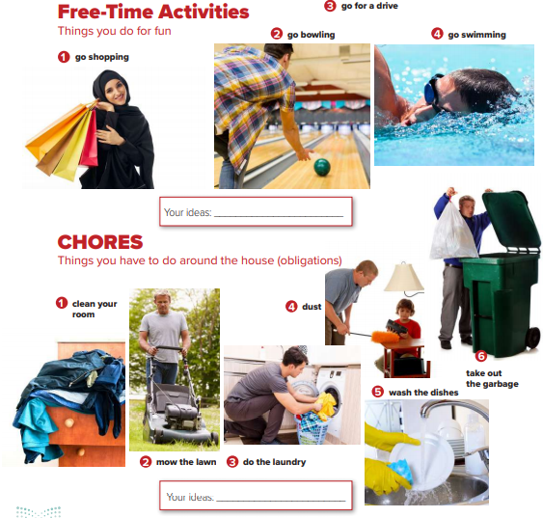
What’s the difference?
How many of the pictures show people having a good time? Doing chores?

Slide 6
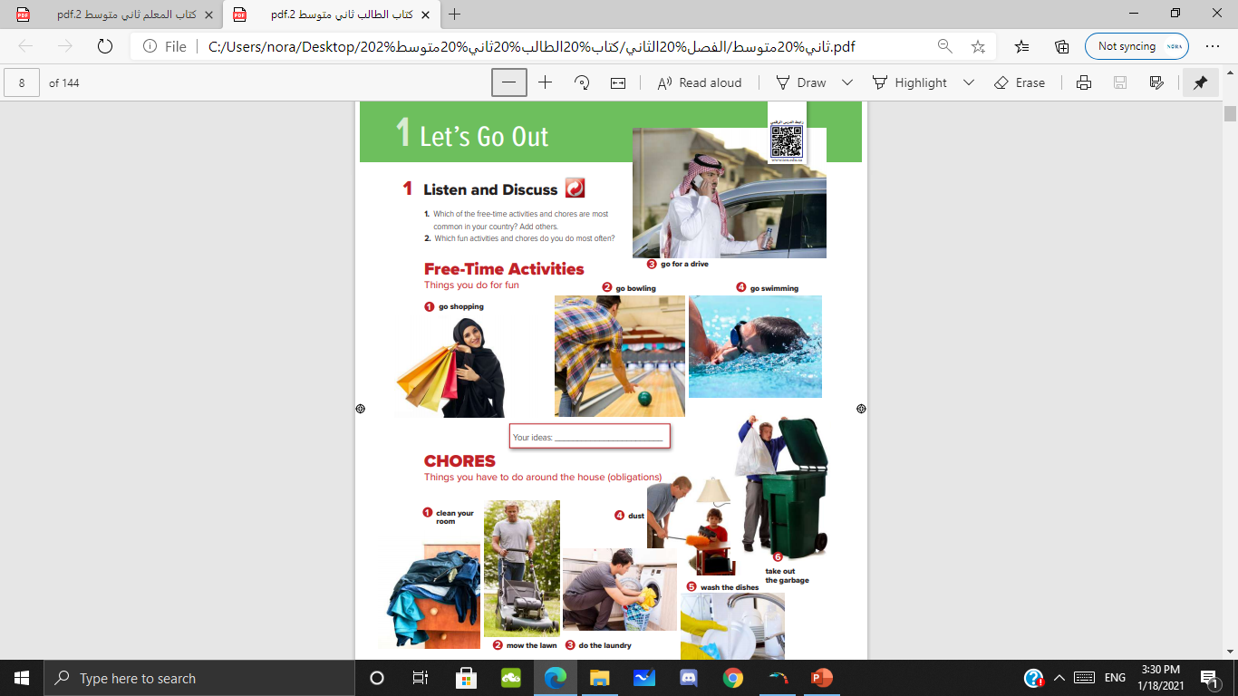
Do the teens in the second group of pictures look as happy as the teens in the first group? Why not? What chores are they doing?
What does the young man in the car like to do?
What does the boy in the pool like to do?

Slide 7


Slide 8


Slide 9
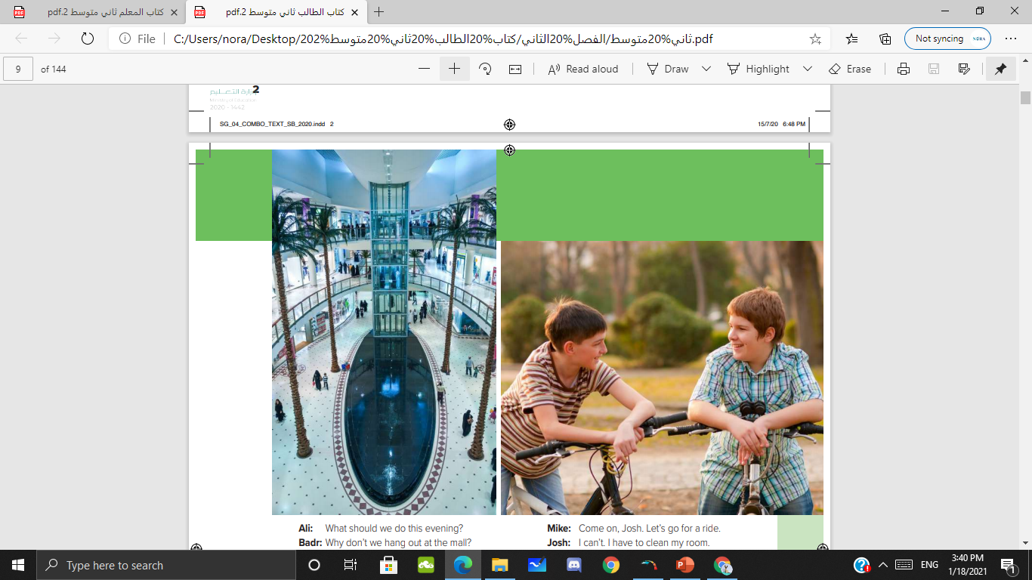
Where are the people in the second picture?
Where are the people in the first picture?

Slide 10
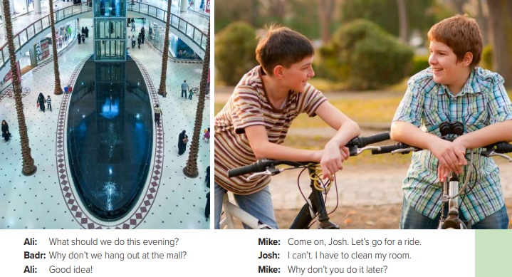
What does Badr suggest to Ali?
What does Mike suggest to Josh?
Does Ali agree?
Does he agree?

Slide 11

Chores | Free-time activities

Slide 12
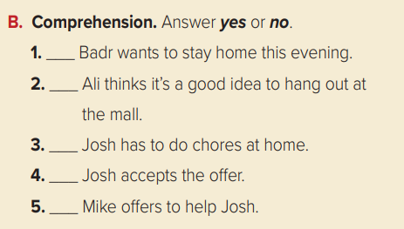
No
Yes
Yes
No
No

Slide 13

P 89
A

Slide 14


