Slide 1
FORM, MEANING AND FUNCTION

Slide 2
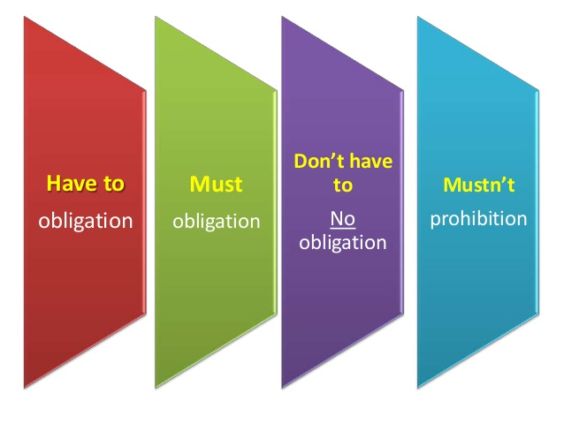

Slide 3
Must is most commonly used to :
1- Express personal obligation
2- Express what the speaker thinks is necessary
3- Express subjective obligation
Example:
All passengers must wear seat belts.
You must study hard .

Slide 4
must not = mustn’t can be used to:
prohibited; it is not allowed. It is important that you do NOT do something.
Example:
You mustn’t kick the ball when you play basketball.
Children mustn’t talk to strangers.

Slide 6
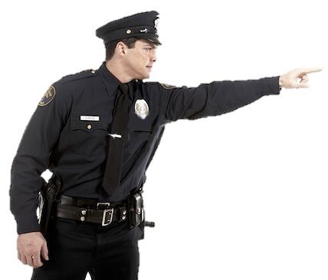
She must wear a helmet.

Slide 7
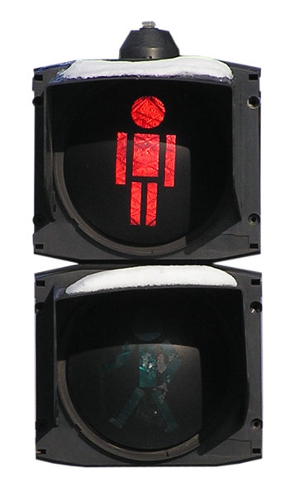
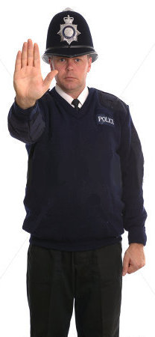
You must stop here.
You mustn’t cross the street now.
You mustn’t cross the street now.

Slide 8
Have to
is most commonly used to :
1- Express impersonal obligation
2-The subject is obliged or forced to act by a separate, external power (for example, the Law or school rules)
3-Express objective obligation
Example:
She has to do her chores
You have to wear uniform in school.

Slide 9
DON’T / DOESN`T HAVE TO :
There is no obligation; you are not required or necessary to do something, especially if you don’t want to
Example:
You don’t have to make excuses for her.
You don’t have to whisper, no one can hear us.

Slide 11
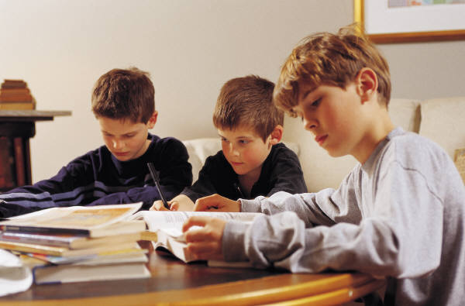
The boys have to study hard.

Slide 12
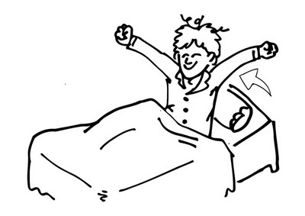
The boy has to wake up at 7 o’clock in the morning.
.

Slide 13
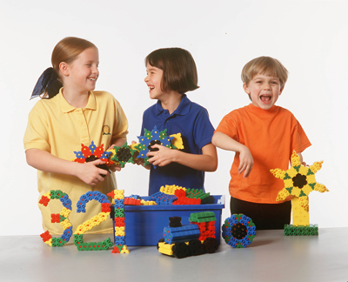
The children don’t have to go to school today.
It’s Saturday!.

Slide 14
She doesn’t have to eat all the fruits.

Slide 15
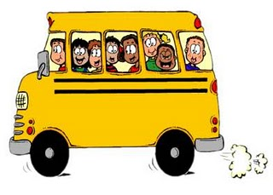
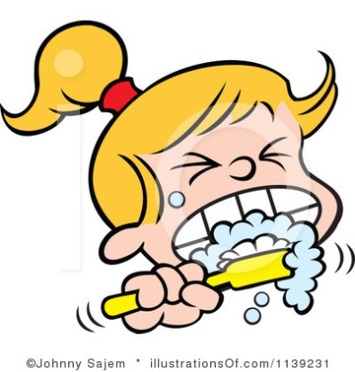
Affirmative Sentences
I / YOU/ WE / THEY
You HAVE TO arrive on time to classes
SHE/ HE / IT
She HAS TO brush her teeth everyday
HAVE TO
HAS TO

Slide 16
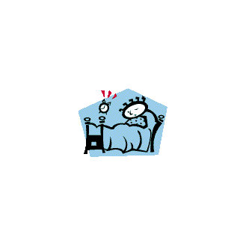
Negative Sentences
S + DON’T HAVE TO/ DOESN’T HAVE TO + VERB + COMPLEMENT
I / YOU / WE / THEY
We don’t have to get up early on Sundays
SHE / HE / IT
He doesn’t have to get up early on Sundays
DON’T
DOESN’T

Slide 19
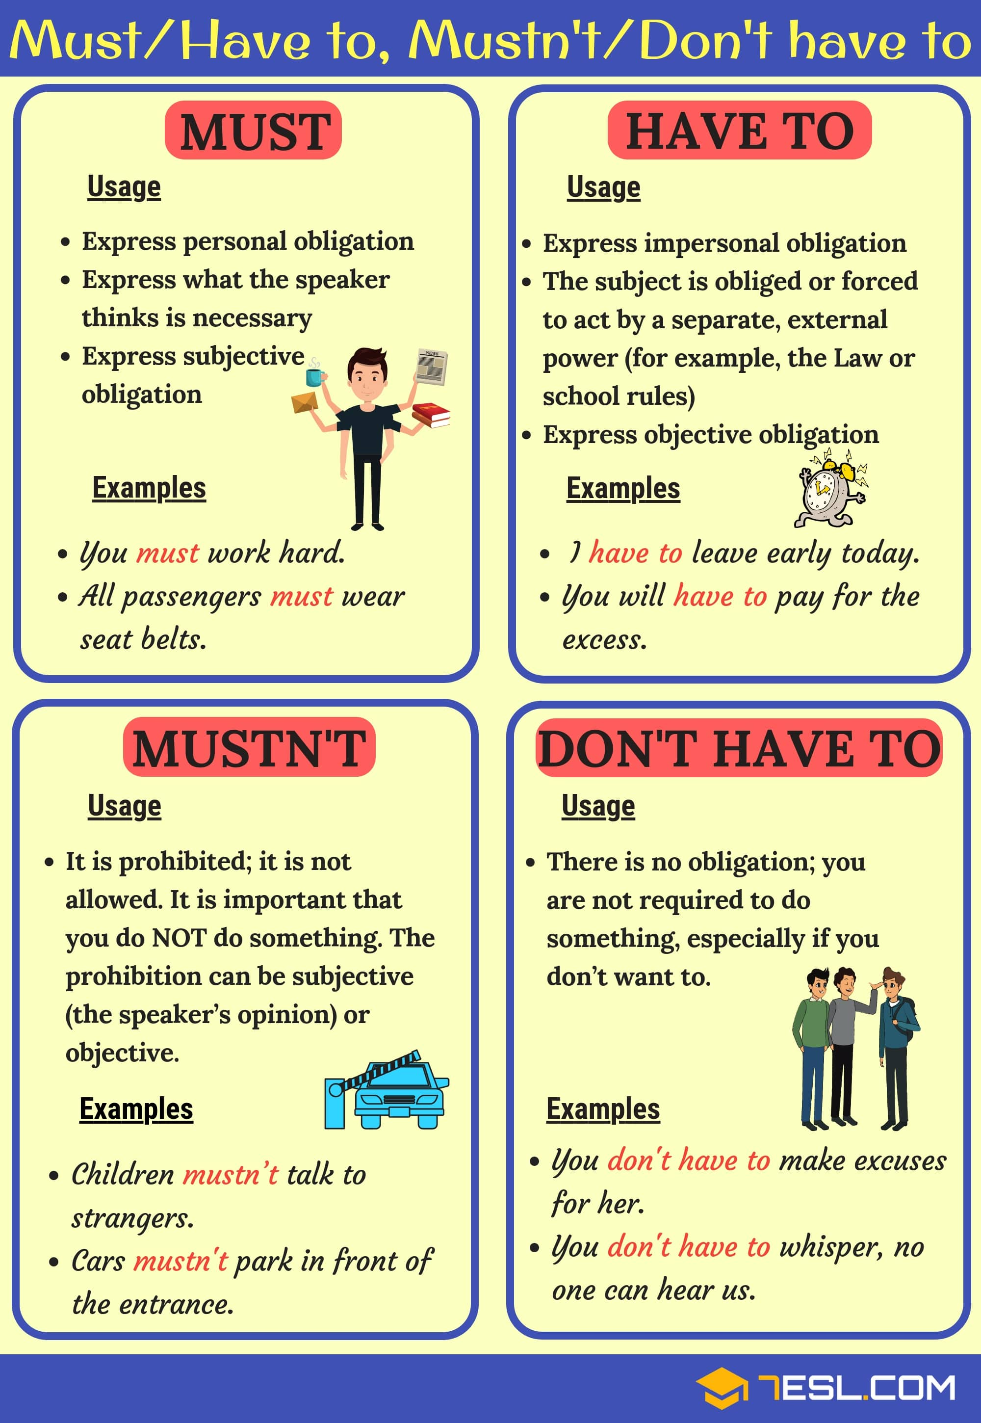

Slide 20
Let`s practice
https://wordwall.net/play/10054/895/478

Slide 21
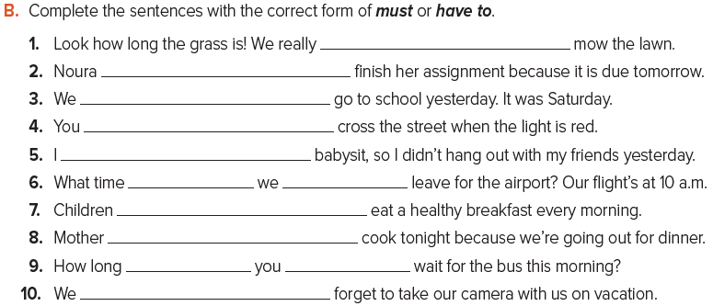
must
has to
didn’t have to
mustn’t
had to
do have to
have to
doesn’t have to
did have to
mustn’t

Slide 22
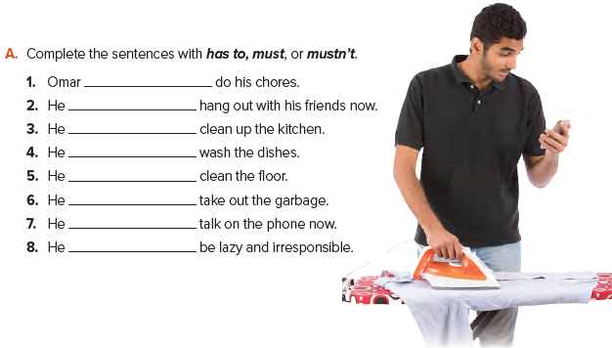
must
mustn’t
has to
must
has to
must
mustn’t
mustn’t

