Slide 1
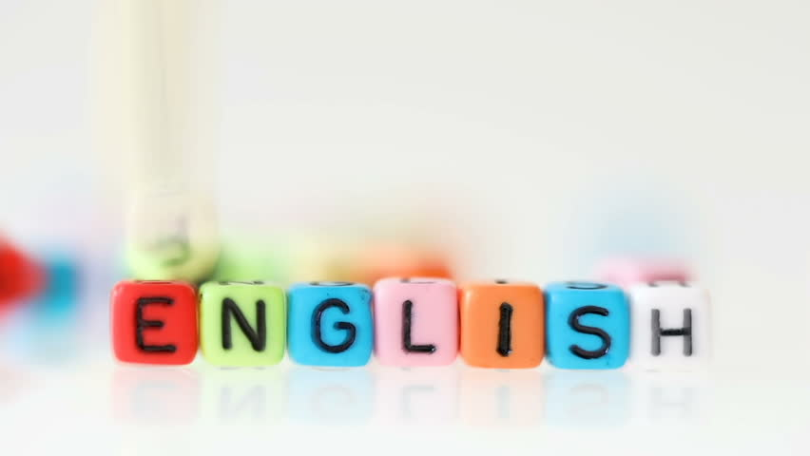

Super goal 1

Slide 2
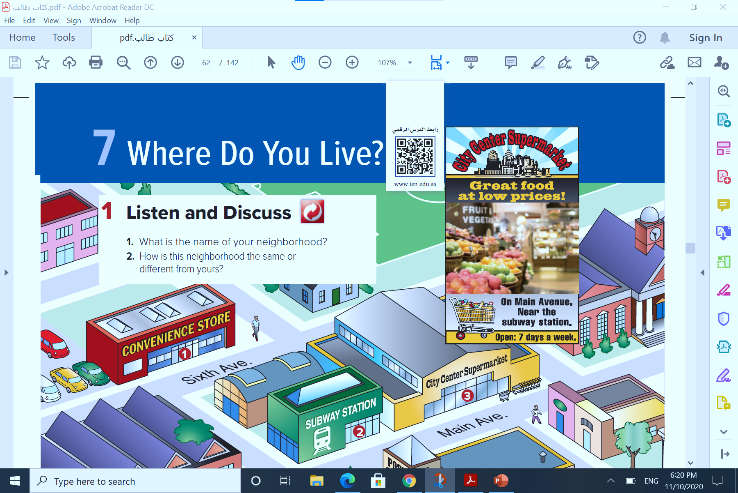



{وَاللَّهُ جَعَلَ لَكُمْ مِنْ بُيُوتِكُمْ سَكَنًا}

Slide 3

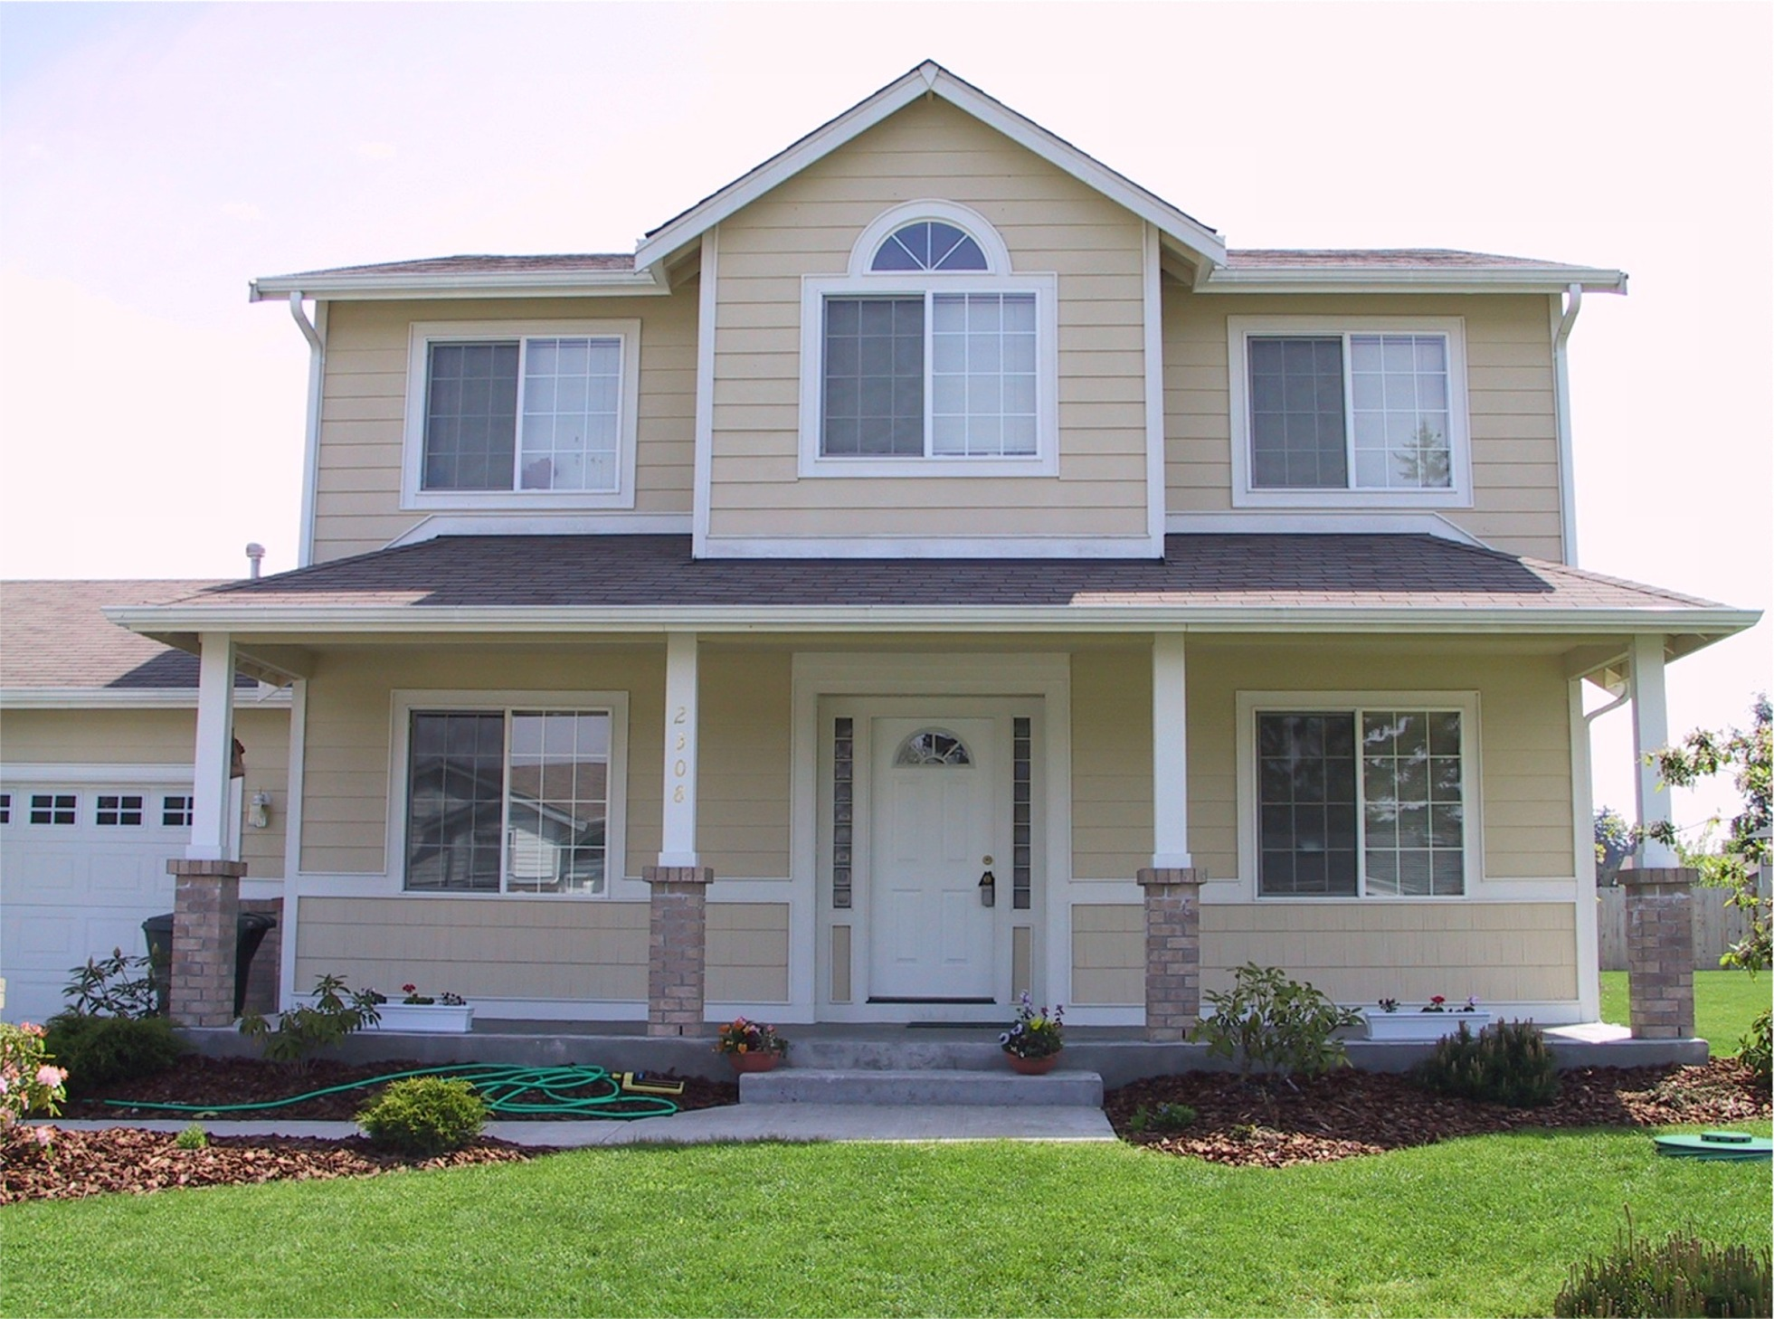
Warm up
Where do you live?
Is there a restaurant near your house?

Slide 4
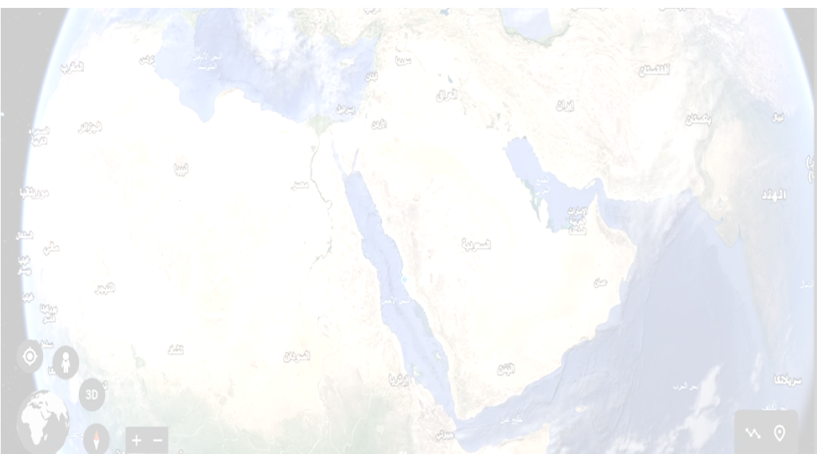

Warm up
How many words can you make from this word?
convenience

Slide 5
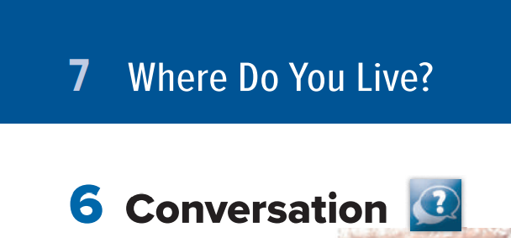
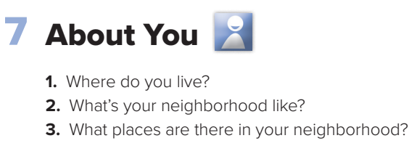
Page 60

Slide 6

Objectives:
At the end of the lesson, students will be able to:
Answer personal questions
☞ Answer questions from the conversation

Slide 7
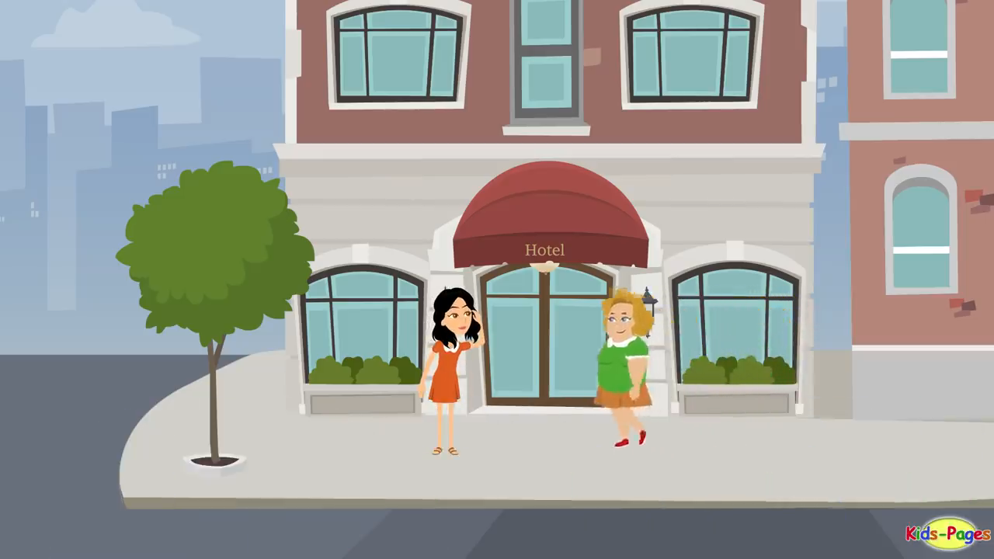

Slide 8
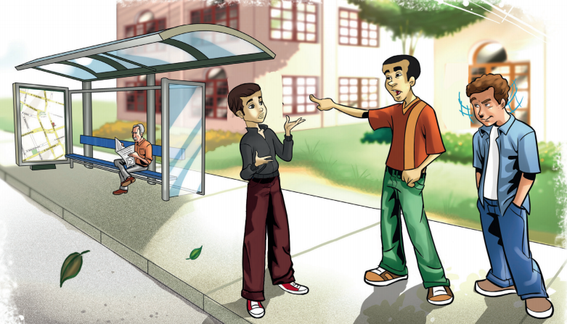
Page 60
Where are the people?
They’re near a bus stop.
What do you think the boy is asking?
He’s probably asking for directions to a place.

Slide 9
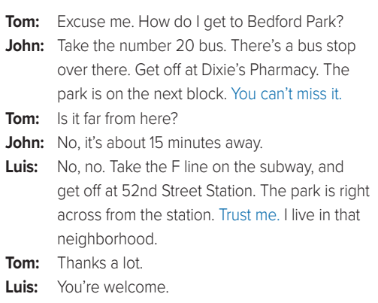
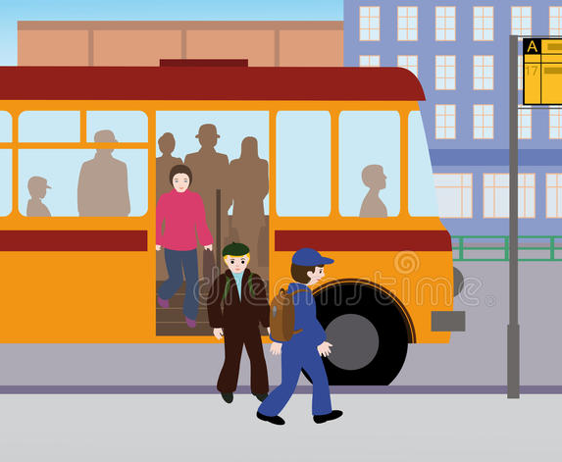
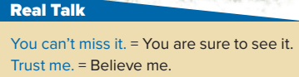

Page 60
What are their names?
people say Trust me when they are very sure about something.

Slide 10

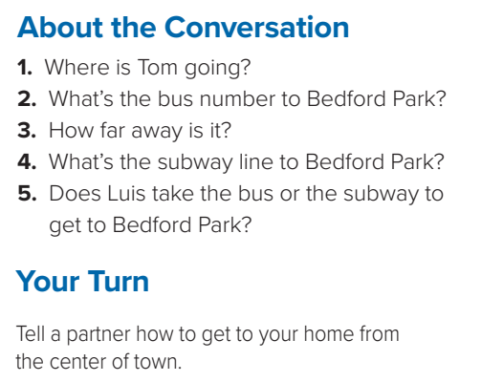
Page 60
He’s going to Bedford Park.
It’s the number 20 bus.
It’s about 15 minutes away by bus.
4. The F line goes to Bedford Park.
5. Luis takes the subway.

Slide 11
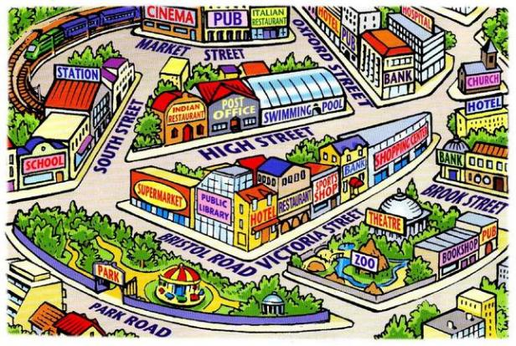

Page 60
Choose one of your friends to answer the question.

Slide 12



Homework:

