Slide 2
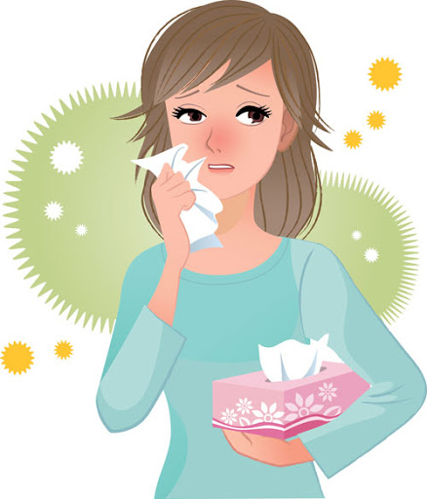
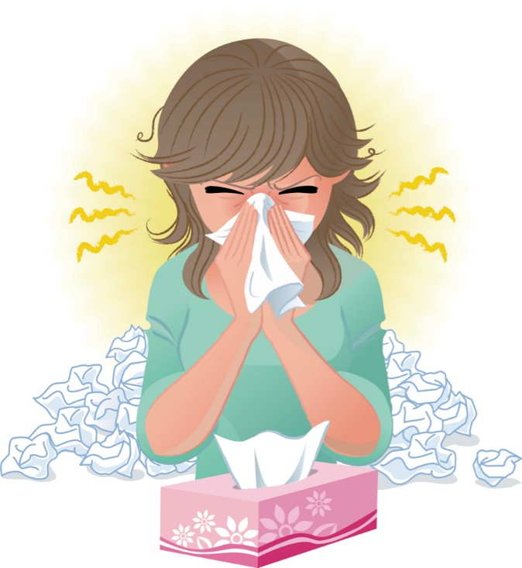
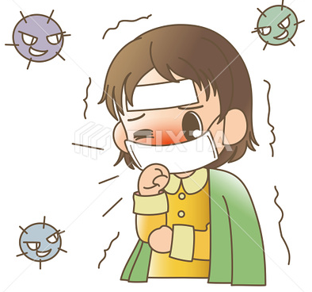
Covid 19
☺Avoid gathering !
☺We must wear a mask before
going out.
☺Social distancing is not a
choice, it is a must!
☺Keep a distance of 2 meters
to avoid accountability
☺wash hands constantly.

Slide 3
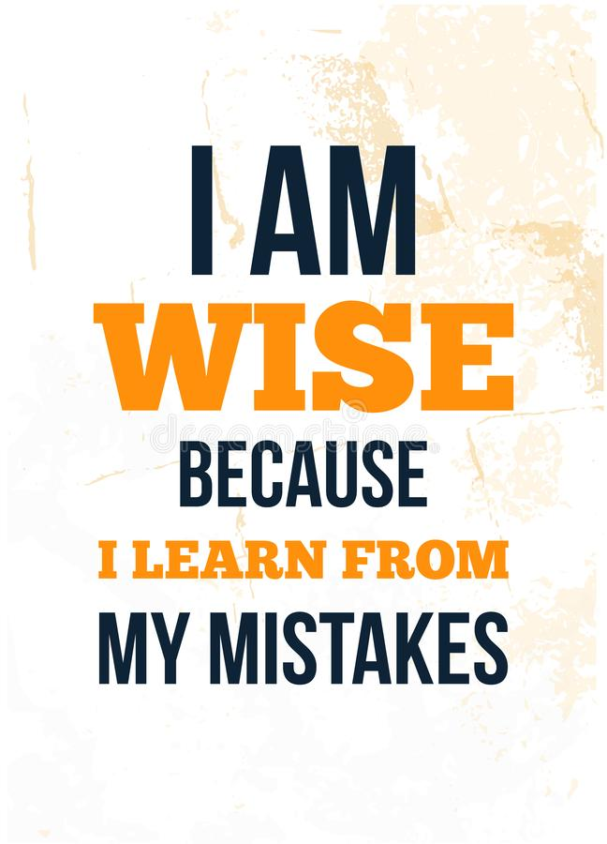

Slide 5
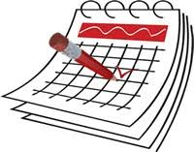
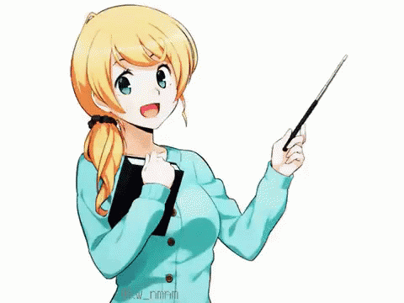
Today: Tuesday
Date:
9-4-1442 H
November 24th \ 2020
everyone,
How is everything going?

Slide 6
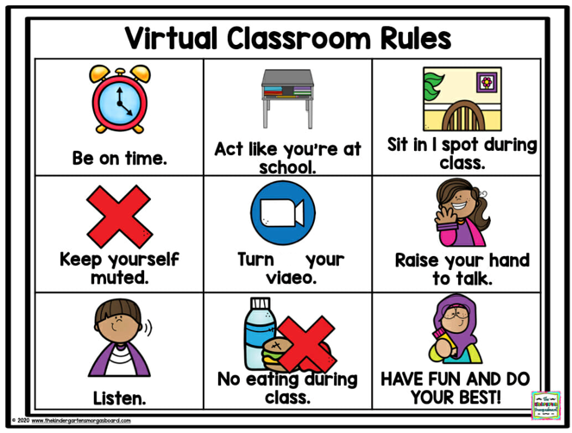
off

Slide 7
☺
♥
Read about the best place to shop
Answer questions about a text
..

Slide 8
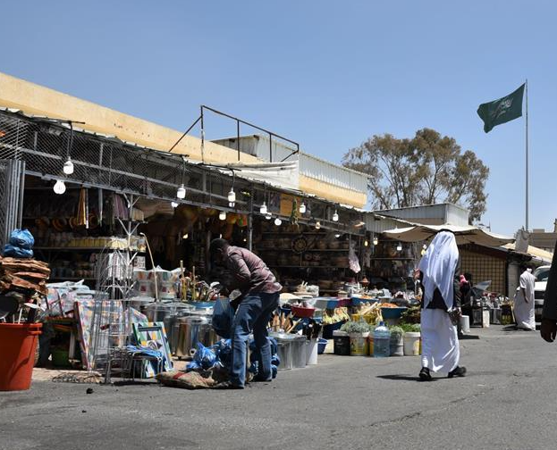
Thulatha Market
in city of Abha
☺ Abha is my hometown.
Traditional Markets
Notes:
Abha is my hometown.

Slide 9
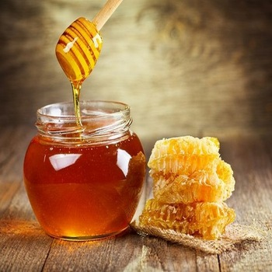
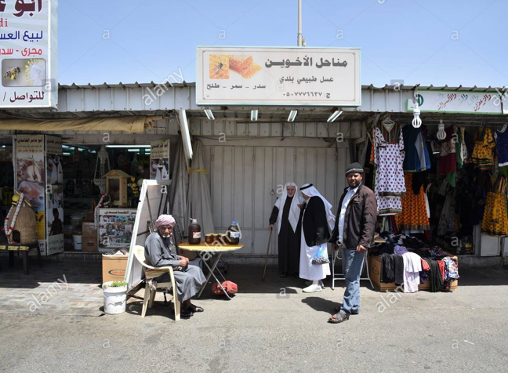
Local honey traders greet visitors at the entrance
of the Thulatha Market in Abha, Asir Province.
Traditional Markets

Slide 10
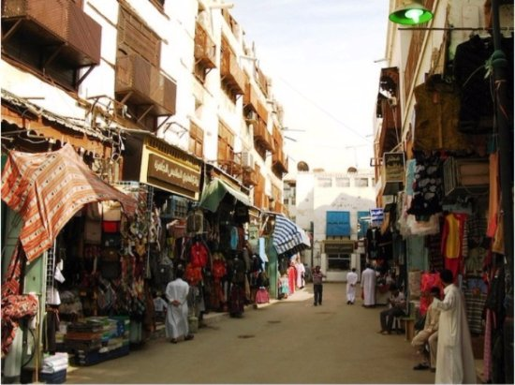
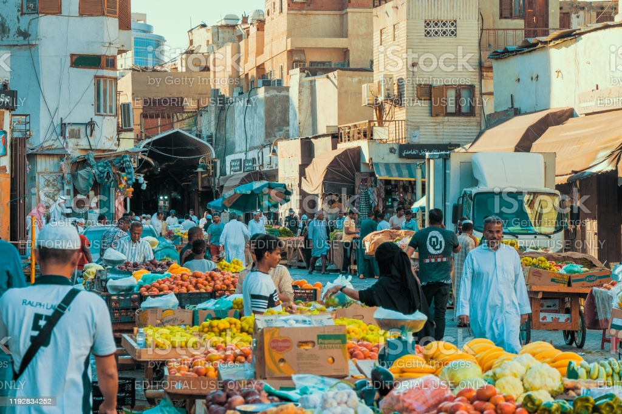
Traditional Markets
Jeddah

Slide 11
Atbakhah Traditional Market in AlMadinah
https://youtu.be/W_v8sySc5d8

Slide 12
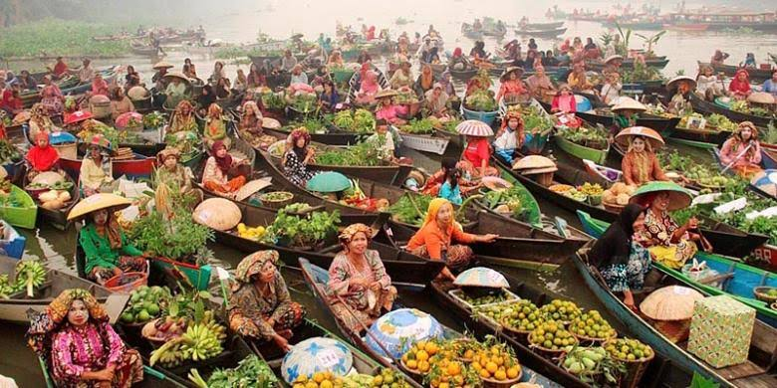
Traditional Markets in Indonesia

Slide 13
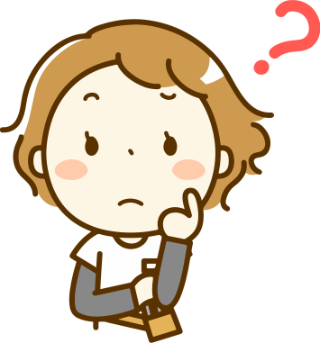
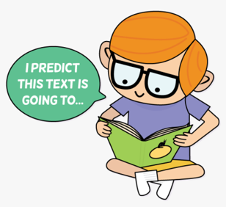
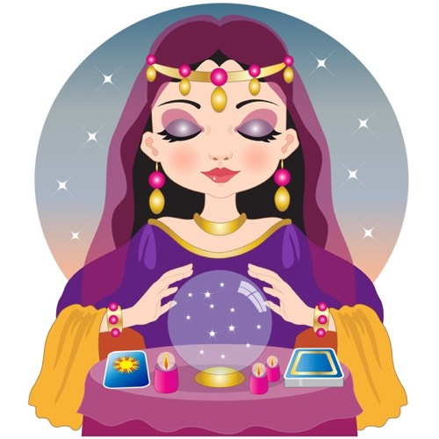
Predict the five words they expect to be in the reading about traditional markets.
READING STRATEGY Predicting
surveys, bargains,
a lot of stuff,
department stores,
lively, expensive, secondhand,
cultural experience,
brand names.

Slide 14
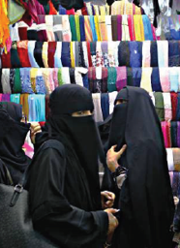
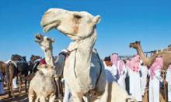
Page 15
Where are the people? (in a street market)
☺It is Souq Al-Thumairi in Riyadh.
What can people buy in this place?
https://www.youtube.com/watch?v=tLIFyFizByI
(Arabic)
☺
https://youtu.be/nQMZrw6zbV4
(English)
Do you like to shop at street markets? Why (not)?

Slide 15
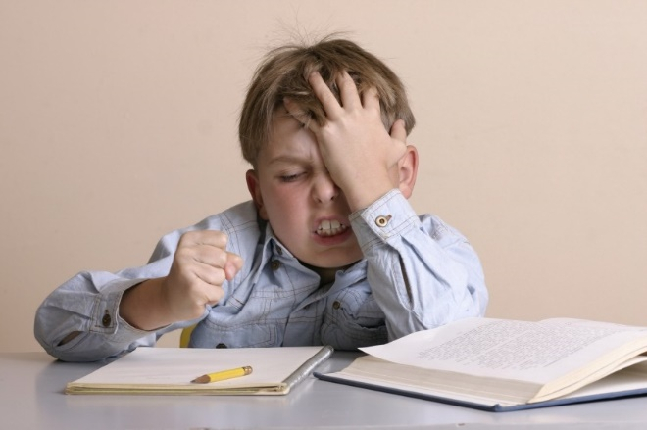
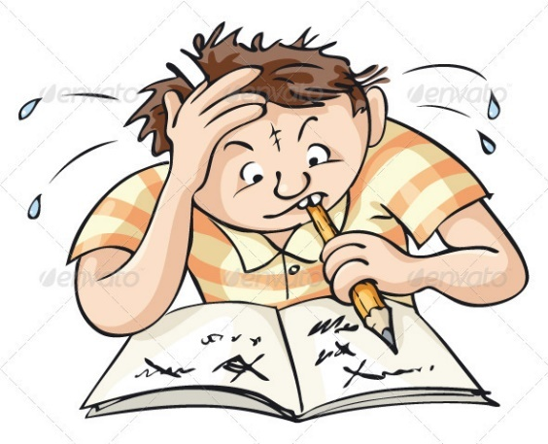
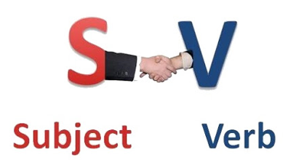
When a sentence is long and difficult,
identifying the subject of the sentence and
the main verb can make it easier to understand.
For example, in the first sentence of the reading,
☺the subject is (thousands of ) people
☺the main verb is prefer.

Slide 16
Page 15

Slide 17
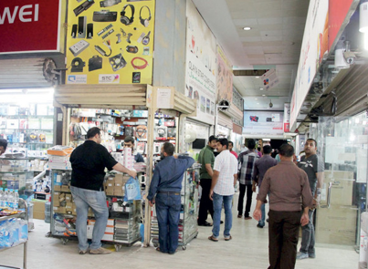
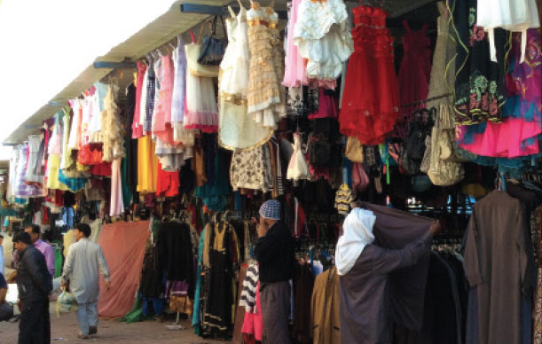
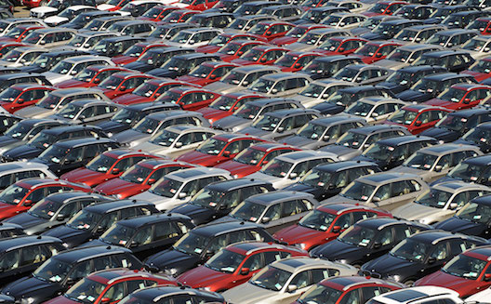
Page 15

Slide 18
Page 15
1. Street markets have the best prices. Many have a lively atmosphere and sell similar things.
2. No, some items aren’t used.
3. (real) bargains, a fraction of the price, ridiculous prices
4. The cultural experience is the most interesting attraction.
You can see and meet of people from around the world.

Slide 19
Page 96
Ex D

Slide 20
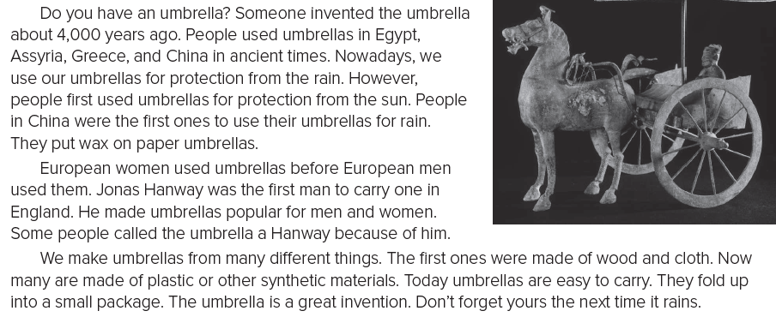
Page 96

Slide 21
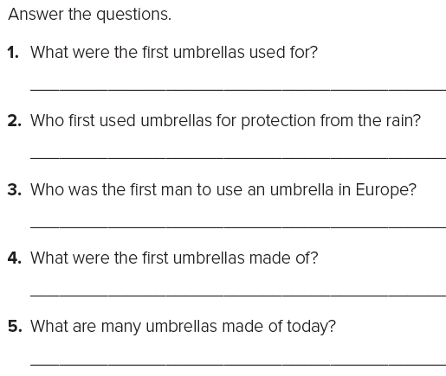
Page 96
The first umbrellas were used for protection from the sun.
People in China first used umbrellas for protection from the rain.
Jonas Hanway was the first man to use an umbrella in Europe.
The first umbrellas were made of wood and cloth.
Today many umbrellas are made of plastic or other synthetic materials.

Slide 22
أتمنى الاهتمام بمتابعة الدروس في قتوات عين الرسمية من وزارة التعليم
T.Noureyah Alghamdi
The end

Slide 23
