Slide 1
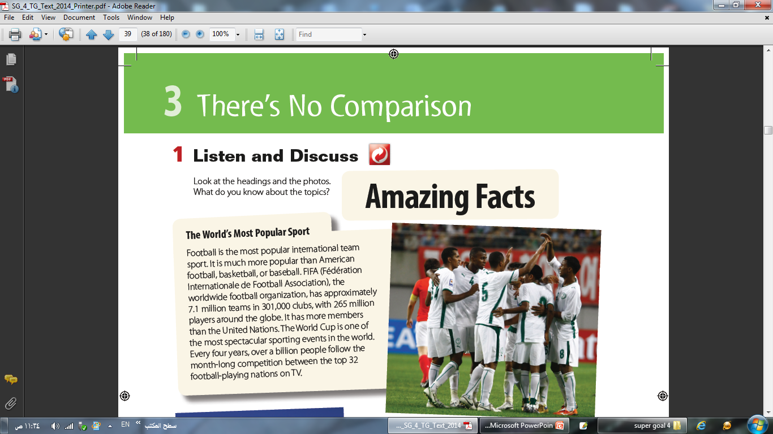
Homework

Slide 2
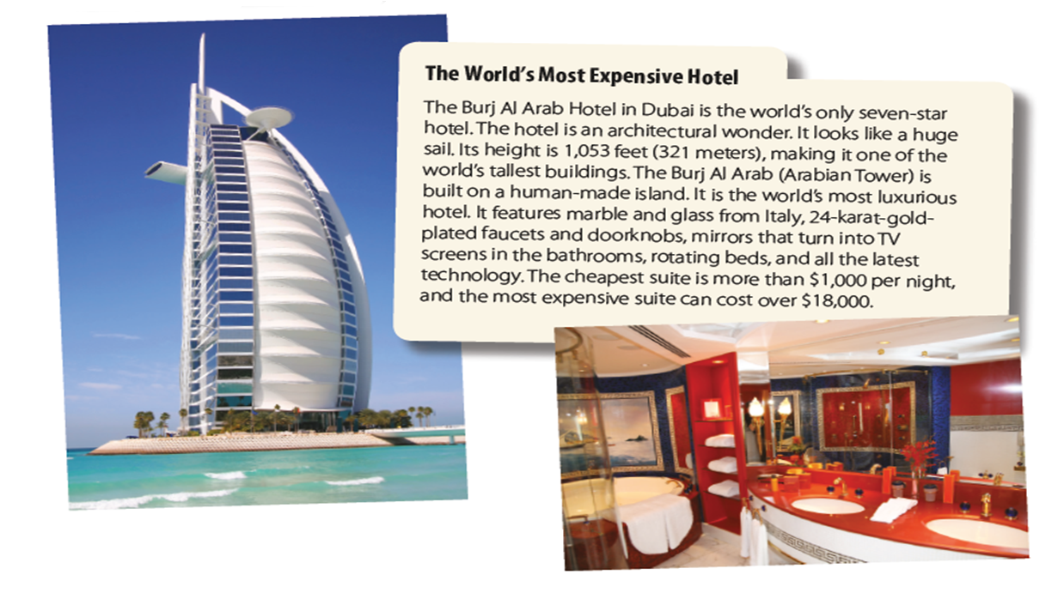
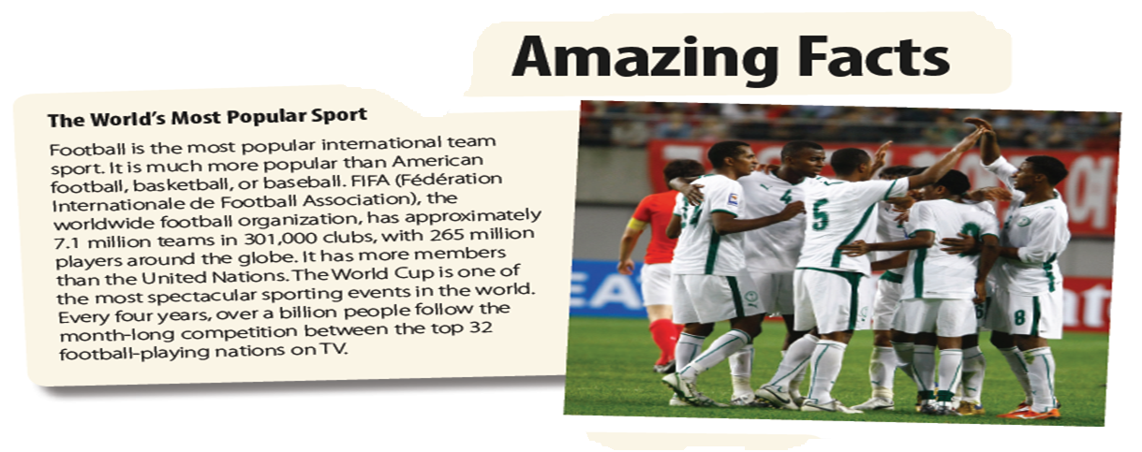
Revision

Slide 3
Grammar

Slide 4

Objectives of the lesson
-Use comparative and superlative forms of adjectives
-Discuss some interesting facts

Slide 5
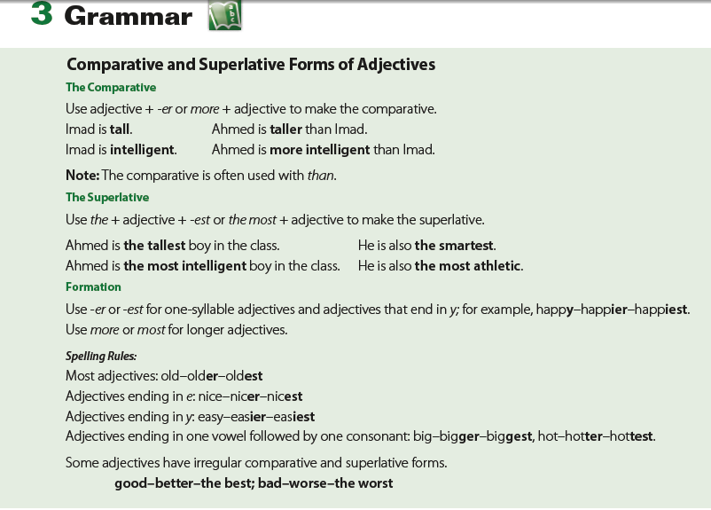

Slide 6
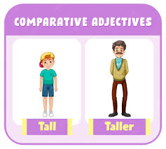
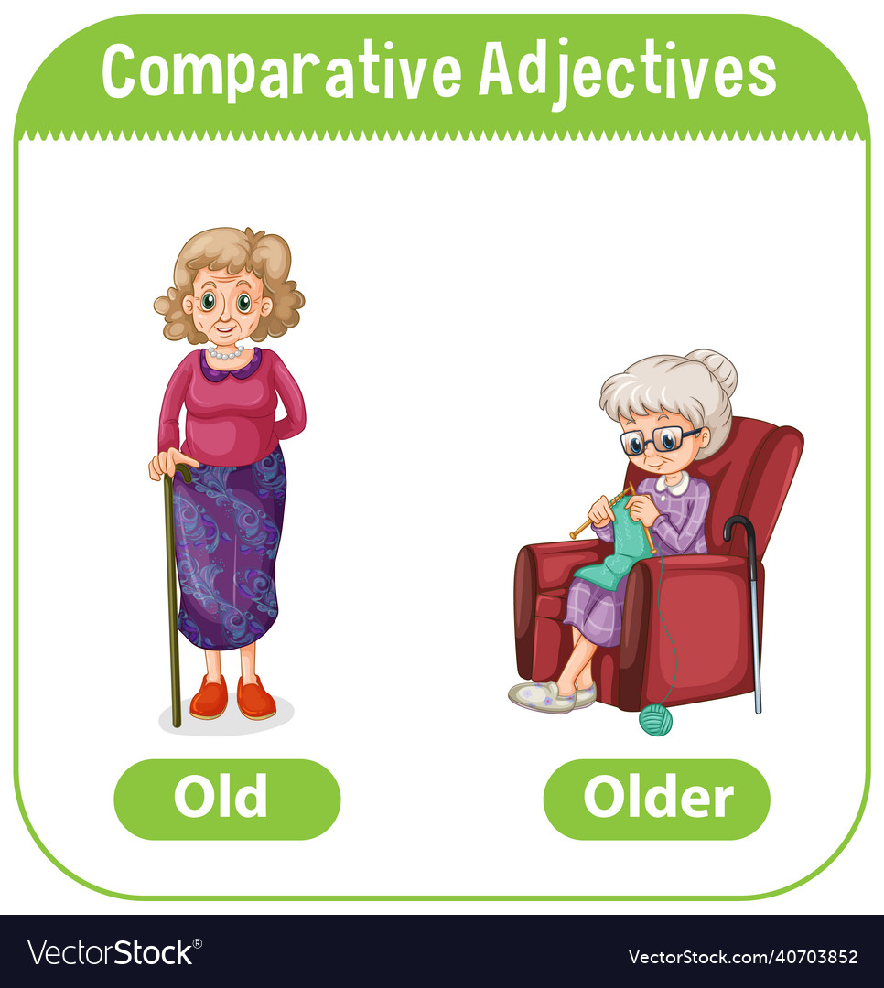
Comparative
A comparative adjective is used to compare two things.

Slide 7



Long adjectives
Important Importanter More important
Expensive Expensiver More expensive
Beautiful Beautifuller More beautiful
Studying is more important than playing

Slide 8
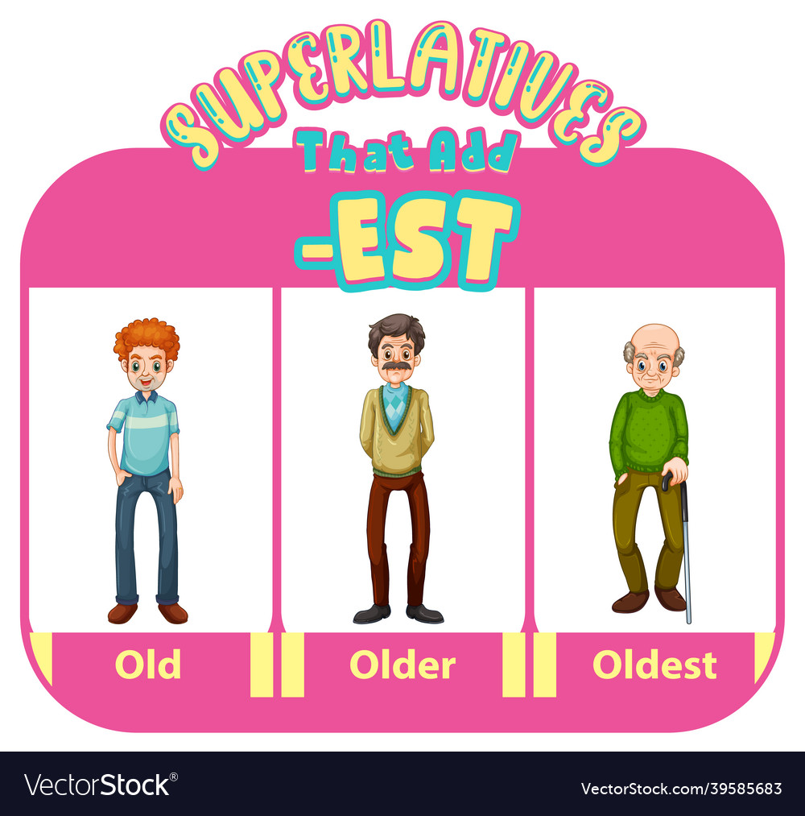
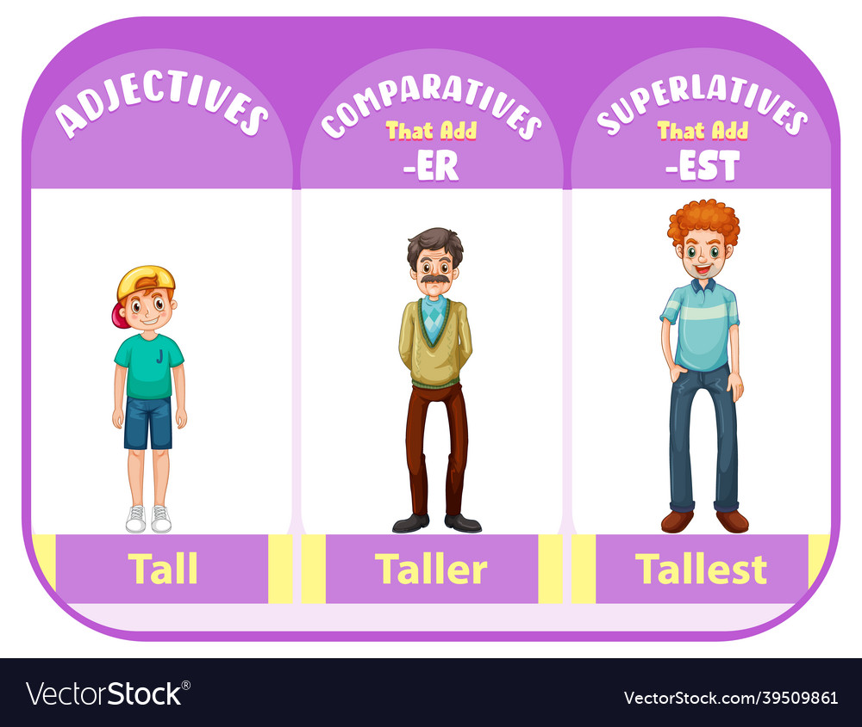
Superlatives
A superlative adjective is used when you compare three or more things.

Slide 9
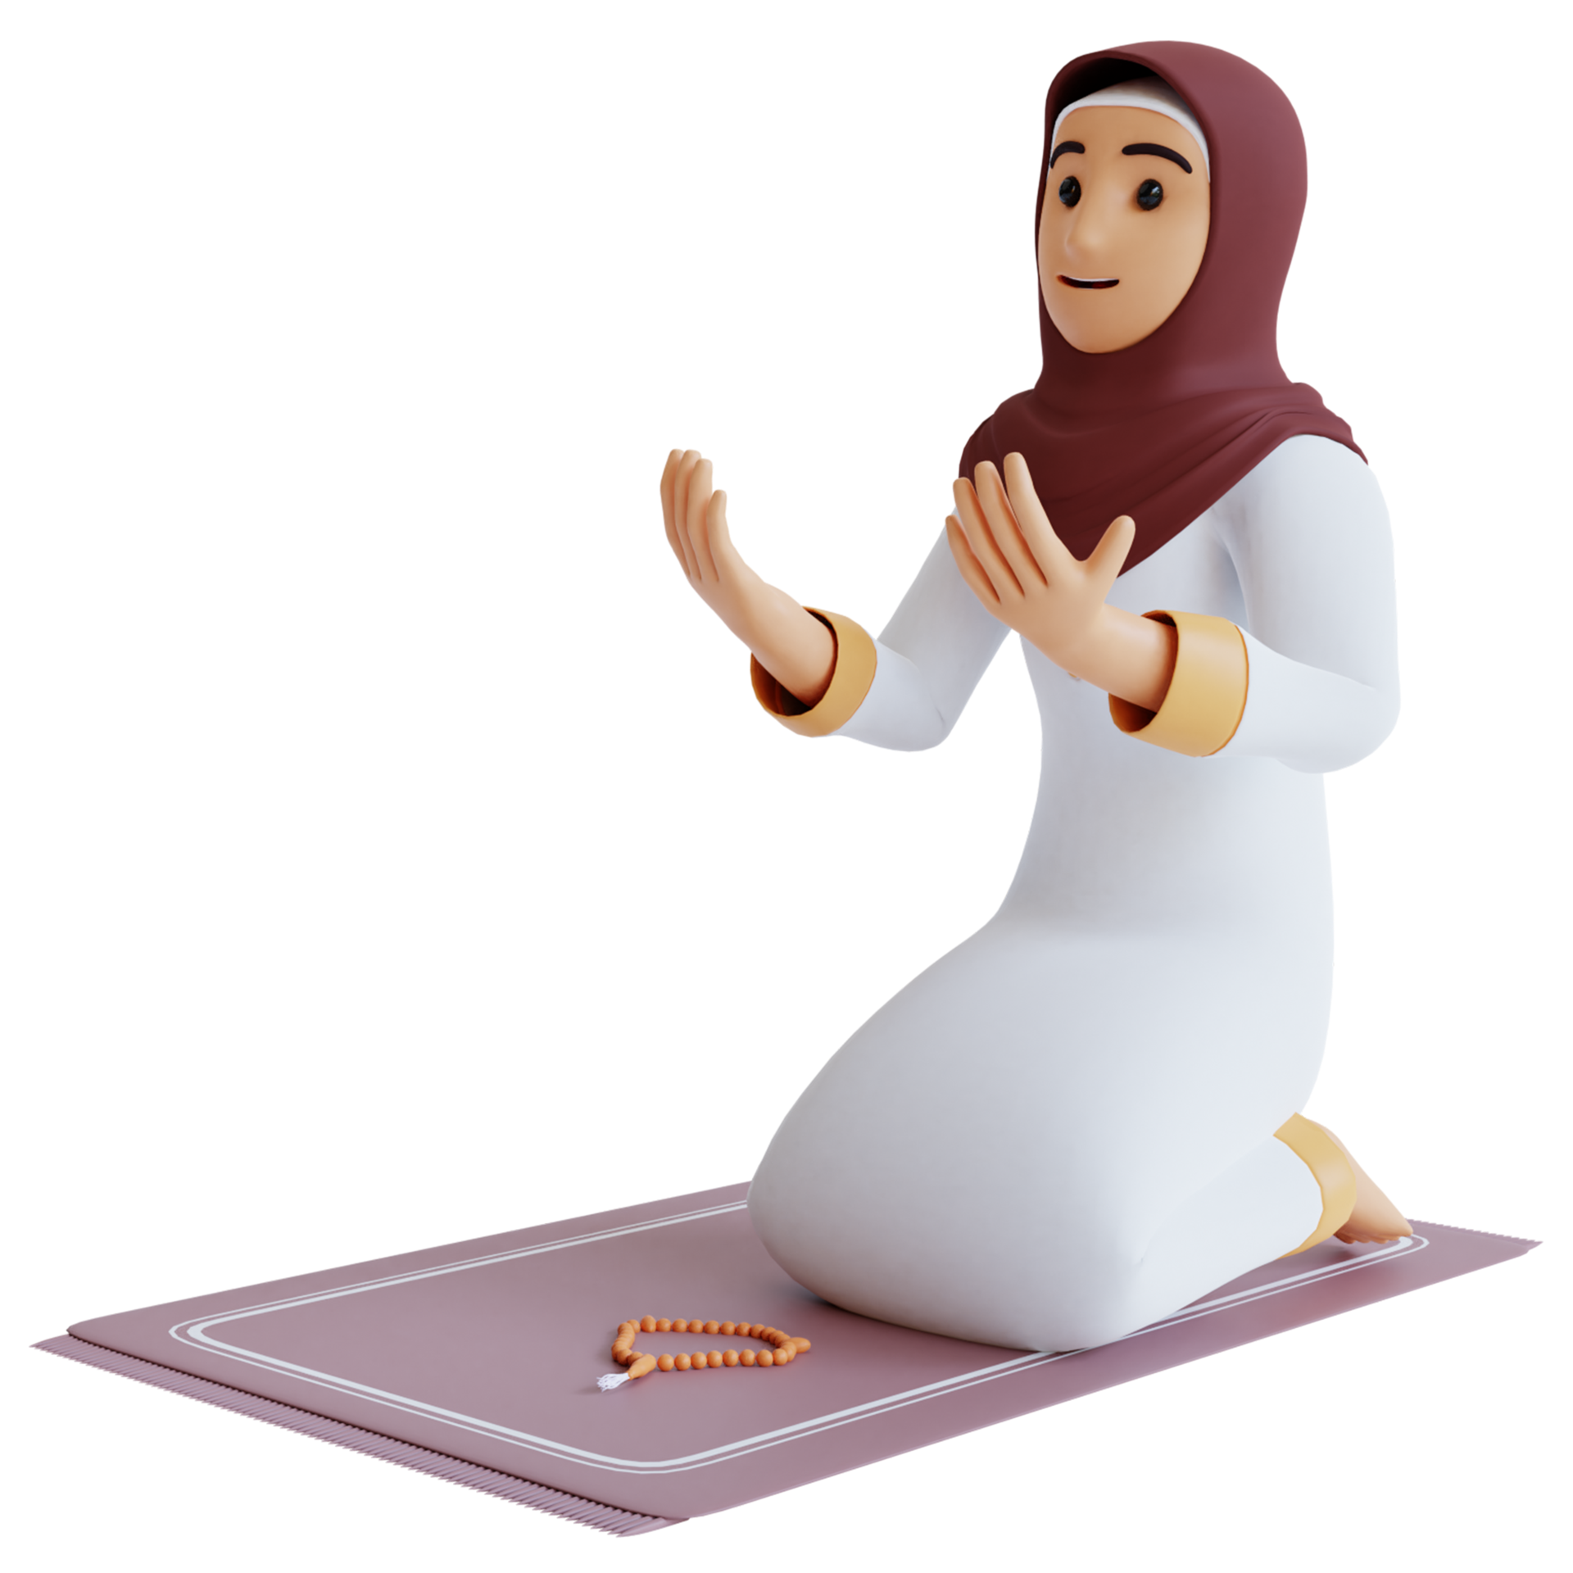
Long adjectives
Important Importantest The most important
Expensive Expensivest The most expensive
Beautiful Beautifullest The most beautiful
Praying is the most important thing you do as a muslim

Slide 10
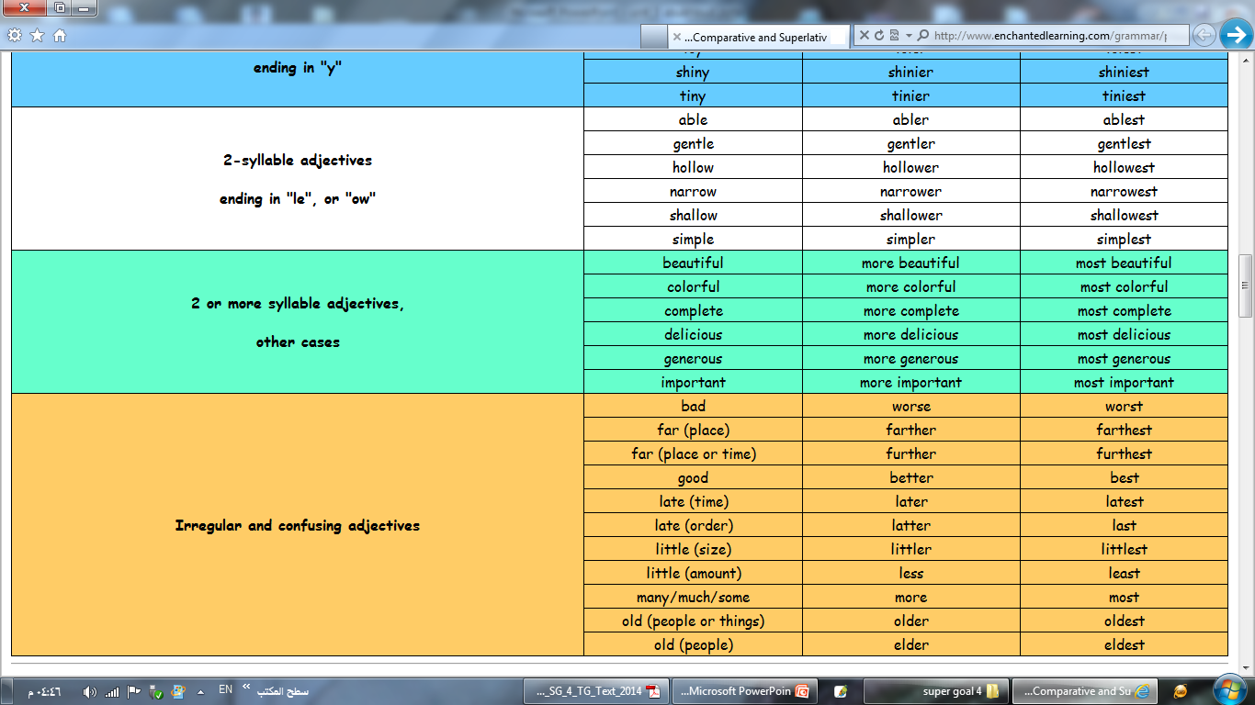
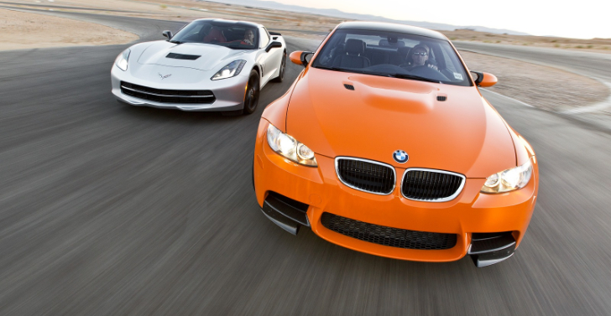
Some comparative and superlative adjectives are irregular such as:
My car is better than your car. ( good )
My car is the best car in the city. ( good )

Slide 11


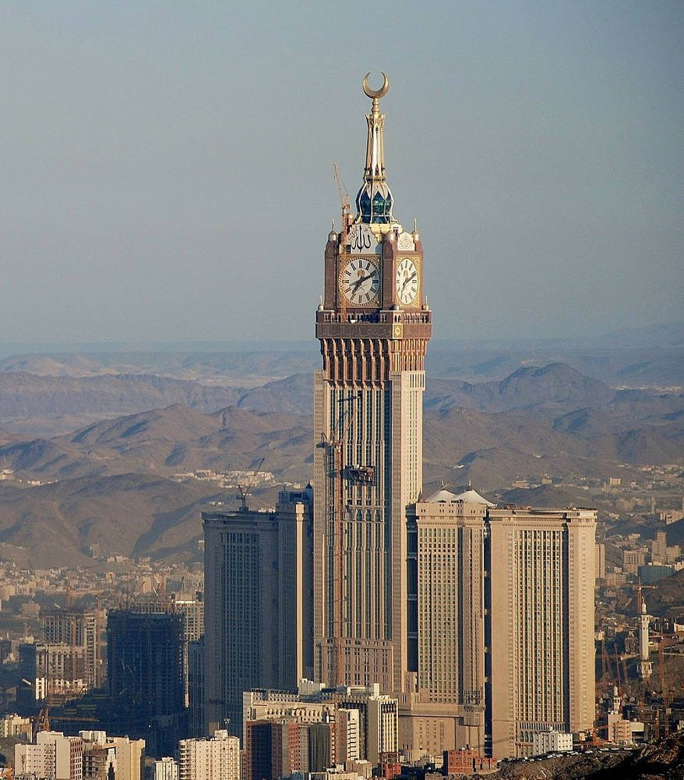
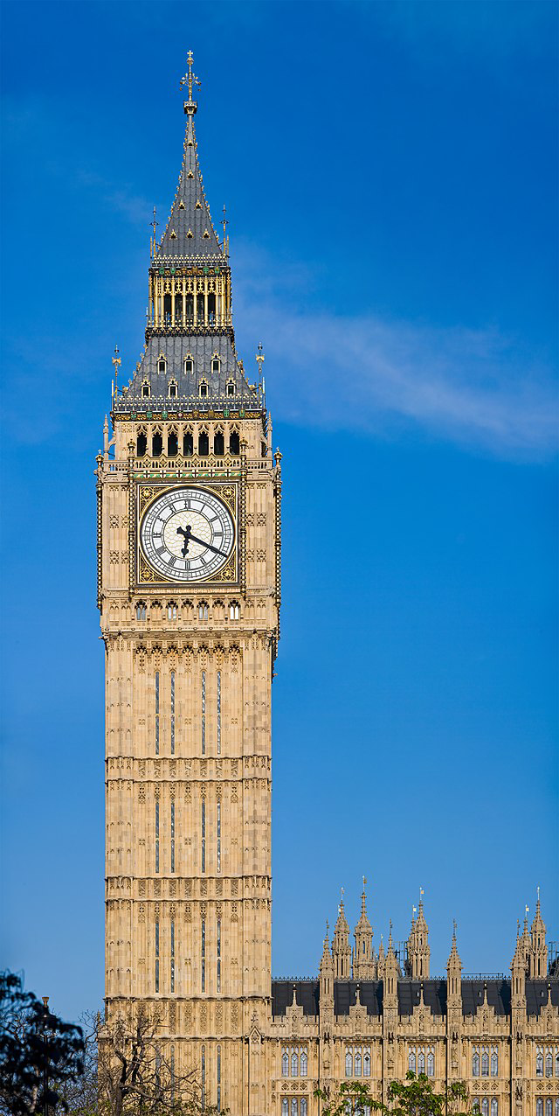
Did you know?
  The tallest clock tower in the world is the Makkah Clock Royal Tower in Mecca, Saudi Arabia

Slide 12
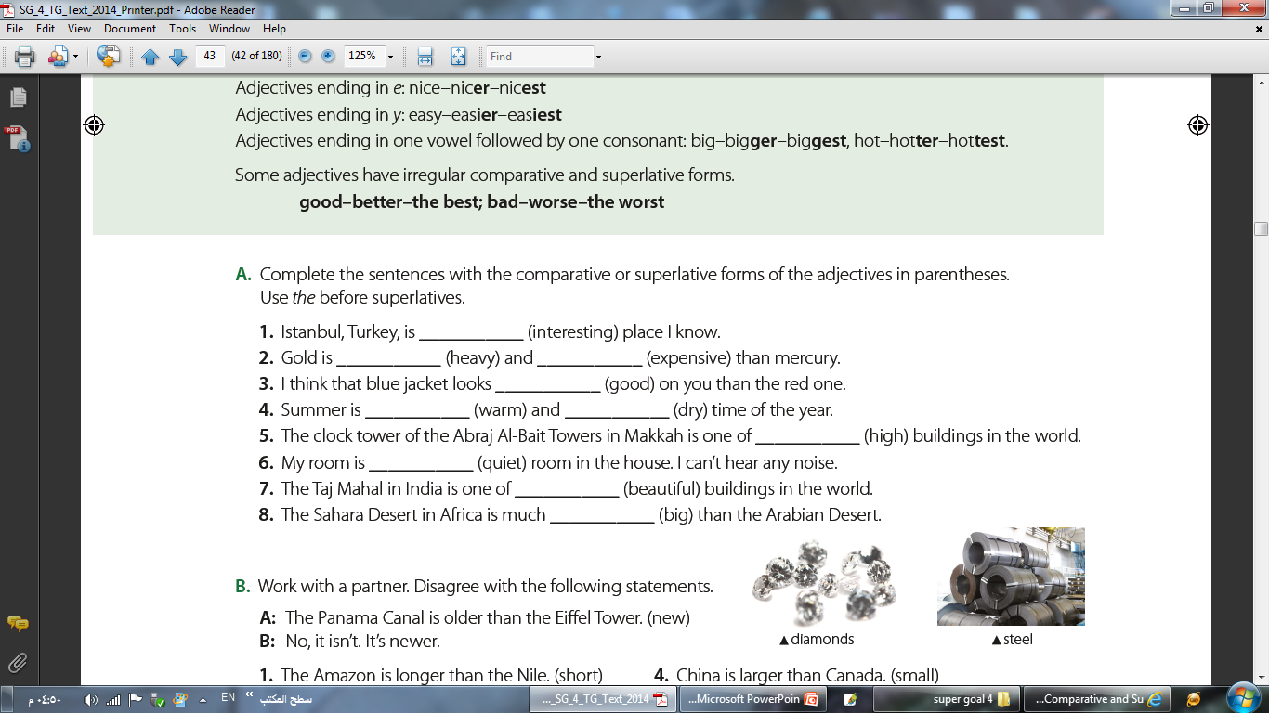
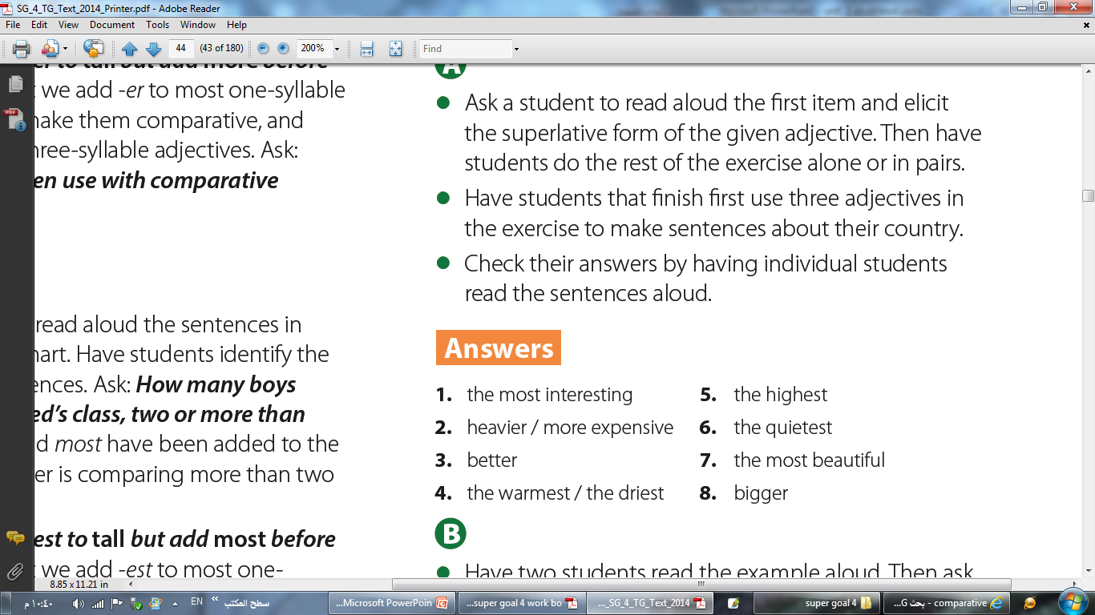
the most interesting

Slide 13
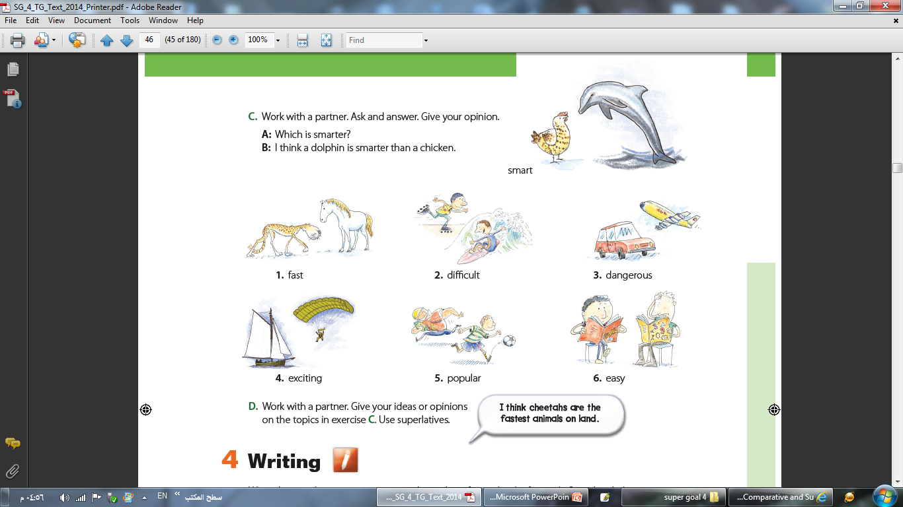
a horse
a cheetah
Which is faster?
I think a cheetah is faster than a horse.

Slide 14
a cheetah
a horse
rollerblading
surfing
Which is faster?
Which is more difficult?
I think a cheetah is faster than a horse.
I think surfing is more difficult than rollerblading.
driving
flying
diving
sailing
Which is more dangerous?
I think driving is more dangerous than flying.
Which is more exciting?
I think sky diving is more exciting than sailing.
rugby
football
English
math
Which is more popular?
Which is easier?
I think football is more popular than rugby.
I think English is easier than math.

Slide 15
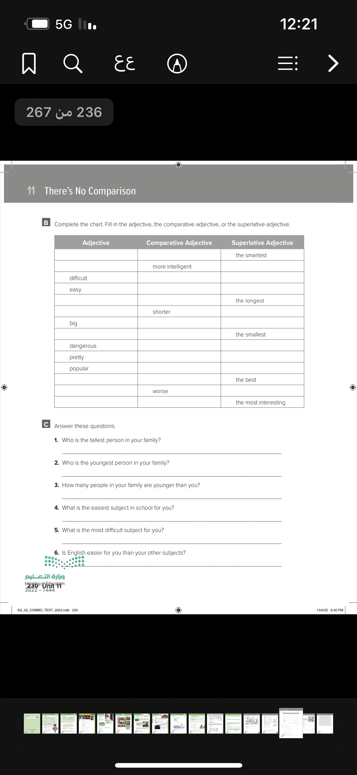
Homework
Page 230/B

