Slide 1
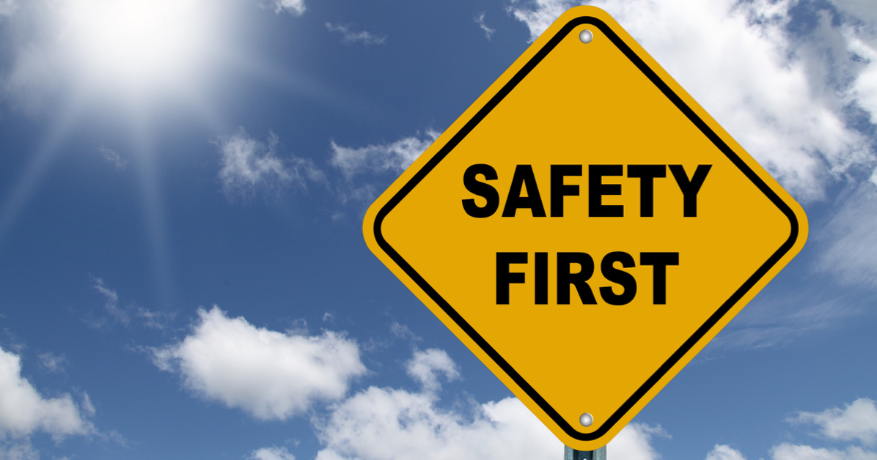
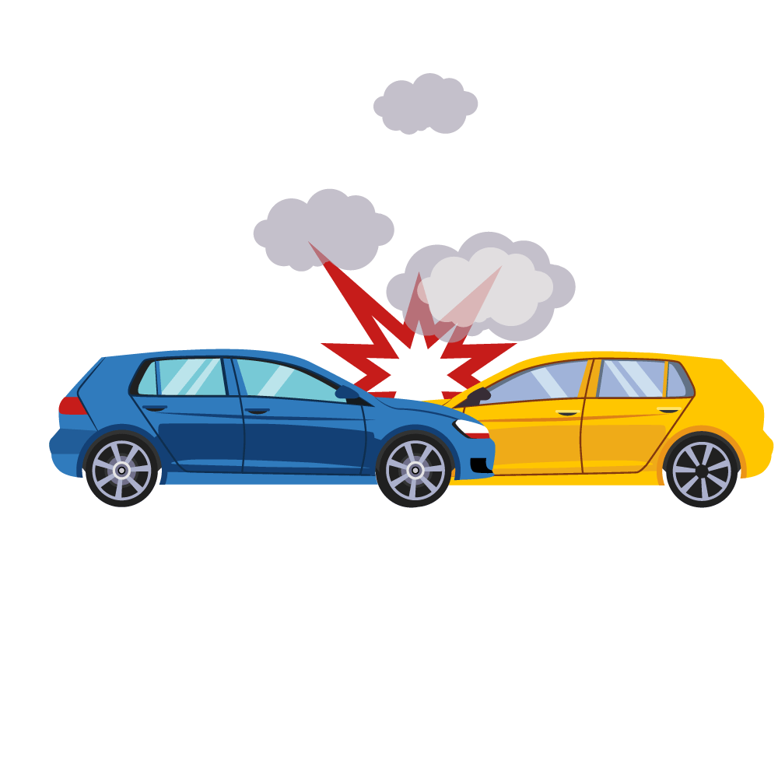
Mega Goal 1.2
U: 1
Did you hurt yourself ?
Listen and Discuss
By: Yousef Hilal Alyazedi

Slide 2
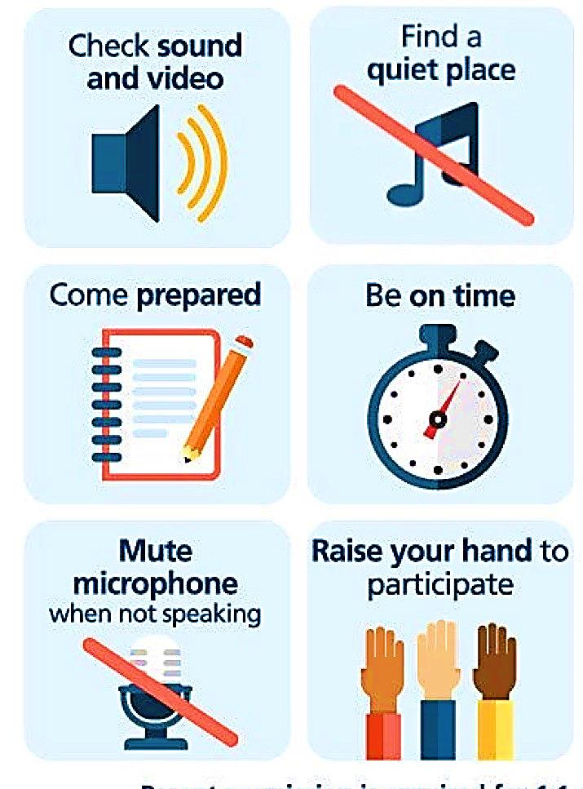
Online Classroom Rules

Slide 3

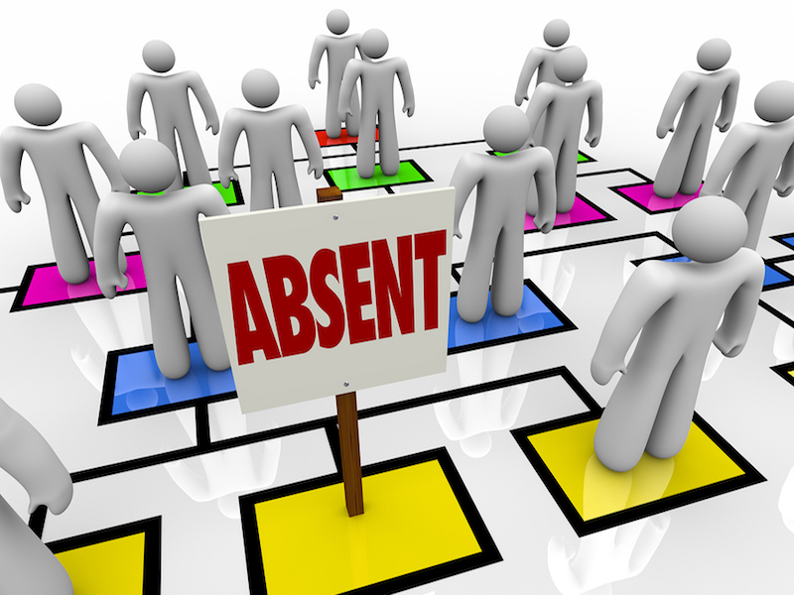

Slide 4

Lesson objectives
Discuss the pictures .
Talk about some common accidents .
Know the most common causes of automobile crashes .
Answer some questions .

Slide 5

Keep
your books
closed

Slide 6
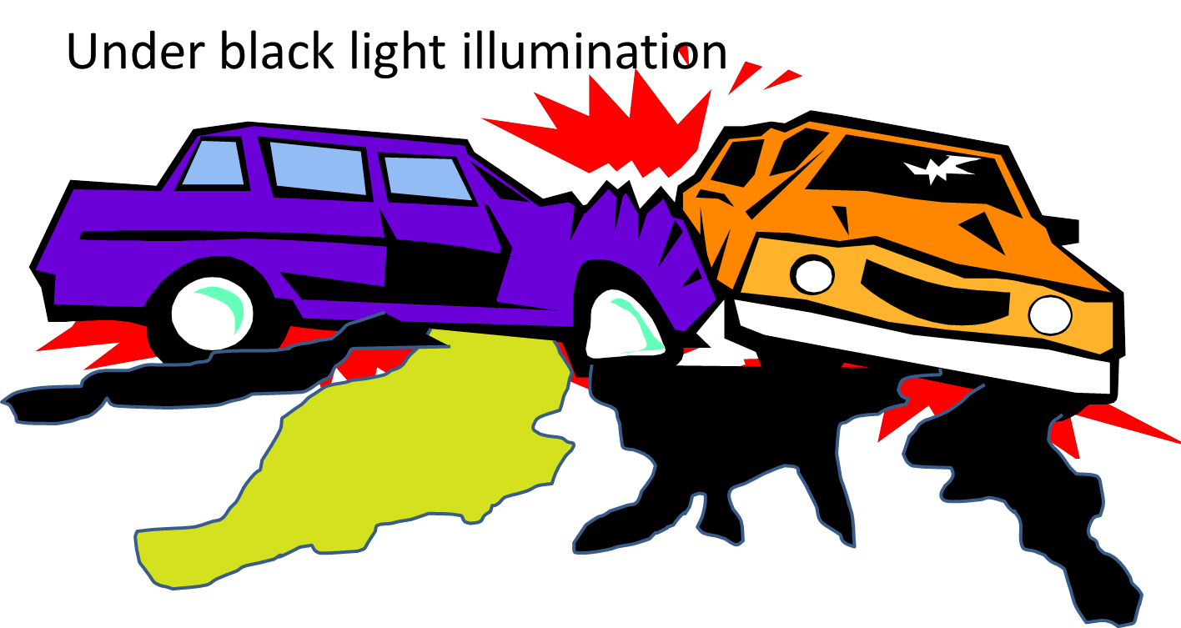
Warm Up
Have you ever been in a car accident ?

Slide 7


Slide 8
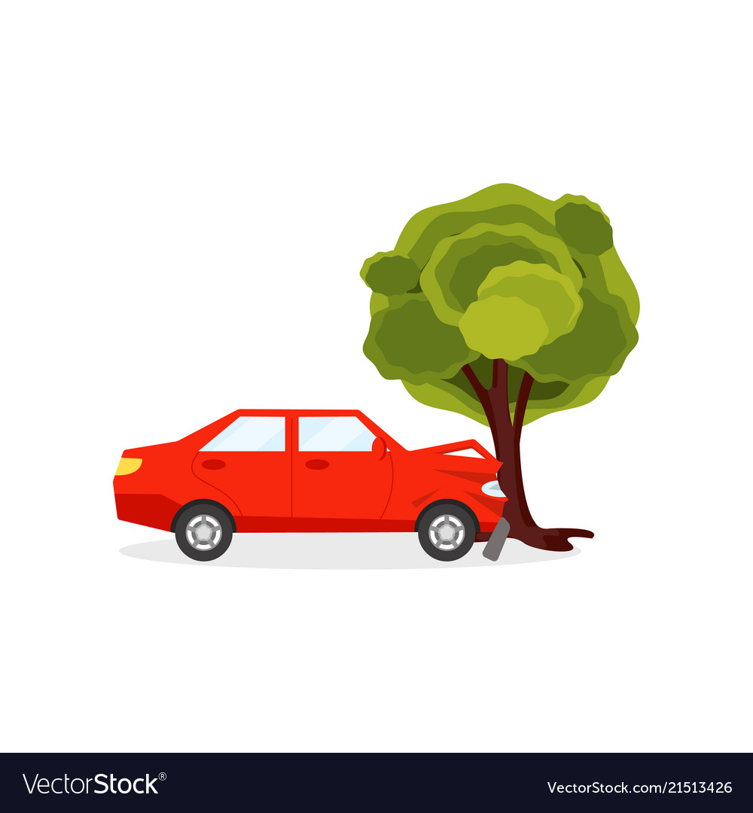
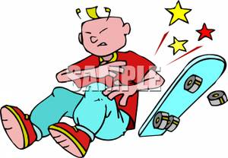
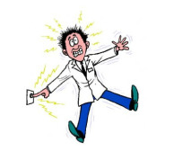

Discuss the following pictures

Slide 9

What is accident ?
A situation in which someone is injured or something is damaged without anyone intending them to be .

Slide 10


Open your Student’s book at page: 4

Slide 11

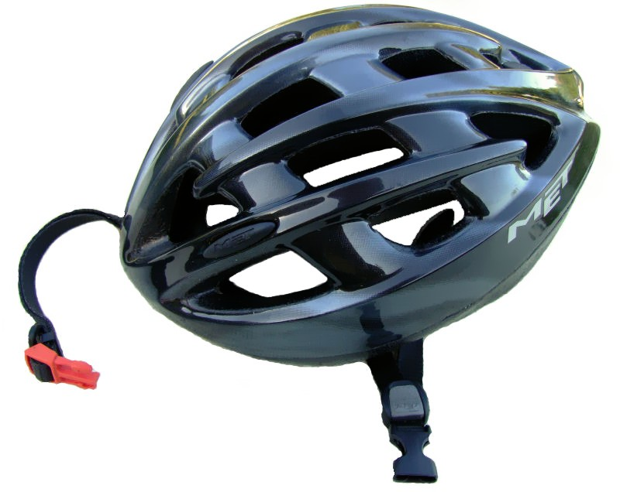
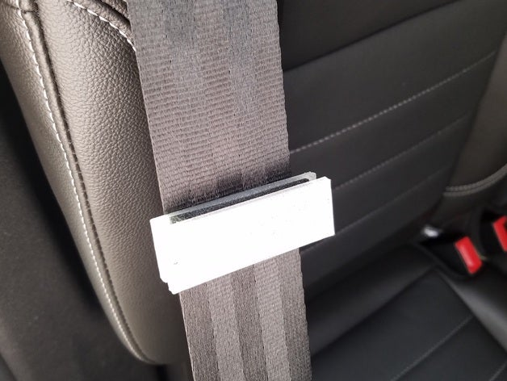
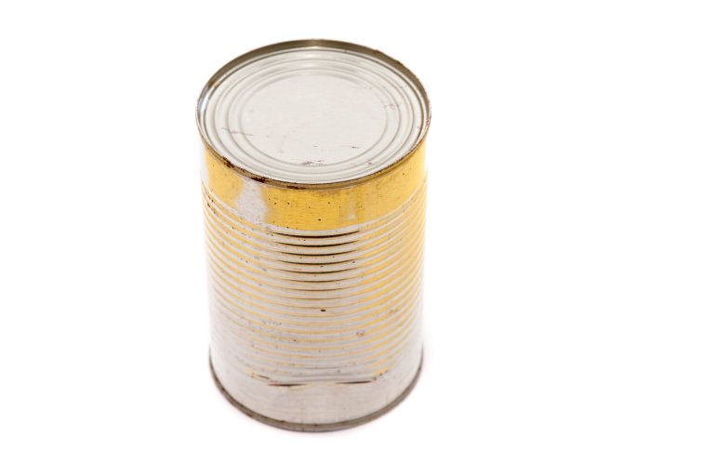

Describe the following pictures

Slide 12
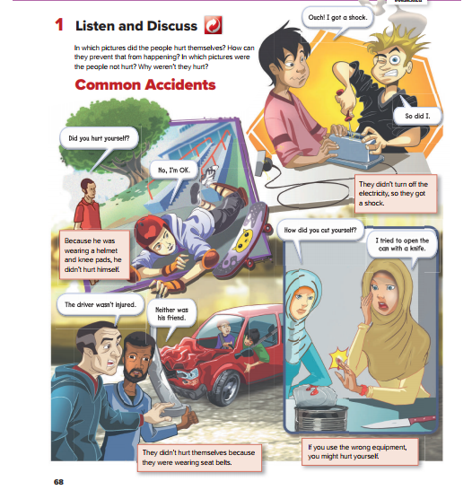

Listen

Slide 13

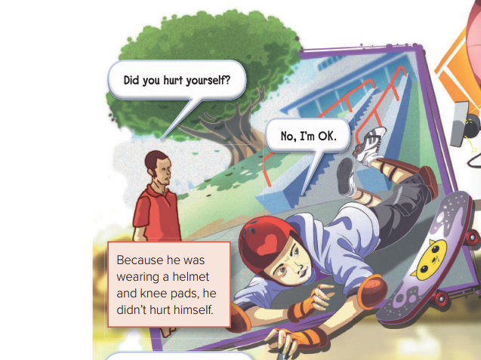
What happened to the boy ?
He fell of his skateboard .
Why didn’t the boy get hurt ?
Because he was wearing a helmet and knee pads .
What was he wearing ?
A helmet and knee pads .

Slide 14
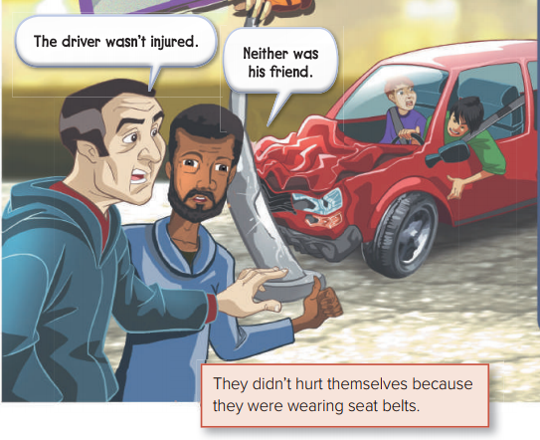
What happened to the driver ?
He hit the pole with his car .
Who was with the driver ?
His friend .
Were they injured ?
No, they weren’t .
Why didn’t they injured ?
Because they were wearing seat belts .

Slide 15
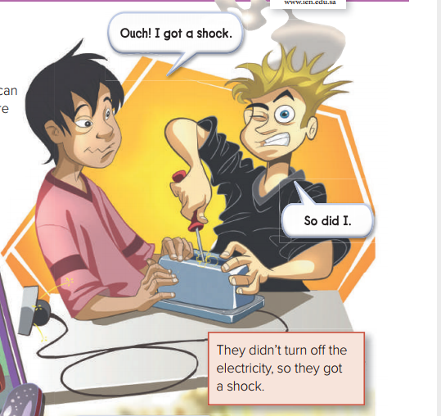
What happened to the boys ?
They got a shock .
Why did they get a shock ?
Because they didn’t turn off the electricity .

Slide 16
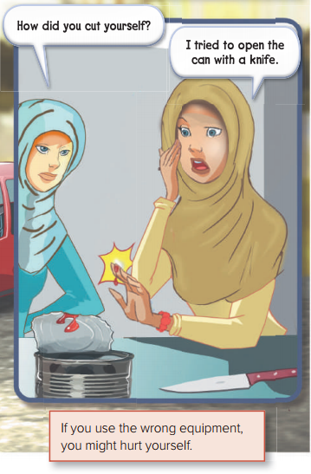
How did the woman cut herself ?
She tried to open the can with a knife .
Was she injured ?
Yes, She was .

Slide 17
Open your Student’s book at page: 5

Slide 18
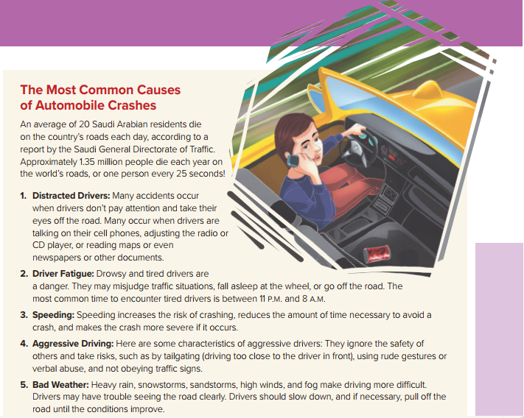
What are the most common causes of car crashes ?
1 – Distracted Drivers .
2 – Driver Fatigue.
3 – Speeding.
4 – Aggressive Driving.
5 – Bad Weather.

Slide 19
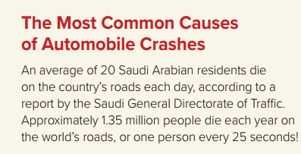
What’s the average of Saudi Arabian residents die on the country’s road each year ?
How many people die each year on the world’s roads ?

Slide 20
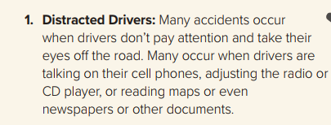
Who are the distracted drivers ?
Those who are talking on the cell phones , adjusting the radio or CD players , reading maps while driving and don’t pay attention to the road .
What is meant by “ take their eyes off “ ?
Don’t look at .

Slide 21

What is meant by “ Driver Fatigue “ ?
The exhaustion that a driver encounter while driving .
What may happen to the drowsy and tired drivers while driving ?
What is the most common time to encounter tired drivers ?

Slide 22

What does speeding increase ?
Speeding increases may lead to death .

Slide 23

What is “ Aggressive Driving “ ?
When an individual commits a combination of moving traffic offenses that endangers other persons or property .
What are the characteristics of aggressive drivers ?

Slide 24

What makes driving more difficult ?
What should a driver do when encounter a bad weather ?

Slide 25
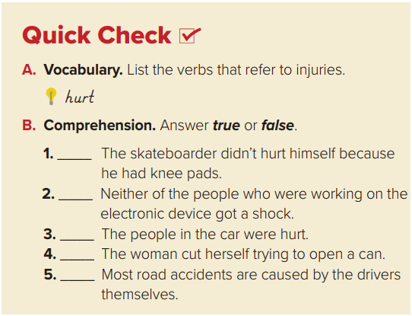

Quick Check
injured
got a shock
cut
true
false
false
true
true

Slide 26

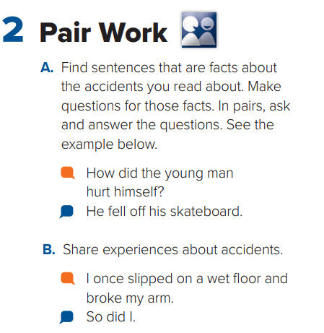

Slide 27


