Slide 1
Mega Goal 1.2
U: 1
Did You Hurt Yourself ?
Form , Meaning and Function
By: Yousef Hilal Alyazedi

Slide 2
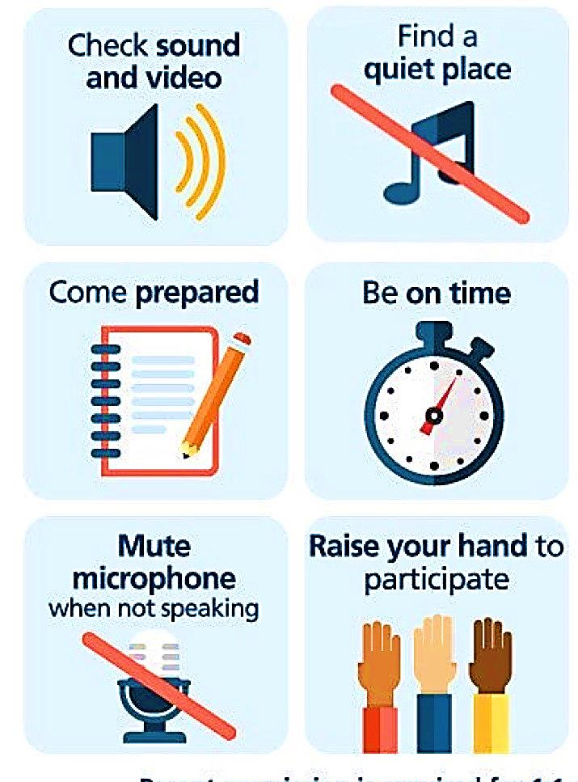
Online Classroom Rules

Slide 3

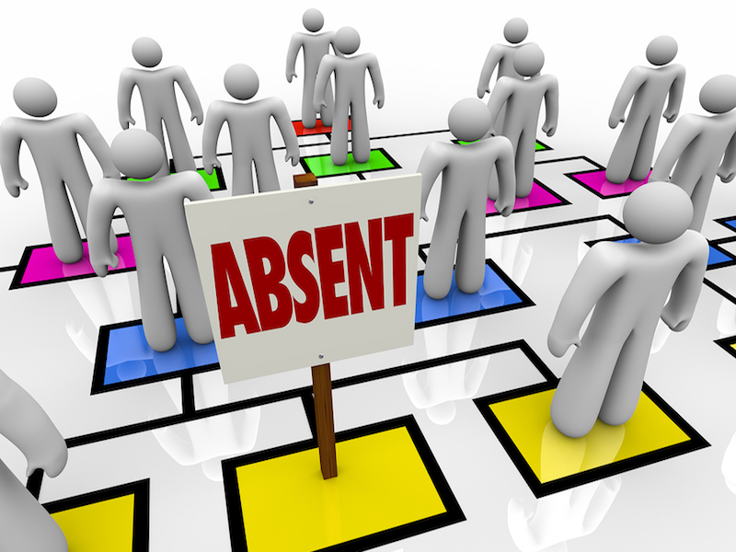

Slide 4

Lesson Goals
The students will be able to :
1 – Use “ must “ to talk about laws and rules .
2 – Use “ should “ to give advice .
3 – Express attitudes using adverbs of manner .
4 – Describe position using prepositions of place .
5- use “ imperatives “ for directions .

Slide 5
Today We have 4 parts
Modal Auxiliaries
Adverbs of manner
Prepositions of place
Imperatives for directions

Slide 6
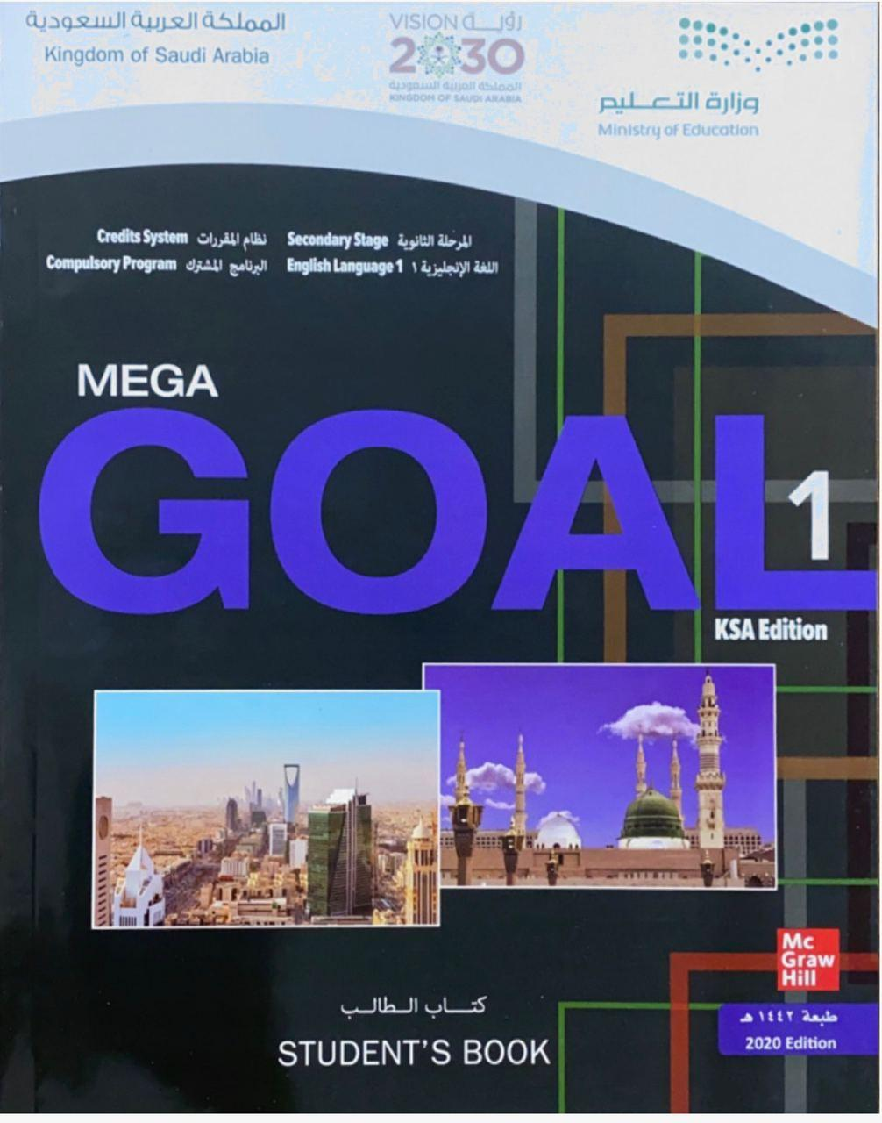

Open your Student’s book at page: 14

Slide 7

Modal Auxiliaries
They are verbs which behave irregularly in English .
They give additional information about the function of the main verb that follows it
They are always followed by an infinitive without “ to “ .
can
could
shall
should
will
would
may
might
must
ought to

Slide 8
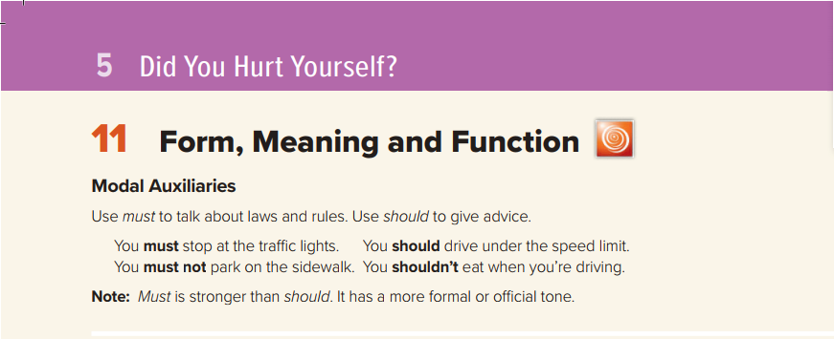
Must & Should
They must stop smoking .
You should see the doctor if you are sick .
He mustn’t use his phone while driving
She shouldn’t drink cold water .

Slide 9
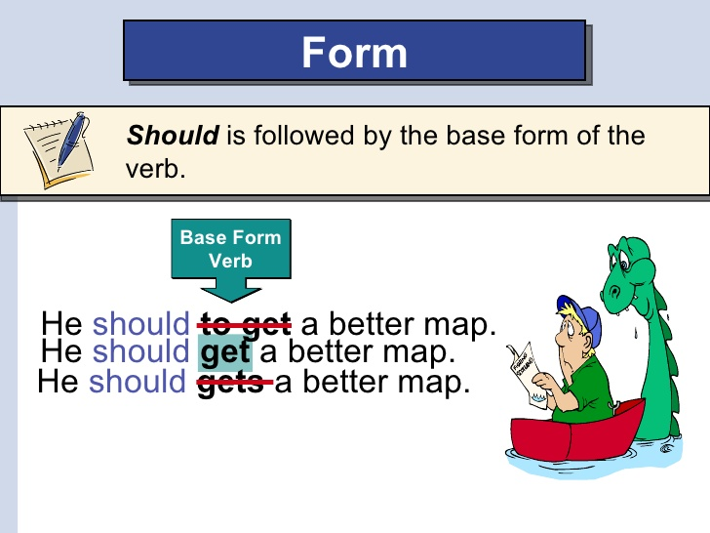

Must
To talk about laws and rules .
followed by the base form of the verb .
Must = prohibition
You mustn’t smoke in the office.

Slide 10

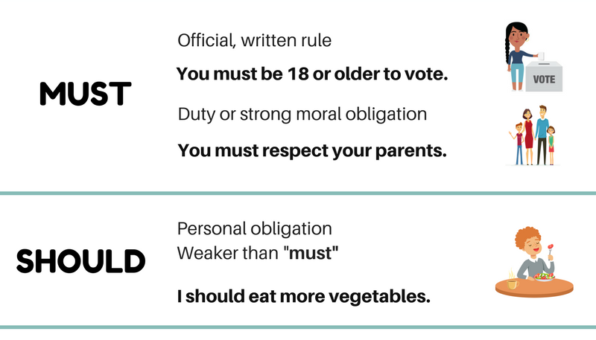

Slide 11
Complete the sentences with must , mustn’t or should .
1 – You go to the hospital if you have a cough .
should
2 – You respect your parents .
must
mustn’t
3 – You use your mobile phone in the class .
4 – We fasten our seatbelts .
must

Slide 12
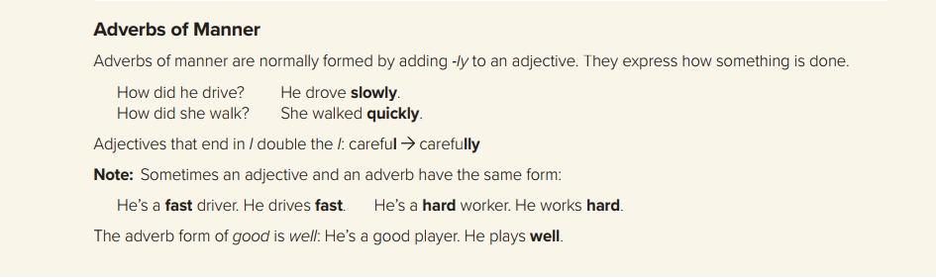

quick
quickly
happy
happily
fast
fast
careful
carefully
hard
hard
safe
safely
good
well

Slide 13
She walked slowly .
I answered the questions correctly .
He drove his car fast .
We form the adverb by adding –ly to an adjective .
Adverbs of manner : mainly modify verbs and tell us the way in which something happens

Slide 14
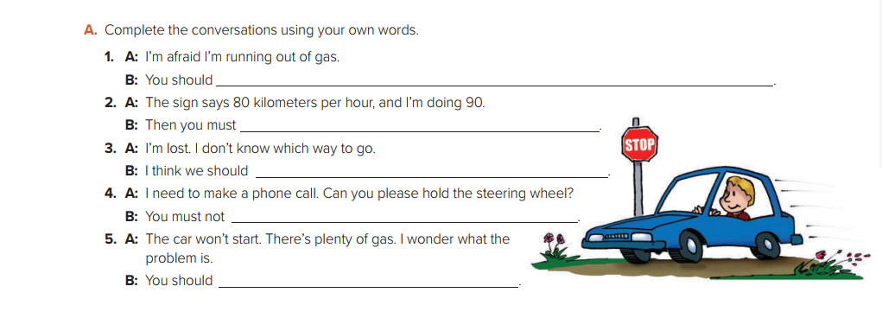
stop at a gas station .
slow down .
ask someone .
speak on the phone when driving
take it to a car mechanic

Slide 15
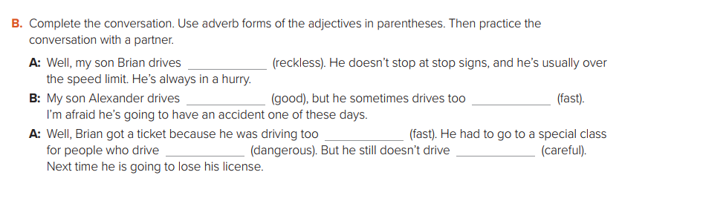
recklessly
well
fast
fast
dangerously
carefully

Slide 16
Open your Student’s book at page: 15

Slide 17
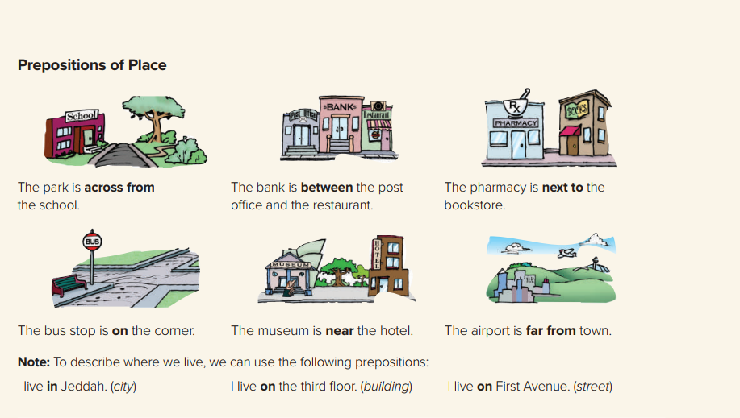

Slide 18
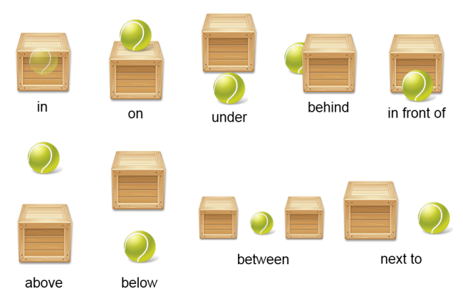

Slide 19


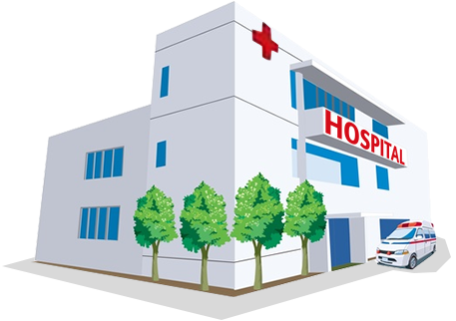
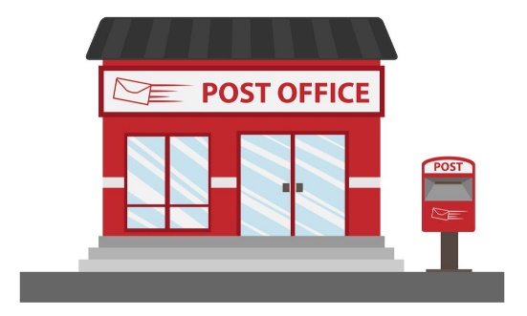
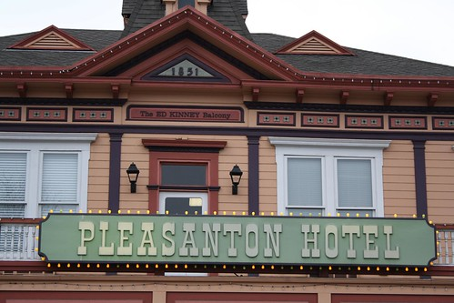
between
The bank is ………… the school and the hospital .
Next to
The post office is ………… the hotel .

Slide 20
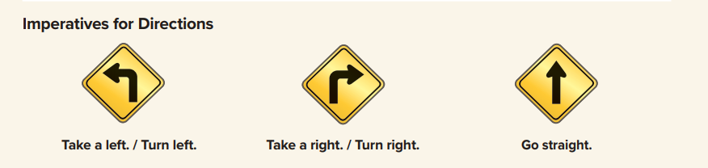
The imperative is the form of the verb we use to give directions .
We simply use the base form of the verb .
Where can I find the bank ?
Go straight then will find the sign to turn right . Walk about 100 meters .Take left and you will see the bank on at the right side .

Slide 21
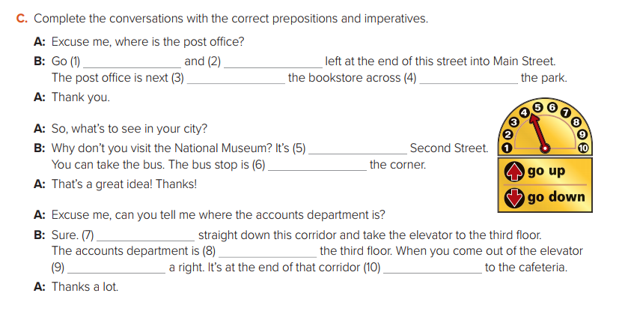
straight
turn
to
from
on
on
Go
on
take
next

Slide 22
