Slide 1

Mega Goal 1.2
U: 1
Grammar
By: Yousef Hilal Alyazedi

Slide 2
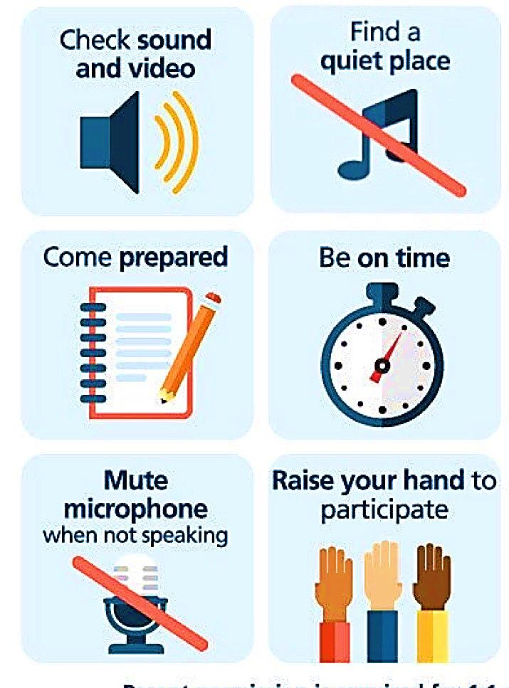
Online Classroom Rules

Slide 3

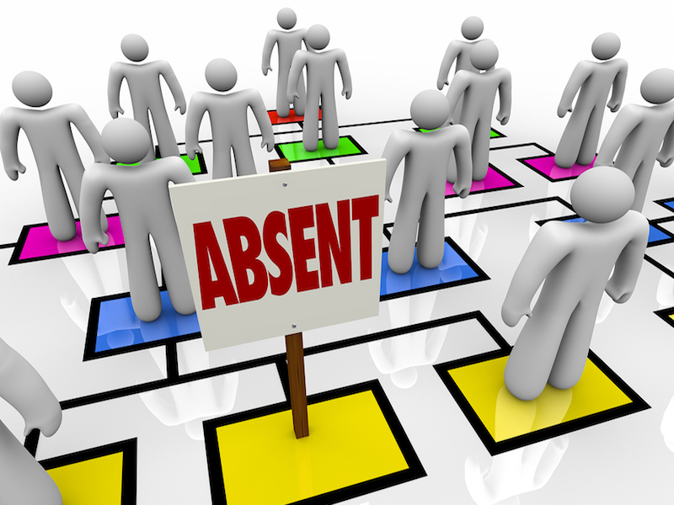

Slide 4


Lesson Goals
1 – use reflexive pronouns to emphasise the person or thing we are referring to .
2 – use “ Because & So “ correctly .
3 – use “ So & Neither “ to show agreement .

Slide 5
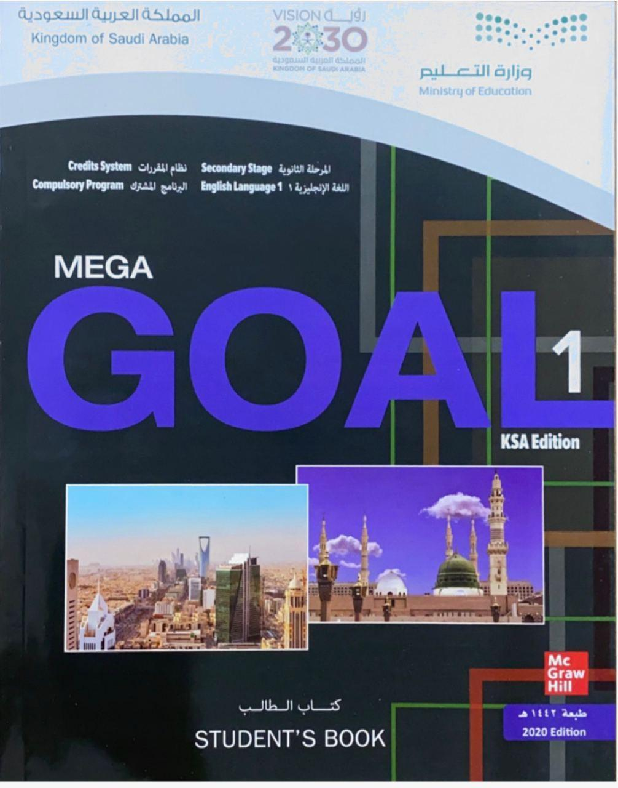

Open your Student’s book at page: 6

Slide 6
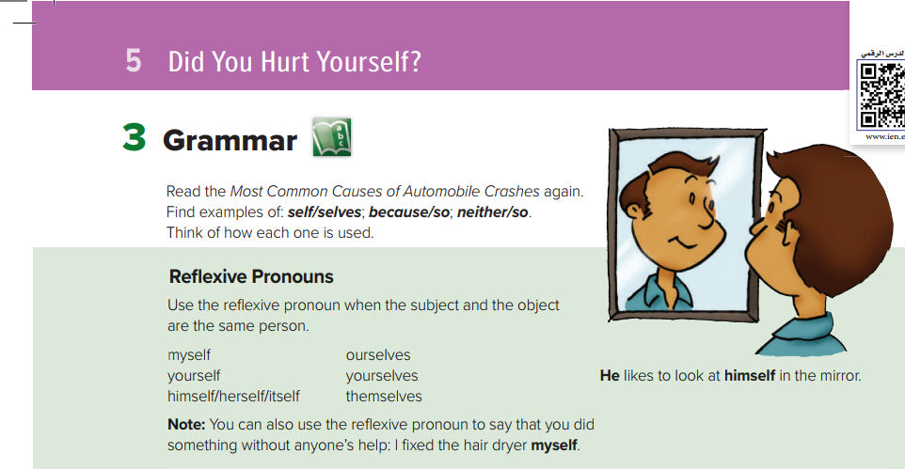

Slide 7


Reflexive Pronouns
I looked at myself in the mirror .
He painted that amazing picture himself .
They planned their trip themselves .
You translated this poem yourselves .
This Photo by Unknown Author is licensed under CC BY-NC

Slide 8
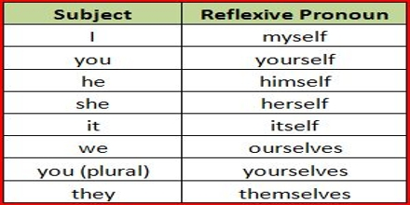
Reflexive pronouns are formed by adding –self to the singular pronouns
Singular Pronouns
my
your
him
her
it
Reflexive pronouns are formed by adding –selves to the plural pronouns
Plural Pronouns
your
our
them

Slide 9
We often put the reflexive pronoun at the end of the clause when we are using it for emphasis.
I fixed the car myself .
She mended the car herself .
They baked the bread themselves .

Slide 10
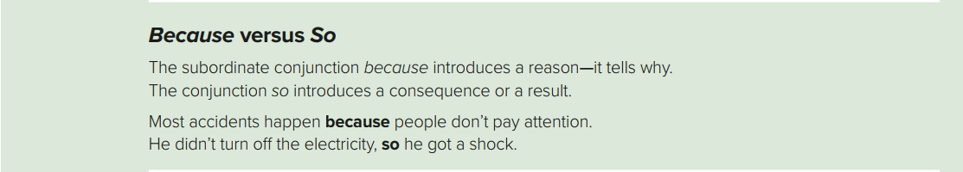


I stopped running because my knees started hurting .
My knees started hurting so I stopped running .
I bought a map because I was lost .
I was lost so I bought a map .

Slide 11
Reason
It is used to show reasons .
Result
It is used to show consequences or results .

Slide 12


Choose
I went to bed ………………….. I was tired .
because
so
I was tired ………………….. I went to bed .
because
so

Slide 13
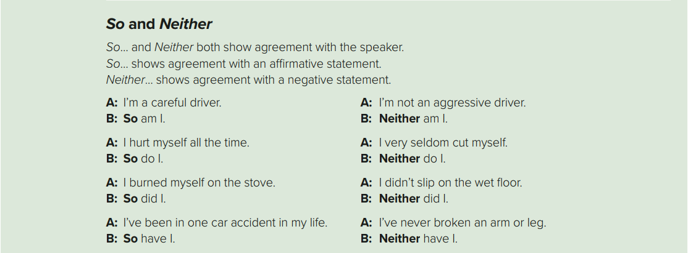

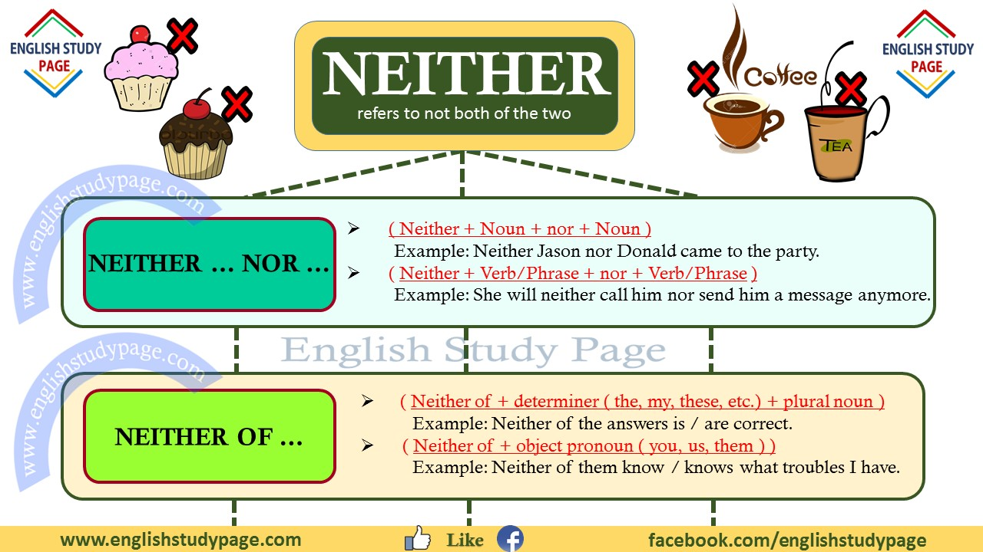
Ali : I’m a good driver .
Fatima : I don’t like pizza .
Salman : So am I .
Amal : Neither do I .
Muna : I watch TV .
Nasir : I didn’t sleep well .
Sara : So do I .
Salim : Neither did I .

Slide 14

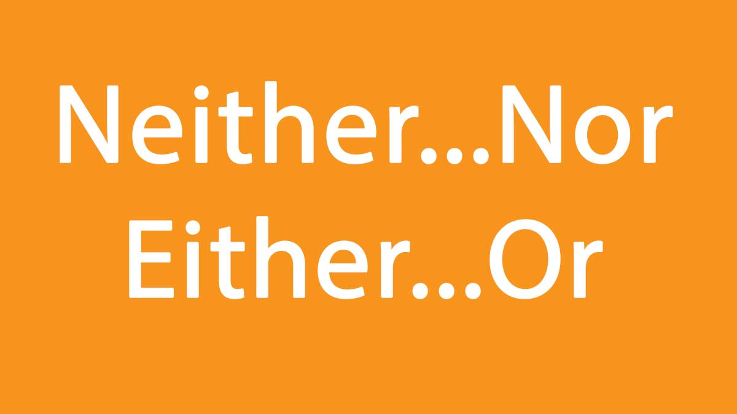
is used to agree with a statement which is affirmative .
is used to agree with a statement which is negative .

Slide 15

So
I played tennis .
So did I .
I’m not a bad driver .
Neither
Neither am I .

Slide 16
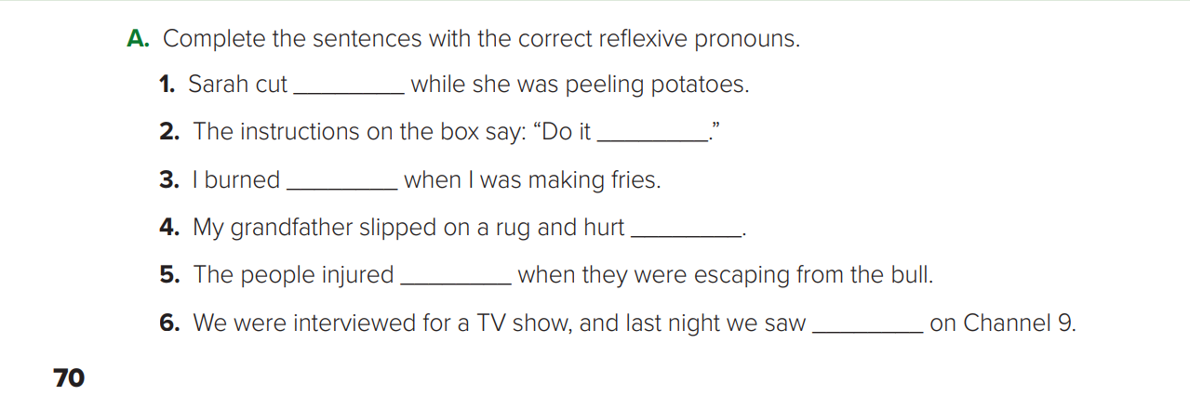
herself
yourself
myself
himself
themselves
ourselves

Slide 17
Open your Student’s book at page: 7

Slide 18
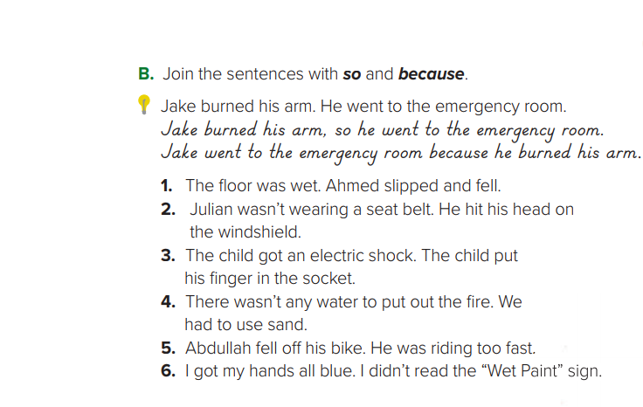
1 - The floor was wet, so Ahmed slipped and fell .
Ahmed slipped and fell because the floor was wet .
2 - Julian wasn’t wearing a seat belt, so he hit his head on the windshield .
Julian hit his head on the windshield because he wasn’t wearing a seat belt .
3 – The child put his finger in the socket , so he got an electric shock .
The child got an electric shock because he put his finger in the socket .
4 – There weren’t any water to put out the fire , so we had to use sand .
We had to use sand because there weren’t any water to put out the fire .
5 – Abdulah was riding too fast , so he fell off his bike .
Abdulah fell off his bike because he was riding too fast .
6 – I didn’t read the “ Wet Pain “ sign , so I got my hands all blue .
I got my hands all blue because I didn’t read the “ Wet Pain “ sign .

Slide 19
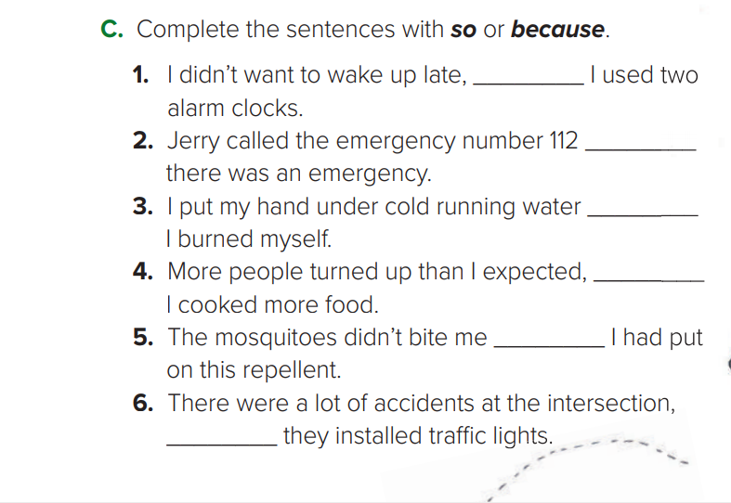
so
because
because
so
because
so

Slide 20
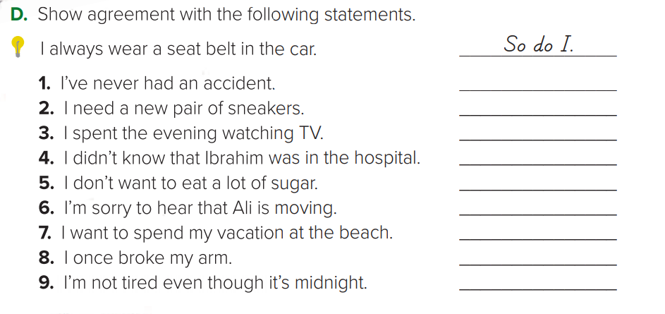
Neither have I
So do I
So did I
Neither did I
Neither do I
So am I
So do I
So did I
Neither am I

Slide 21

Workbook P. 49 + 50

Slide 22
