Slide 1
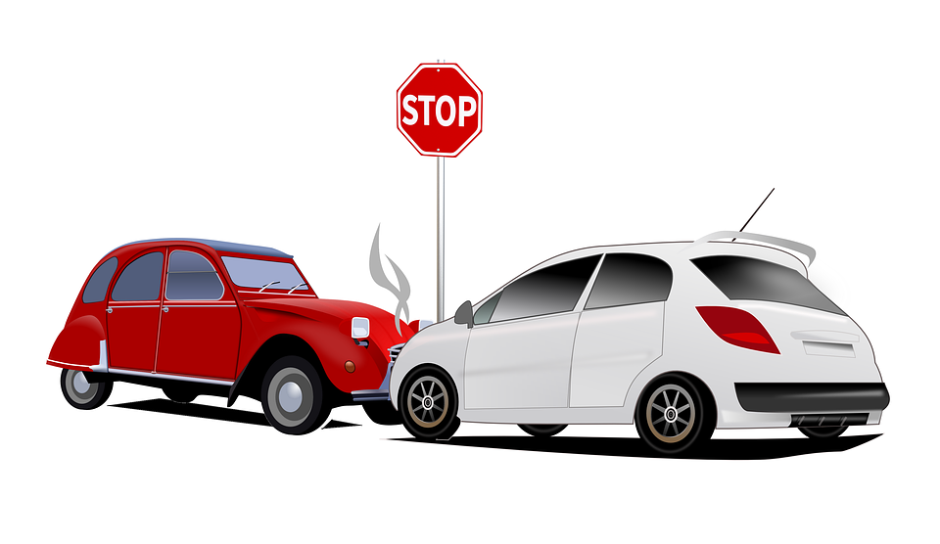

Mega Goal 1.2
U: 1
Did You Hur Yourself ?
Writing
By: Yousef Hilal Alyazedi

Slide 2
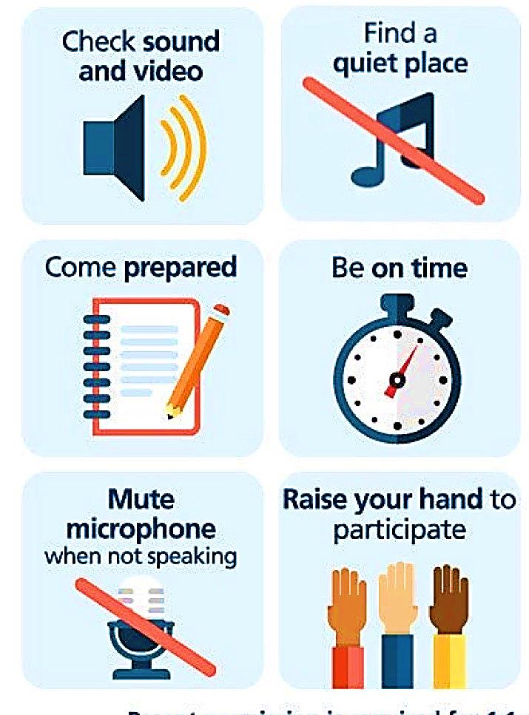
Online Classroom Rules

Slide 3
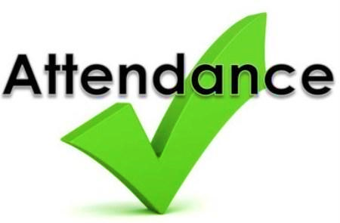
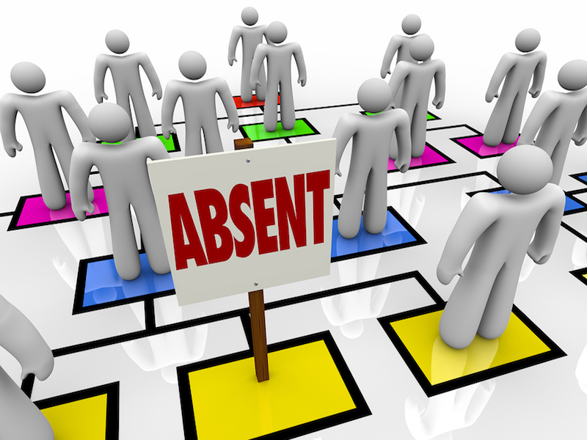

Slide 4

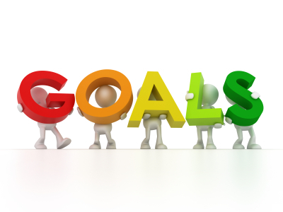
Lesson Goals
Read the text and highlight the words or phrases that give information about .
Use your notes to summarize the accident in your own words .
Write a short account of an accident .

Slide 5
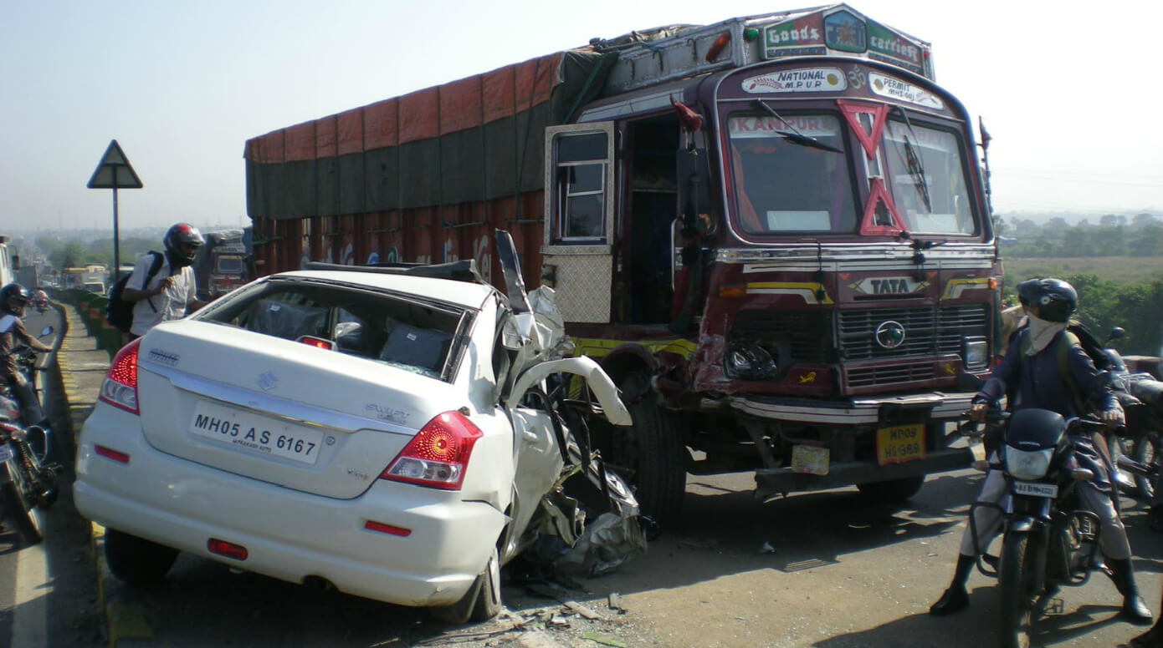
Warm Up
Have you ever witnessed an accident ?
Why do accidents happen ?

Slide 6
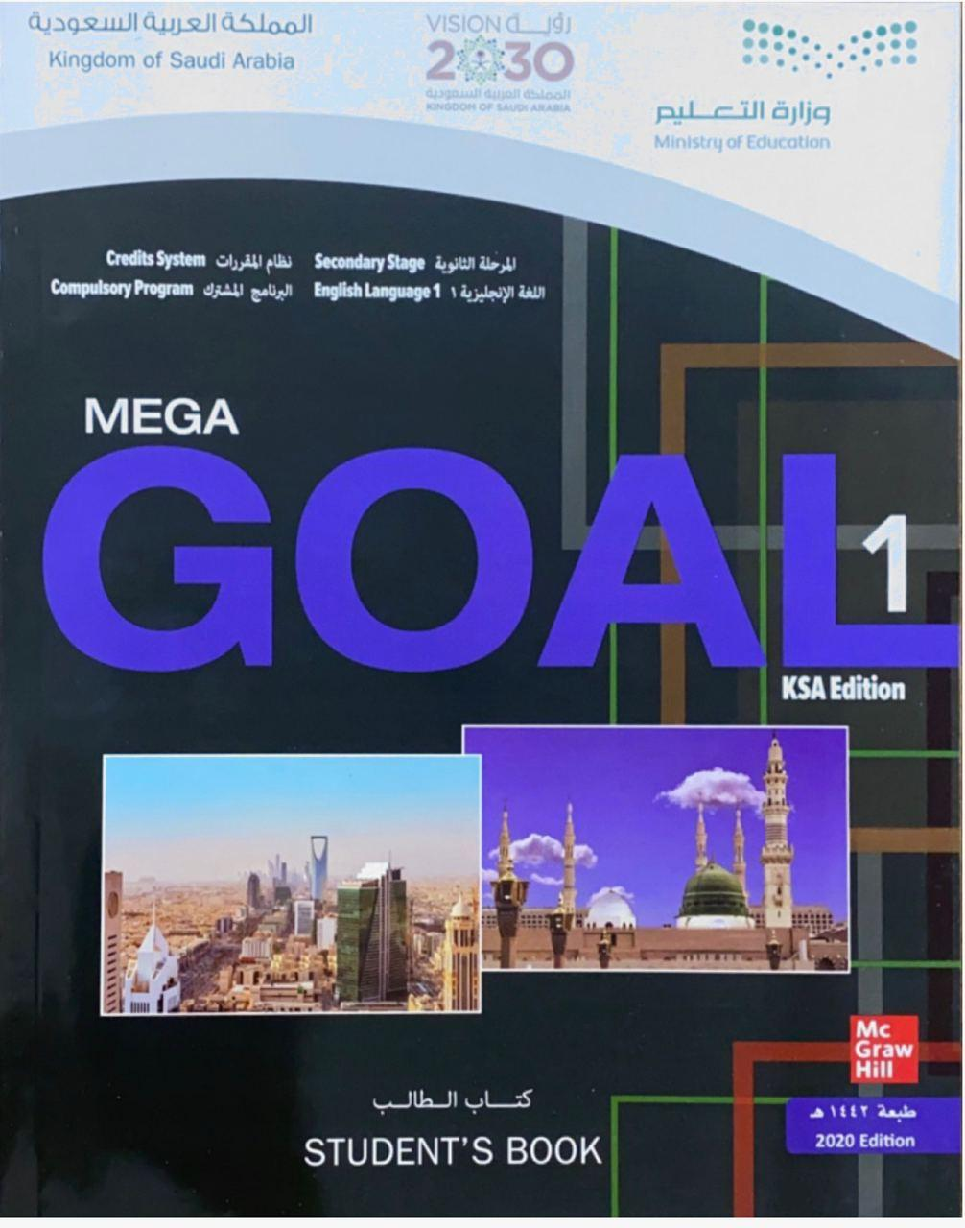

Open your Student’s book at page: 12

Slide 7
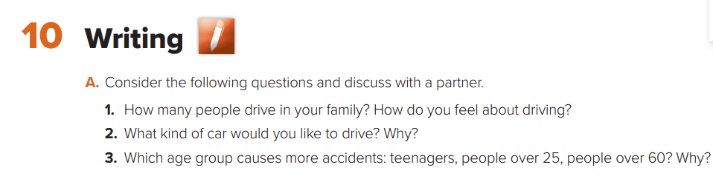
Discuss the following questions .

Slide 8
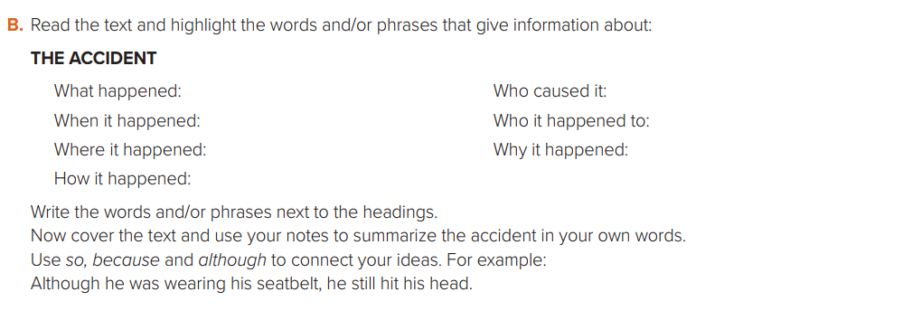

Slide 9
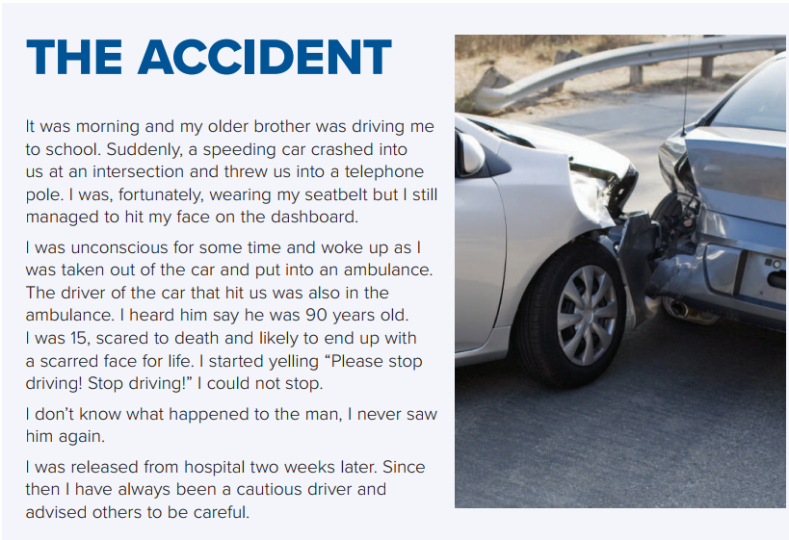


Slide 10
Car crushed into us / threw us into a telephone pole / hi my face on the dashboard .
driver of the other car
morning
the writer and his brother
on the way to school
the other driver was 90
years old .
speeding car didn’t stop at
the intersection /crushed into us

Slide 11
Open your Student’s book at page: 13

Slide 12
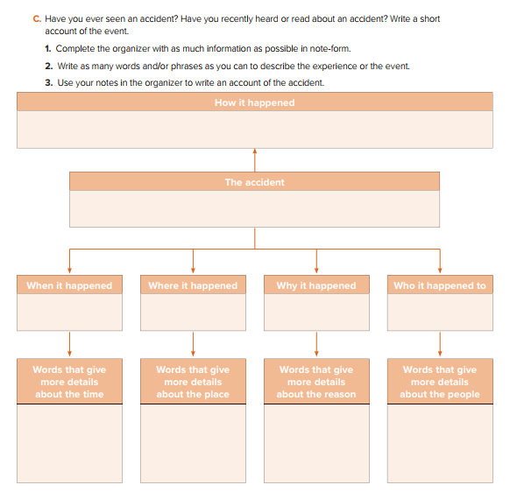
A man in a red sport car was driving very fast and crashed into a man in a big blue truck in the middle of the intersection .
Car accident
morning
on the way to school
the red car’s driver was calling and didn’t stop at stop sign
the driver of the red sport car
At the corner of Park Lane / in the middle of the intersection
this morning
Driving very fast
Speak
man
old man
police

Slide 13
Car accident
I saw an accident this morning on my way to school . I was standing at the corner of Park Lane
and High Street . A man in a red sport car was driving down Park Lane very fast . He was speaking
on his cell phone and he didn’t stop at the stop sign . He crashed into an old man in a big blue truck in
the middle of the intersection . He was drinking tea while driving and it spilled all over him . The
police arrived quickly and asked if I would be a witness to the accident . I agreed and went to the
police station to make a statement .

Slide 14
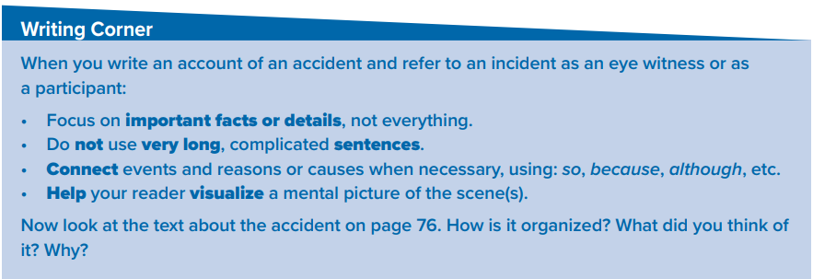

Slide 15

The stages of the writing process
Prewriting ( planning )
Drafting
Revision
Editing ( proofreading )
Publishing

Slide 16
