Slide 1
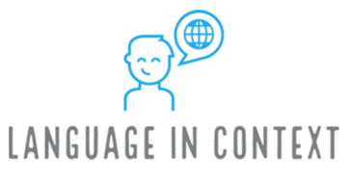
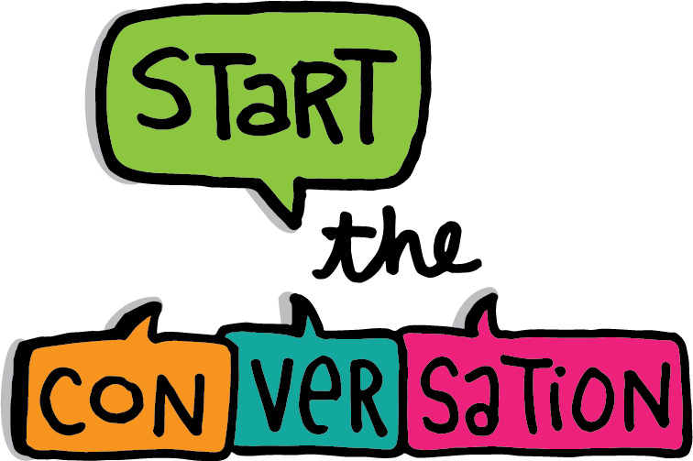
Mega Goal 1.2
U: 1
Did You Hurt Yourself ?
Language in conext
&
Conversation

Slide 2

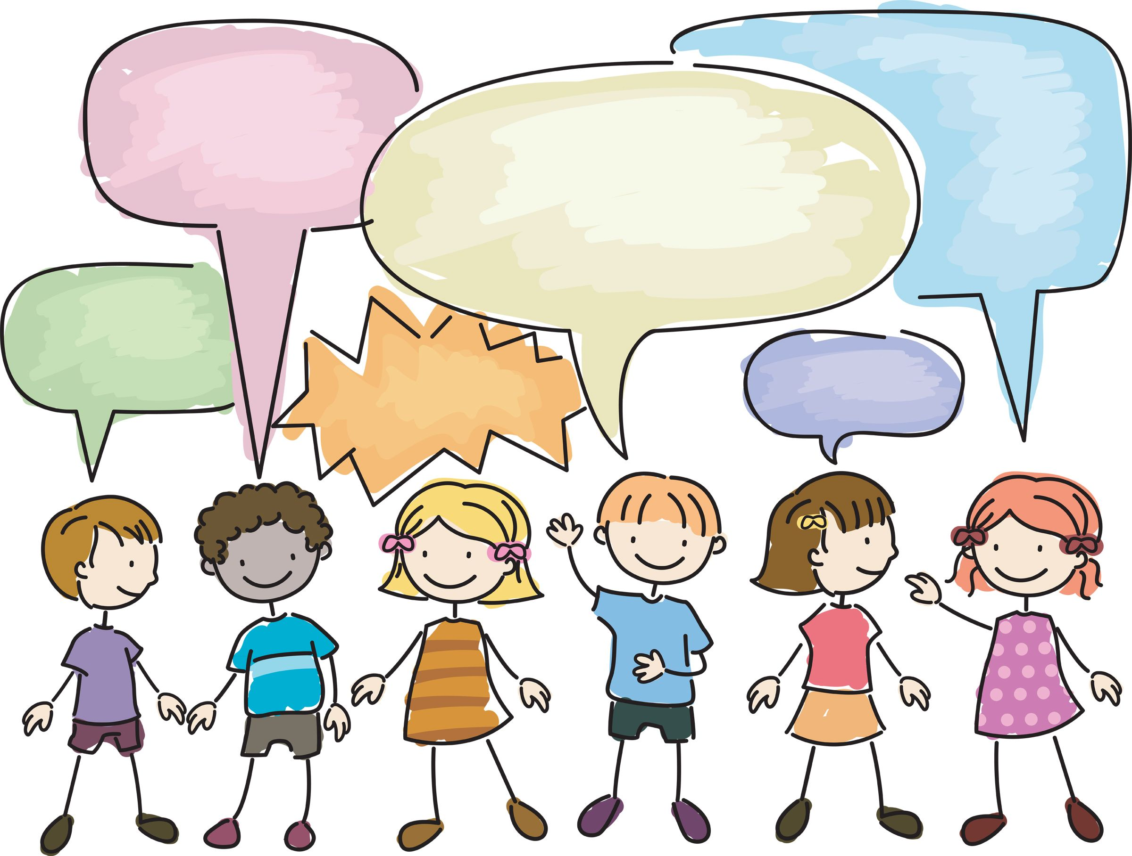
Lesson Goals
Describe an accident.
Match words with their suitable pictures .
Mark the items that mentioned in the audio track .
Practice Pronouncing cluster consonants at the end of the word .
Use real talk phrases in a conversation .
Answer questions in a conversation .

Slide 3

Keep
your books
closed

Slide 4
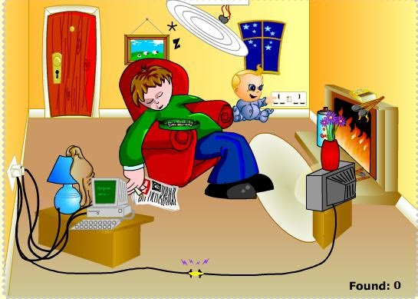
Warm Up
Have ever faced or heard about household dangers ?

Slide 5
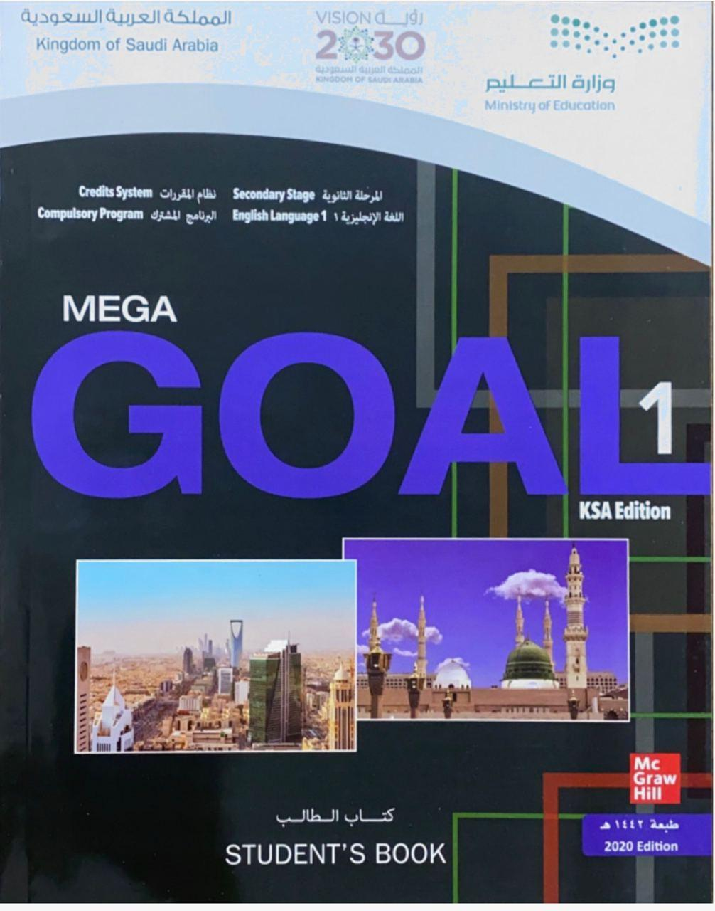

Open your Student’s book at page: 8

Slide 6
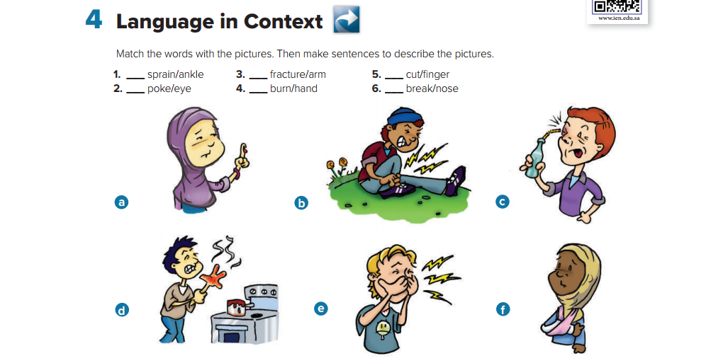
b
f
a
c
d
e

Slide 7
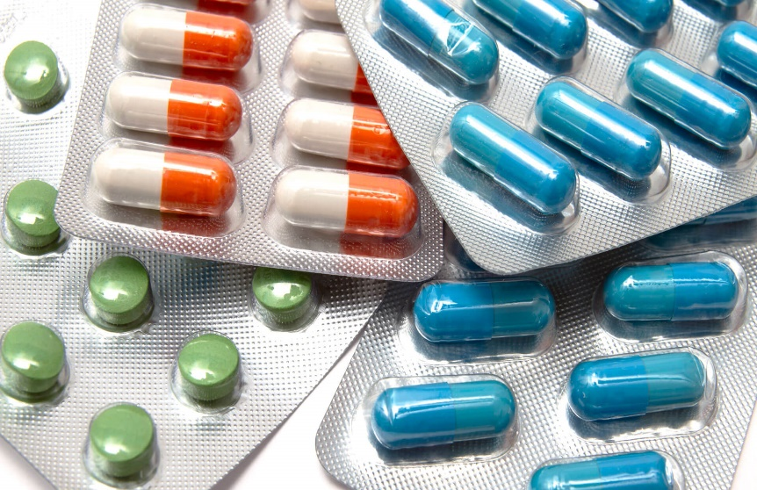
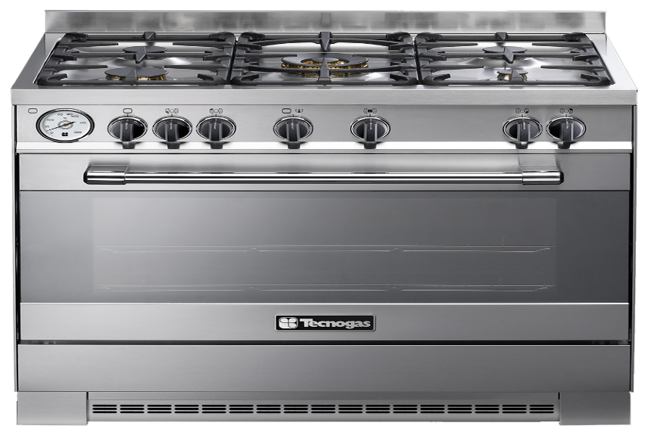
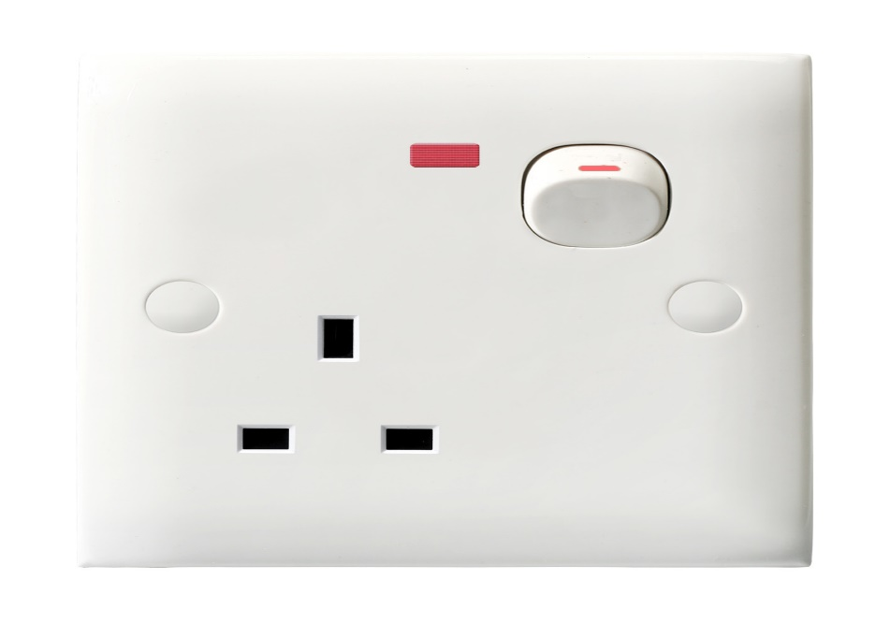
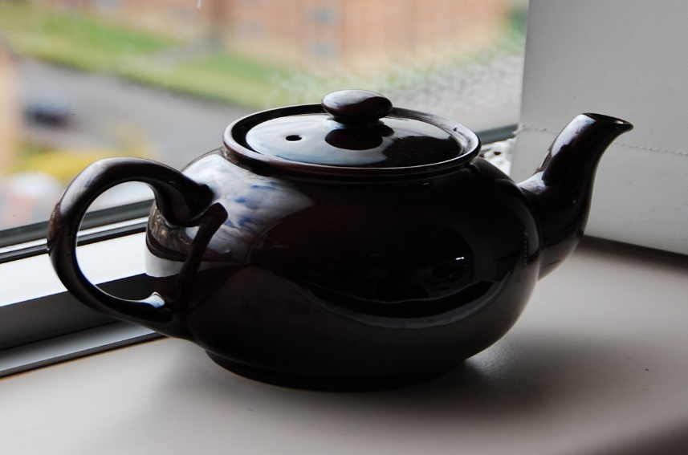
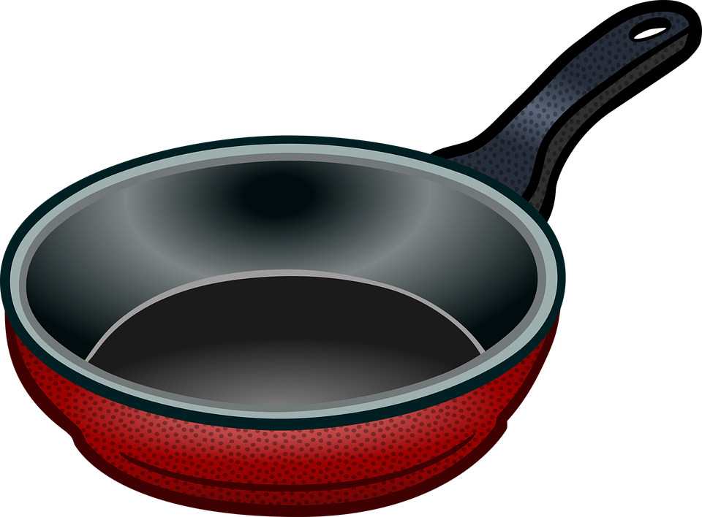
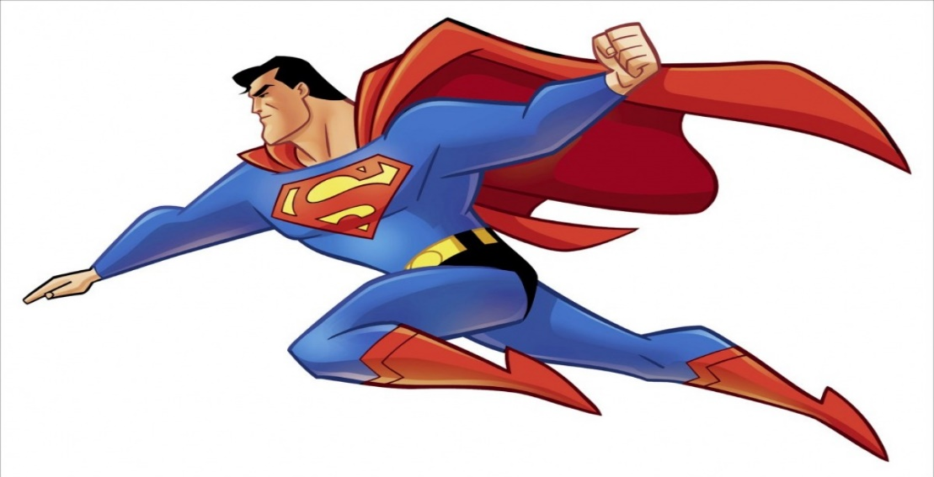
Describe the following pictures and their dangers on young children

Slide 8
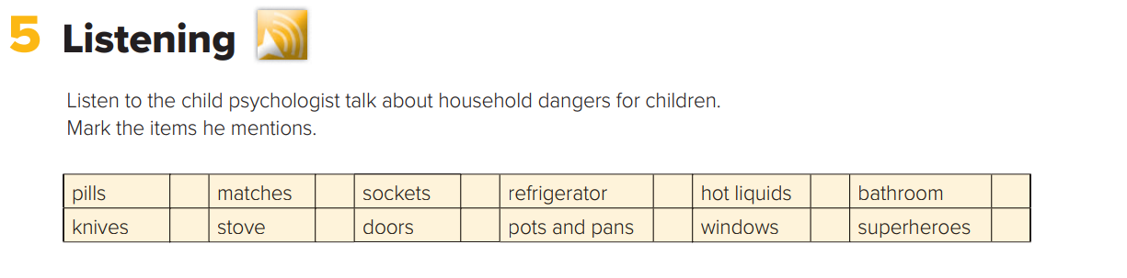

You will hear a child psychologist talk about household dangers for children .
✓
✓
✓
✓
✓
✓

Slide 9
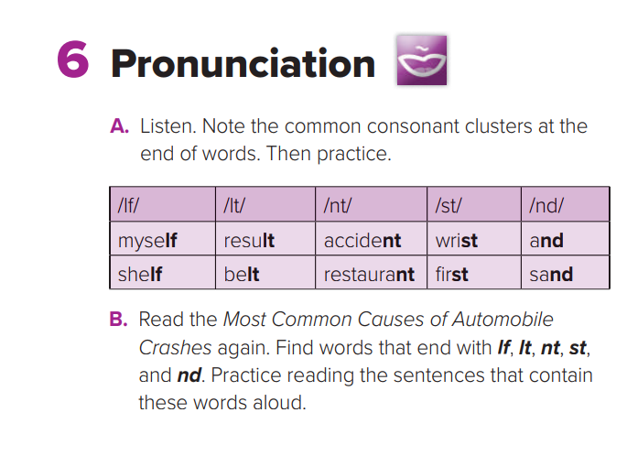
Consonants clusters
are where you have two or more consonants together in your pronunciation .

Slide 10
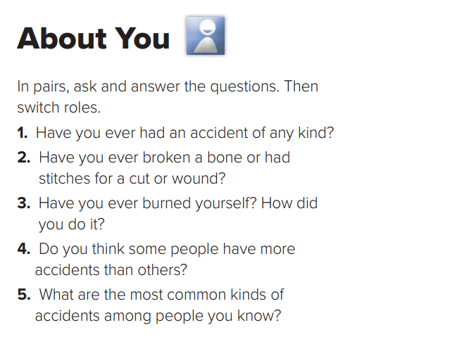

Slide 11
Open your Student’s book at page: 9

Slide 12
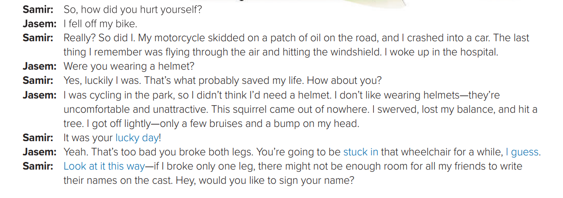
What happened to Jasem ?
What happened to Samir’s motorcycle ?
What saved Samir’s life ?
Where was Jasem cycling ?
What made Jassim lose his balance and hit a tree ?

Slide 13
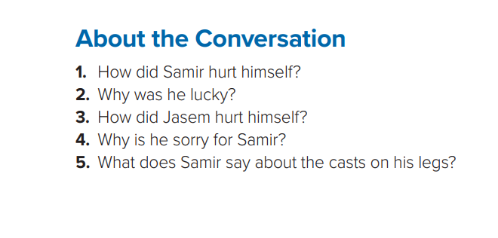
1- Samir’s motorcycle skidded on a patch of oil, and it crashed into a car.
2- He was lucky because he was wearing a helmet, and it probably saved his life.
3- Jasem was cycling in the park. A squirrel ran in front of him, so he swerved to avoid it and hit a tree.
4- Jasem is sorry for Samir because he is going to be stuck in a wheelchair for a while.
5- He says that with two casts, he has enough room for all his friends to write their names on his casts.

Slide 15
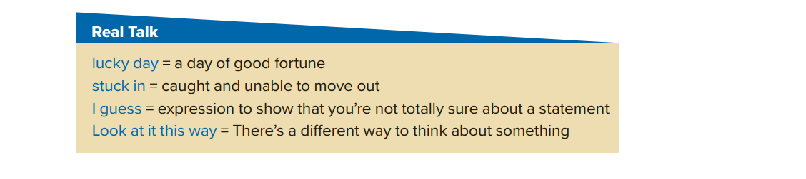
This is your lucky day. There is one ticket left .
He got stuck in a revolving door .
He didn’t see me , I guess .
Look at it this way. if you don’t do your homework , you ‘ll never pass the test.

Slide 16
