Slide 1
Mega Goal 1.2
U: 2
Take My Advice
Language in conext
&
Conversation
By: Yousef Hilal Alyazedi

Slide 2
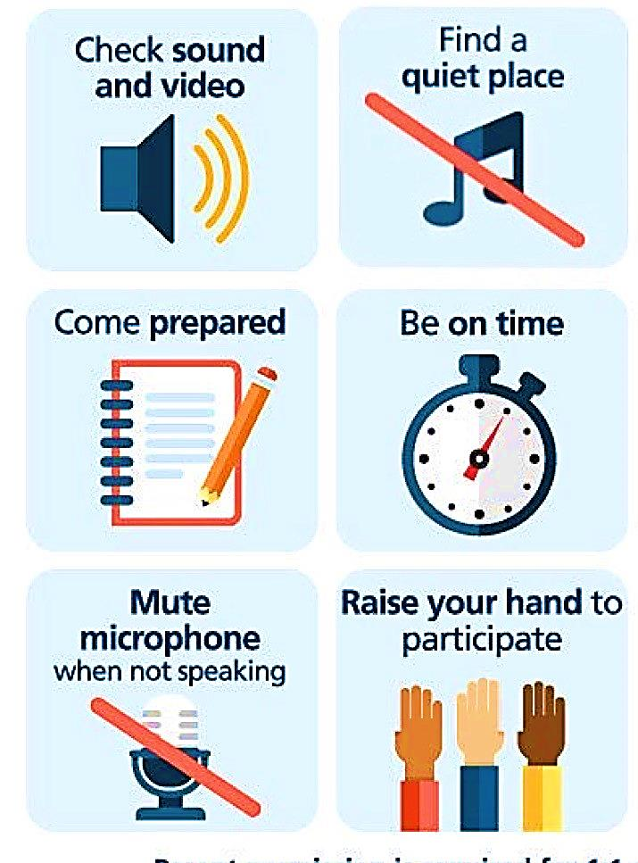
Online Classroom Rules

Slide 4
Lesson Goals
Write advice based on information .
Listen for specific information .
Recognize the stress in two and three-word verb .
Read the conversation with a partner .
Use the real talk phrases in a conversation .
Answer questions in a conversation .

Slide 5
Keep
your books
closed

Slide 6
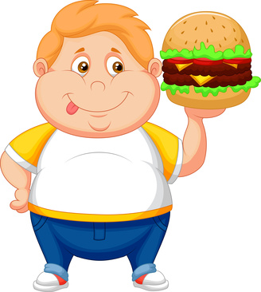
Warm Up
What is your advice to a person who is suffering from obesity ?

Slide 7
Open your Student’s book at page: 22

Slide 8
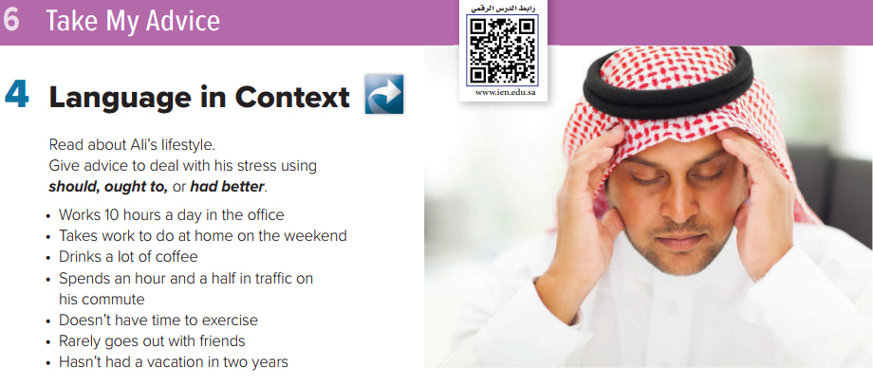
1- He ought to work less .
2- He shouldn’t work on weekends .
3- He ought not to drink a lot of coffee .
4- He should move closer to work .
5- He’d better start to exercise .
6- He should go out with friends more .
7- He’d better take a vacation .

Slide 9
You will hear a problem and the doctor’s advice .
He’s gaining weight
He should change his diet and take up sport or do some other physical activity
He has a problem with his skin
He should stop eating nuts
He feels weak every time he exercises
He should start having salt in his food again

Slide 10
When the phrasal verb is describing an action, the stress will be on the particle or the second word .
The stress on the particle helps you understand that it’s
a phrasal verb , because prepositions aren’t usually stressed

Slide 12
Open your Student’s book at page: 23

Slide 13
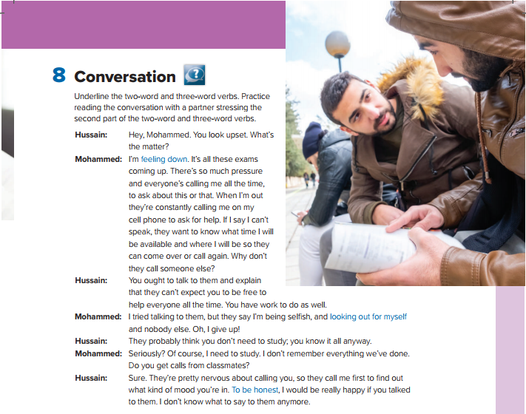
Why does Mohammed look upset ?
What do they say when Mohammed say he can’t speak ?
What’s Hussain’s advice to Mohammed?

Slide 14
I was feeling down when I didn’t get the thing I was waiting for long time .
I have to look out for myself after graduation .
To be honest, I’m just not interested in playing golf .

Slide 15
1- Mohammed’s classmates keep calling him to ask questions or ask him to help them prepare for the
exam .
2- He says that Mohammed ought to talk to their classmates and explain that he has to work / study
as well so they can’t expect him to be free all the time .
3- They think Mohammed knows everything and doesn’t need time to study .
4- To find out what kind of mood Mohammed is in before they call him .
5- He is fed up with people calling him and has run out of things to say. He wants Mohammed to
talk their classmates and explain that he needs time to prepare before the exams as well.

Slide 16
