Slide 1


Mega Goal 1.2
U: 2
Take My Advice
Listen and Discuss
By: Yousef Hilal Alyazedi

Slide 2
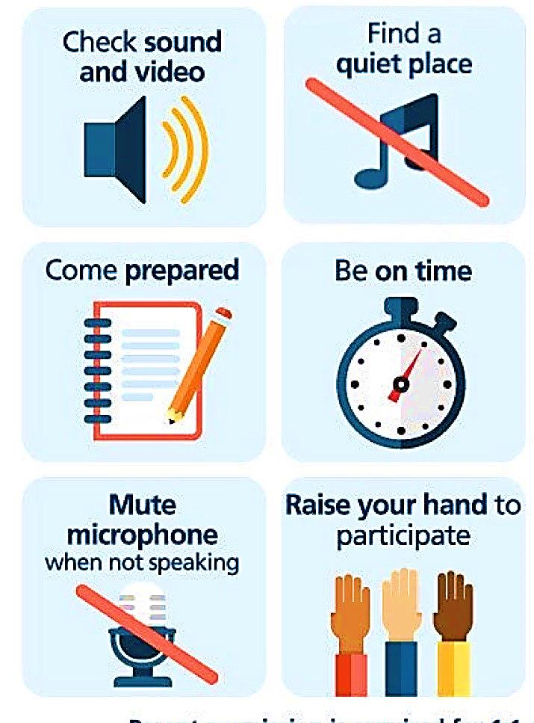
Online Classroom Rules

Slide 3

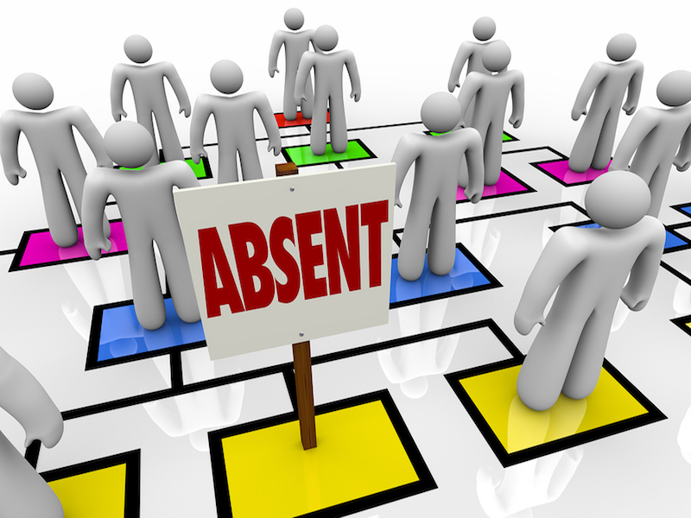

Slide 4

Lesson Goals
Name a helping website .
Listen for some advice from HelpSite4U .
Discuss each advice .
Recognize expressions of advice .
Answer some questions .

Slide 5

Keep
your books
closed

Slide 6

Warm Up
What do you do when you have problems ?
Do you go online to get advice ?

Slide 7


Open your Student’s book at page: 18

Slide 8

What is advice ?
An opinion you give someone about what they should do .

Slide 9
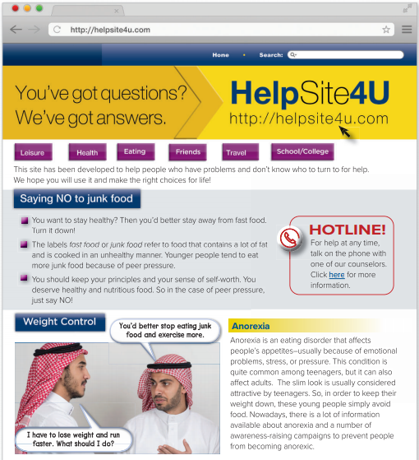

What is the main title ?
What is the address ?
What are the subtitles ?
How many photos do we have ?

Slide 10
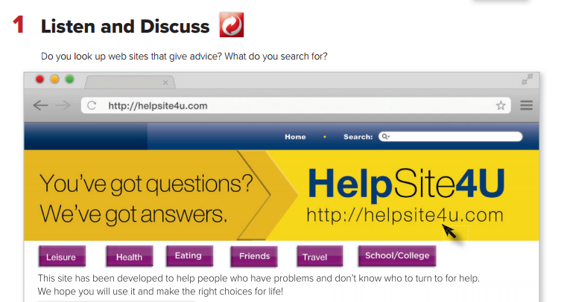
What’s the name of the website ?
Why has this site been developed ?

Slide 11
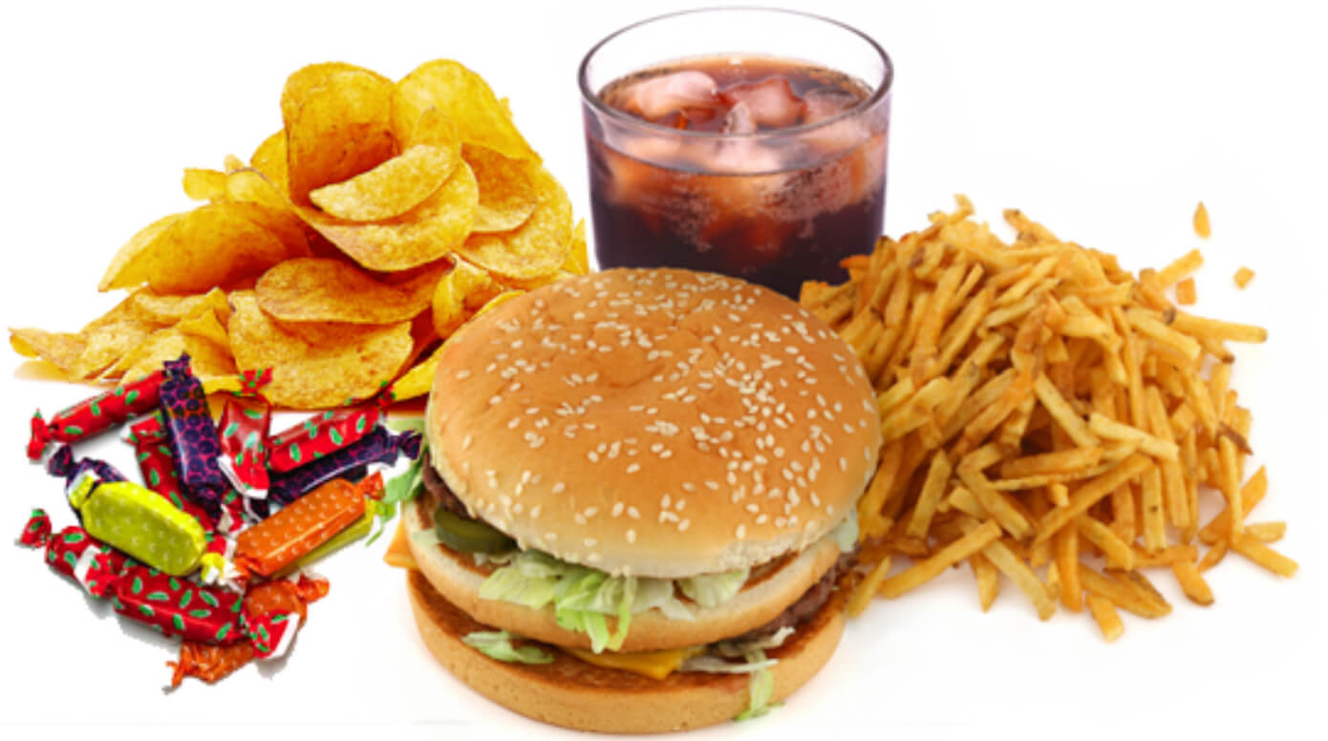
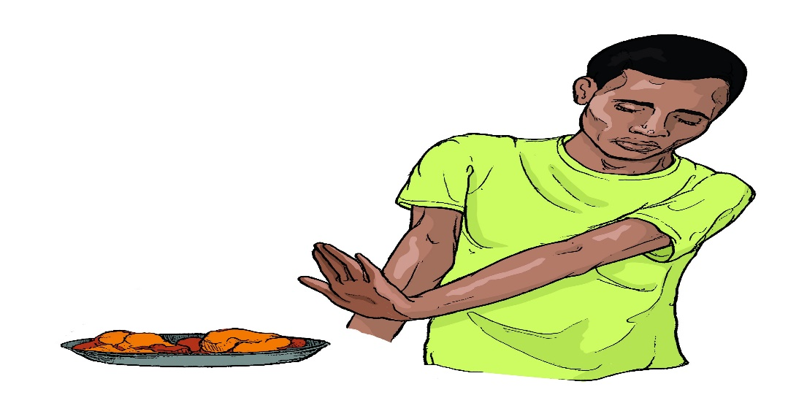
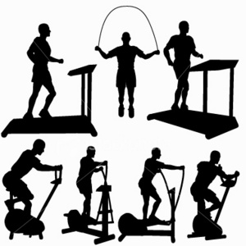
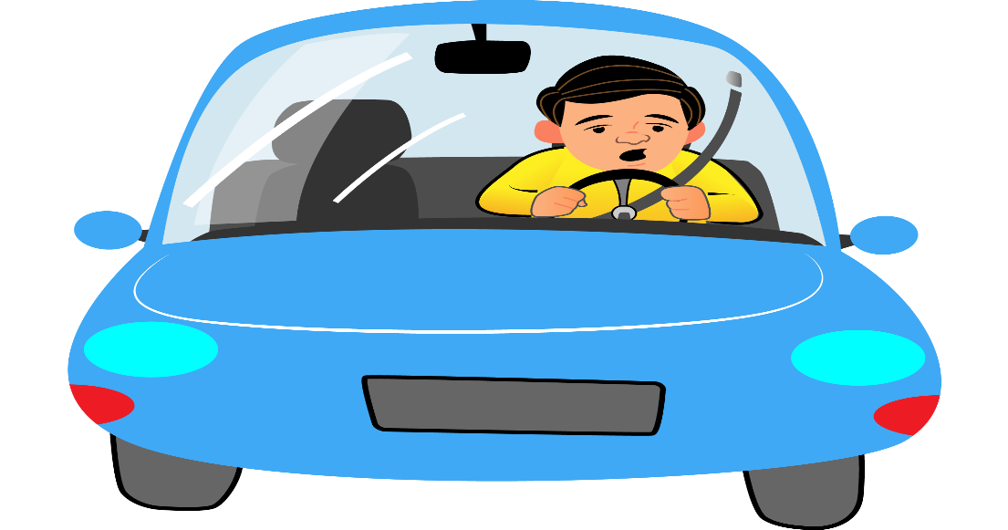
Discuss the following pictures

Slide 12
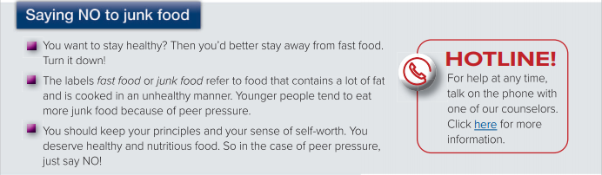
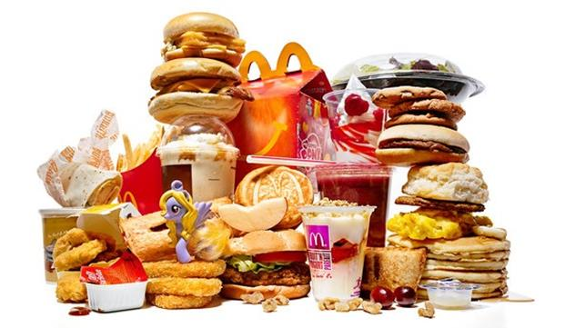
What is the best way to stay healthy ?
What is junk food ?
Why do younger people tend to eat more junk food ?
What is the given advice in the case of peer pressure ?

Slide 13
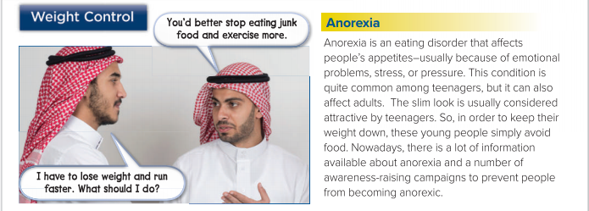
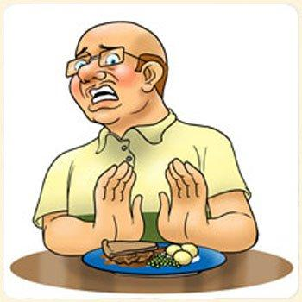
What is anorexia ?
Which people are anorexia quiet common among them ?
Why do young people simply avoid food ?
Why do we have a number of awareness-raising compaigns ?

Slide 14

are phrases or expressions that consist of a verb plus another word or two .They have different meaning to the original verbs .
turn to
go to for help
Stay away from
avoid
turn down
refuse
Keep down
control

Slide 15
Open your Student’s book at page: 19

Slide 16
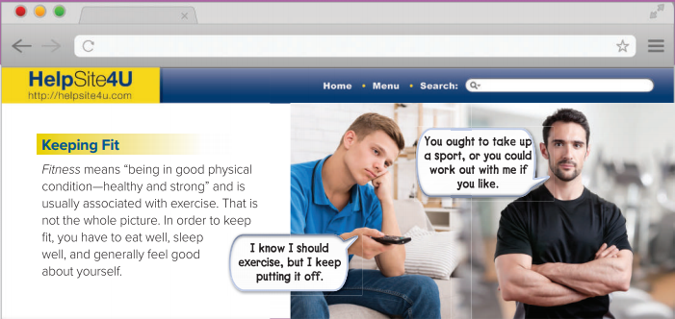

What does fitness mean ?
Does the word “ Fitness “ associate only with exercise ? Explain ?
Underline the phrasal verbs that mentioned in the dialogue .

Slide 17
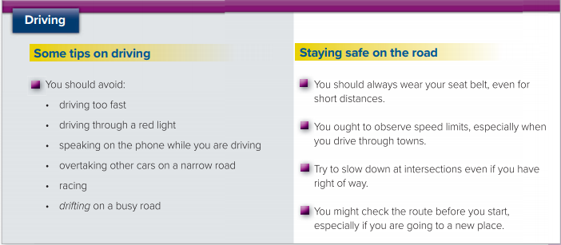
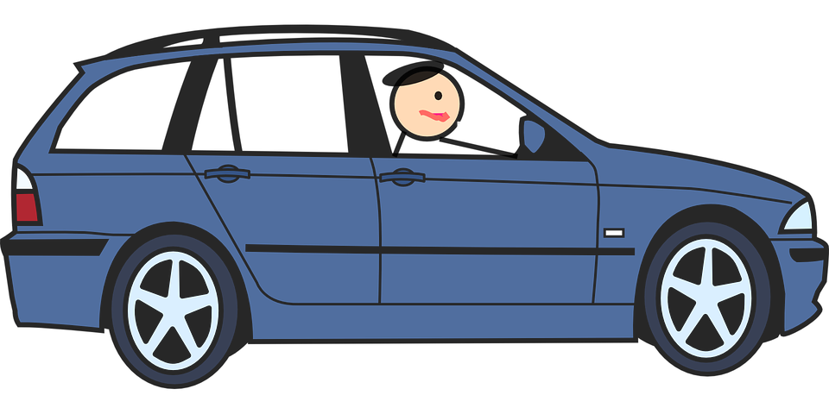
What are the tips that a driver should avoid while driving ?
What are the verbs used to give advice ?

Slide 18
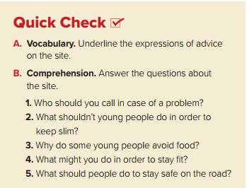

Quick Check
1- You should call the counselor on the website .
2- They shouldn’t avoid food .
3- Some young people avoid food to look attractive . .
4- You might take up a sport or work out .
5- They should wear their seat belt. They should slow down on intersections .

Slide 19

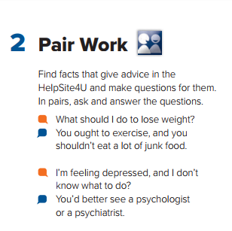

Slide 20
