Slide 1


Mega Goal 1.2
U: 2
Take my advice
Writing
By: Yousef Hilal Alyazedi

Slide 2
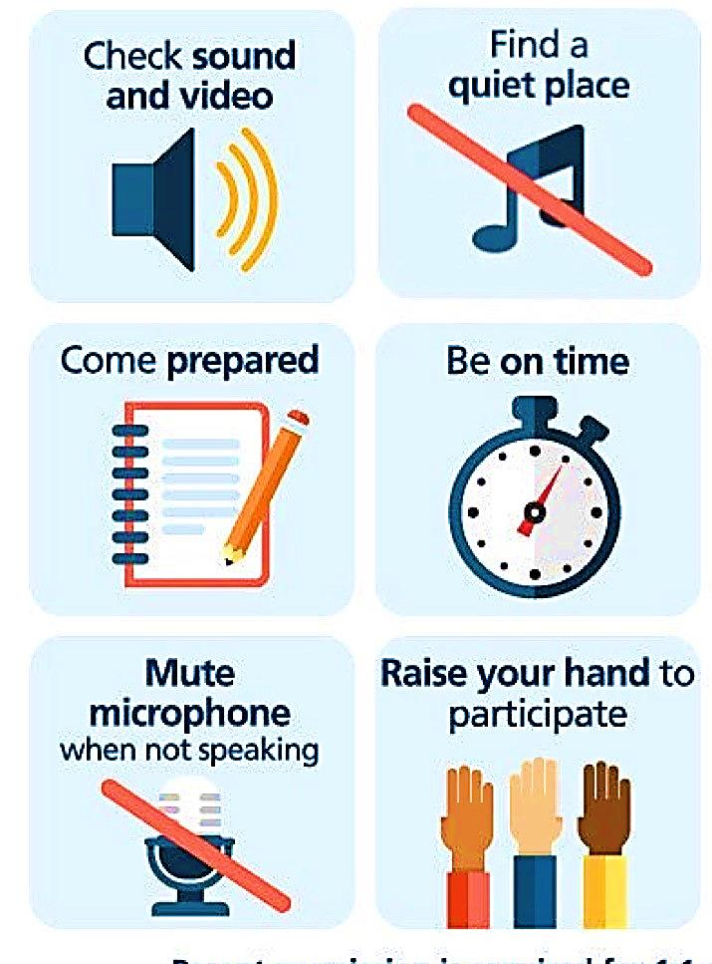
Online Classroom Rules

Slide 3



Slide 4


Lesson Goals
Ask friends about their problems .
Write notes about a letter .
Find a problem in a text.
Find advice and solution in a text .

Slide 5


Open your Student’s book at page: 26

Slide 6
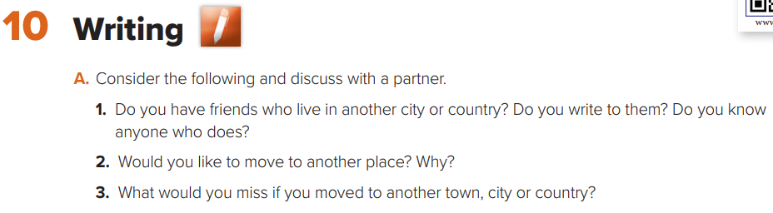
Discuss the following questions .

Slide 7


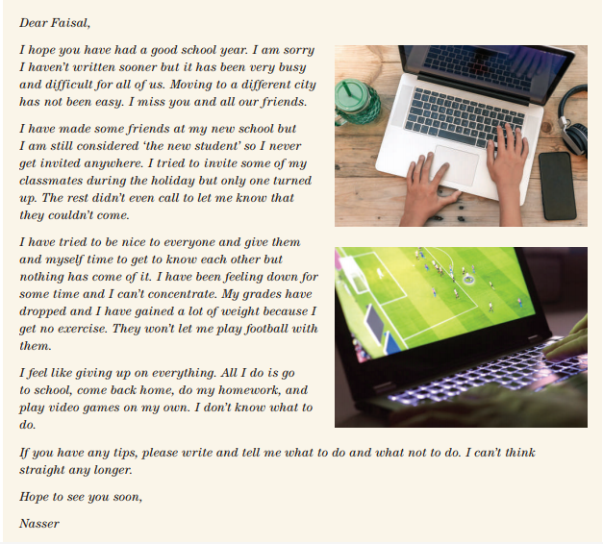


Slide 8
Who wrote the letter ?
To whom Nasser wrote the letter ?
Did he move to another city ?
What was his problem ?
Why did he gain a lot of weight ?
What do you think he means when he says “ I feel like giving up on everything “ ?

Slide 9

Could you summarize
the problem ?
He feels isolated .
He is very unhappy and bored .
He can’t concentrate not think straight .
He can’t function well at school .

Slide 10
Open your Student’s book at page: 27

Slide 11
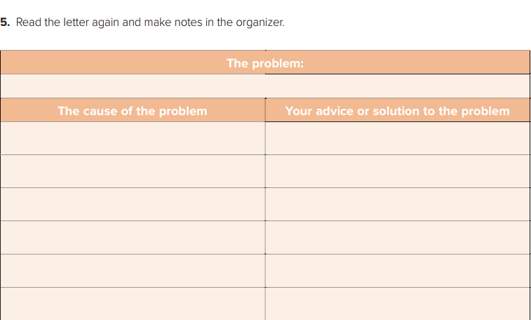
He is very unhappy and bored . He misses his friends . He can’t adjust to his new school .
He has not accepted by his classmates in his new school
He should join study groups to make new friends
He is the “ new student “
He should have a calm relaxed manner
He is not invited anywhere
He should go out with his family .
He is not allowed to participate in the football team / or play football at school
He should show them his skills in football .
He is ignored and rejected by his classmates
He should deal with them in a good way .
Only one person turned up when he invited them
He should give them time and try to invite them in a different way .

Slide 12
How to plan the letter
Introduction ( 1st paragraph ) Make the purpose of you letter clear and show understanding
Main Body ( 2nd paragraph ) Give your advice to help him/her solve the problem.
Main Body ( 3rd paragraph ) Add some more advice .
Conclusion ( 4th paragraph ) Hope everything will be fine + closing + signature

Slide 13
Dear Nasser,
I am really sorry to hear about your problem . I don’t understand why your new classmates do that with you . Please don’t worry . It will be over soon.
It’s very common for students to have problems making friends . From your letter , I would feel the same way . I recommend that you should make friends from other classes . I think you should ask the school counselor for help . You should join study groups to make new friends . How about playing football alone and show them you perfect skills ?That will attract them . You should go out with your family to spend a nice time .
Moving to a new school is not easy but it is not also difficult to deal with . That always happens to every new student . The best thing for you is to give yourself more time , be patient and you will adjust to your new school .
I hope my advice will help you . Please write to me a gain if you need more help . Take care.
Best wishes,
Yousef

Slide 14
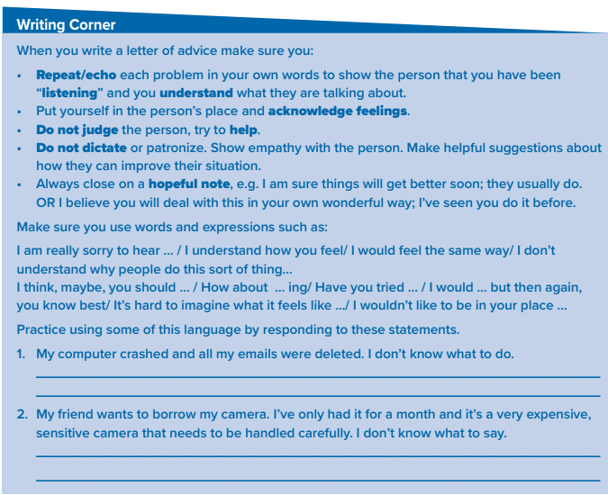
I think, maybe, you should take to an expert .
Have you tried to tell him about that . I think he will get your point.

Slide 15

The stages of the writing process
Prewriting ( planning )
Drafting
Revision
Editing ( proofreading )
Publishing

Slide 16
