Slide 1


Mega Goal 1.2
U: 2
Take My Advice
Reading
By: Yousef Hilal Alyazedi

Slide 2
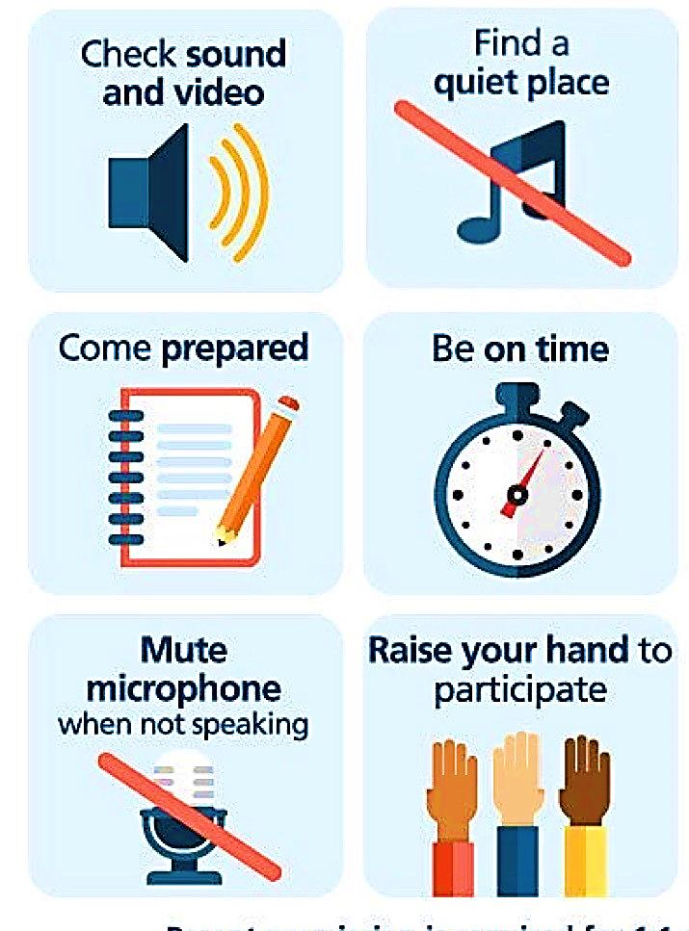
Online Classroom Rules

Slide 3

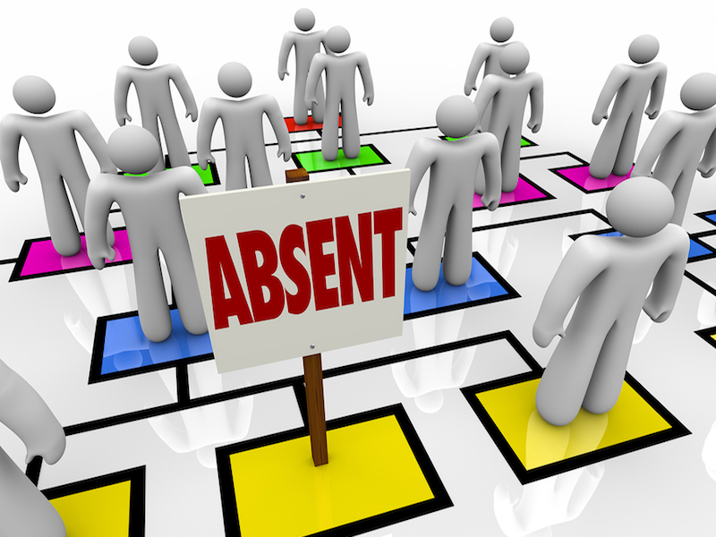

Slide 4

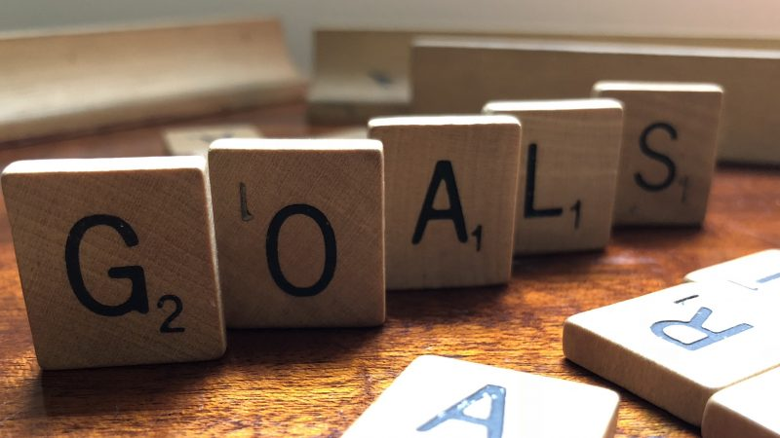
Lesson Goals
List junk food attractive ingredients .
List factors that led to addiction to junk food .
Find signs of junk food addiction .
Answer some questions .

Slide 5
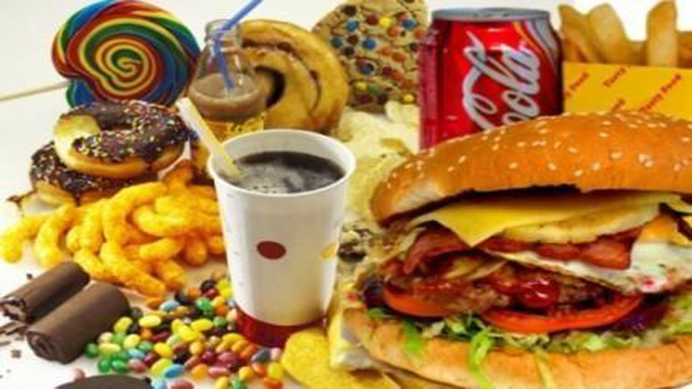

Warm Up
What is your favourite food ?
Is it healthy or not ?

Slide 6
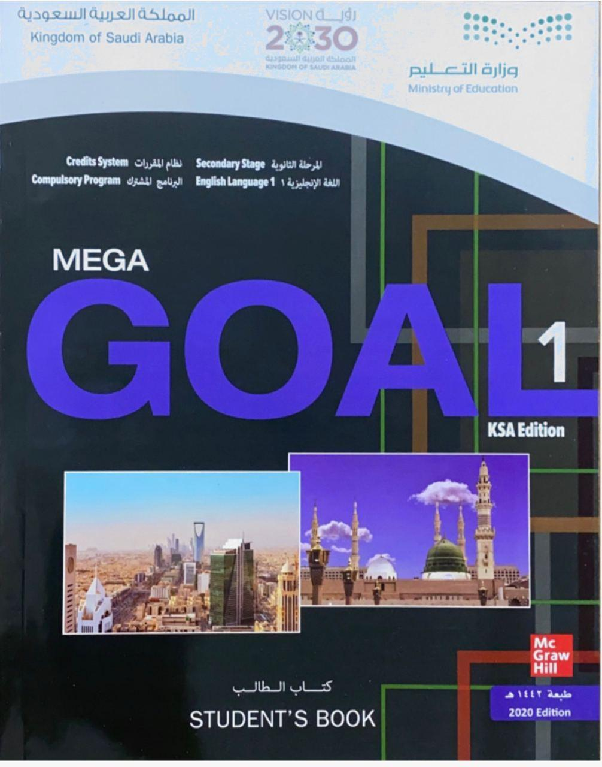

Open your Student’s book at page: 24

Slide 7

Our reading strategy is
Listing ideas about a topic

Slide 8
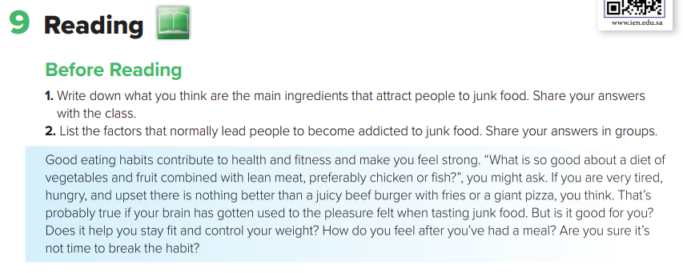
Before Reading
1- Refined carbohydrates , fat , sugar and salt .
2- Going out with friends , the delicious taste and living alone .

Slide 9
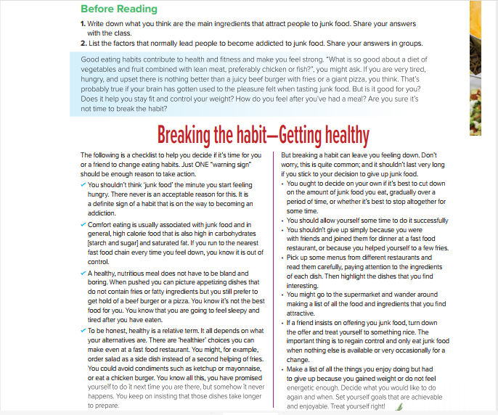


Read and Listen

Slide 10
What’s the title?
How many sections do we have ?
How many paragraphs ?

Slide 11
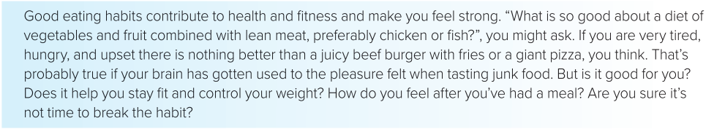
The 1st section is about
Do good eating habits contribute to health and fitness ? How
A way of eating in which you only eat certain foods to lose weight or to improve your health.
What is diet ?
What is lean meat ?
A meat that has little fat .
What is the main idea of this section ?

Slide 12

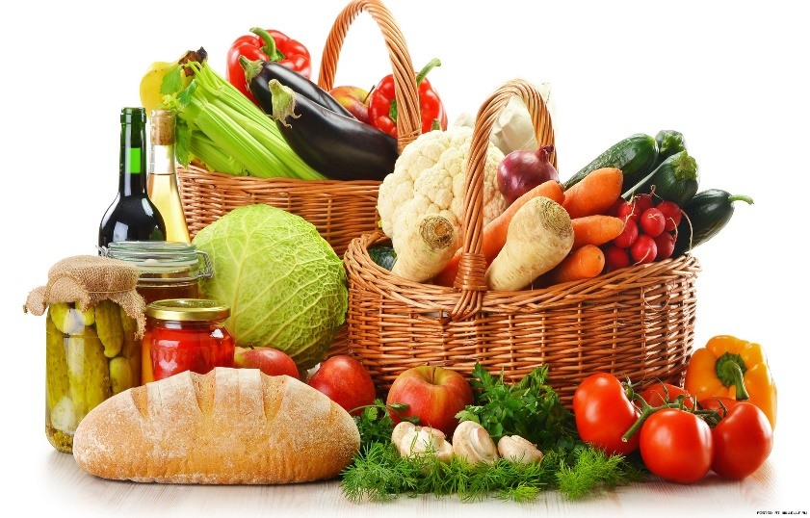
The Title
What does the title mean ?
To stop eating junk food in order to become healthy .

Slide 13
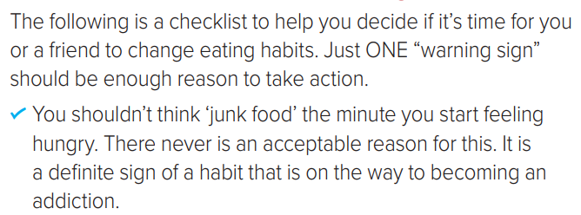
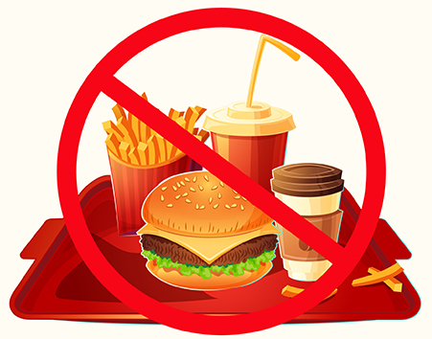
The 2nd section is “ Reasons to change eating habits “
A list that helps you to change eating habits .
What is meant by “ checklist “ ?
The first reason
What is the main idea ?

Slide 14
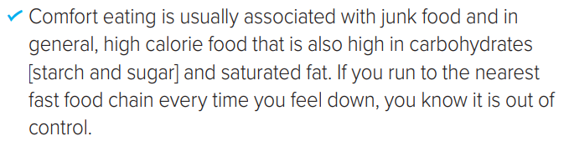
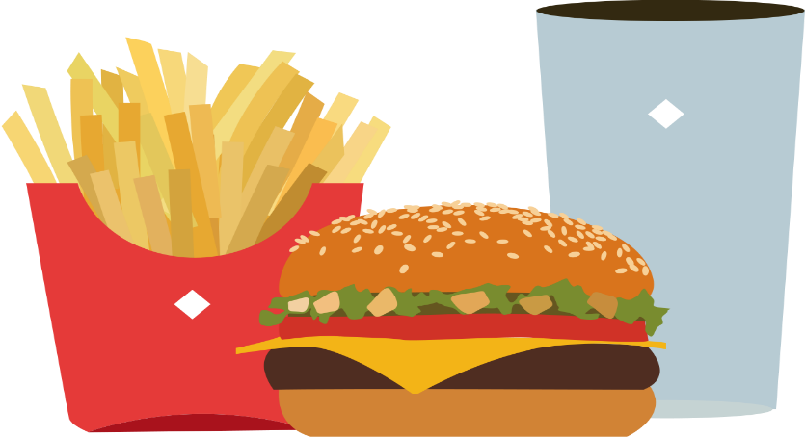
The second reason
What is comfort eating ?
having unhealthy food often when we feel stressed , bored , or lonely .
Signs of comfort eating
What is the main idea ?

Slide 15
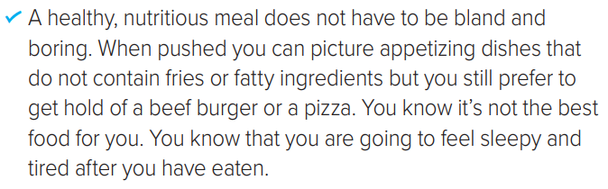
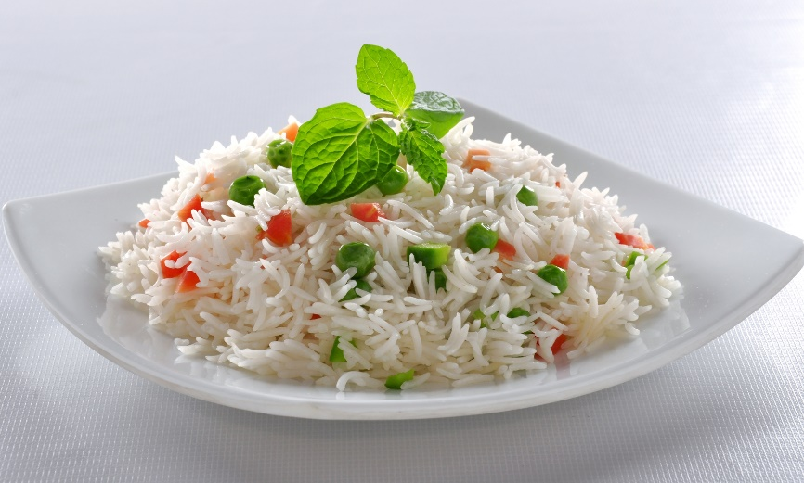
The third reason
Does a healthy and nutritious meal have to be bland and boring ?
What is a bland meal ?
A meal that has very little taste .
What can you picture when pushed to a fast food ?
What is the main idea ?

Slide 16
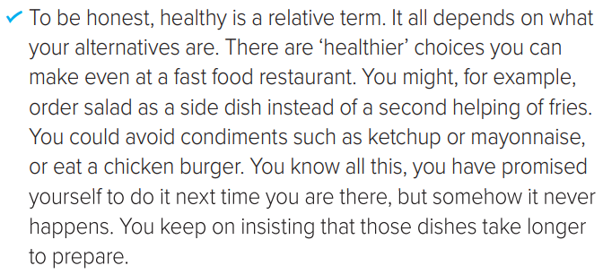
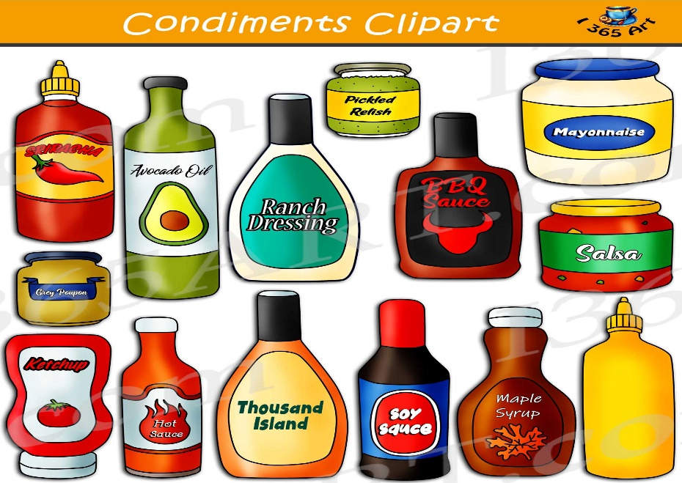
The fourth reason
How is healthy a relative term ?
What are the healthy choices that you can make at a fast food restaurant ?
Give examples of condiments ?
What is the main idea ?

Slide 17
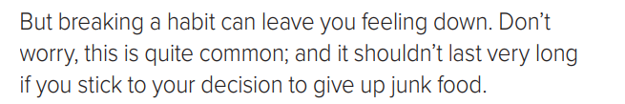
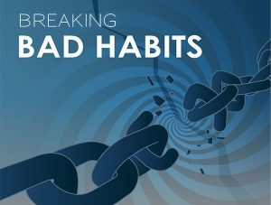
The 3rd section is “ Ways to stick to your decision “
Can breaking a habit leave you feeling down ?
What is meant by “ stick on your decision “ ?
To keep doing what you said you would do even when it’s difficult .
What is the main idea ?

Slide 18
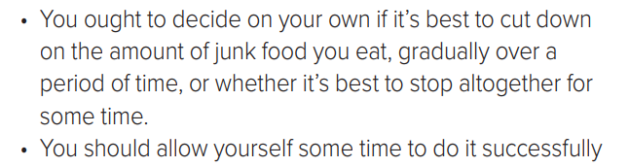
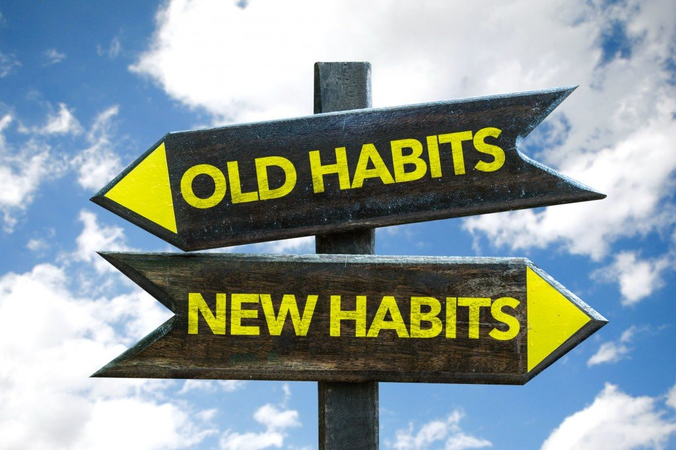
What is the best way to stop eating junk food ?
What is the main idea ?

Slide 19
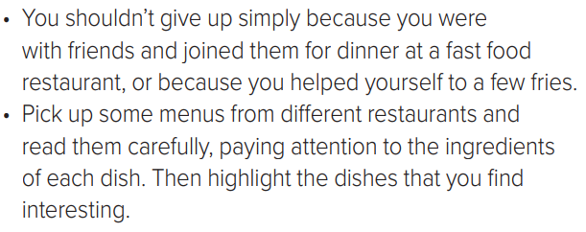
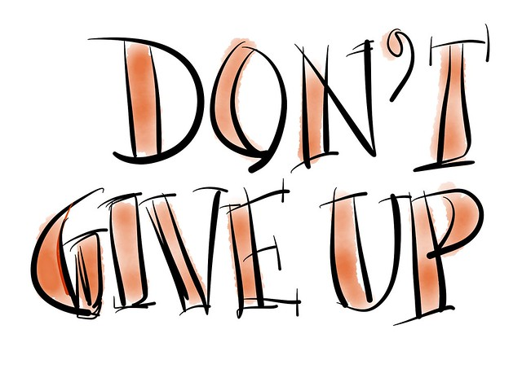
Here is another solution to find interesting dishes when you join friends at a fast food restaurant ?

Slide 20
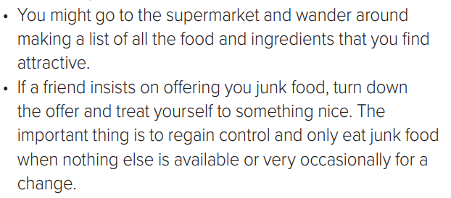

What do you do if a friend insist on offering
You junk food ?
What’s the reason behind turning down the offer ?

Slide 21
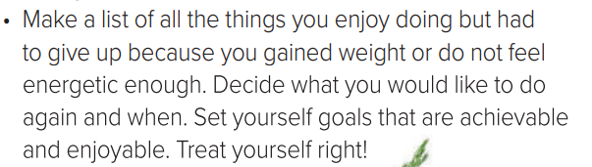

Setting your goals is the first step to achieve what you decide to do .

Slide 22
Open your Student’s book at page: 25

Slide 23
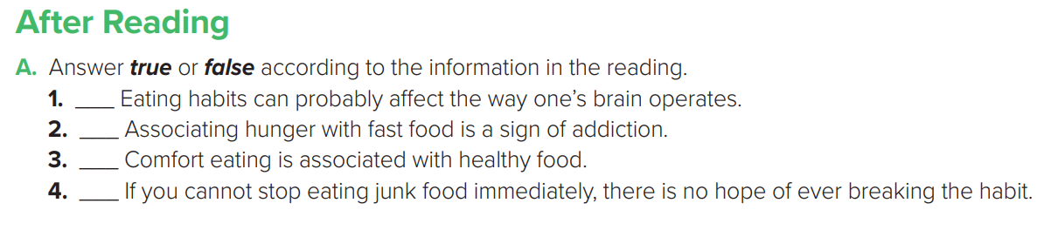
true
true
false
false

Slide 24
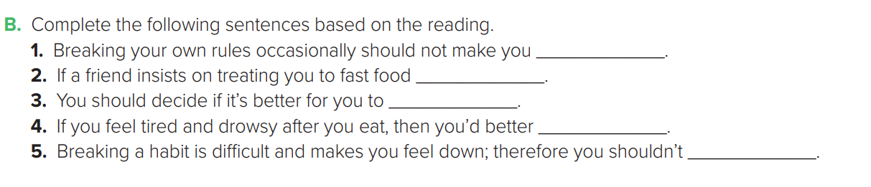
worry
turn down the offer
cut down food gradually or altogether
change your eating habits
give up

Slide 25
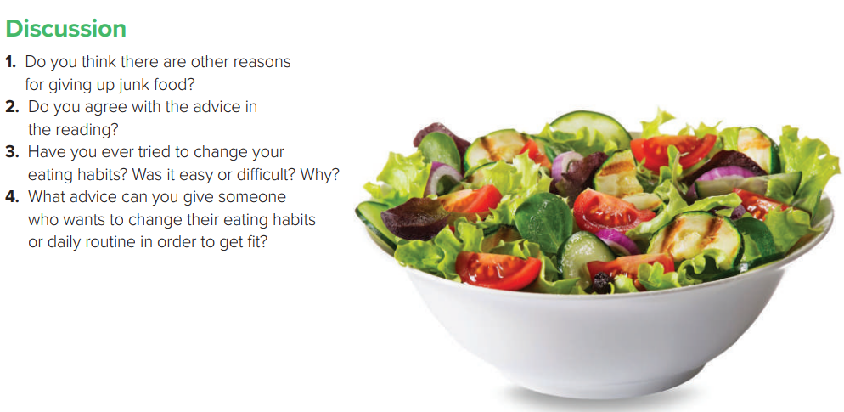

Slide 26


