Slide 1


Slide 2
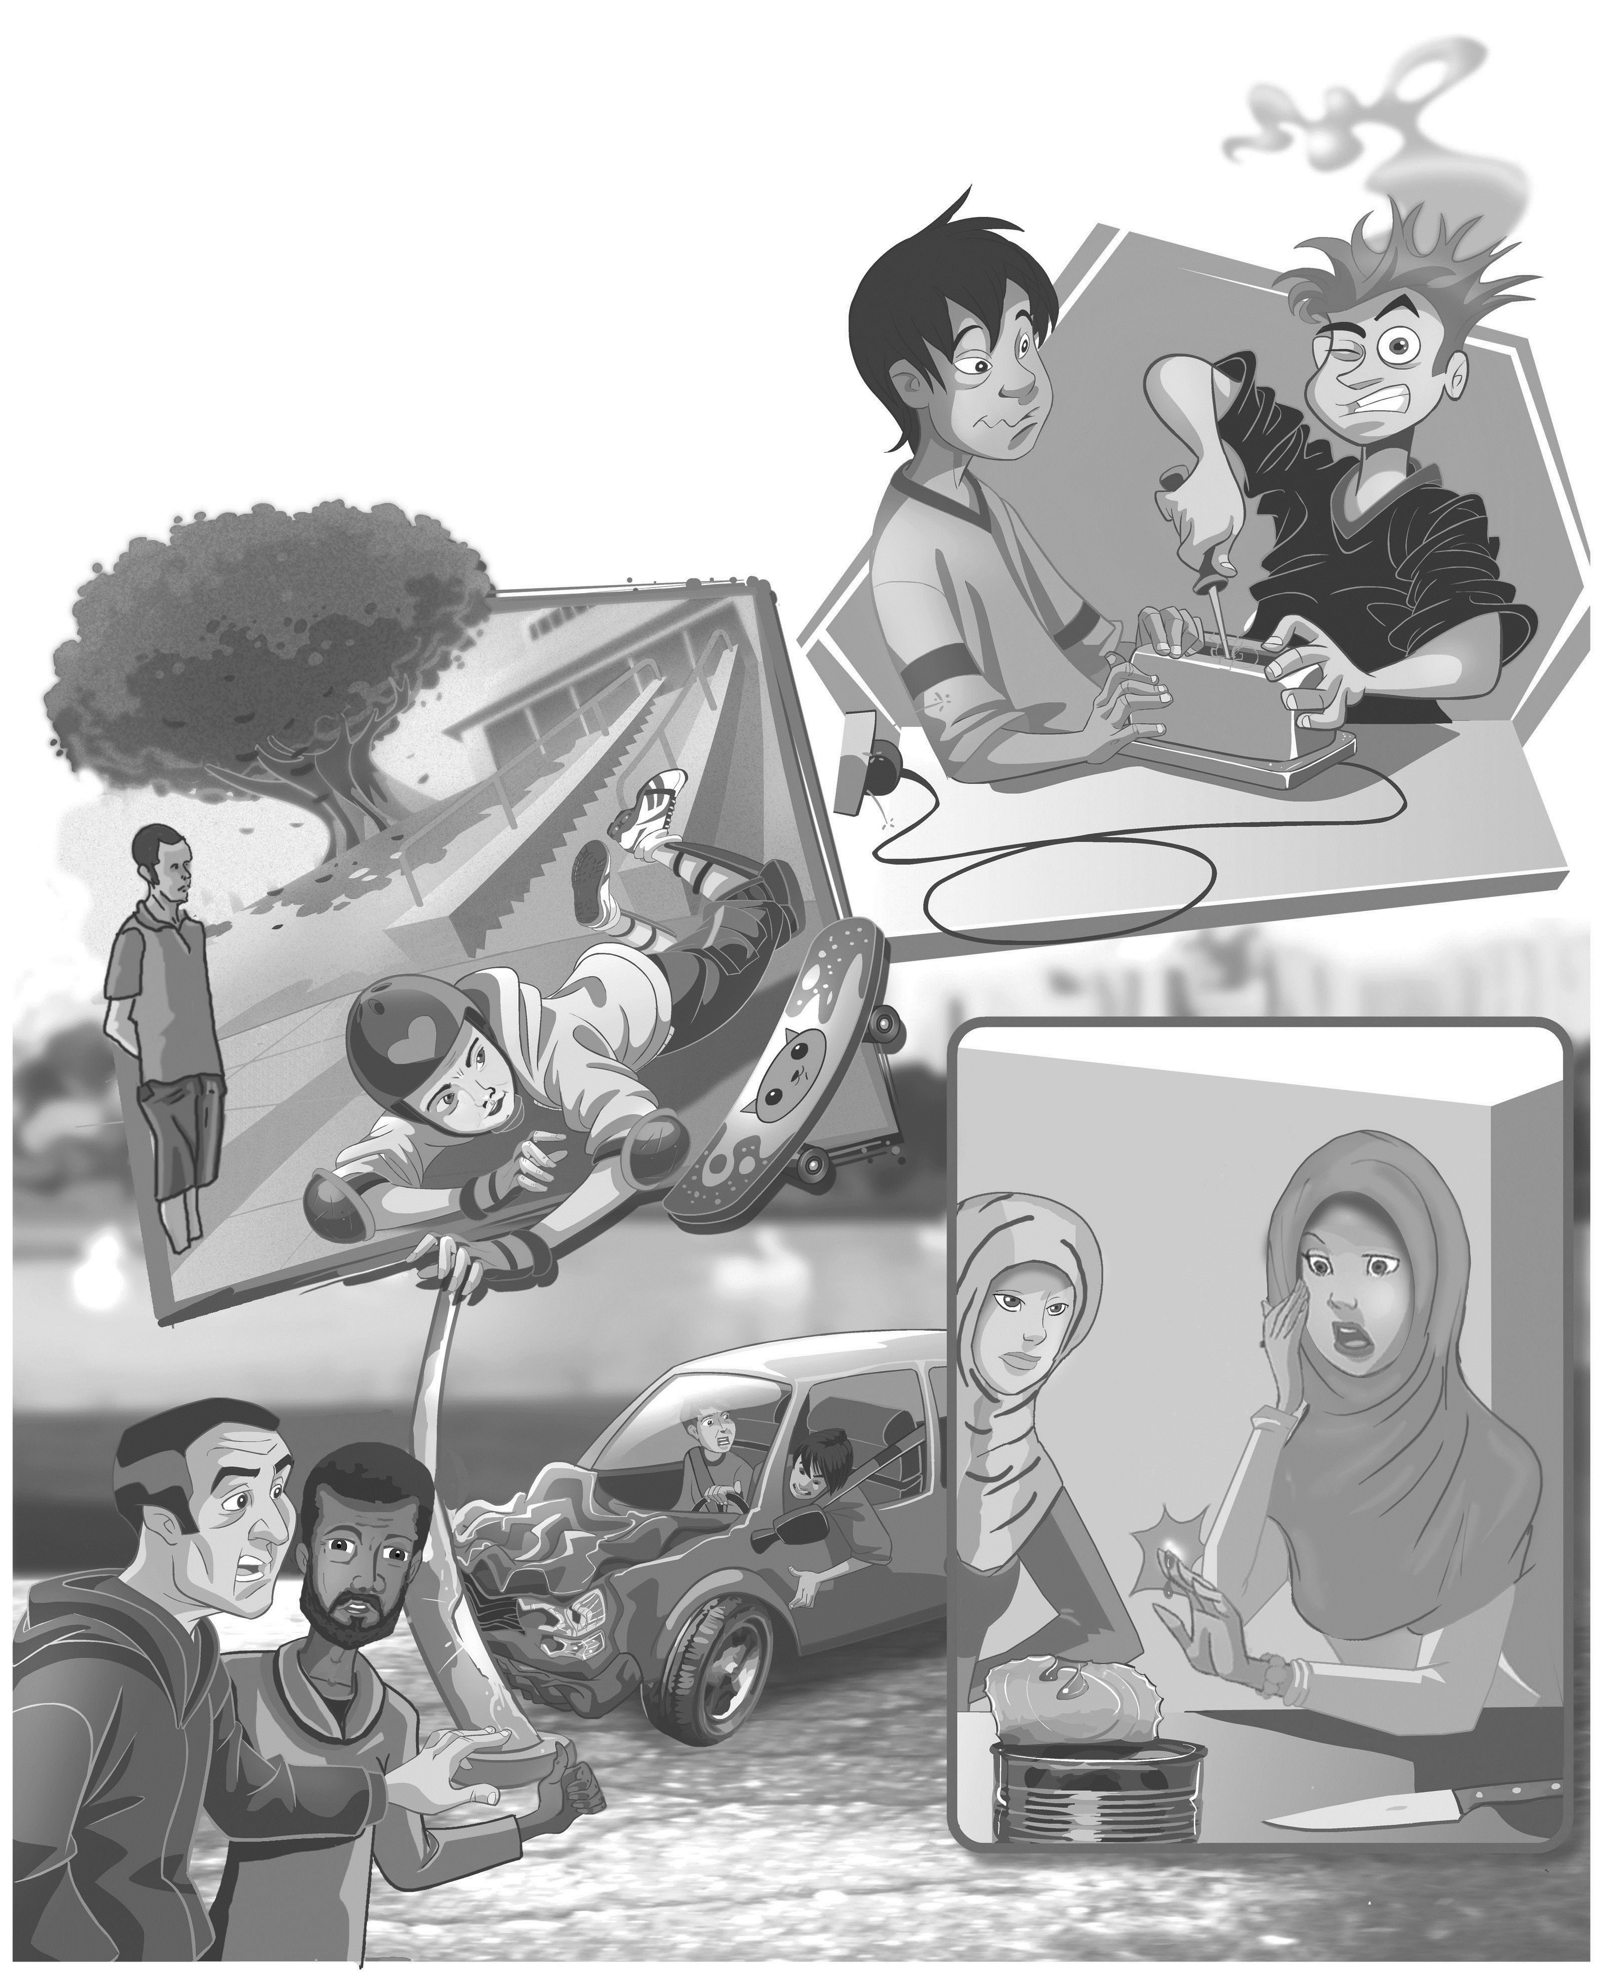
Unit-1-
Did You Hurt Yourself
3-Grammar

Slide 3

Objectives
1
Complete the sentences with correct reflexive pronouns a& so and because
2
Join the sentences with so and because
3
Practice using so , because and reflexive pronouns in sentences
4
Practice cause & effect sentences

Slide 4
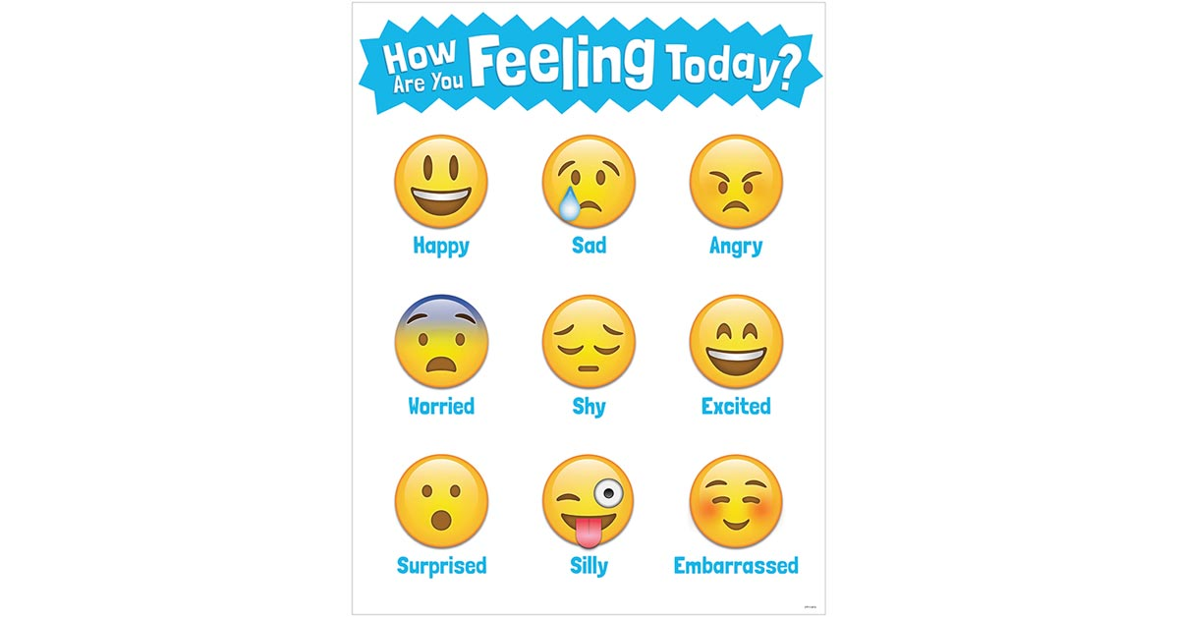

Slide 5
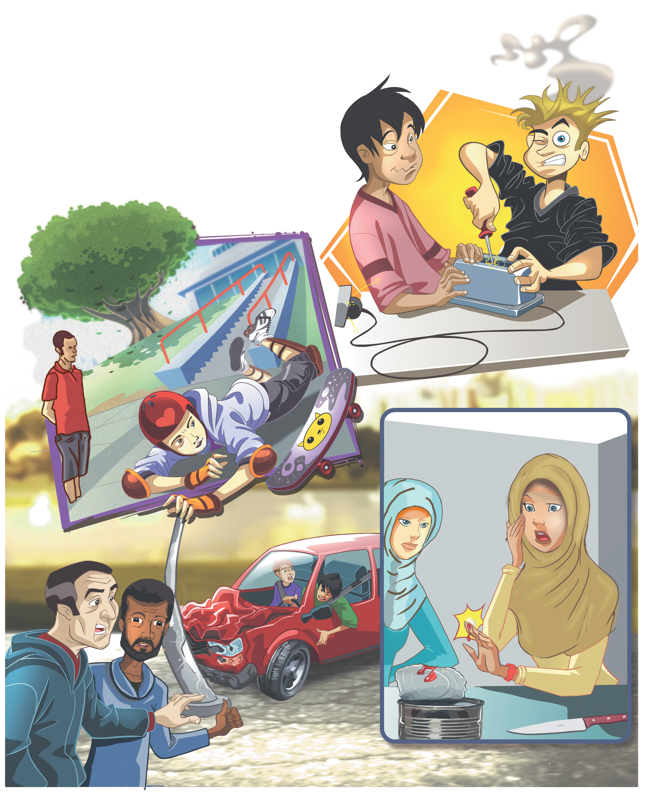
Read the Most Common Causes of Automobile Crashes again. Find examples of: self/selves; because/so; neither/so. Think of how each one is used
Ouch! I got a shock
Did you hurt yourself?
So did I.
No, I’m OK.
They didn’t turn off the electricity, so they got a shock.
How did you cut yourself?
Because he was wearing a helmet and knee pads, he didn’t hurt himself.
The driver wasn’t injured
Neither was his friend.
I tried to open the can with a knife
They didn’t hurt themselves because they were wearing seat belts.
If you use the wrong equipment, you might hurt yourself.

Slide 6
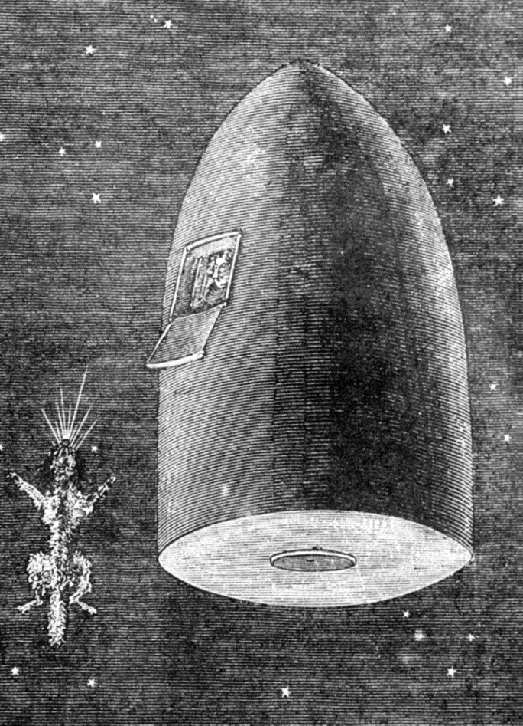
Reflexive Pronouns
Use the reflexive pronoun when the subject and the object are the same person.
self
My
Him
Her
Your
it
Your
Our
Their
self
self
self
self
selves
He likes to look at himself in the mirror
selves
Note: You can also use the reflexive pronoun to say that you did something without anyone’s help: I fixed the hair dryer myself
selves

Slide 7



Slide 8


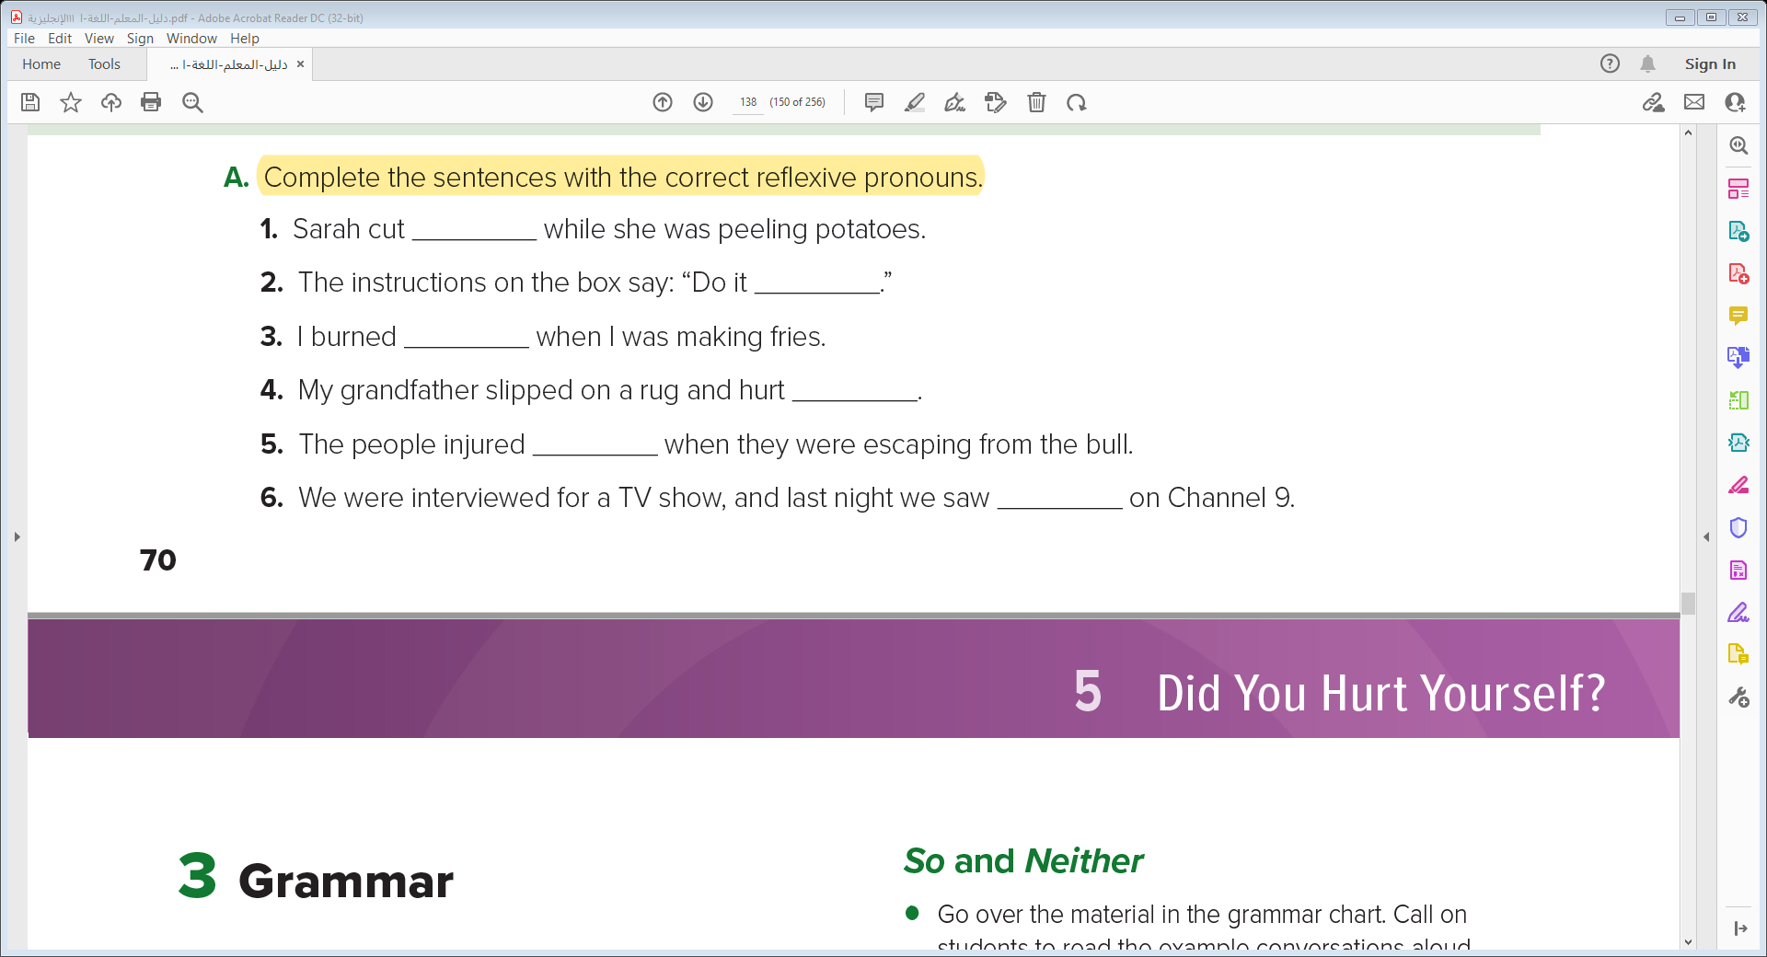
herself
yourself
. myself
himself
themselves
ourselves

Slide 9

Because versus So
The subordinate conjunction
introduces a reason—it tells why.
. Most accidents happen because people don’t pay attention.
The conjunction
introduces a consequence or a result
He didn’t turn off the electricity, so he got a shock

Slide 11
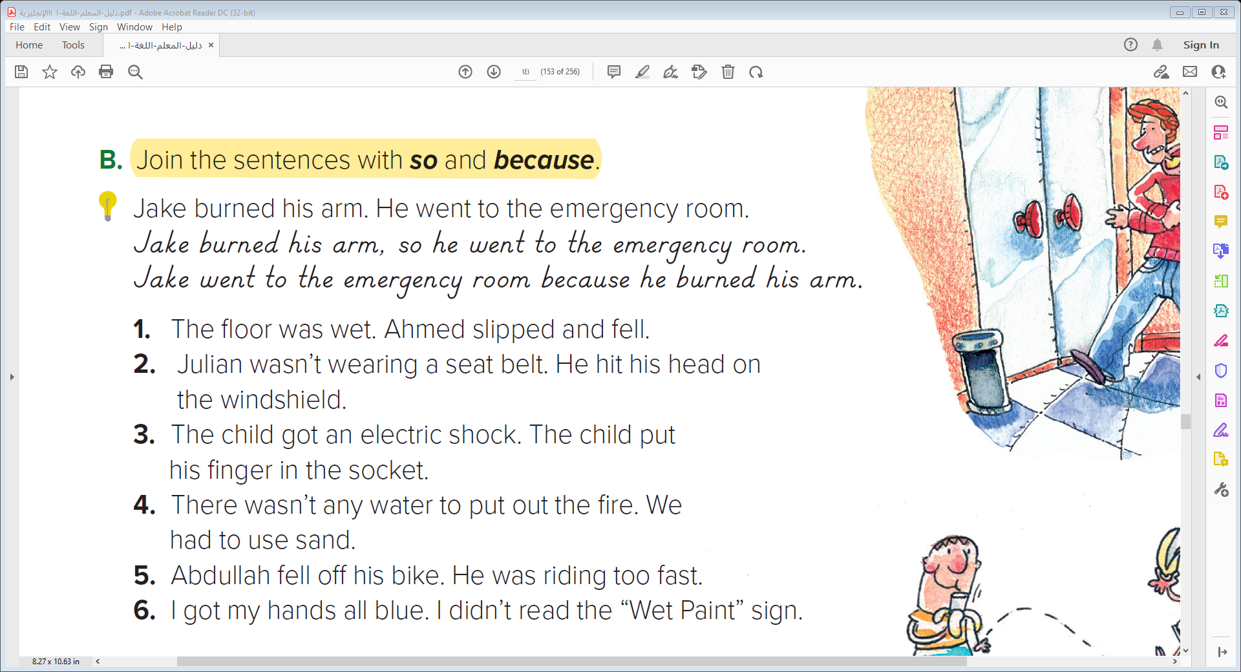

Slide 12
1. The floor was wet. Ahmed slipped and fell.
The floor was wet, so Ahmed slipped and fell.
Ahmed slipped and fell because the floor was wet. a
2. Julian wasn’t wearing a seat belt. He hit his head on the windshield.
Julian wasn’t wearing a seat belt, so he hit his head on the windshield.
Julian hit his head on the windshield because he wasn’t wearing a seat belt
3. The child got an electric shock. The child put his finger in the socket.
The child put his finger in the socket, so he got an electric shock.
The child got an electric shock because he put his finger in the socket.
4. There wasn’t any water to put out the fire. We had to use sand.
There wasn’t any water to put out the fire, so we had to use sand.
We had to use sand because there wasn’t any water to put out the fire..
5. Abdullah fell off his bike. He was riding too fast.
Abdullah was riding too fast, so he fell off his bike.
Abdullah fell off his bike because he was riding too fast.
6. I got my hands all blue. I didn’t read the “Wet Paint” sign.
I didn’t read the “Wet Paint” sign, so I got my hands all blue.
I got my hands all blue because I didn’t read the “Wet Paint” sign.

Slide 13

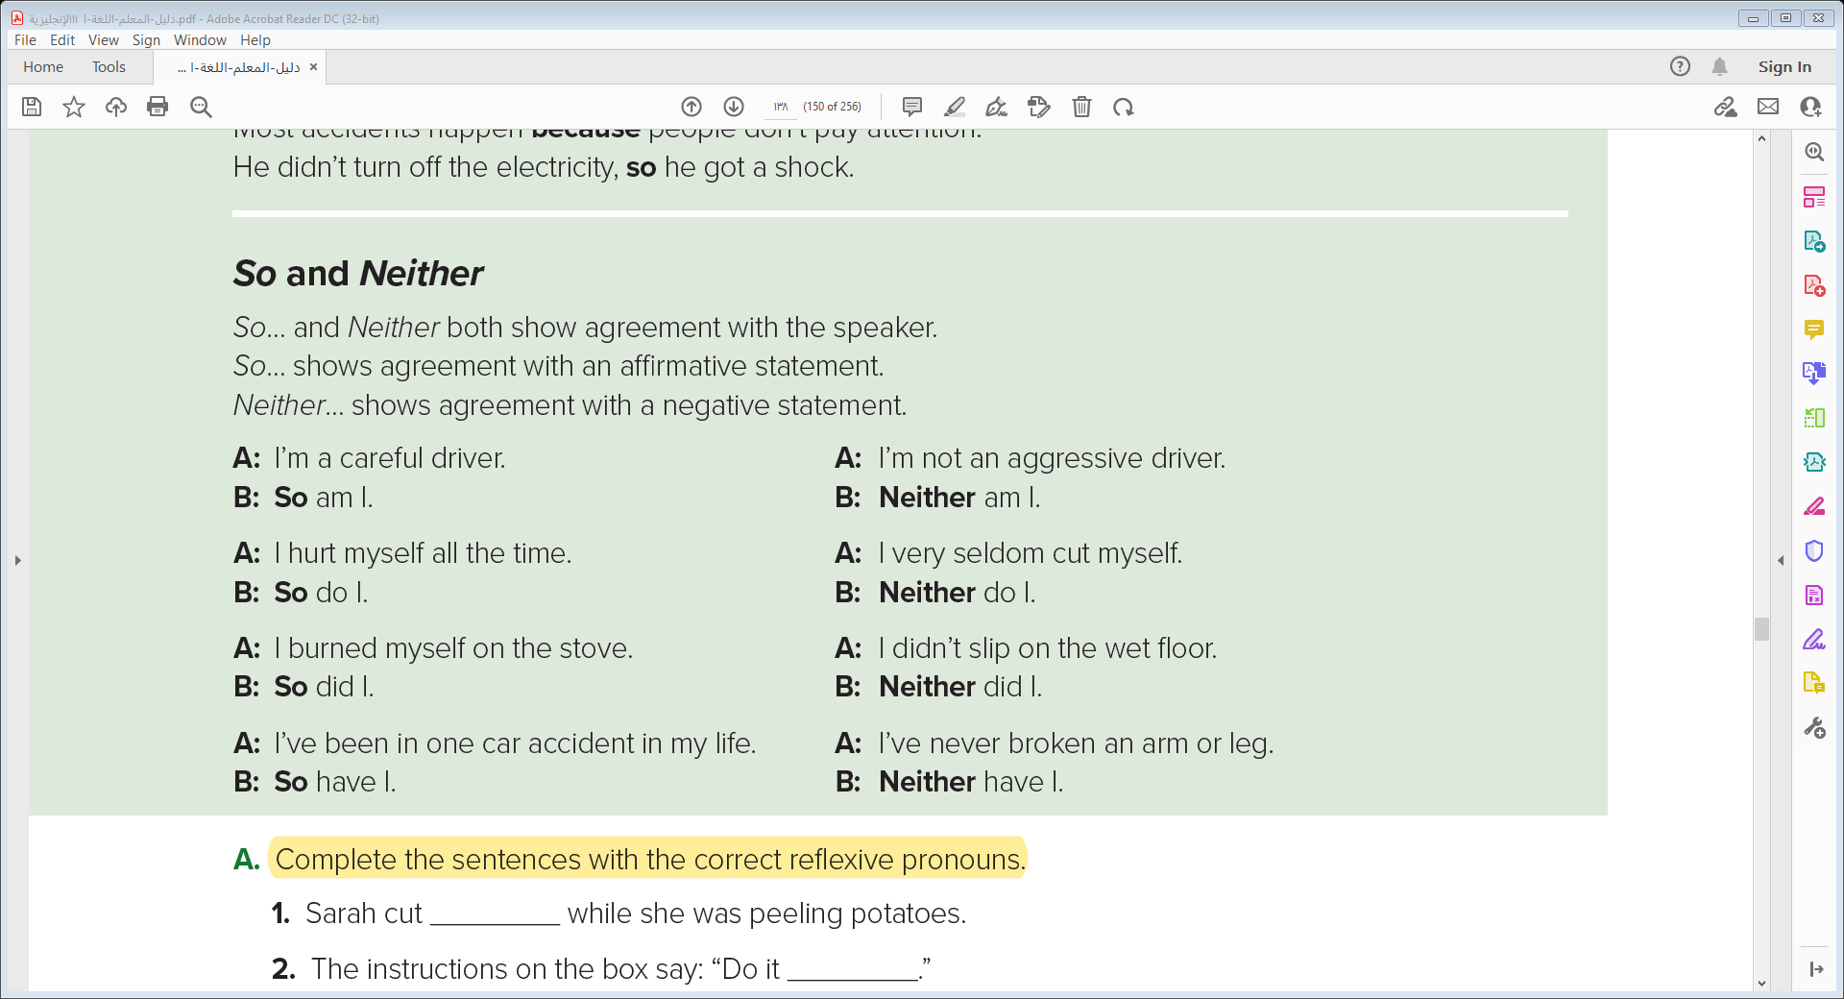
So… and Neither both show agreement with the speaker
So and Neither
So… shows agreement with an affirmative statement
Neither… shows agreement with a negative statement

Slide 14
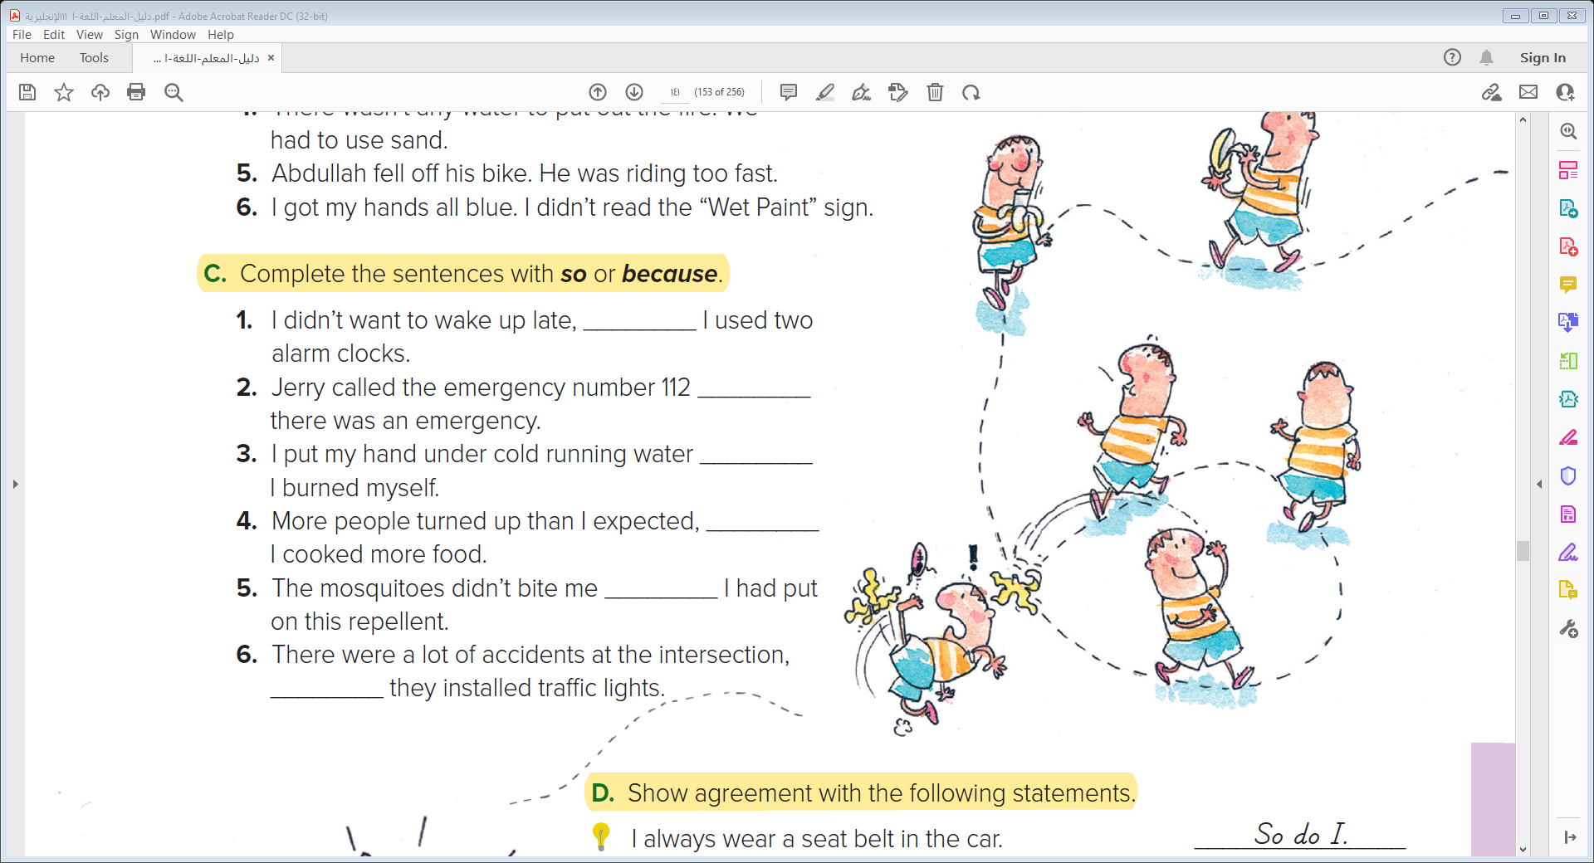
so
because
because
so
because
so

Slide 15
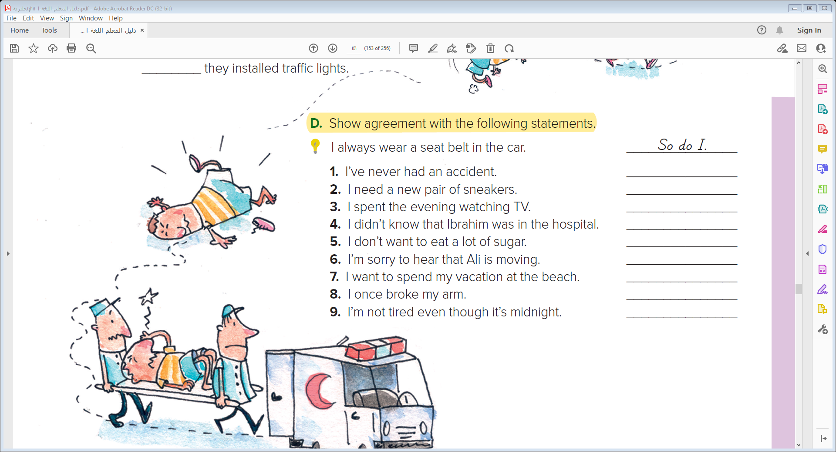
Neither have I
So do I
So did I
Neither did I
Neither do I
So am I
So do I
So did I
Neither am I

Slide 16

Exit Ticket
Form a dialogue Using the grammar you learned today

Slide 17


