Slide 1
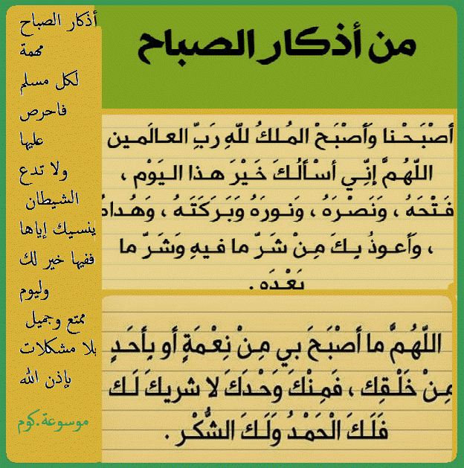

Slide 2

GOOD MORNING

Slide 3
Unit-1-
Did You Hurt Yourself
Done by Hissah Alotaibi

Slide 4
11 Form , Meaning & Function

Slide 5
Modal Auxiliaries
Adverbs of Manner
Prepositions of Place
Imperatives for Directions

Slide 6
Objectives
1
– Use “ must “ to talk about laws and rules .
– Use “ should “ to give advice .
– Express attitudes using adverbs of manner .
– Describe position using prepositions of place .
use “ imperatives “ for directions
Share positively in pair work .
2
3
4
5
6

Slide 7
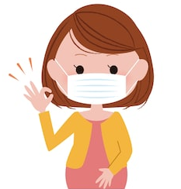
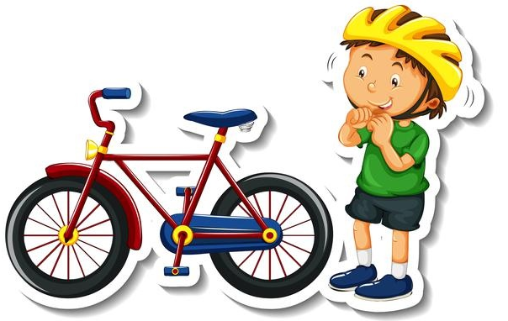
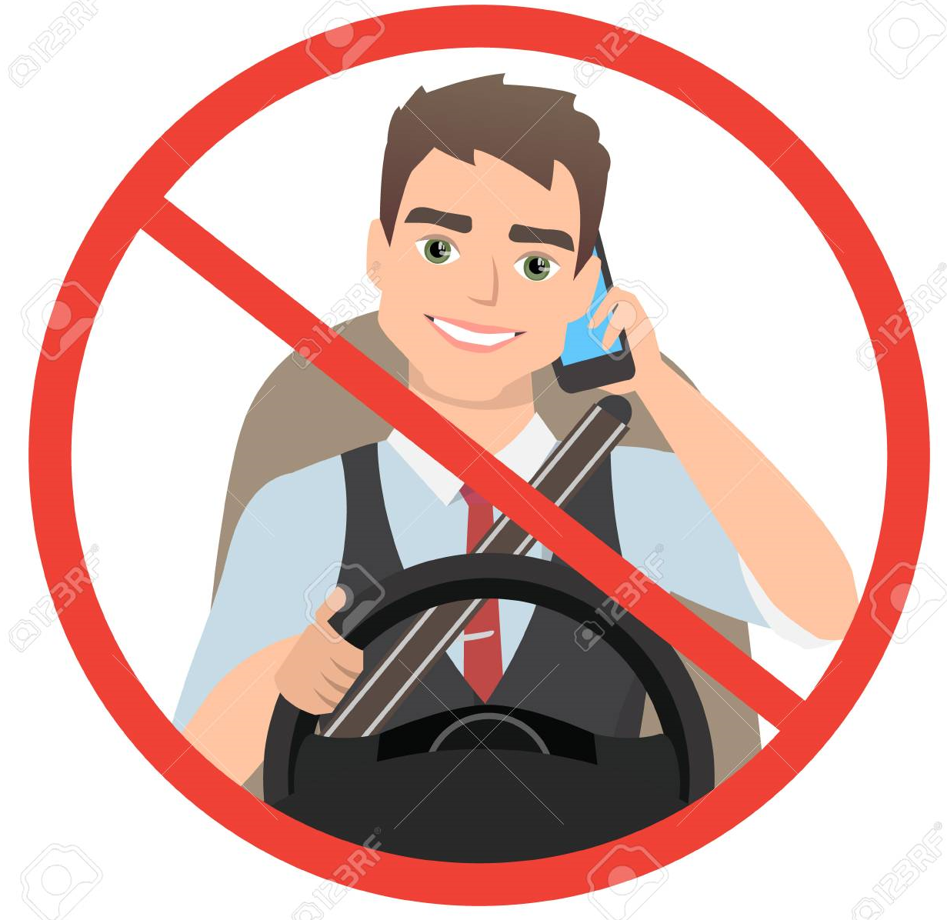
Modal Auxiliaries
You must wear a mask
Use must to talk about laws and rules
You must wear a helmet
You must not use phone while driving
Notes:
Language Builder
Must expresses obligation, or something that is necessary
and very important to do. There is no choice. For example:
I must get the brakes on the car fixed.
In American English, have to is used more often than must
to express obligation or necessity.
Must not (or mustn’t) means that something is prohibited.
This means that there is no choice. For example: You must
not jump a red light. It’s illegal.
Should is used to give advice or make a suggestion that
might be important, but it gives the listener the choice to
take the advice or not. For example: You should study hard
when you are young.

Slide 8
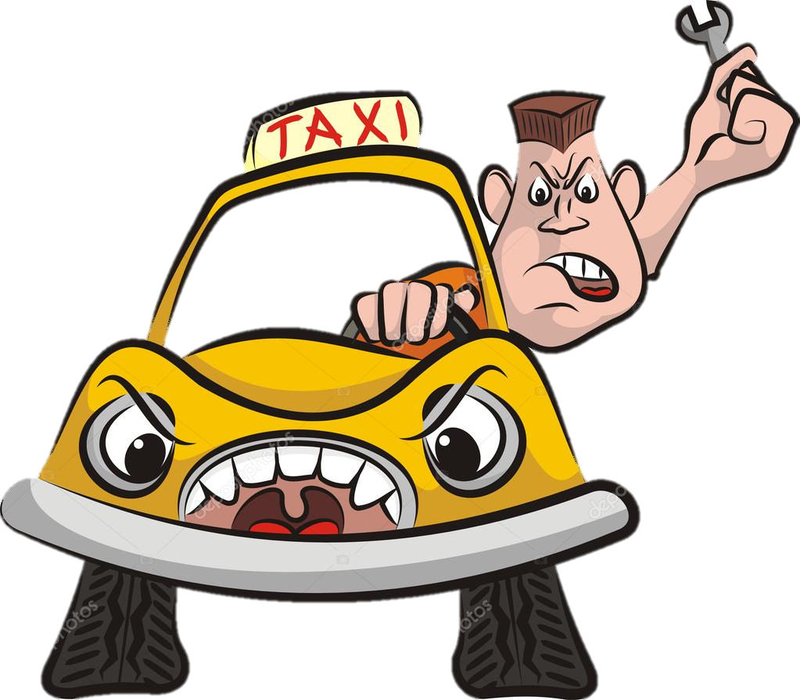
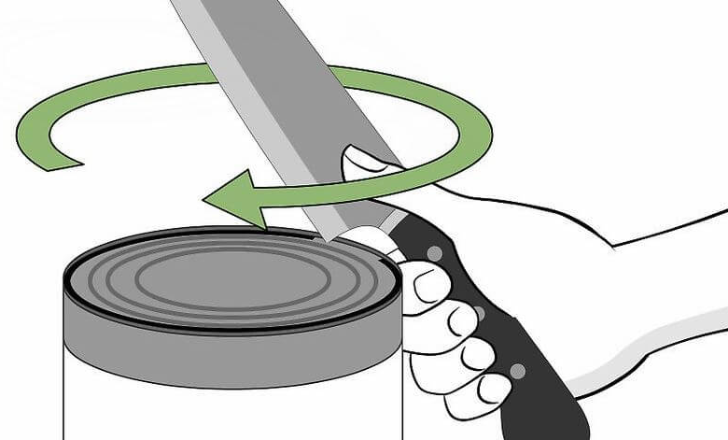
You should avoid aggressive driver
Use should to give advice
You should not use a knife to open a can
Note: Must is stronger than should. It has a more formal or official tone.

Slide 9
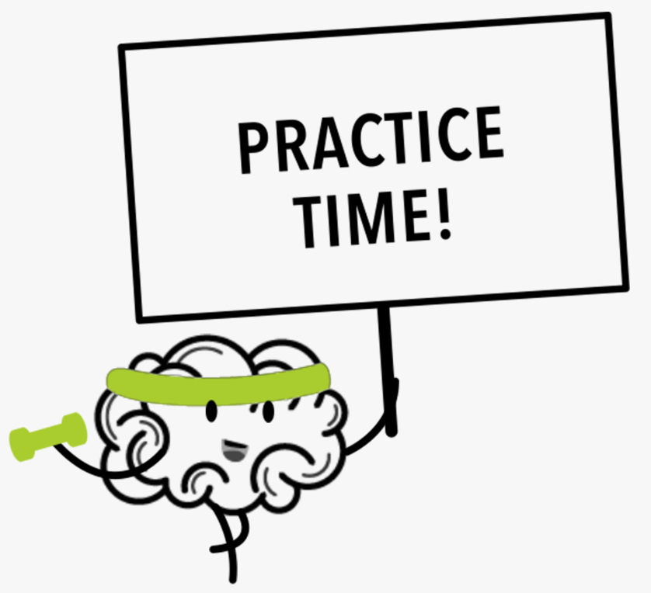

Slide 10

Complete the conversations using your own words.
1. A: I’m afraid I’m running out of gas.
B: You should .
2. A: The sign says 80 kilometers per hour, and I’m doing 90.
B: Then you must .
3. A: I’m lost. I don’t know which way to go.
B: I think we should .
4. A: I need to make a phone call. Can you please hold the steering wheel?
B: You must not .
5. A: The car won’t start. There’s plenty of gas. I wonder what the problem is.
B: You should
stop at a gas station
slow down
ask someone
speak on the phone when driving
take it to a car mechanic

Slide 11
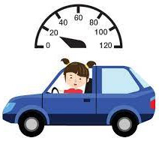
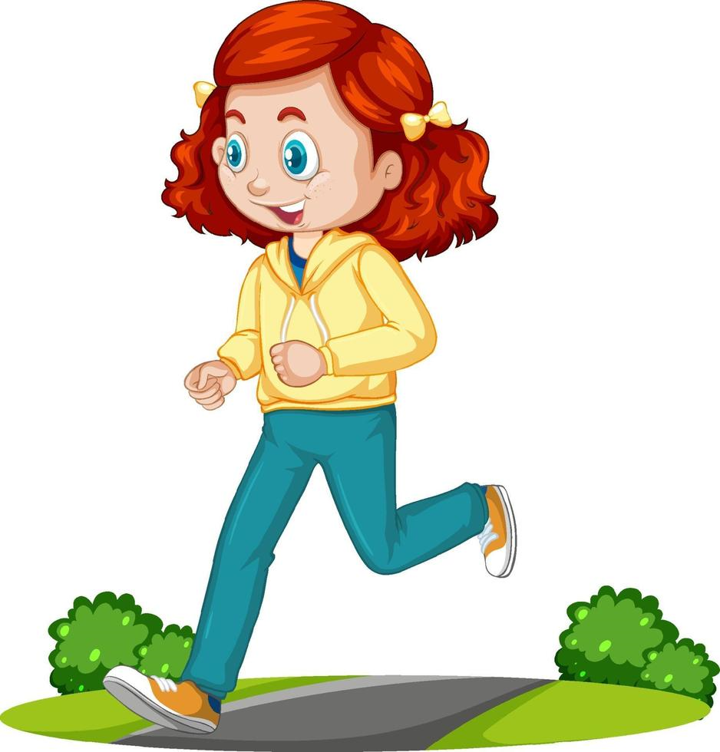
Adverbs of Manner
Adverbs of manner are normally formed by adding -ly to an adjective. They express how something is done.
How did she drive? She drove slowly
How did she walk? She walked quickly

Slide 12

Adjectives that end in l double the l: careful carefully
Note: Sometimes an adjective and an adverb have the same form:
He’s a fast driver. He drives fast. He’s a hard worker. He works hard.
The adverb form of good is well: He’s a good player. He plays well.

Slide 14
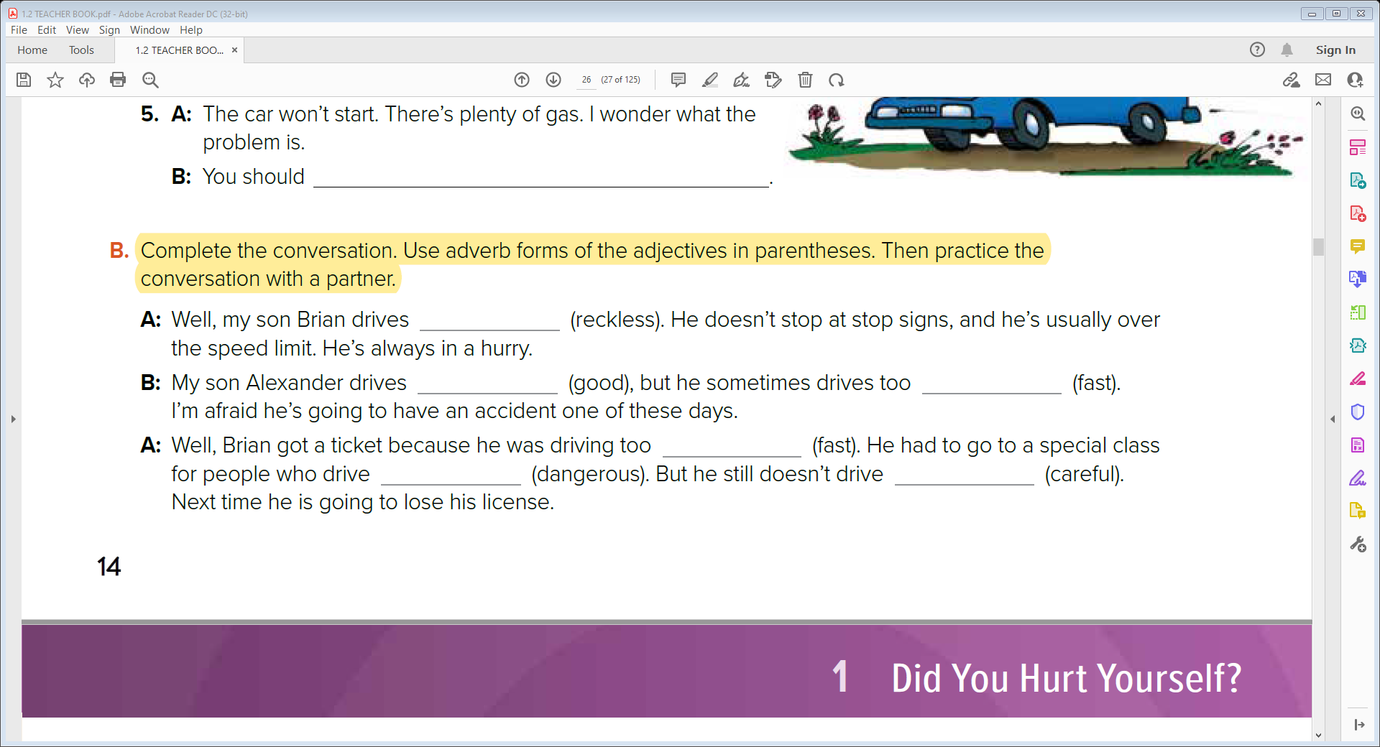
recklessly
well
fast
fast
dangerously
carefully

Slide 15
Prepositions of Place
The park is across from
the school.
The bank is between the post
office and the restaurant..
The pharmacy is next to the
bookstore
The museum is near the hotel.
The airport is far from town
The bus stop is on the corner

Slide 16
Note: To describe where we live, we can use the following prepositions:
I live in Jeddah. (city) I live on the third floor. (building)
I live on First Avenue. (street)

Slide 17


Imperatives for Directions
Take a left./ Turn left Go straight. Take a right / Turn right.

Slide 19
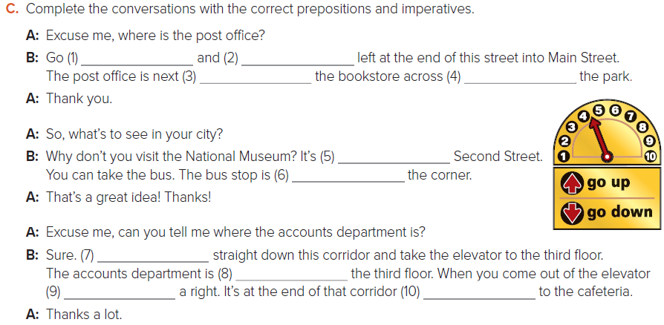
C. Complete the conversations with the correct prepositions and imperatives.
A: Excuse me, where is the post office?
B: Go (1) ……………………….and (2)…………………….. left at the end of this street into Main Street.
The post office is next (3)………………………… the bookstore across (4)…………………… the park.
A: Thank you.
A: So, what’s to see in your city?
B: Why don’t you visit the National Museum? It’s (5)………………………… Second Street.
You can take the bus. The bus stop is (6)………………………….. the corner.
A: That’s a great idea! Thanks!
A: Excuse me, can you tell me where the accounts department is?
B: Sure. (7) ……………………………straight down this corridor and take the elevator to the third floor.
The accounts department is (8) …………………………………..the third floor. When you come out of the elevator
(9) ………………………..a right. It’s at the end of that corridor (10) ………………………….to the cafeteria.
A: Thanks a lot.
straight
turn
to
from
on
on
on
Go
on
on
take
next

Slide 20


