Slide 1
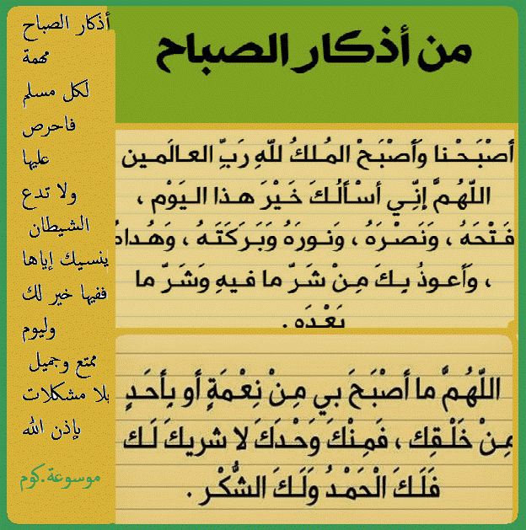

Slide 2
GOOD MORNING

Slide 3
Unit-1-
Did You Hurt Yourself
Done by Hissah Alotaibi

Slide 4
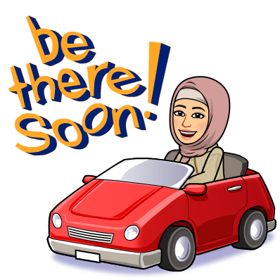
10 Writing

Slide 5
Objectives
Students will be able to
1
Write information about accident.
Analyze an accident article to its main points
Answer the questions
highlight the words and/or phrases that give information
Share positively in pair work
Justify their answers about accidents
2
3
4
5
6

Slide 6

Warm Up
Have ever witnessed an accident
or been in one?
why accidents happen?
How they feel when they
are driving ?

Slide 7
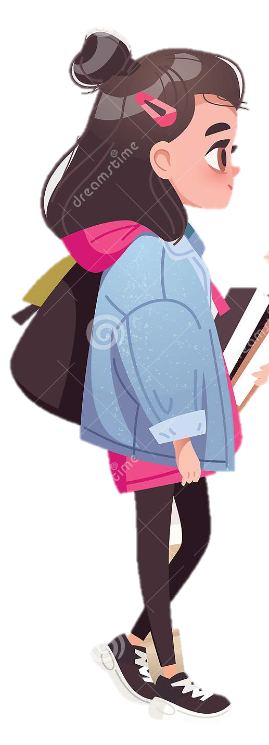
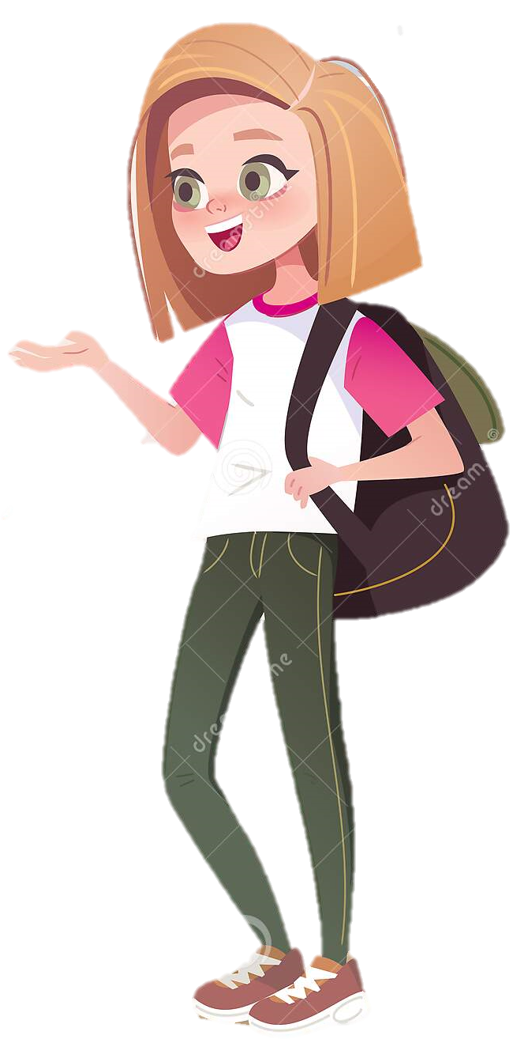
A. Consider the following questions and discuss with a partner.
1. How many people drive in your family? How do you feel about driving?
2. What kind of car would you like to drive? Why?
3. Which age group causes more accidents: teenagers, people over 25, people over 60? Why?

Slide 8

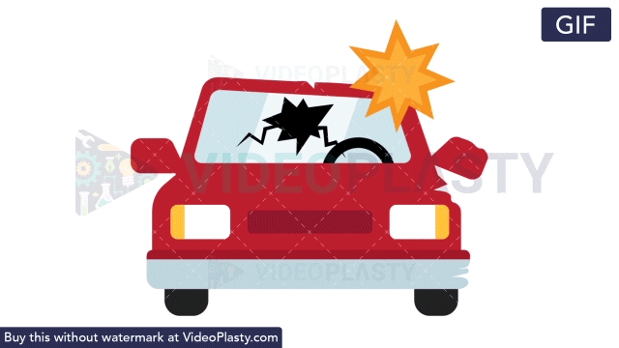

Slide 9
car crashed into us/threw us into telephone pole/
hit my face on dashboard
morning
on the way to school
B. Read the text and highlight the words and/or phrases that give information about:
What happened
speeding car didn’t stop at the intersection/
crashed into us
THE ACCIDENT
THE ACCIDENT
It was morning and my older brother was driving me
to school. Suddenly, a speeding car crashed into
us at an intersection and threw us into a telephone
pole. I was, fortunately, wearing my seatbelt but I still
managed to hit my face on the dashboard.
I was unconscious for some time and woke up as I
was taken out of the car and put into an ambulance.
The driver of the car that hit us was also in the
ambulance. I heard him say he was 90 years old.
I was 15, scared to death and likely to end up with
a scarred face for life. I started yelling “Please stop
driving! Stop driving!” I could not stop.
I don’t know what happened to the man, I never saw
him again.
I was released from hospital two weeks later. Since
then I have always been a cautious driver and
advised others to be careful.
When it happened
driver of the other car
Where it happened
The writer and his brother
How it happened:
the other driver was 90 years old
Who caused it:
Who it happened to
Why it happened

Slide 10
THE ACCIDENT
It was morning and my older brother was driving me
to school. Suddenly, a speeding car crashed into
us at an intersection and threw us into a telephone
pole. I was, fortunately, wearing my seatbelt but I still
managed to hit my face on the dashboard.
I was unconscious for some time and woke up as I
was taken out of the car and put into an ambulance.
The driver of the car that hit us was also in the
ambulance. I heard him say he was 90 years old.
I was 15, scared to death and likely to end up with
a scarred face for life. I started yelling “Please stop
driving! Stop driving!” I could not stop.
I don’t know what happened to the man, I never saw
him again.
I was released from hospital two weeks later. Since
then I have always been a cautious driver and
advised others to be careful.

Slide 11
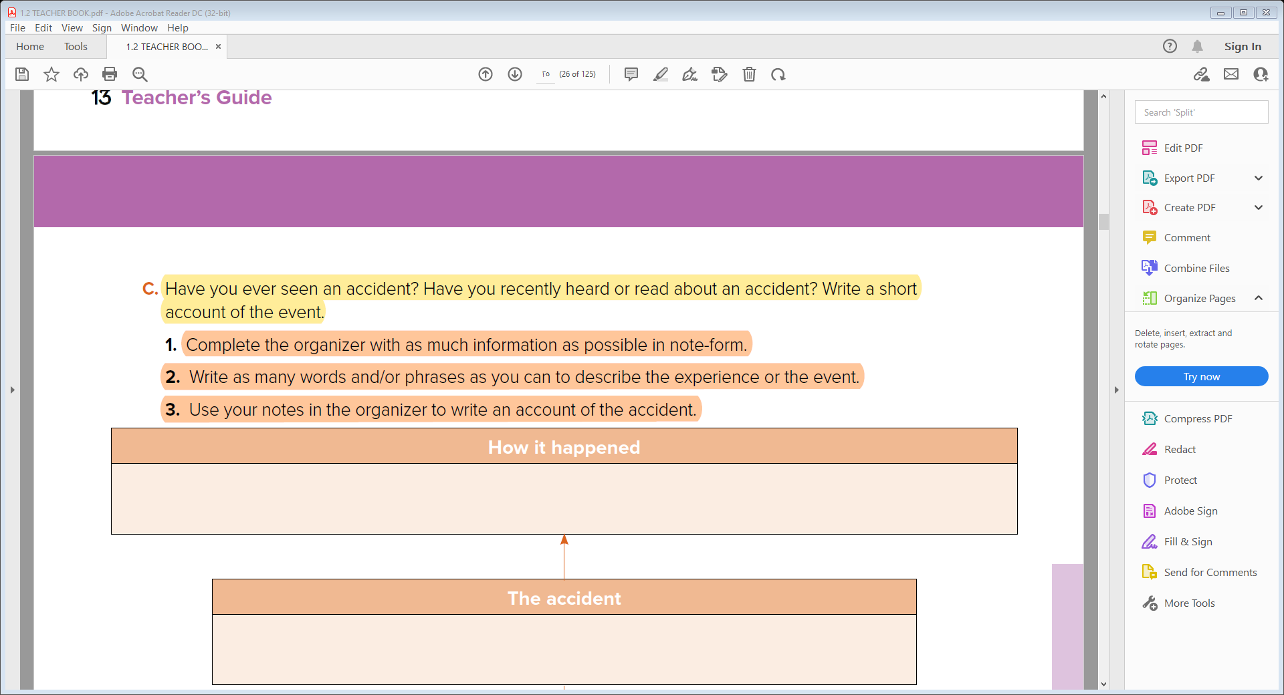
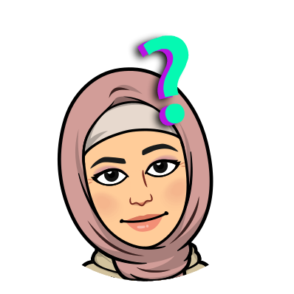

Slide 12
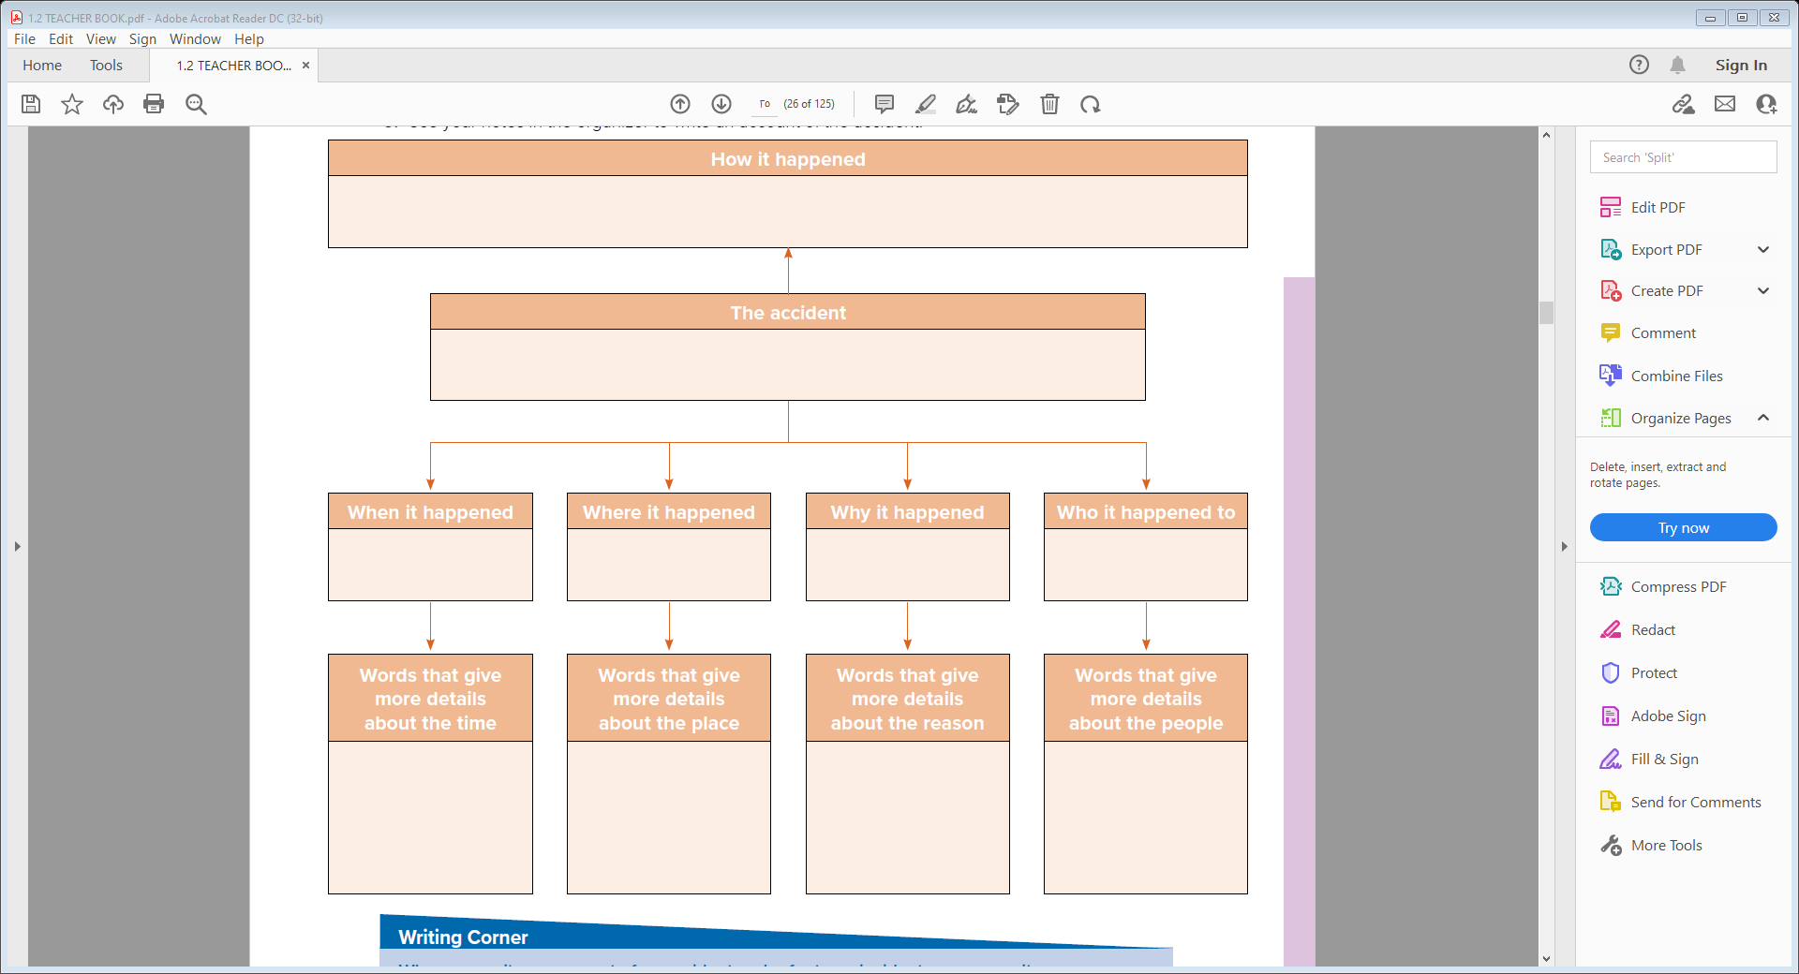
a large truck crashed into a small car at the intersection and the small car’s driver didn’t move.
The Morning Accident
on the way to school
The truck’s driver did not see the small car
the small car’s driver
morning
at the intersection
He was distracted & aggressive
Morning while driving to school
A young man

Slide 13

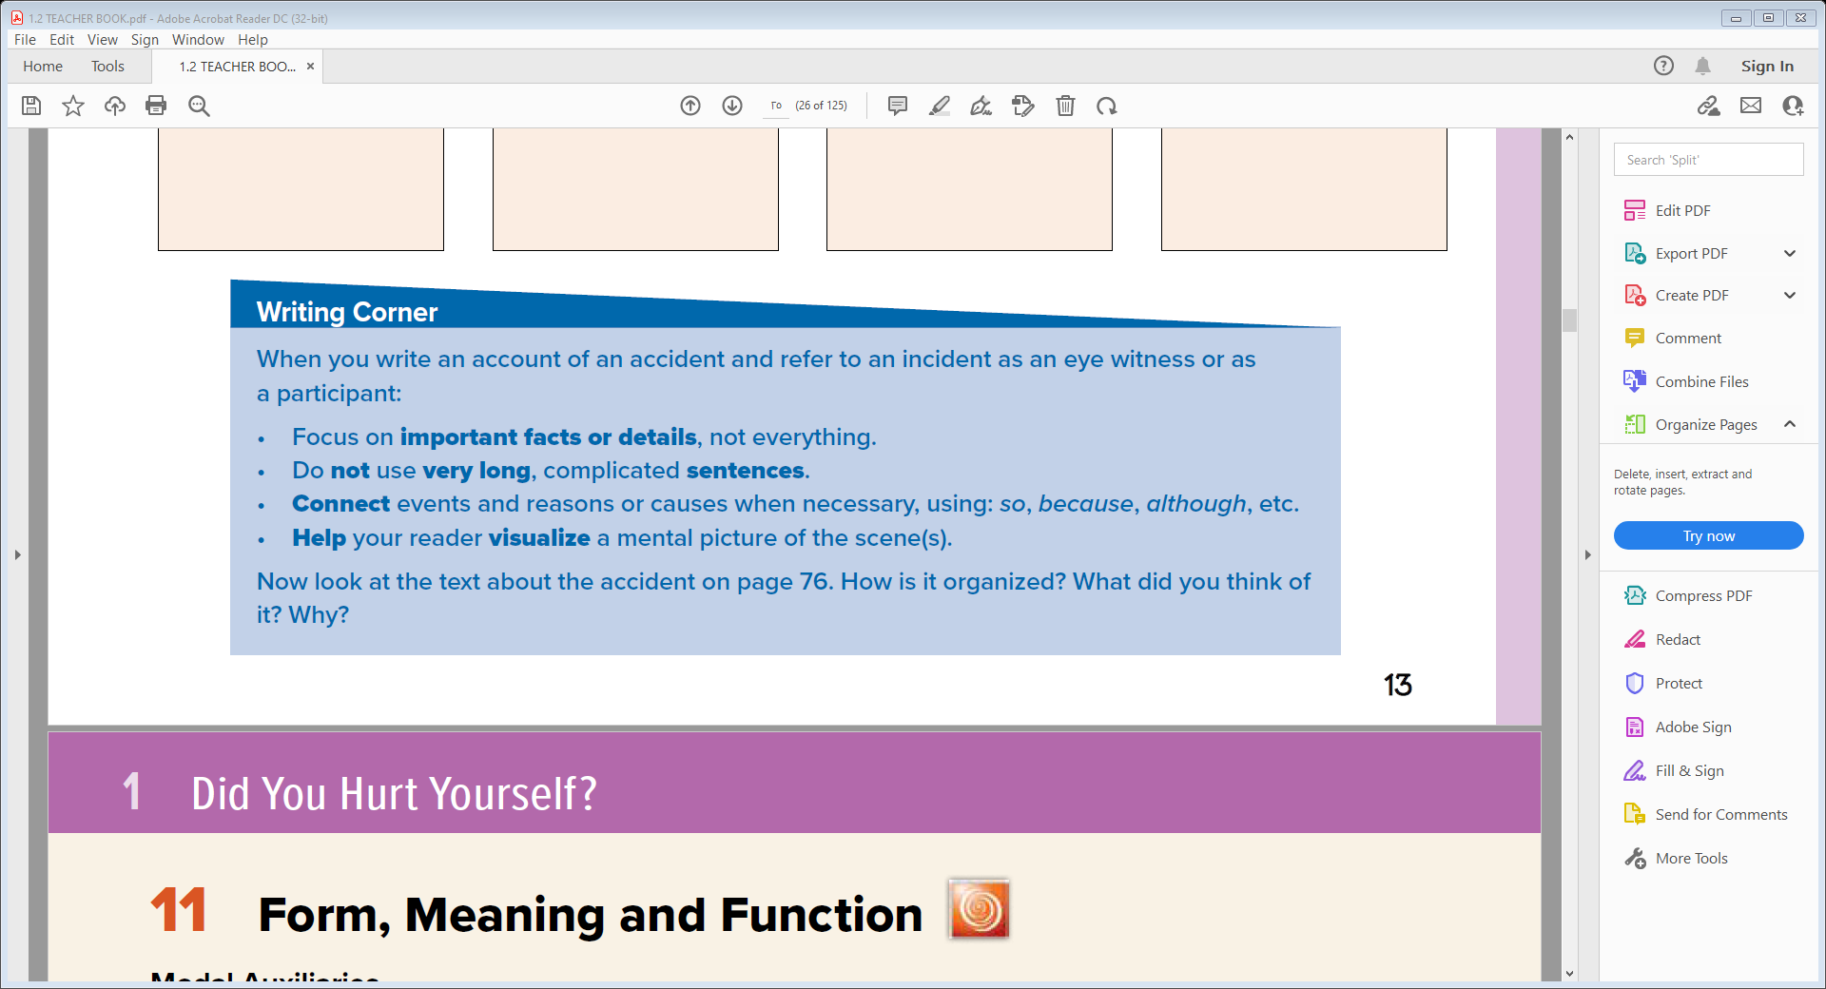

Slide 14
The Morning Accident
One morning I was driving to school with my sister. Suddenly a large truck crashed into a small car at the intersection and the small car’s driver didn’t move.
The truck’s driver did not see the small car He was distracted & aggressive . This made people for rescue . In few minutes ,an ambulance arrived and took the injured man to the hospital.
The police came and investigated the truck’s driver. driver who kept saying “I did not see him.”

Slide 15
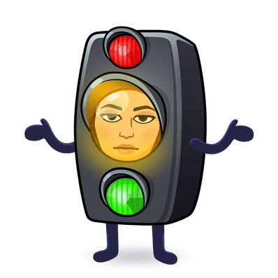
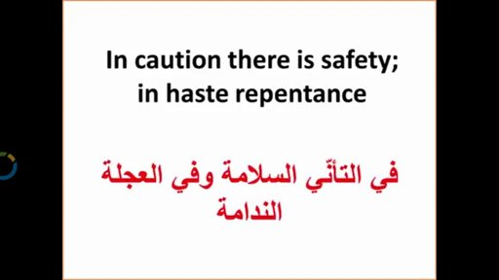

Slide 16


