Slide 1


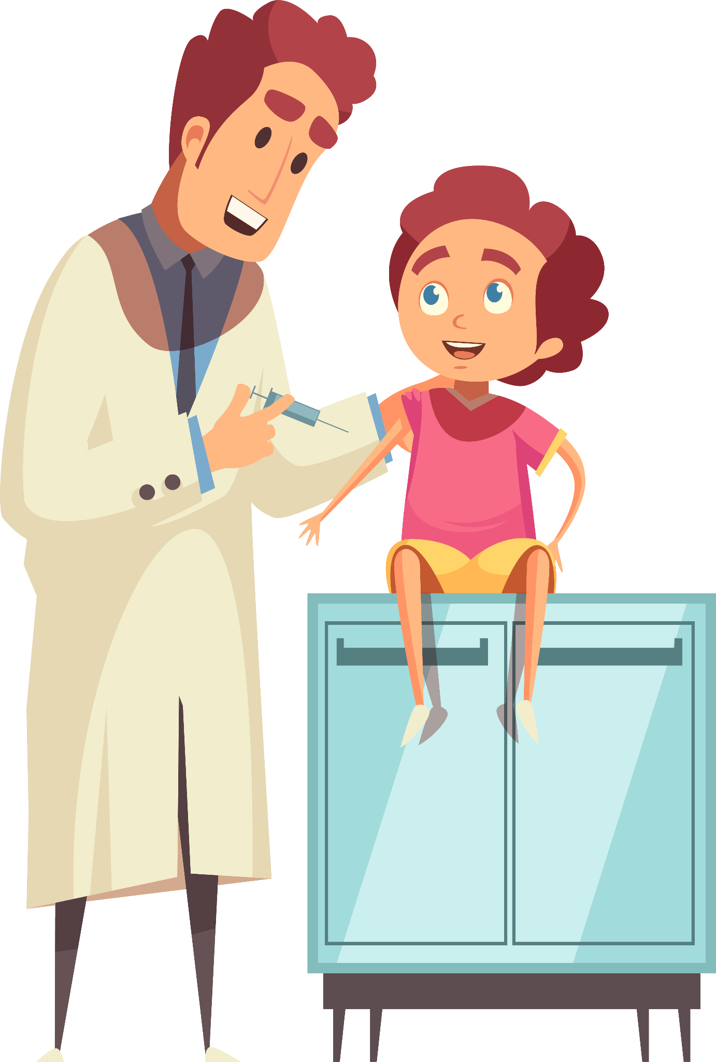
Unit 1
Did You Hurt Yourself?
Mega Goal 1.2
Listen & Discuss
Done by : Entisar Al-Obaidallah

Slide 2

Lesson Objectives
01
02
Describe
Listen
03
04
Read
Discuss
the pictures using their own words correctly
for specific information
about accidents and injuries correctly
the most common causes of car accidents.

Slide 3

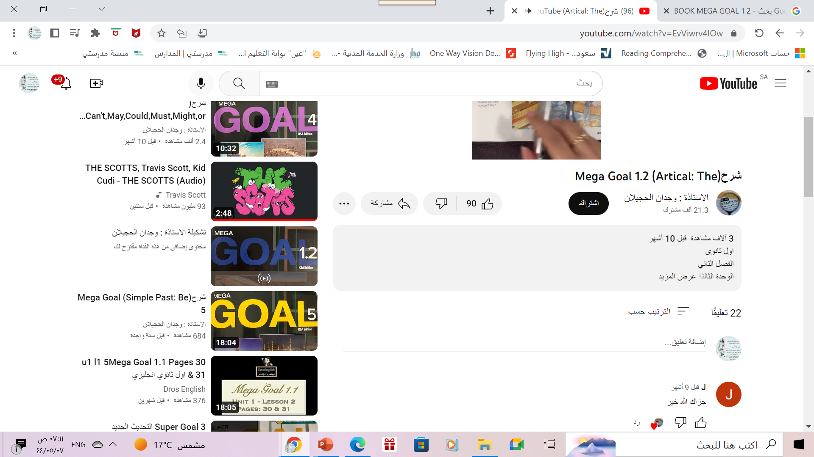
Open
Your student’s book , p.( 4-5)

Slide 4
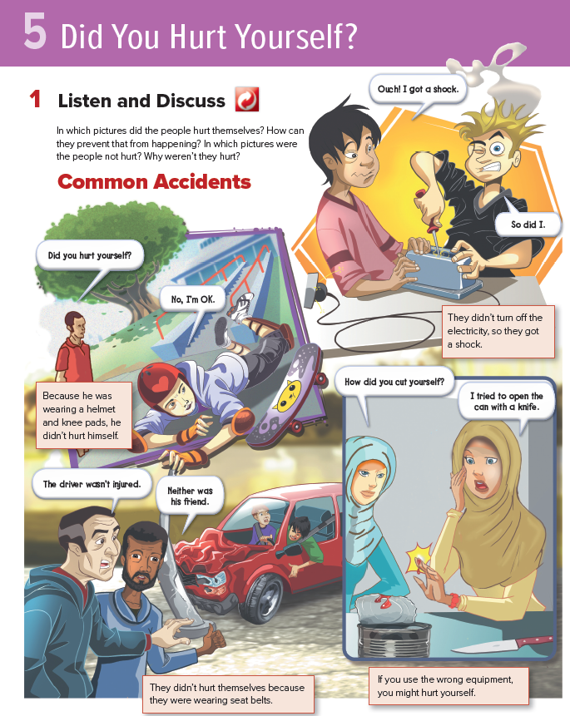
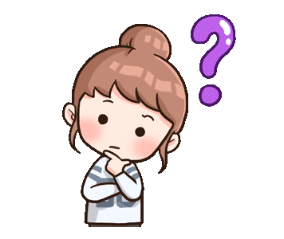
What is the title of the unit?

Slide 5
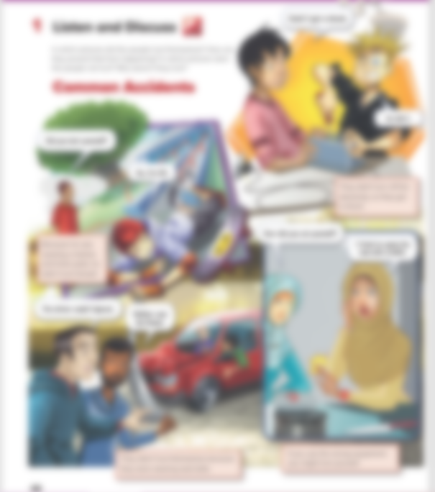
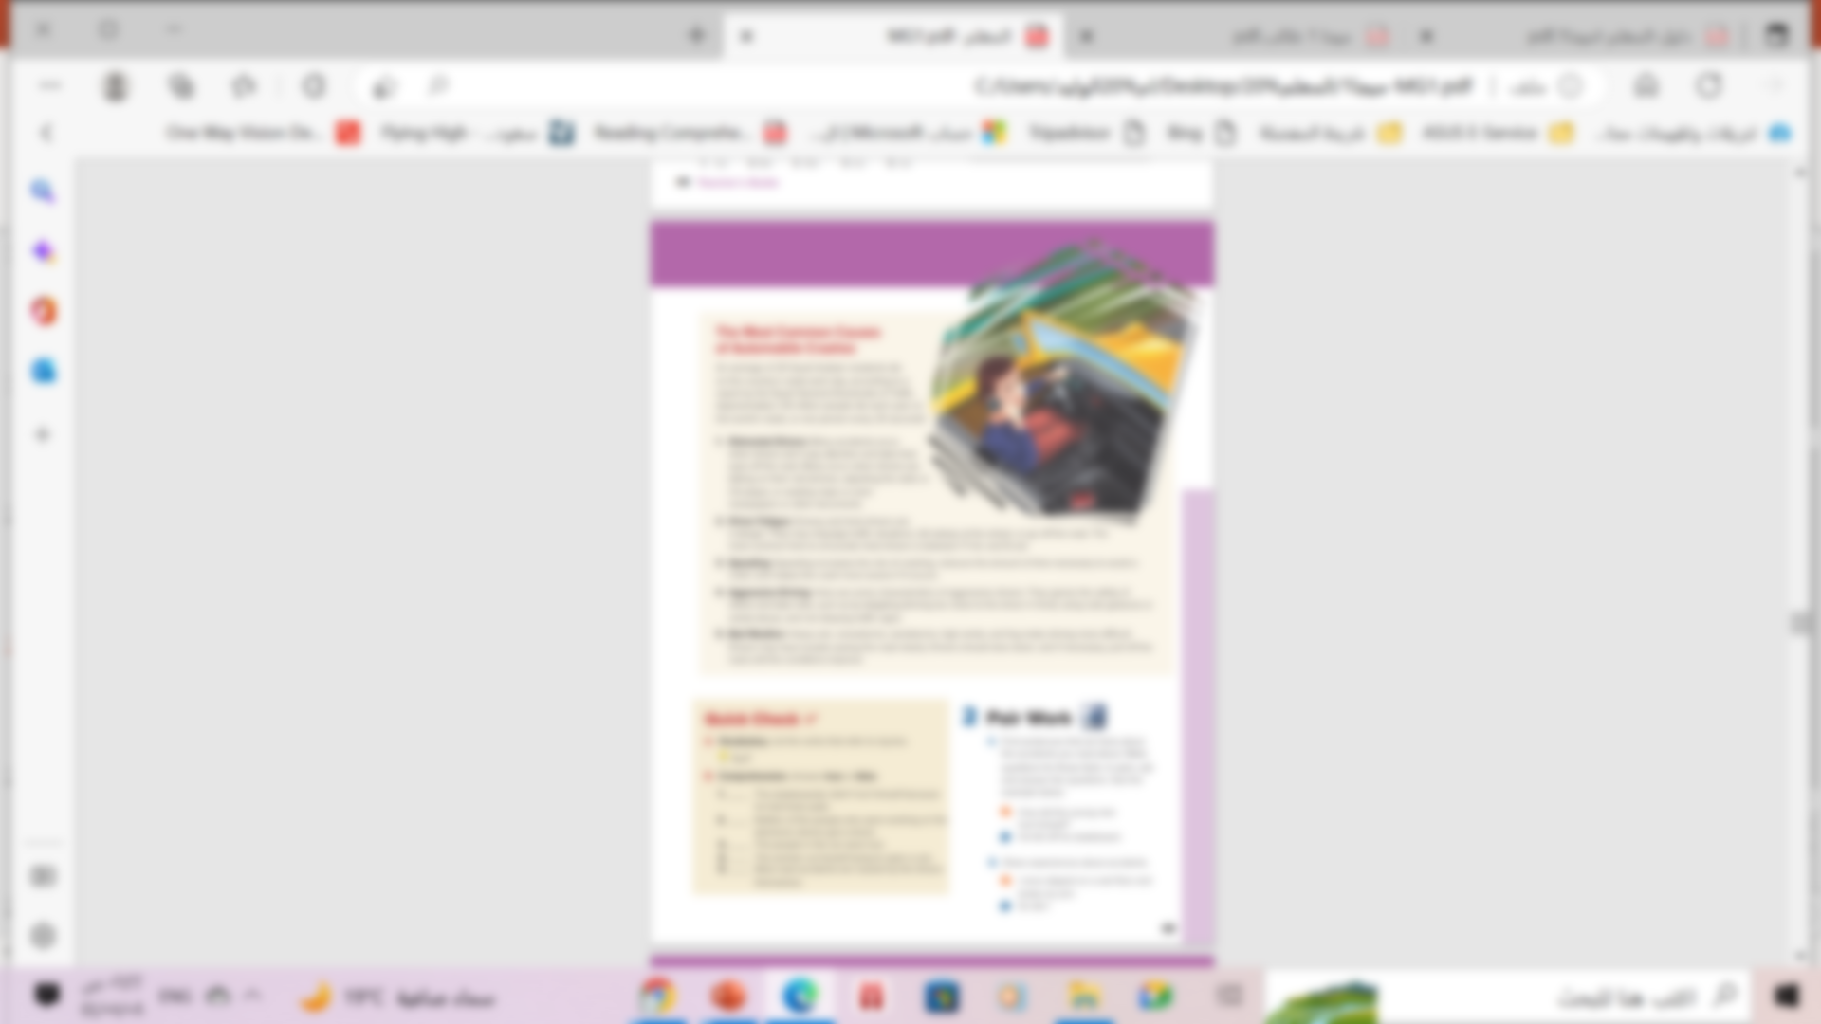

Read along as you listen
Pages: (4 – 5)

Slide 6
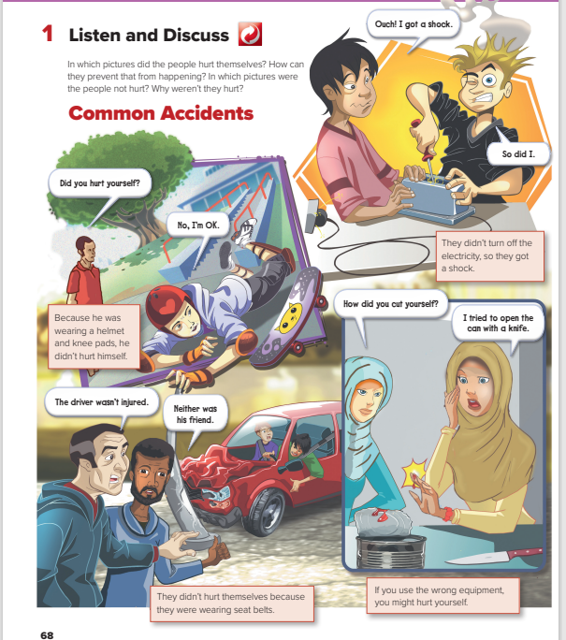

Guess
What do the pictures show?
accidents

Slide 7
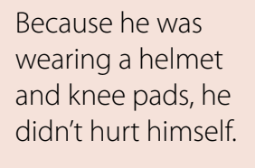
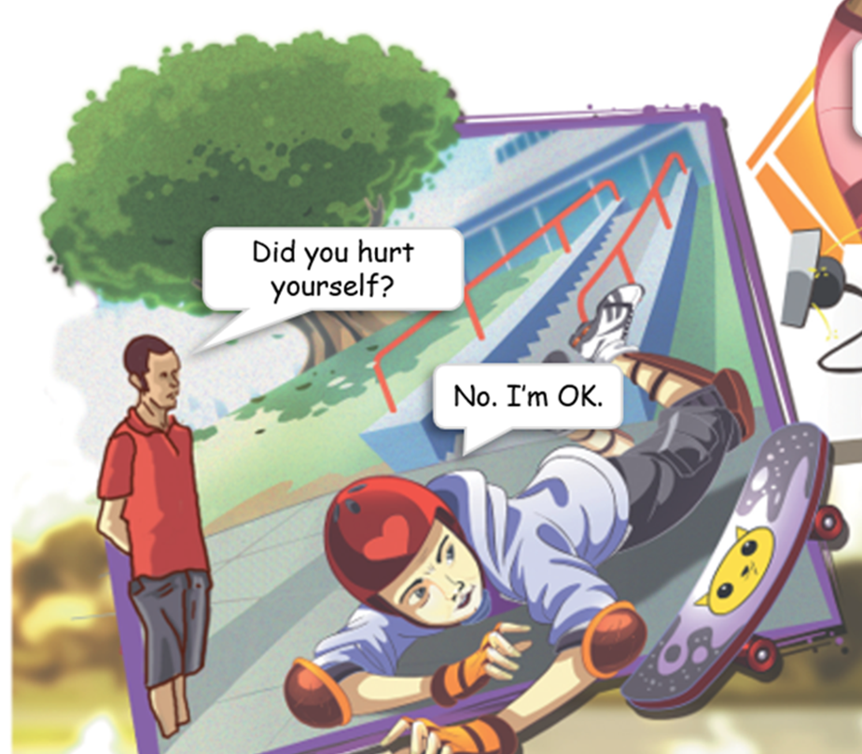
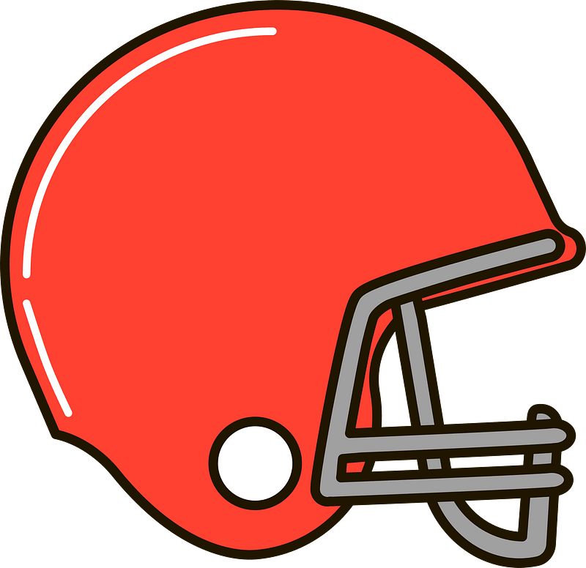
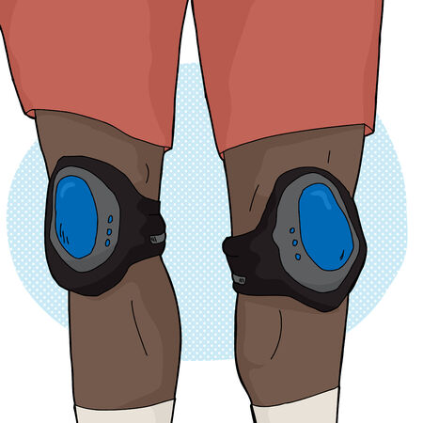
Discuss
What happened ?
He fell off the skateboard
Did the boy hurt himself?
No , he didn’t.
Why??
Because He was wearing
a helmet and knee pads.
helmet
Knee pads

Slide 8
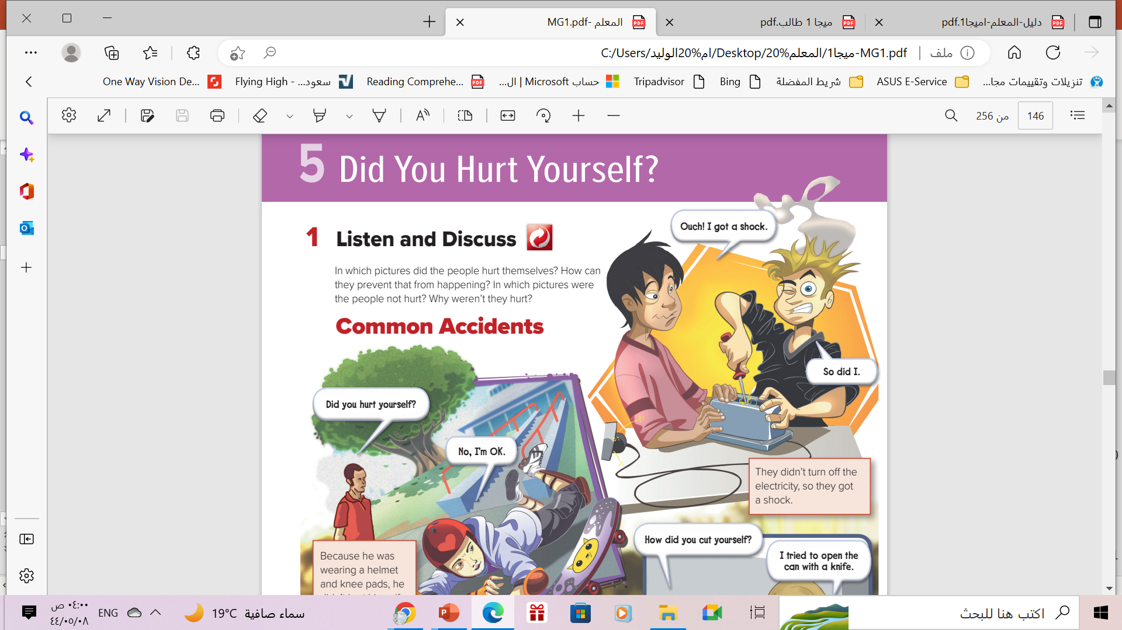
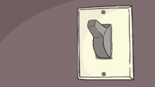
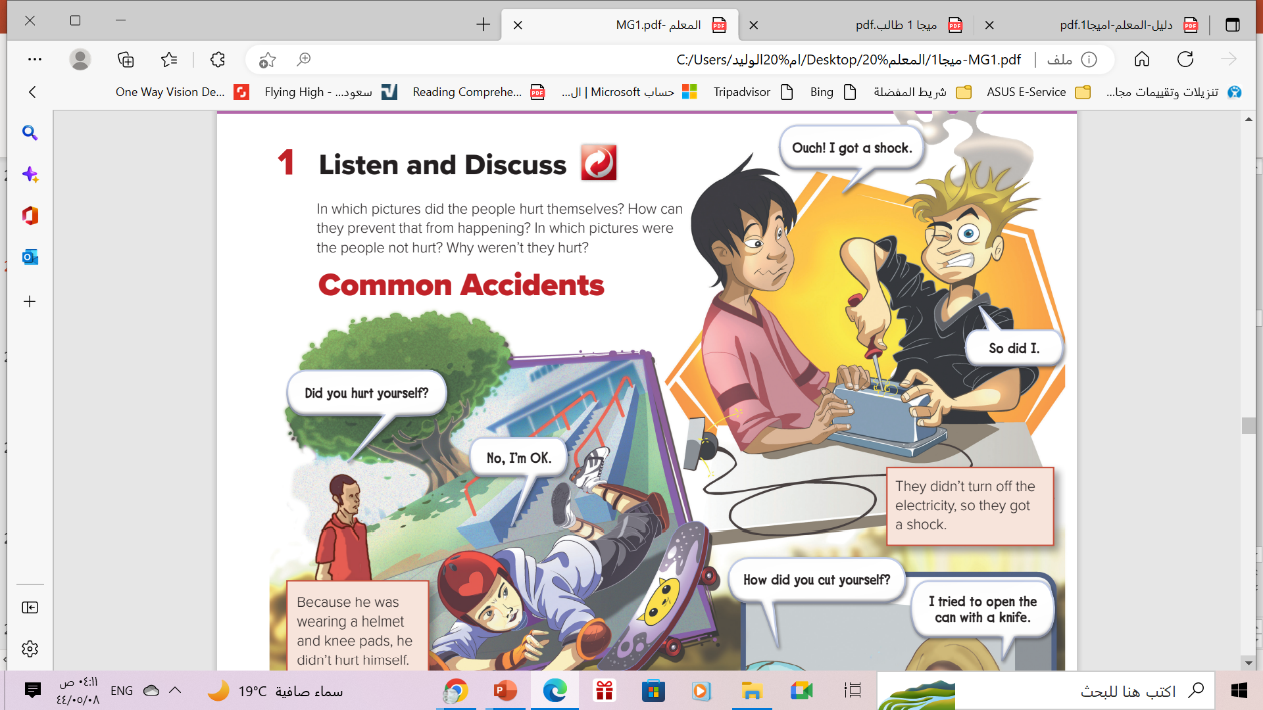
Discuss
What happened ?
They got a shock.
Did they hurt themselves?
Yes, they did
Why??
Because They didn’t turn off the electricity.
Turn off

Slide 9
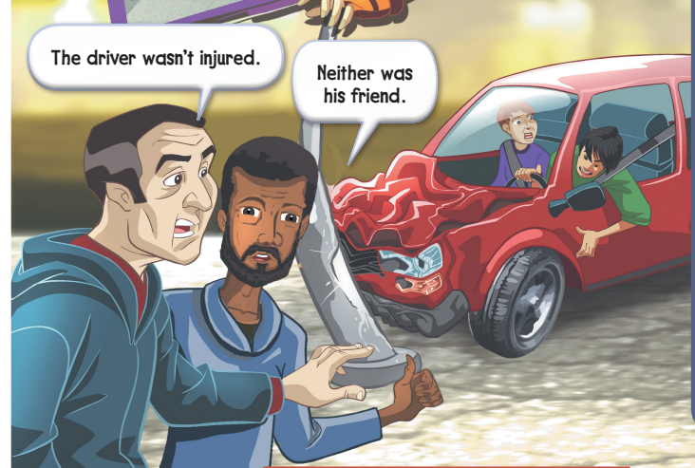
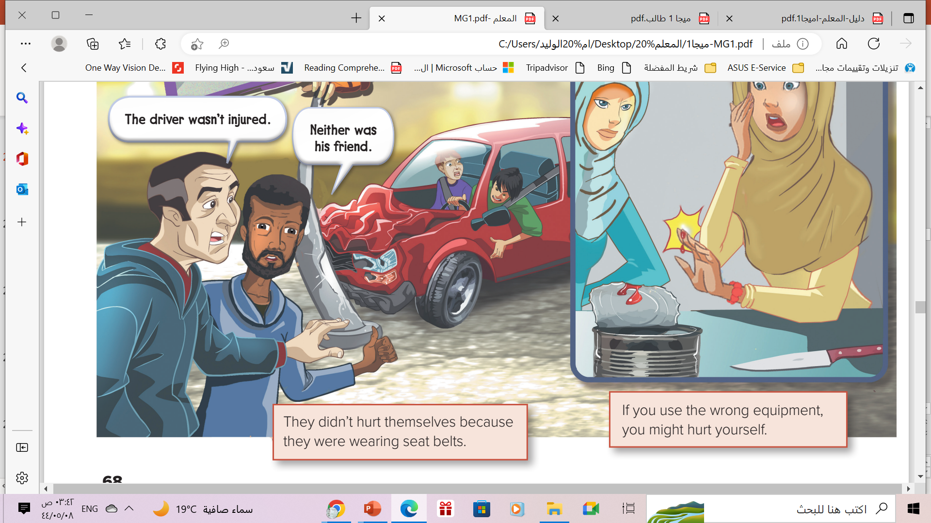
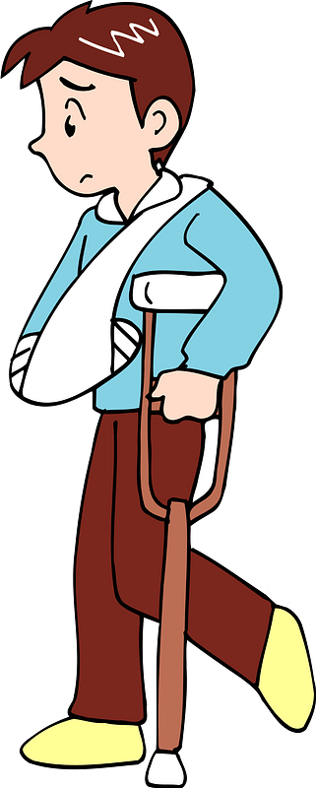
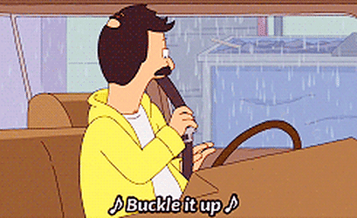
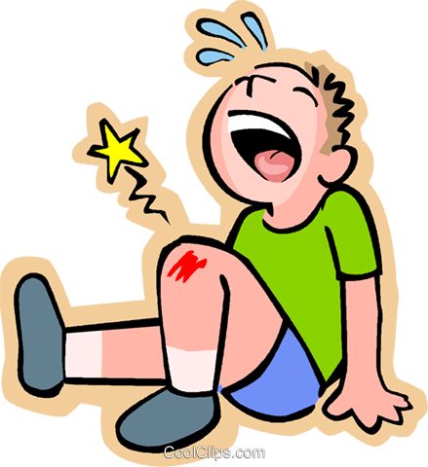
Discuss
What happened ?
They had a car crash.
Did they hurt themselves?
No , they didn’t.
Why??
Because they were wearing
a seat belt.
a set belt
Injured (adj)
Injury (n)

Slide 10
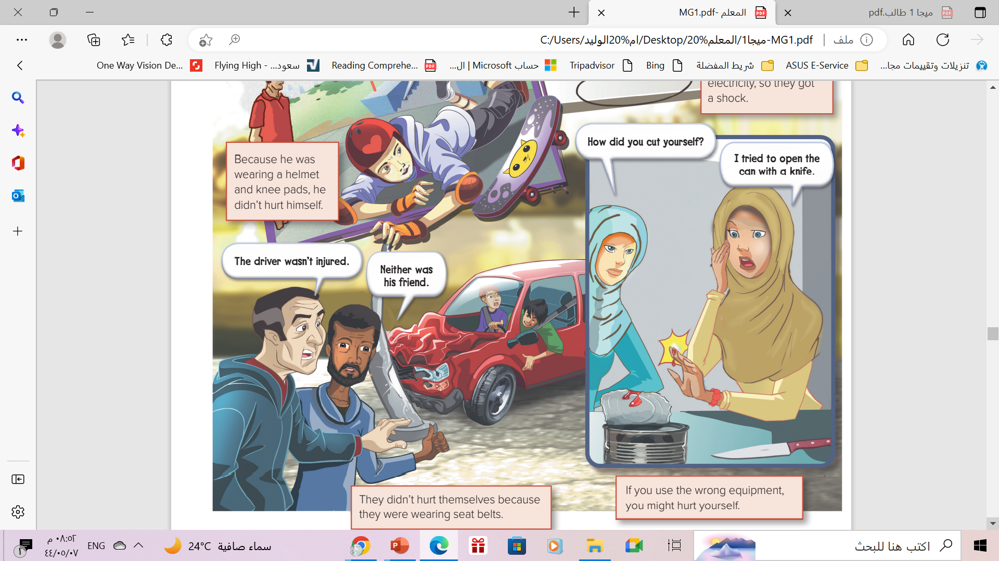
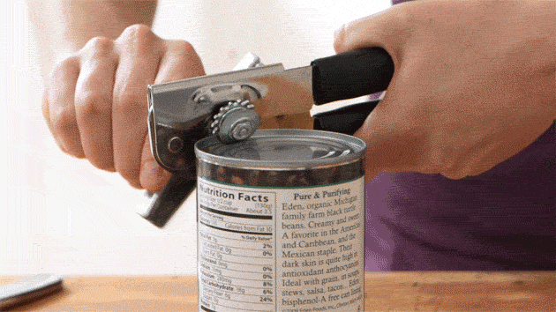
Discuss
What happened ?
She cut herself.
Did she hurt herself?
Yes , she did .
Why??
Because she tried to open the can with a knife .
She didn’t use the correct equipment.

Slide 11
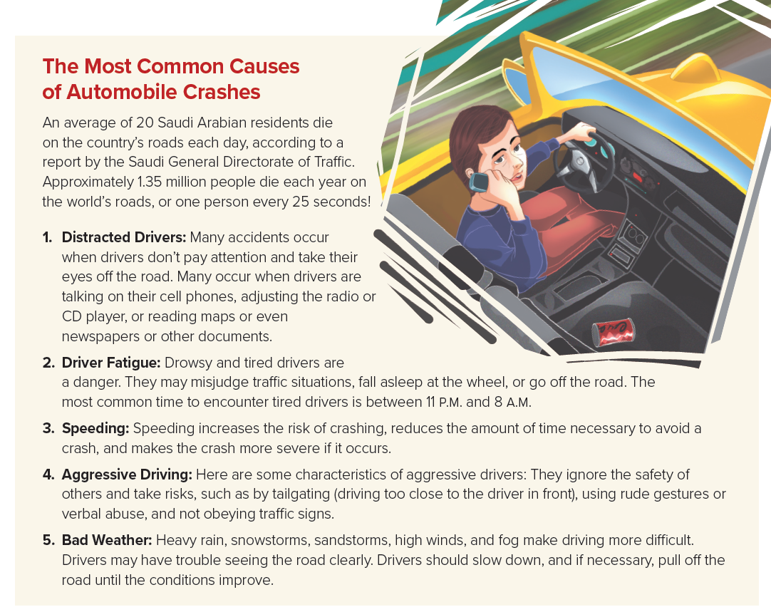
Read & Scan
What are
the five most common causes of car crashes?
How many
people die
each year
on the world’s
road?

Slide 12


Slide 13

documents
important papers

Slide 14
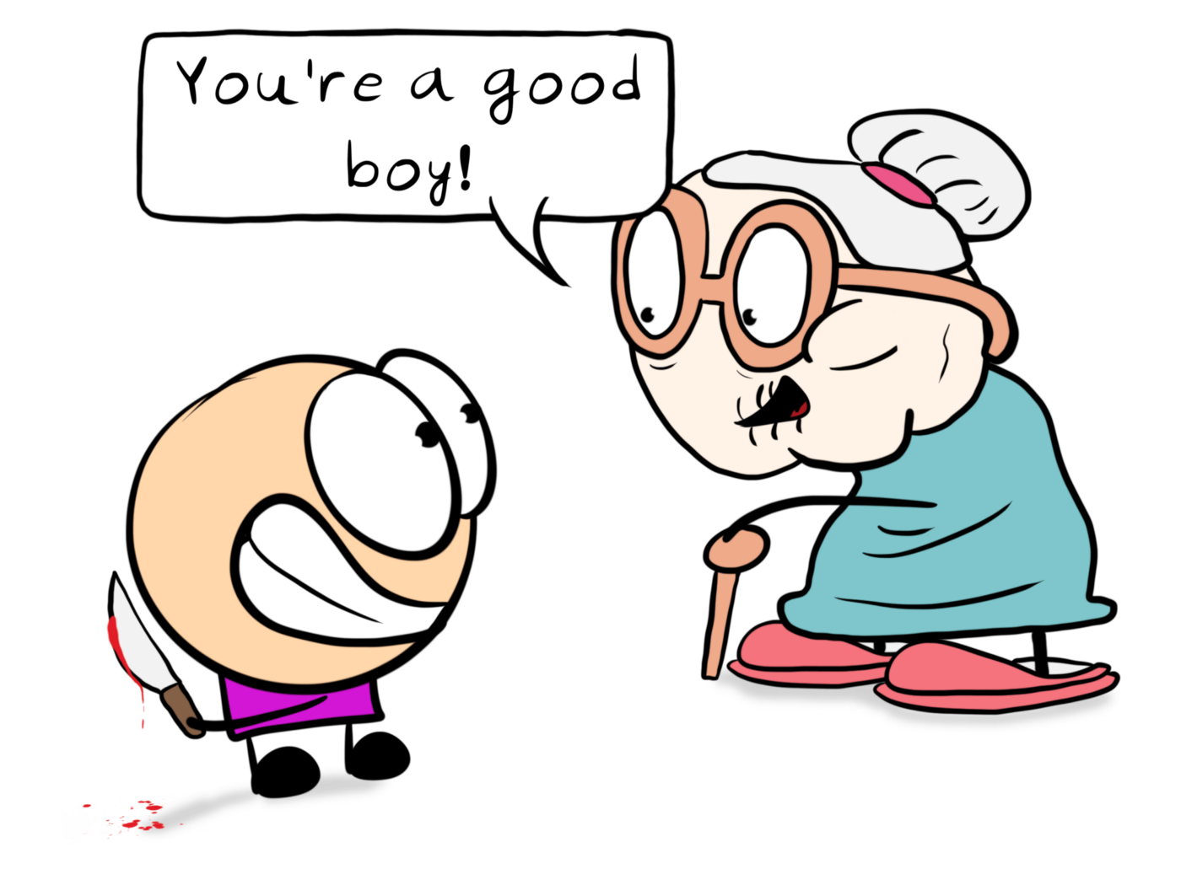
misjudge
judge incorrectly

Slide 15
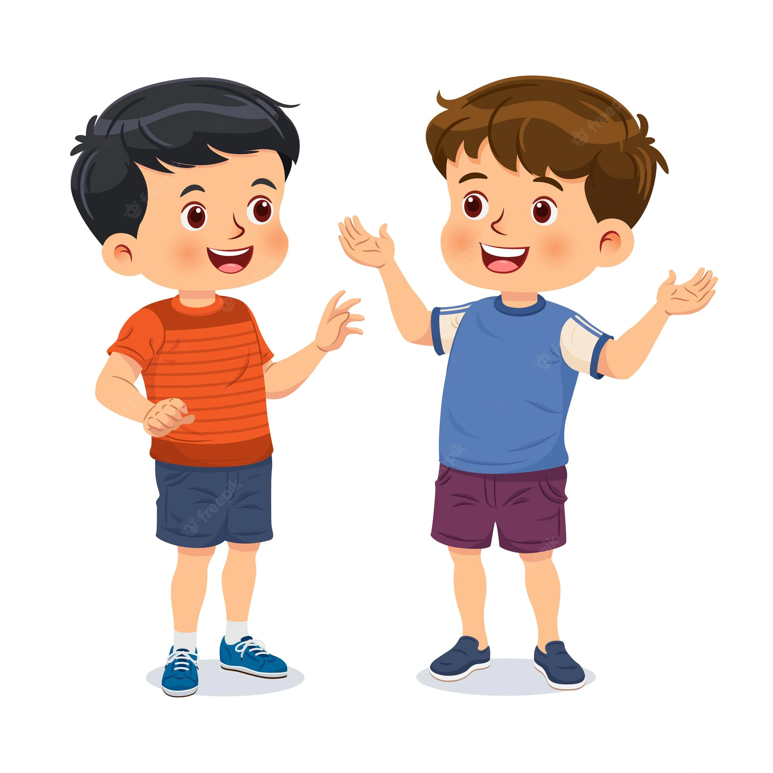
encounter
meet

Slide 16
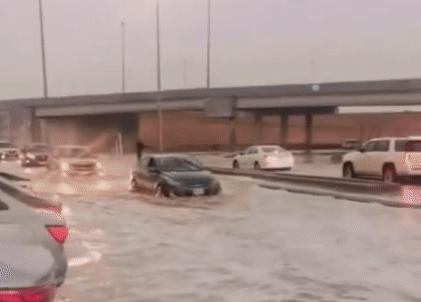
severe
extreme or very bad

Slide 17

rude gestures
impolite hand signals

Slide 18
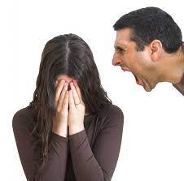
verbal abuse
very strong, unpleasant words spoken to another person

Slide 19


Open
Your student’s book , p.(5)

Slide 20
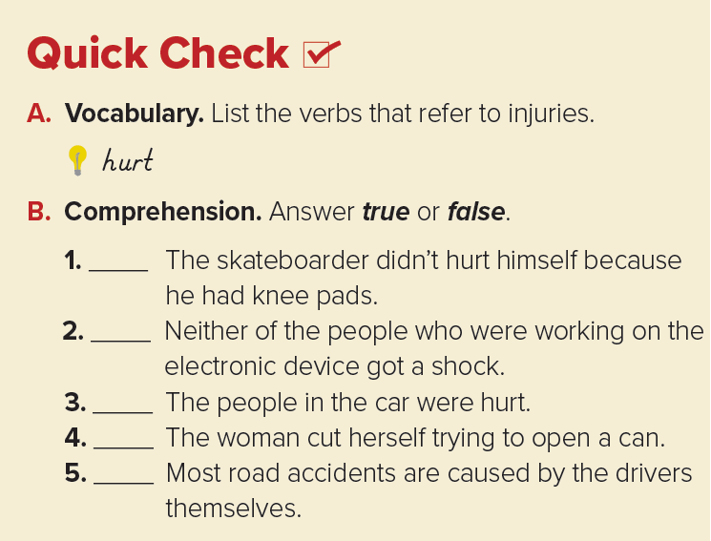

got a shock, injured, cut
T
F
F
T
T

Slide 21
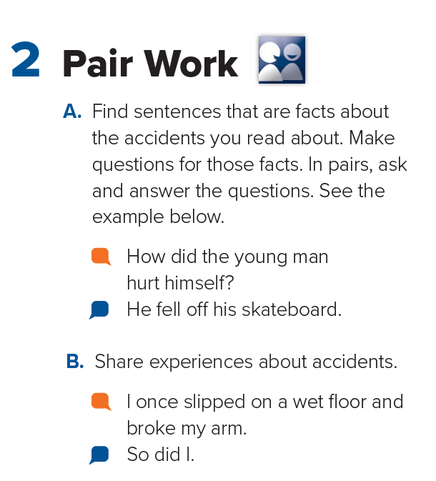
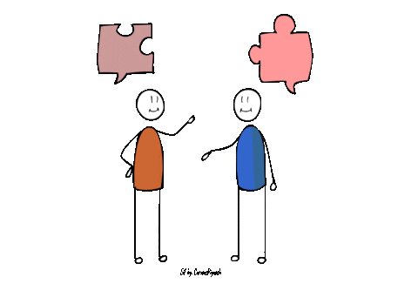
Pair Work

Slide 22
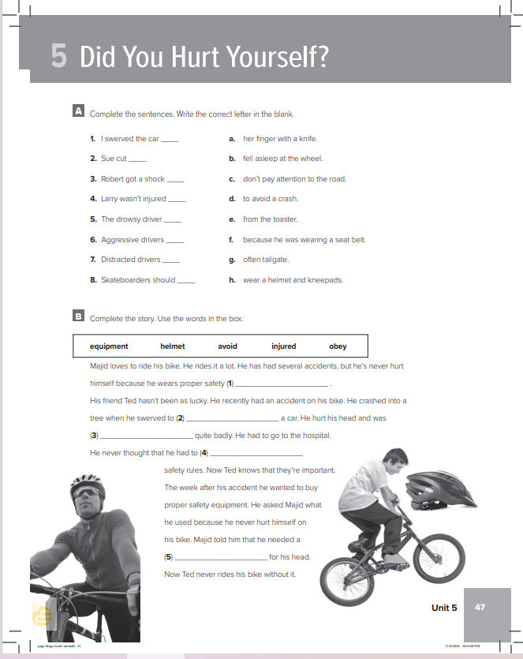
Homework
Workbook , P.(77) , exercises
( A-B)

Slide 23
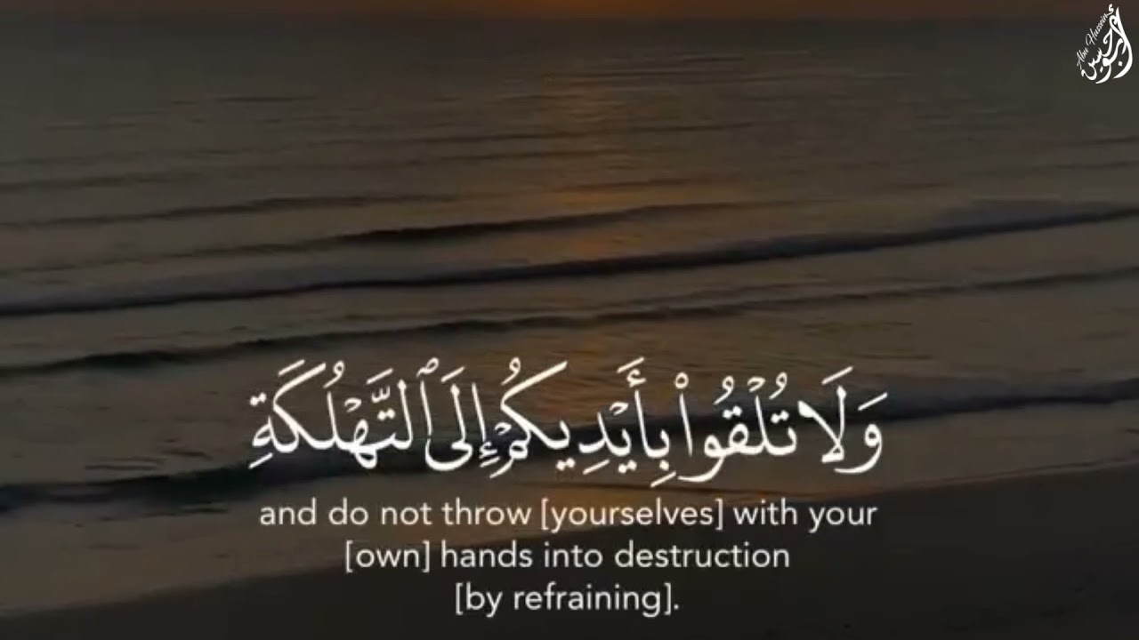
From The Holy Quran

Slide 24
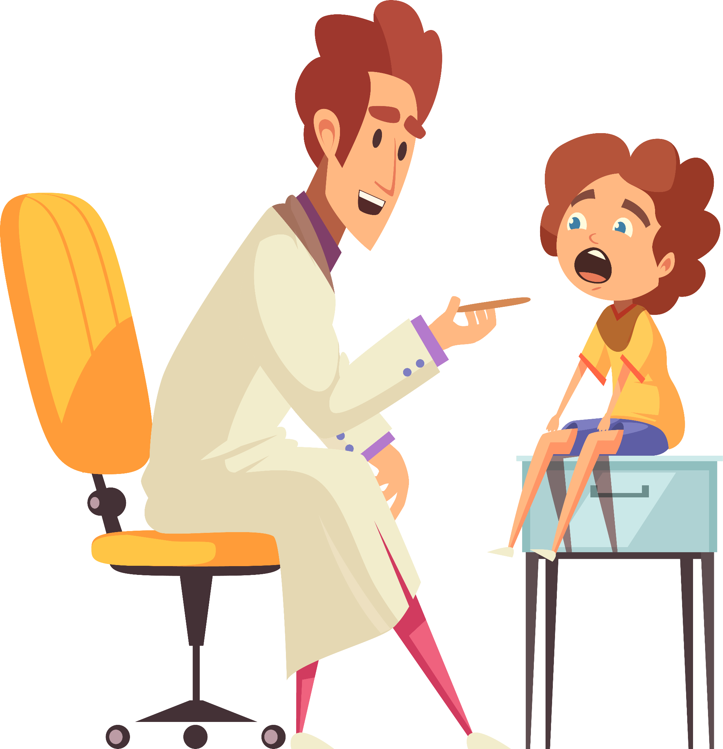

Thanks

