Slide 1

Unit 1
Did You Hurt Yourself?
Writing
Mega Goal 2.1
Done by: Entisar Al-Obaidallah

Slide 2
Lesson Objectives
01
03
02
04
Read
Complete
the text for specific information
the organizer with as much information as possible
Summerize
Write
a short account of an accident .
summarize the accident using their own words .

Slide 3
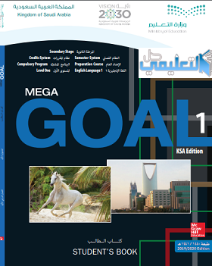
Book Closed

Slide 4
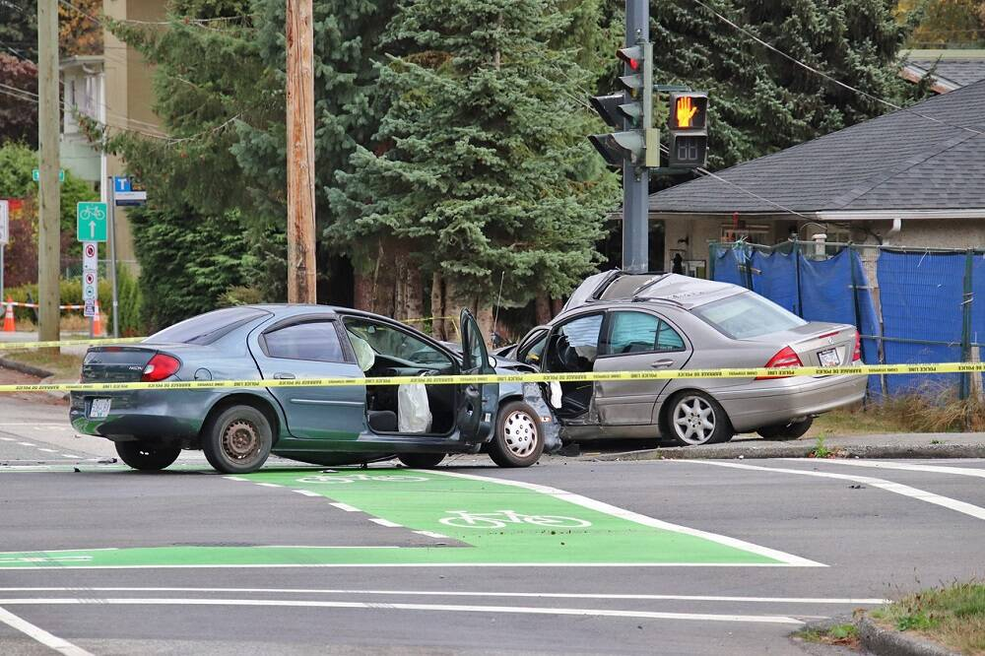

Have you ever witnessed an accident or been in one?
Why do accidents happen?

Slide 5
Open
Your student’s book p.(12)

Slide 6
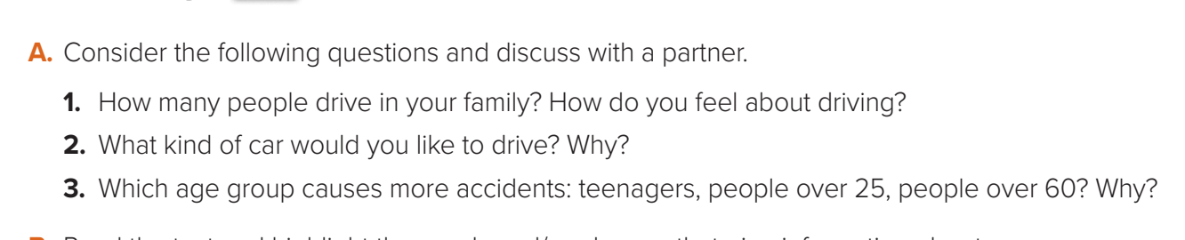

Slide 7
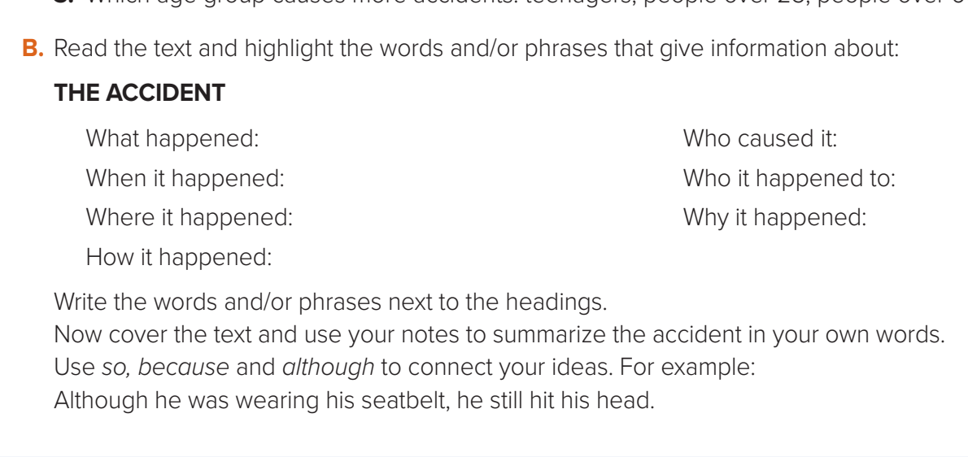

Slide 8

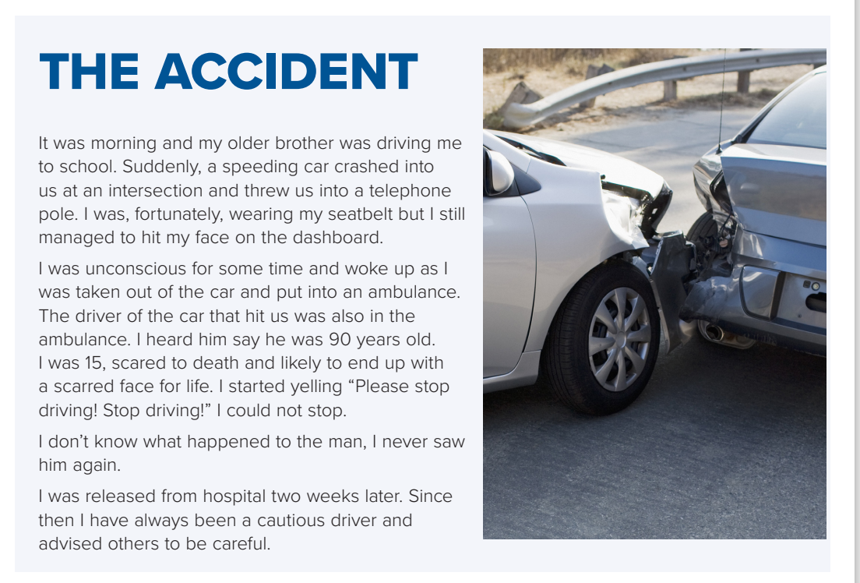

Slide 9
Car crushed into us / threw us into a telephone pole / hit my face on the dashboard
driver of the other car
morning
The writer & his brother
on the way to school
the other driver was 90
years old .
speeding car didn’t stop at the intersection /crushed into us

Slide 11
Open
Your student’s book p.(13)

Slide 12
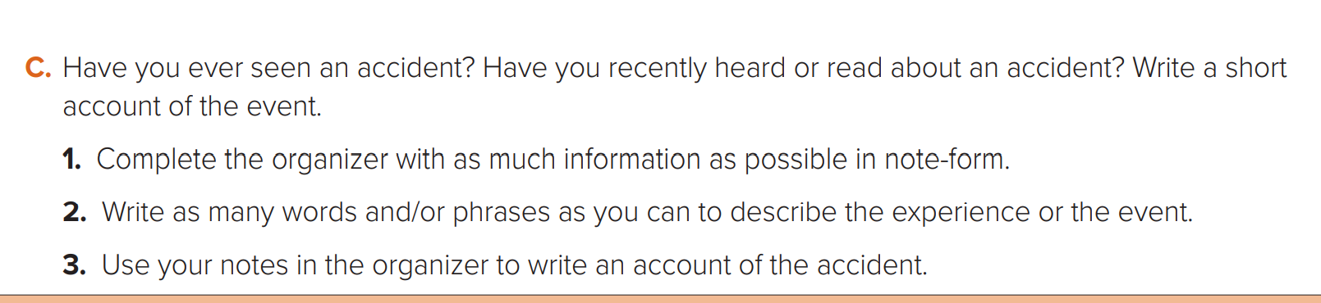
Students book p.( 18)

Slide 13
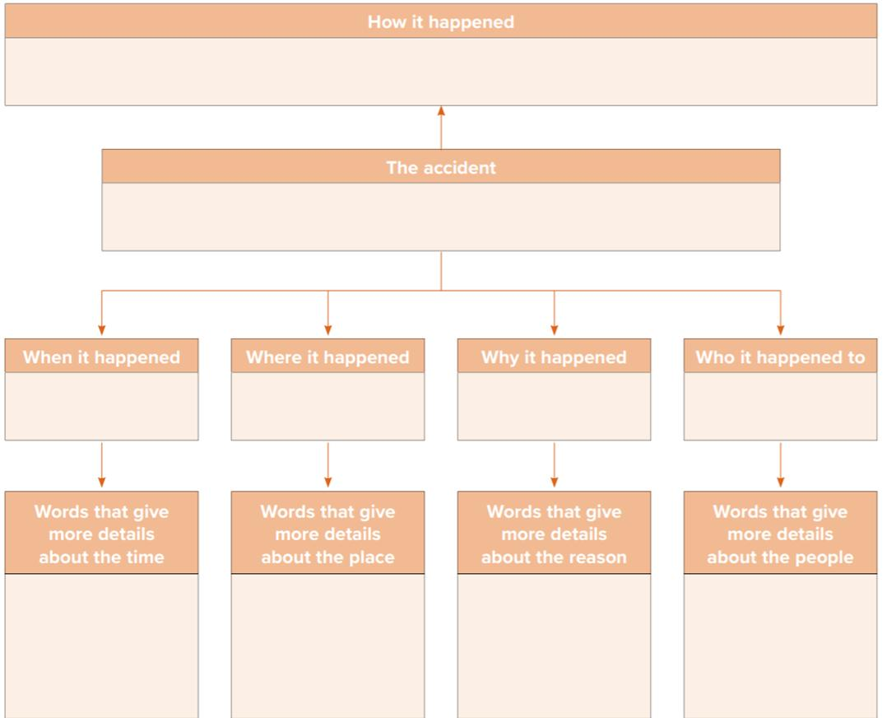
Two cars were driving very fast and crashed into each other
Cars Accident
Last week
Dhahran S.T
drove fast
The two cars collided each other
In Sunday morning
Next to my home
The speed was over 100 k\h
Both drivers were wrong

Slide 14
Car Accident
Last night , on Dhahran street , I was standing
near my home. At that time , I saw two cars drove fast .
Suddenly, they collided with each other because
their speed were 100 km\h .
In a few minutes , the traffic police came and after
investigation, they decided that both drivers were wrong .

Slide 15
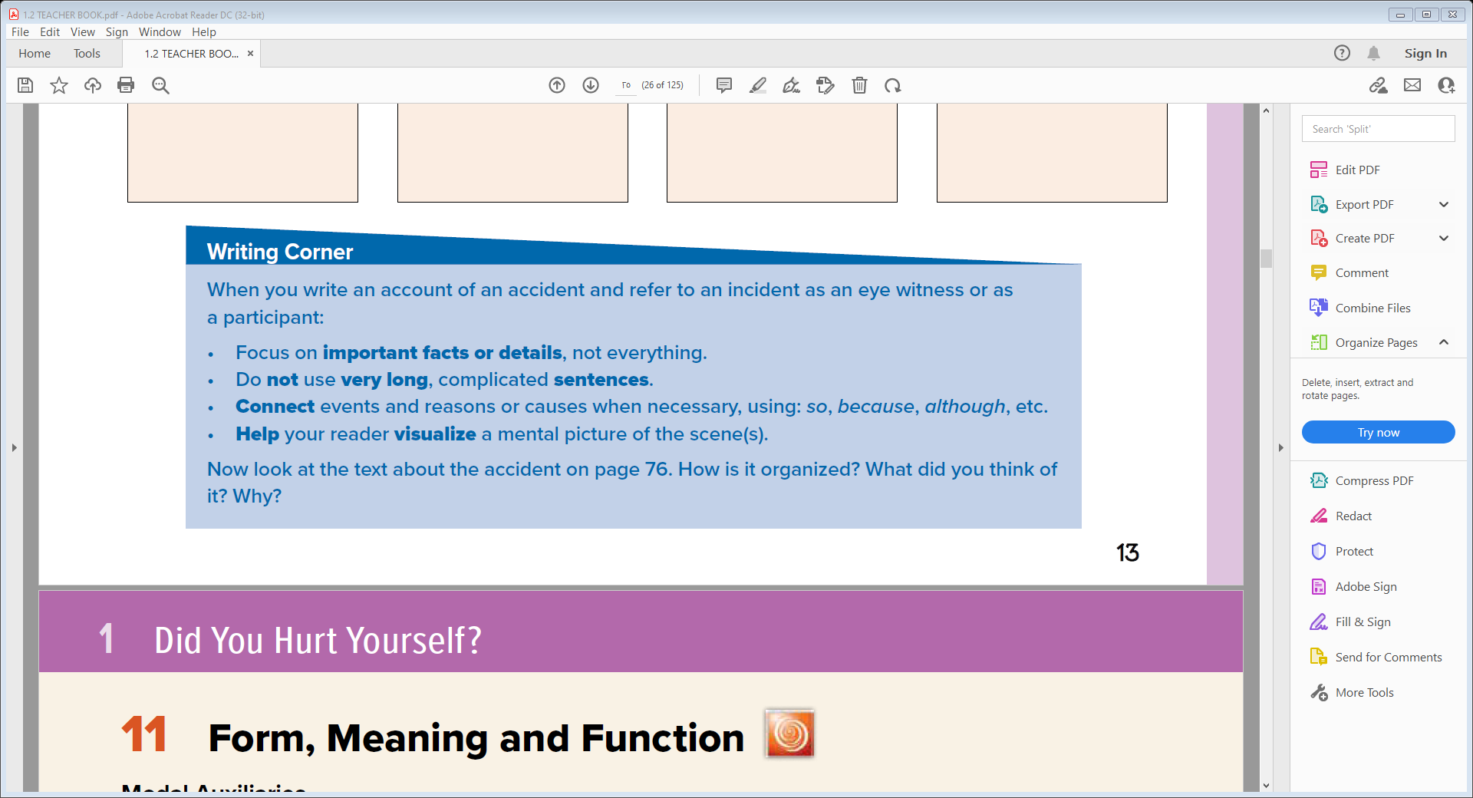
Read the guidelines to answer the question

Slide 16
Paragraph 1: the scene: time, setting/place, people
Paragraph 2: events immediately after the accident/the other driver
Paragraph 3: Closing statement/Outcome/effects of the accident

Slide 17
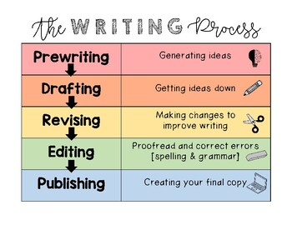

Slide 18
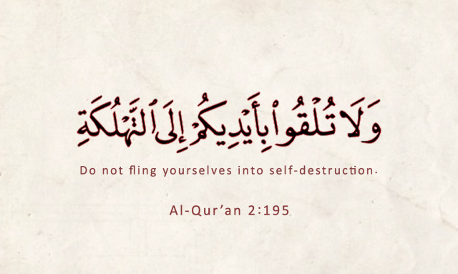
Remember

Slide 19
Homework
Workbook p.(86),
exercise(M)

Slide 20

Thanks!

