Slide 1
Unit 1
Did You Hurt Yourself?
Mega Goal 1.2
Reading
Done by: Entisar Al-Obaidallah

Slide 2
Lesson Objectives
01
02
03
04
Describe
Determine
The events using their own words correctly
happy and unhappy endings.
Identify
Read
the meanings of the new words correctly
for specific information

Slide 3

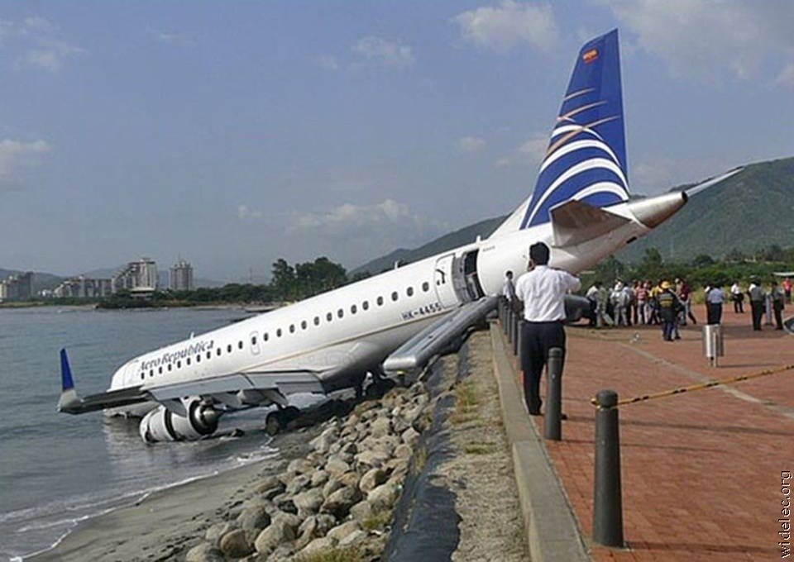
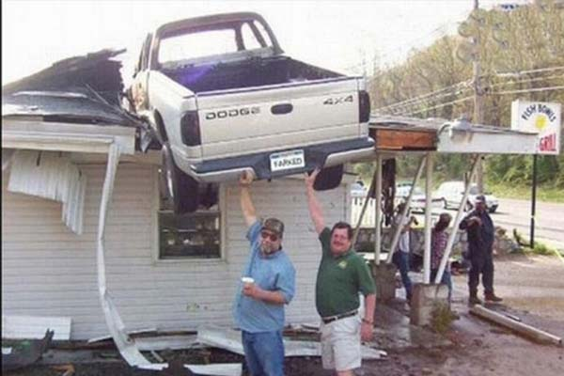
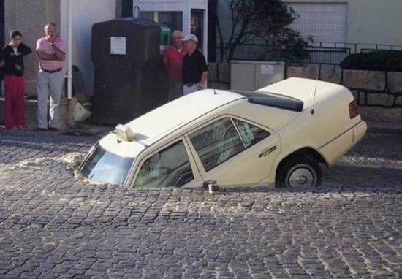
Warm up
Have you ever seen a strange accident?

Slide 4
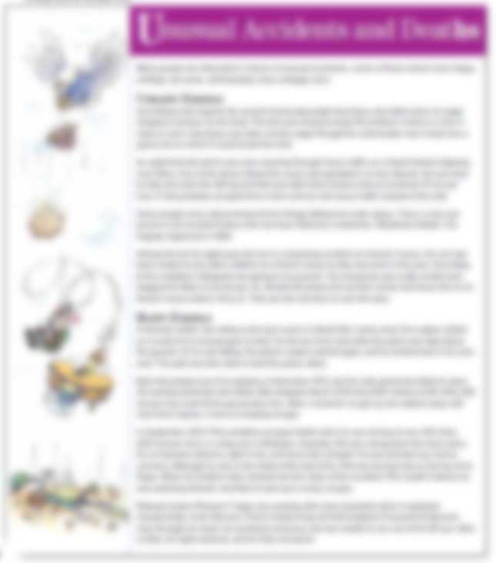
Open
Your student’s book p. (8-9)

Slide 5
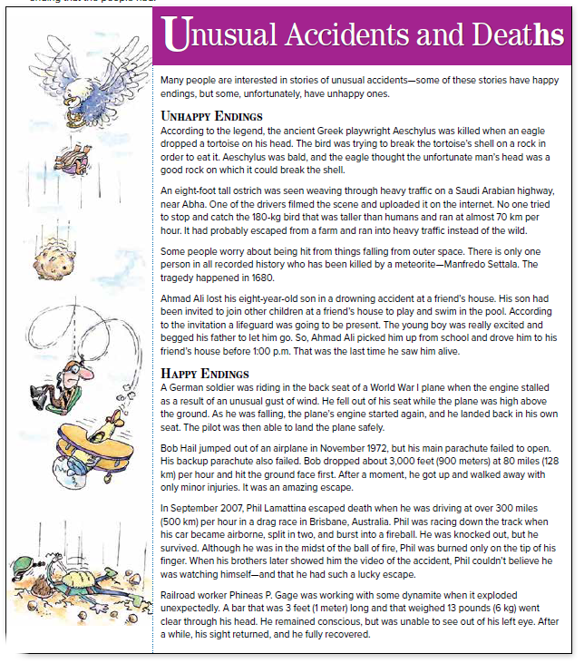
What is the title of the text?
1
How many subheads are there ?
How many stories are there under each subhead ?
2
What do pictures have in common ?
The pictures show unusual accidents & deaths

Slide 6
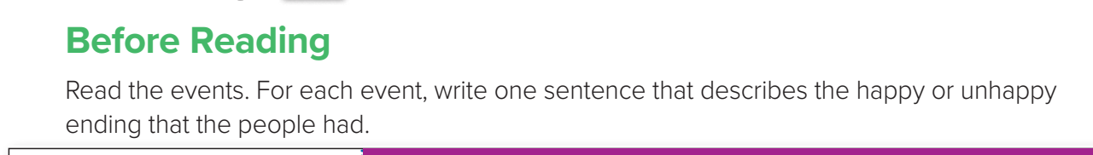
Before Reading

Slide 7

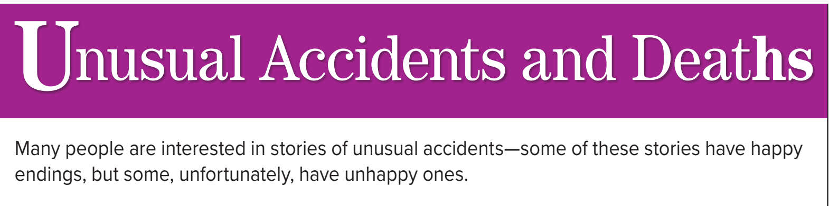
Can you predict what the reading is about?

Slide 8
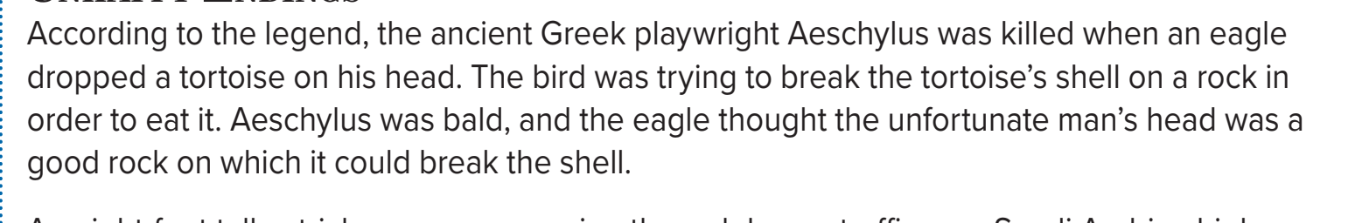

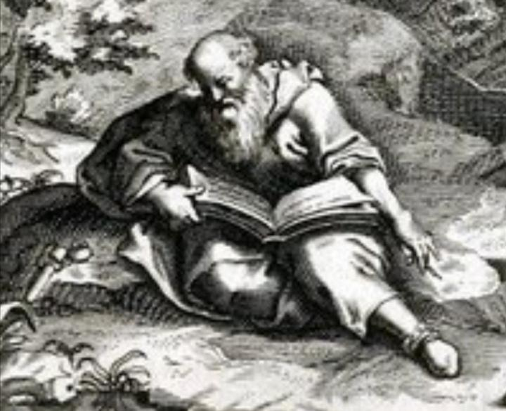
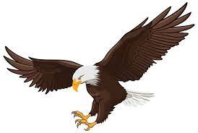
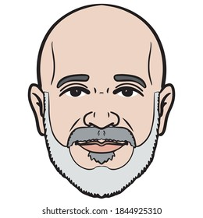
What happened to Greek playwright Aeschylus?
He was killed when an eagle
dropped a tortoise on his head.
Is it happy or unhappy ending?
Underline the sentences that express that.
Unhappy ending
eagle
bald
Aeschylus
a tortoise

Slide 9
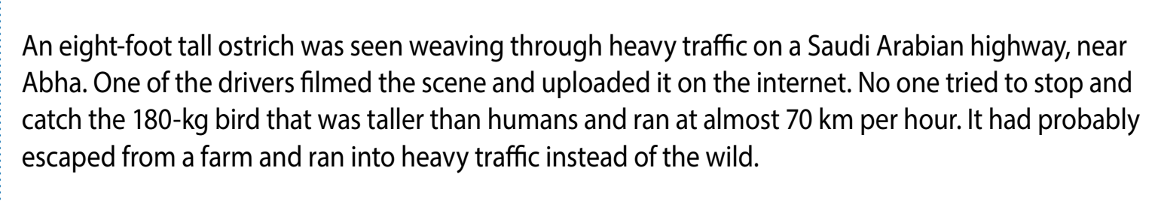
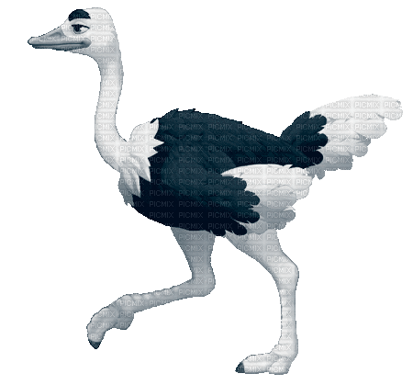
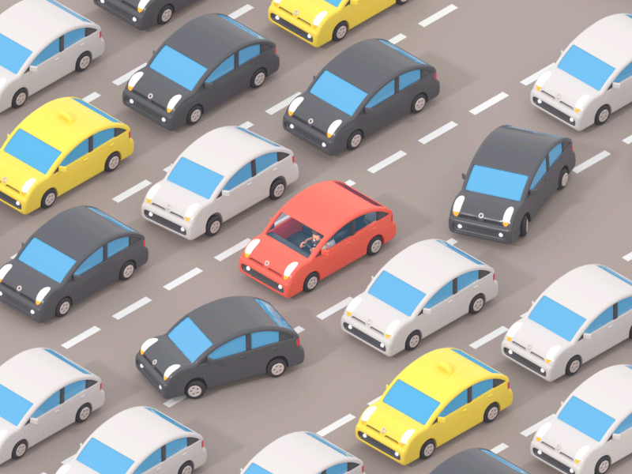
What happened on a Saudi Arabian highway, near Abha.?
An eight-foot-tall ostrich was seen weaving through heavy traffic
Is it happy or unhappy ending?
Underline the sentences that express that.
Unhappy ending
ostrich
traffic

Slide 10
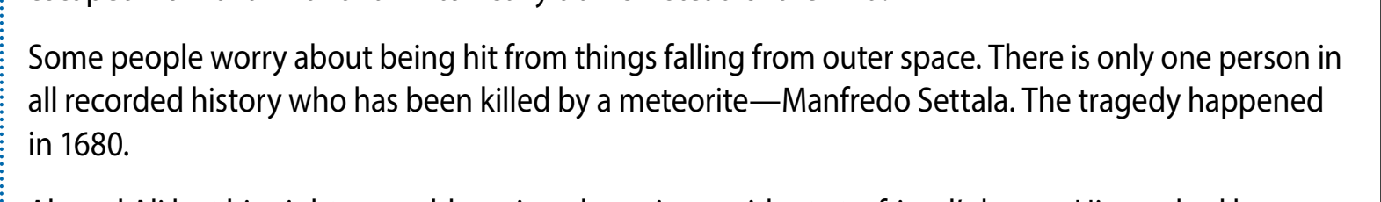
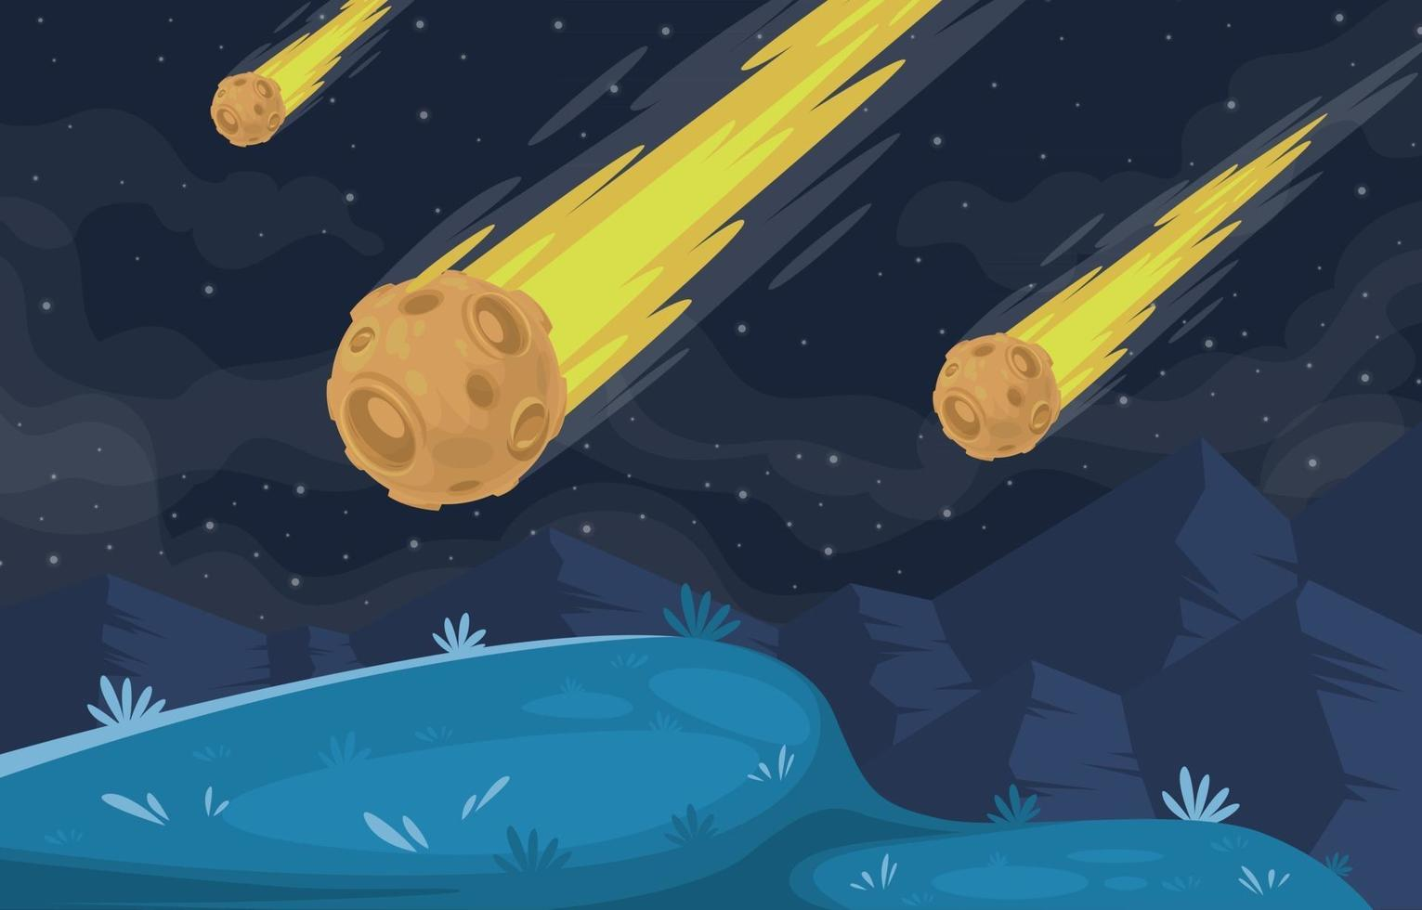
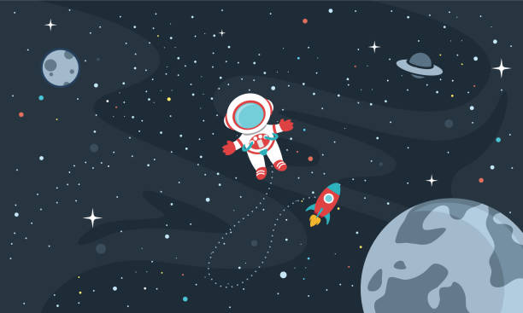
What happened to Manfredo Settala?
He has been killed by a meteorite
Is it happy or unhappy ending?
Underline the sentences that express that.
Unhappy ending
meteorite
Outer space

Slide 11
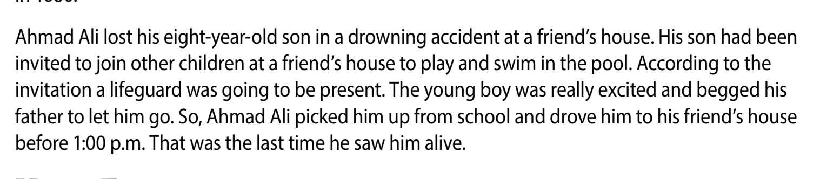

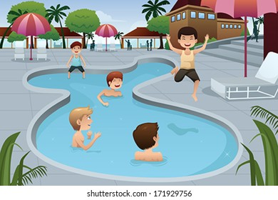
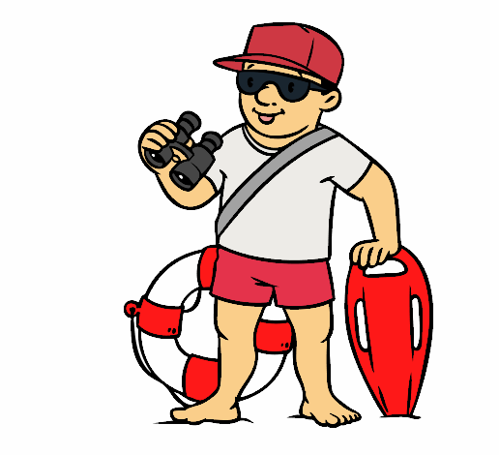
What happened to Ahmad Ali’s son ?
He lost his son in a drowning accident at a friend’s house.
Is it happy or unhappy ending?
Underline the sentences that express that.
Unhappy ending
A lifeguard
pool
beg

Slide 12
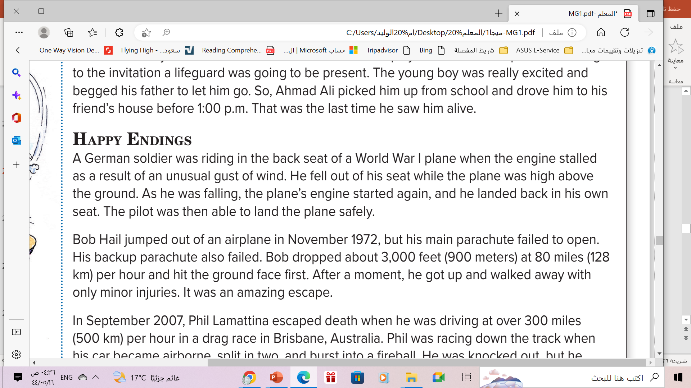
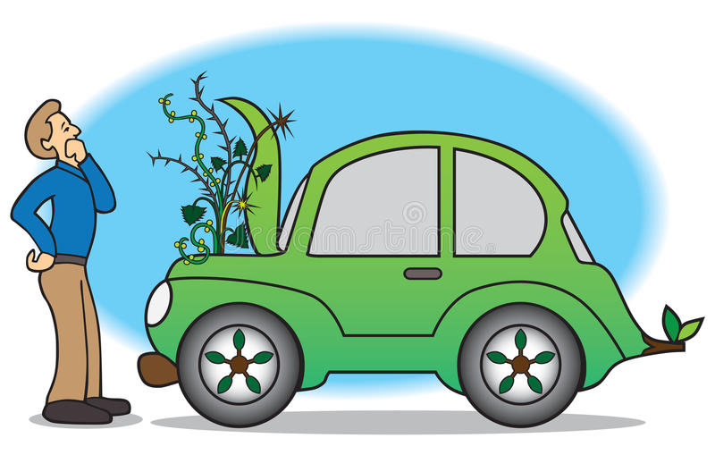

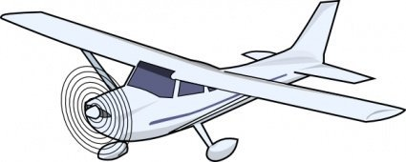
What happened to the German soldier?
He fell out of his seat while the plane was high above the ground
Is it happy or unhappy ending?
Underline the sentences that express that.
Happy ending
plane
Engine stalled
Gust of wind

Slide 13
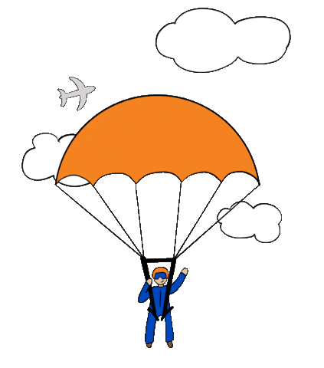

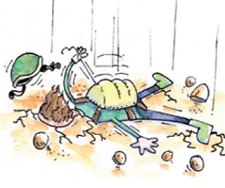
What happened to Bob Hail when his main parachute failed to open?
He dropped and hit the ground face first
Happy ending
Is it happy or unhappy ending?
Underline the sentences that express that.
hit the ground face
parachute
minor injuries

Slide 14
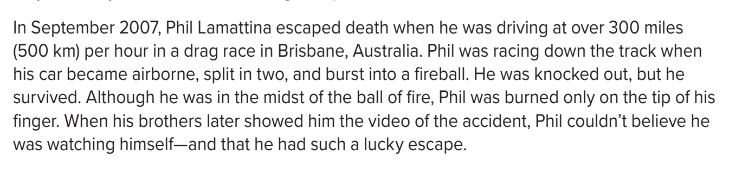
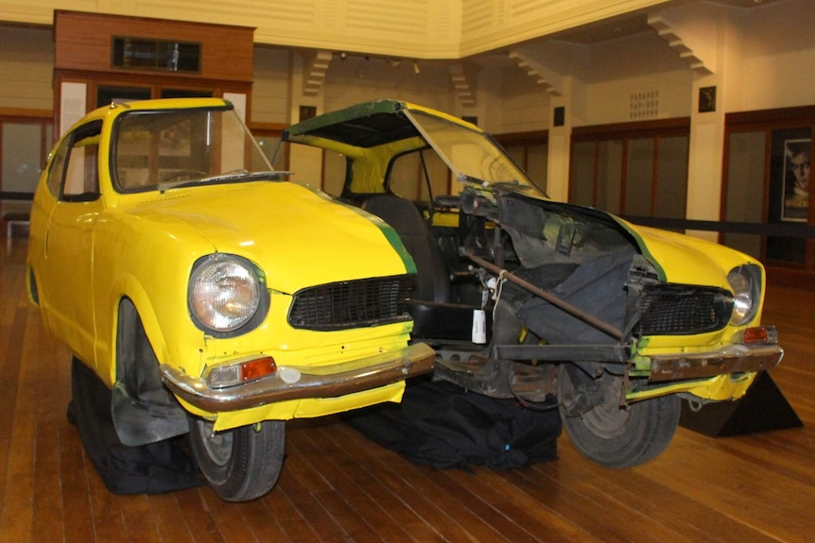
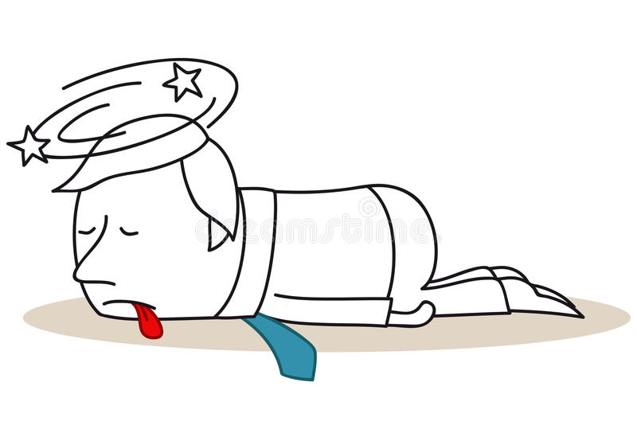
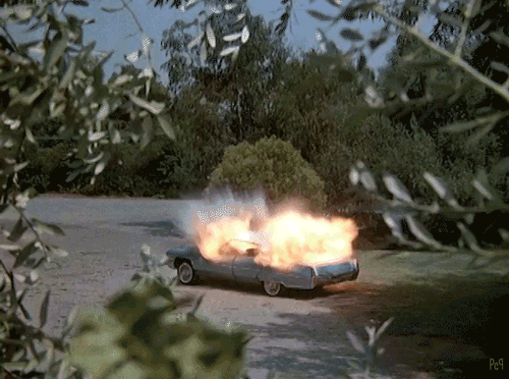
What happened to Phil Lamattina’s car?
His car became airborne, split in two, and burst into a fireball.
Is it happy or unhappy ending?
Underline the sentences that express that.
Happy ending
split
Knocked out
split

Slide 15
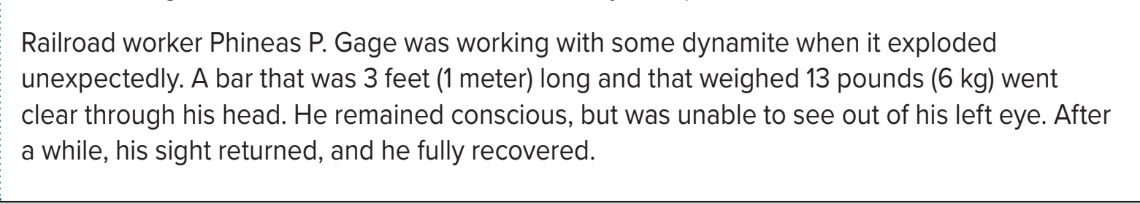
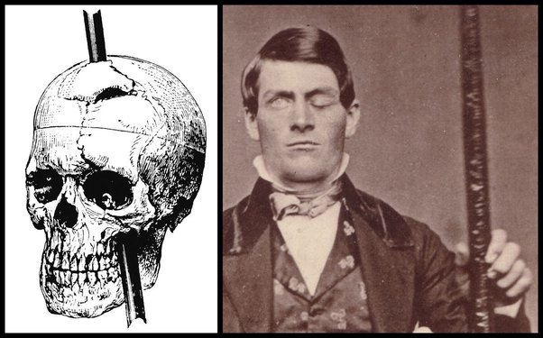
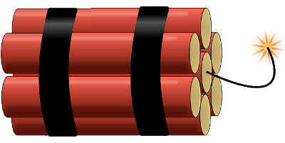
What damage happened to Phineas Gage?
He remained conscious but was unable to see out of his left eye.
Is it happy or unhappy ending?
Underline the sentences that express that.
Happy ending
dynamite
dynamite

Slide 16


Slide 17
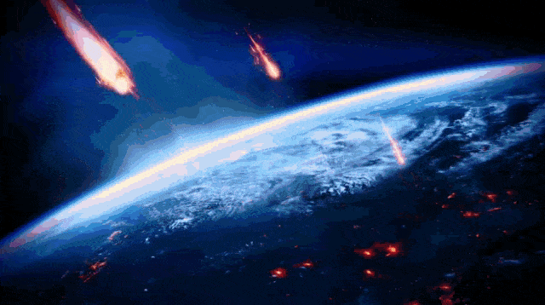
meteorite
a mass of stone or metal from space that reaches Earth

Slide 18

on the spot
immediately

Slide 19
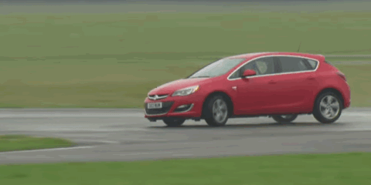
stall
when a motor stops working

Slide 20
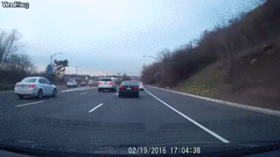
weave through
(traffic) = run in and out of the way of obstacles (cars), zigzag

Slide 21
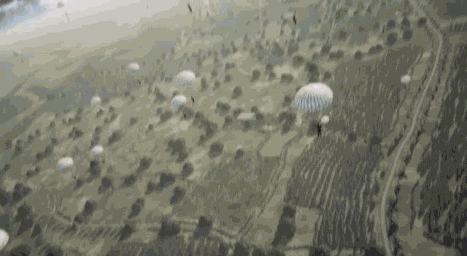
airborne
in the air

Slide 22

conscious
awake and able to understand what is going on

Slide 23
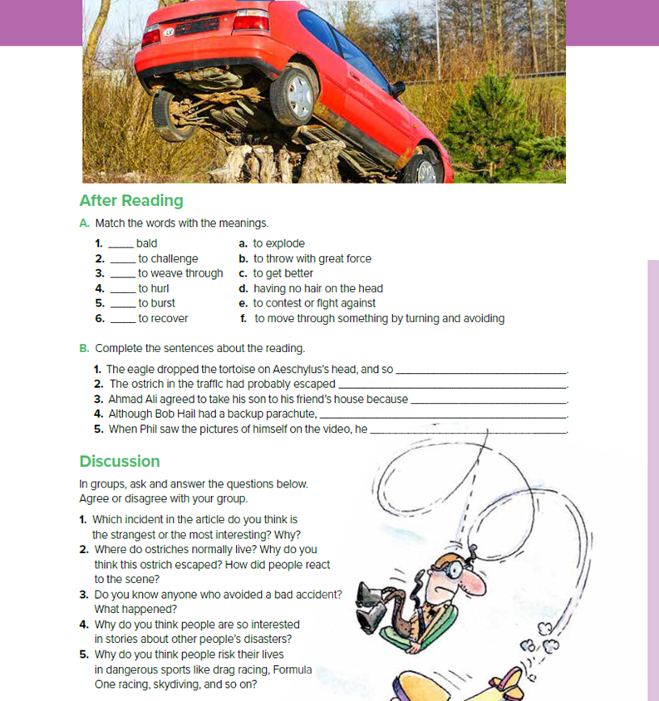
Open
Student’s book , p.( 11 )

Slide 24

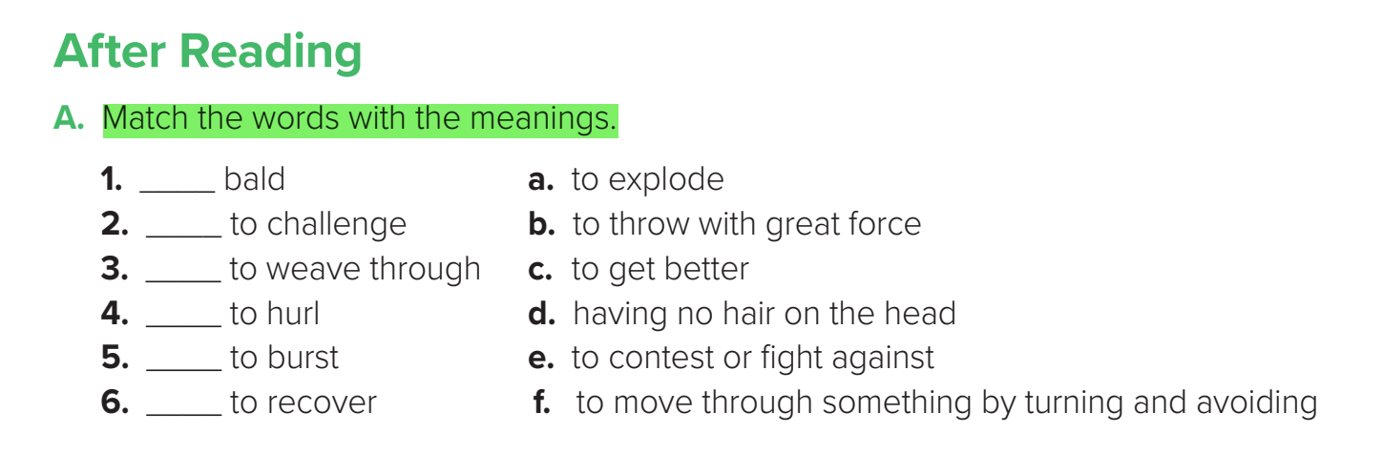
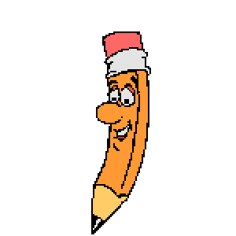
Student’s book p.(11)
d
e
f
b
a
c

Slide 25

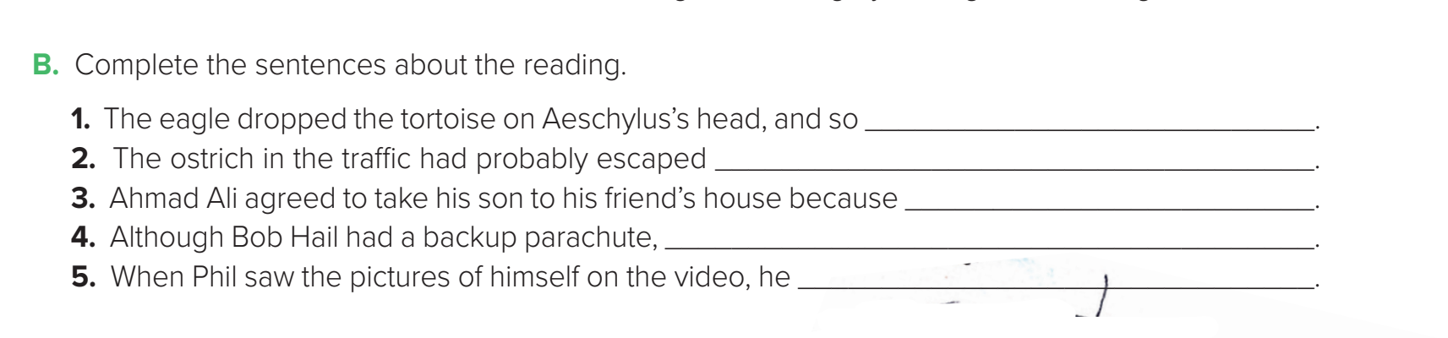
Student’s book p.(11)
Aeschylus was killed
from a farm
many children were invited and a lifeguard was going to be present
It didn’t open
couldn’t believe he survived

Slide 26
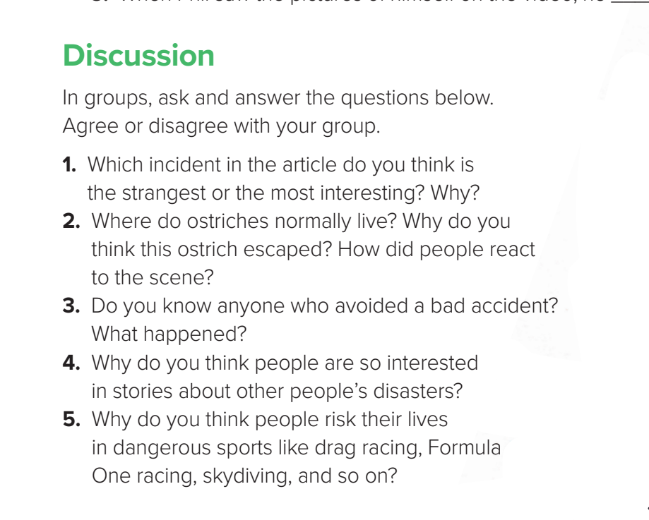


Slide 27
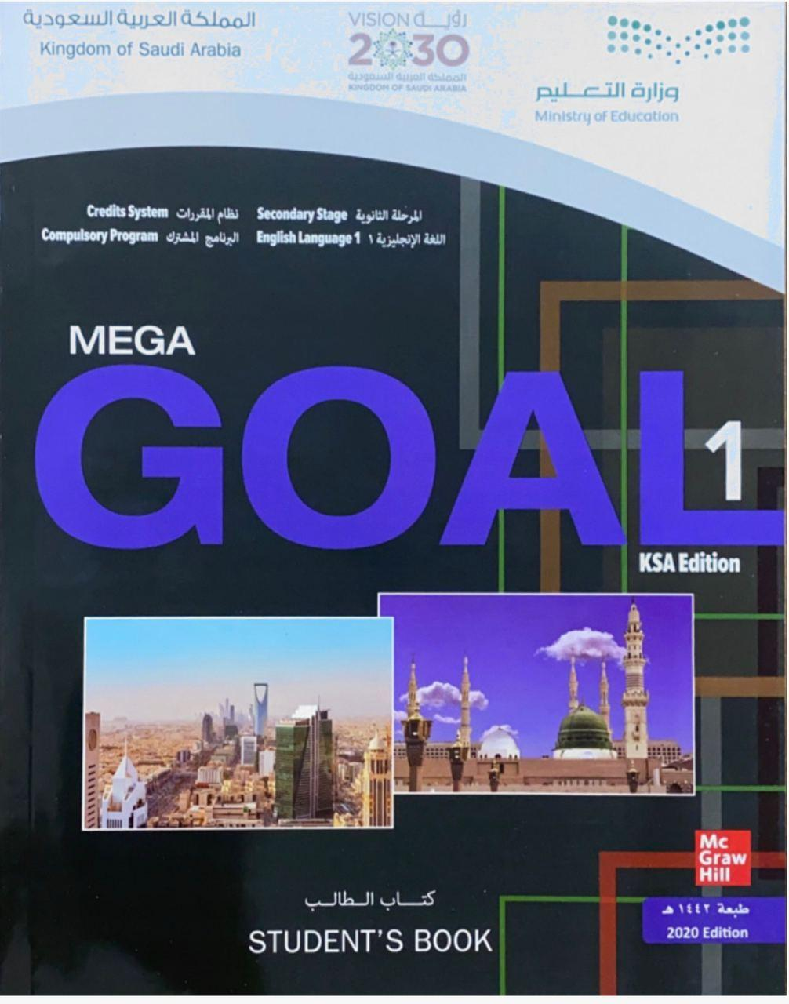
Homework
Your workbook exercise
( 81 ) p.( I )

Slide 28
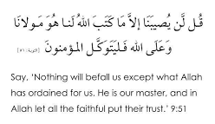
Always Remember

Slide 29

THANKS!

