Slide 1
Unit 1 Did You Hurt Yourself ? Language in Context + Conversation
Mega Goal 1.2
Done by; Entisar Al-Obaidallah

Slide 2
Lesson Objectives
01
02
03
Match
Use
Listen
Match words with their suitable pictures correctly.
real talk phrases in a conversation correctly .
For specific information correctly

Slide 3
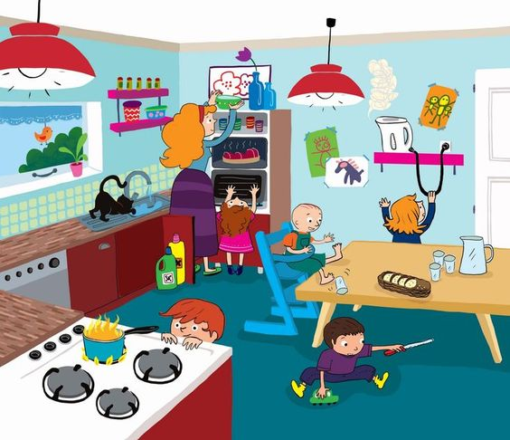
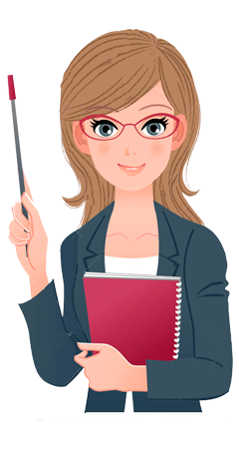
Warm up
Have ever faced or heard about household dangers?

Slide 4
b
f
a
c
d
e

Slide 5
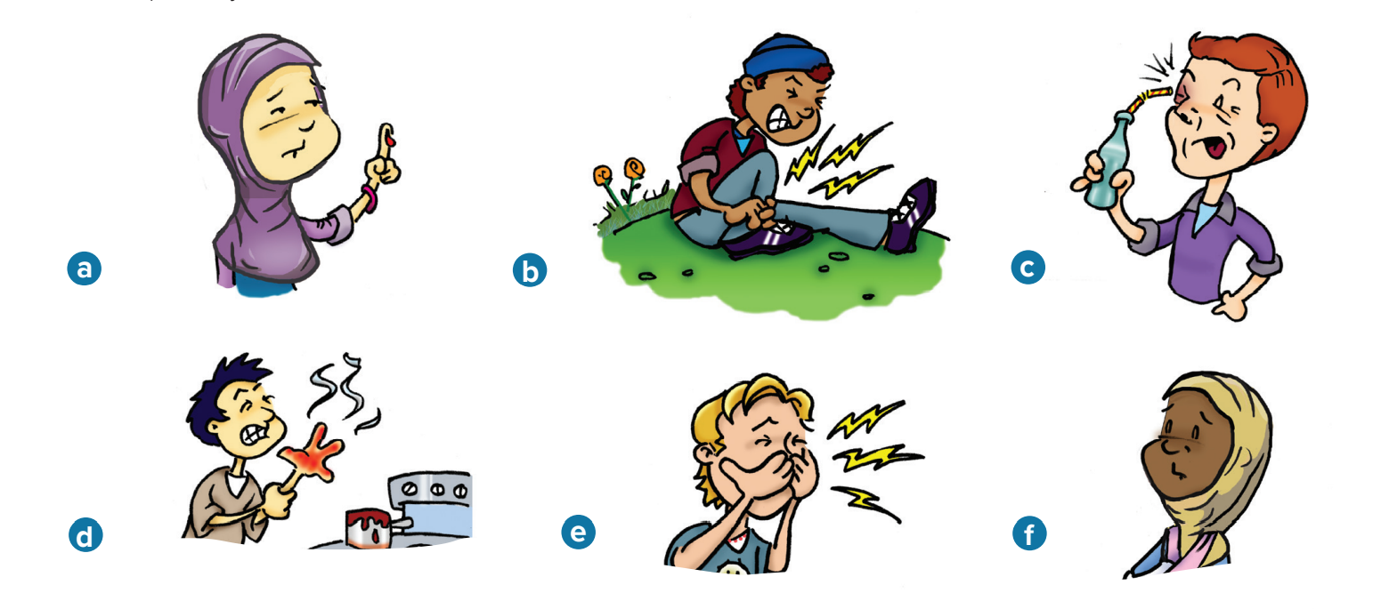
Describe each picture
1. He sprained his ankle.
2. He poked his eye.
3. She fractured her arm.
4. He burned his hand.
5. She cut her finger.
6. He broke his nose.

Slide 6
Read aloud the items in the chart
✓
✓
✓
✓
✓
✓

Slide 7
Consonants clusters
are where you have two or more consonants together in your pronunciation .

Slide 8
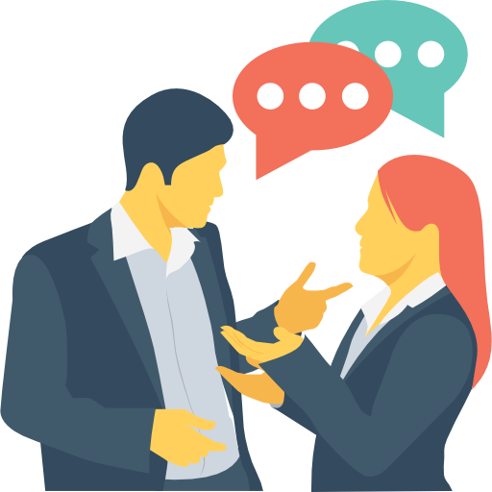

Slide 9
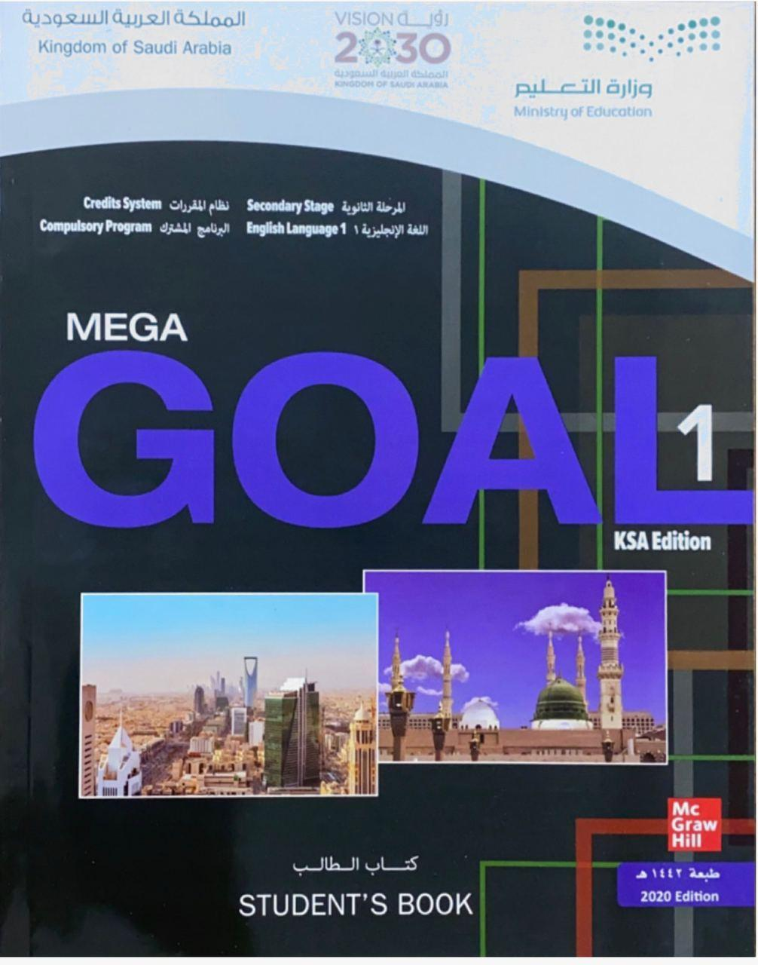
Open
Student’s book , p. ( 8)

Slide 10
Open
Student’s book , p. ( 9)

Slide 11
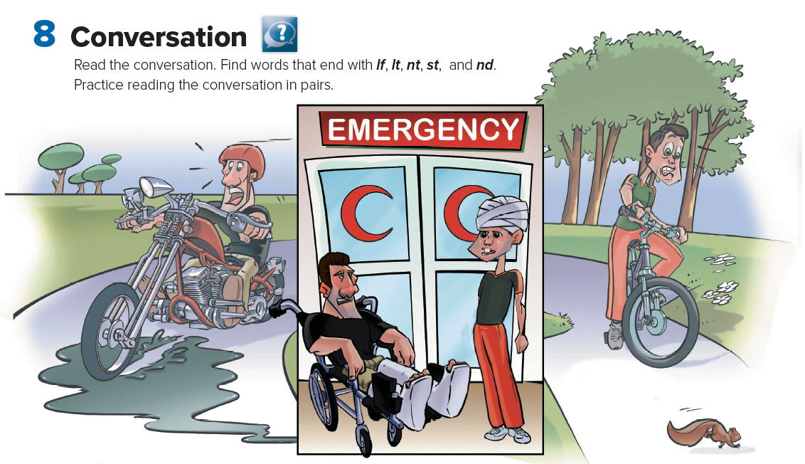
What Can You see in the picture?

Slide 12
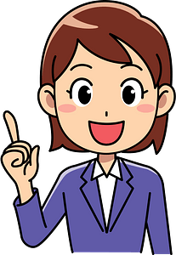
Who are the speakers?
Samir & Jasem
What do you think they are taking about?
About accidents
Listen and Read along

Slide 13
What happened to Jasem first ?
What happened to Samir’s motorcycle ?
What saved Samir’s life ?
Where was Jasem cycling ?
What made Jassim lose his balance and hit a tree ?

Slide 14
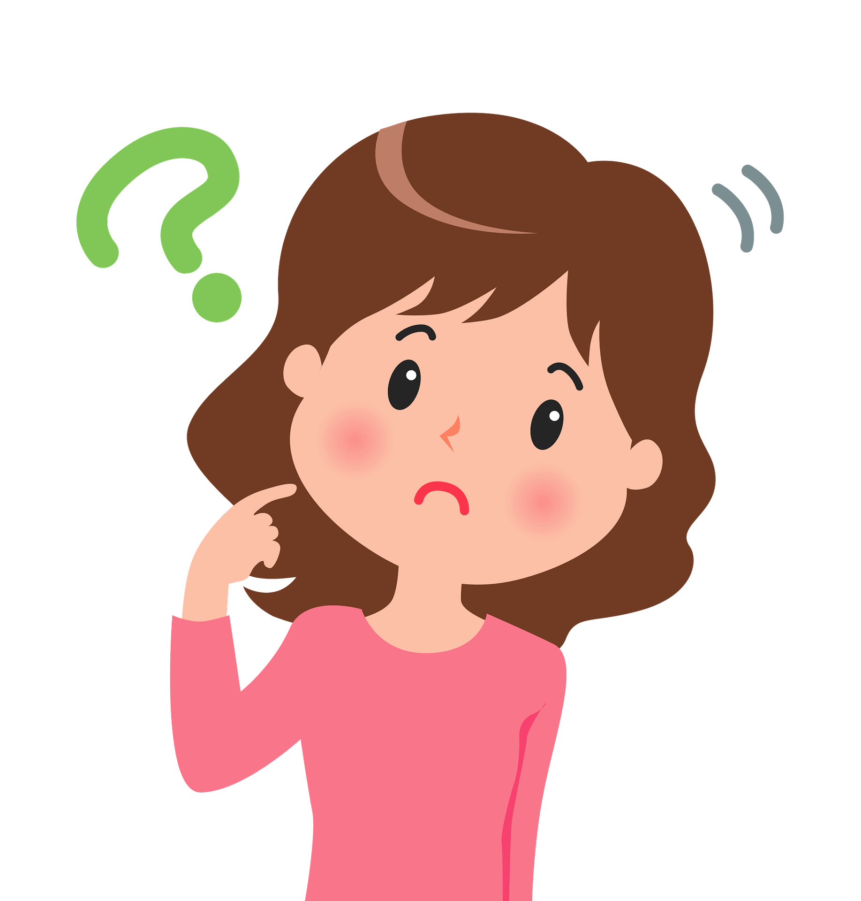

Slide 15
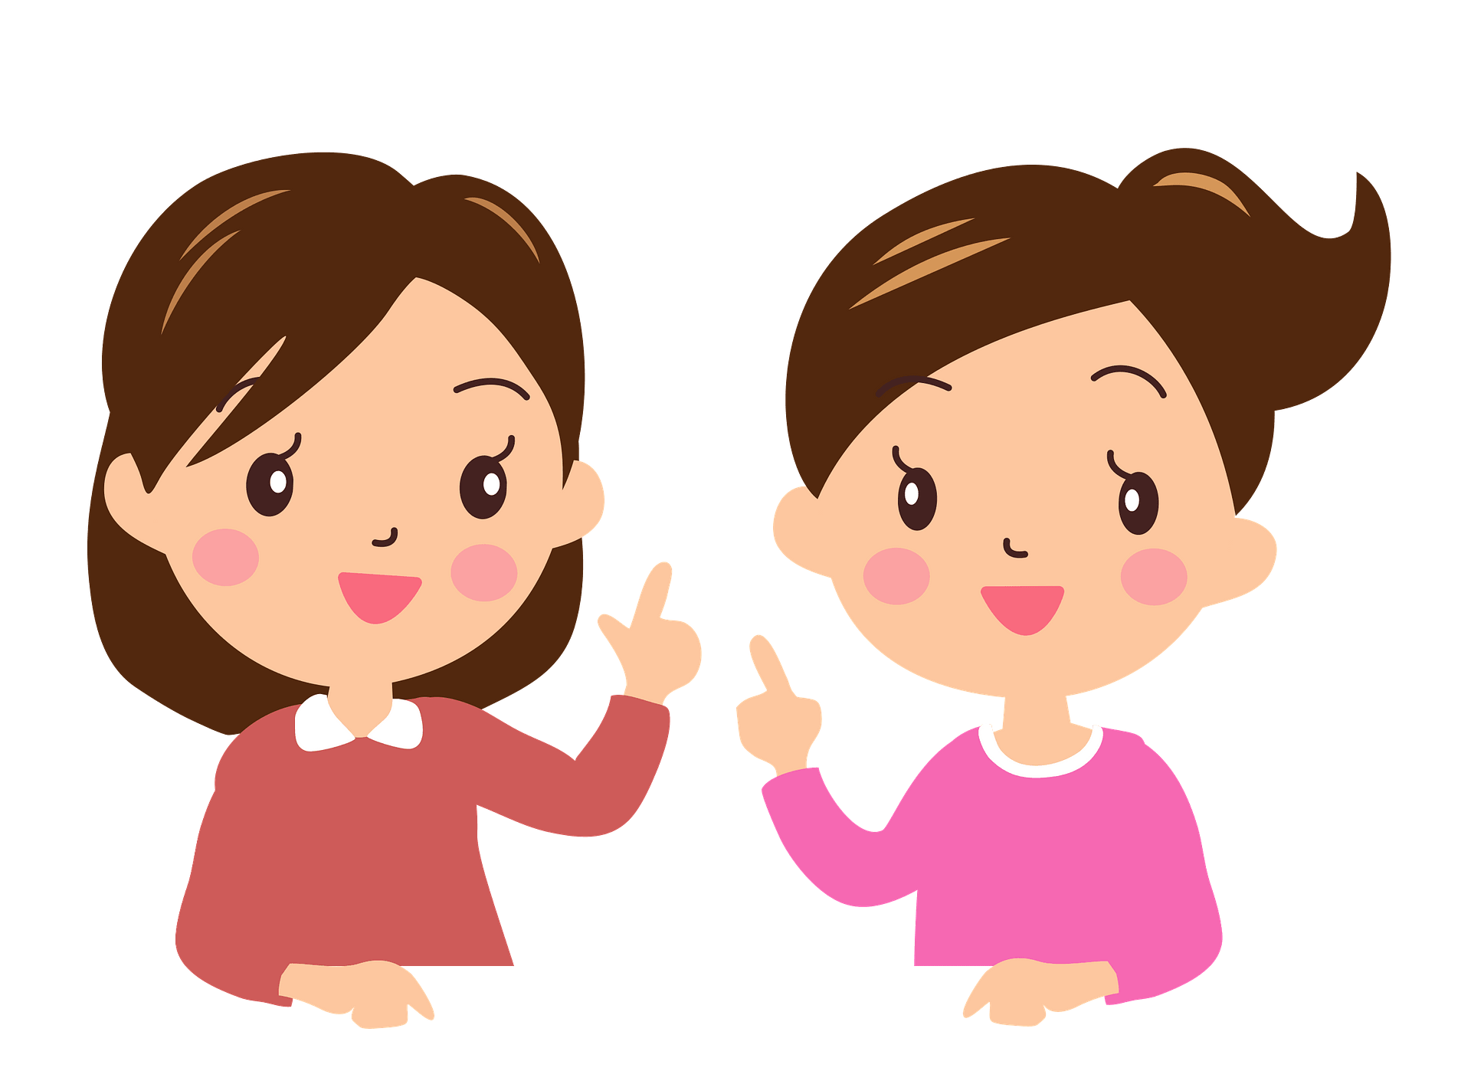
Who says ………
it was your lucky day?
Samir

Slide 16
Who says ………
stuck in a wheelchair?
Jasem

Slide 17
Who says ………
Look at it this way?
Samer

Slide 18
Read the words and their meaning:

Slide 19
1. Samir’s motorcycle skidded on a patch of oil, and it crashed into a car.
2. He was lucky because he was wearing a helmet, and it probably saved his life.
3. Jasem was cycling in the park. A squirrel ran in front of him, so he swerved to avoid it and hit a tree.
4. Jasem is sorry for Samir because he is going to be stuck in a wheelchair for a while.
5. He says that with two casts, he has enough room for all his friends to write their names on his casts.

Slide 20
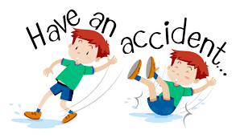
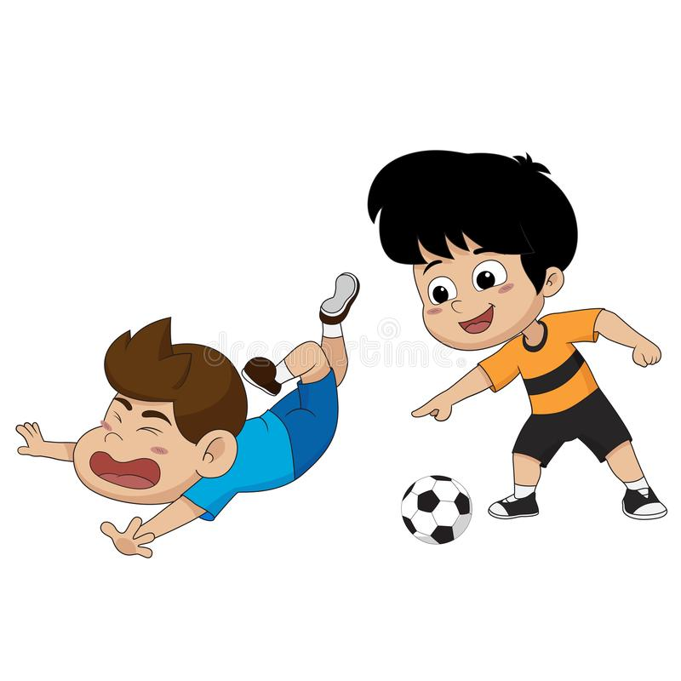
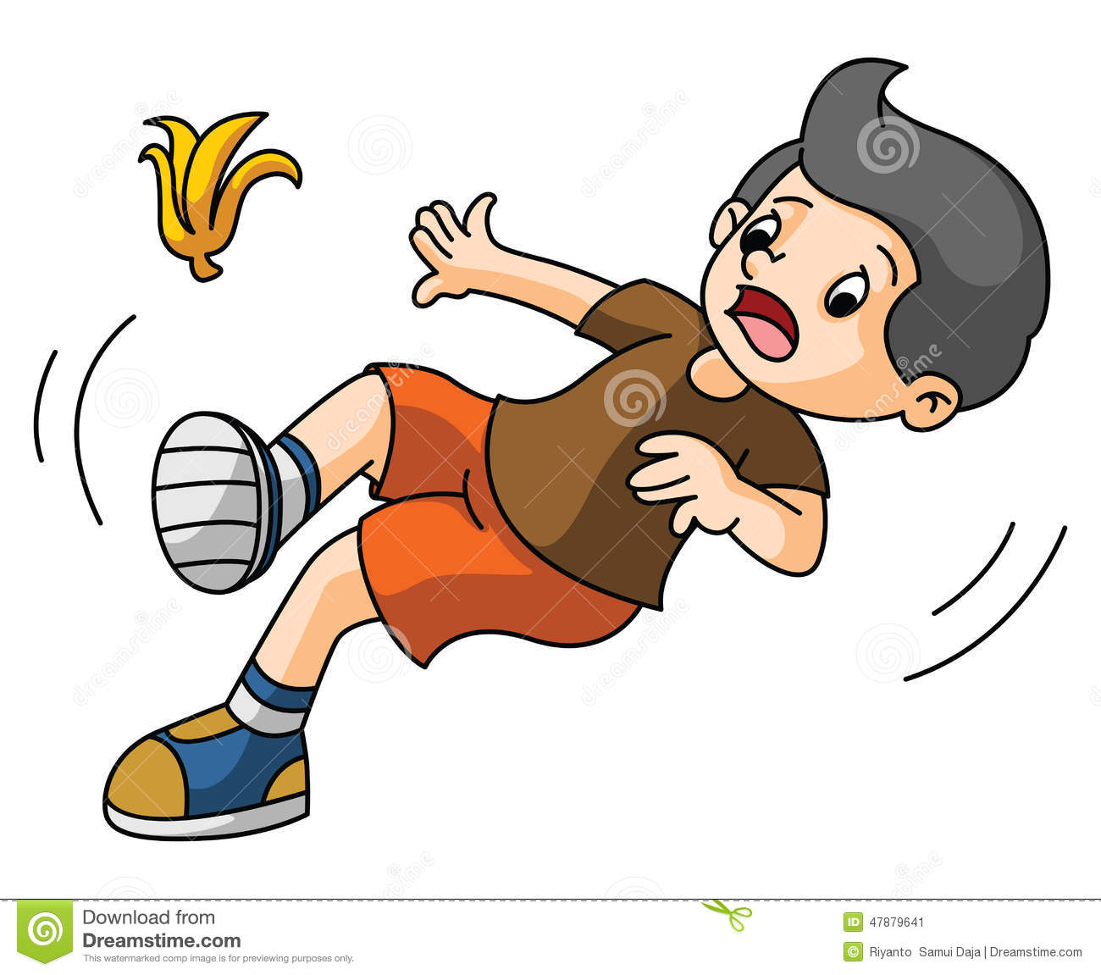

Slide 21
Homework
Workbook p.( 80 ) , exercise ( H )

Slide 22
THANKS!

