Slide 1



Unit 2
Take My Advice
Mega Goal 1.2
Listen & Discuss
Done by: Entisar Al-Obaidallah

Slide 2
Lesson Objectives
Name
Recognize
01
02
Listen
Answer
03
04
a helping website .
expressions of advice correctly
for some advices to discuss each one.
Some questions correctly

Slide 3
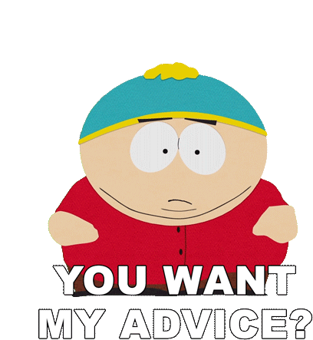


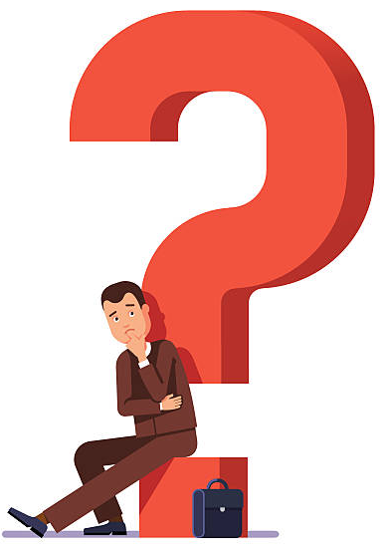
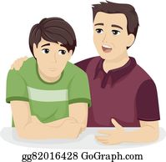
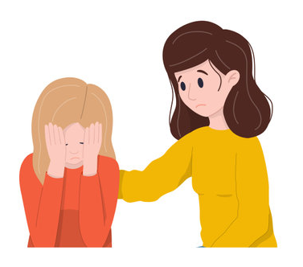

Warm up
Do you go online to get advice?
Who do you go to?
What do you do when you have problems?
What kind of problem do you have?

Slide 4
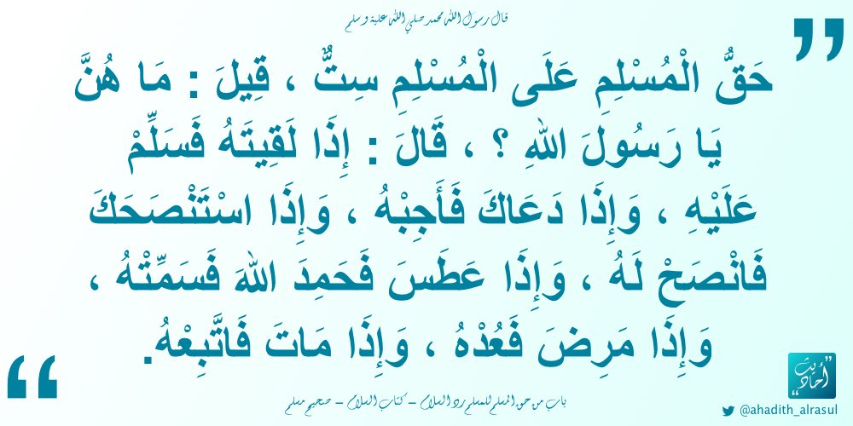
“Give advice when you’re asked to”

Slide 5
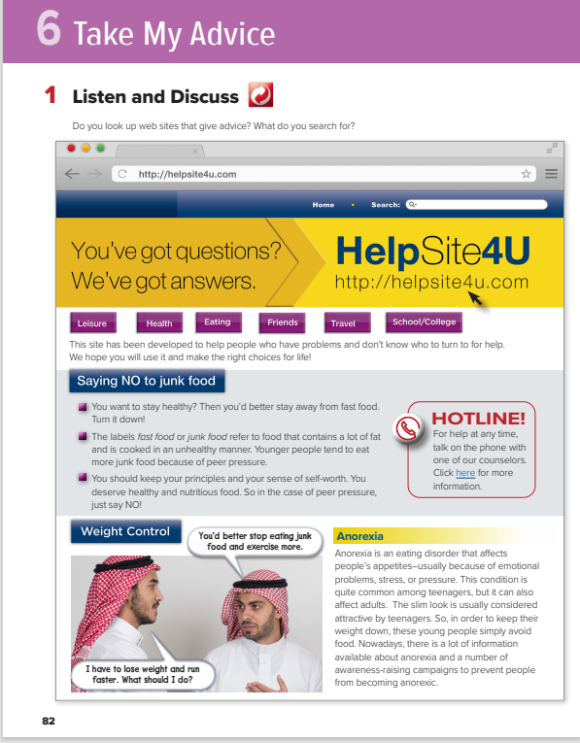
Open
Your student’s book , p.(18)

Slide 6
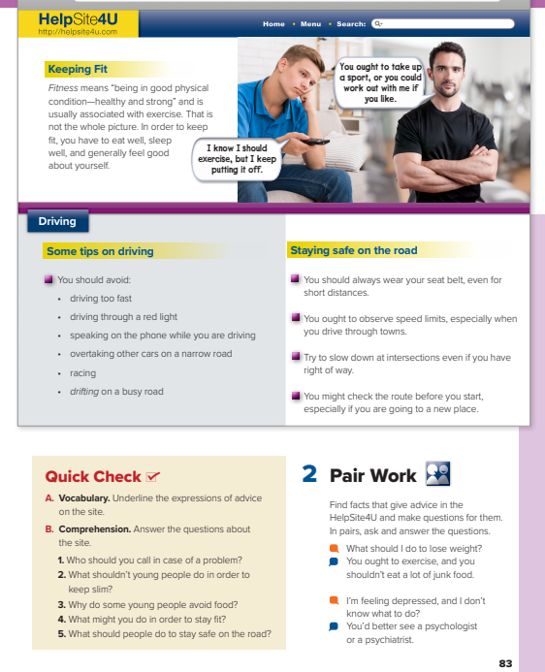
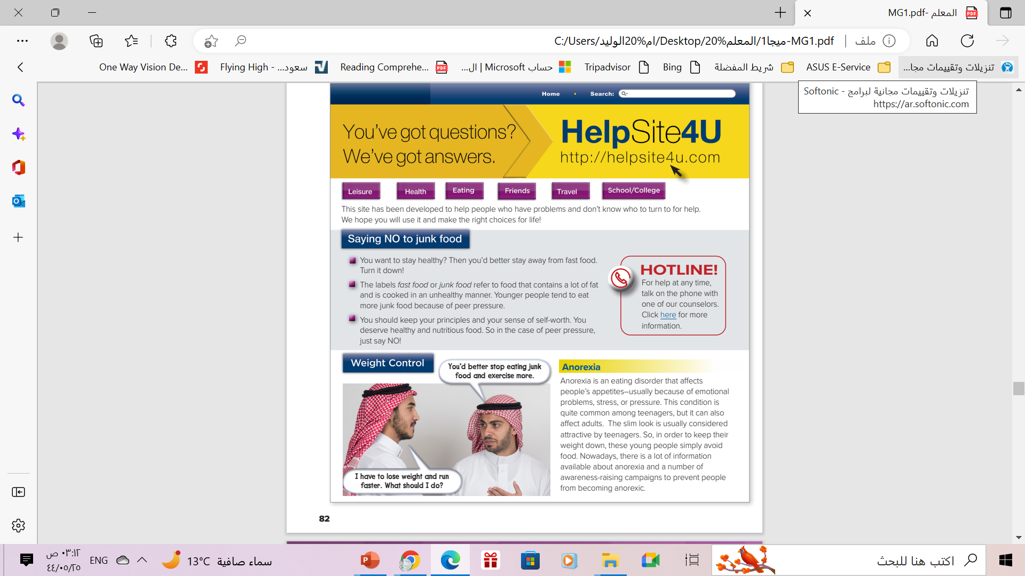
What is the title?
3
What is the address?
4
1
What are the 6 sections?
What are the 4 subtitles?
2

Slide 7
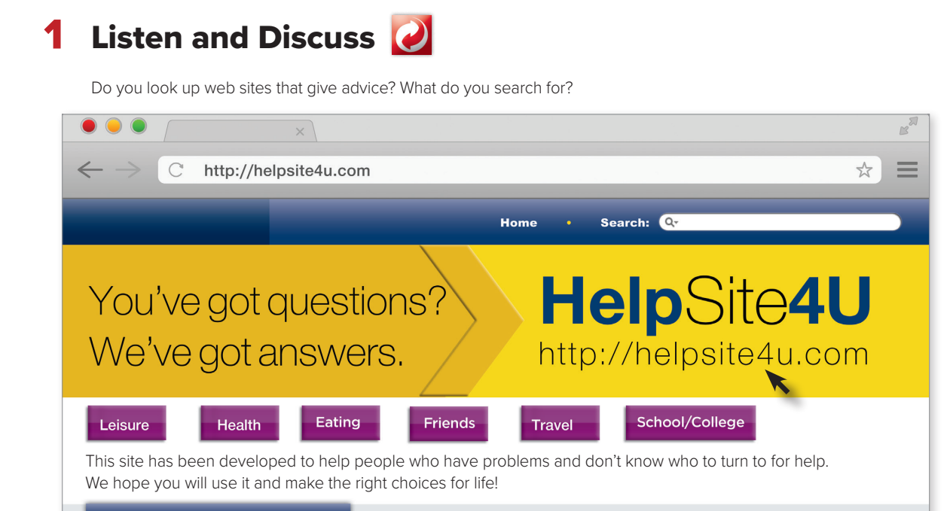
What is the name of the website?
Why has this site been developed?

Slide 8
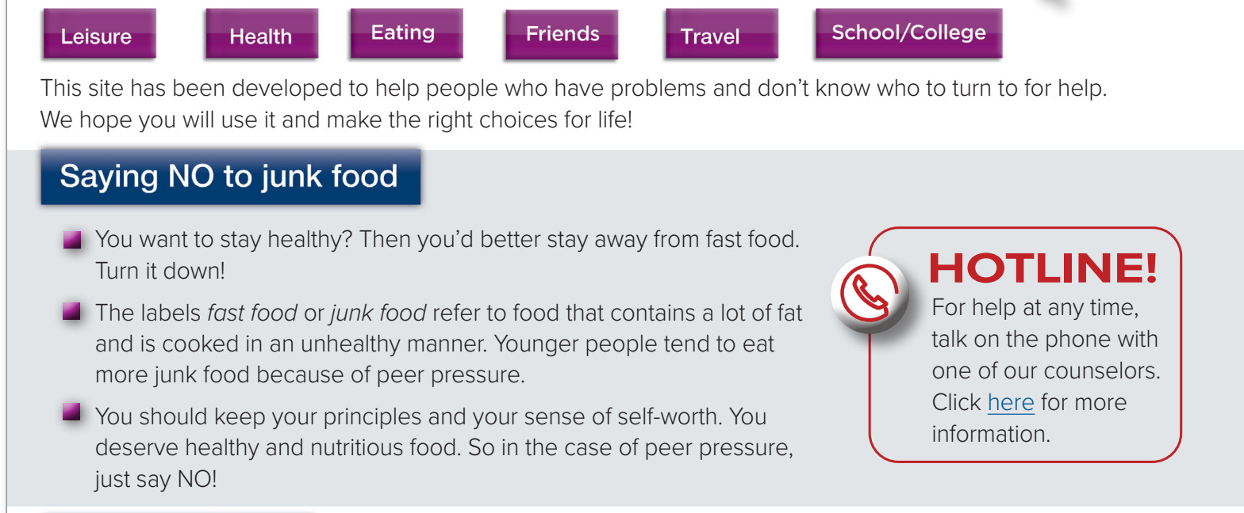


How to stay healthy?
What is it for?
Why Younger people tend to more junk food
How to avoid junk food
turn to = go to for help
stay away from = avoid
turn down = refuse
Underline the phrasal verbs

Slide 9
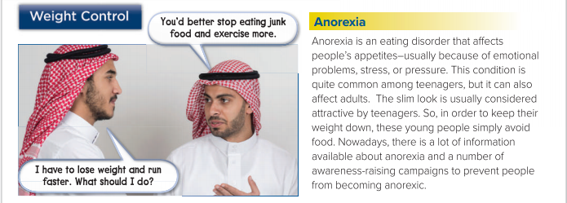
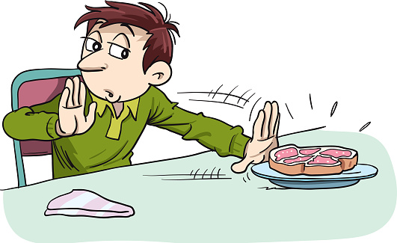
What is “anorexia”?
Underline the phrasal verbs
keep down = control

Slide 10
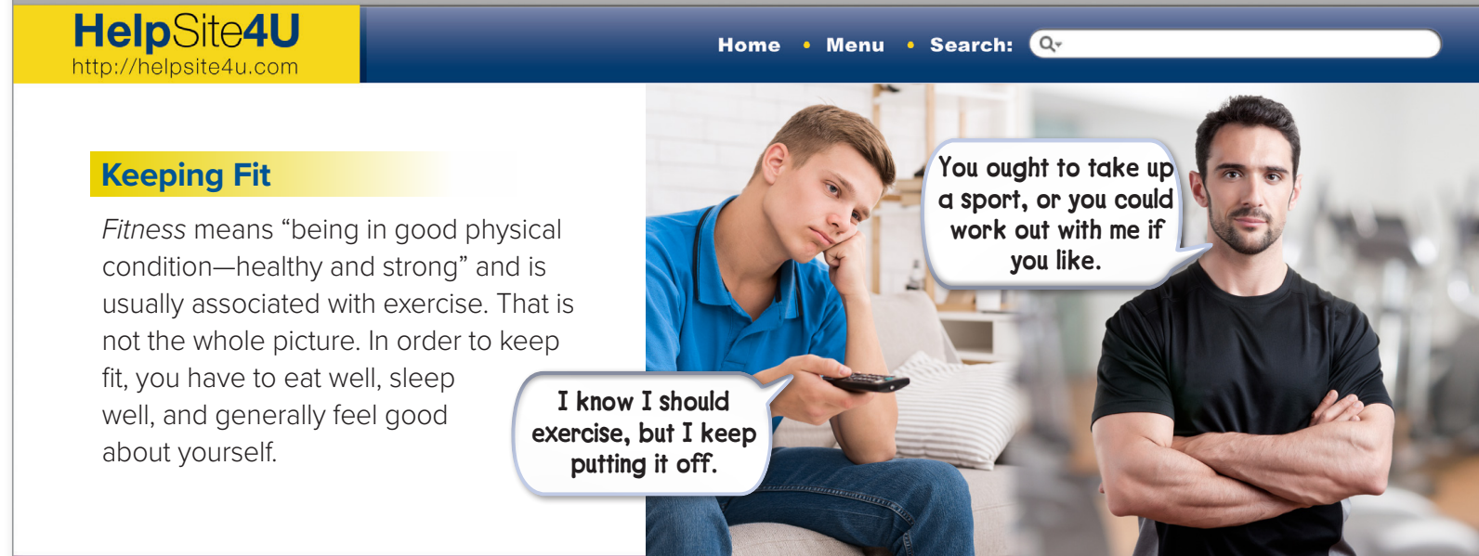
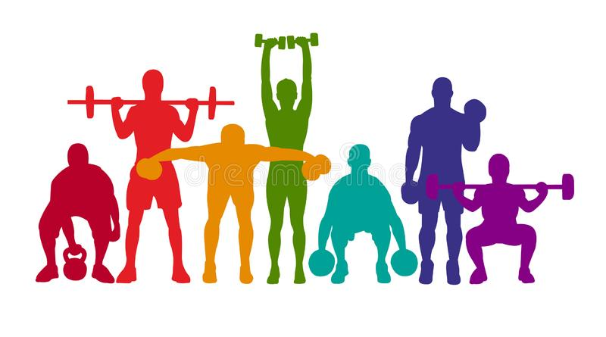
What does “Fitness”
mean?
Underline the phrasal verbs that mentioned in the dialogue.
put off = postpone
take up = start, learn how to play
work out = exercise

Slide 11
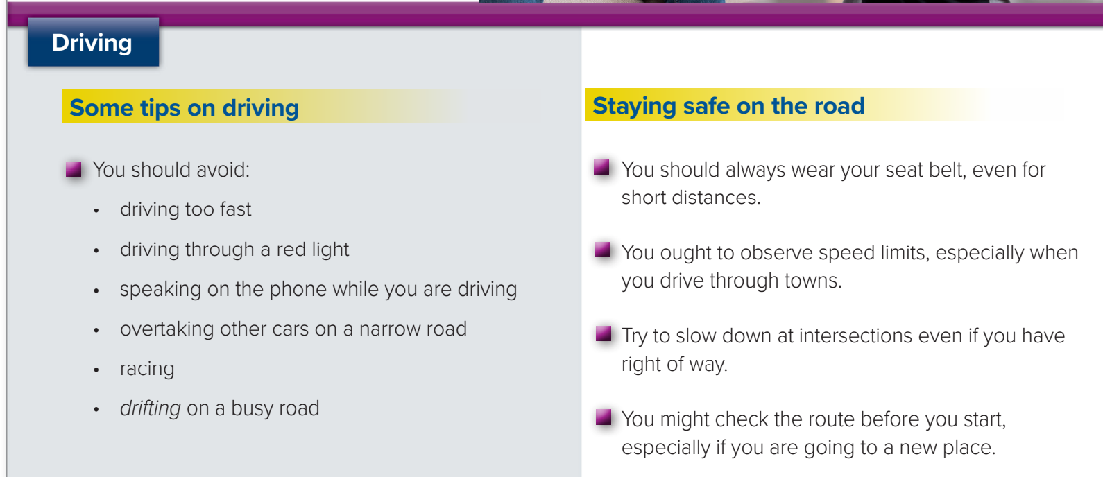

Tips you shouldn’t do while driving
Tips you should do while driving

Slide 12
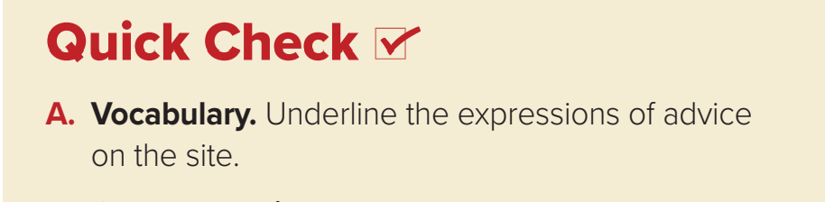
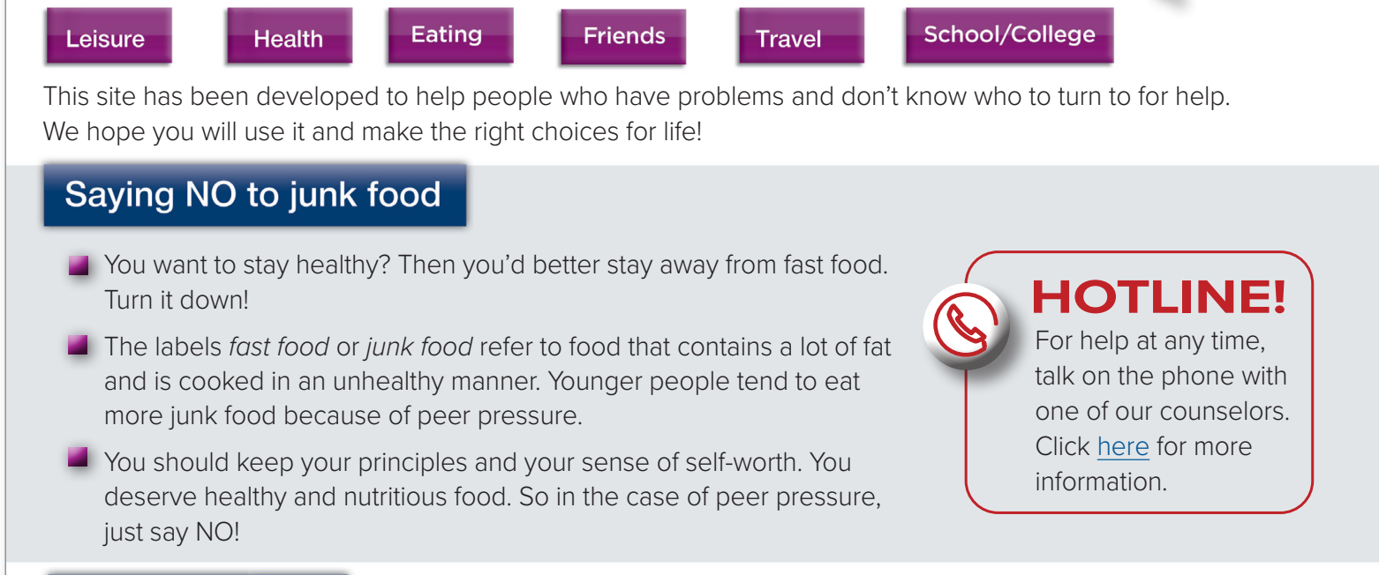
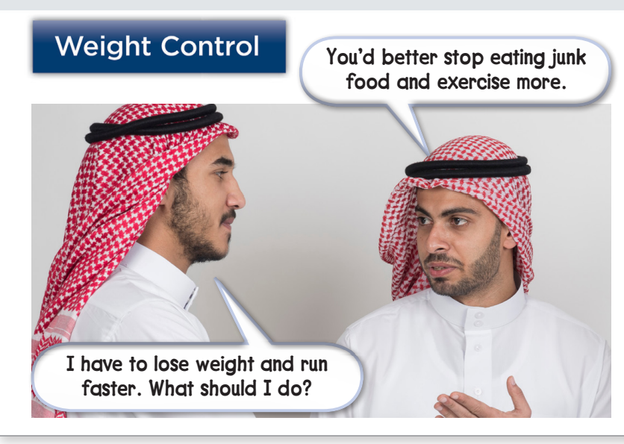

Slide 13
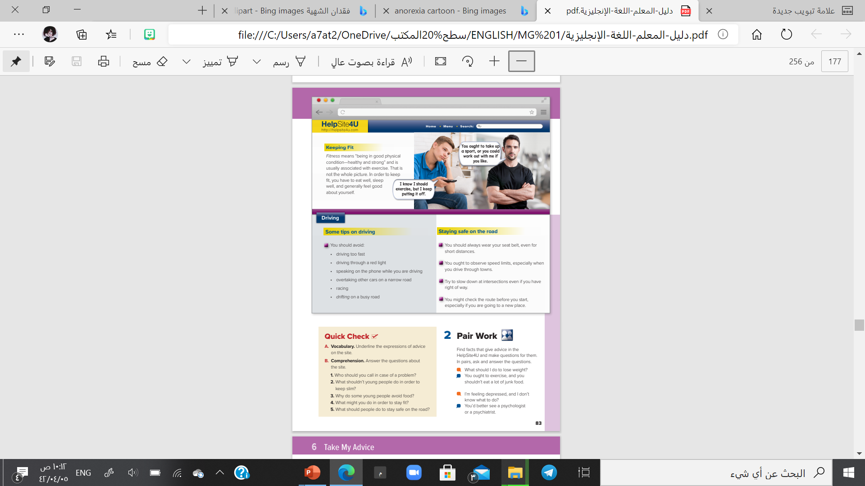
Open
Your student’s book
p.( 19 ) .

Slide 16


1- You should call the counselors on the website.
2. They shouldn’t avoid food.
3. Some young people avoid food to look attractive.
4. You might take up a sport or work out.
5. They should wear their seat belt. They should
slow down on intersections

Slide 17
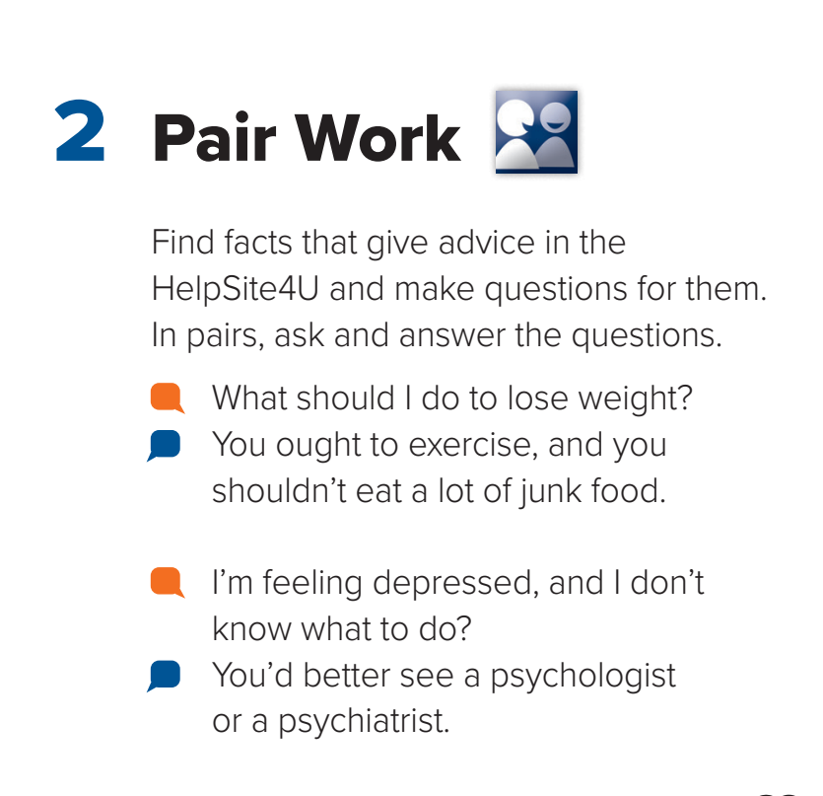



Slide 18
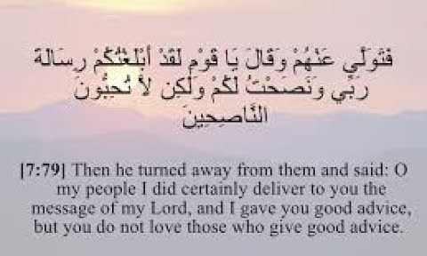
Rmember

Slide 19

Home Work
Workbook p.( 87 ) ,
exercise ( A )

Slide 20

Thank you!

