Slide 1
Unit2
Take My A dvice
Form, Meaning & Function
Mega Goal 1.2
Done by: Entisar Al-Obaidallah

Slide 2
Lesson Objectives
01
02
03
04
05
06
Ask
Distinguish
Express
a question about quantity correctly
between countable and uncountable correctly
quantity in a sentence correctly
Connect
Use
Apply
clauses with “ When “ correctly
words connected with medicine correctly
the rules to do the exercises correctly

Slide 3
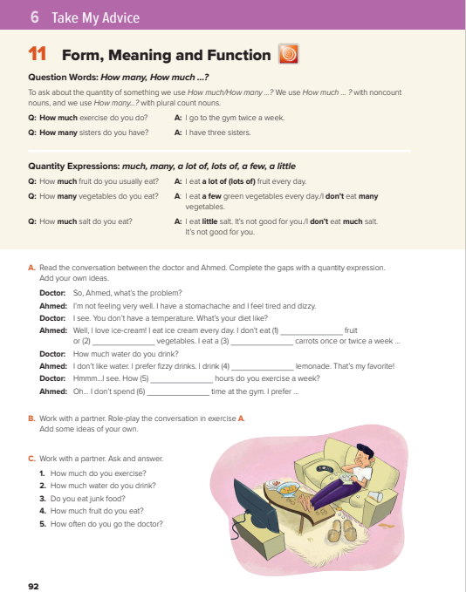
Open
Student’s book , p. ( 28)

Slide 4
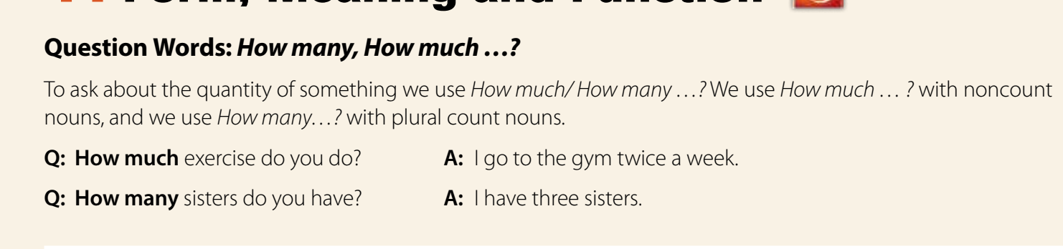

Slide 5


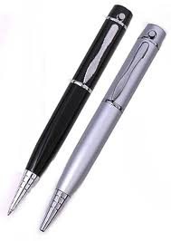
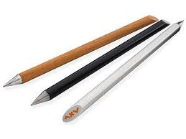
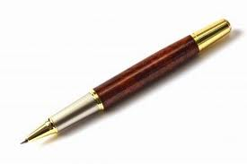
What is the difference between
countable & uncountable
Countable nouns are nouns that t we count them .
For example: one carrot, two carrots, etc.
They have singular and plural forms.
Example
Two pens
three pens
One pen
plural
plural
singular

Slide 6
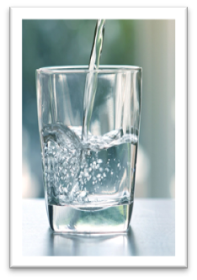
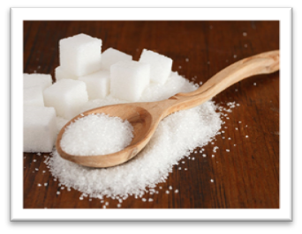
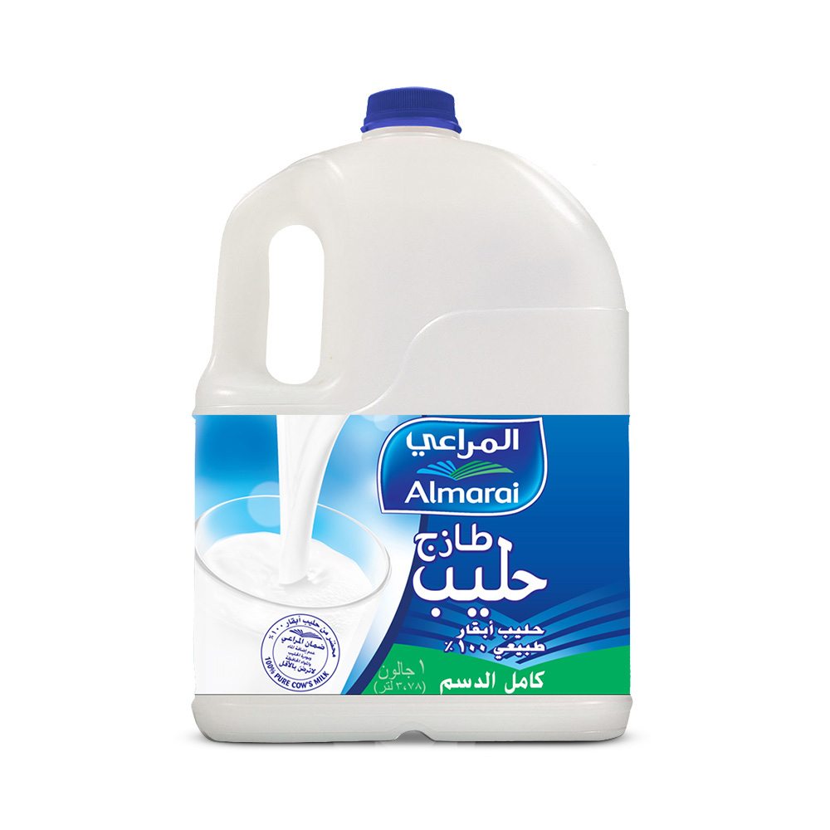
What is the difference between
countable & uncountable
Uncountable nouns :nouns that you can’t count them : rice, tea.
They don’t use a/an. They don’t have plural forms.
Example
milk
sugar
water

Slide 7


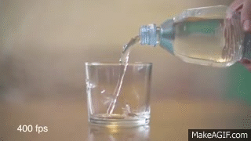
HOW MANY ….? Vs HOW MUCH …..?( Question)
How many…?
used to ask about
countable nouns.
How much…?
used to ask about
uncountable nouns.
countable
Example
How Many books are in the library ?
uncountable
How much water do you drink a day?

Slide 8
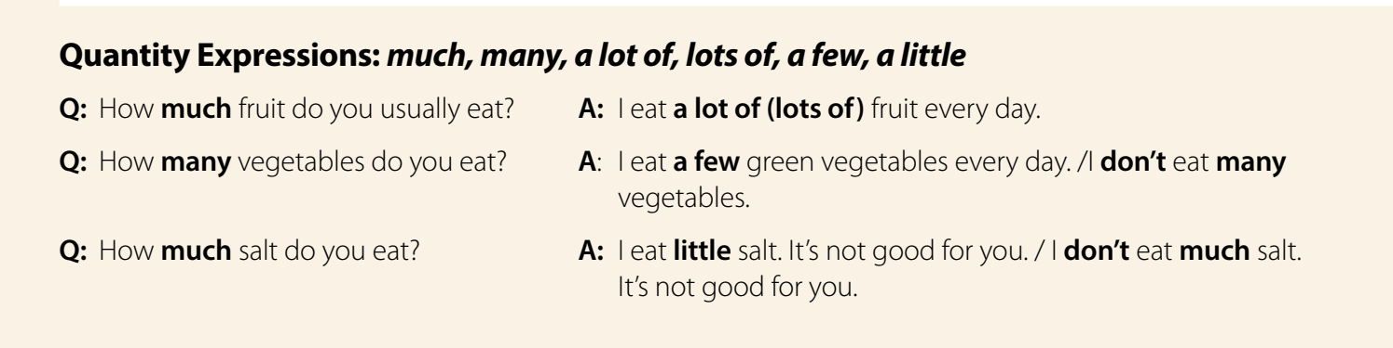

Slide 9


Many vs Much
Much is used if the noun is non-countable (e.g., water, sand).
Example
uncountable
I don’t have much money.
Many is used if the noun is countable (e.g., oranges, children).
Example
countable
She does not have many friends.

Slide 10
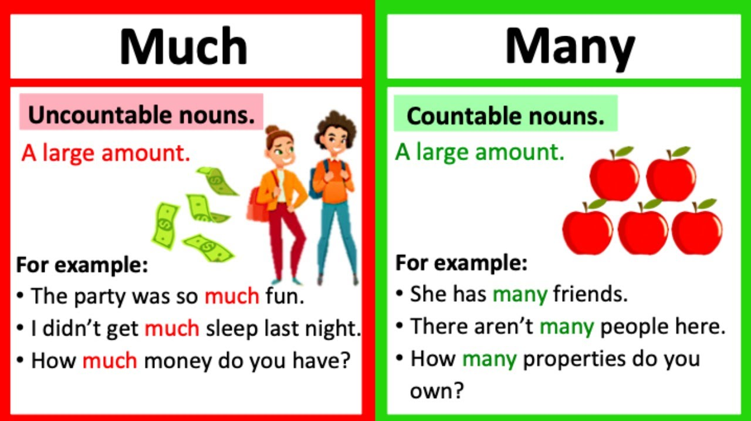
Many vs Much

Slide 11


Slide 12

1- We saw _____ animals at the zoo.
2- How _____ oranges did you put in the box?
3- There isn’t _____ sugar in my coffee.
4- I don’t have ______ friends.
5- The old man hasn’t got _____ hair on his head.
6- I’ve packed _____ bottles of water.
7- I didn’t get _____ sleep last night.
8- How _____ fruit do you eat in an average day?
many
many
much
many
much
many
much
much

Slide 13
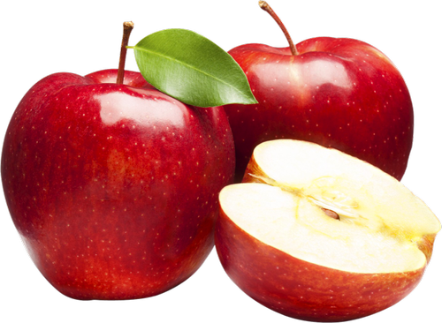
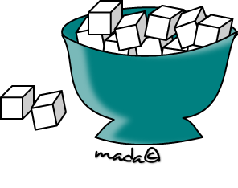
A few vs A little
A few used to express a positive idea with plural countable nouns
Example
countable
There are a few apples in the fridge
A little used to express a positive idea with singular uncountable nouns.
Example
uncountable
I need a little sugar in my tea.

Slide 14

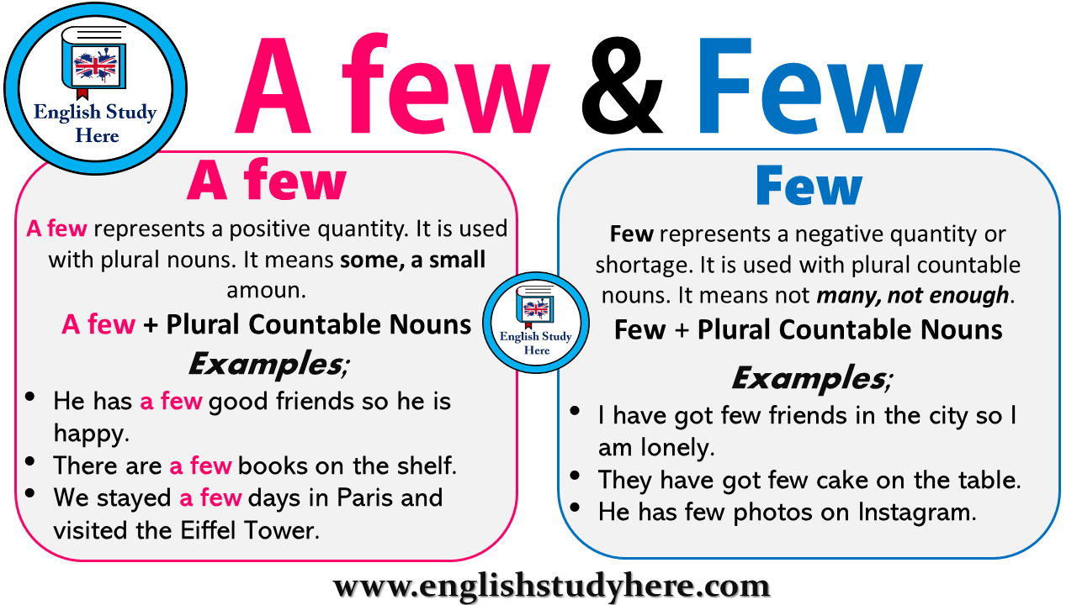

Slide 15
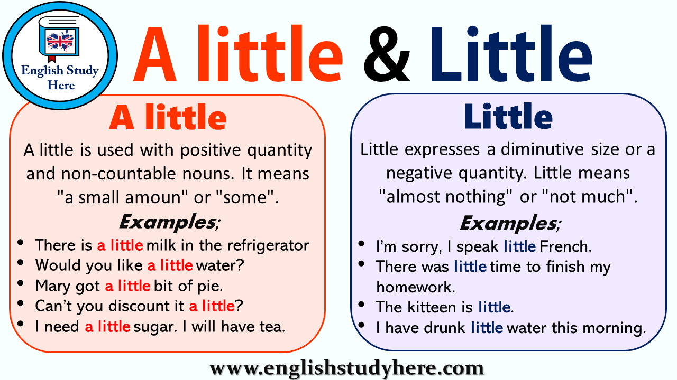

Slide 16

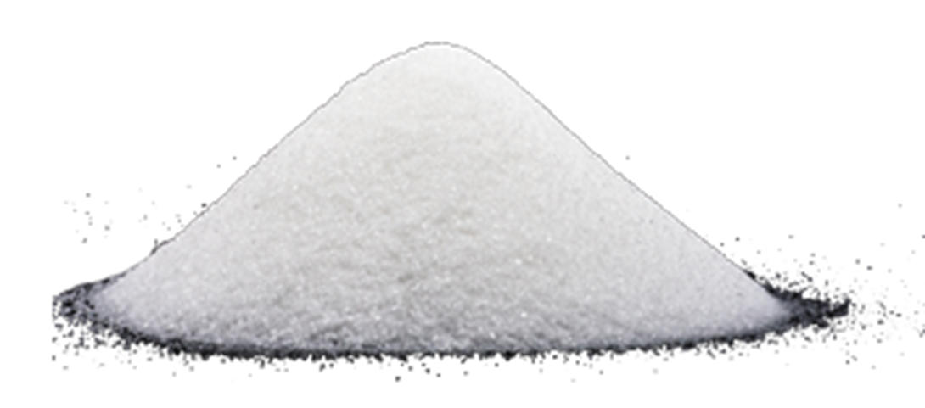
A lot of vs lots
a lot of used with countable and uncountable nouns
Example
countable
There are a lot of students in the class
uncountable
There is a lot of sugar in the kitchen

Slide 17
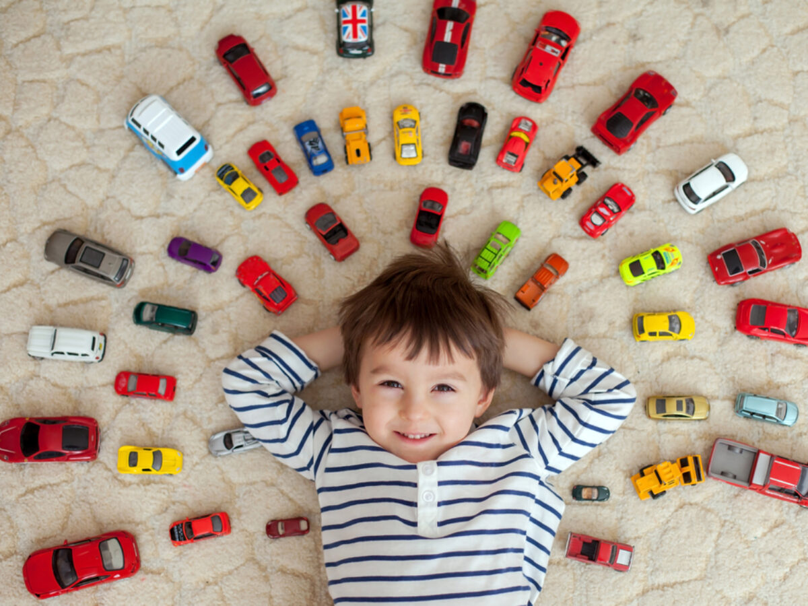
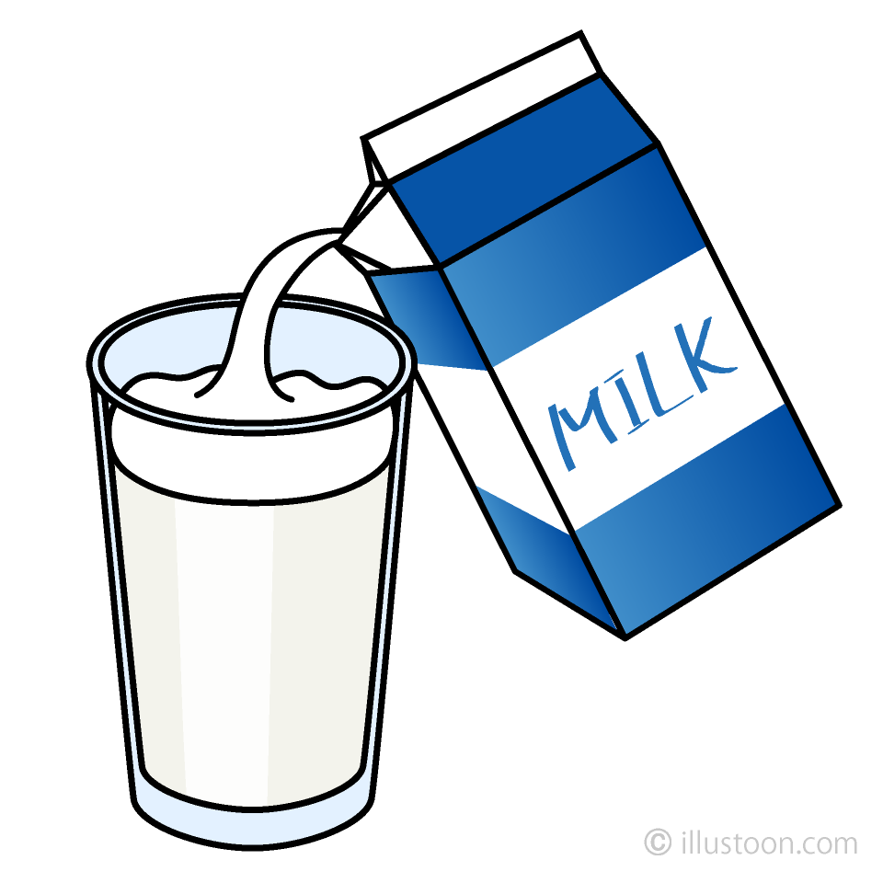
A lot of vs lots
lots of means a large number of amount. It can be used for countable or
uncountable nouns (negative, positive and question) countable and uncountable nouns
countable
Example
I have lots of toy cars.
uncountable
There is lots of milk in the glass.

Slide 18
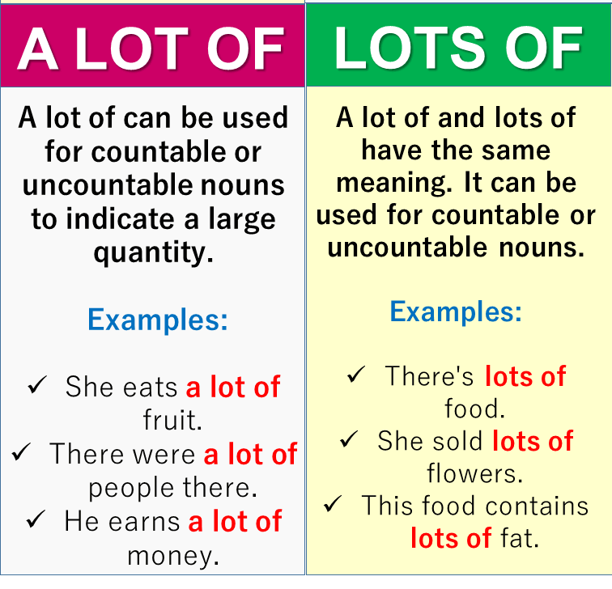

Slide 20
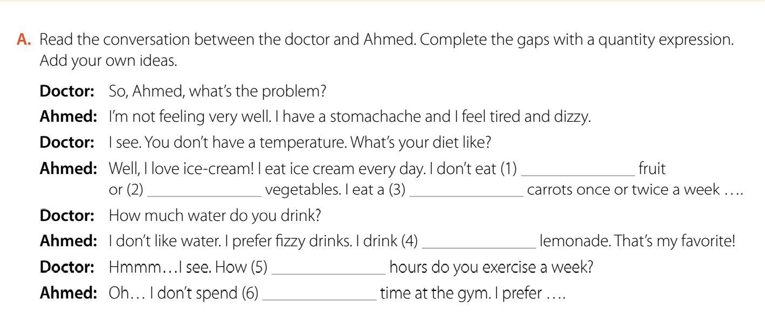
much
many
few
a lot of/lots of
many
much

Slide 21
Extra Activities
https://www.liveworksheets.com/kp356299pd
https://www.liveworksheets.com/su515595rb
https://www.liveworksheets.com/gq3069279xj

Slide 22
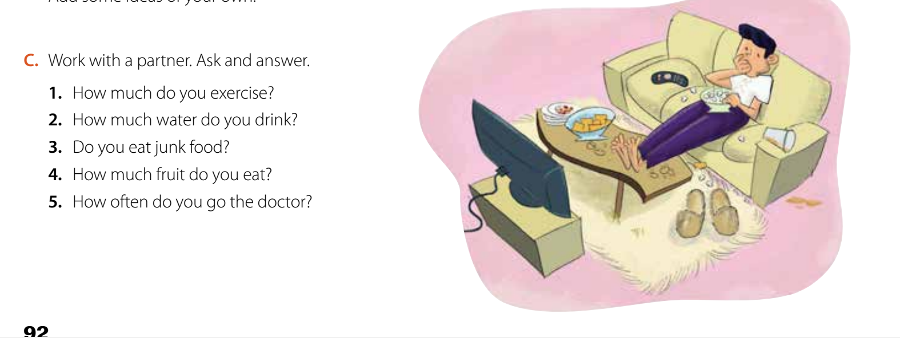
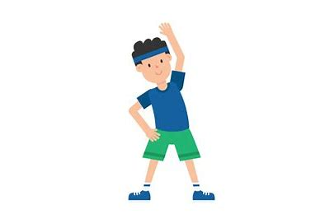
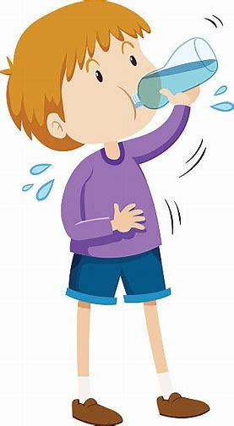
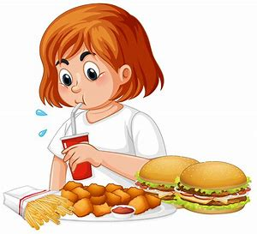
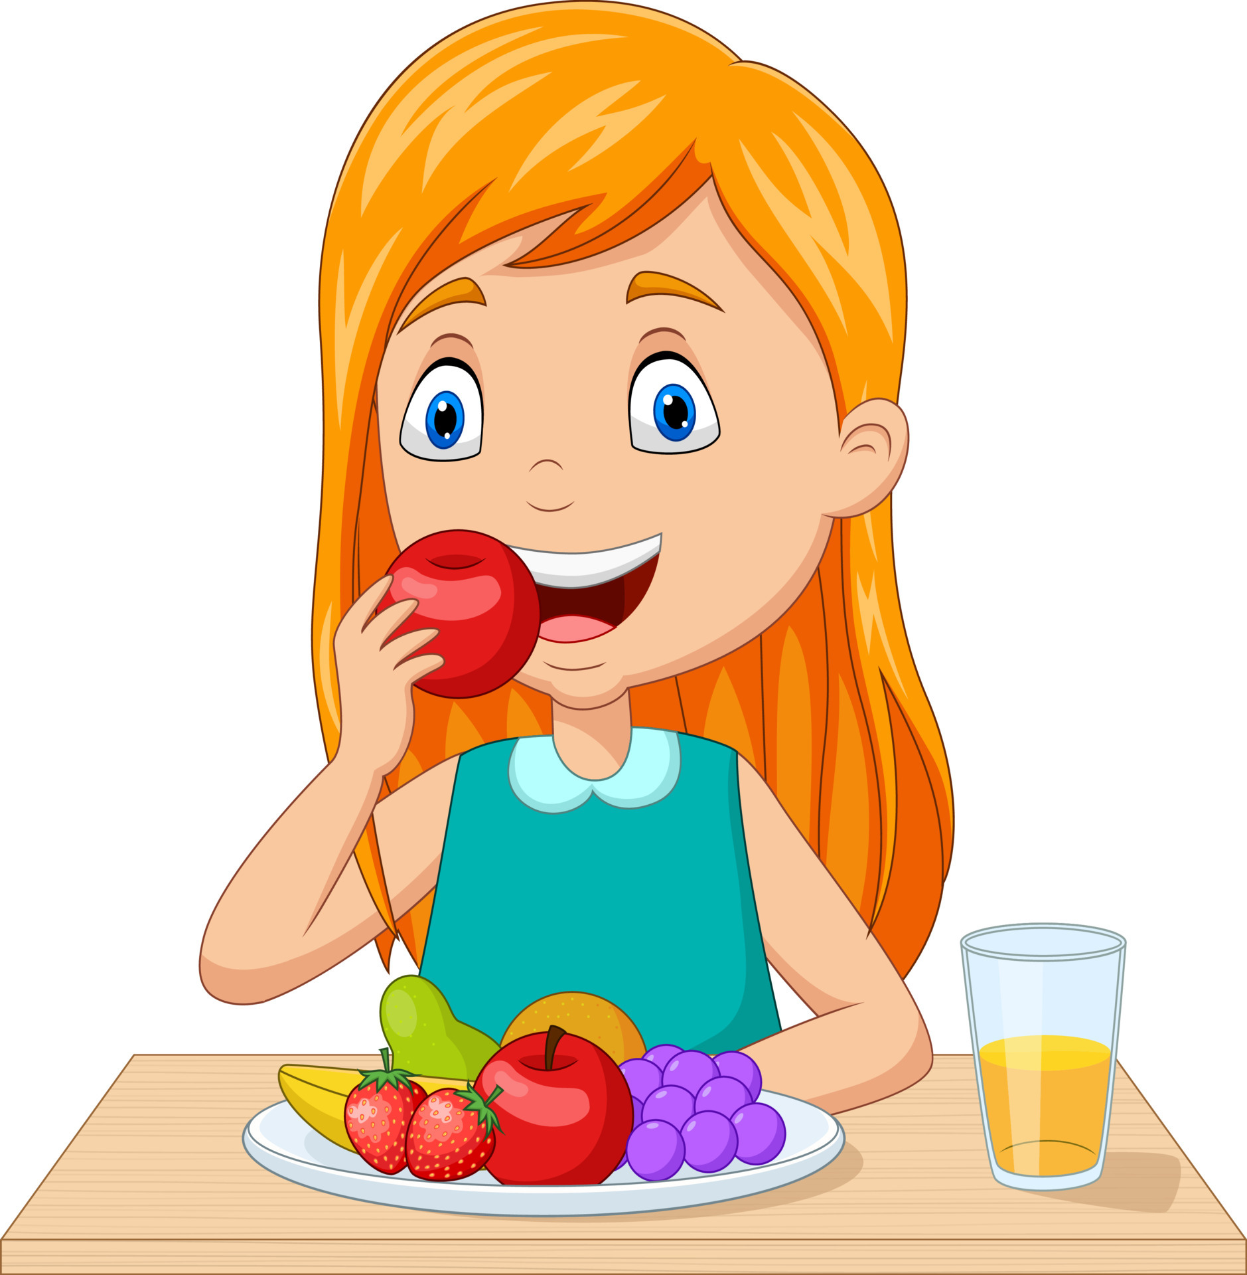


Slide 23
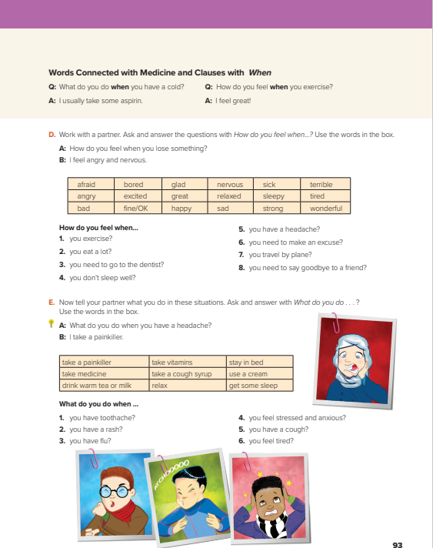
Open
Your book p.( 29)

Slide 24
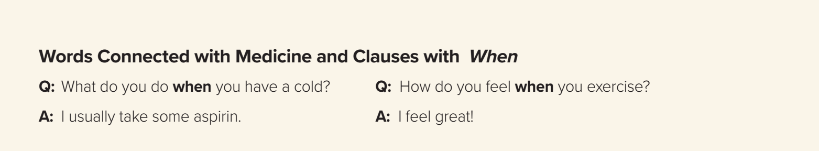



These two question ask about what the person usually does in certain situations.

Slide 25
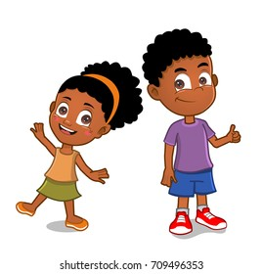
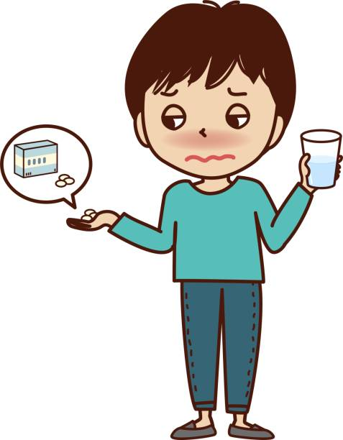
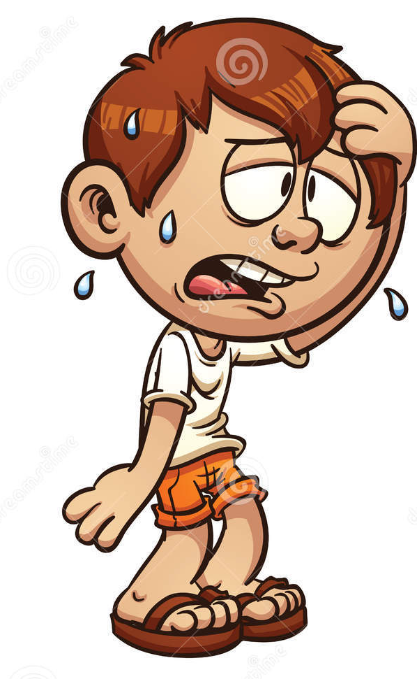
I feel great
I take aspirin.
How do you feel when you exercise?
What do you do when you have a cold?

Slide 26
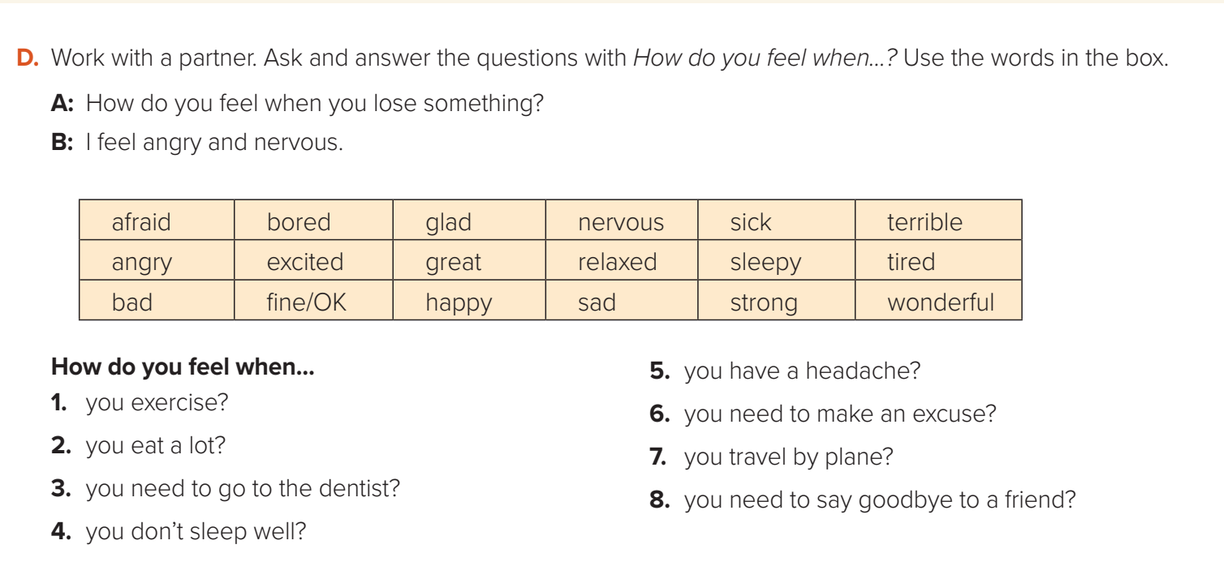

Slide 27
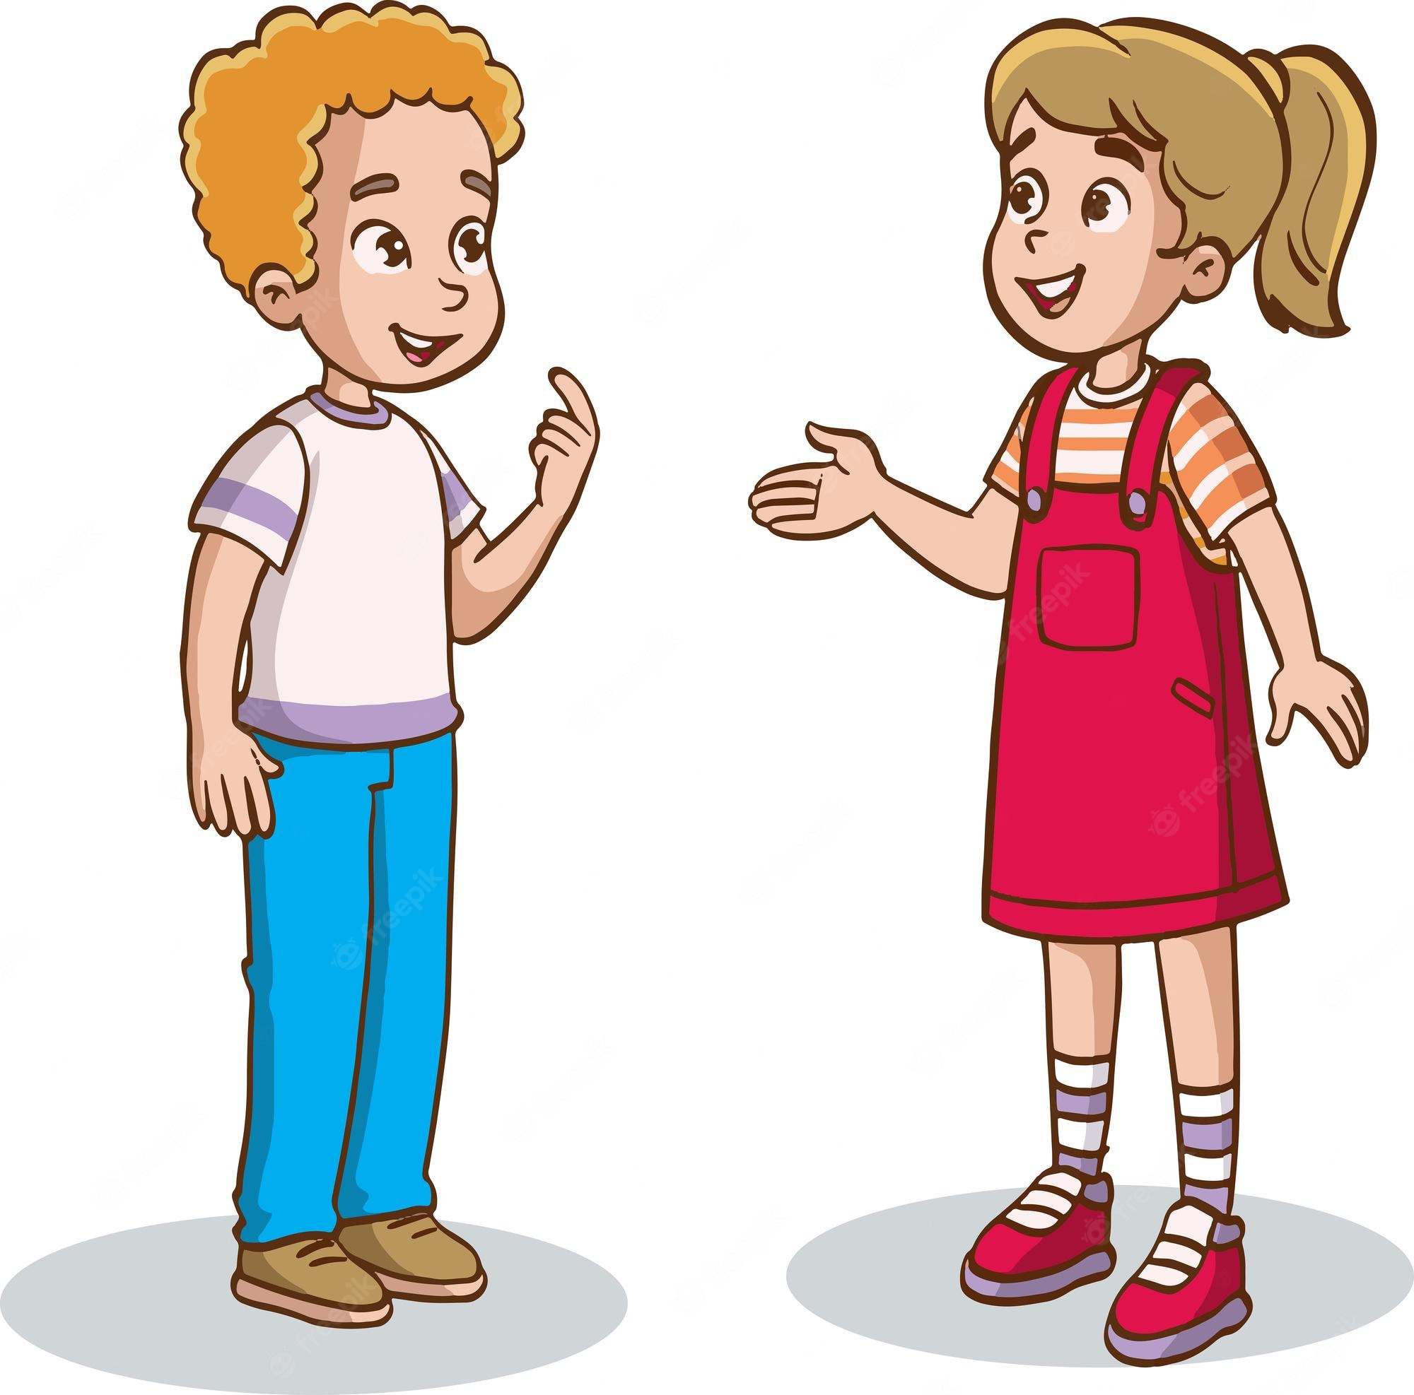
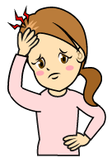



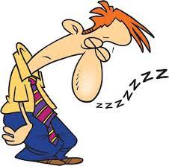
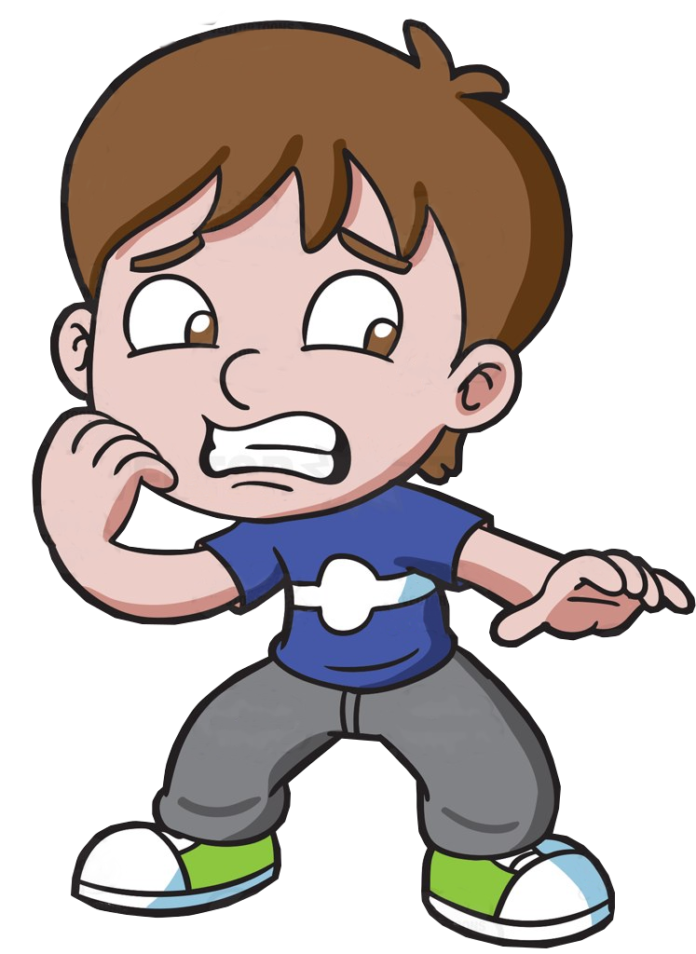
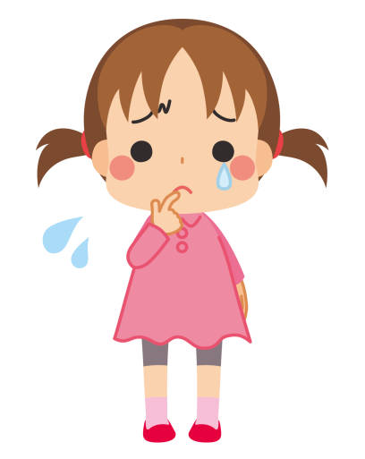


Let’s Practice
How do you feel when..
you exercise?
I feel…
strong / great / happy / tired.

Slide 28
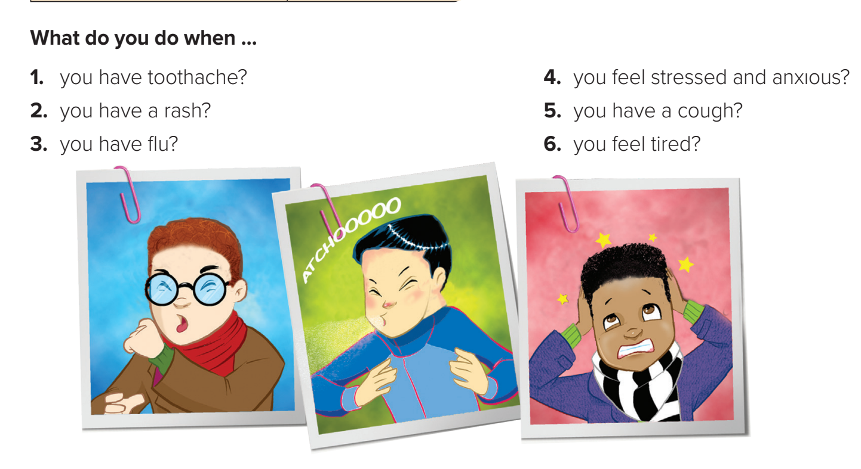

Slide 29
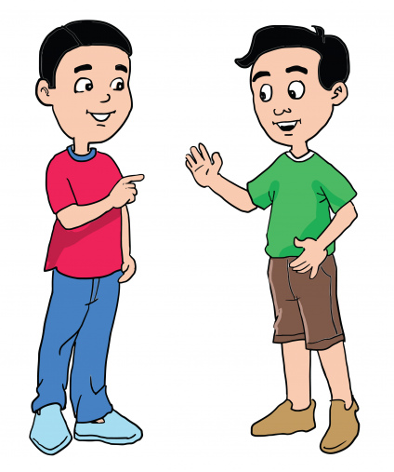
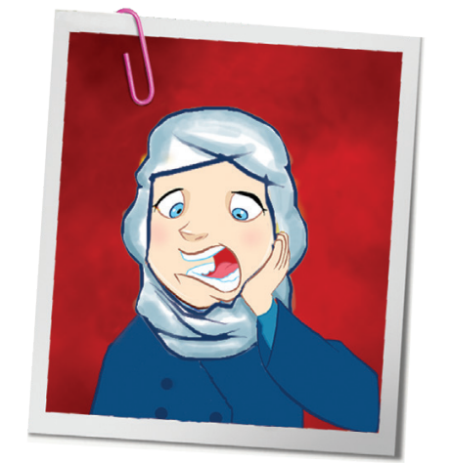
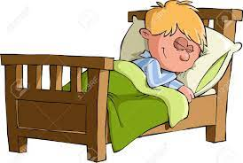
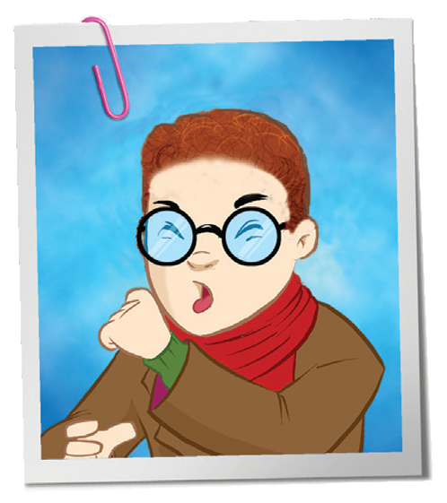

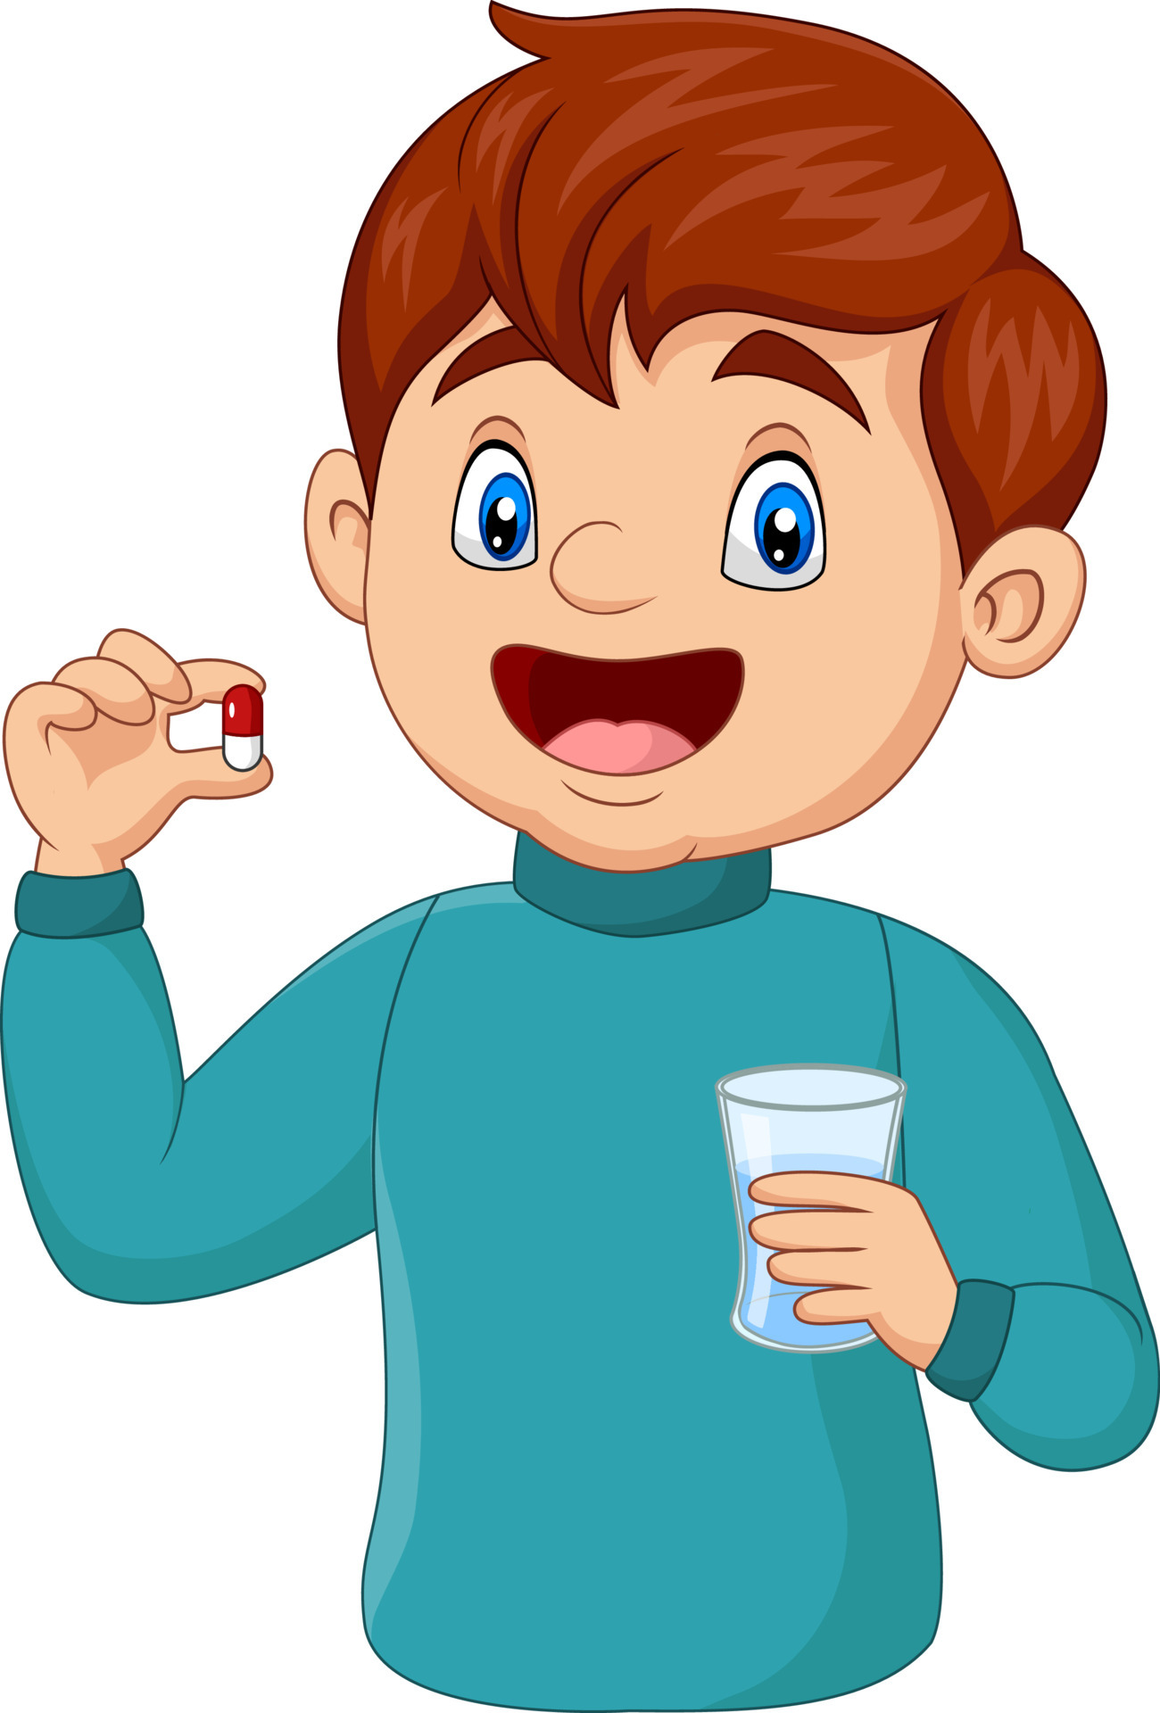
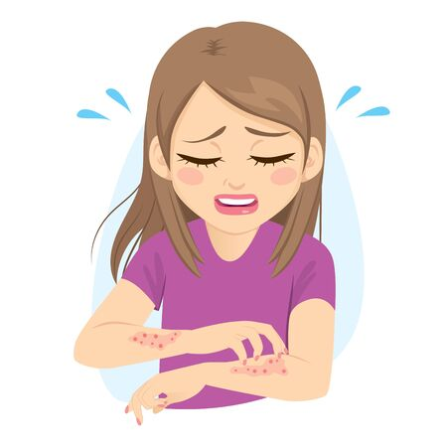
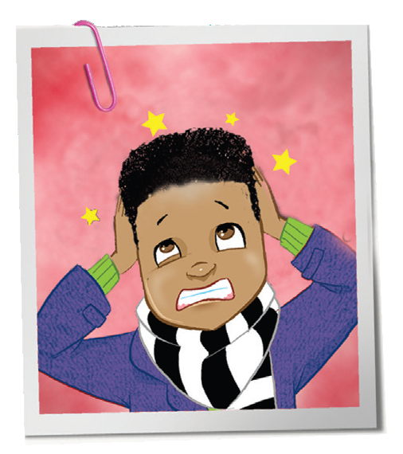

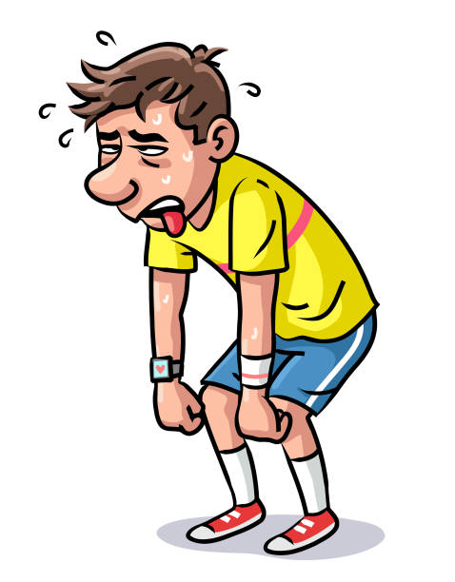

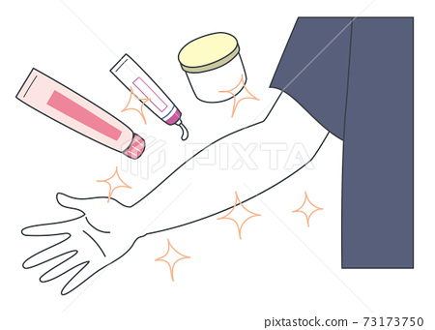
Let’s Practice
I take medicine and stay in bed
I take painkillers
I try to relax
I use a cream
I take some a cough syrup
What do you do when……
you have a rash?
I go to bed and have an early night
What do you do when……
you have a cough ?
What do you do when……
you have a toothache?
What do you do when……
you feel tired?
What do you do when……
you have flu?
What do you do when……
feel stressed and anxious ?

Slide 30

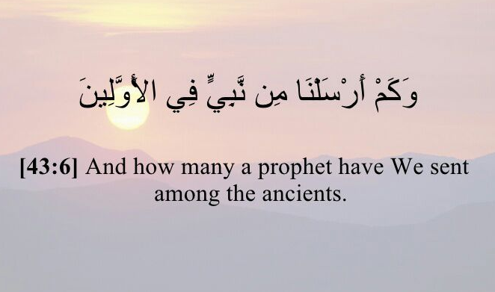
R emember

Slide 31
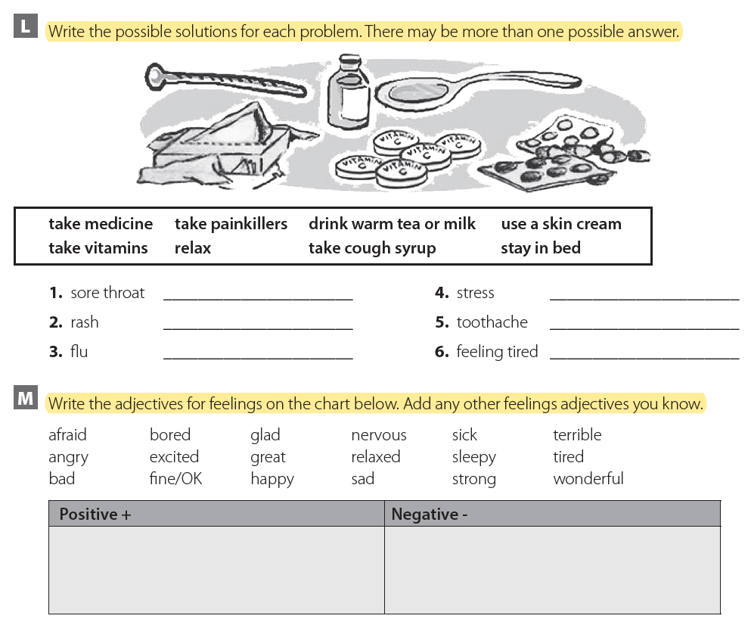
Homework
Workbook p.( 96 ) , exercises ( L , M )

Slide 32

THANKS!

