Slide 1

Grammar
MG2
Unit 1
Grammar
Done by : Entisar AL-Obaidallah

Slide 2
Lesson Goals
1
3
2
Use
Join
Use
The construction preposition+ gerund correctly
Sentences using Althought , Even thought , In spite of , As soon as & When
So ……that to express result of degree

Slide 3
Our Grammar Rules Today
1
2
3
4
Preposition+ Gerund
Althought , Even Thought , In Spite of
As Soon as , When
So ……( That)

Slide 4
Examples:
Preposition +Gerund ( V+ing)
Listen & Discuss
Prepositions can be followed by nouns , pronouns , or gerund .
I apologize to Saraa.
nonn
I apologize to her.
pronoun
I apologize for forgetting her graduation day .
gerund

Slide 5
There are some verbs followed by certain prepositions:
Ask
decide
apologize
Look forward
about | against | for | to
More Examples of Verb + Preposition

Slide 6
There are some verbs followed by certain prepositions:
1
I apologize for arriving late .
Apologize for
2
I look forward to having a job .
Lookforward to
3
Thinking of
I am thinking of moving to a new house .
4
Dreaming of
I am dreaming of becoming a doctor one day

Slide 7
There are some verbs followed by certain prepositions:
5
I apologize for arriving late .
Decided against
6
I look forward to having a job .
Insist on
7
Succeeded in
I am thinking of moving to a new house .
8
Asked aout
I am dreaming of becoming a doctor one day

Slide 8
There are some adjectives followed by certain prepositions:
1
I’m tired of waiting
for an answer
tired
adjective
I’m used to having
Coffee at breakfast
2
adjective
used

Slide 9

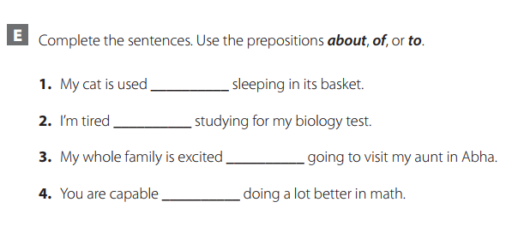
Let’s Practice :
Listen & Discuss
Open your work book p.2 , exercise E
to
of
about
of

Slide 10
But there is a difference in the structure used with them
Although , Even Thought , In Spite of
Preposition +Gerund ( V+ing)
All of them have similar meaning and they used to express a contrast between two ideas ..
Although & even thought introduce a clause that has subject + verb
Form : Although + Subject + Verb
Even thought + Subject + Verb
In Spite of followed by a noun or gerund
Form : In spite of + noun
+ v-ing

Slide 11
Although , Even thought , In spite of
Note :
When the although – even thought & in spite of clause comes before the main clause (at the beginning of the sentence), we usually put a comma at the end of the clause .When the main clause comes first, we don’t need to use a comma .
Although he is intelligent , he can't get a job.
He can't get a job although he is intelligent.
Although
Even thought it rained a lot , we enjoyed our vacation .
We enjoyed our vacation even thought it rained a lot .
Even Thought
In spite of the traffic , I arrived on time .
I arrived on time in spite of the traffic .
In spite of

Slide 12
As Soon As - When
These conjunctions of time are not followed by future forms of verbs even though the verbs tell us about future time. The present is used instead.
future
Examples
2
1
present
present
future
I’ll tell you as you as I know.
I’ll call you when I arrive .
As Soon As
When

Slide 13
So…….( That)
So … (That)
Use so with an adjective or with many, much, few, or little to express result or degree.
action
Examples
2
1
result
result
action
The movie was so good ( that ) we saw it twice .
There were so many cars ( that) I couldn’t
find a place tp park
So …………( That )
So ……………( That )

Slide 14

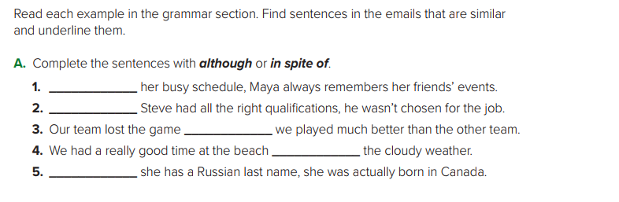
Let’s Practice :
Listen & Discuss
Open your student’s book p.8 , exercise A
In spite of
Although
Although
In spite of
Although

Slide 15
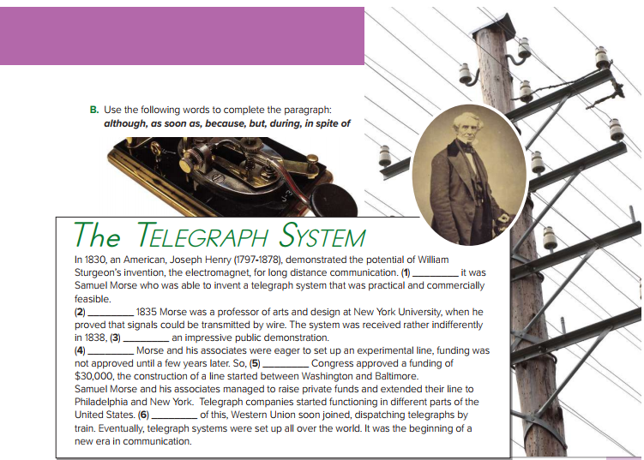
Look at your student’s book p.9 , exercise B
Let’s Practice :
Listen & Discuss
1-But
2-During
3- in spite of
4-Although
5- as soon as
6- Because

Slide 16
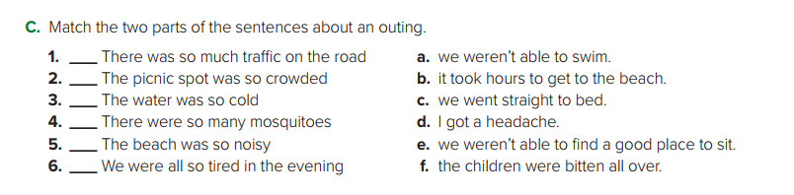
Let’s Practice :
Listen & Discuss
Look at your student’s book p.9 , exercise C
B
E
A
F
D
C

Slide 17
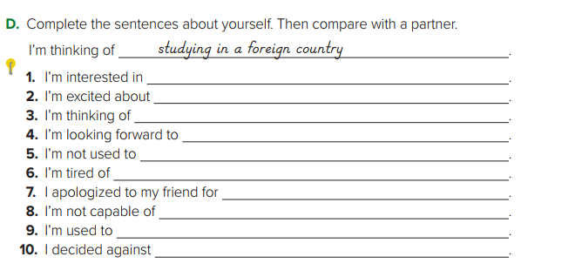
Let’s Practice :
Listen & Discuss
Look at your student’s book p.9 , exercise D
studying English
Going a way on vacation
Studying engineering
Going to your graduation ceremony
Speaking in public
Doing homework every night
Arriving late
Waking up early in the morning
Going to bed late at night
Going to the beach today

Slide 18


