Slide 1
Mega Goal 1.2
Unit 3 - You’ve Got Mail
L. 1 Listen and Discuss
By: Essa Al Hussaini

Slide 2
Lesson Goals
Discuss the purpose of sending mails and letters.
Practice saying apology for not doing something
Practice whishing someone the best
Answer about specific information on mails given.

Slide 3
Books Closed

Slide 4
4 Pics - 1 Word
Guess
the word
e
M
a
i
L
E
D
L
S
B
I
S
A
M
F
G
N

Slide 5
warm up
Do you know how people sent mails years ago?
What do you use emails for?
Have you ever got an e-card?
How do you typically invite people?

Slide 6
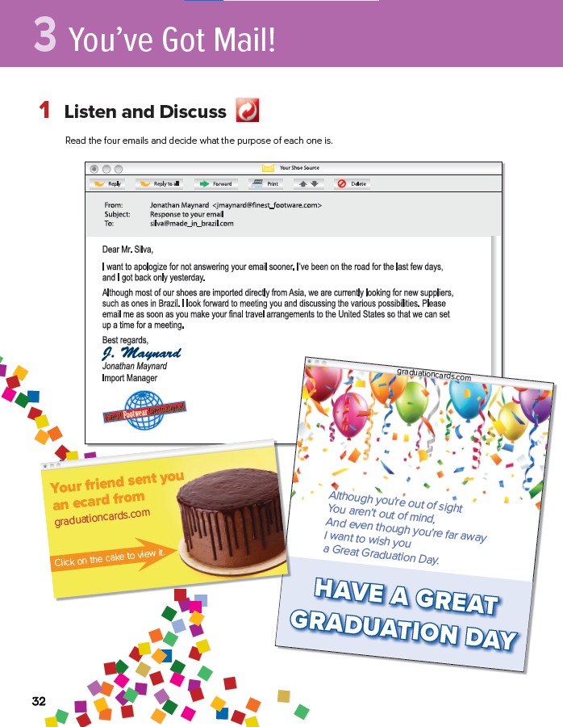
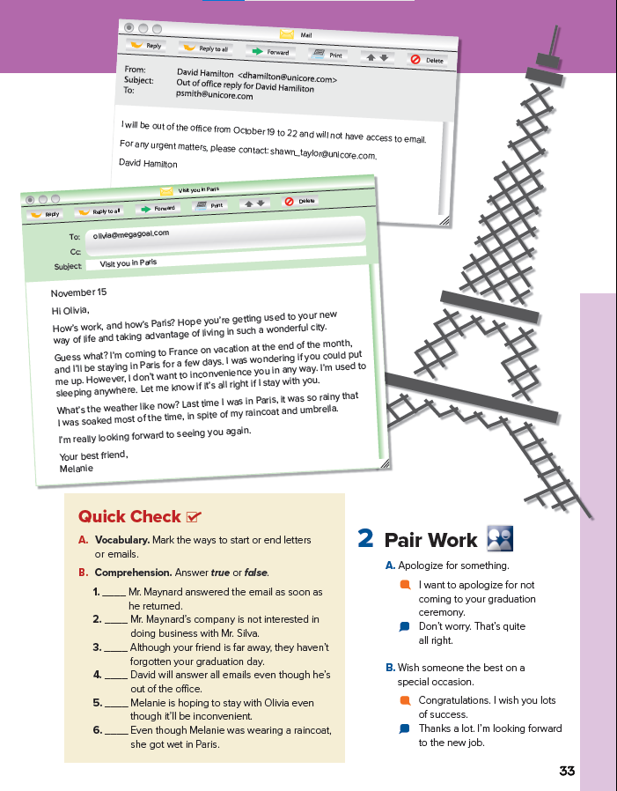
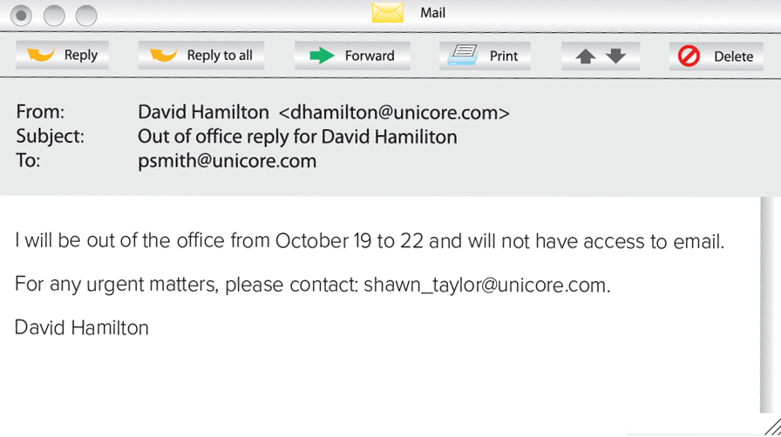
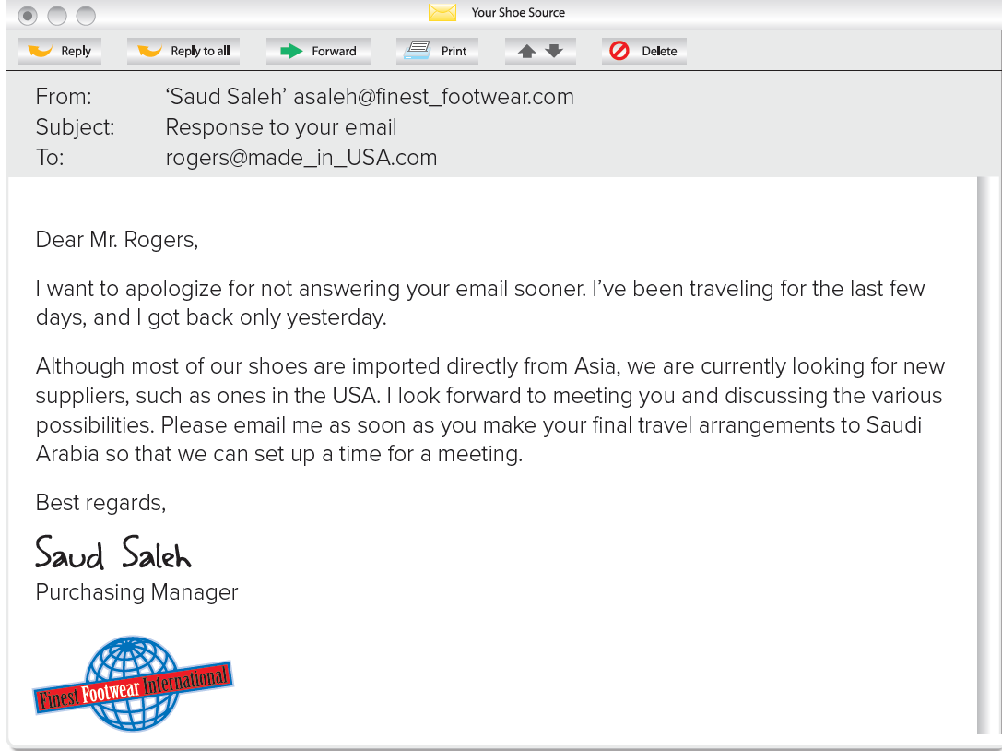
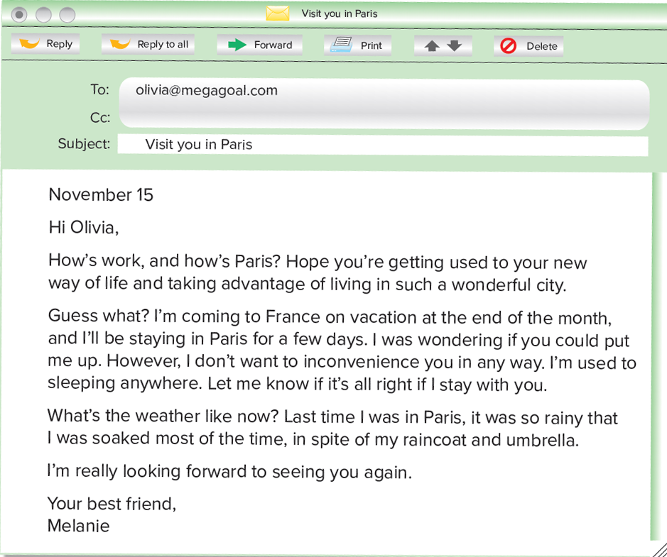
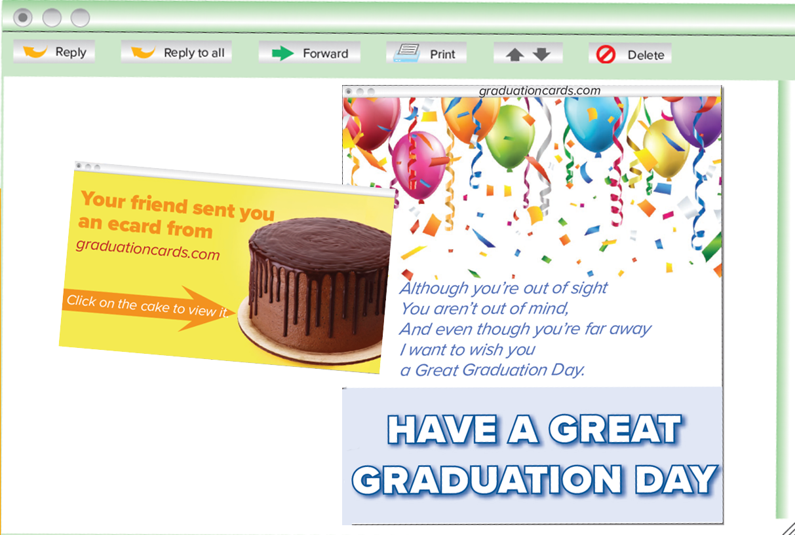
3
.. the title of unit 3?
There are ___ e-mails.
the 4 emails look like same?.
1
4
YES
NO
Books Open 32-33
2

Slide 9
Read
then
decide
What are the 2 purposes of the email?
Which words tell you that?
Who was the sender?
Who got the mail?
What opening word did Mr. Saleh start his letter with?
What close phrase did he use?
Vocabulry
1- Welcome a friend
2
2- Expressing an apology
3- Requesting an action
3

Slide 10
Read
then
decide
What is the purpose of this e-card?
Which words tell you that?
Is it a birthday
e-card?
What’s that?
a graduation ecard
Expressing a wish

Slide 11
Read
then
decide
Who was the sender?
What is the purpose of this e-card?
He sent it to his ___
Which words tell you that?
Vocabulry
1- friend?
2- workmate?
1- Welcome a friend
2- Requesting an action

Slide 12
Read
then
decide
Which words tell you that?
What is the purposes of the email?
Melanie started her email with “Hi” because Olivia is ___?
Vocabulry
1- Requesting favor
2- Requesting a wish

Slide 13
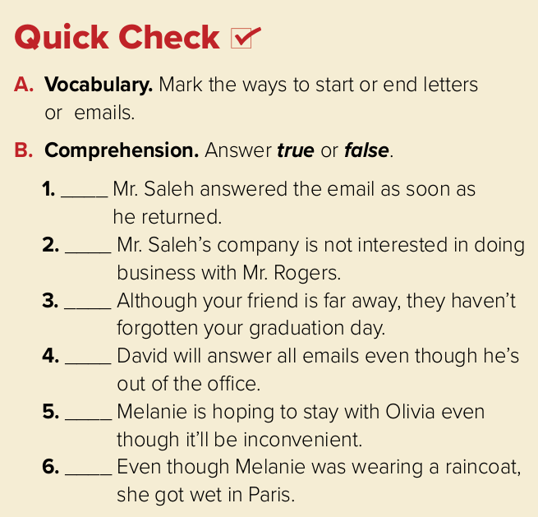
Dear Mr. Rogers,
Hi Olivia
Best Regards
Your Best Friend
To start
To end
T
F
T
F
F
T

Slide 14
How to apologize for not doing something
He apologized for getting to the meeting late.
He apologized for not getting to the
meeting on time.
I apologized for not doing my homework.
Complete
He apologized for __________ me. (no call)
She apologized for __________ my pen. (lose)
not calling
losing

Slide 15
Congratulations. I wish you lots of success.
I wish you a blessed Eid day.
I wish you all the best for the exam.
How to
wish someone the best on an occasion
Rearrange
weekend / you / I / a happy / wish
__________________________________
I wish you a happy weekend

Slide 17
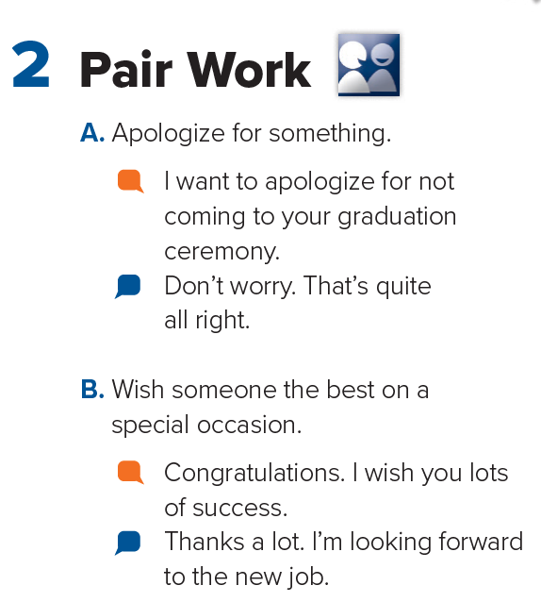

Slide 18
Vocabulary
Recall
to say sorry
bring from another country
very important
Let me stay in your home
apologize
import
urgent
put me up
supplier
soaked
import
advantage
apologize
Dear Sir,
inconvenience
put me up
urgent
cause problem or worry
benefit; good
a person who provides something
Extremely wet
inconvenience
advantage
soaked
supplier

Slide 19
HOMEWORK
97

