Slide 1
Unit 1
Yoy’ve Got Mail
Form , Meaning and Function
Done by :Entisar Al-OBAIDALLAH

Slide 2
Lesson Objectives
01
02
03
04
Practice
Complete
Use
Use
using simple past with used to or would .
the sentences using There is & There are correctly .
Singular and plural nouns correctly
the definite article the correctly .

Slide 3

Open your student’s book p.16

Slide 4
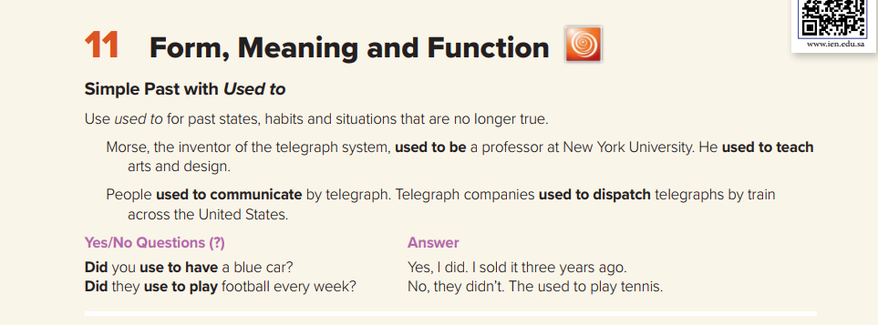
01
When we use “Used to”?
Used to + infinitive
We can use (used to) to talk about past states that are not true any more.
Examples:
We used to live in New York when I was a kid.
There didn't use to be a supermarket there. When did it open?
Did you use to have a garden?

Slide 5
01
When we use “Used to”?
Used to + infinitive
We can also use used to to talk about past habits (repeated past actions) that don't happen any more.
Examples
I used to go swimming every Thursday when I was at school.
She used to smoke but she gave up a few years ago.

Slide 6
“Used to” Form
Affirmative Form
Subject + used to + verb( infinitive) .
Example:
I used to work very hard
I used to watch Disney cartoon when I was a child
He used to walk to school

Slide 7
“Used to” Form
Negative Form
Subject + didn’t + use to + verb( infinitive) .
Example:
She didn’t use to sleep early
They didn’t use to play in the street
No -d with did
base form

Slide 8
“Used to” Form
Question Form
Did + Subject + use to + verb( infinitive) ?
Example:
Did she use to wake up early ?
Yes , she did or No, she didn’t
No -d with did
base form

Slide 9
Used to & Would
Would
Used to
Use used to for past states, habits and situations that are no longer true.
We can also use would in place of used to for past habits but we cannot use would for past states.
So , Would can only be used for actions.

Slide 10
01
02
03
What is the difference between “Used to” and “ would”?
Used to
Would
Can be used with any kind of verbs : action or states
e.g. I used to walk to school .
e.g. We used to have a big car.
Can be used with action verbs only
e.g. I would walk to school .
But Not We would have a big car.
Can be used in statements , negative and questions
e.g. I didn’t use to walk to school .
e.g. Did we use to have a big car?
Can be used in statements only
e.g. I would go to the same beach every summer.
Used to describe actions or situations repeated again and again and again.
e.g. When he was at university , he would sleep until noon at the weekend.
Used for any extended actions or situations in the past
e.g. I used to live in Riyadh but I moved to Al-Hasa last year .
Notes:
s

Slide 11
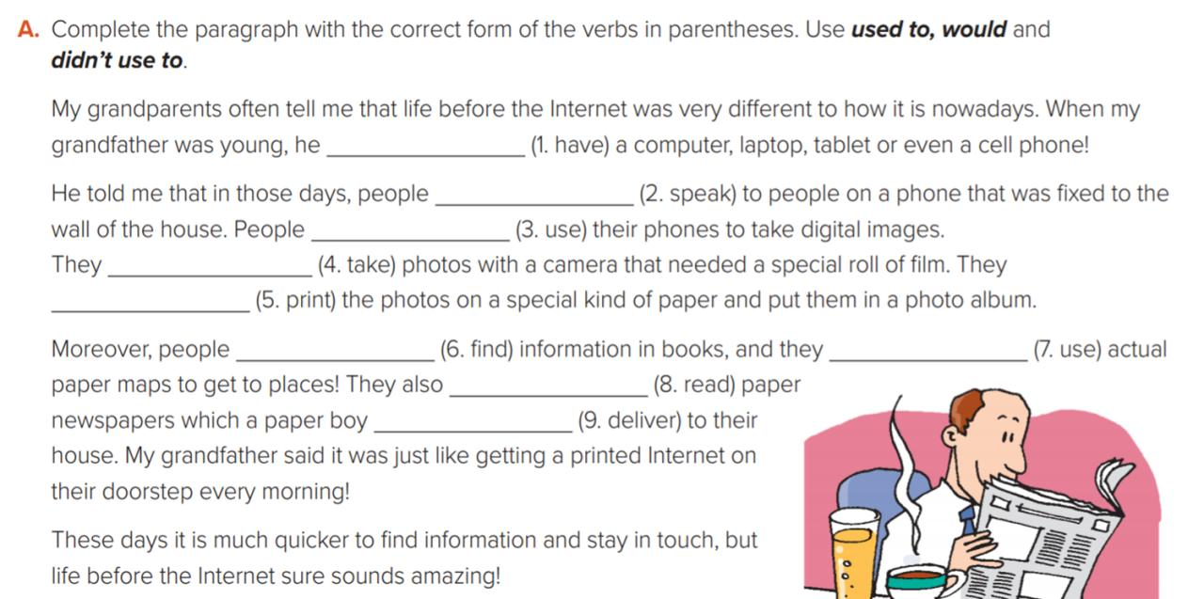
CONTENTS OF THIS TEMPLATE
didn’t use to have
would speak
used to speak /
didn’t use to use
used to take/
would take
used to print/
would print
would find
used to find/
used to use/
used to read/
would read
would use
used to deliver/
would deliver

Slide 12
Open your student’s book p.17

Slide 13
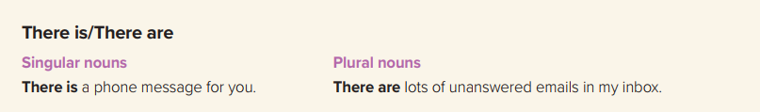
We use there is and there are to say that something exists.
We use there is for singular and
there are for plural.
There is one table in the classroom.
There are three chairs in the classroom.
There is a spider in the bath.
There are many people at the bus stop.
We also use There is with
uncountable nouns:
There is milk in the fridge.
There is some sugar on the table.
There is ice cream on your shirt.

Slide 14
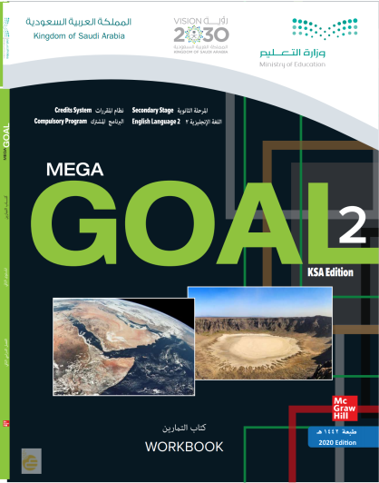
Open your workbook p.10

Slide 15
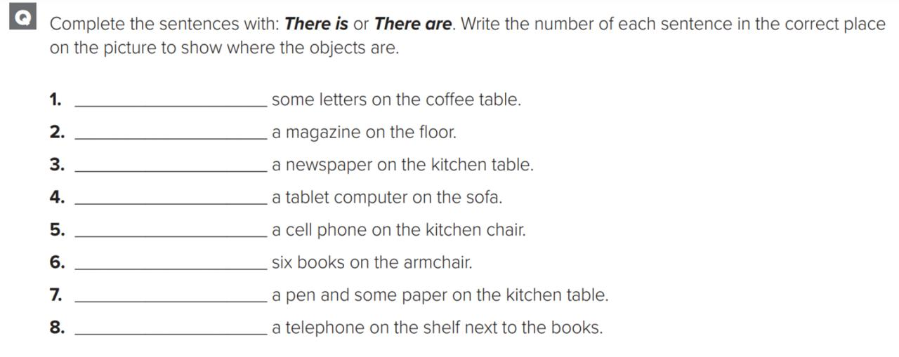
There are
There is
There is
There is
There is
There are
There is
There is

Slide 16
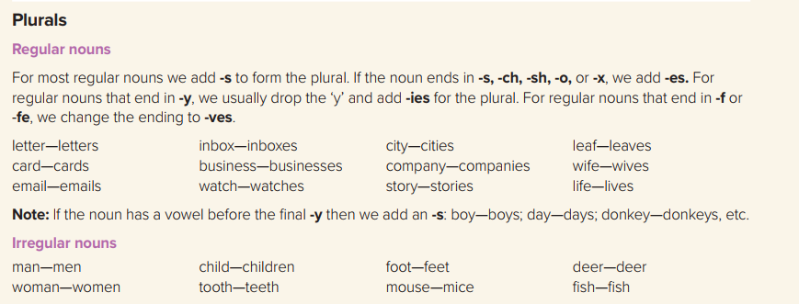
Plural

Slide 17
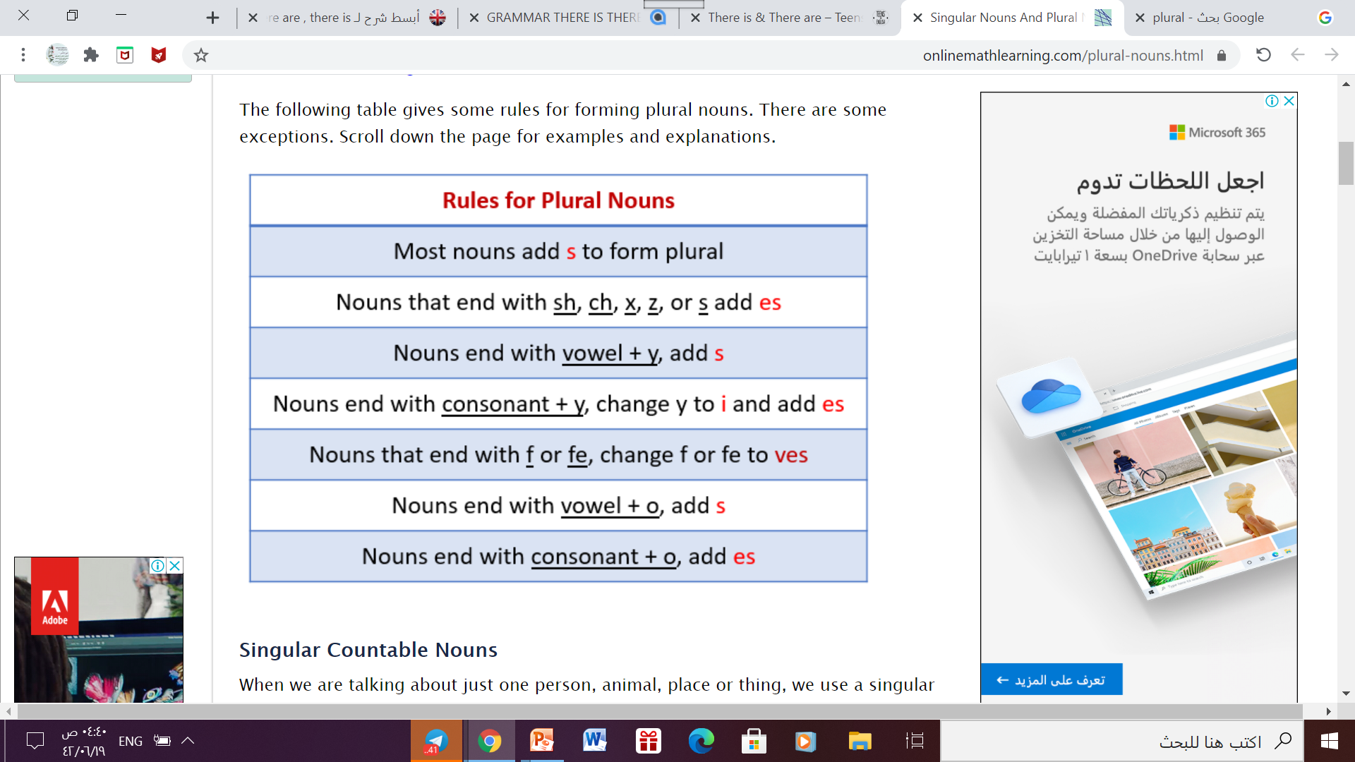
The Rules of Plural Nouns

Slide 18
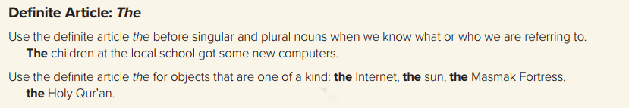
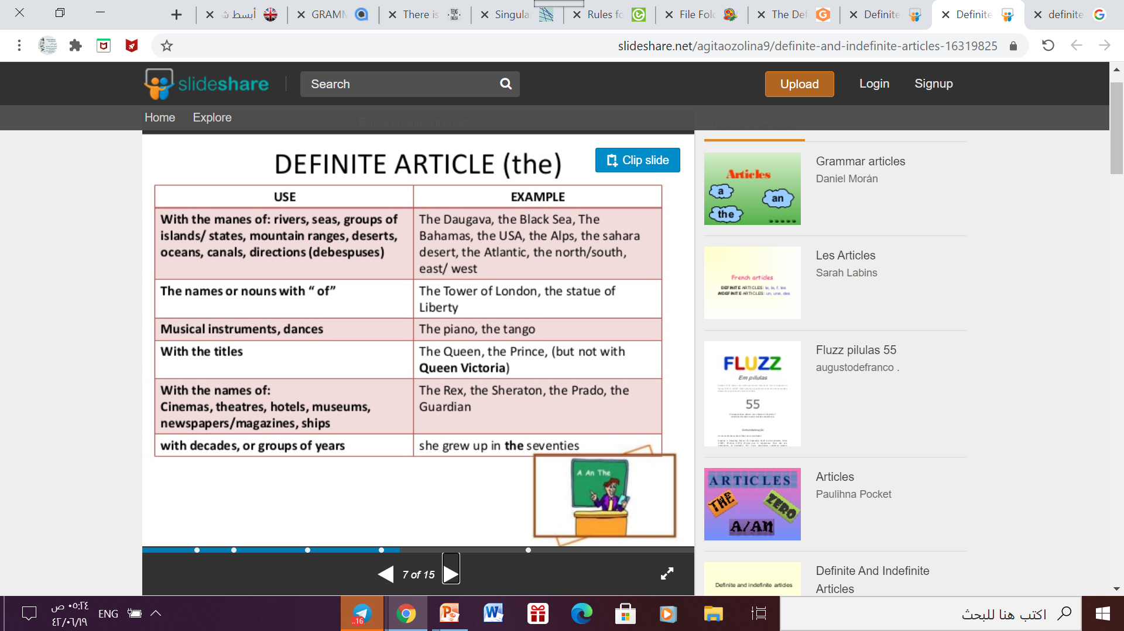
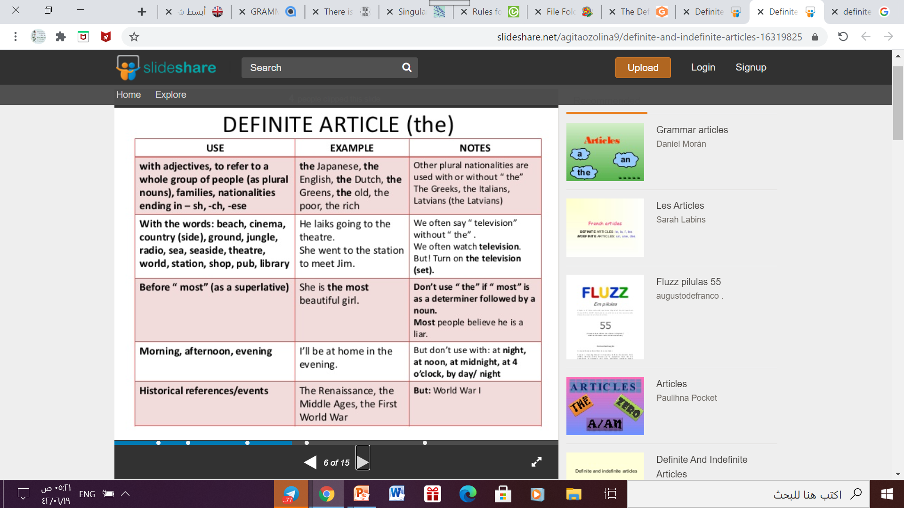
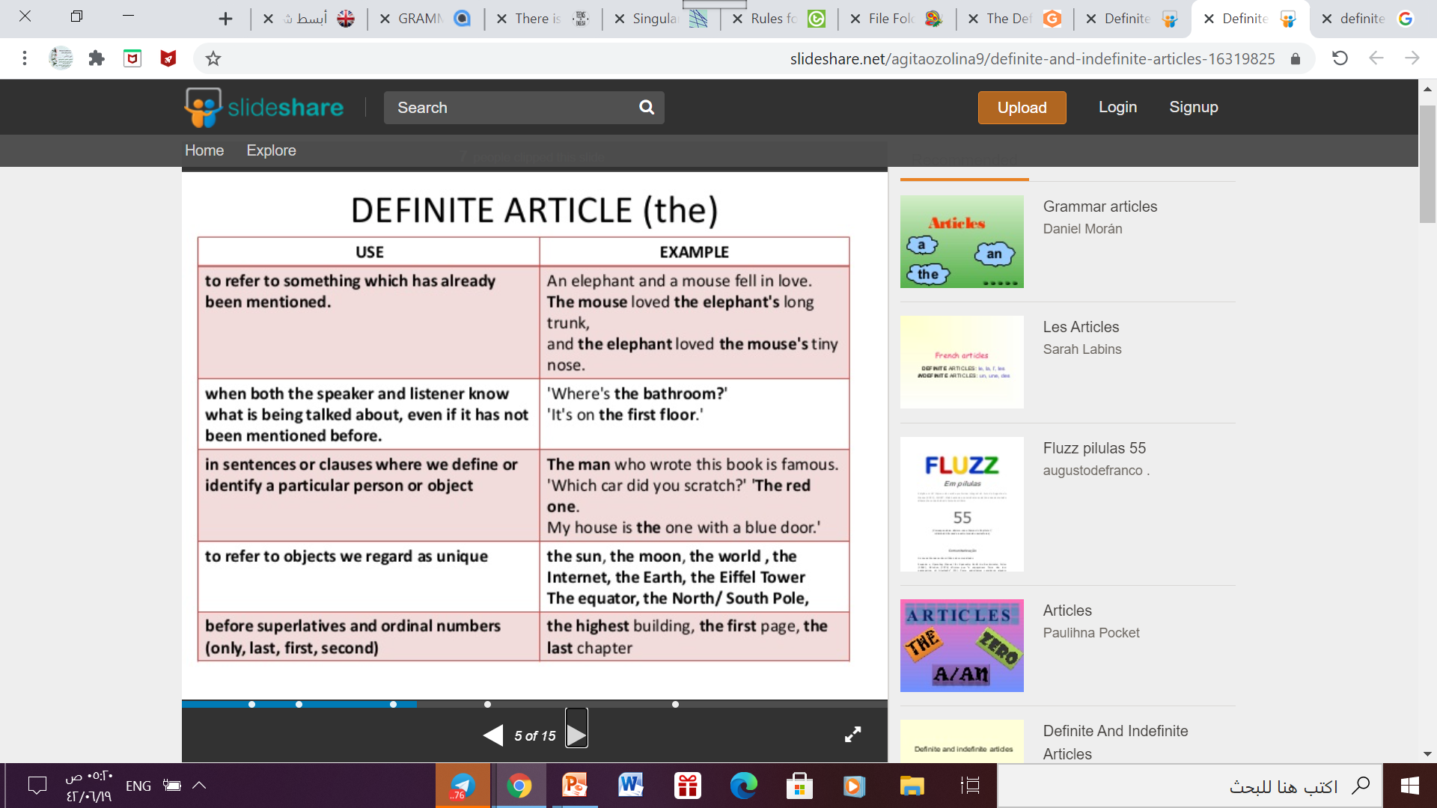
Definite Article : The

Slide 19
Open your workbook p.10

Slide 20
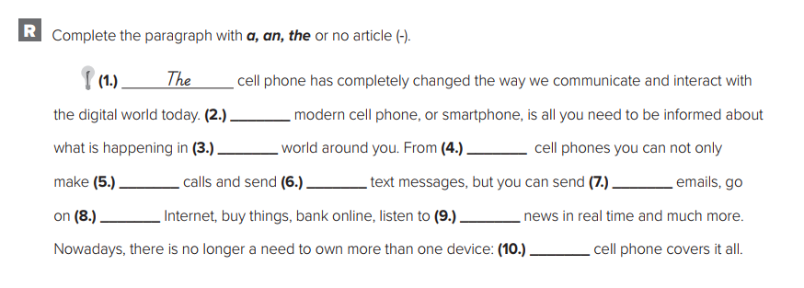
Let’s Practice
The
The
-
-
-
-
The
The
The - a

Slide 21

Thanks

