Slide 1



Slide 2


Slide 3
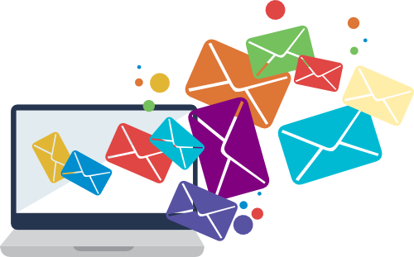
Unit -3-
You’ve Got Mail!

Slide 4
11 Form, Meaning and Function

Slide 5
Simple past with Used to
Used to & would
There is / There are
Plurals ( Regular / Irregular nouns )
Definite Article : The

Slide 6

Objectives
1 – Express past states , habits and situations with “ used to “.
2 – Model a sentence with “ would “ .
3 – use “ there is / there are “ correctly.
4 – Form correct plural ( regular nouns ) .
5 – Form correct plural ( irregular nouns ) .
6- use “ the “ correctly .

Slide 7
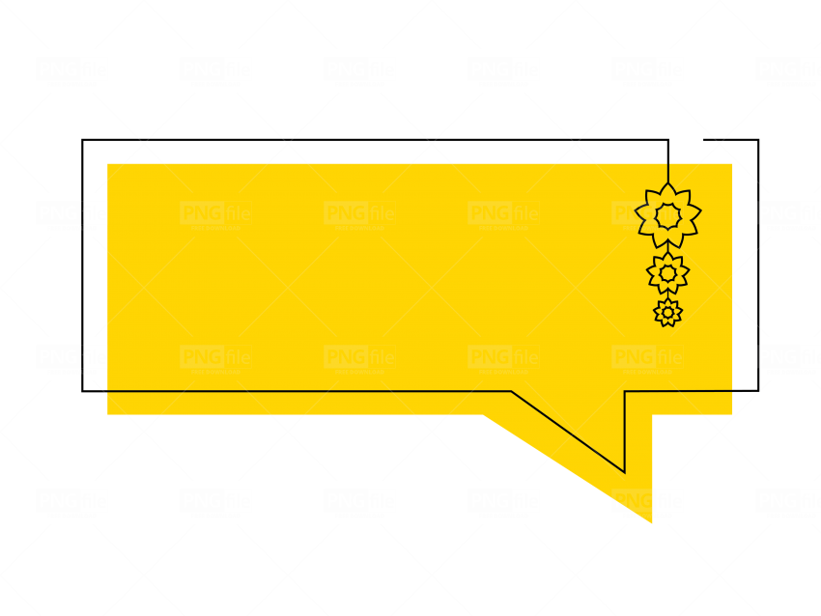


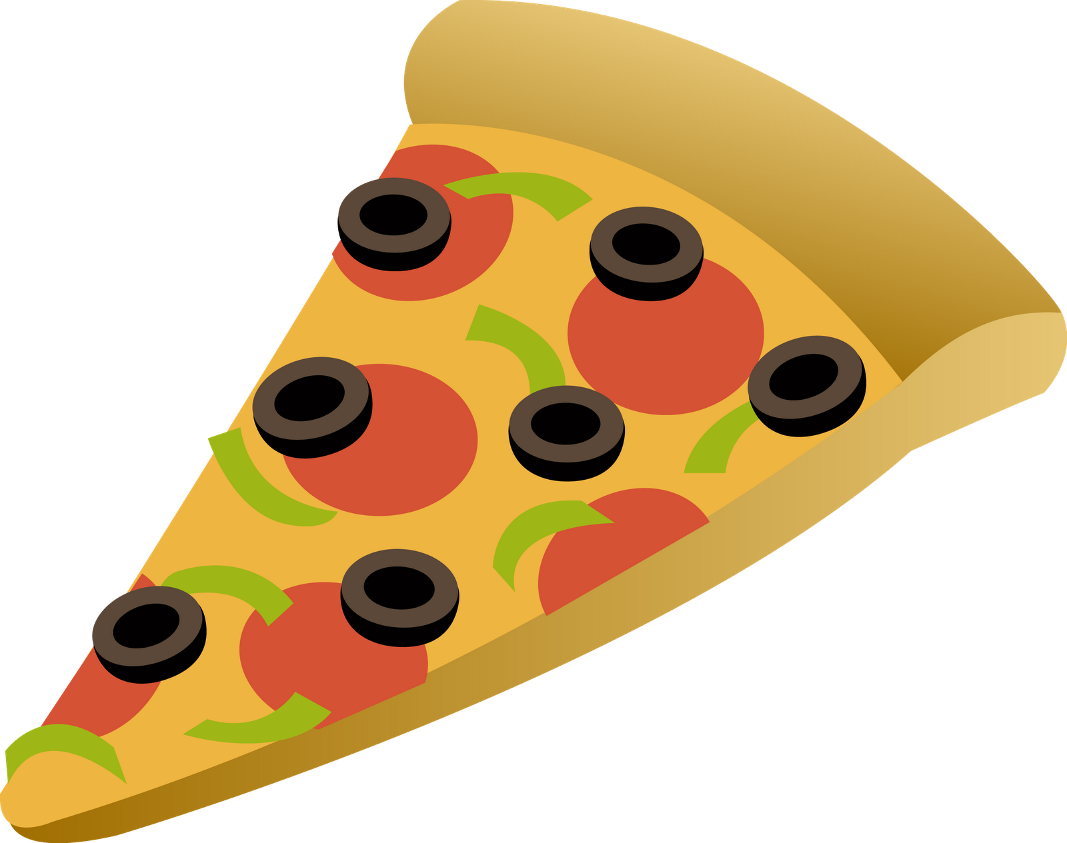

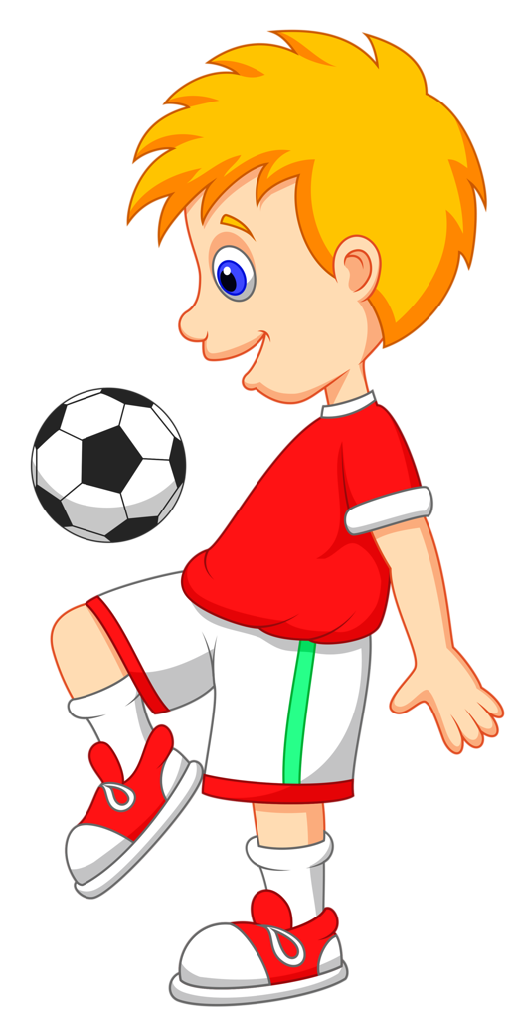
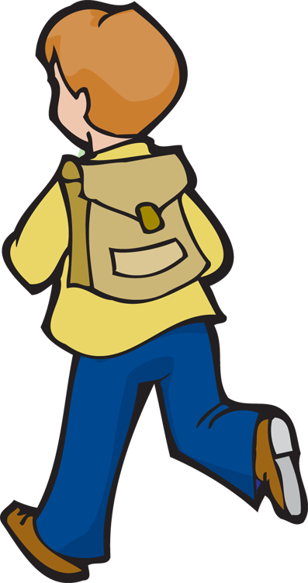
Warm Up
Form sentences about the pictures using ( be used to )
He is used to eating pizza .
Simple past with Used to
Subject + be + used to gerund
He is used to playing football .
He is used to going to school.

Slide 8
Simple past with Used to

Slide 9
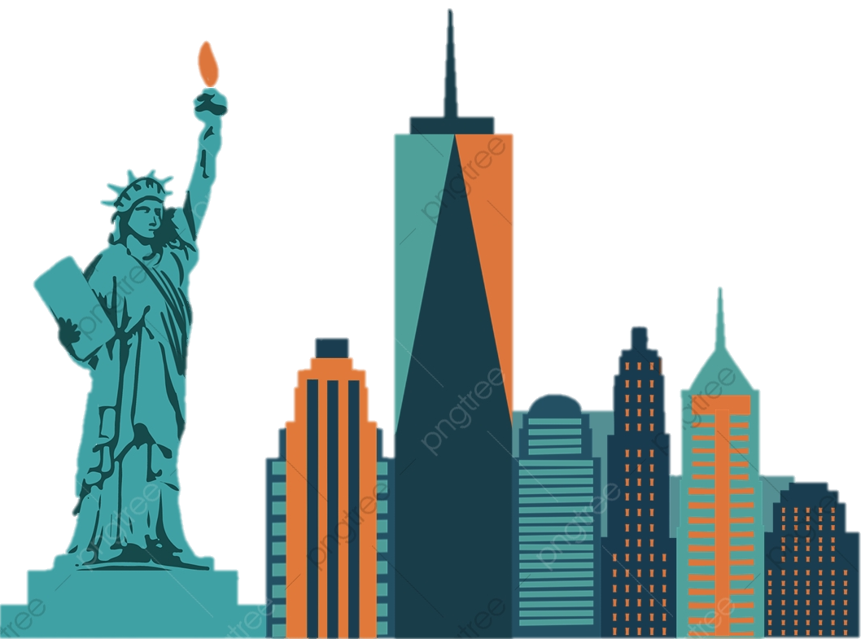
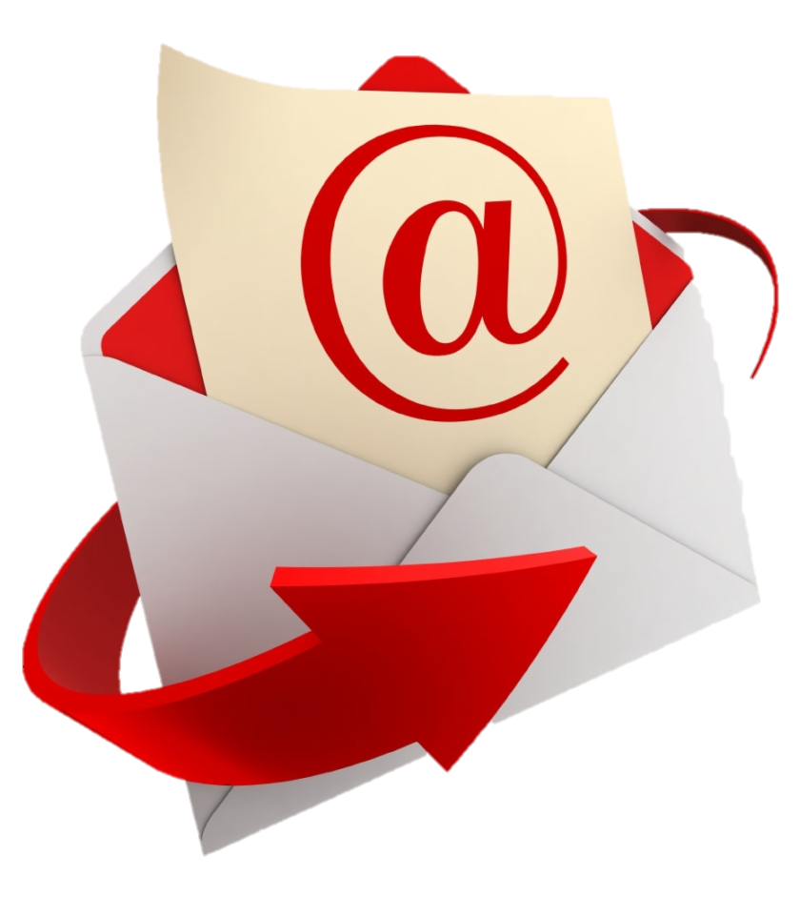
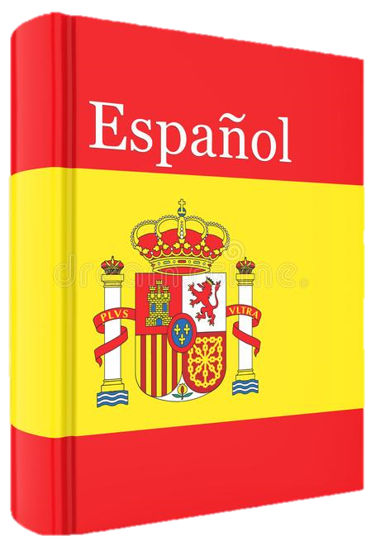
Form
Subj + used to + verb
We used to live in New York when I was a kid .
I used to work for a big company .
Question Form
She used to communicate using e-mail . ( but now she doesn't) .
Did + subj + use to + verb
Did She use to know a lot of songs ?
Did he use to study Spanish ?
Yes, she did .
No she didn’t .

Slide 10
Form
We used to live in New York when I was a kid .
She used to communicate using e-mail . ( but now she doesn't) .
Did he use to study Spanish ?
Subj + used to + verb
I used to work for a big company .
Question Form
Use used to for past states, habits and situations that are no longer true.
Did + subj + use to + verb
Did She use to know a lot of songs ?
Yes, she did .
No she didn’t .

Slide 11
Form
Subj + used to + verb
I used to work for a big company .
Question Form
Did + subj + use to + verb
Did She use to know a lot of songs ?
Yes, she did .
No she didn’t .
Use used to for past states, habits and situations that are no longer true.

Slide 12
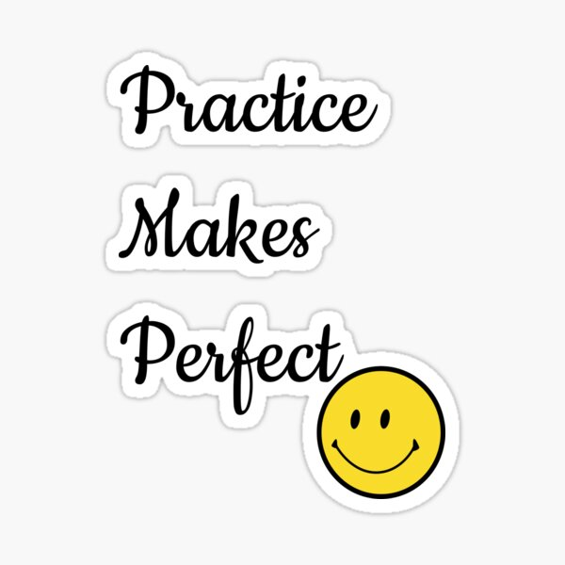

I
Work Book

Slide 13
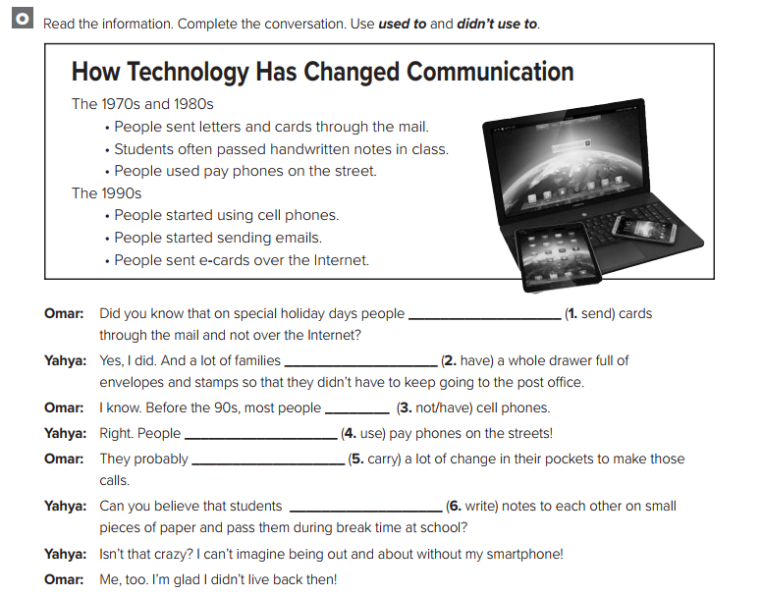
I
Work Book
Used to & would
used to send
used to have
didn’t use to have
used to use
used to carry
used to write

Slide 14


Used to
Would
Used to & would

Slide 15

Used to
Would
They used to live in London .
We would go to the same beach every summer .
I didn’t use to like olives .
I would often play outside in the garden when I was a child .
There used to be a supermarket here .
People used to have very powerful voices in those days!
People would have very powerful voices in those days!
We can also use would in place of used to for past habits but we cannot use would for past states.

Slide 16
Information Questions (?)
How did people in the Americas use to transmit messages?.
Why did people use to shout from signal towers?.
What did you use to do when you were young?.
Answer
They used smoke signals
They wanted to pass on messages
I used to ride my bike in the park

Slide 17
I
Student Book p-42

Slide 18
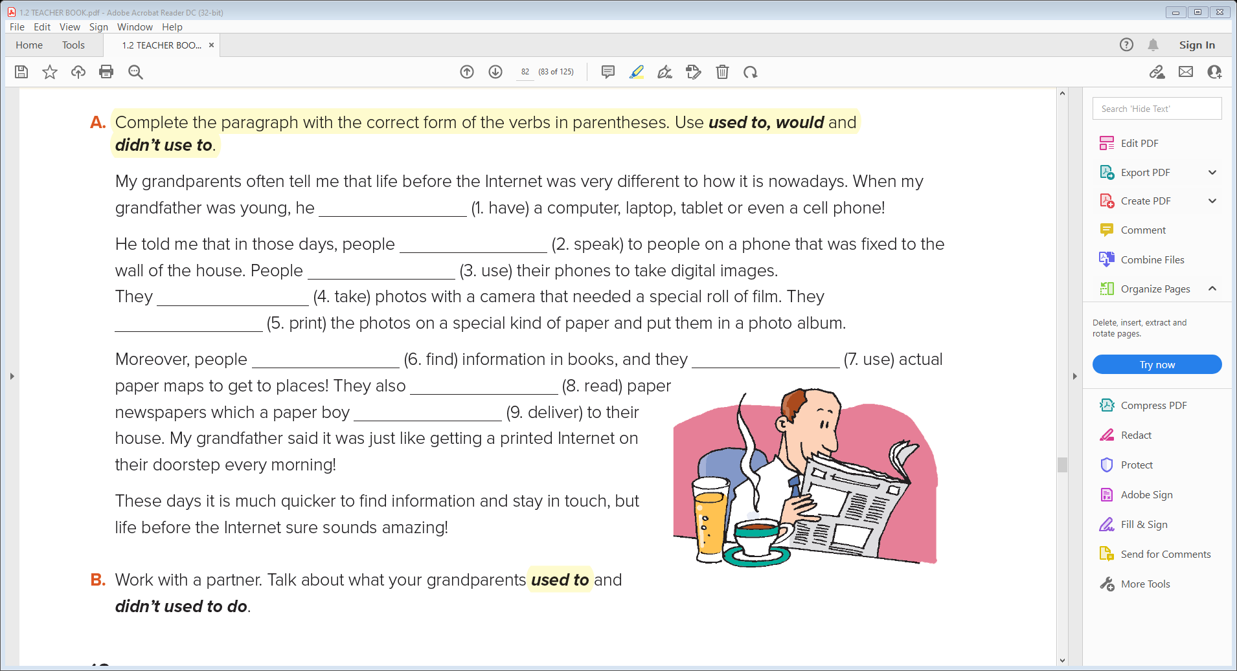
I
Student Book p42
1- didn’t use to have
2- used to ( would ) speak
3- didn’t use to use
4- used to ( would ) take
5- used to ( would ) print
6- used to ( would ) find
7- used to ( would ) use
8- used to ( would ) read
9- used to ( would ) deliver

Slide 19


There is / There are

Slide 20
Singular nouns
Plural nouns
There is / There are

Slide 21
Singular nouns
Plural nouns
There is
pen
watch
story
woman
There are
pens
watches
stories
women
Notes:
Language Builder
Explain that there’s is a contraction for there is. There is no
contraction for there are.

Slide 22
I
Work Book p-106

Slide 23
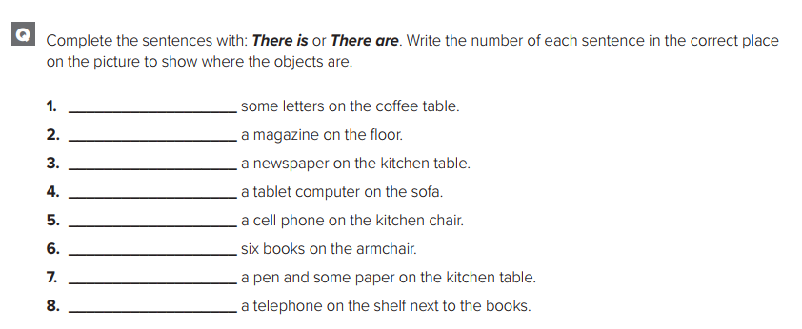
I
Work Book p-106
There are
Plurals ( Regular / Irregular nouns )
There is
There is
There is
There is
There are
There is
There is

Slide 24
Regular
Plurals ( Regular / Irregular nouns )

Slide 25
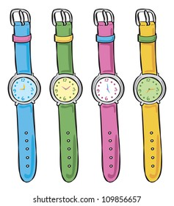
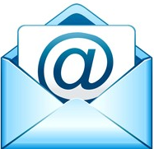

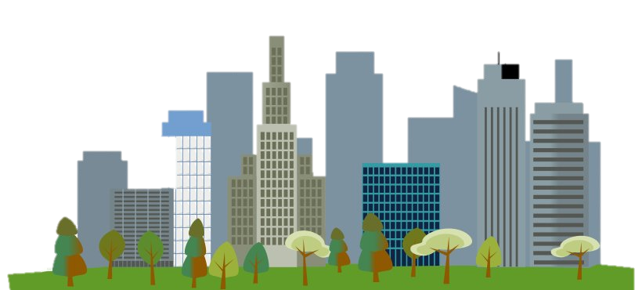
Irregular
Regular
Letter —letters
Card —cards
email—emails
Inbox —inboxes
Business —businesses
Watch —watches
City —cities
Company —companies
Story —stories
Leaf —leaves
Wife —wives
Life —lives

Slide 26
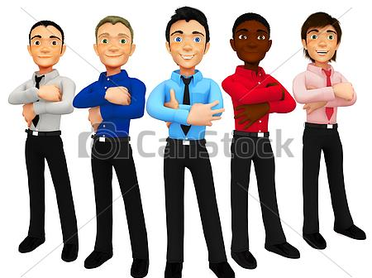
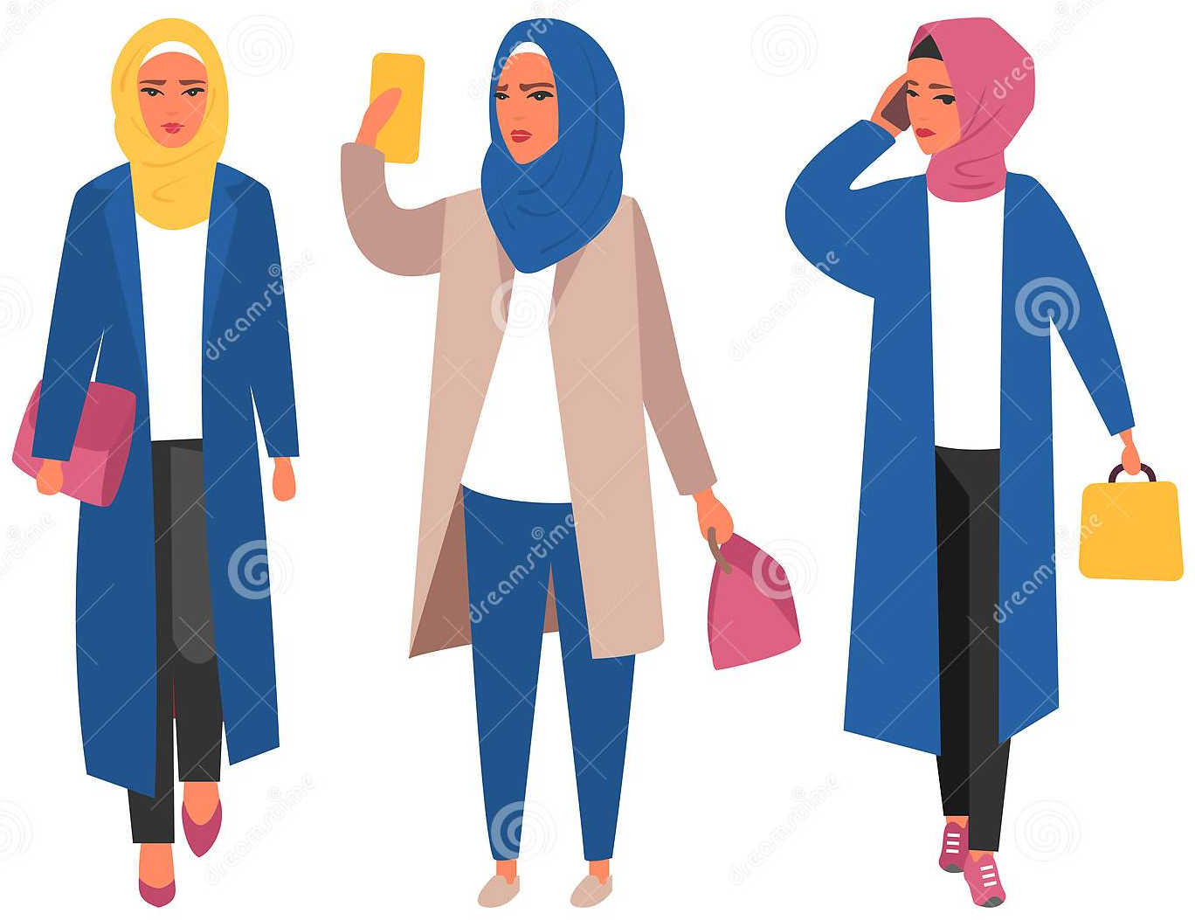
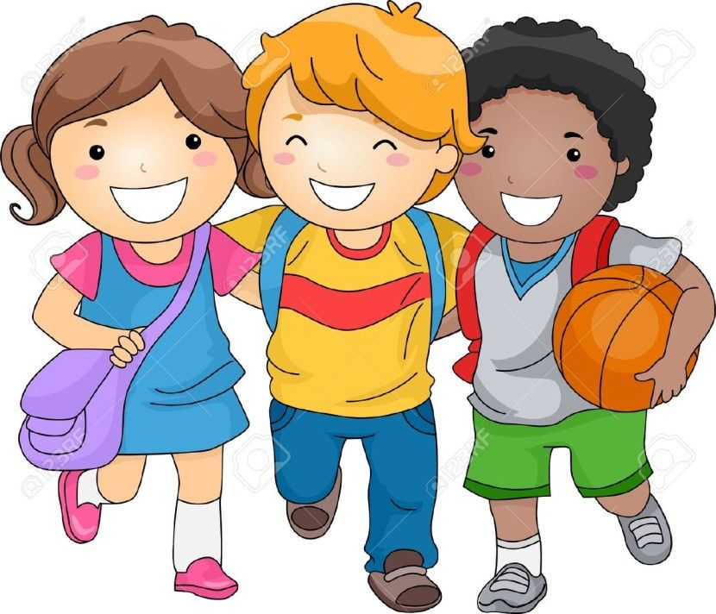

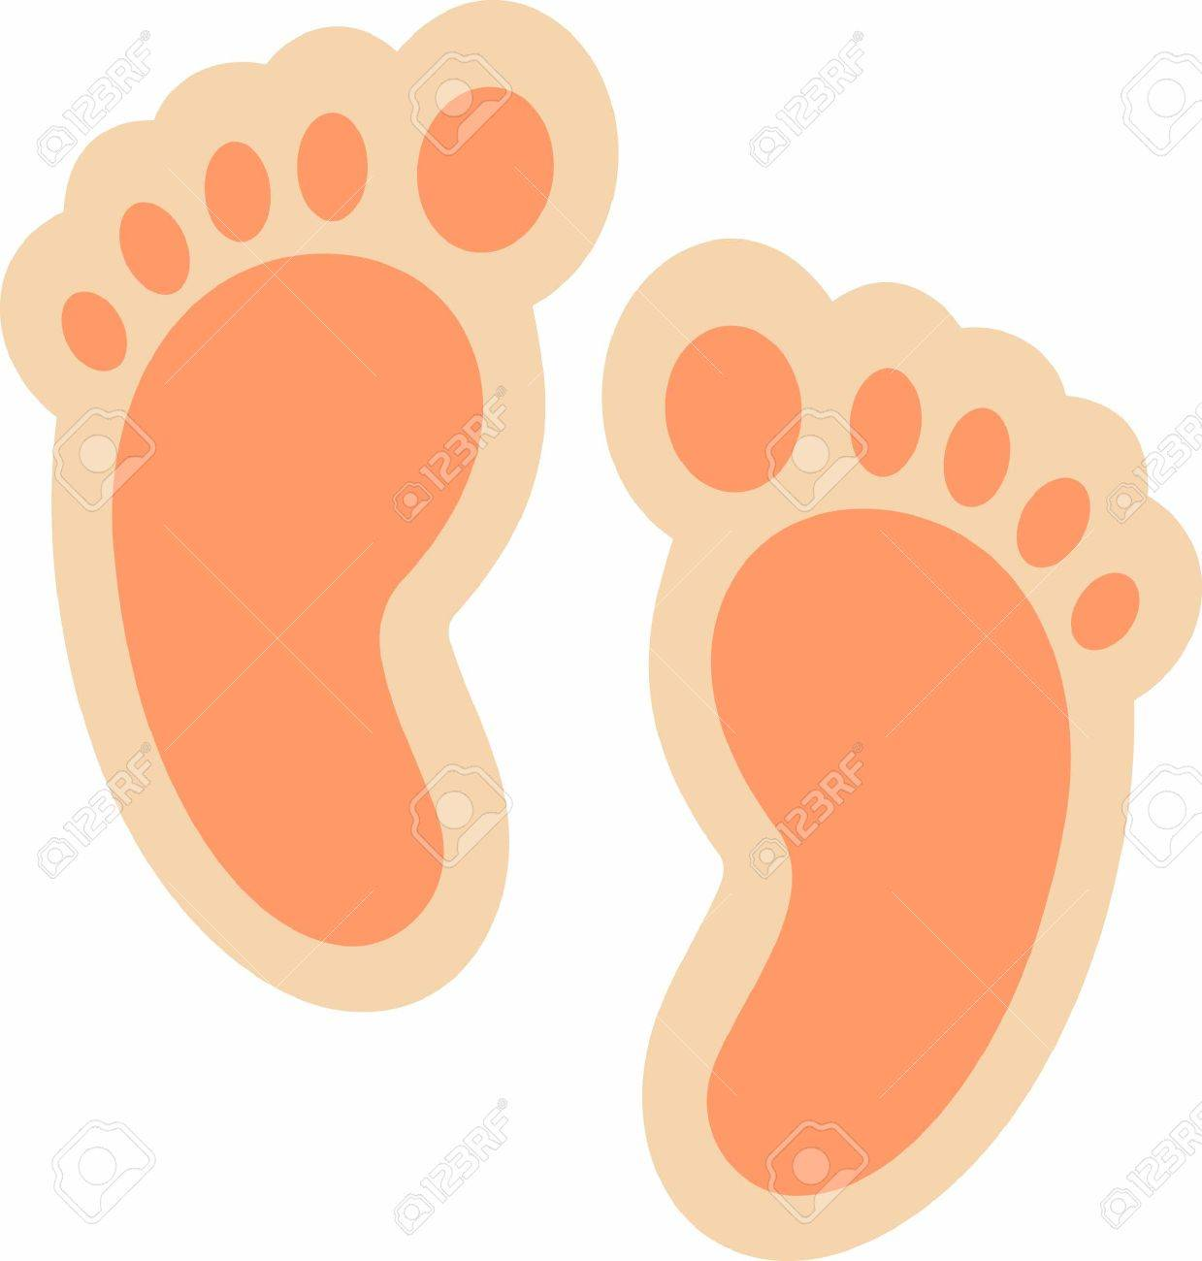
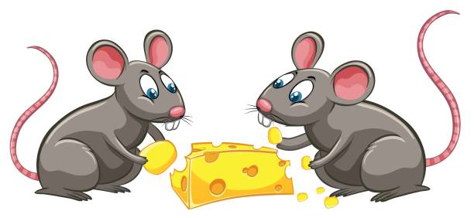
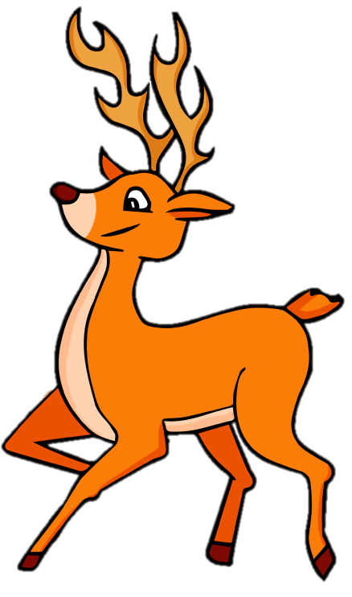

Irregular
man
woman
child
tooth
foot
mouse
deer
fish
—men
—women
—children
—teeth
—feet
—mice
—deer
—fish

Slide 28

Definite Article : The

Slide 29
Definite Article : The

Slide 30

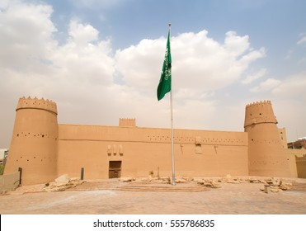
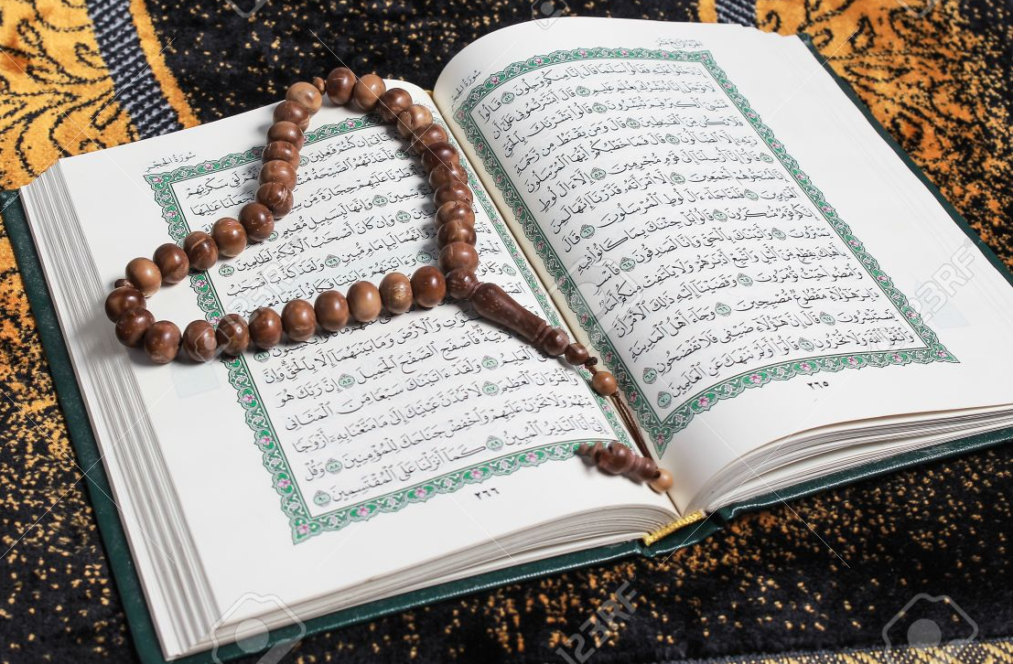
The children at the local school got some new computers
Use the definite article the before singular and plural nouns when we know what or who we are referring to.
Use the definite article the for objects that are one of a kind
:
the Internet,
the sun,
the Masmak Fortress,
the Holy Qur’an.

Slide 31
I
Work Book p-106

Slide 32
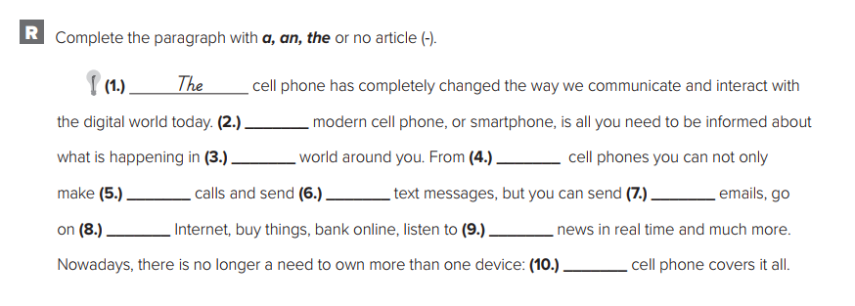
I
Work Book p-106
The
_
The
_
_
_
the
the
A / the

Slide 33


