Slide 1
Unit 4
Wishful Thinking
Grammar
Mega Goal 1.2
Done by : Entisar Al-Obaidallah

Slide 2
Lesson Objectives
01
02
03
Use
Express
Use
conditional sentence (if-clause ) to express imaginary situations .
possibility with (might) and ( could )
in a conditional sentence .
The verb wish with
Present and future tense

Slide 3

Open
Student’s book , p.( 48)

Slide 4
01.
Conditional sentence with if clause
Imaginary situation

Slide 5
Warm up
What would you do if you were a millionaire?
If I were a millionaire, I would travel around the world!
If Clause
Main Clause
If Clauses – Type 2 is used to express dreams, unreal situations and things that are unlikely to happen.
Conditional clauses consist of two sentences. One is a clause that starts with if, which is called as ‘if clause’. The other is called the Main clause.

Slide 6
If conditional
Imaginary situations
The 2ND conditional sentence:-
If + past tense , would + infinitive
If Clause
Main Clause
We can change the order :
would + infinitive + if + past tense
Main Clause
If Clause

Slide 7
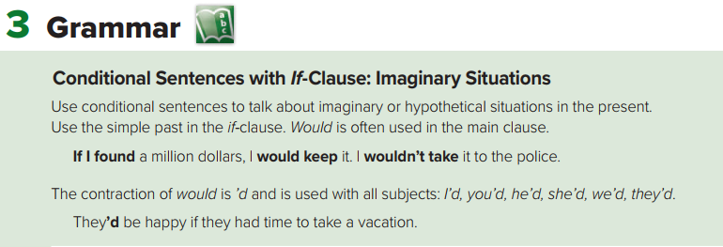
Note
We use “were” instead of “was” with all the pronouns in the 2nd conditional form .
I
She were
He
It
Example:
If he were rich , he would buy the Ferrari
I would have some rest if I were you.
She would buy diamond ring if she were rich.

Slide 8
02.
Conditional sentence with might and could
possibility

Slide 9
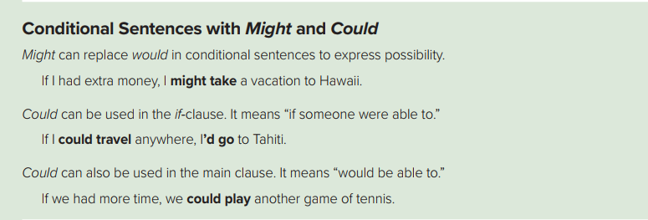
possibility
If conditional
If + past tense… , might + infinitive
Example:
If I could visit any city , I might go to Paris.
Past Simple
Might+ infinitive

Slide 10
03.
Conditional sentence with might and could
ability

Slide 11
ability
If conditional
If + could….., would + infinitive
Example:
If I could travel , I would go to Paris.
could
would+ infinitive

Slide 12
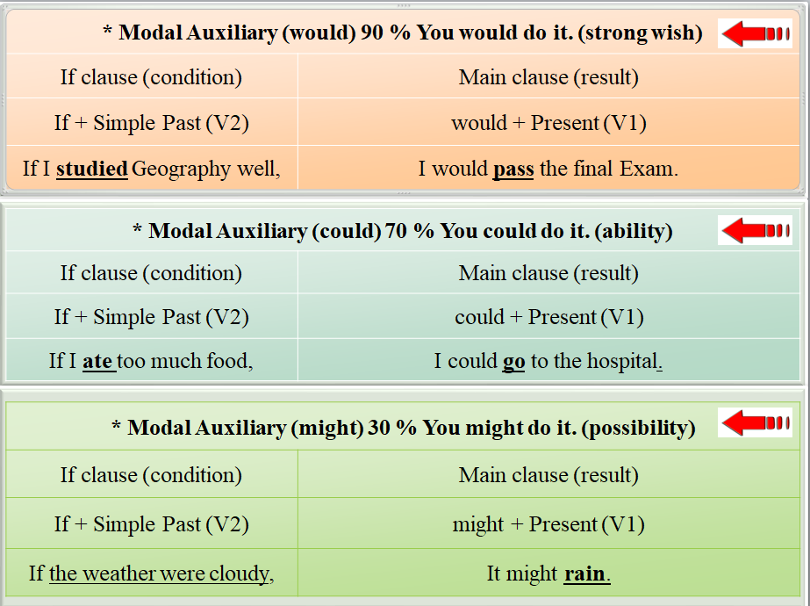

Slide 13
04.
Verb : Wish

Slide 14
Structure:
I wish I + would, could, might + Present (V1)
I wish I + Simple Past (V2)
Write the following sentences with "Wish":
1. I don’t study English well.
I wish I studied very well.

Slide 15


Slide 16
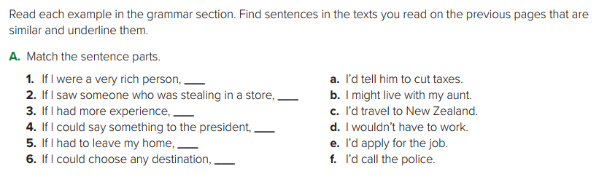
d
f
e
a
b
c

Slide 17
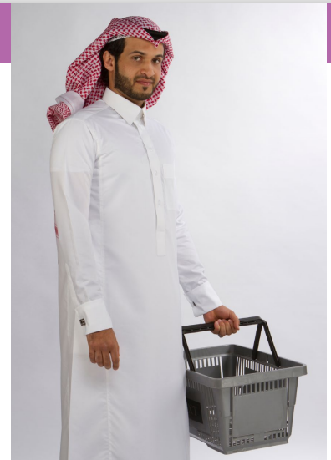
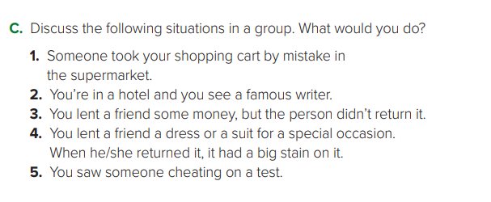
1- If someone took my shopping cart by mistake, I’d just say, “Sorry. That’s my cart.”
2. If I were in a hotel and I saw a famous writer at a nearby table, I wouldn’t bother the celebrity and ask for
an autograph.
3. If I lent a friend some money, I’d politely ask for the money back.
4. If I lent a friend a dress for a special occasion and the friend returned it with a spot, I wouldn’t say
anything. I’d just take the item to the dry cleaners.
5. If I saw someone cheating on a test, I might tell the teacher

Slide 18
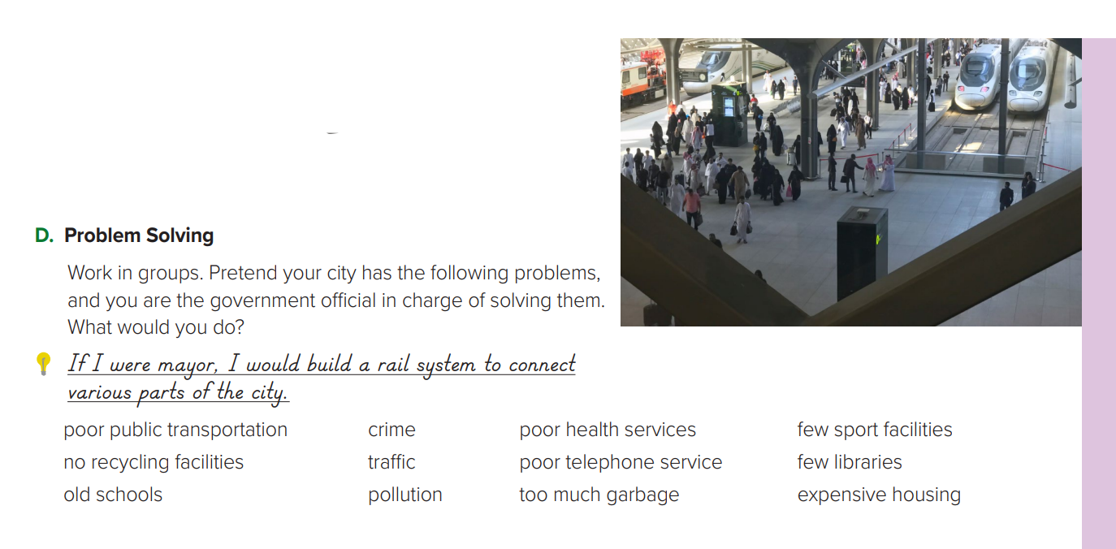
If I were mayor, …
…I’d put more buses on the road
…I’d have more recycling bins on the streets.
…I’d pass laws against pollution by factories.
…I’d have more police officers on the street.
…I’d limit access to the downtown area to buses and taxis.
…I’d have built new schools.
…I’d build a new city hospital.
…I’d improve the telephone service.
…I’d have the garbage picked up more often.
…I’d build a sports complex.
…I’d have a library in every neighborhood.
…I’d encourage builders to build more houses and apartment buildings.

Slide 19
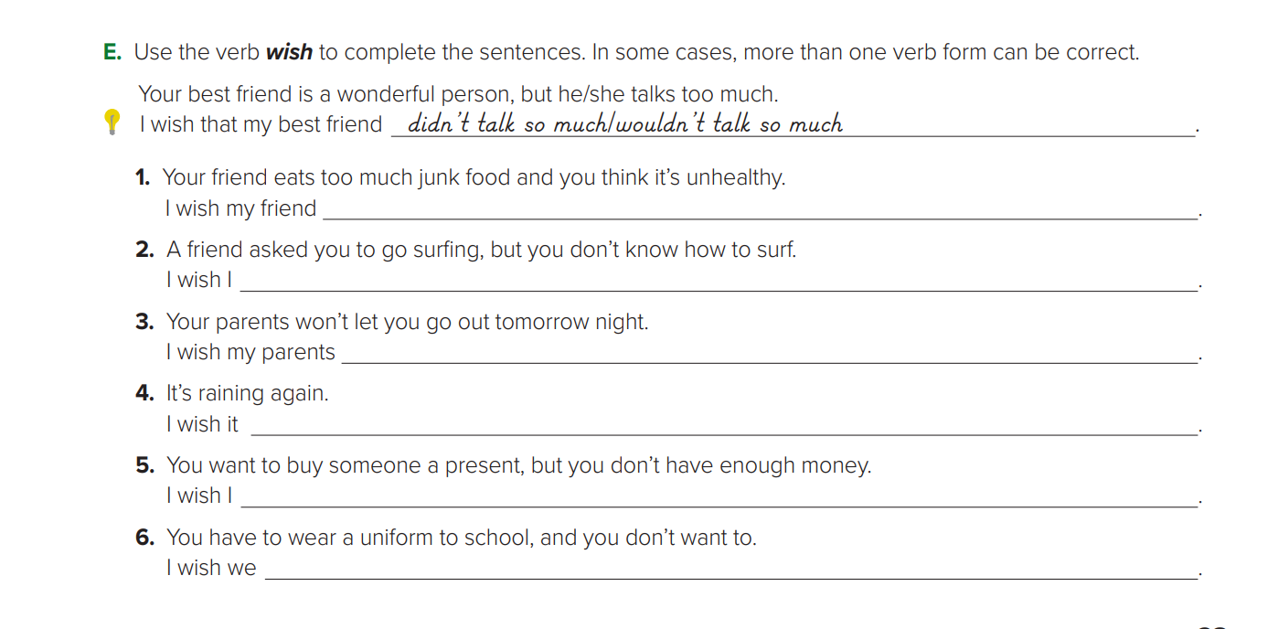
didn’t/wouldn’t eat too much junk food
knew how to surf
would let me go out tomorrow night
weren’t raining
had enough money to buy a present
didn’t have to wear a uniform to school

Slide 20
Homework
workbook , p.( 108),
Exercise ( E )

Slide 21

Thanks

