Slide 1
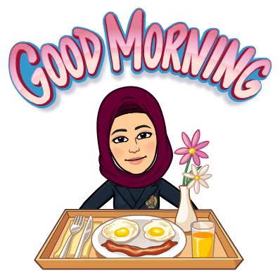

Slide 2
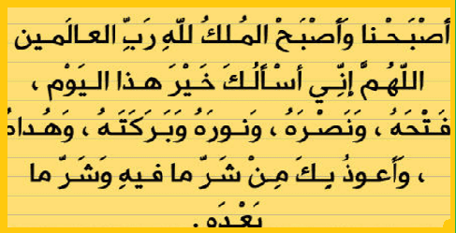

Slide 3
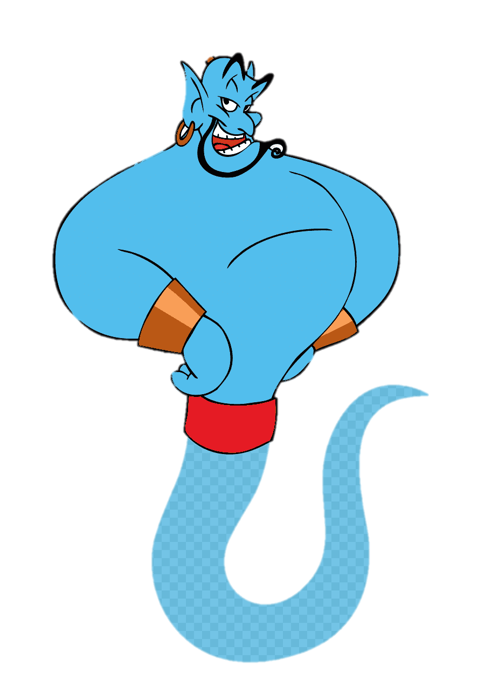
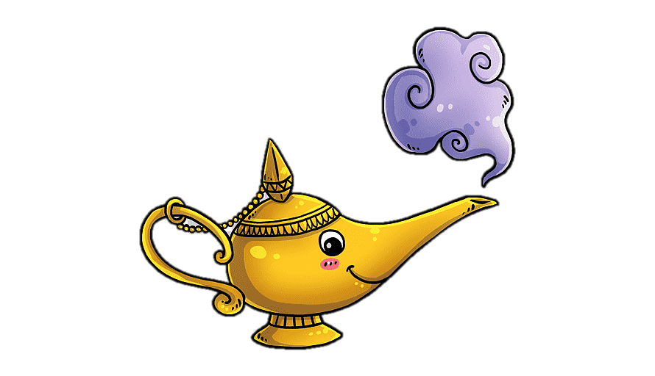
Unit-4
Wishful Thinking

Slide 4
11 Form , Meanings &
Functions

Slide 5
Count/Noncount Nouns
Expressions of Quantity: Some, Any, No
Words Connected with Money, Shopping Habits and Prices

Slide 6

Count/Noncount Nouns
Objectives
The students will be able to :
1 – Identify count nouns and noncount nouns .
2 – Express quantity correctly .
3 – Use words connected with money, shopping habits and prices .
4 – Recognize words connected with money and shopping .
5 – Practice using shopping terms .
6- Write a conversation about shopping situation .

Slide 7

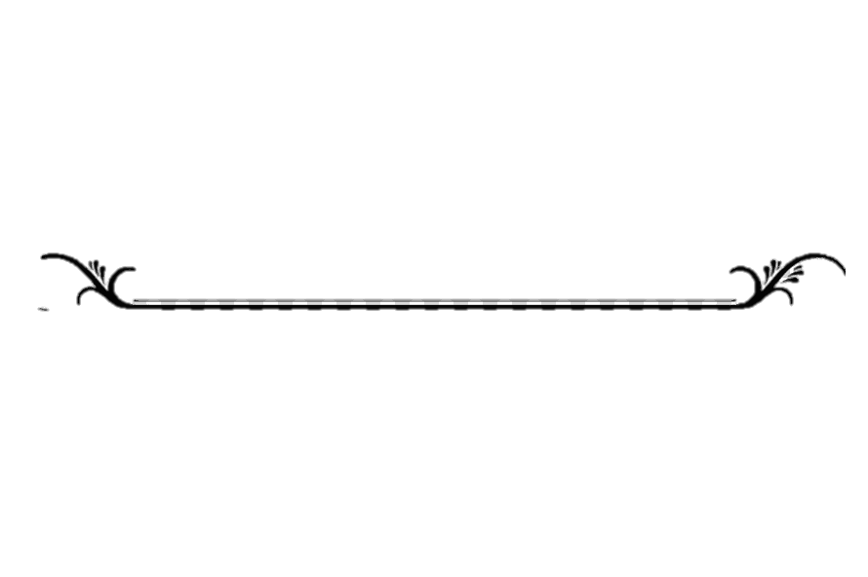

Count Nouns
Noncount Nouns
Count/Noncount Nouns

Slide 8
Lets Check What you Know
Classify the nouns into Count & Noncount Nouns
rice
quiz show
philanthropist
furniture
sugar
universe prize
leader
charity
Count Nouns
water
Noncount Nouns
quiz show
rice
philanthropist
furniture
universe prize
sugar
leader
water
charity

Slide 9
Noncount Nouns
Count Nouns
Singular
Plural
A quiz show
Two quiz shows
A philanthropist
Three philanthropists
An universe prize
Five universe prizes
A leader
four Leaders
A charity
Six charities

Slide 10


Noncount Nouns
rice
furniture
sugar
money
air
water
BUT NOT waters

Slide 11
Find the differences
Count Nouns
Non Count Nouns
Singular + plural
One form
Use: a / an
s plural
Use:
(the)
------

Slide 12
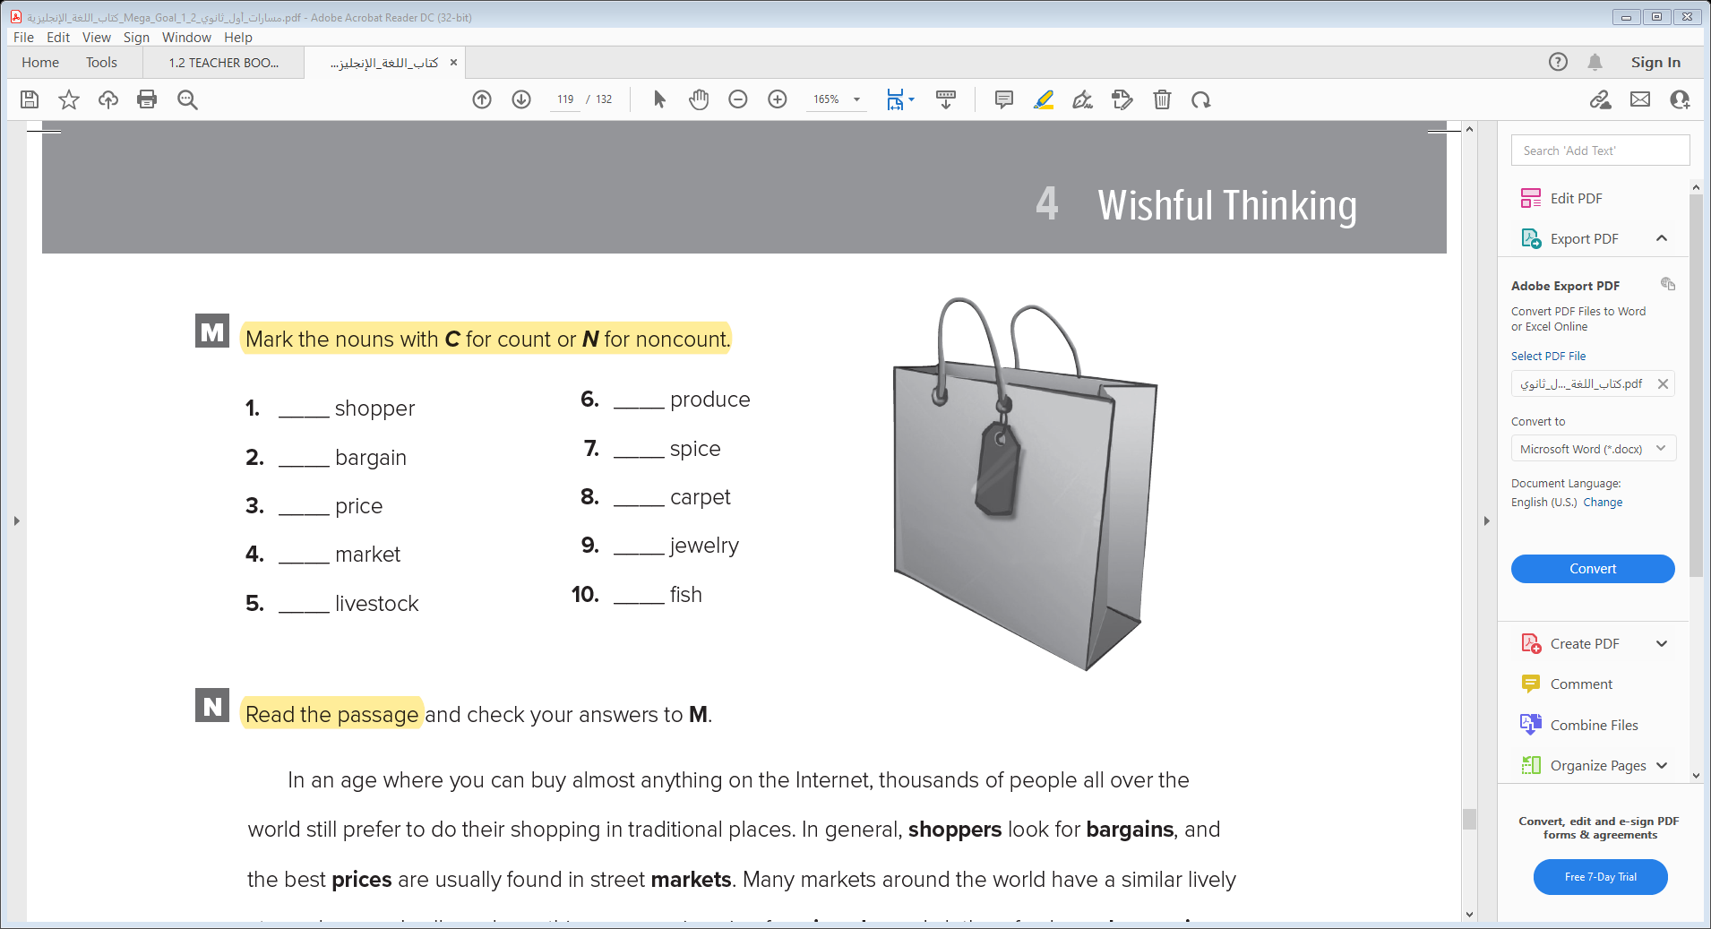
Expressions of Quantity:
Some, Any, No
Work Book P.115
N
C
C
C
C
C
C
N
Affirmative +
N
N
Negative -

Slide 13
Affirmative +
Negative -
Expressions of Quantity:
Some, Any, No
Questions ?

Slide 14
Questions ?
Affirmative +
There are some quiz shows
There is some rice
There are some universe prizes
There is some water
Negative -
There isn’t any quiz show
There isn’t any rice
There aren’t any universe prizes
There isn’t any water

Slide 15
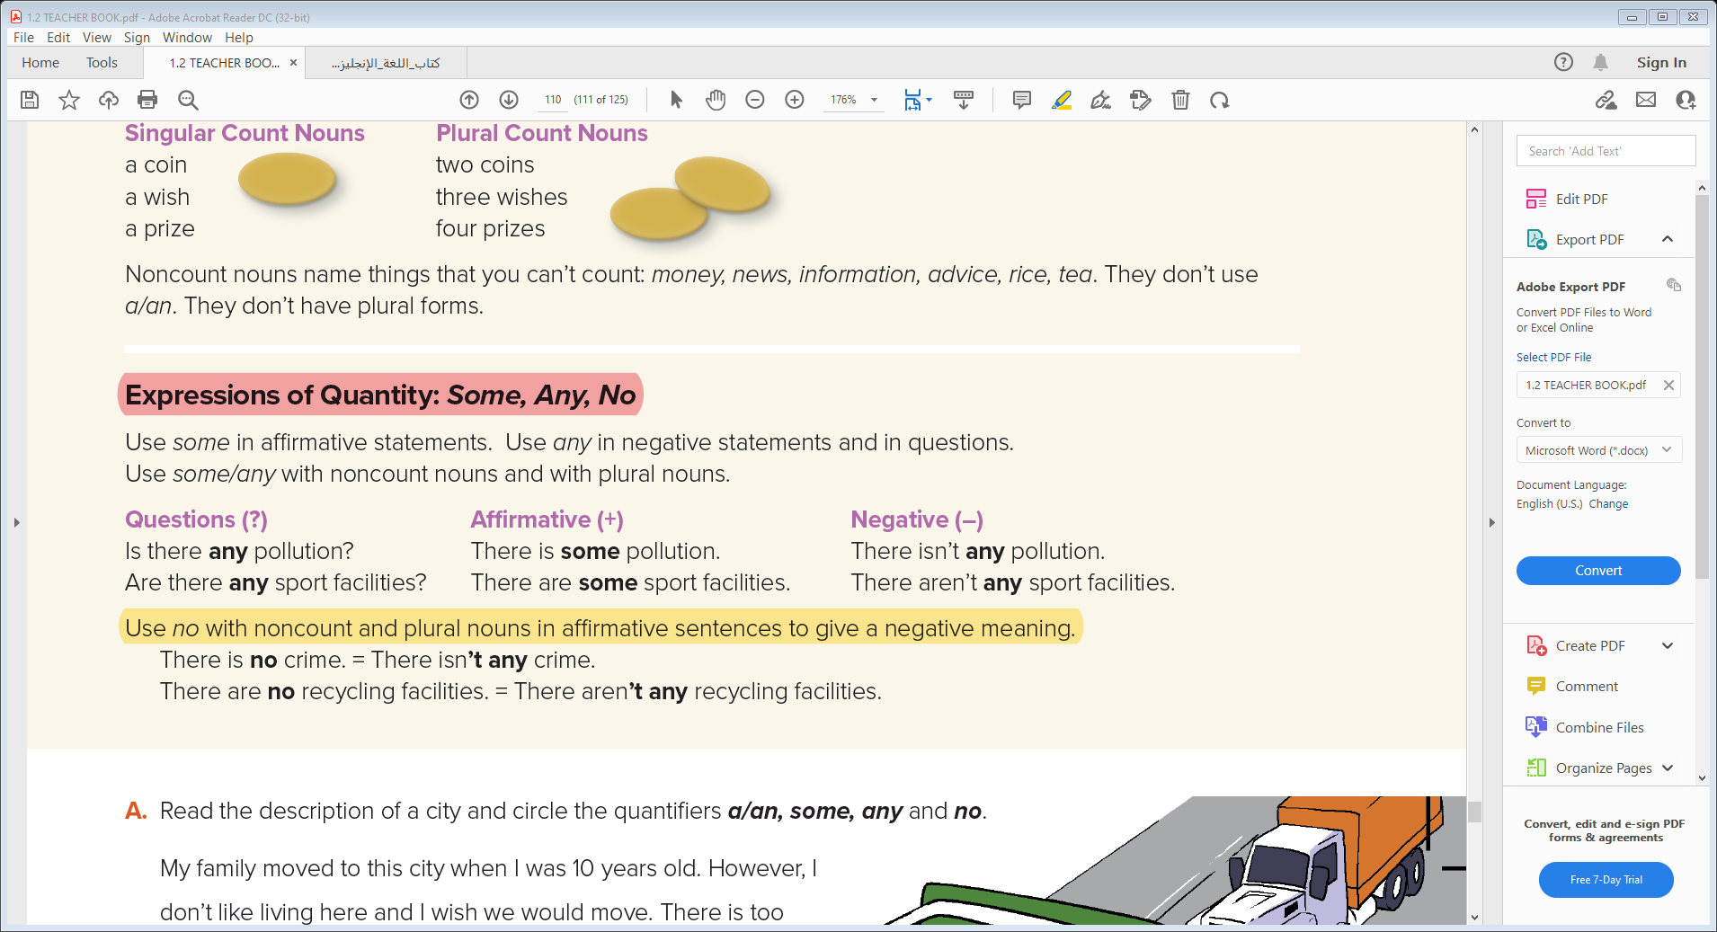
Questions ?
There are some quiz shows
There is some rice
Are there any quiz shows?
Is there any rice?
There are some universe prizes
There is some water
Are there any universe prizes?
Is there any water?

Slide 16
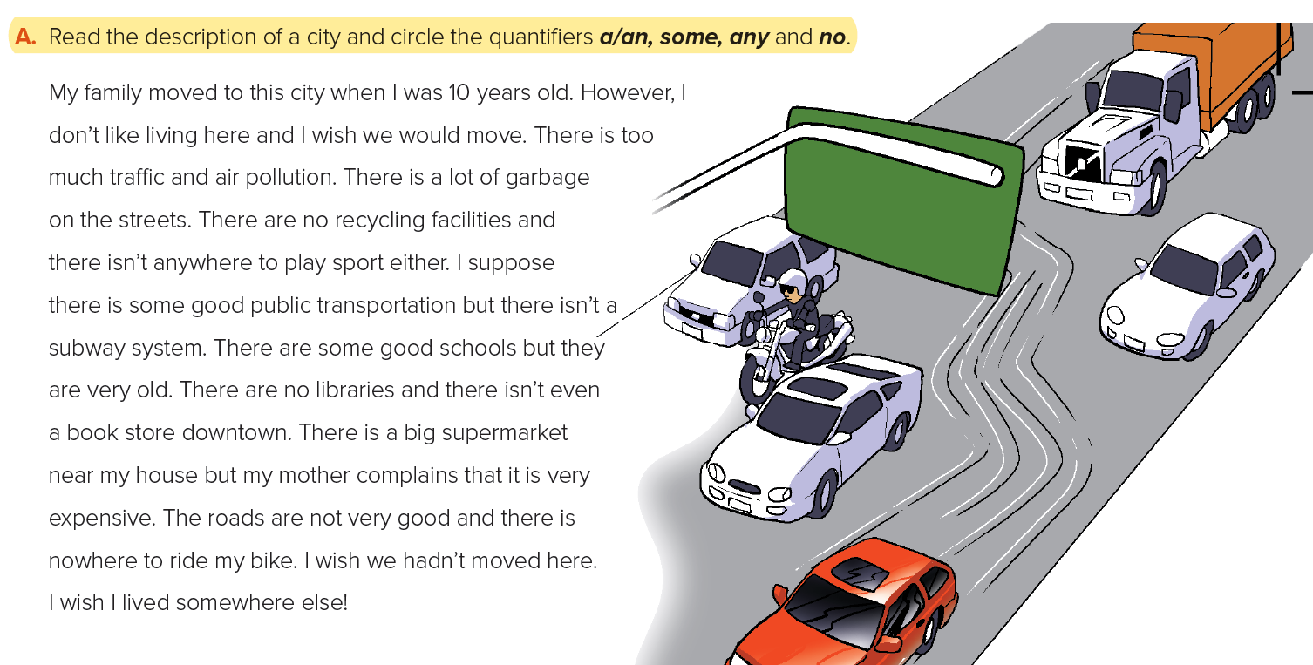
Student Book P.56

Slide 17
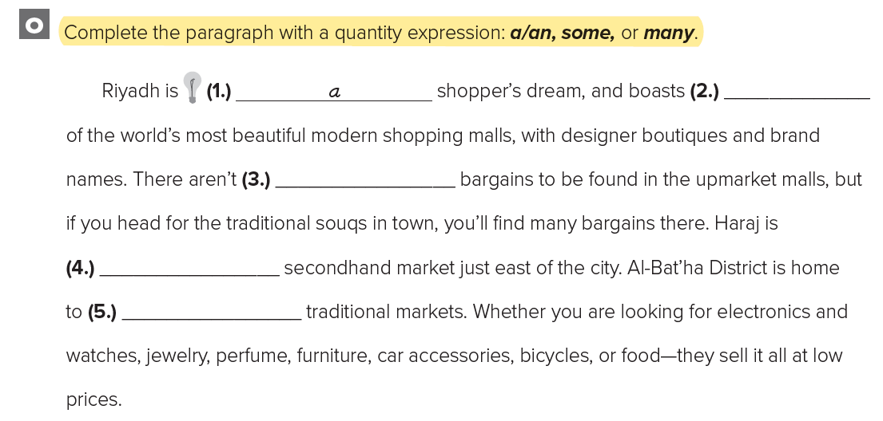
Words Connected with Money, Shopping Habits and Prices
Work Book P.115
some
any
a
many

Slide 18
Words Connected with Money, Shopping Habits and Prices

Slide 19
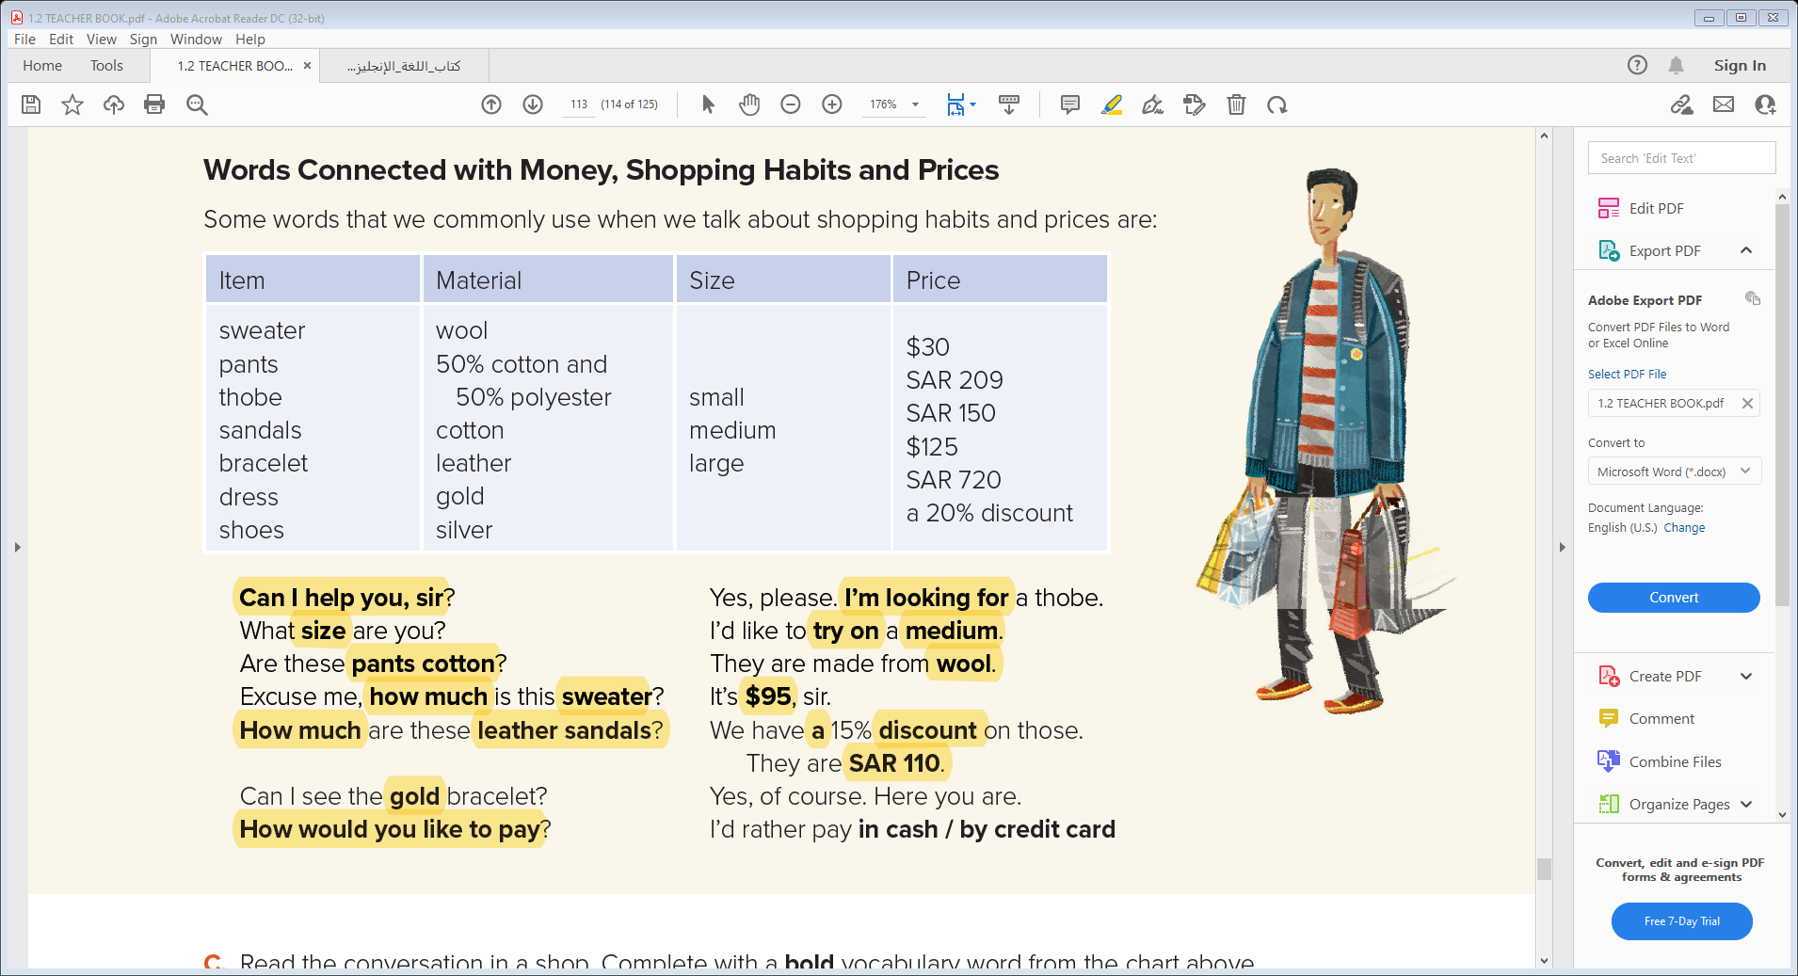

Slide 20
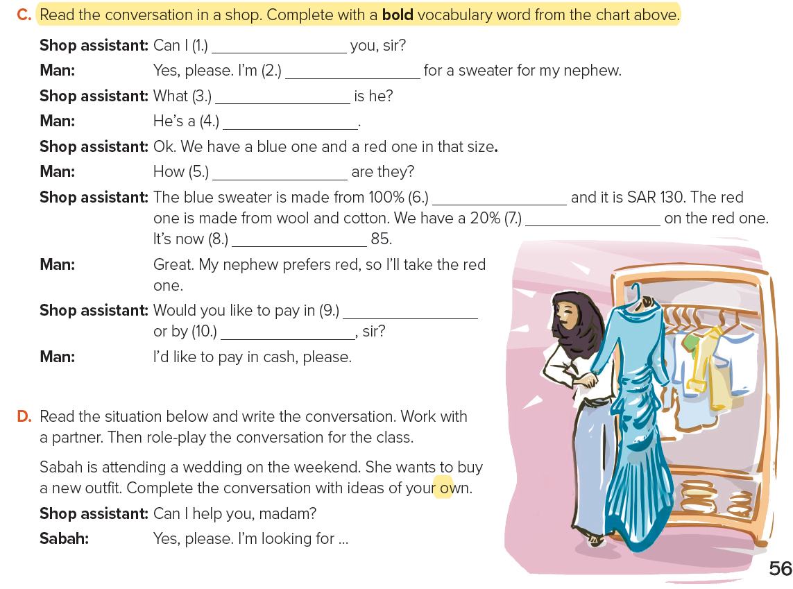
Student Book P.57
help
looking
size
small
much
wool
discount
SAR
cash
credit card

Slide 21


Quick Check

Slide 22


