Slide 1


Slide 2


Slide 3
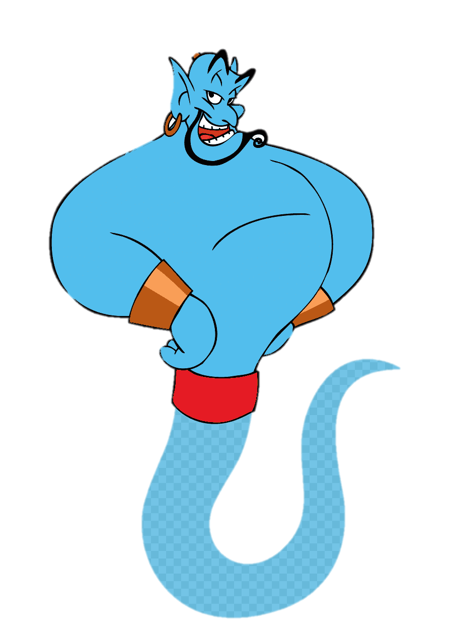
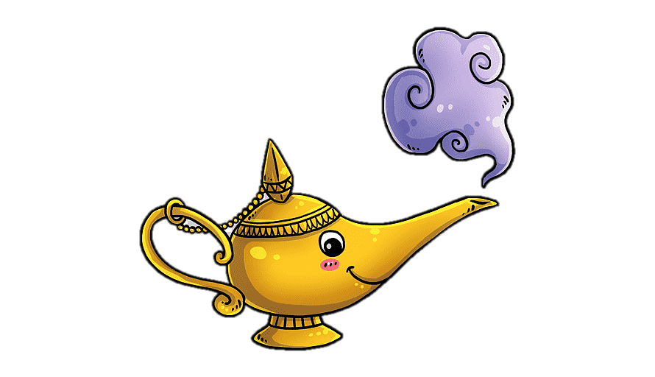
Unit-4
Wishful Thinking

Slide 4
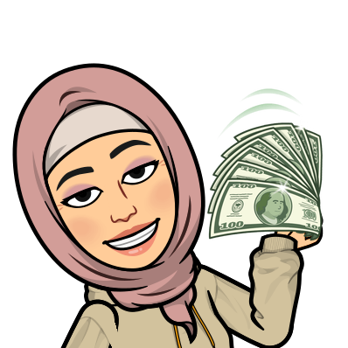
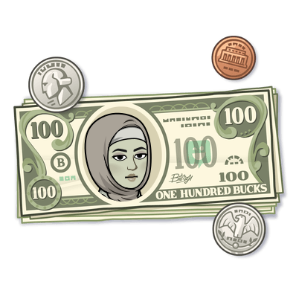
9-Reading

Slide 5

Warm Up
Objectives
The students will be able to :
Find problems of winning money in the reading text.
Find money expressions in the reading text .
Make notes about ideas in the text.
Find the meaning of new words in the text .
Find the main idea of a paragraph
Share positively in pair work.
Compare their answers with partner.

Slide 6
Students Book
52-53
Warm Up
What kinds of problems would you think money would bring?

Slide 7


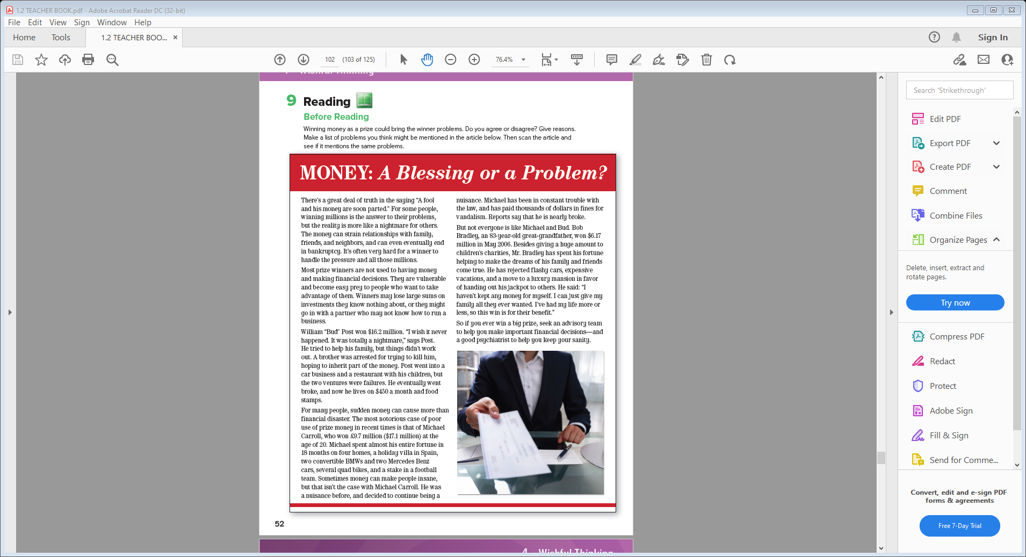
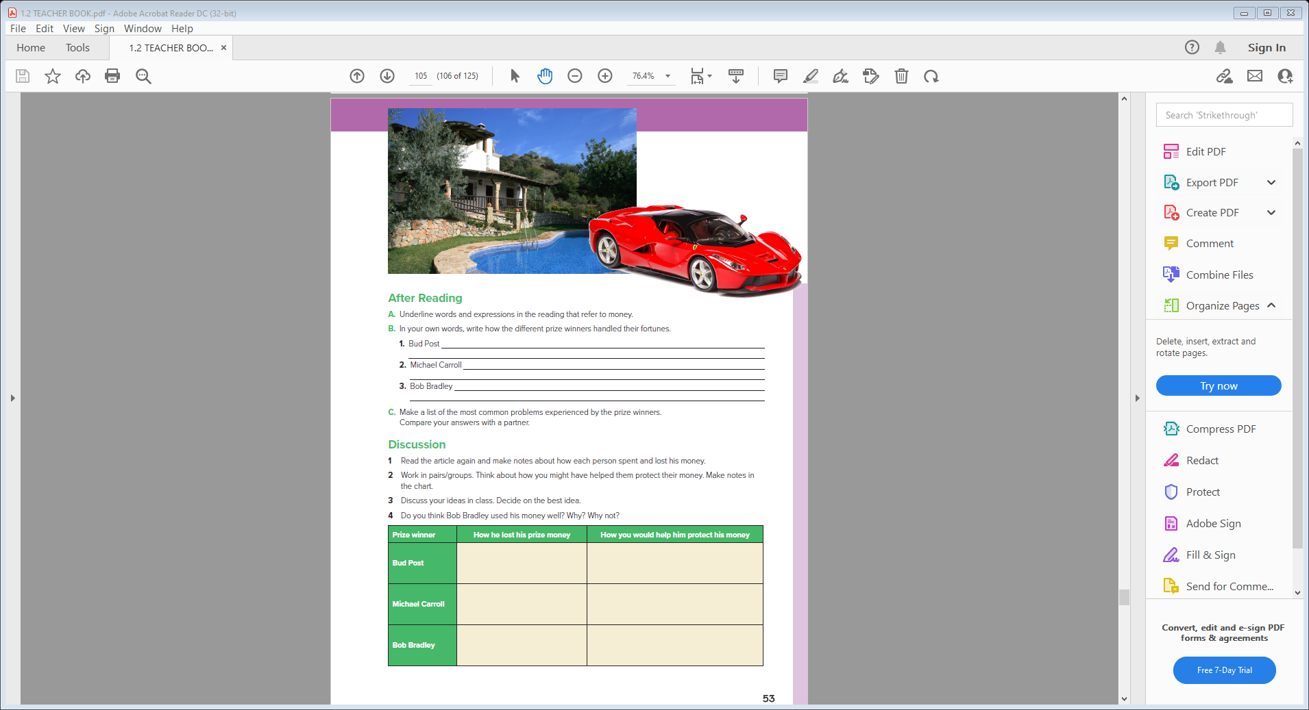
………the title?
……paragraphs are there ?
Skimming
………. photos ?
Students Book
52-53

Slide 8


Who won?
What did he or she buy?
What happened to him or her?
Skimming
How much did he or she win?
………the title?
……paragraphs are there ?
………. photos ?

Slide 9

Read & Listen
Who won?
What did he or she buy?
What happened to him or her?
How much did he or she win?

Slide 10
Scan
…Unfamiliar words?

Slide 11

Legal status of having no money
bankruptcy
prey
easily be deceived or harmed
vulnerable
easily harmed
sums
amounts
group that gives advice
advisory team
sanity
ability to think in a normal way
Psychiatrist
A doctor trained in the treatment of mental illness
inherit
receive property from someone who has died

Slide 12
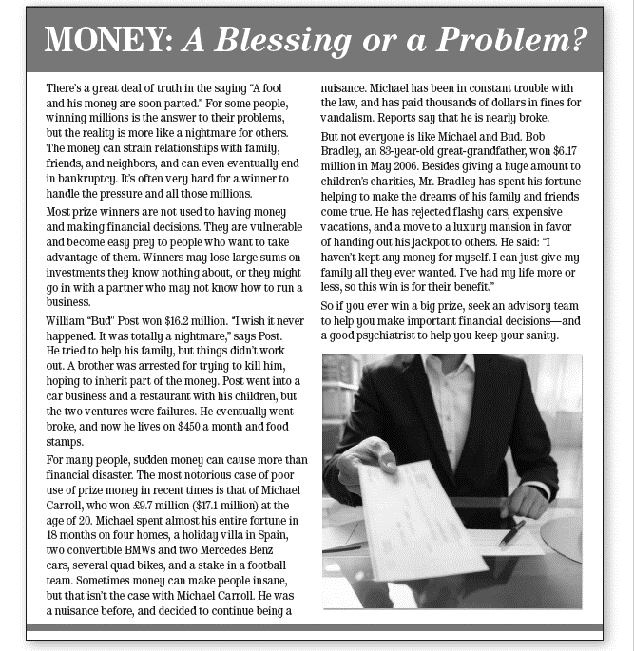

Strategy
Finding the main idea
What does this saying mean ( A fool and his money are soon parted ) ?
A person who acts carelessly with their money will lose it fast .
What is the main idea of this paragraph ?
Money can strain relationships with family and friends and end in bankruptcy .

Slide 13
Strategy
Finding the main idea
Do most prize winners know what to do with that money ? Why ?
No, they don’t .
Because it’s the first time they have this money and they lack financial decisions .
What is the main idea of this paragraph ?
Prize winners are usually not good in financial decisions .

Slide 14
Strategy
Finding the main idea
What did William say after getting that money ?
I wish it never happened, It was totally a nightmare
What is the main idea of this paragraph ?
A problem to his family .

Slide 15
Strategy
Finding the main idea
How much did Michael pay in fines for vandalism ?
paid thousands of dollars in fines for
vandalism
What is the main idea of this paragraph ?
Michael Carroll’s story .

Slide 16
Strategy
Finding the main idea
Has Bradley spent his money in buying expensive cars ?
No, he hasn’t .
What is the main idea of this paragraph ?
Bob Bradley’s story .

Slide 17
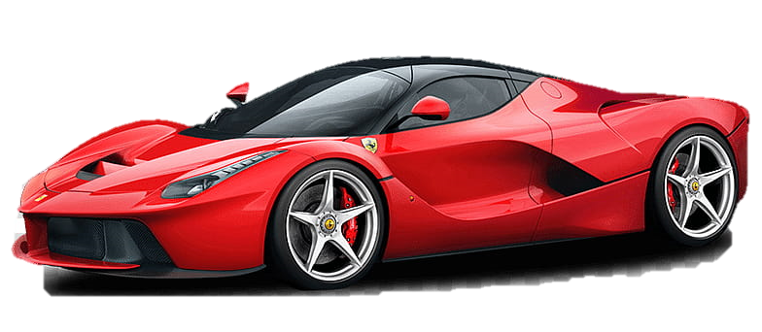
After Reading
A. Underline words and expressions in the reading that refer to money.
winning million
bankruptcy
financial decisions
investments
went broke
spent his fortune
fine

Slide 18
B. In your own words, write how the different prize winners handled their fortunes.
1. Bud Post tried to help his family, but his brother tried to kill him. He
invested money in businesses but they failed
2. Michael Carroll spent his fortune in 18 months. He bought things like a Mercedes and a villa in Spain. He was in trouble with the law and paid fines
3. Bob Bradley gave huge amounts of money to charity. He didn’t buy things for himself. He gives money to make the dreams of his family and friends come true
C. Make a list of the most common problems experienced by the prize winners.
Compare your answers with a partner.

Slide 19
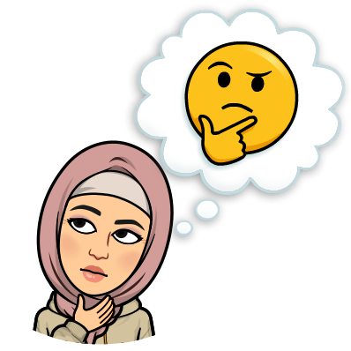
Does the author think winning a big prize is,
in general, a good thing or a bad thing?
Based on this reading, would you want to win
a big prize?

Slide 20
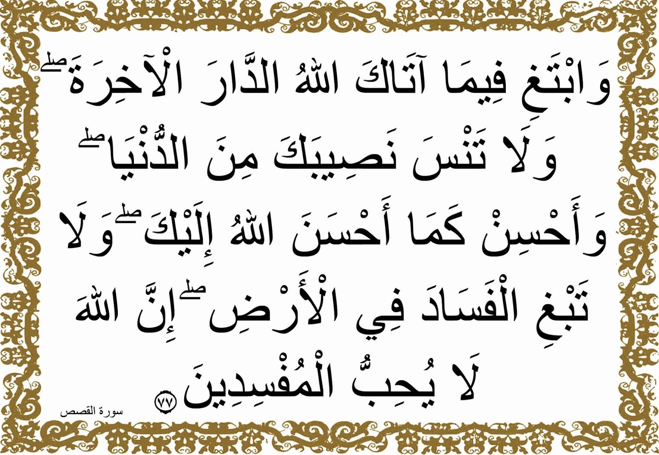

Slide 21


