Slide 1
TV
Unit 4
Wishful Thinking
Writing
Mega Goal 1.2
Done by : Entisar Al-Obaidallah

Slide 2
01
02
Lesson
Objectives
03
04
Match
the answers given by the winner of a popular quiz show, with the right questions
Answer
Some questions about quiz show
Fill in
a chart with the important information about their own life .
Write
a description of a day in the life of a quiz show winner

Slide 3

Open
student’s book
p. 54

Slide 4
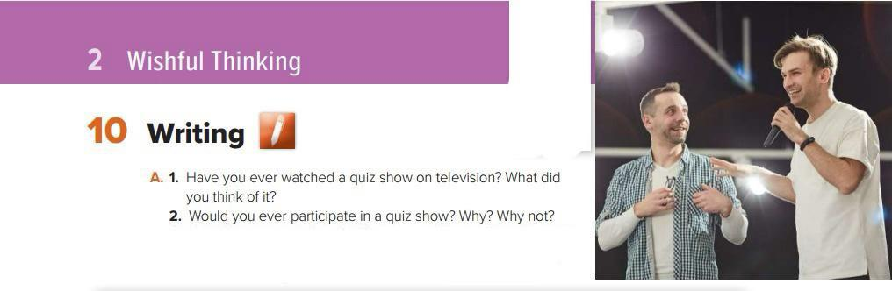


A quiz show

Slide 5
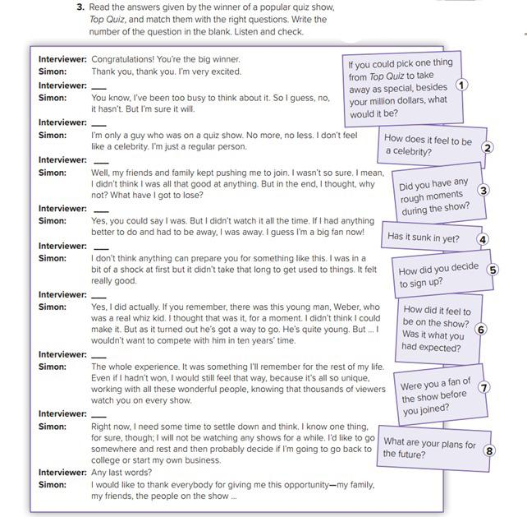

4
2
5
7
6
3
1
8

Slide 6

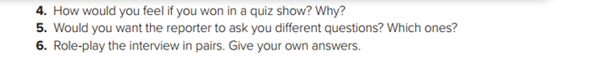

Slide 7
Open your student’s book p. 29

Slide 8
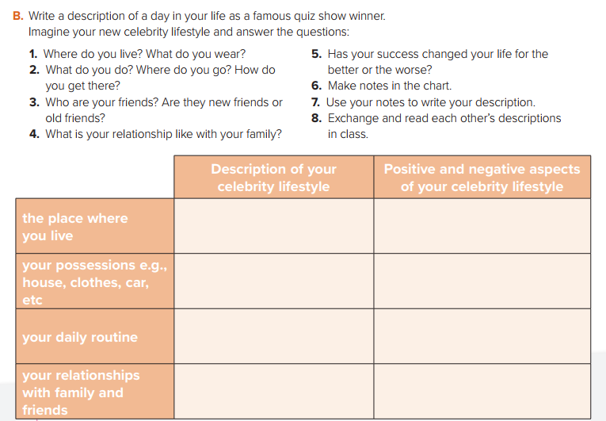
a villa near the sea
Far away from the city
Brand bags ,watches & shoes
Fancy cars
Many interviews – No privacy
fancy gifts – special treatment
Gym - watch TV - shopping
Healthy style
Hang out with friends
spend time with family
powerful relationships
fake friends – attract stalkers

Slide 9
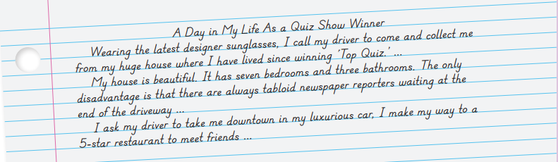
Descriptive essay
Use present tense
Use a lot of descriptive vocabulary
Use paragraphs to describe different aspects of someone’s lifestyle

Slide 10
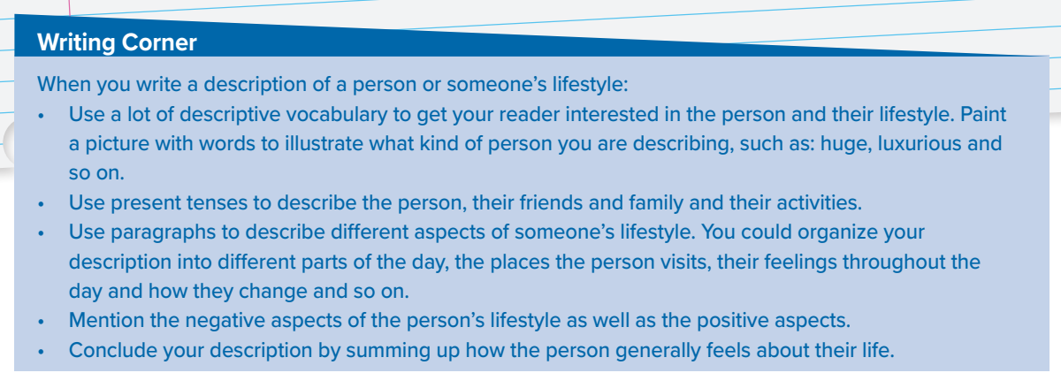
Follow these steps when you write a descriptive essay

Slide 11

Homework
workbook p.(84),
exercise (M)

Slide 12

Thank you!

