Slide 1
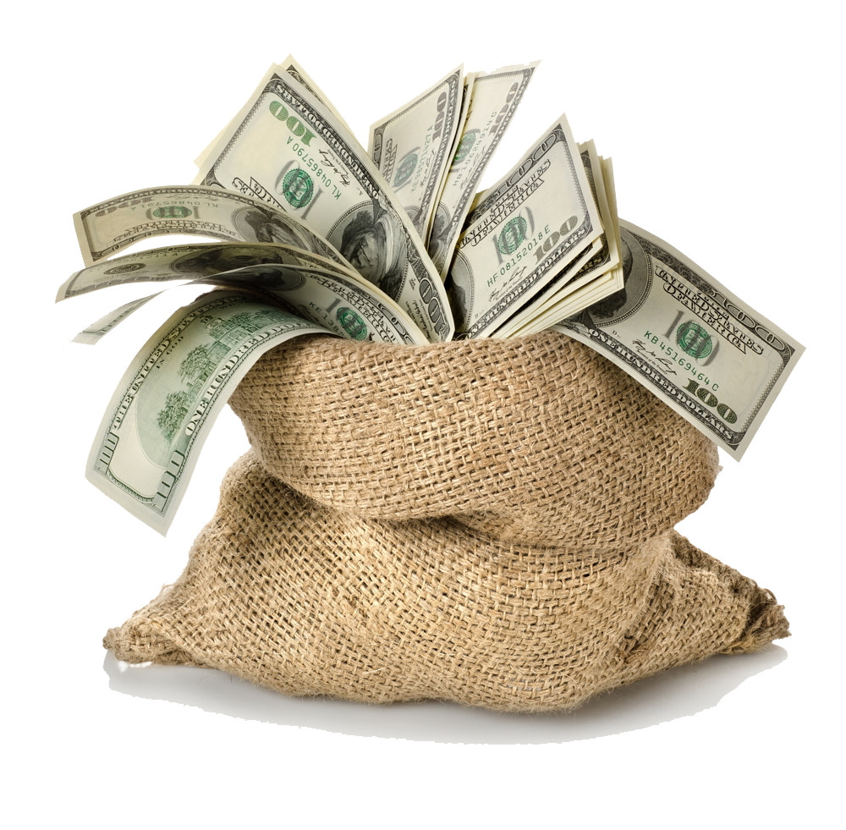
Mega Goal 1.2
U: 4
Wishful Thinking
Reading
By: Khadijah Fallatah

Slide 2

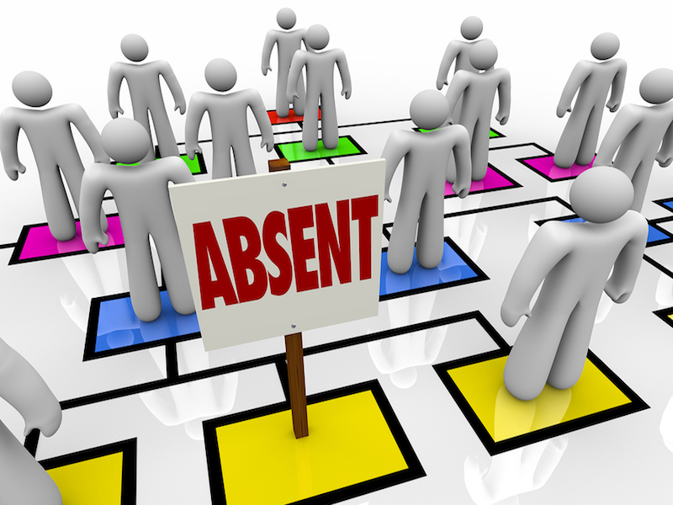

Slide 3

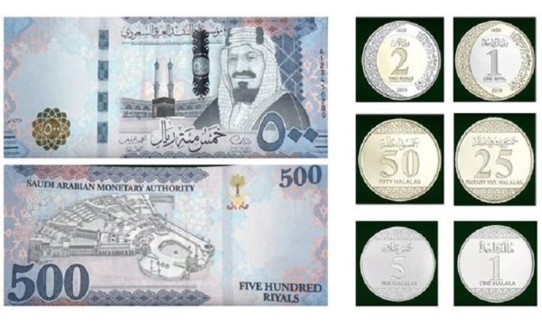
Lesson Objectives
The students will be able to :
Find problems of winning money in the reading text.
Find money expressions in the reading text .
Make notes about ideas in the text.
Find the meaning of new words in the text .
Find the main idea of a paragraph

Slide 4
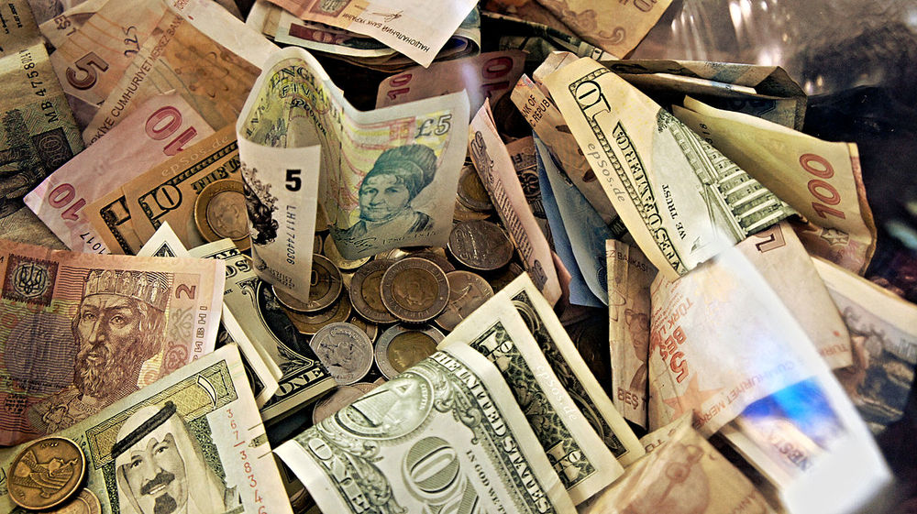
Warm Up
What does this picture show ?
What words come to your mind when you see this picture ?

Slide 5
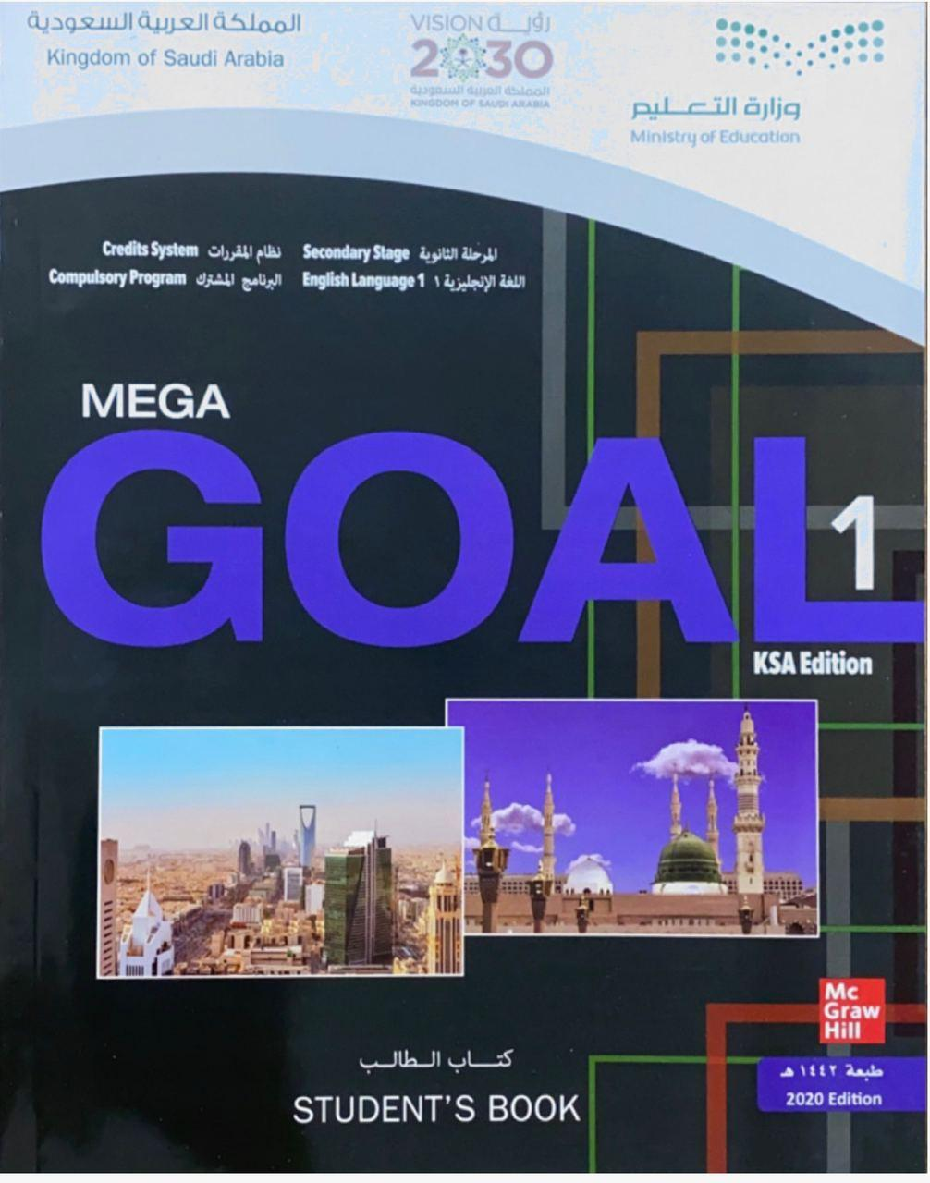

Open your Student’s book at page: 52

Slide 6

Our reading strategy is
Finding the main idea

Slide 7
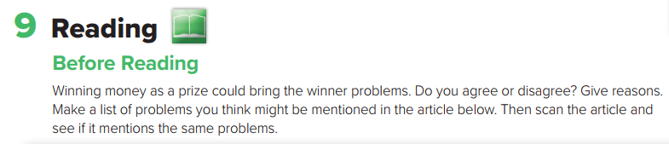
Before Reading

Slide 8
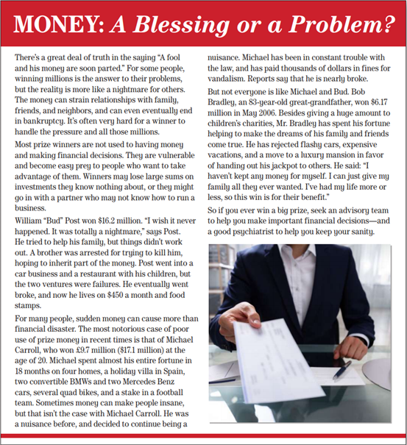


Read and Listen

Slide 9
What’s the title?
Money: A Blessing or a problem ?
How many paragraphs are there ?
Six
How many photos ?
A picture of a cheque .

Slide 10
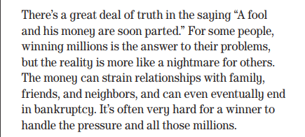
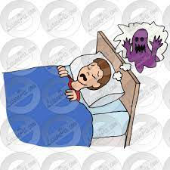

What does this saying mean ( A fool and his money are soon parted ) ?
A person who acts carelessly with their money will lose it fast .
What do some people think about money ?
What problems can money do ?
What is the main idea of this paragraph ?
Money can strain relationships with family and friends and end in bankruptcy .

Slide 11
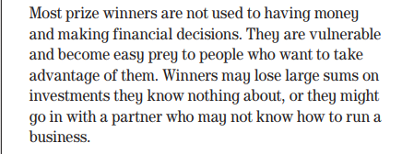
Do most prize winners know what to do with that money ? Why ?
No, they don’t .
Because it’s the first time they have this money and they lack financial decisions .
What is the main idea of this paragraph ?
Prize winners are usually not good in financial decisions .

Slide 12
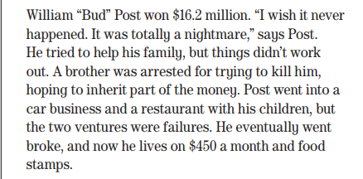
Who won $16.2 million ?
What did William say after getting that money ?
Does William have a problem with his family ?
Why was his brother arrested ?
Does William still get that money ? Explain ?
What is the main idea of this paragraph ?
A problem to his family .

Slide 13


Bud Post
This is Bud Post
He won 16.2 million dollars
He tried to help my family but it didn't work out
He went into tow failures ventures
Now, He lives on 450 dollars a month

Slide 14
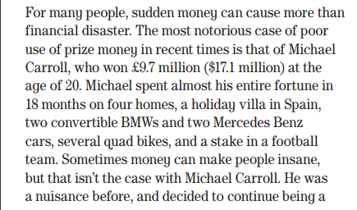

How much did Michael Carroll win ?
How did Michael spend his fortune ?
How much did Michael pay in fines for vandalism ?
Does Michael still have this money ?
What is the main idea of this paragraph ?
Michael Carroll’s story .

Slide 15

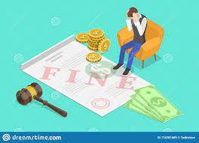
Michael Carroll
This is Michael Carroll
He won 17.1 million dollars at the age of 20
He spent almost my entire fortune in 18 months buying homes, luxurious holidays and flashy cars
Now, He is in trouble with the law . I have to pay thousands of dollars in fines

Slide 16
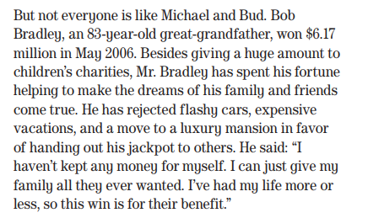
How old is Bob Bradley ?
How much did Bob win ? When ?
What did Mr. Bob do with his fortune ?
Has Bradley spent his money in buying expensive cars ?
No, he hasn’t .
What did Mr. Bradley say ?
What is the main idea of this paragraph ?
Bob Bradley’s story .

Slide 17
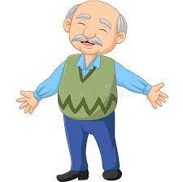

Bob Bradley
This is Bob Bradley, 83-year- old-great grand father
He won 6.17 million
He gave huge amount to children's charities
He helped to make the dreams of my family and friends come true.

Slide 18

Quick Check
https://www.liveworksheets.com/1-ie1723293za

Slide 19



Why do you seek an advisory team if you win a big prize ?
What can a good psychiatrist do ?
What is the main idea of this paragraph ?
Ask for professional & financial advice .

Slide 20
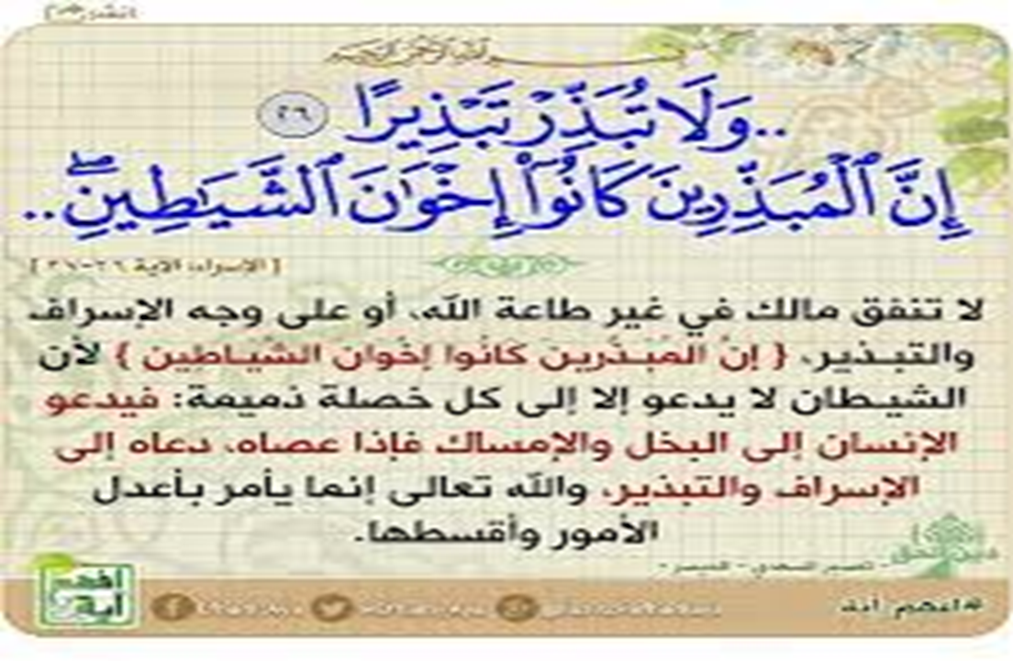

Slide 21

Let’s practice the new vocabulary via flash cards
What do the following words mean ?

Slide 22
Legal status of having no money
easily harmed
vulnerable
easily be deceived or harmed
bankruptcy
prey
sums
amounts
group that gives advice
inherit
advisory team
A doctor trained in the treatment of mental illness .
receive property from someone who has died
Psychiatrist
ability to think in a normal way
sanity

Slide 23
Quick Check
https://wordwall.net/resource/10619353

Slide 24
Open your Student’s book at page: 53

Slide 25
winning million
bankruptcy
financial decisions
investments
went broke
spent his fortune
fine

Slide 26
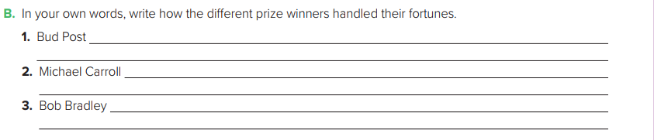
Post tried to help his family, but his brother tried to kill him. He invested money in businesses but they failed .
Carroll spent his fortune in 18 months. He bought things like a Mercedes and a villa in Spain. He was in trouble with the law and paid fines .
Bradley gave huge amounts of money to charity. He didn’t buy things for himself. He gives money to make the dreams of his family and friends come true.

Slide 28
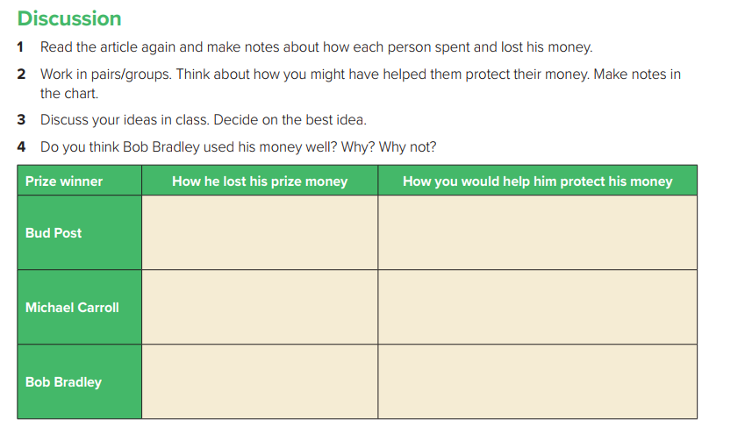
He tried to help his family but things didn’t workout . He invested money in different business but he failed .
Be partner with his brother .
Ask for financial advice .
Carroll spent his fortune in 18 months . He bought things like a Mercedes and a villa in Spain. He was in trouble with the law .
Save some money .
Ask for financial advice .
He gave money to charity. He didn’t buy things for himself. He made the dreams of his family and friends come true .
Divide his money to third or quarters .
Not to forget himself .

Slide 29

Workbook P. 111
Exercise H

Slide 30
