Slide 1
TV
Unit 4
Wishful Thinking
Project
Done by : Entisar Al-Obaidallah

Slide 2
01
02
Lesson
Objectives
03
Research
about TV games with large prizes for winners
Write
The notes in the chart
Make
A PowerPoint or poster using the notes in the chart

Slide 3

Open
student’s book
p. 58

Slide 4
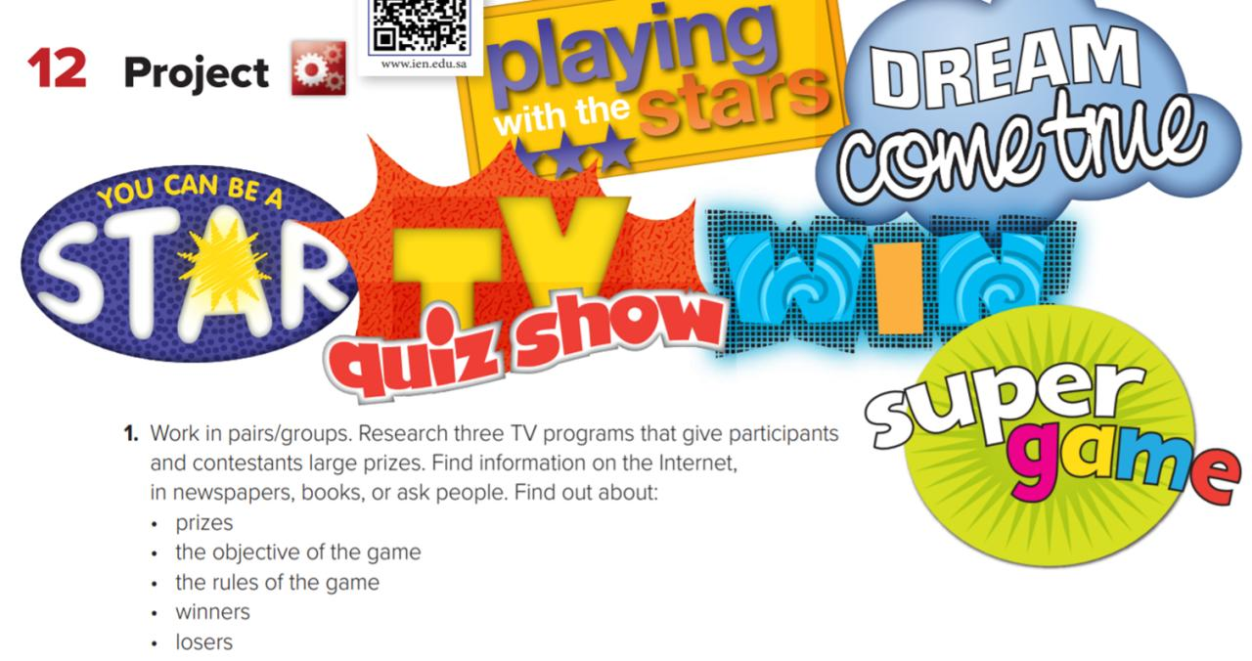

Slide 5






TV show
What is the difference between them?

Slide 6
Open student’s book p.58

Slide 7
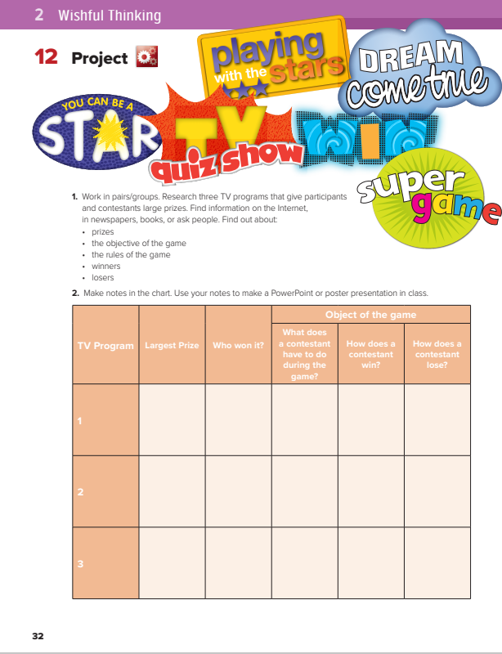

Slide 8
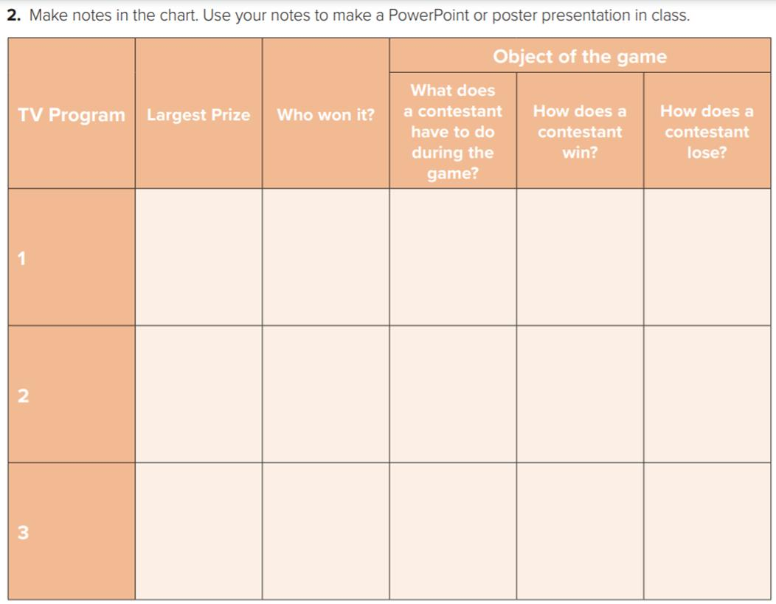
participant who answer a lot of questions
Answer the questions on time- ask for friend’s help
Succeed to answer the questions
on time
Fail to answer questions correctly on time
Who Will
Win
One Million
One Million SAR
Family which name the most popular responses to survey questions
two families compete to name the most popular responses to survey questions
Family succeed to name the most popular responses to survey questions
Family fail to name the most popular responses to survey questions
500.000
SAR
"family feud"
participant who reach the live final,
participant who auditions attempts
to secure a place
in the live episodes
Participant get both the judges' and public's vote
Participant fail to get both the judges' and public's vote
Arabs Got Talent
500.000
SAR

Slide 9

Homework
student’s book
p.58

Slide 10

Thank you!

