Slide 1
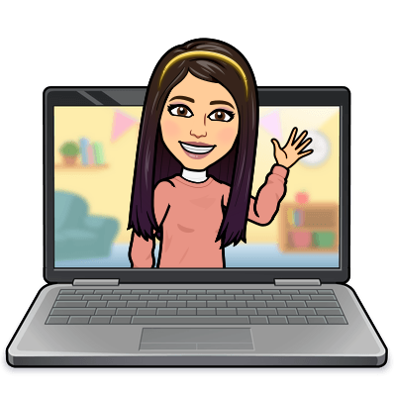

Hello My lovely students
I’m your teacher
Hanan AlShobaily

Slide 2




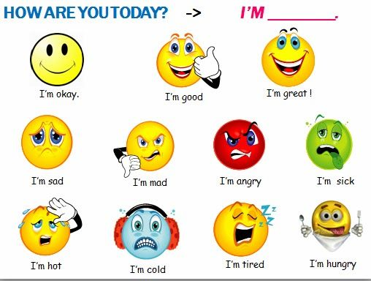
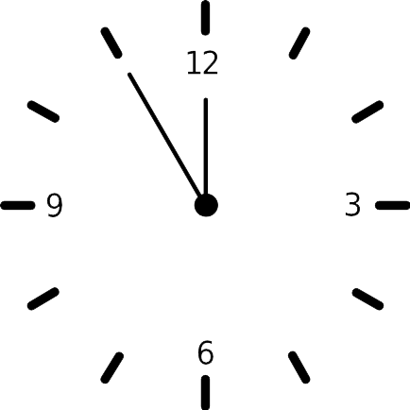



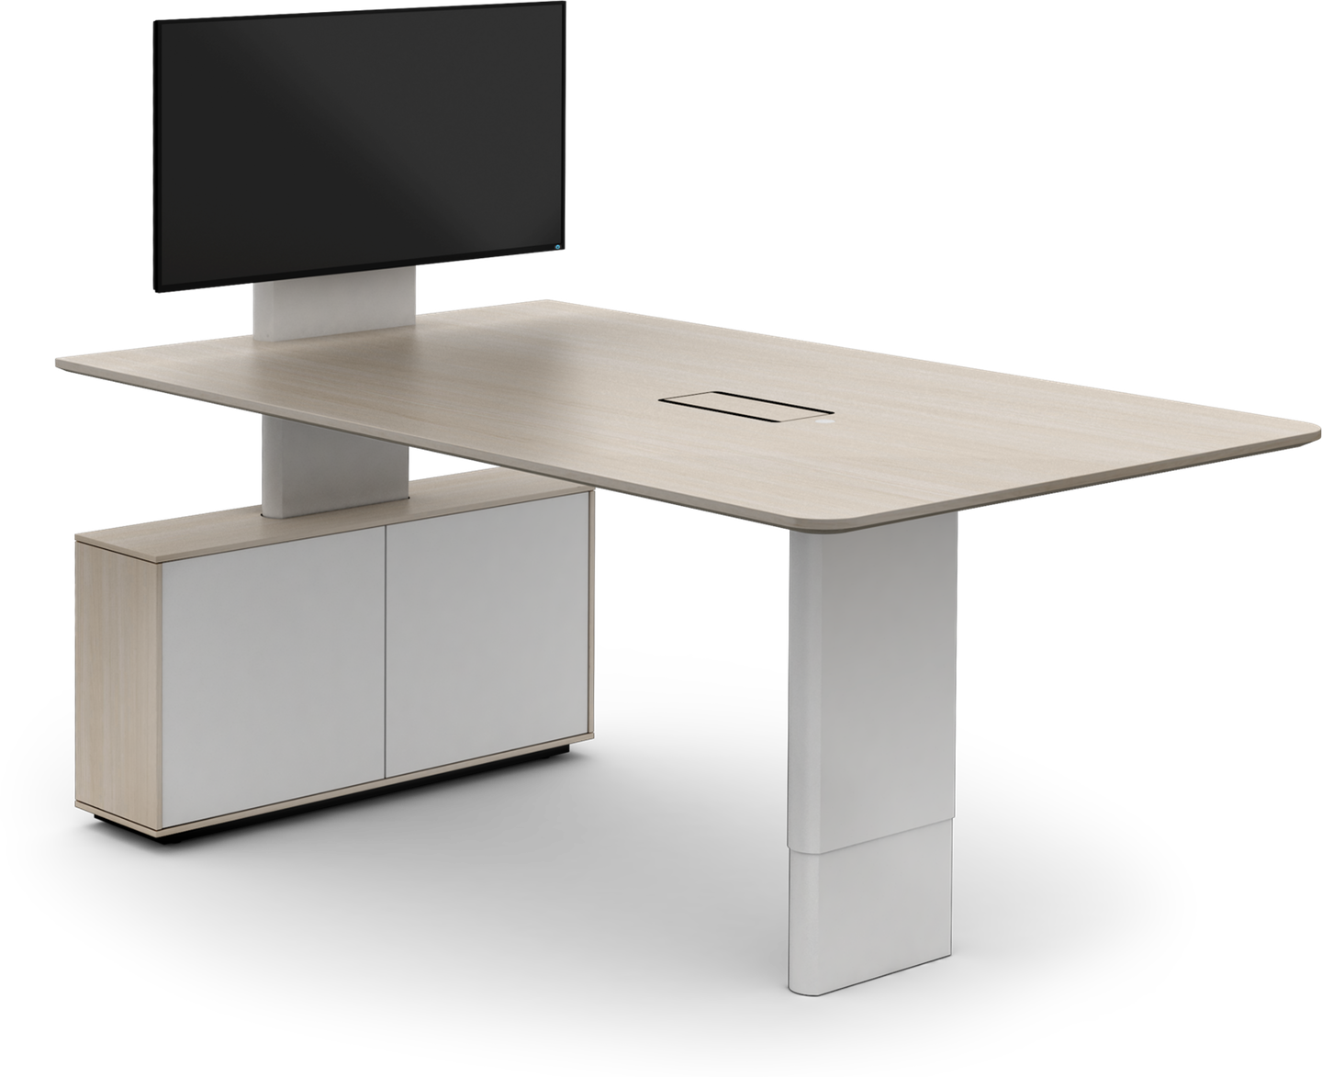
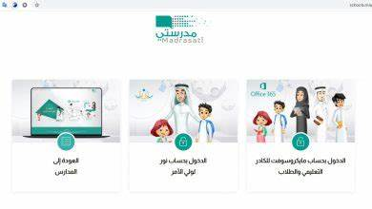



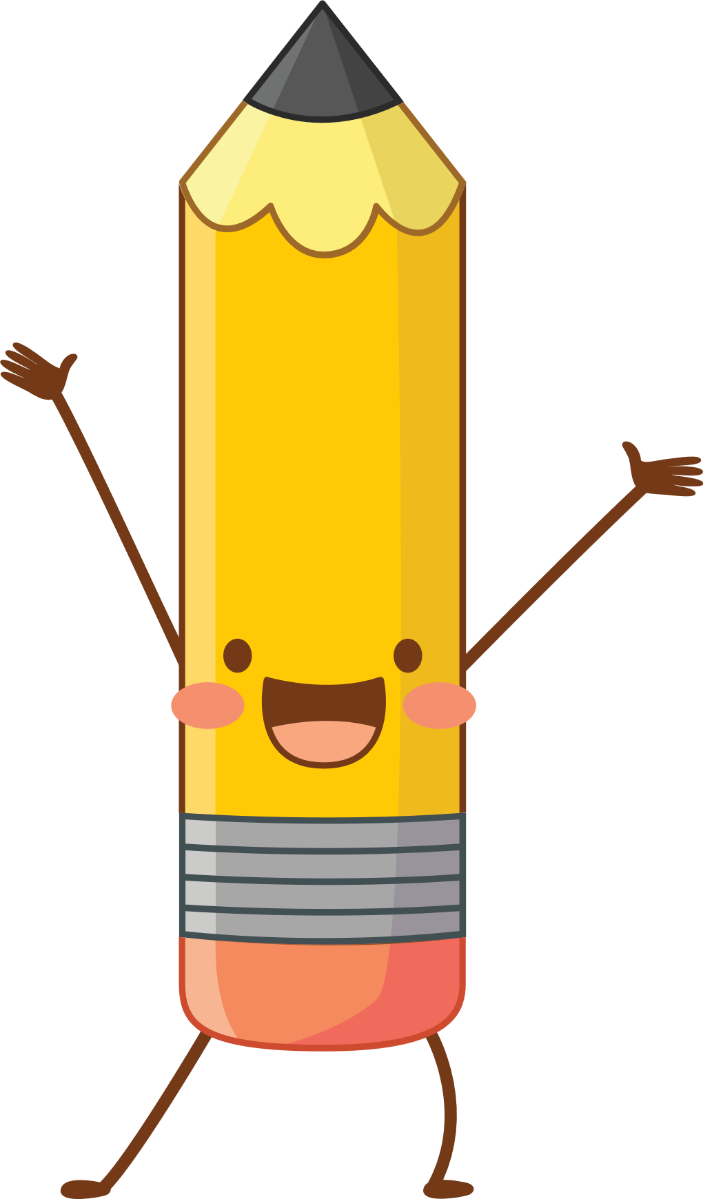



I love English

Slide 3
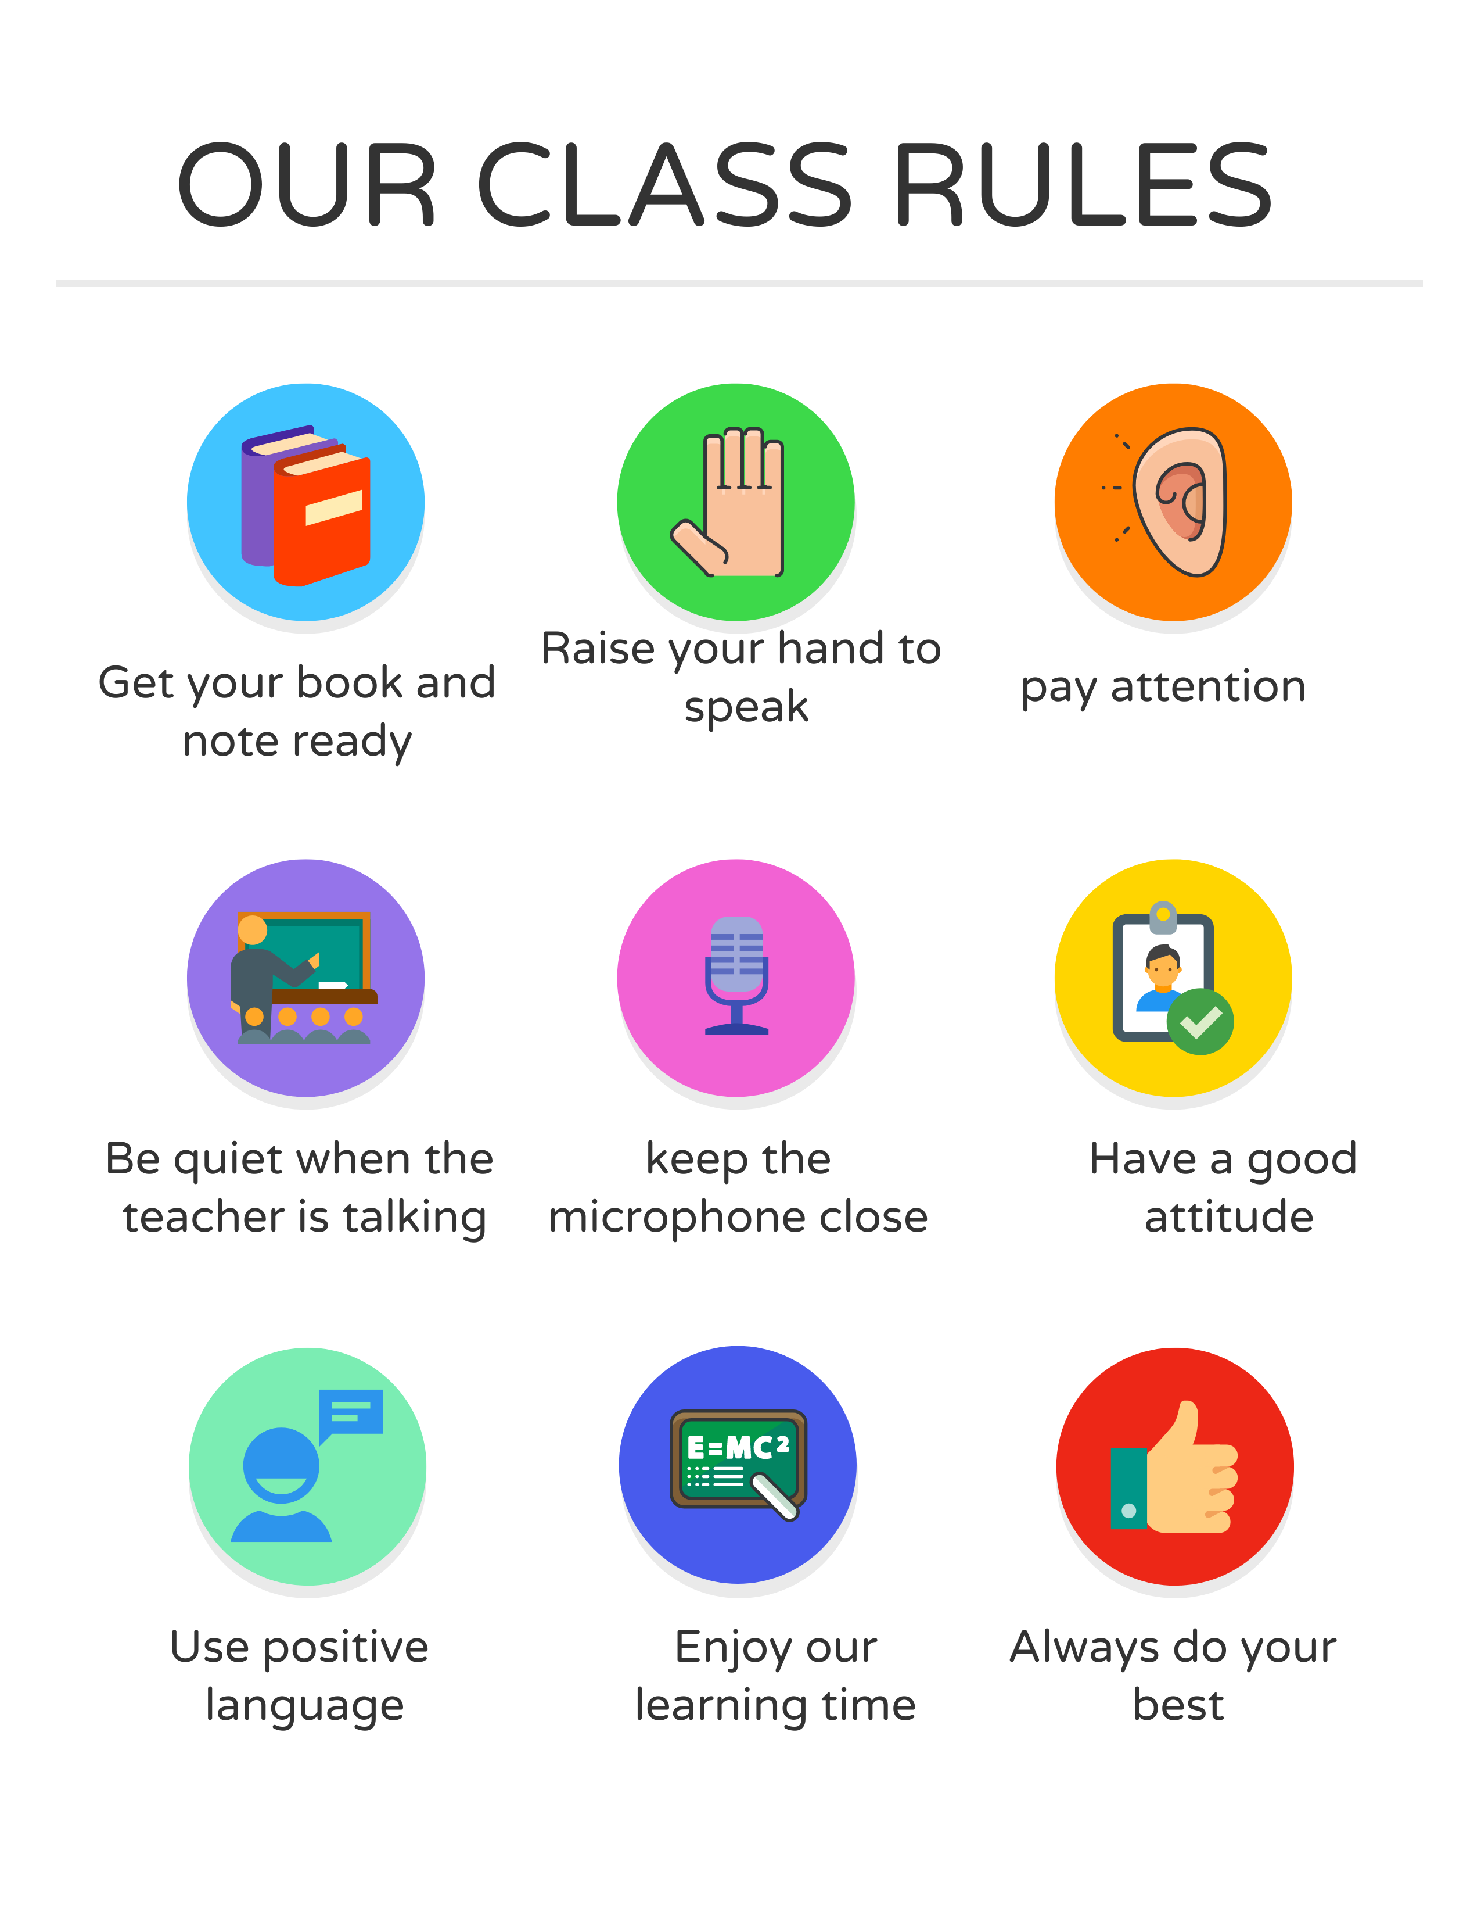
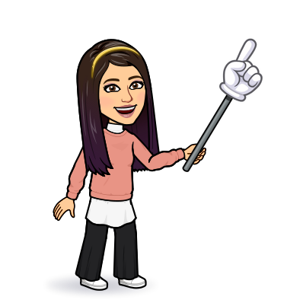
I love English

Slide 4


I love English
Mega Goal 2
Unit 2
(Wishful Thinking)
Form, Meaning and Function
Monday
3/7/1442

Slide 5

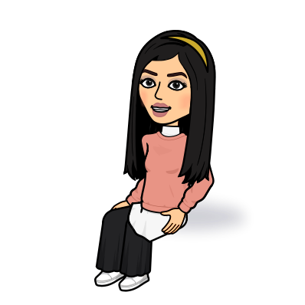
I love English
Lesson Goals
Students will be able to:
Identify count nouns and noncount nouns.
Use quantifiers “some”, “any”, “no” in sentences.
Form a conversation using words connected with shopping.

Slide 6
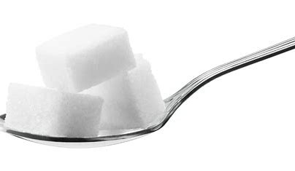
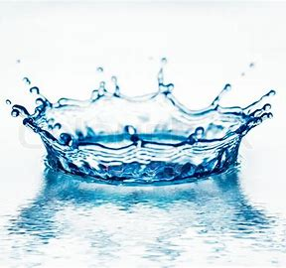

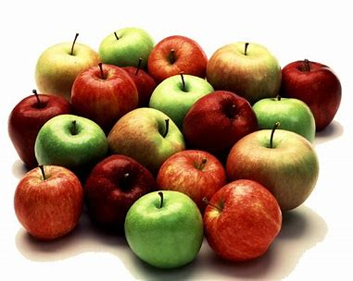
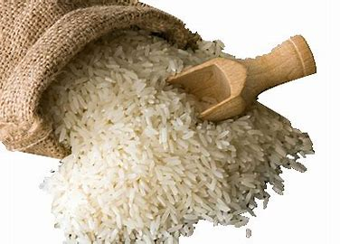
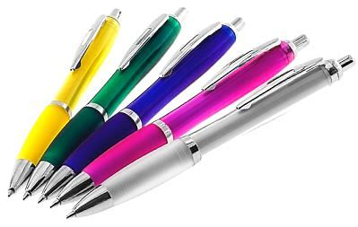

I love English
Sugar
Books
Water
Look at the pictures then guess the correct noun
Apples
Rice
Pens

Slide 7

I love English
Noncount nouns | Count nouns
Sugar
Books
Water
Now let’s classify them
Apples
Rice
Pens

Slide 8


Let’s learn more about count and noncount nouns

Slide 9
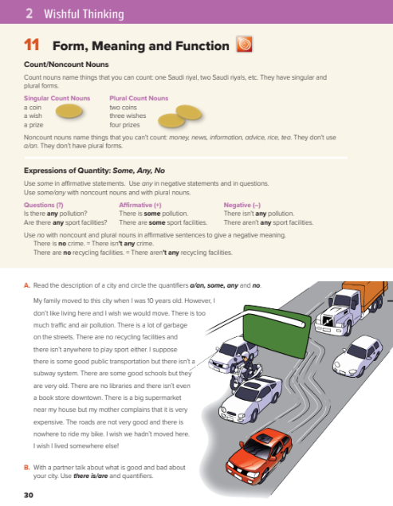
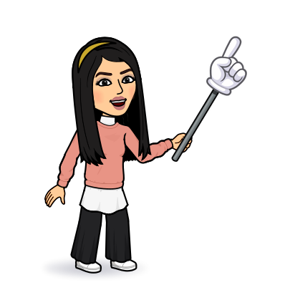
I love English
Open your Student’s book page: 30

Slide 10
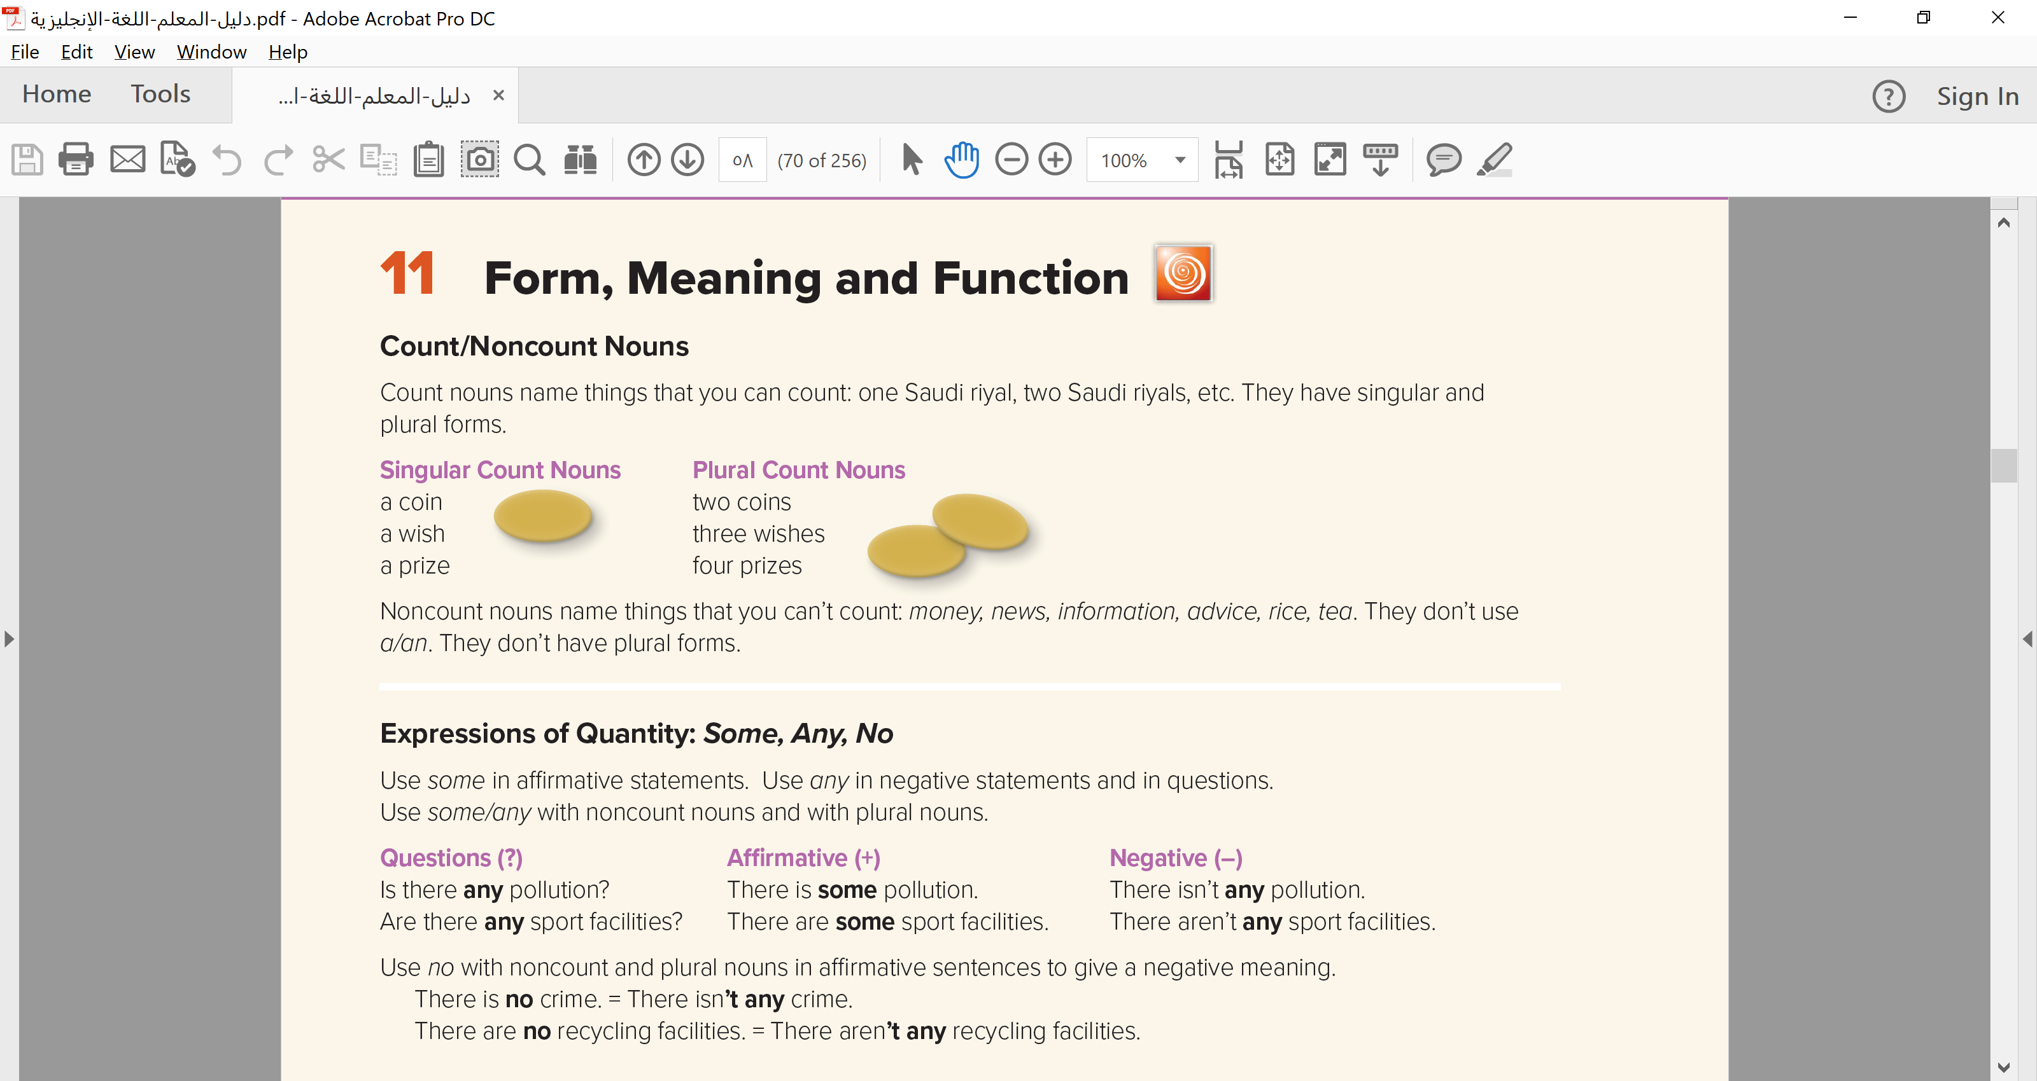

Slide 11
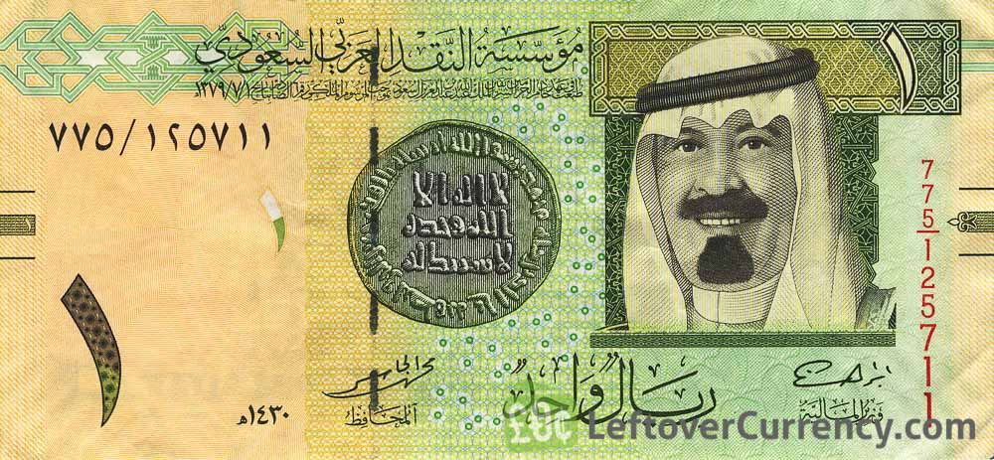


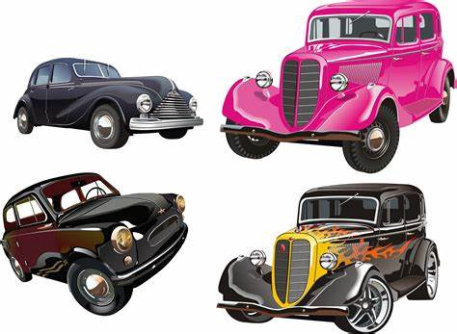
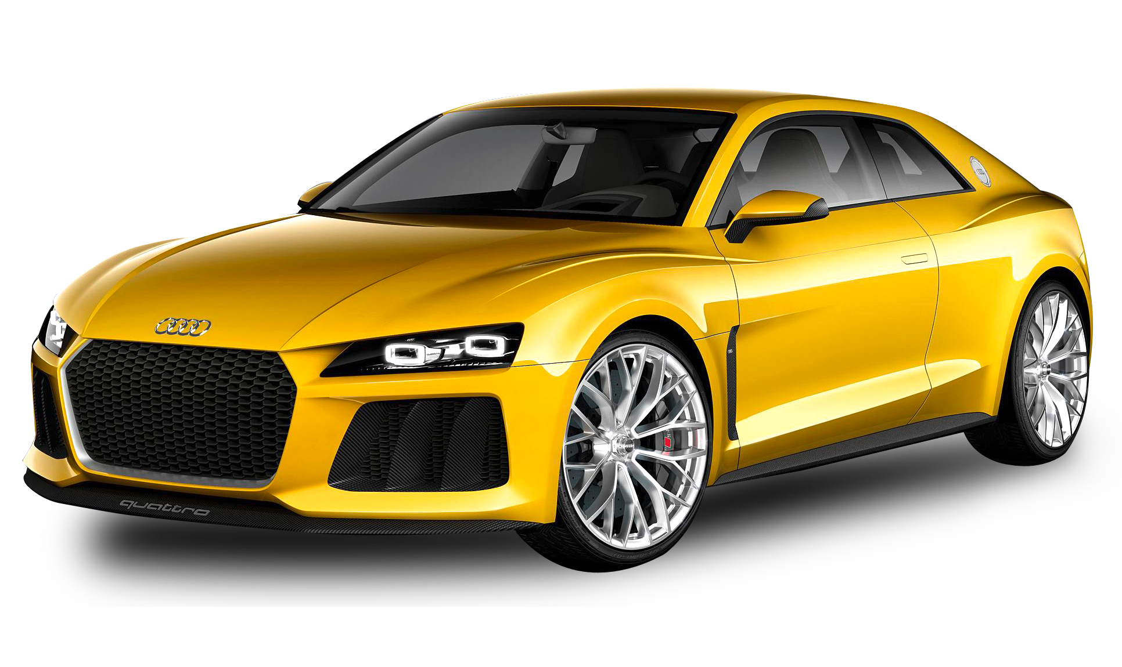
Count nouns:
-Name things that you can count.
-They have singular and plural forms.
-They use a / an.
Examples:
a riyal
a book
a car
2 riyals
3 books
4 cars

Slide 12

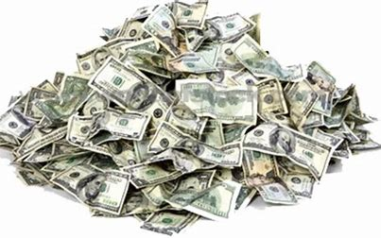
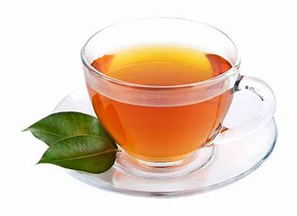
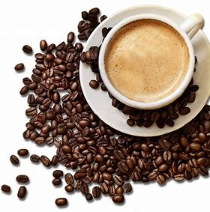
Non-count nouns:
-Name things that you can’t count.
-They don’t use a/an.
-They don’t have plural forms.
Examples:
Money
News
Tea
Coffee
Rice
Water
Information

Slide 13


https://wordwall.net/resource/5478371

Slide 15
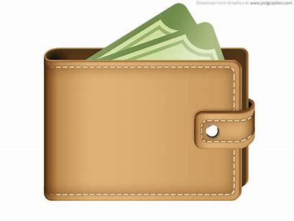
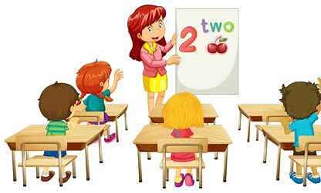
Some:
-Use it in affirmative statements.
-Use with non-count nouns and with plural nouns.
There is some money in my wallet. (non-count)
There are some students in the class. (plural)

Slide 16
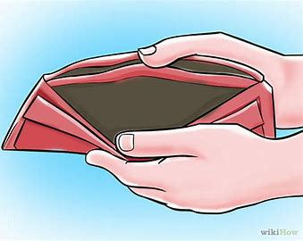
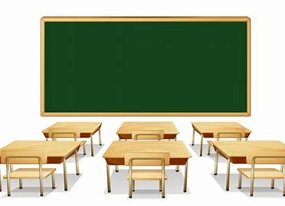
any:
-Use it in negative statements and in questions.
-Use with non-count nouns and with plural nouns.
There isn’t any money in my wallet. (non-count)
There aren’t any students in the class. (plural)
Is there any money in your wallet?
Are there any students in the class?

Slide 17
no:
-Use in affirmative statements to give negative meaning.
-Use with non-count and plural nouns.
There is no bread. = There isn’t any bread.
There are no books. = There aren’t any books.

Slide 18
Quantifiers
Some
Any
No
Affirmative with negative meaning
Negative
+
Questions
Affirmative

Slide 19
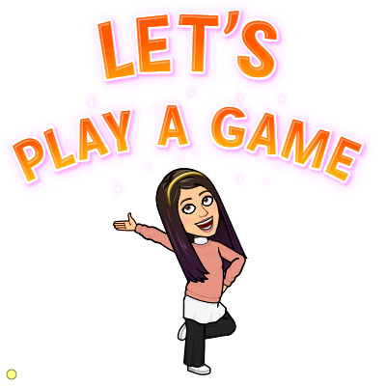
https://wordwall.net/resource/10820078

Slide 20
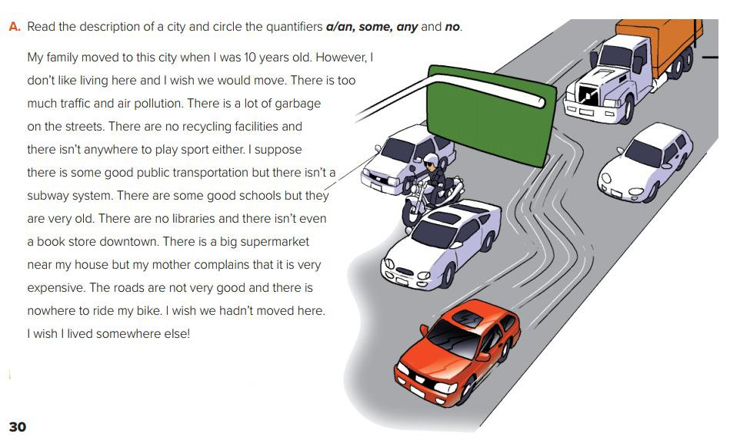
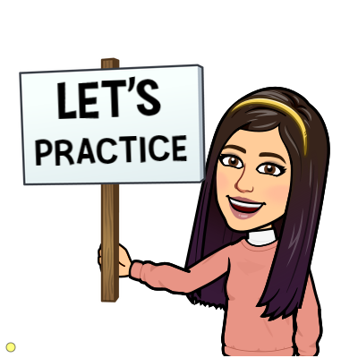


Slide 21

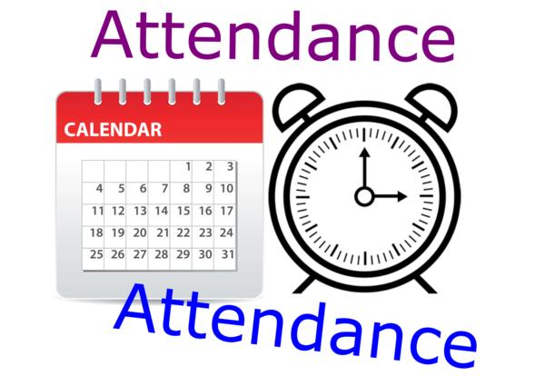
I love English

Slide 22
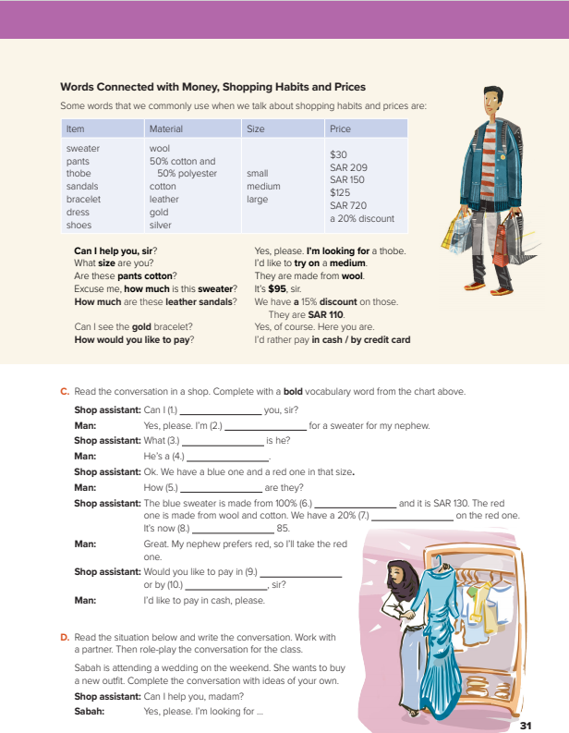
I love English
Open your Student’s book page: 31

Slide 23
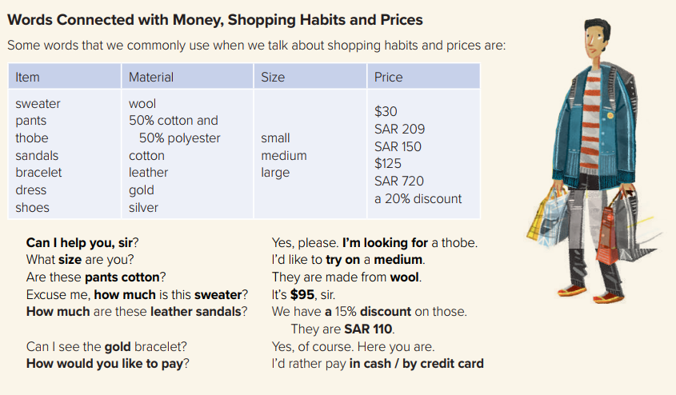

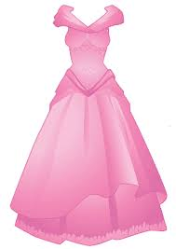
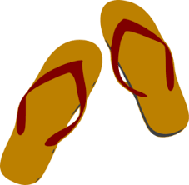
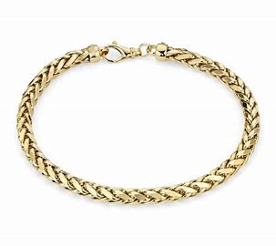
sweater
pants
shoes

Slide 24
https://wordwall.net/resource/10775396

Slide 25
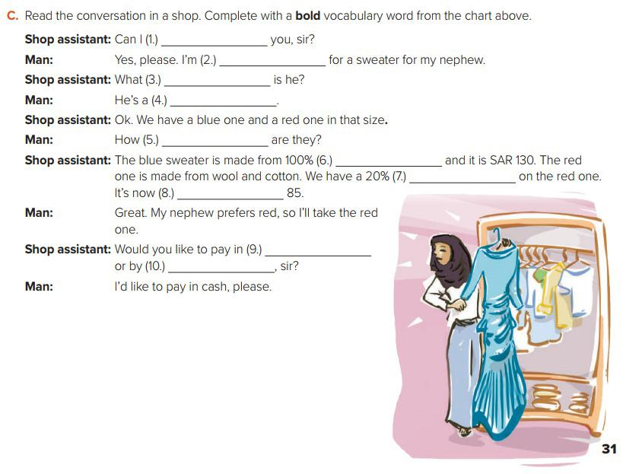
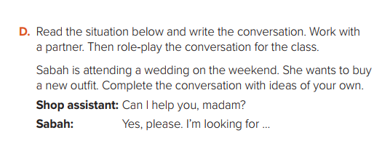
help
looking
size
small
much
wool
discount
SAR
cash
credit card

Slide 26



Homework
I love English
WORKBOOK Page19

Slide 27
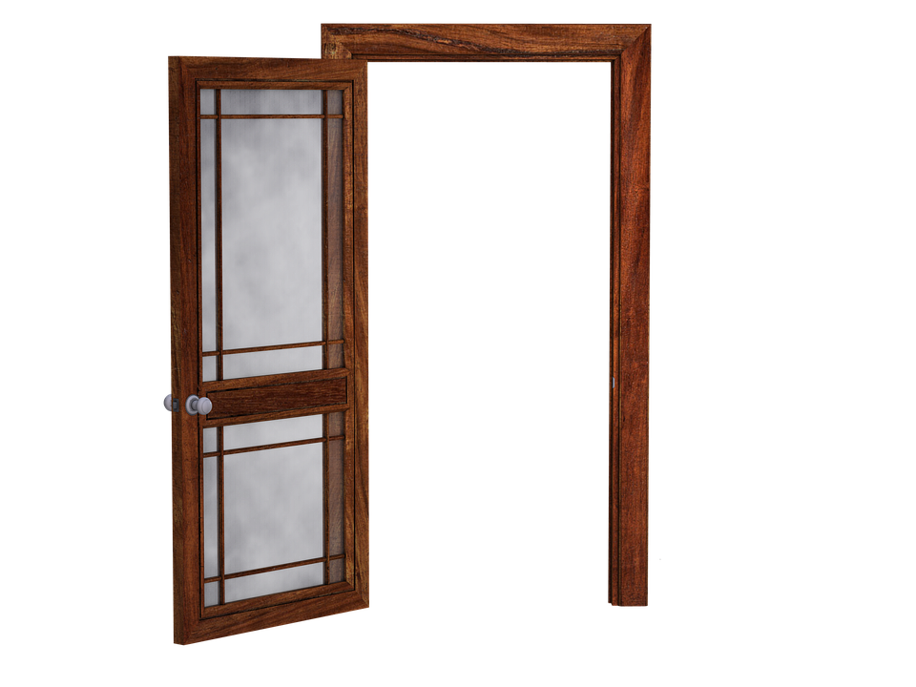
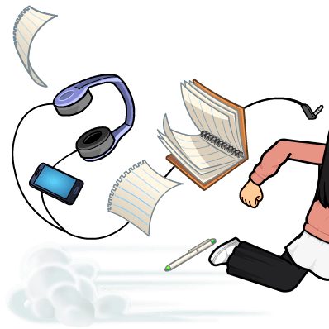
Homework
WORKBOOK Page19

Slide 28
Homework
WORKBOOK Page19

Slide 29
Homework
WORKBOOK Page19

Slide 30
Homework
WORKBOOK Page19

Slide 31
Homework
WORKBOOK Page19

Slide 32

Homework
WORKBOOK Page19

