Slide 1
Mega Goal 1.2
Unit 2 GAME
Take My Advice
By: Essa Al Hussaini

Slide 2


Slide 3
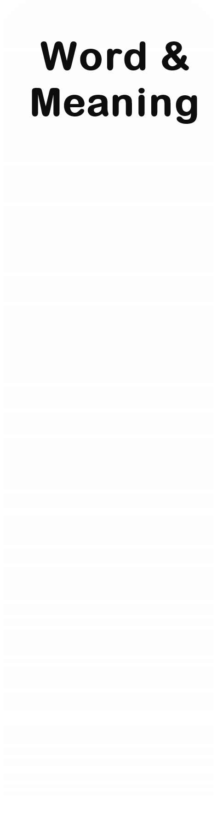



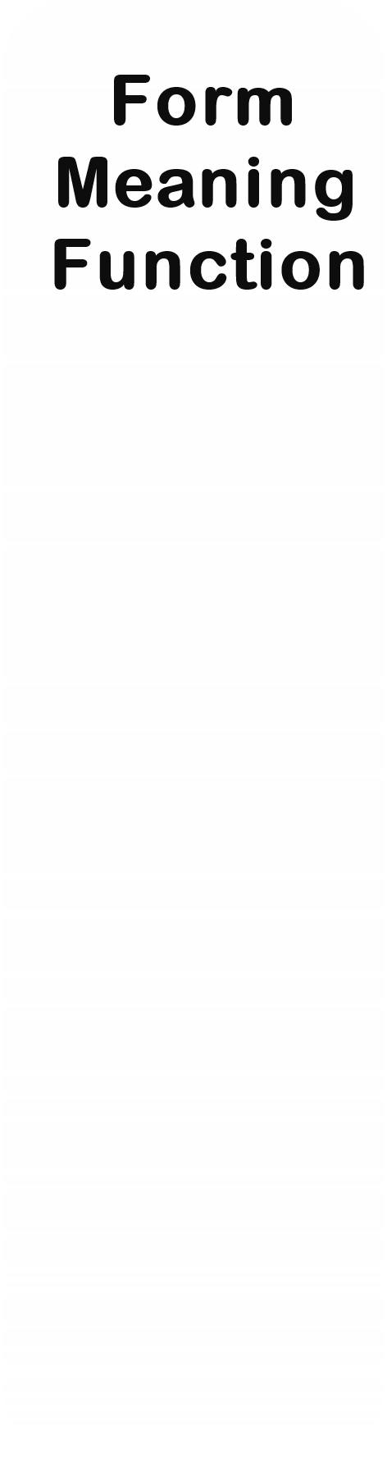
U2
Take My Advice
1
1
1
1
1
2
2
2
2
2
3
3
3
3
3
4
4
4
4
4
5
5
5
5
5

Slide 4


Eating disorder like (anorexia) is common between teenagers.
loss of appetite
junk food
eating habit

Slide 5
I'm (feeling down) because of all these exams coming up.
afraid
depressed
honest

Slide 6
Refuse the (food that contains a lot of fat and cooked in unhealthy manner) please.
healthy food
nutritious food
junk food

Slide 7
He (is being in good health) by going to the gym.
plays well
gains weight
keeps fit

Slide 8
Opposite of
" gain weight "
regain weight
lose weight
control weight

Slide 9
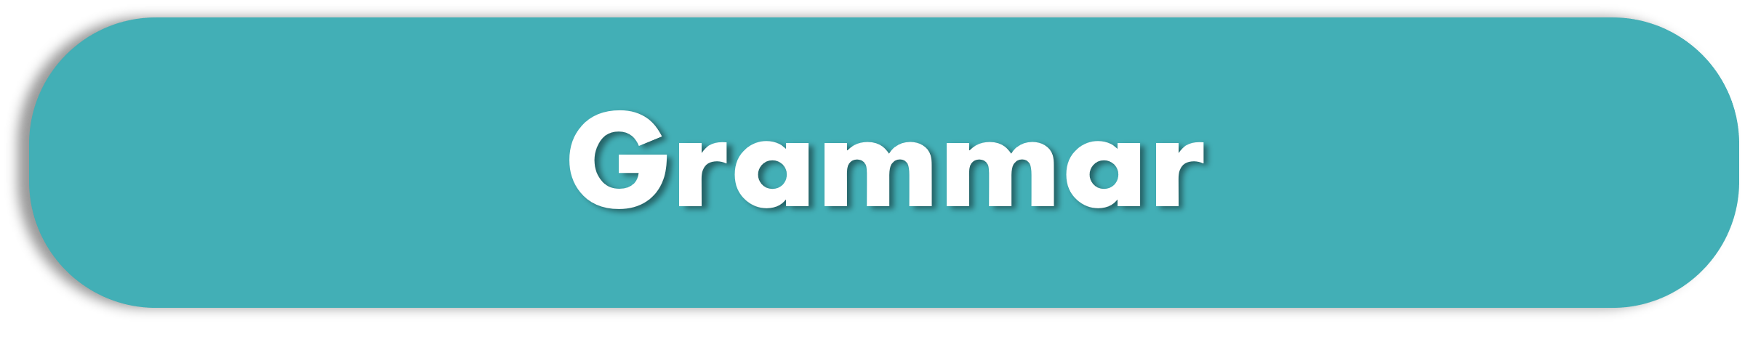
He should ________ a sport and exercise to be slim.
start
starts
starting

Slide 10
Identify the correct NEGATIVE form
1- You not ought to ignore speed limits.
2- You ought to not ignore speed limits.
3- You ought not to ignore speed limits.
1
2
3

Slide 11
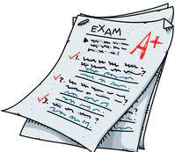
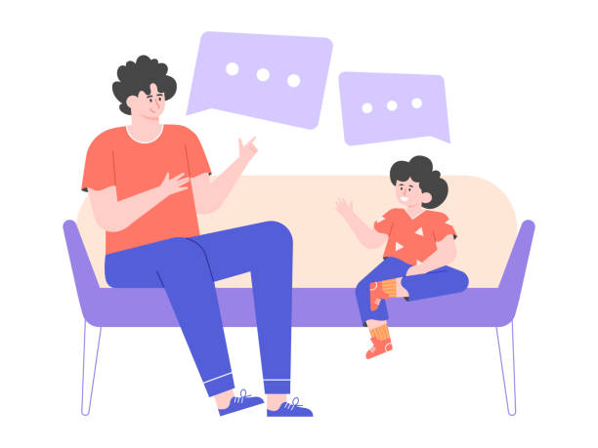
Give strong advice
You _______ study harder if you want to pass the exam.
had better
should
might

Slide 12
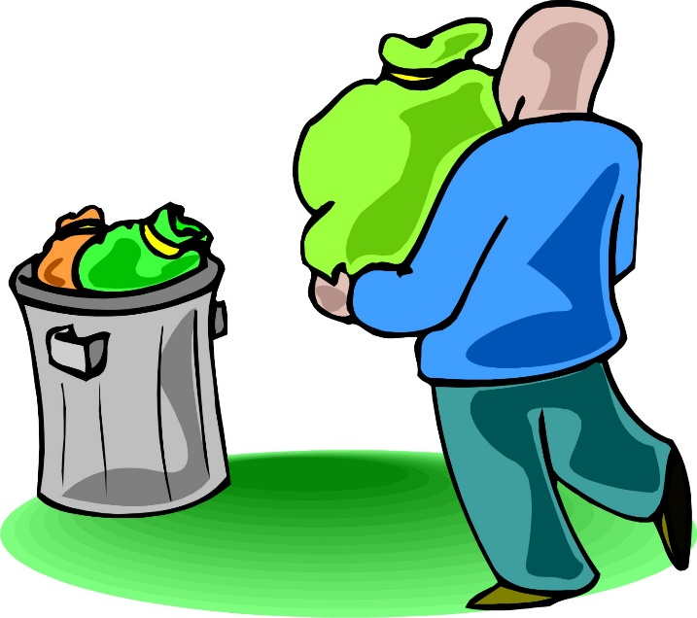
Use a pronoun object
I always (throw away the trash)
before I go to bed.
throw away it
throw the trash away
throw it away

Slide 13

Substitute with a two-word verb
Thank you for your offer, but I have to ____________ (refuse) your help.
turn down
get along with
take up

Slide 14
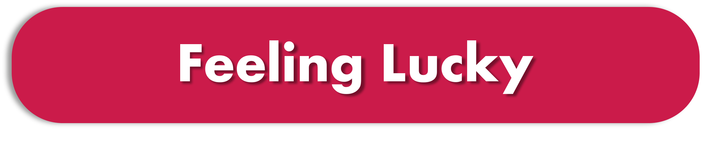
Identify the odd word
headache
flu
eye
cough

Slide 15
The correct prefix to form the opposite of (healthy) is
healthiness
unhealthy
mishealthy

Slide 16
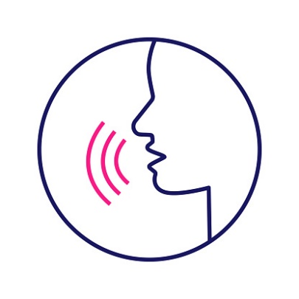
the main stressed part is on …
I put off my new diet.
1- put off
2- put off
3- put off

Slide 17
Identify the odd word
bored
rash
nervous
excited

Slide 18


glad - relaxed - strong - happy - excited
Positive Feelings (+)
Oops!!
WRONG
Negative Feelings (-)
happy – angry – sad – glad - sleepy
angry - afraid - sad - sick - sleepy

Slide 19
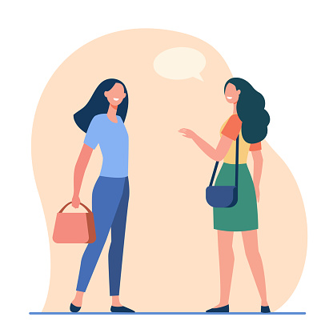
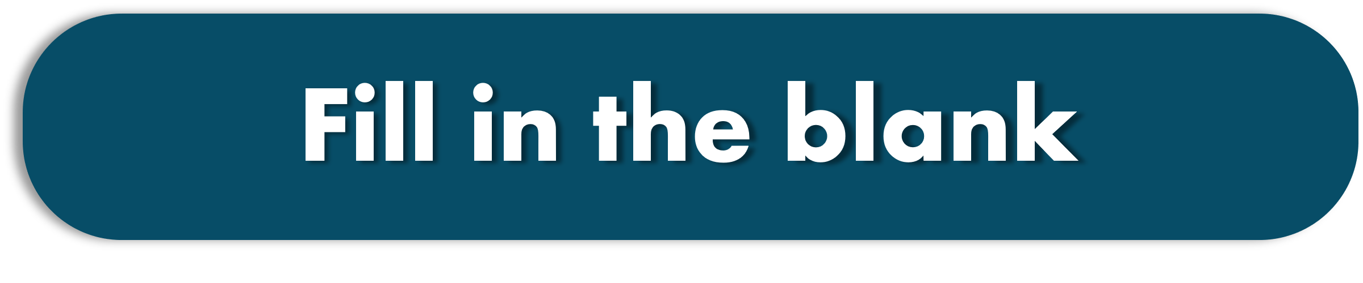
Nora gives her friend some ______ to drive well and safely.
advice
painkiller
pizza

Slide 20
For better health, people should ______ eating junk food.
start
keep
avoid

Slide 21
If you want to _______ , you can join a gym.
eat healthy food
get some sleep
keep fit

Slide 22
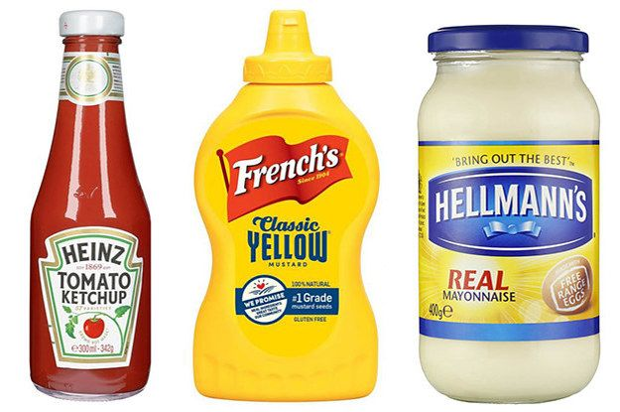
Be healthy and avoid adding ________ such as ketchup or mayonnaise in your food.
carbohydrates
condiments
fats

Slide 23
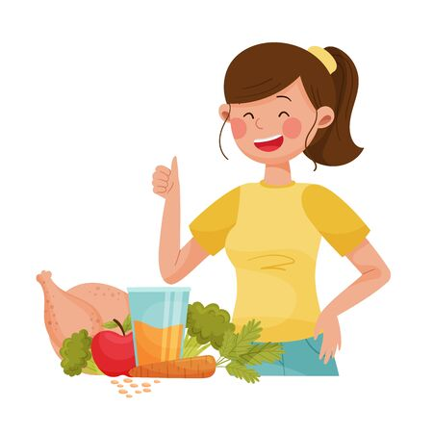
It’s my _____ to change my eating habit, not anyone’s else.
site
addiction
decision

Slide 24

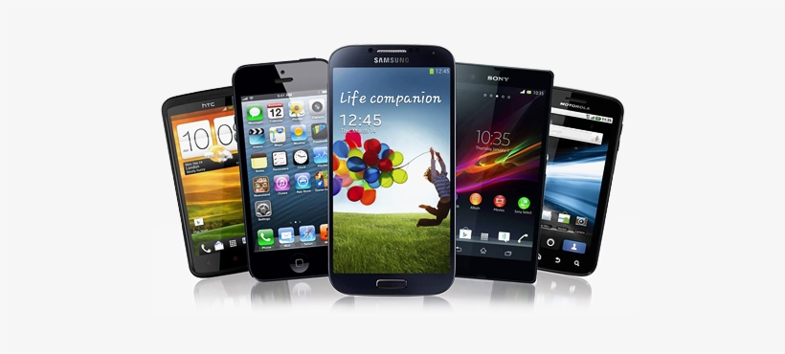
How ______ cell phones have you bought ?
much
time
many

Slide 25
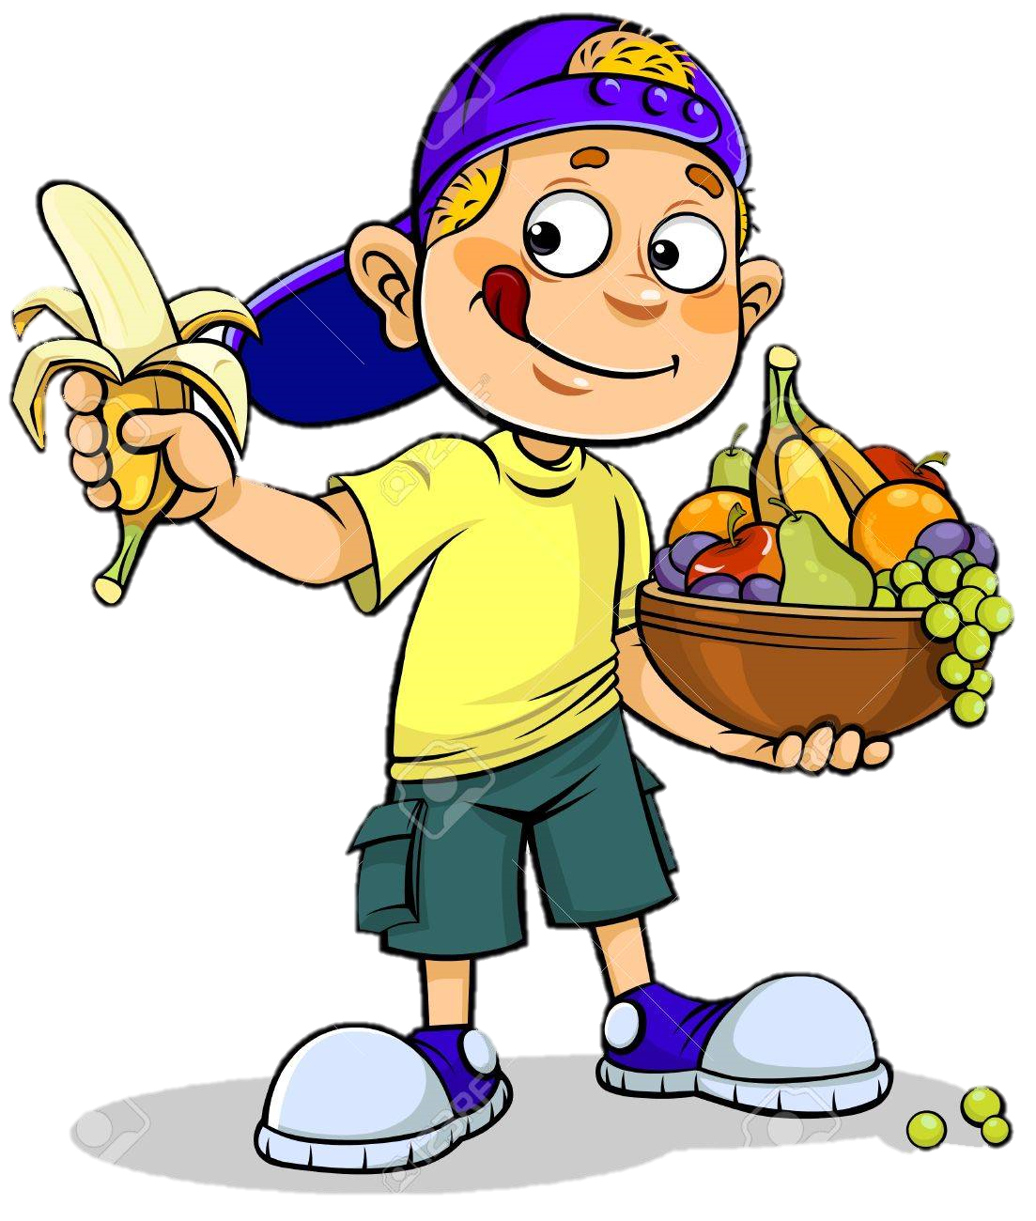
I eat _____ fruit every day.
many
a lot of
much

Slide 26
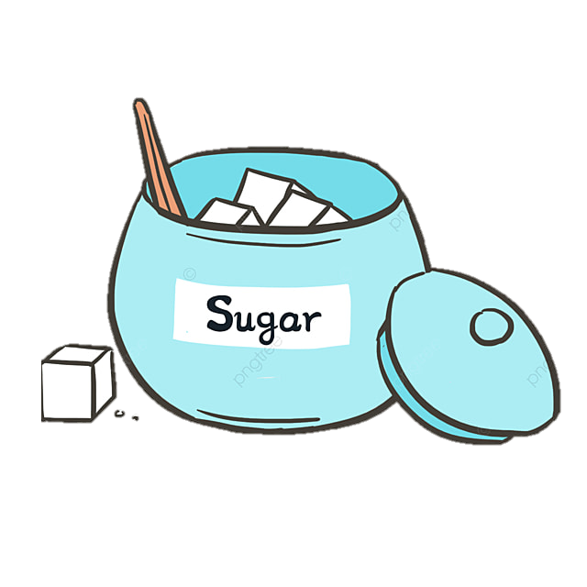
How _______ spoons of sugar do you put in your tea?
I put _____ sugar. I avoid putting much.
many // a little
much // a few
much // a little

Slide 27
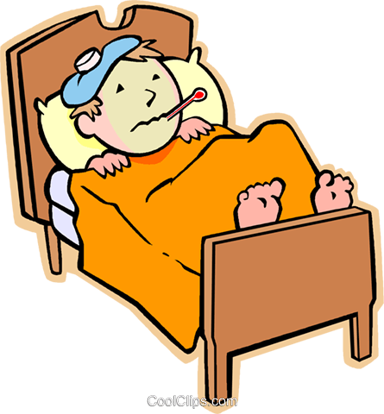
___________ when you have flu ?
I drink warm tea and stay in bed
How do you feel
What do you do
How much you feel

Slide 28
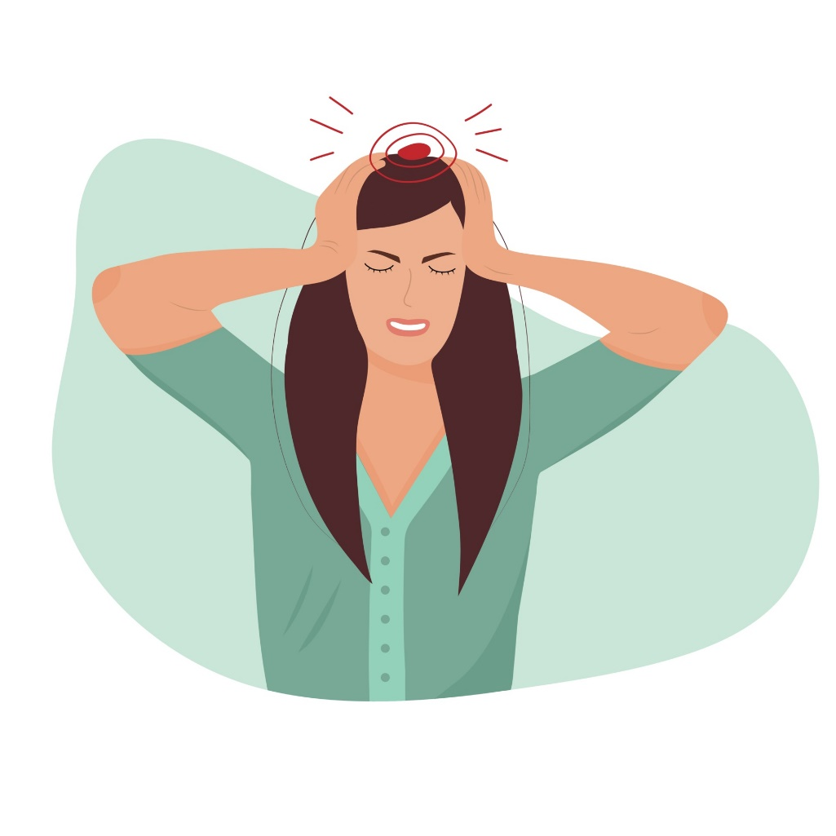
________ when you have a headache?
I feel sick and tired.
What do you feel
How do you do
How do you feel

