Slide 1
Unit 2
Sporting Life
Grammar
Done by: Entisar Al-Obaidallah

Slide 2
Lesson Goals
01
02
Use
Use
04
05
Use
Apply
gerunds as subjects
Gerund phrases as subjects
superlative + the present perfect
The rules to do the exercises

Slide 3

Book Open
Pages ( 22 )

Slide 4
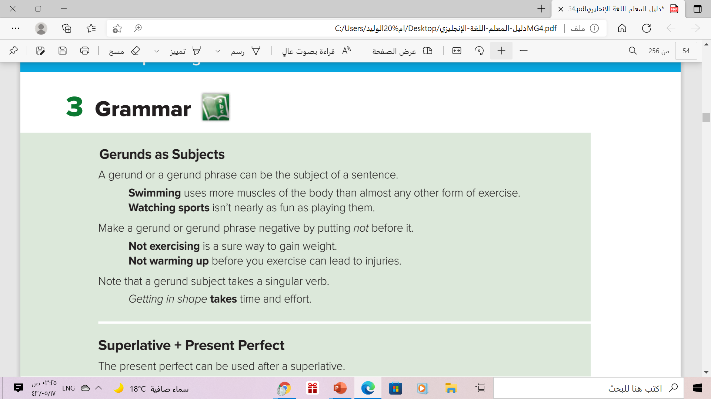

But
Getting in shape take time and effort.

Slide 5
What is Gerunds ?
Gerund = verb + ing
Walk+ ing = walking clean + ing = cleaning
What is Gerund phrase ?
Gerund phrase = gerund + other words
Reading book Sitting at home

Slide 6
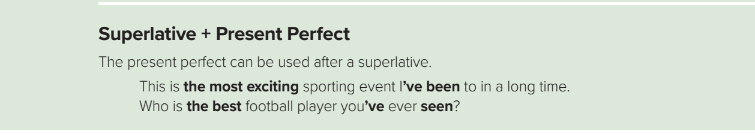
Use:
We often use the Present Perfect with Superlative for the biggest
and the best things in our lifetime .
Examples:
A) What is the most beautiful country that you have visited?
B) Italy is the most beautiful country that I have visited.

Slide 7

More Examples
McDonald’s beef is the best meat that I have eaten.
This book is the worst book that I’ve read.
➔We can also switch the order of the sentence
 The best meat that I have eaten is McDonald’s beef
 The worst book that I have read is this book.
Look:
McDonald’s beef is the best meat that I have eaten.
The best meat that I have eaten is McDonald’s beef

Slide 8
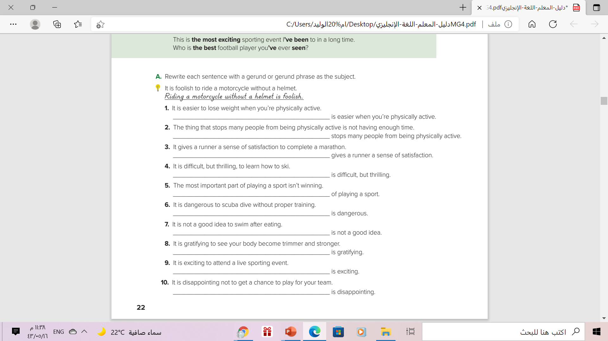
Losing weight
Not having enough time
Completing a marathon
Learning to ski
Winning is the most important part
Scuba diving without proper training
. Swimming after eating
Seeing your body become trimmer and stronger
Attending a live sporting event
Not getting a chance to play for your team

Slide 9
Book Open
Pages ( 23 )

Slide 10
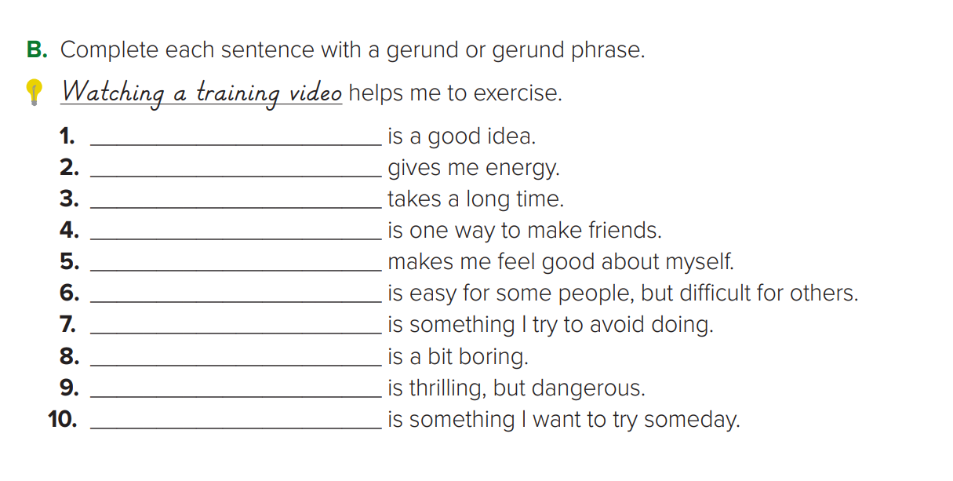
Sleeping eight hours
Exercising
Reading a book
Joining a club
Doing well in school
Making new friends
Buying things I don’t need
Watching TV
Sky diving
Mountain climbing

Slide 11
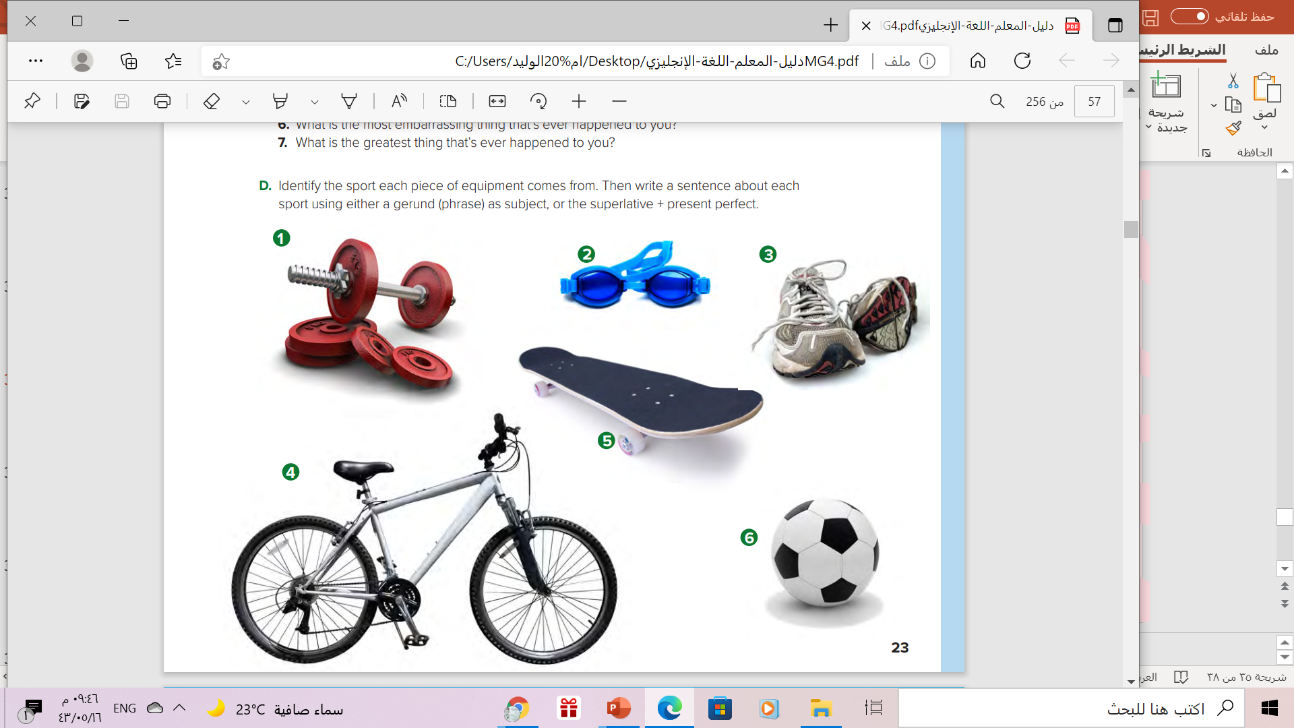
Swimming
Weightlifting
Running
Bicycling
skateboarding
football

Slide 12
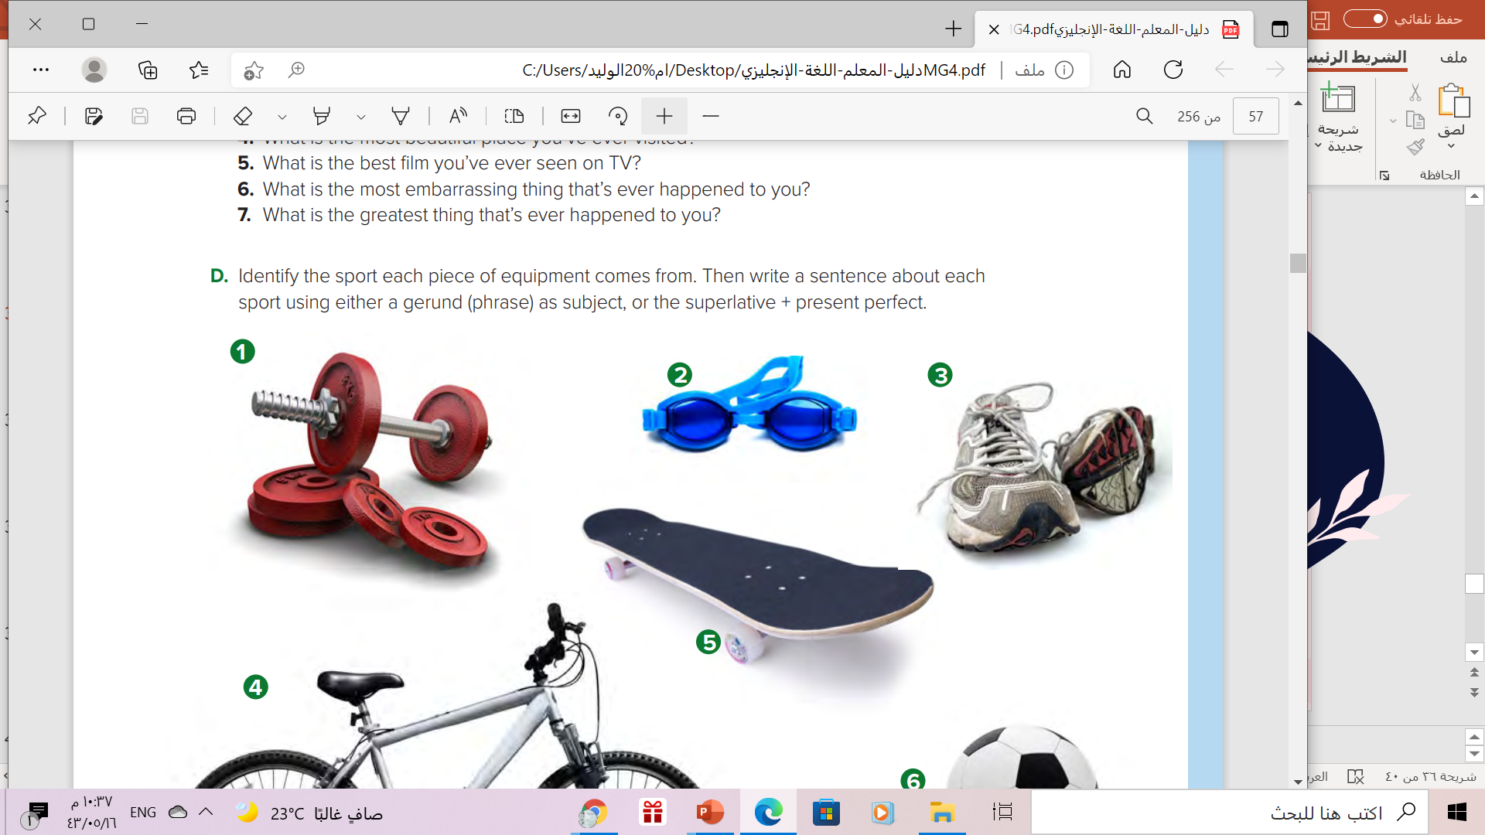
Gerund / Superlative + present perfect | Sport
 | 1) Weightlifting
 | 2) Swimming
 | 3) Running
 | 4) Bicycling
 | 5)Skateboarding
 | 6) Football
Weightlifting is one of the most difficult sports on the world
Swimming is an activity that burns lots of calories
Running every day is good for your heart.
Riding a bicycle is the best way to get around town.
Skateboarding is the most difficult sport I’ve ever tried.
Playing football with friends is a fun thing to do

Slide 13

Remember..

Slide 14
Homework
Work book page ( 12 ), exercise ( D ),
and exercise ( E ) ,page ( 13 )

Slide 15

Thanks

