Slide 1
Unit 2
Sporting Life
Form , Meaning& Function
Mega Goal 4
Done by : Entisar Al-Obaidallah

Slide 2
Lesson Goals
Distinguish
01
04
Form
Form
02
05
Form
Use
03
between present perfect simple and present perfect progressive
Sentences with comparative form of adjectives and adverbs
sentences using present perfect progressive
Sentences using as……as
Apply
06
The rules to do the exercises
Adverb of manner in correct sentence

Slide 3

Book Open
Page ( 30)

Slide 4
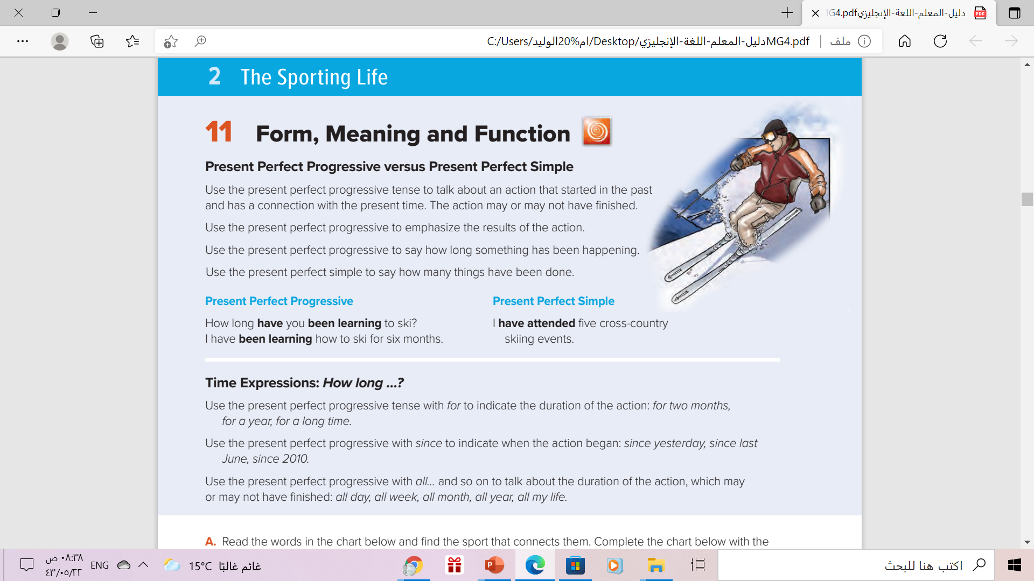

Slide 5


What do you know about the Present Perfect Progressive?
Using :
to talk about an action that started in the past and has a connection with the present time.
The action may or may not have finished.
to emphasize the results of the action.
to say how long something has been happening.
Use “ for” and ‘ all “ to to indicate the duration of action.
Use “ since” to indicate when the action began
The beginning of action
The duration of action
Example :
He has been working since 7:00 a.m.
He has been working for eight hours

Slide 6

We can form present perfect progressive using this structure
Form :
Example :
She
He
It
Singular
You
I
We
They
plural
She has been studying since 3:00pm.
She hasn’t been studying since 3:00pm
Has she been studying since 3:00pm ?
has + been + v-ing
They have been studying since 3:00pm.
They haven’t been studying since 3:00pm
Have they been studying since 3:00pm ?
have + been + v-ing

Slide 7
What do you know about the Present Perfect Simple?
Using :
to say how many things have been done. ( quantity)
to talk about recently completed action.
Use “ How many ” with countable nouns
Use “ How much ” with uncountable nouns
Example :
Countable nouns
Uncountable nouns
How many programs have you watched?
How much money have you spent?

Slide 8
Book Open
Page ( 31)

Slide 9
Adverbs of Manner
expresses HOW something is DONE.
describes a verb
How did he explain?
He explained carefully / badly / well
We usually add -ly to an adjective to form an adverb
slow  slowly
quick  quickly
loud  loudly
Sometimes an adjective and adverb have the same form.
He’s a fast runner. → He runs fast.
He’s a hard worker.→ He works hard.
The adverb form of good is well
Can Ali dive?
He’s a good diver. He dives really well.

Slide 10
More irregular adverbs
adjective | adverb
good | well
fast | fast
hard | hard
late | late
early | early
straight | straight

Slide 11
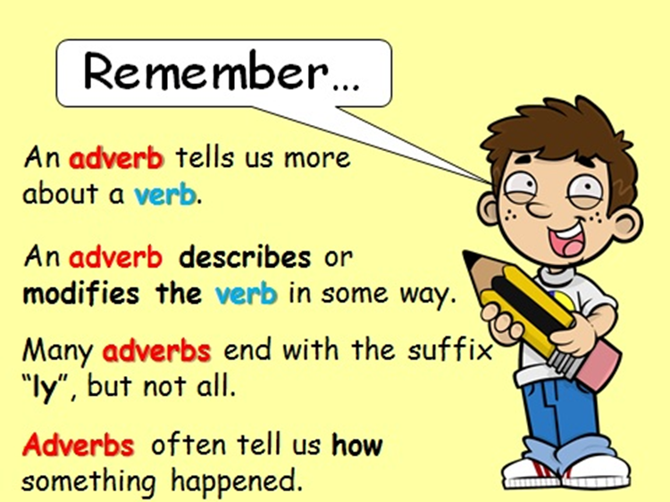

Slide 12



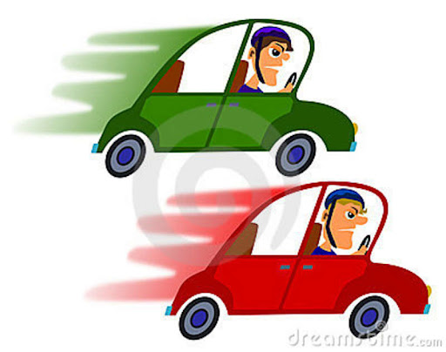

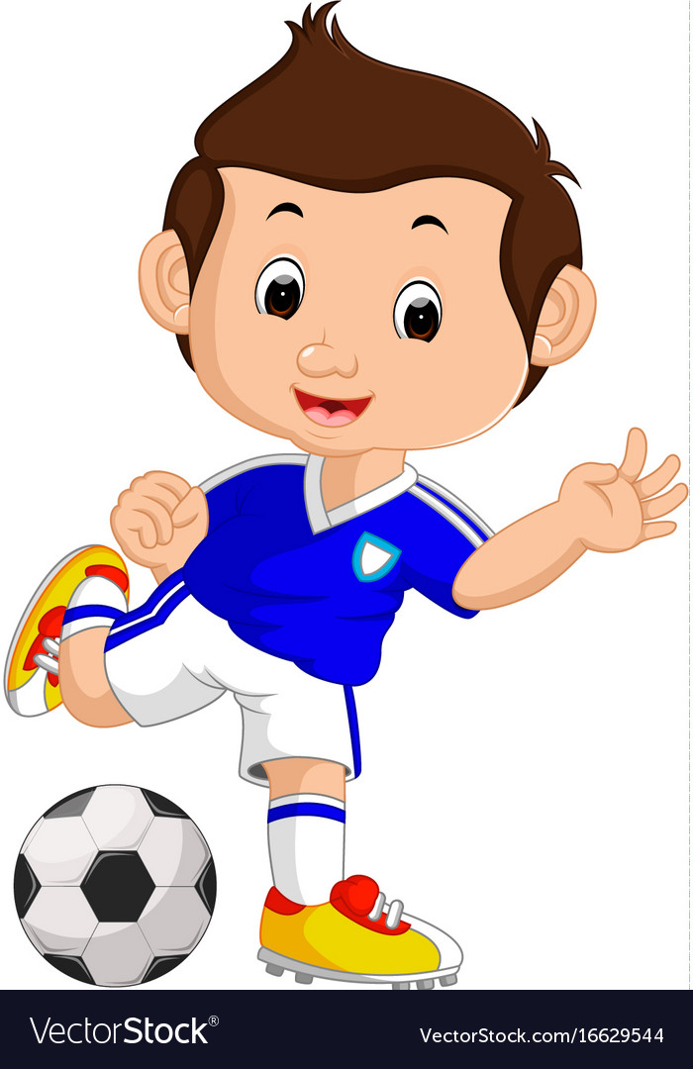
Comparative
1-Add -er to one syllable ( adjectives & adverbs)
He is taller than his brother. (adjective)
tall
taller
He drives faster than his brother. (adverb)
fast
faster
2-Add more\less before two or more syllables (adjectives & adverbs)
Football is more popular than basketball. (adjective)
popular
more popular
She drives more carefully than her brother. (adverb)
carefully
More carefully

Slide 13
Comparative
1- There are some irregular adjective
Ali is better than Saad.
good
better
He drives worse than his brother.
bad
worse
We can’t go any further; the road’s blocked.
far
further

Slide 14

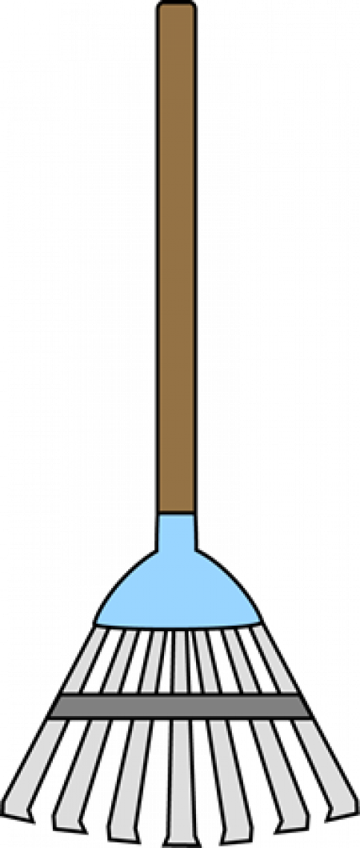


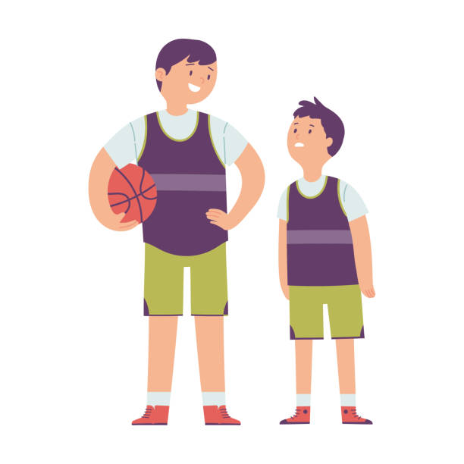
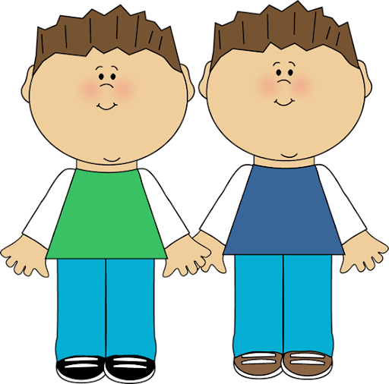
As……….As
As……….As
Not as…………as
to show two items are the same in some way
to show two items are not the same in some way
Example :
Example :
I’m as busy as bee
I’m very busy
A turtle is not as fast as rabbit.
He’s as thin as a rake
He’s very thin
He’s as tall as his brother
He is not as tall as his brother.

Slide 15
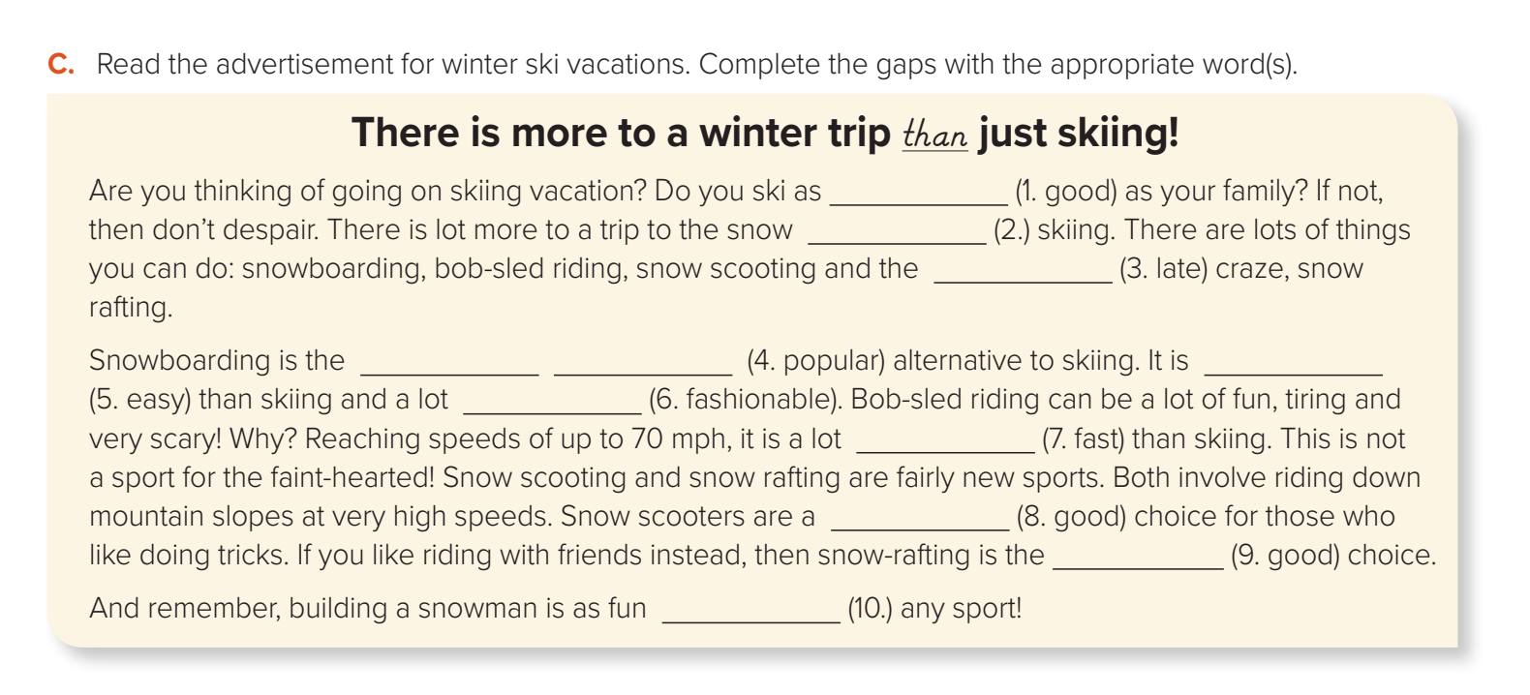
Read & Complete:
well
than
latest
most popular
easier
more fashionable
faster
good
best
as

Slide 16


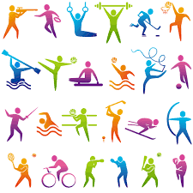
Remember..

Slide 17

Homework
Work book
Exercise ( N ) , page ( 20)

Slide 18

THANKS!

