Slide 1
Unit2
The Sporting Life
Conversation+ Listening
Done by : Entisar Al-Obaidallah

Slide 2





Lesson Goals
1
2
3
4
5
Listen
Use
Express
Complete
Find
For specific information
“Real Talk” phrase in correct sentences
confidence in someone
the chart according to the profile's audio
The meaning of the new words

Slide 3

Book closed

Slide 4

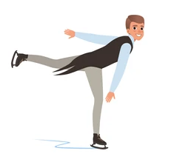
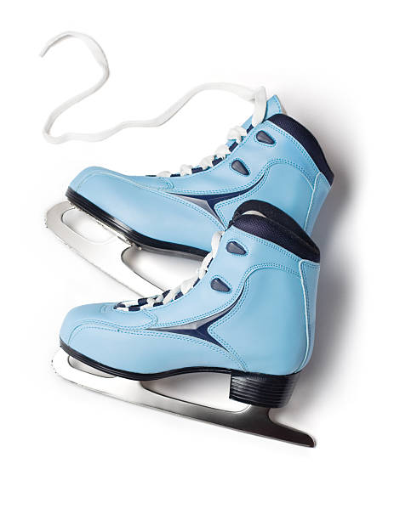

What sport are these for ?
Figure skating

Slide 5
Book Open
Page ( 24 )

Slide 6
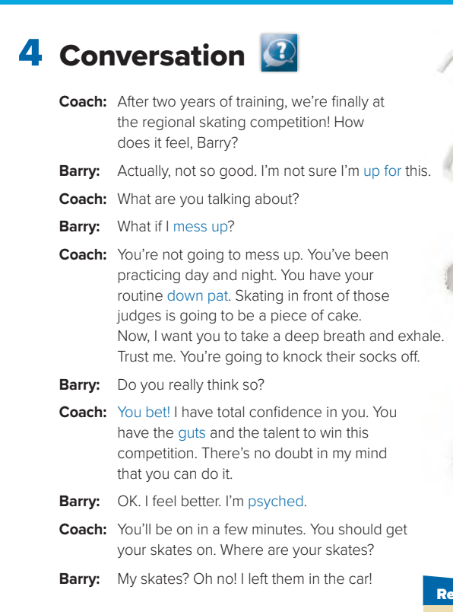


Listen to to someone who is about to skate in an important competition talking to his coach.

Slide 7


How many persons are there ?
Two persons
Who are they?
The coach and Barry
What are they talking about
about skating in an important competition

Slide 8






Who says ………
Up for
Barry

Slide 9
Who says ………
Mess up
Barry

Slide 10
Who says ………
Down pat
The coach

Slide 11
Who says ………
You bet
The coach

Slide 12
Who says ………
guts
The coach

Slide 13
Who says ………
psyched
Barry

Slide 14
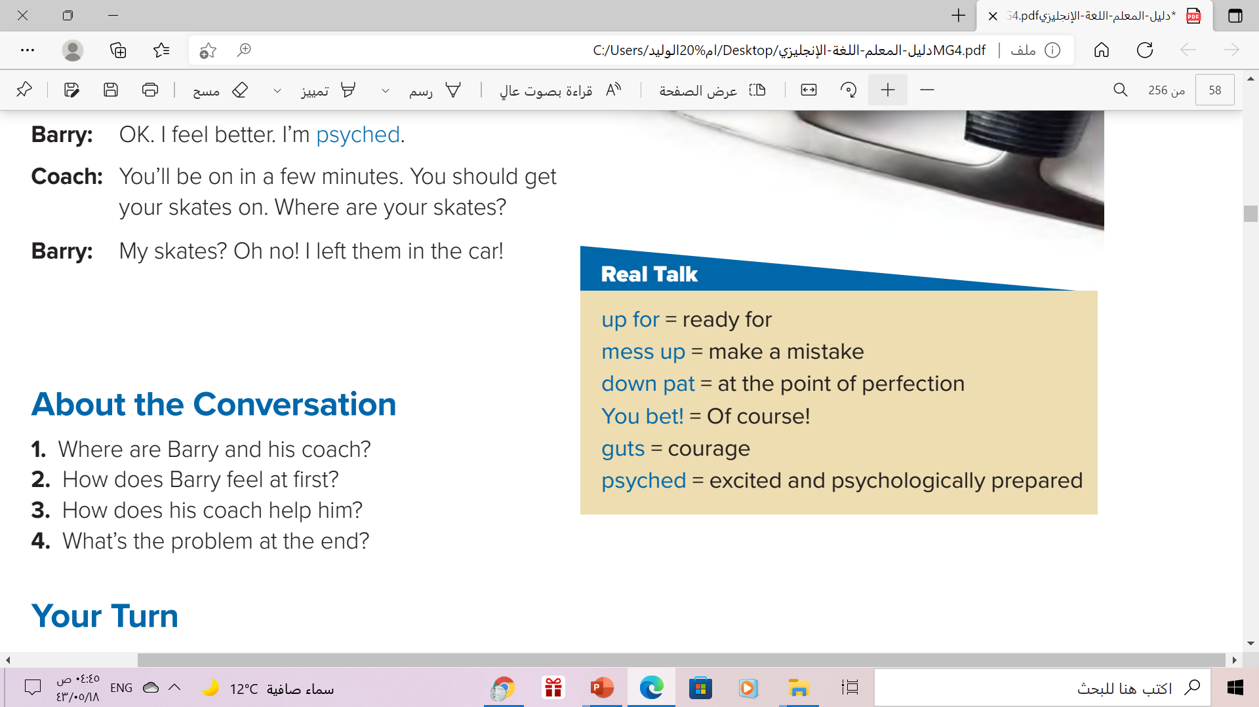
 Read the words and their meanings:

Slide 15


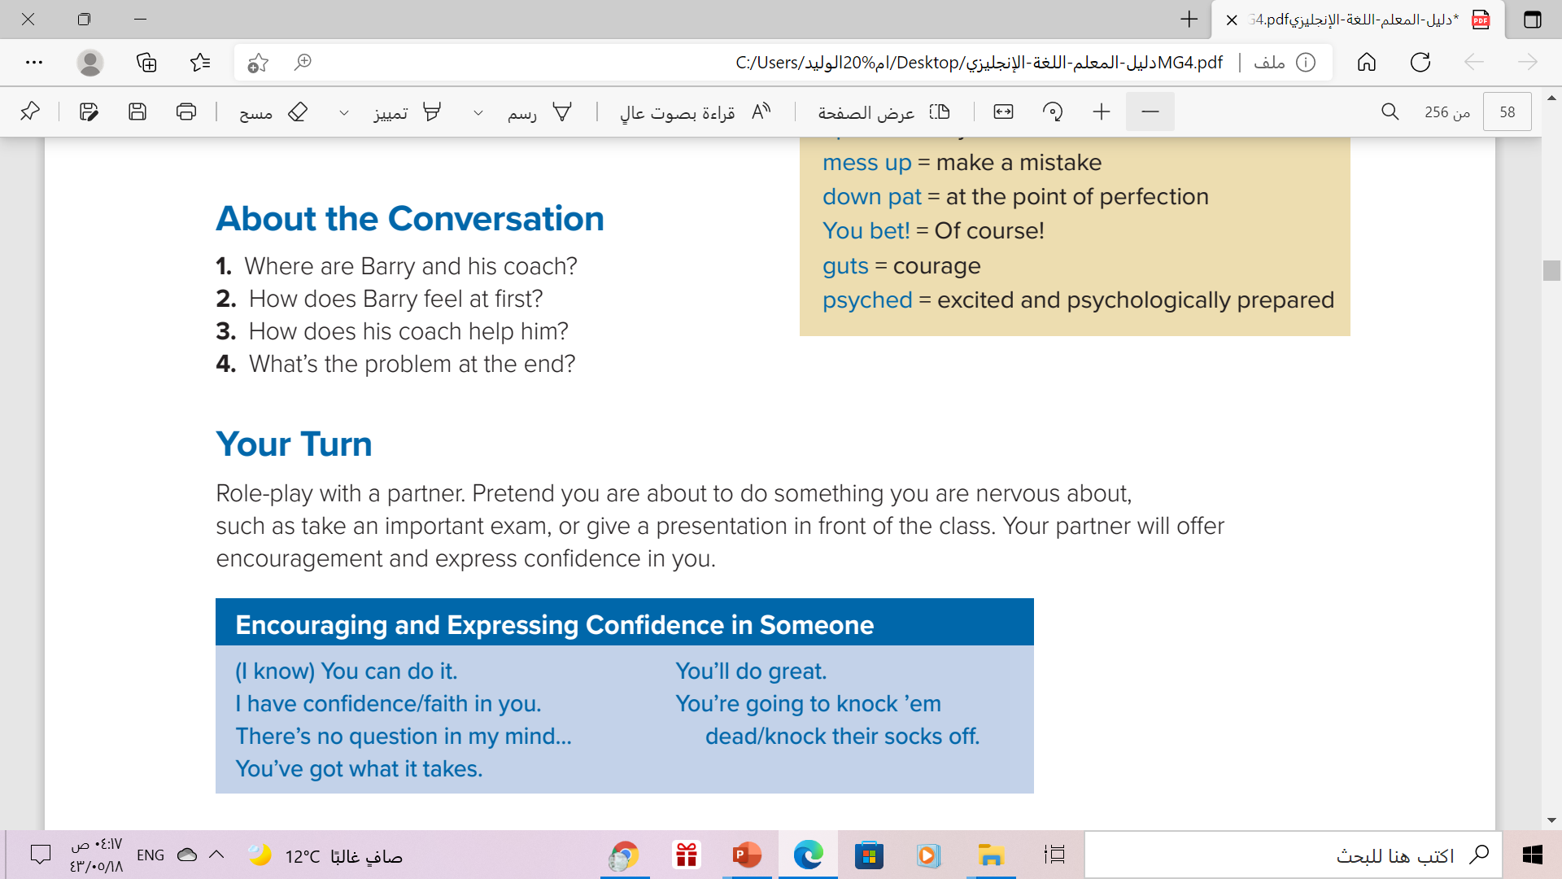
1. They are at an ice-skating competition.
2. He is nervous.
3. His coach encourages him and gives him more confidence.
4. Barry forgot his skates in the car

Slide 16

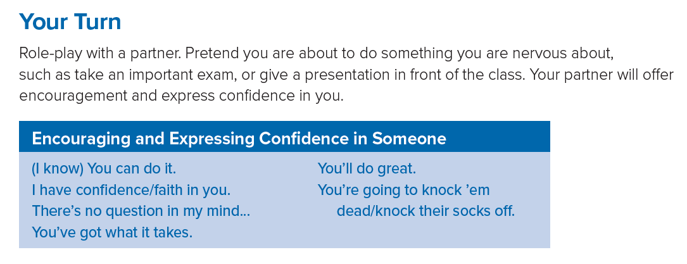


These phrases for
Encouraging and Expressing Confidence in Someone.

Slide 17


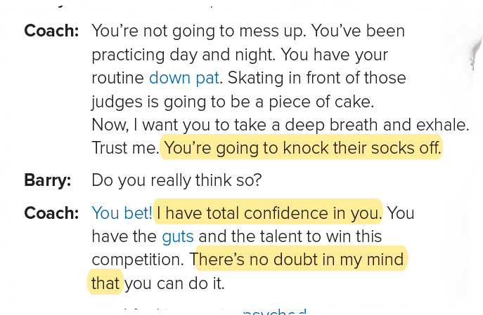
Which expressions does the coach use to encourage Barry?

Slide 18


Slide 19


Book Open
Page ( 24 )

Slide 20
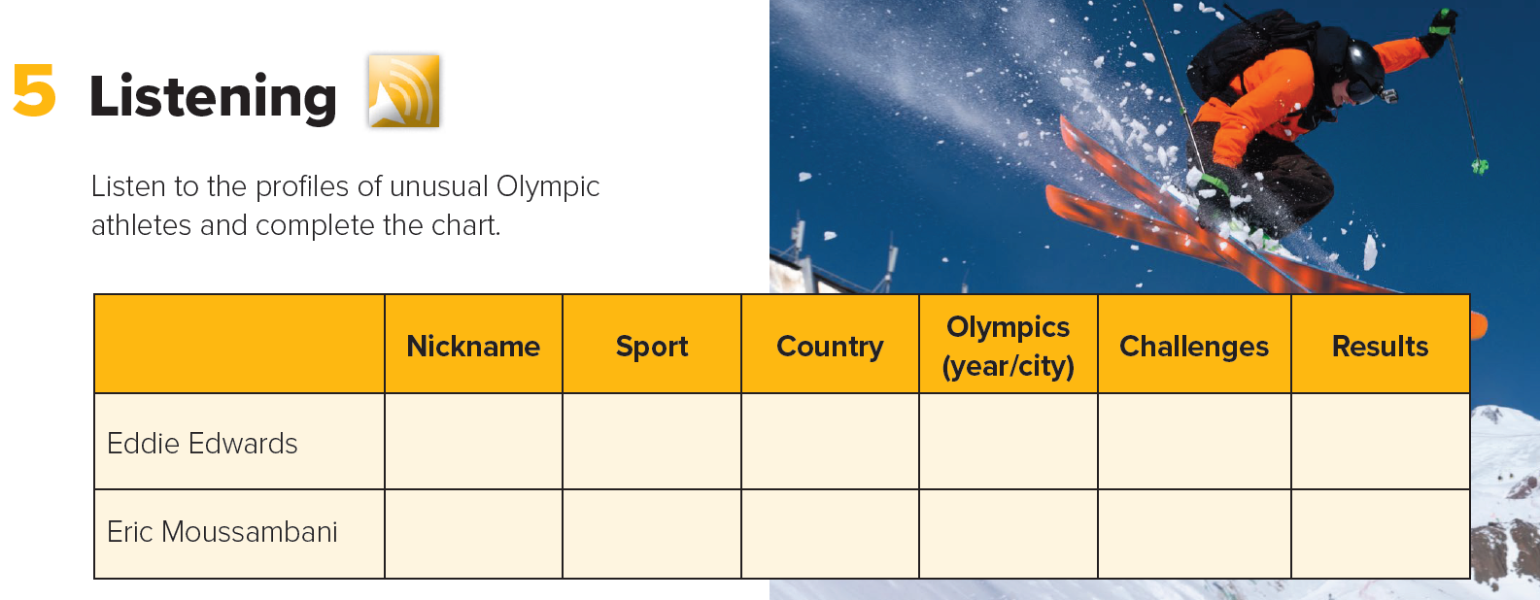

Slide 21
Complete the chart:
Results | Challenges | Olympics (year/city) | Country | Sport | Nickname
 |  |  |  |  |  | Eddie Edwards
 |  |  |  |  |  | Eric Moussambani
finished last in event
*heavier than competitors
* near-sighted
*Only practiced
for 2 seasons
The Eagle
Ski jumping
Great Britain
1988, Calgary
*only been swimming for
8 months
*Never seen an Olympic-sized pool
finished a full
minute behind
any
competitive time
Swimming
Equatorial Guinea
The Eel
2000, Sydney

Slide 22
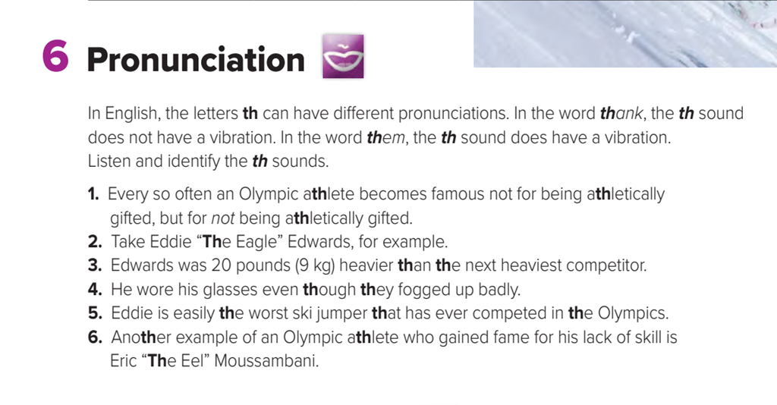

Slide 23
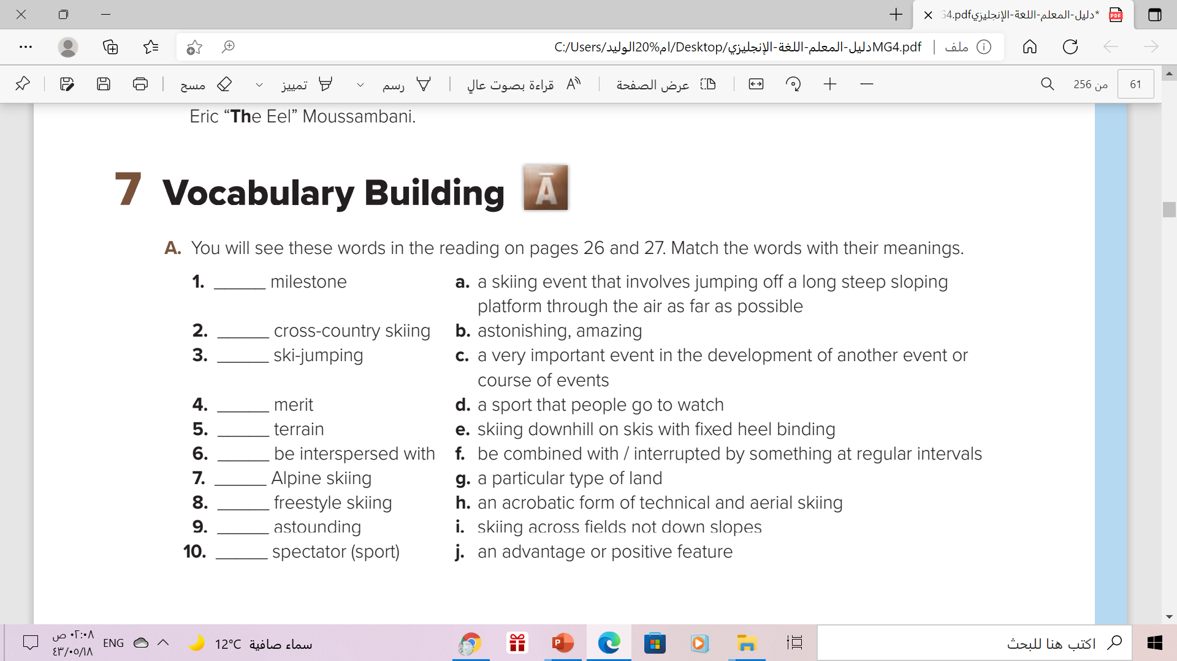
c
i
a
j
g
f
e
h
b
d

Slide 24

Remember..

Slide 25
Homework
Workbook page ( 14 ) , Exercise ( H )

Slide 26

Thanks!

Slide 27


Alternative resources

