Slide 1
Unit 1
There is No Place Like Home
Conversation+ Listening
Mega Goal 4
Done by:: Entisar Al-Obaidallah

Slide 2
Lesson Goals
Read the conversation for specific information
Answer some questions about the conversation
Match the new vocabulary with its meaning
Use the “Real Talk”in a sentence.
Stress on two-syllable nouns and verbs

Slide 3
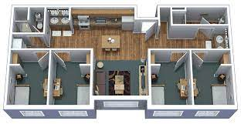
Which Saudi university has dormitory buildings for students?
King Faisal University , King Abdul Aziz University, Um Al-Qura University, King Saud University , Jizan University, Tabuk University and Princess Norah University

Slide 4

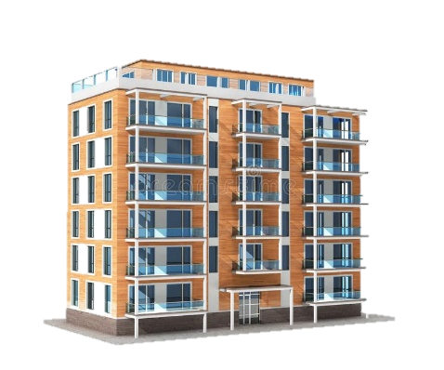
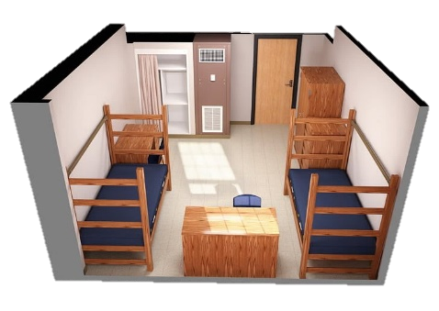
Warm Up
With their families
Where do college and university students in Saudi Arabia live?
in an won apartment
Or on campus in dormitories
Where do they live if they come from another town or city?

Slide 5
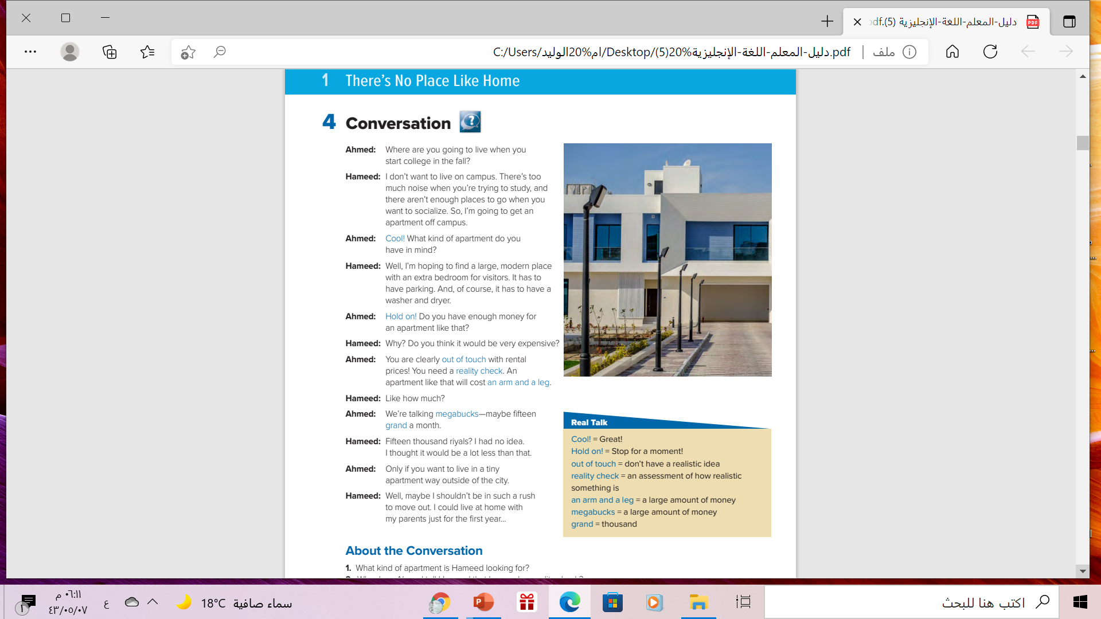


Listen to a student talking about where he’s going to live when he starts college.

Slide 6
How many persons are there in this conversation?
Two persons
Who are they?
Ahmed & Hameed
What are they talking about
Where university student live

Slide 7

What expression(s) does Ahmed ....
think that Hameed’s idea about
the apartment is great ?

Slide 8
What expression(s) does Ahmed....
tell Hameed to stop talking about his plans for a minute?

Slide 9
What expression(s) does Ahmed ....
tell Hameed that his plans are not realistic?

Slide 10
What expression(s) does Ahmed ....
use to say one thousand dollars?

Slide 11
What expression(s) does Ahmed ....
tell Hameed that apartment will be very expensive?

Slide 12
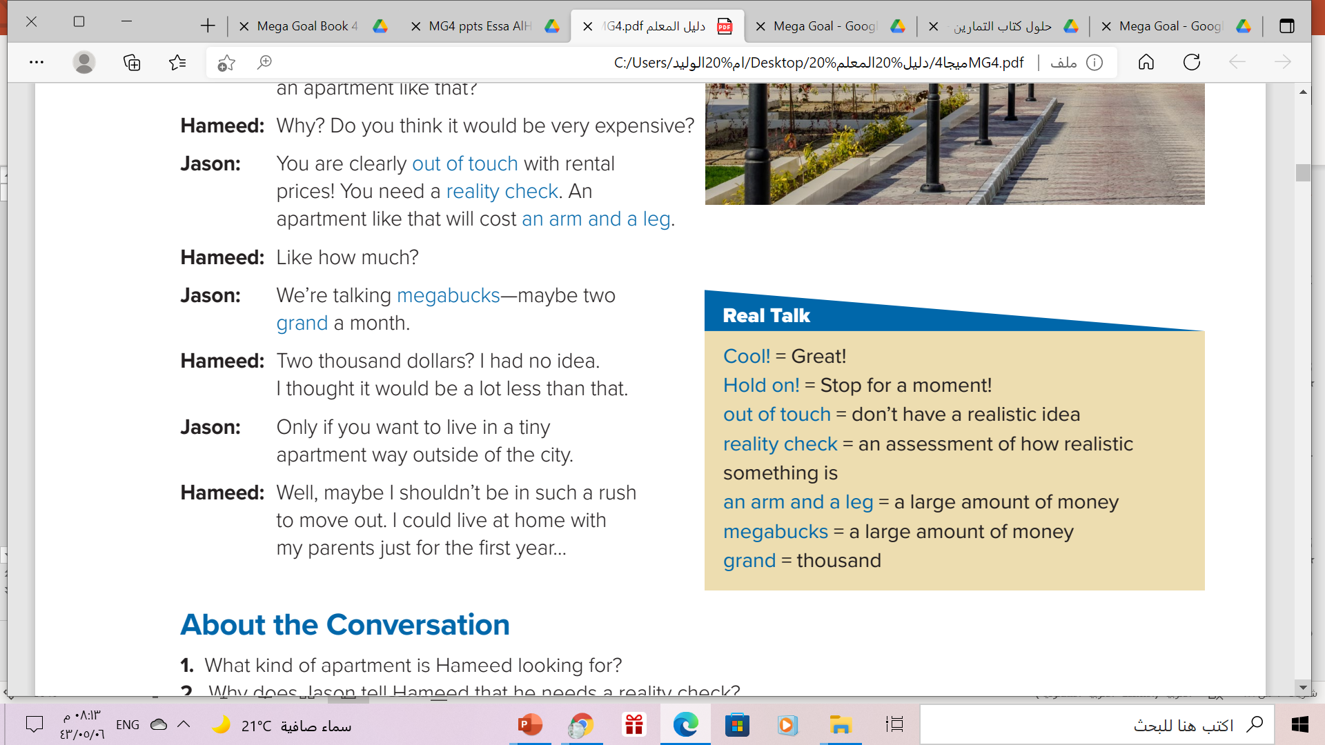
Read the words and their meaning:
Ahmed is the one who uses
all of these expressions.

Slide 13
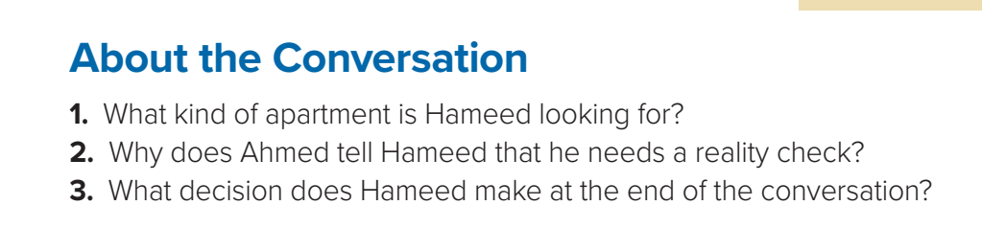
He wants a large modern apartment off campus with an extra
bedroom, parking, and a washer and dryer.
2. He will not be able to afford an apartment like that.
3. He decides to keep living at home for another yea

Slide 14
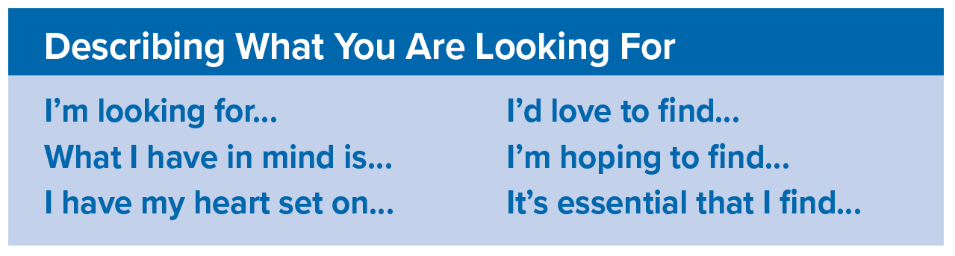

Phrases used as an introduction to describe
what you are looking for / seeking

Slide 15
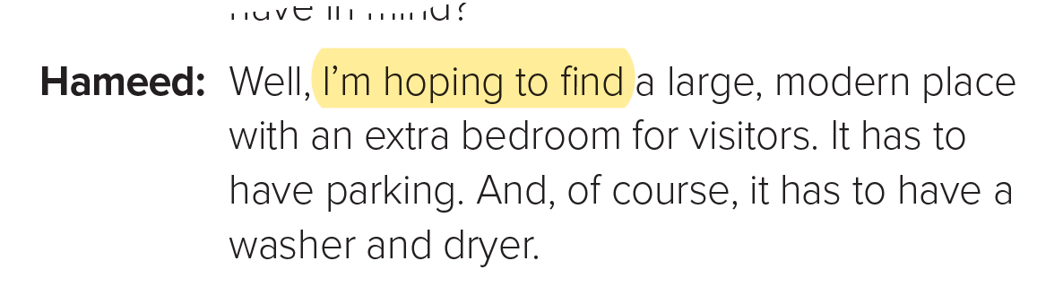
Which expression does Hameed use in the conversation?

Slide 16
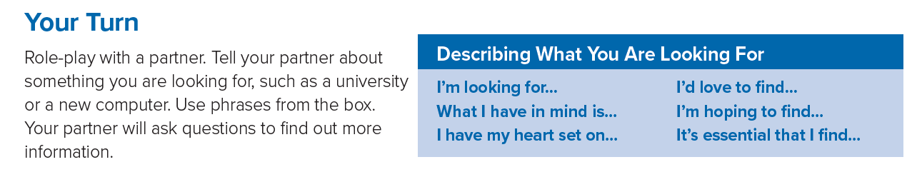

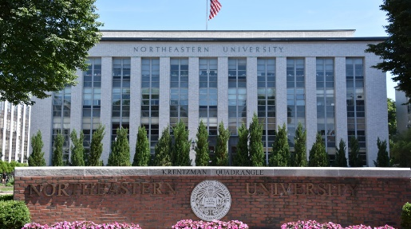
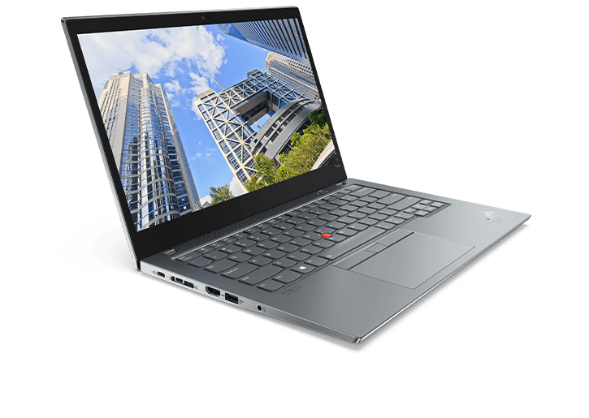

Slide 17
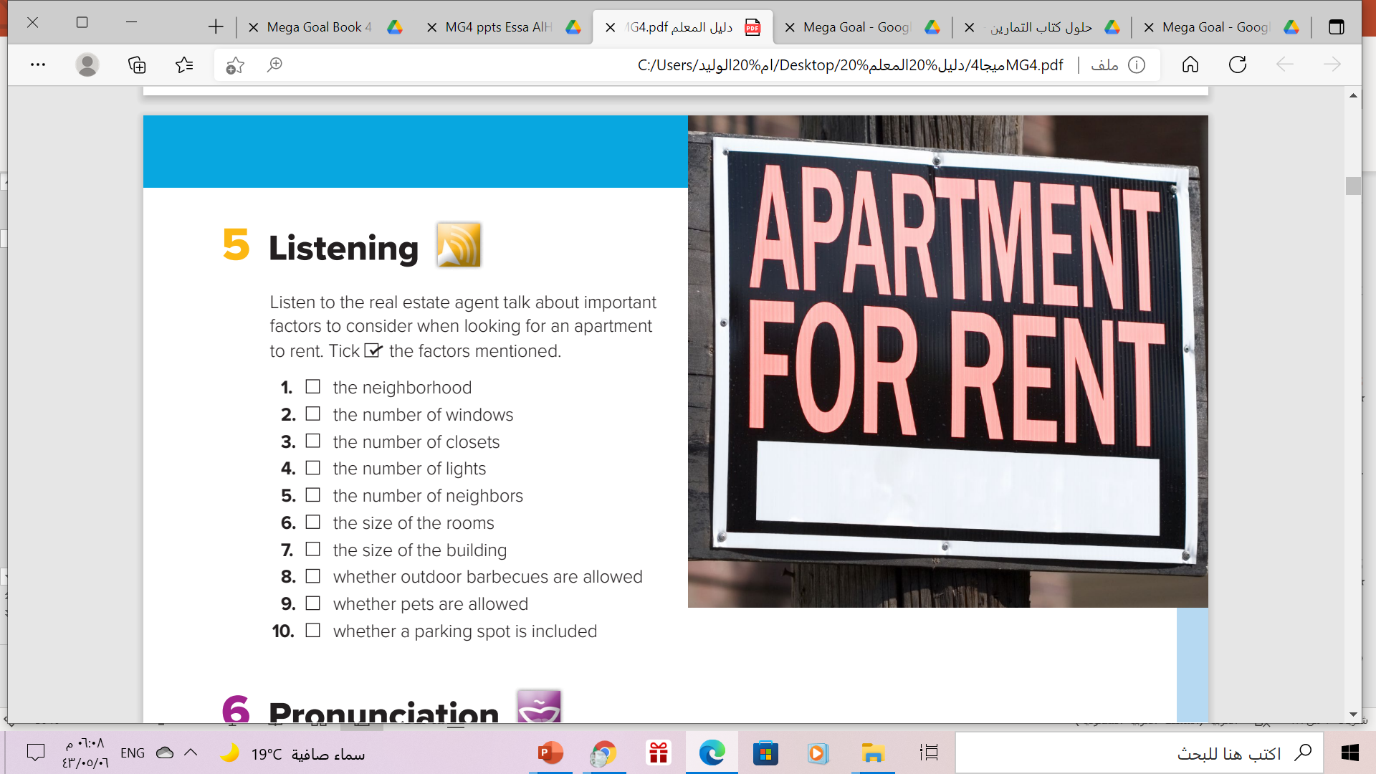


Slide 18
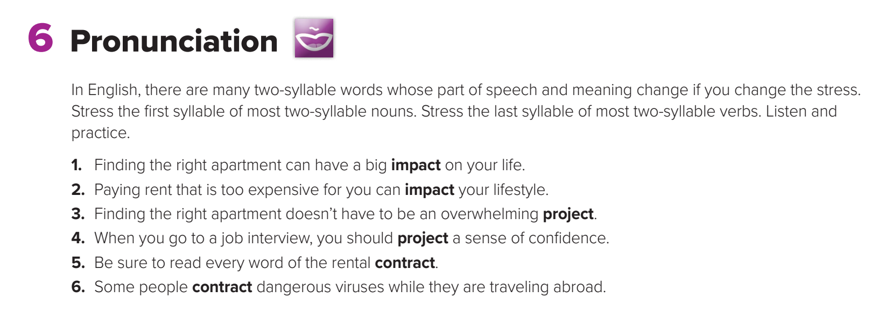

Slide 19
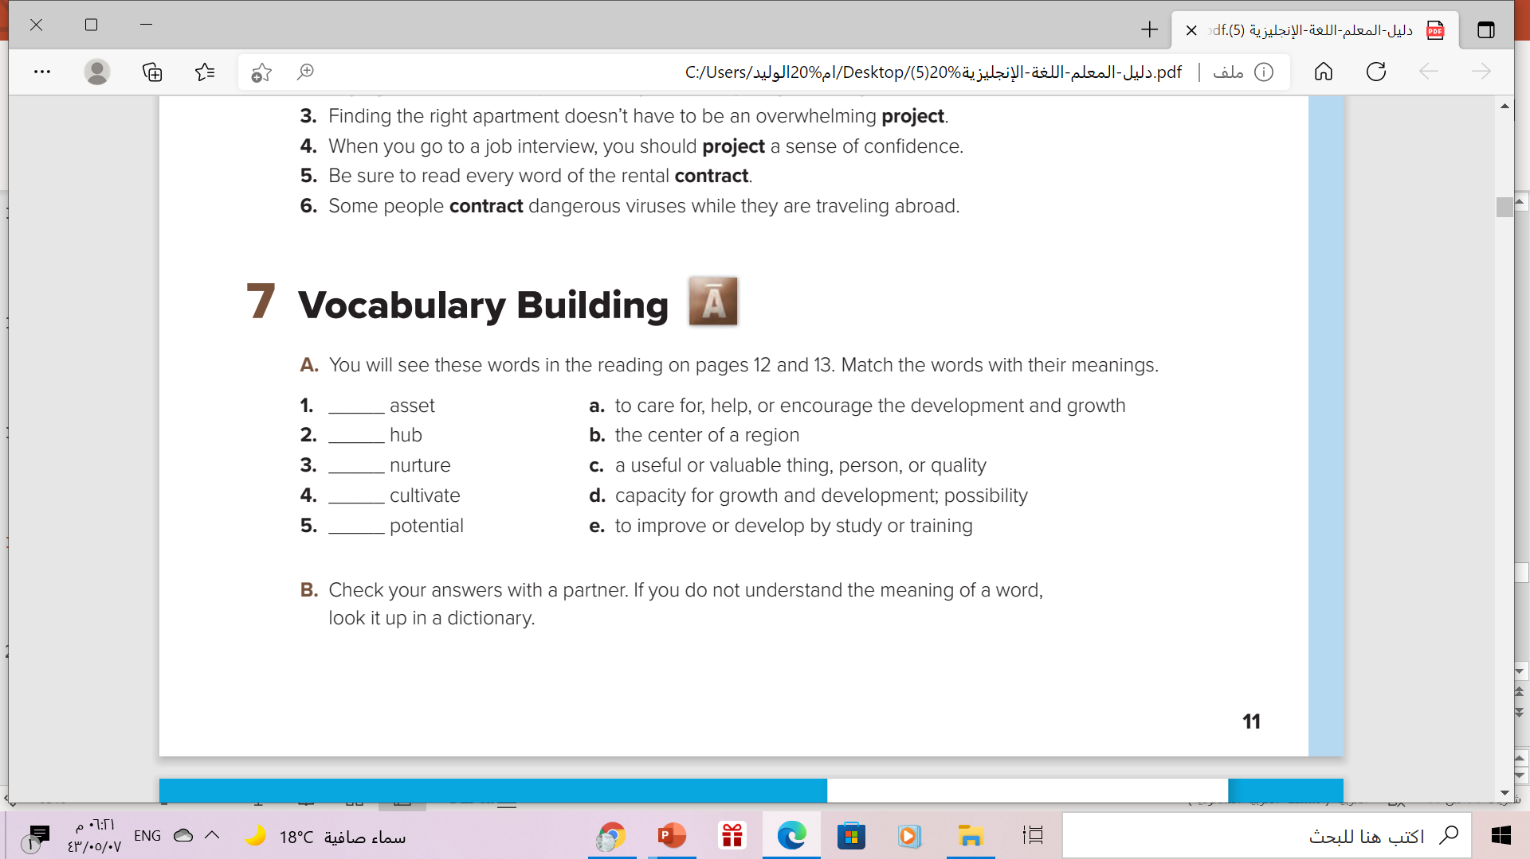
c
b
a
e
d

Slide 20

Remember

Slide 21
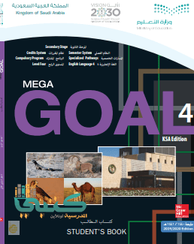
Homework!!
workbook
p. (11) , exercise (i)

Slide 22

Thanks!!

