Slide 1
Expansion
Units 1-4
Done by : Entisar Al-Obaidallah

Slide 2
Lesson Objectives
01.
Use
02.
Combine
03.
Write
04.
Rewrite
Too and enough in correct sentences.
Two sentences using a gerund as subject correctly
Sentences using two or three ajectives correctly
The sentences using the.....the comparative correctly

Slide 3
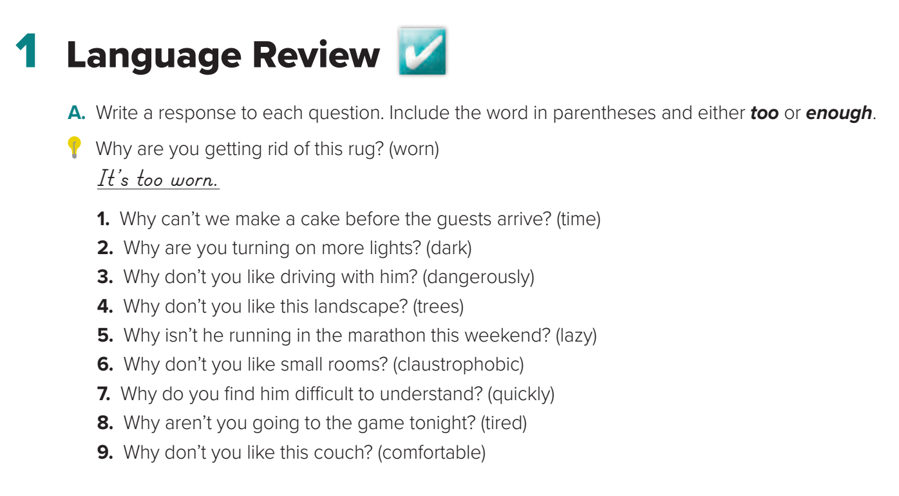

Slide 4
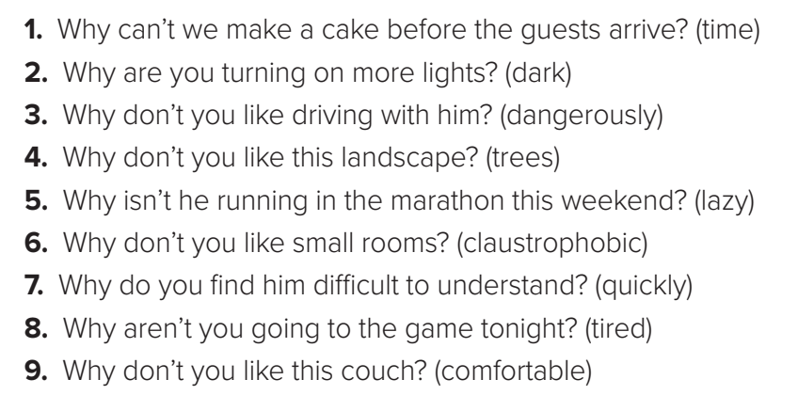
1. We don’t have enough time./There isn’t enough time.
2. It’s too dark.
3. He drives too dangerously.
4. It doesn’t have enough trees.
5. He’s too lazy.
6. They make me feel too claustrophobic.
7. He speaks too quickly.
8. I’m too tired.
9. It isn’t comfortable enough.

Slide 5
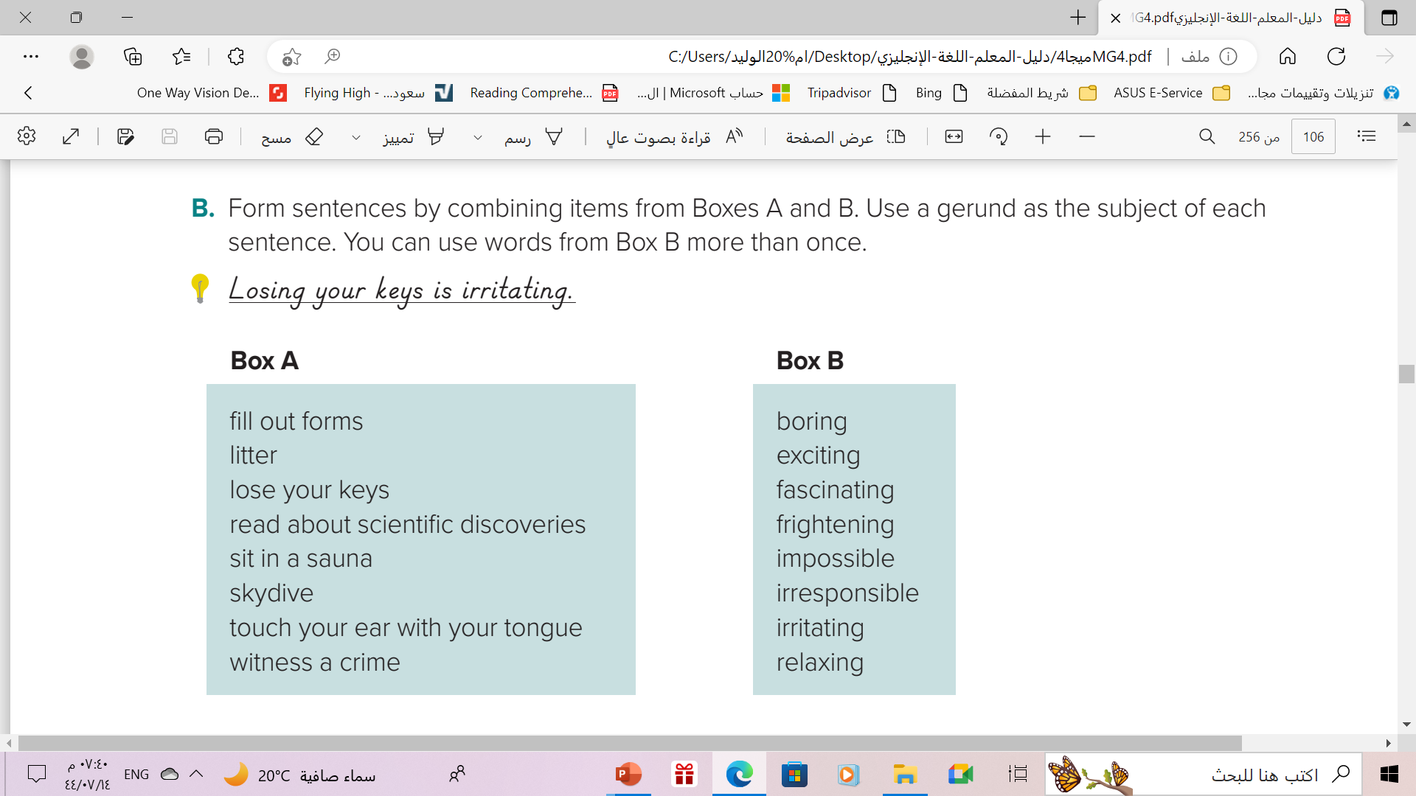

Slide 6
Answers will vary. Sample answers:
1. Filling out forms is boring.
2. Littering is irresponsible.
3. Losing your keys is irritating.
4. Reading about scientific discoveries is fascinating.
5. Sitting in a sauna is relaxing.
6. Skydiving is exciting.
7. Touching your ear with your tongue is impossible.
8. Witnessing a crime is frightening.

Slide 7
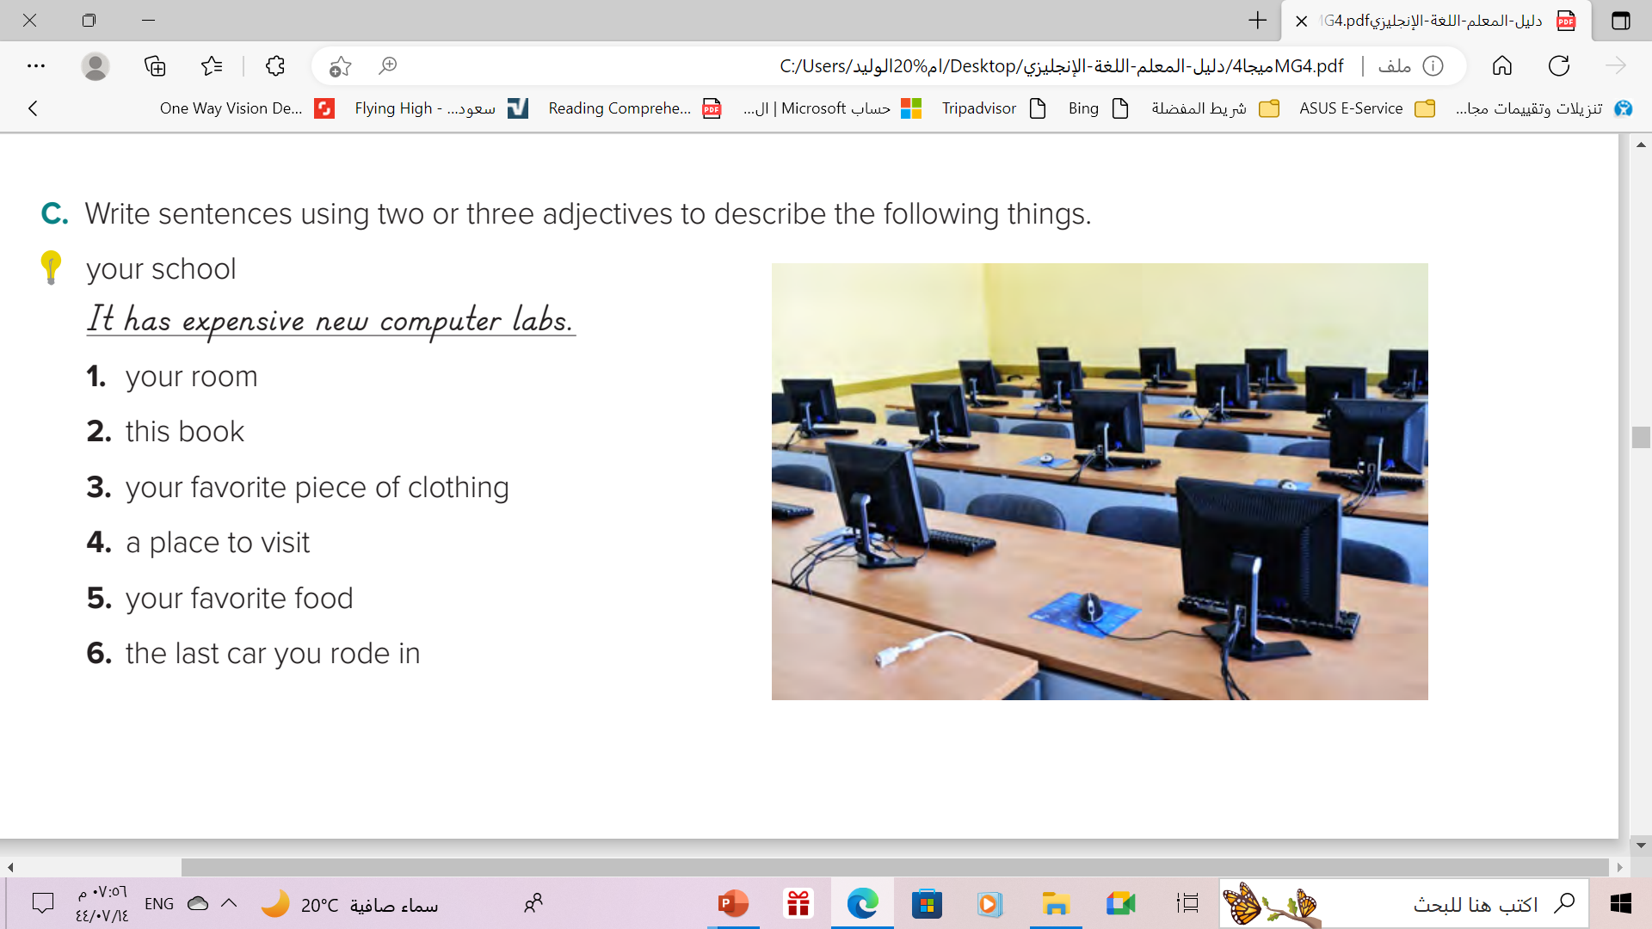

Slide 8
1- There’s a big, wooden mirror in my room
2- This is an interesting , comic book .
3- I have a beautiful , new, velvet dress.
4- Dubai is an amazing ,modern , glamorous city .
5- Pasta is a delicious , Italian dish .
6- It was a beautiful , red , sport car .

Slide 9
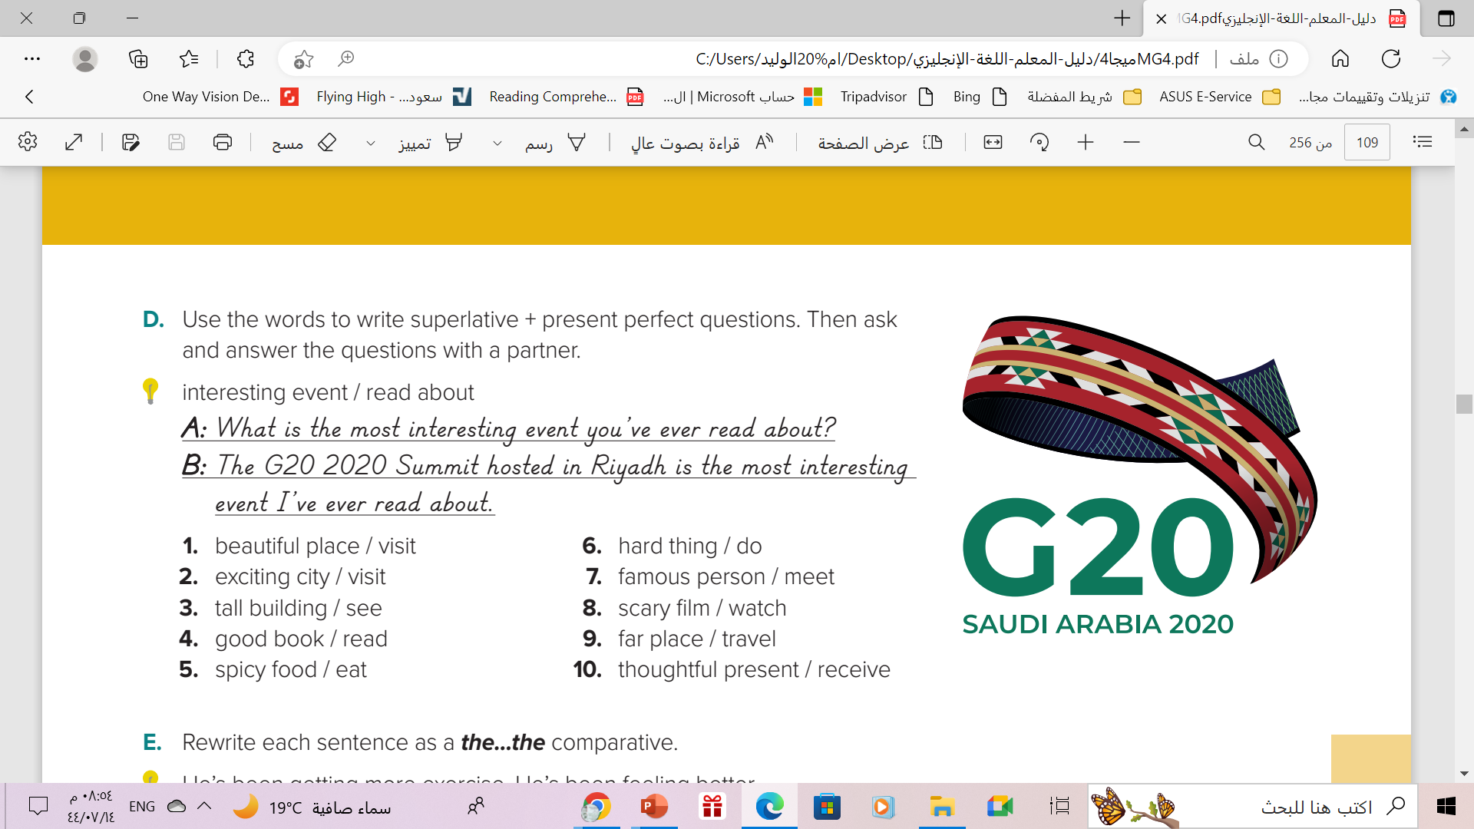

Slide 10
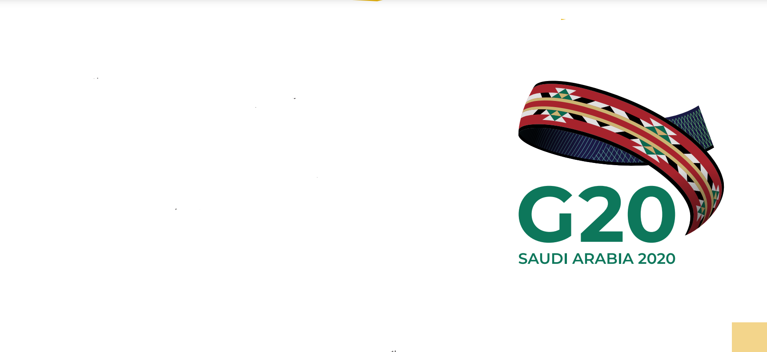
1. What is the most beautiful place you’ve ever visited?
2. What’s the most exciting city you’ve ever visited?
3. What’s the tallest building you’ve ever seen?
4. What’s the best book you’ve ever read?
5. What’s the spiciest food you’ve ever eaten?
6. What’s the hardest thing you’ve ever done?
7. Who’s the most famous person you’ve ever met?
8. What’s the scariest film you’ve ever watched?
9. What’s the farthest place you’ve ever traveled to?
10. What’s the most thoughtful present you’ve ever received?

Slide 11
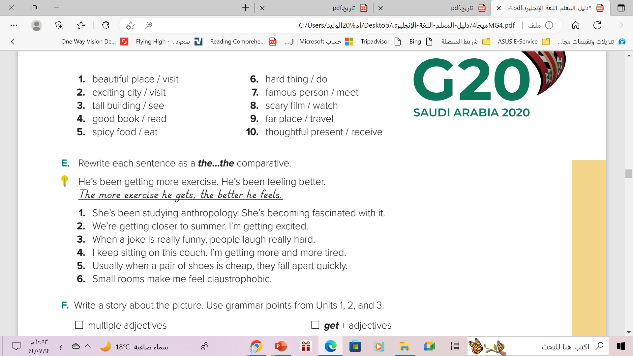

Slide 12
1. The more she studies anthropology, the more fascinated she becomes with it.
2. The closer we get to summer, the more excited I get.
3. The funnier the joke, the harder people laugh.
4. The longer I sit on this couch, the more tired I get.
5. The cheaper the shoes, the more quickly they fall apart.
6. The smaller the room, the more claustrophobic I feel

Slide 13
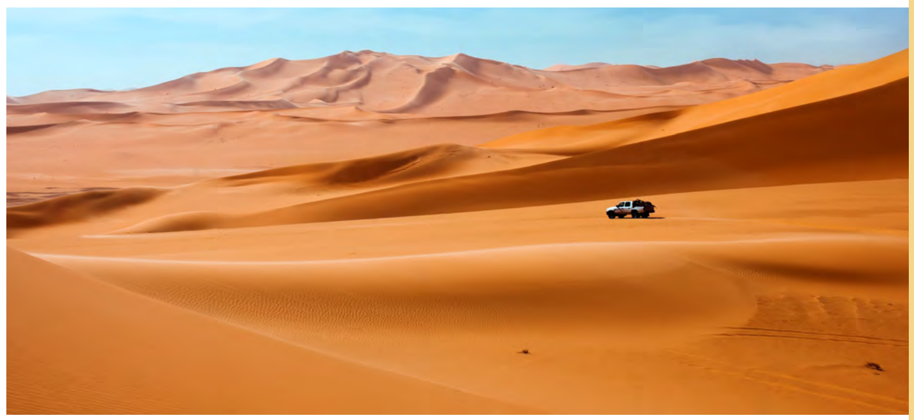
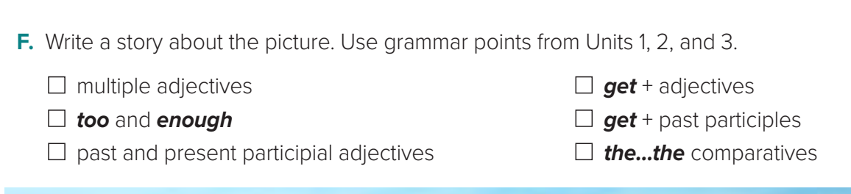

Slide 14

Remember

Slide 15
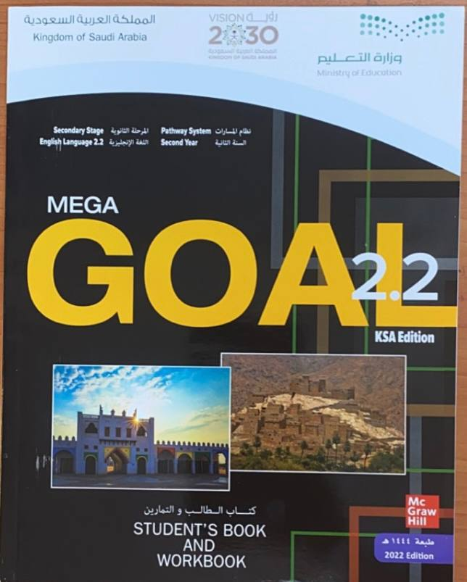
Homework
Workbook , pages (123-124) for review of grammar and vocabulary
presented in Units 1–3

Slide 16

Thanks!

