Slide 1
Done by: Entisar Al-Obaidallah
Mega Goal 2.2
Unit 5
Working 9 to 5
Grammar

Slide 2
Lesson Goals:
1- Use the subjunctive correctly
2-Use the subjective with correct verbs and expressions.
3-Use (I'd like you-I want you) correctly.
4- Apply the rules to do the exercises correctly

Slide 3
Book Opeen
Page (70)

Slide 5
Look at these two examples:
✓ Verb +s
What is the difference between them ?
He usually finishes his work on time
Since the subject is (he),
we add “s” to the verb “finish ”
✓ Verb ( no s)
It is imperative that he finish this job on time.
The verb in the base form
In this example the subject is (he), but we can not add “s” to the verb “finish ” because this is subjunctive .

Slide 6
When do we use the
“ subjunctive”??
We use the subjunctive to stress the importance or urgency of an action.
➔Use the simple form of the verb.
➔The simple form is the infinitive without "to“.
➔The negative by putting not in front of the verb.
➔It doesn’t use auxiliary verbs or contracted forms.
Example:
What should we do to make
“ subjunctive”??
The manager insisted that he work late.

Slide 7
What is the form of the
“ subjunctive”??
Verb or expression
That
subject
(not) base form
The subjunctive is used with certain verbs , like the following:
ask request demand require insist suggest recommend urge
Example:
The manager insisted that he work late.
suggestion
subjunctive

Slide 8
You can also use a suggesting expression to express that something should be done or must be done such as:
It is essential that … It is important that …
It is necessary that …. It is imperative that …..
Example:
It is essential that you brush your teeth.
expression
It is necessary that you sleep early.
expression

Slide 9
Correct the errors in the use of the subjunctive:
talk
I recommend that you talks about your skills.
It is important you write your name at the top.
Father asked that we don’t eat junk food.
Mother requested that they studied math first.
Teacher insists that the project is handed by Monday.
important that you
not eat
study
be

Slide 10
NEGATIVE Subjunctive
Use “ not ” before the base form of the verb
Example:
✓ Not write
My teacher suggests that I don’t write an essay.
Ali insisted that I shouldn’t use his phone.
✓ Not use

Slide 11
Example:
✓ infinitive
I’d like you to meet my parents..
I want you to cook the dinner this evening.
✓ infinitive

Slide 12
Rearrange the following to form sentences:
dress nicely / you / want / I / to
I want you to dress nicely.
shopping / to / you / go / I’d / like
I’d like you to go shopping.

Slide 13
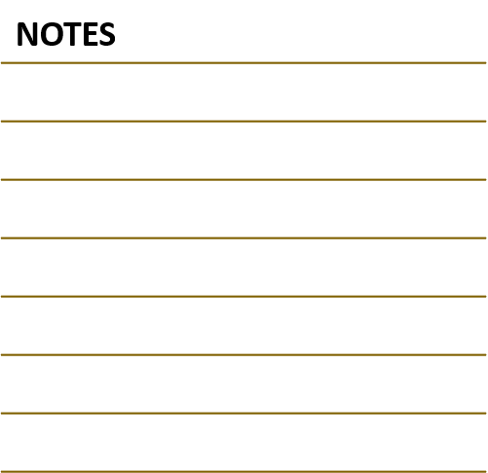
Book Open
Page (71)

Slide 14
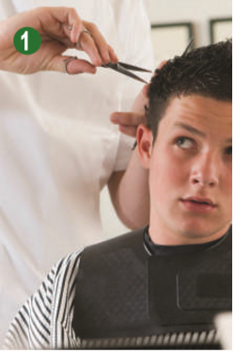
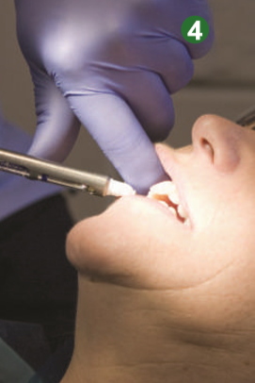
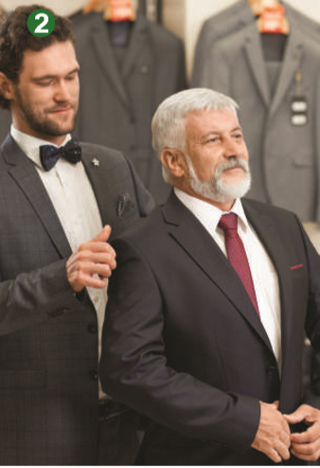
Write “ subjunctive” sentence
1. I recommend you cut your hair shor
3. It’s important that we catch this train.
4. It’s essential that you brush well twice a day
2. I suggest that you try this on.

Slide 15
6. I want you to study the new proposals very carefully.
7. I’d like you to take two pills every morning.
5. I want you to stop smoking.

Slide 16
Homework
Page (78) , exercise ( D)

Slide 17
Thanks

