Slide 1
Unit 1 Working 9 to 5
Mega Goal 2.2
Conversation and Listening
Done y: Entisar Al-Obaidalla

Slide 2
Lesson Goals
01
02
03
04
Listen
Use
Practice
Match
For specific information
“Real Talk” phrases in correct sentence
Asking for Favors in pairs
The words with the correct menings

Slide 3
4
Conversation

Slide 4
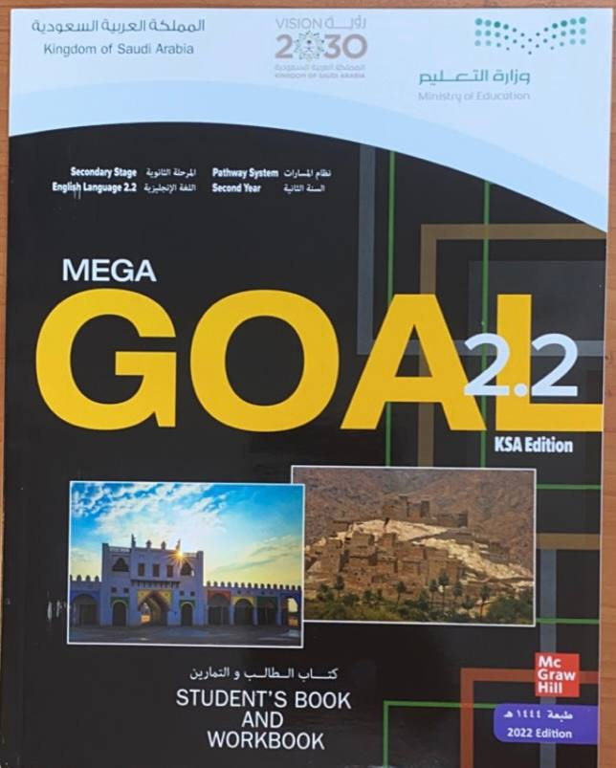
Book Open
On student’s book Page ( 6)

Slide 5
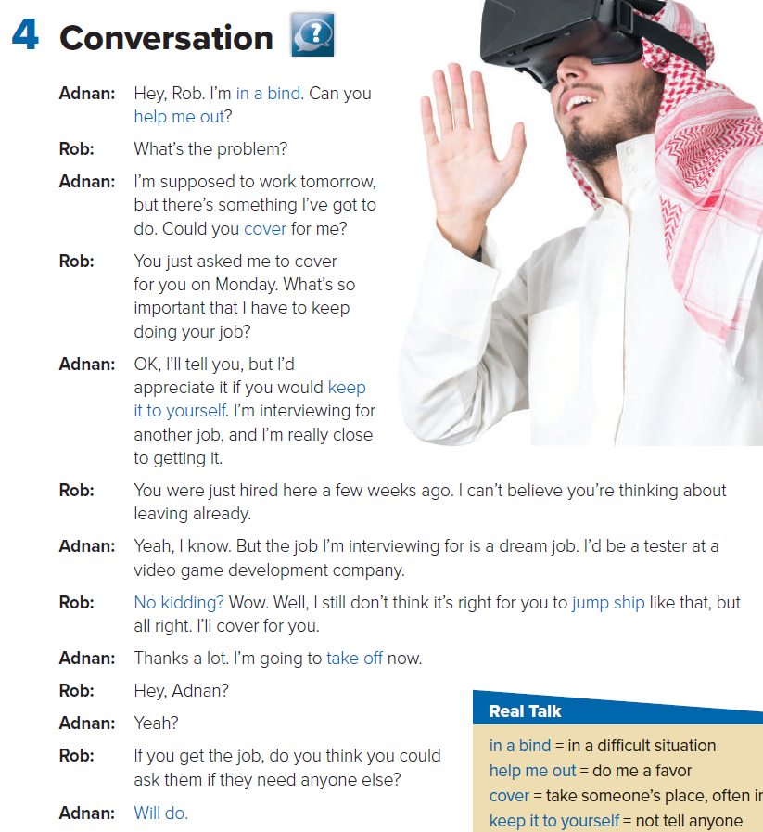
How many people are there ?
Tow persons
Who are they ?
Adnan and Rob
What does the picture show ?
A man covers his eyes

Slide 6
Read along as u listen

Slide 7
Why does Adnan say that he’s in a bind?
He can’t go to work the next day
How is Rob going to help Adnan out?
He’s going to cover for him
Why does Adnan say it isn’t right for Rob to jump ship?
He thinks Rob shouldn’t change jobs suddenly like that
What does Adnan mean when he says he’s going to take off now?
He’s going to leave the office.

Slide 8
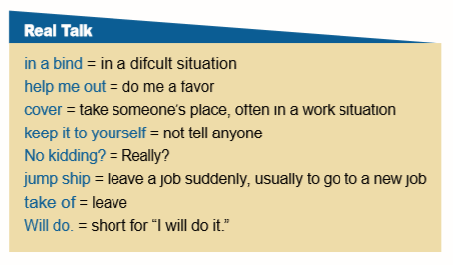
Read the words and their meaning

Slide 9
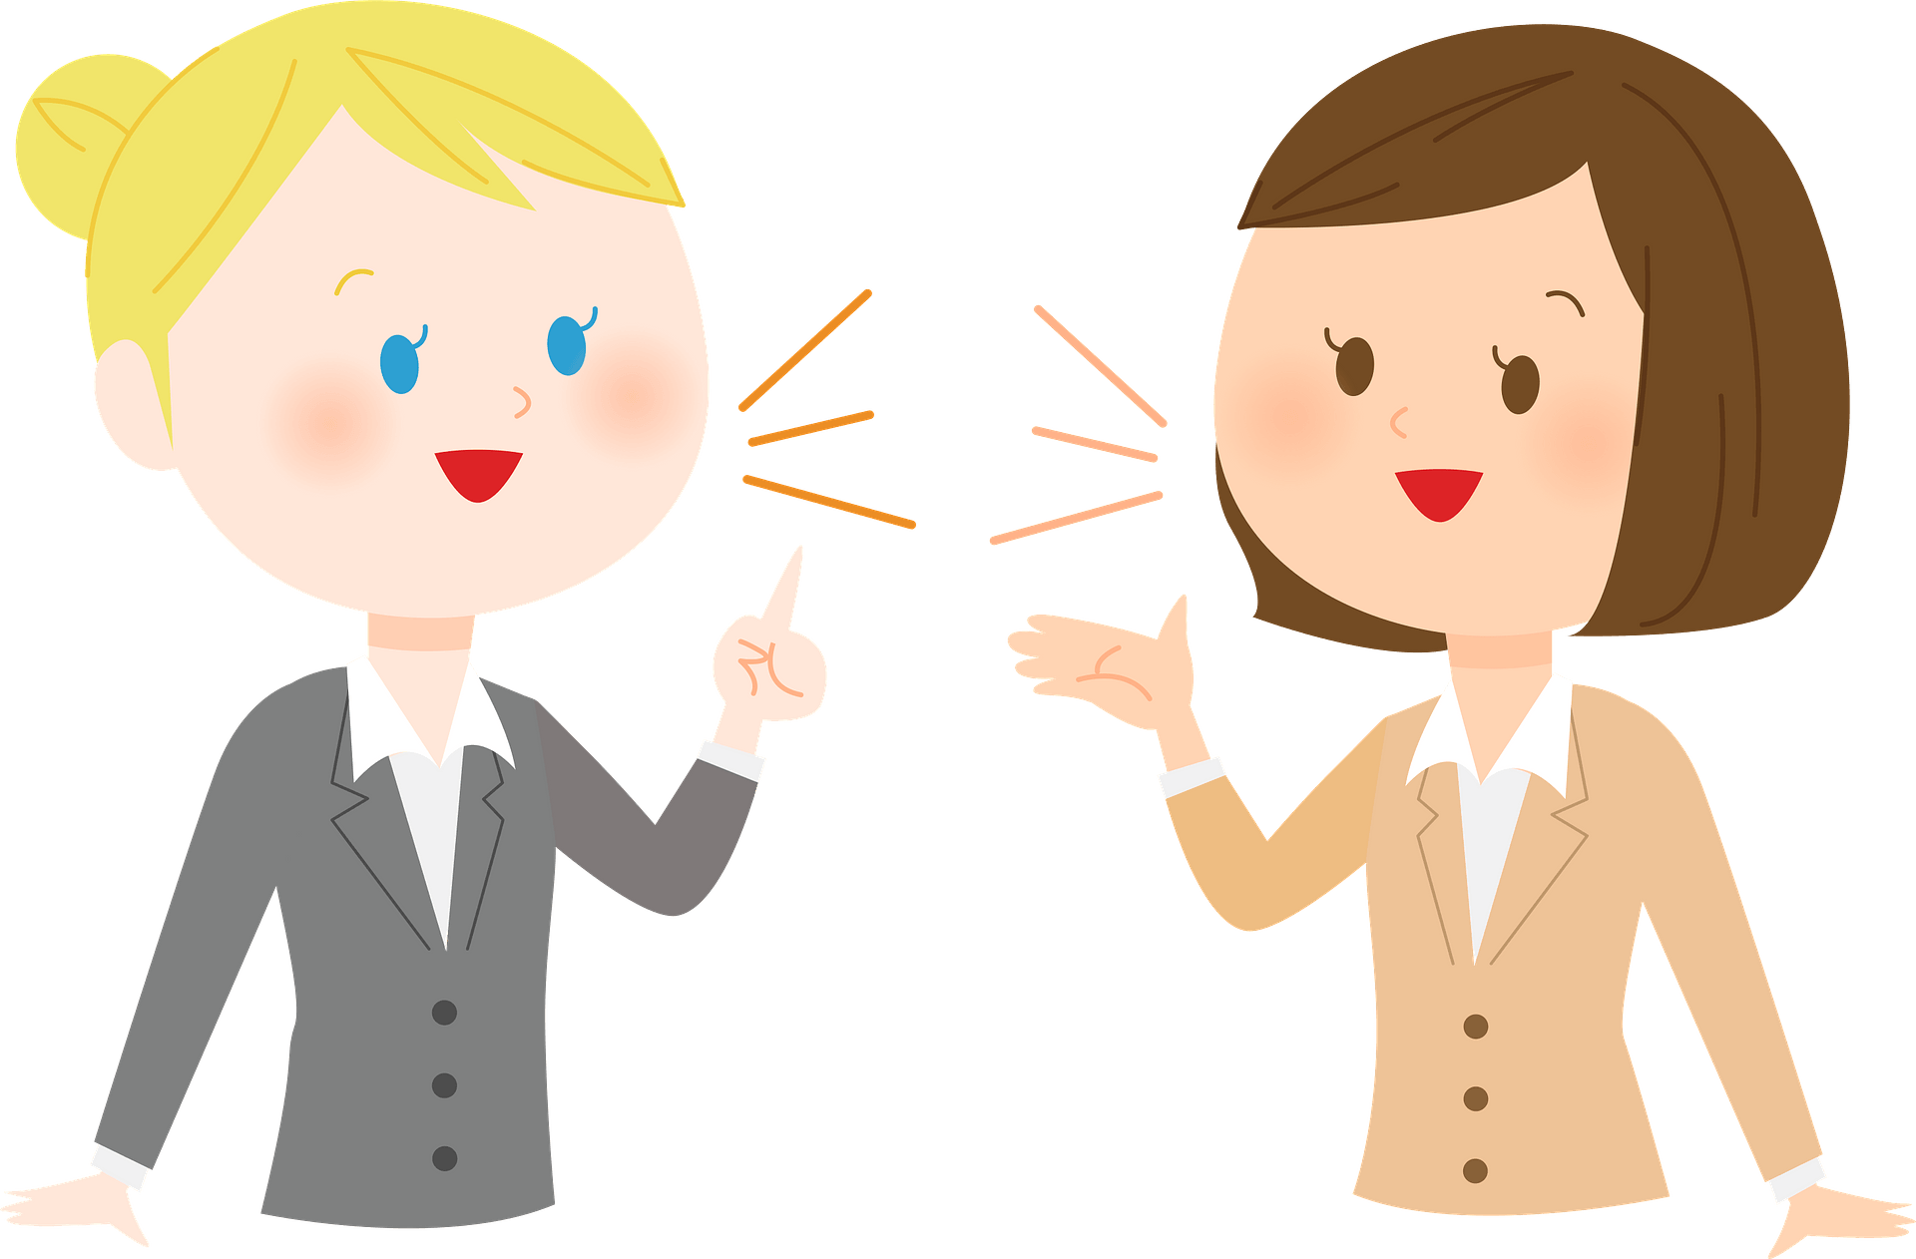
Who says ………
In a bind
Adnan

Slide 10
Who says ………
Help me out
Adnan

Slide 11
Who says ………
cover
Adnan

Slide 12
Who says ………
No kidding
Rob

Slide 13
Who says ………
Gump ship
Rob

Slide 14
Who says ………
Take off
Adnan

Slide 15
Who says ………
Will do
Adnan

Slide 16
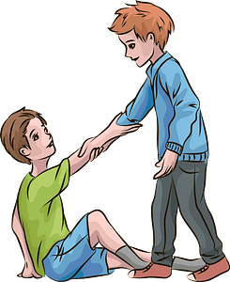
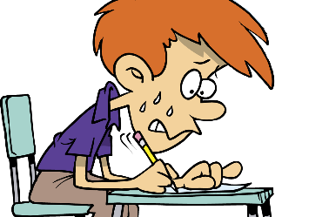
In bind
Keep it to yourself
Help me out
cover
not tell anyone
in a difficult situation
do me a favor
take someone’s place, often in
a work situation

Slide 17
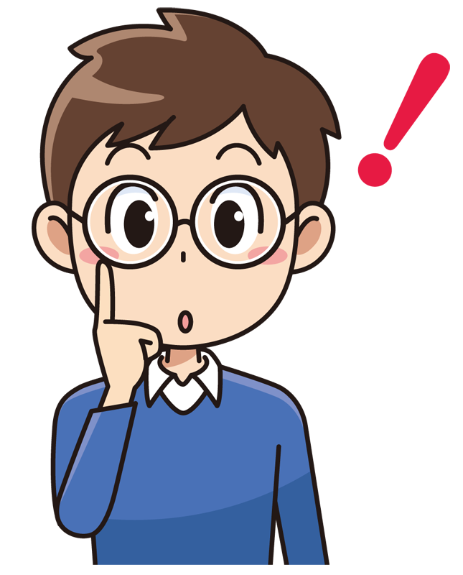
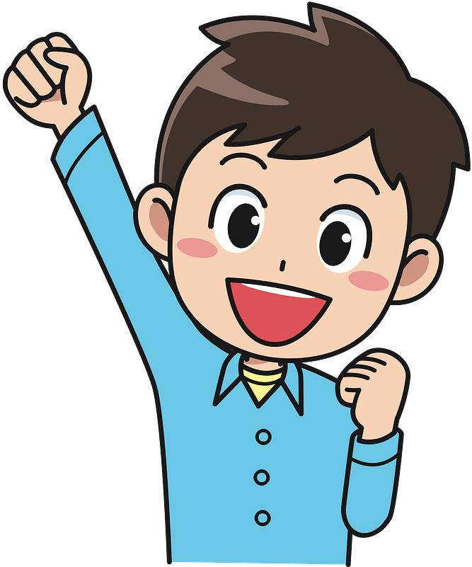
Will do
No kidding?
Take off
Jump ship
Really??
short for “I will do it.”
leave
leave a job suddenly, usually to go to a new job

Slide 18
Because he has an interview for another job.
At first, Rob doesn’t want to cover for Adnan since he worked for him another time recently.
Rob is interested in applying for the job that Adnan is interviewing in need..

Slide 19
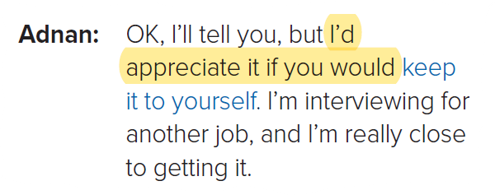
a student to read aloud the directions
Which phrase does Adnan use in the conversation?
Phrases used when asking for favors.
They make the request sound more polite

Slide 20
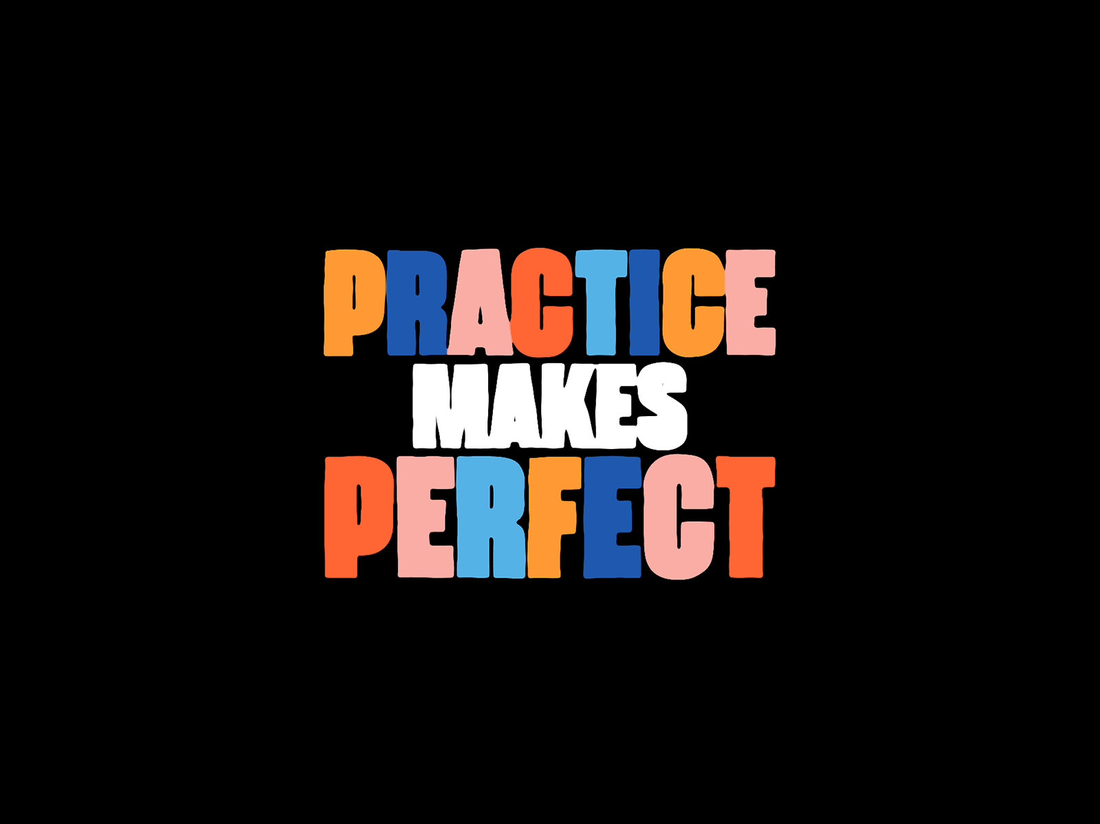

Slide 21
In a bind
Keep it to yourself
Will do
Jumped ship
Take off
cover
Not kidding

Slide 22
Book Open
On student’s book Page ( 7 )

Slide 23
5- Listening

Slide 24
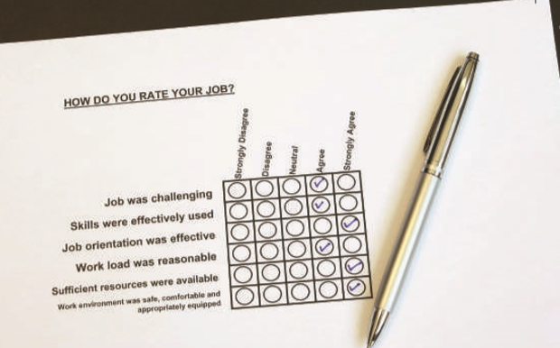
Satisfaction from helping others
Exciting, & protecting others is satisfying
Creativity & flexibility
High stress & great responsibility
Helping children & watching them grow up
Repetitive & efforts aren’t appreciated
Repetitive & efforts aren’t appreciated

Slide 25
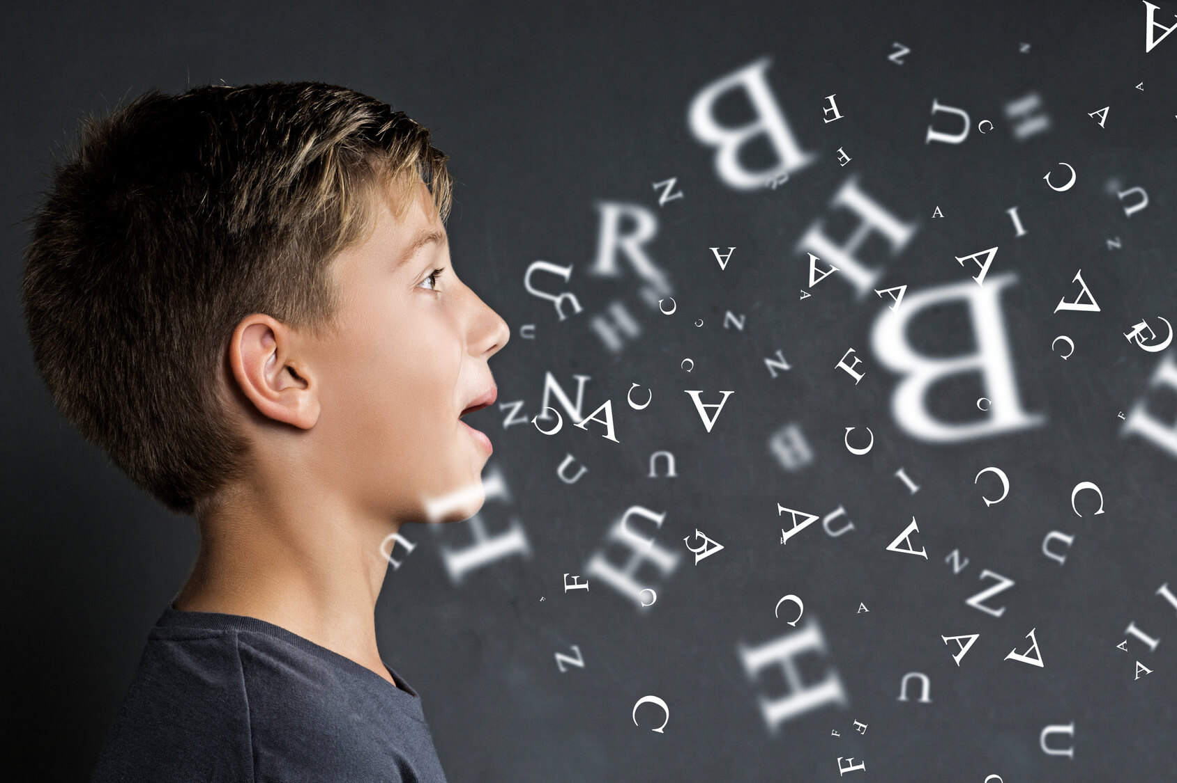
Pronunciation

Slide 26
Vocabulary Building
g
c
f
h
b
e
d
a

Slide 27
Homework
Page ( 80) , exercise ( H )

Slide 28
Remember

Slide 29
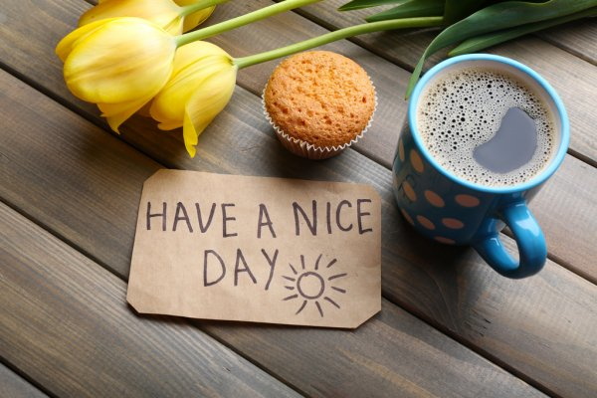
Thanks

